Slide 1
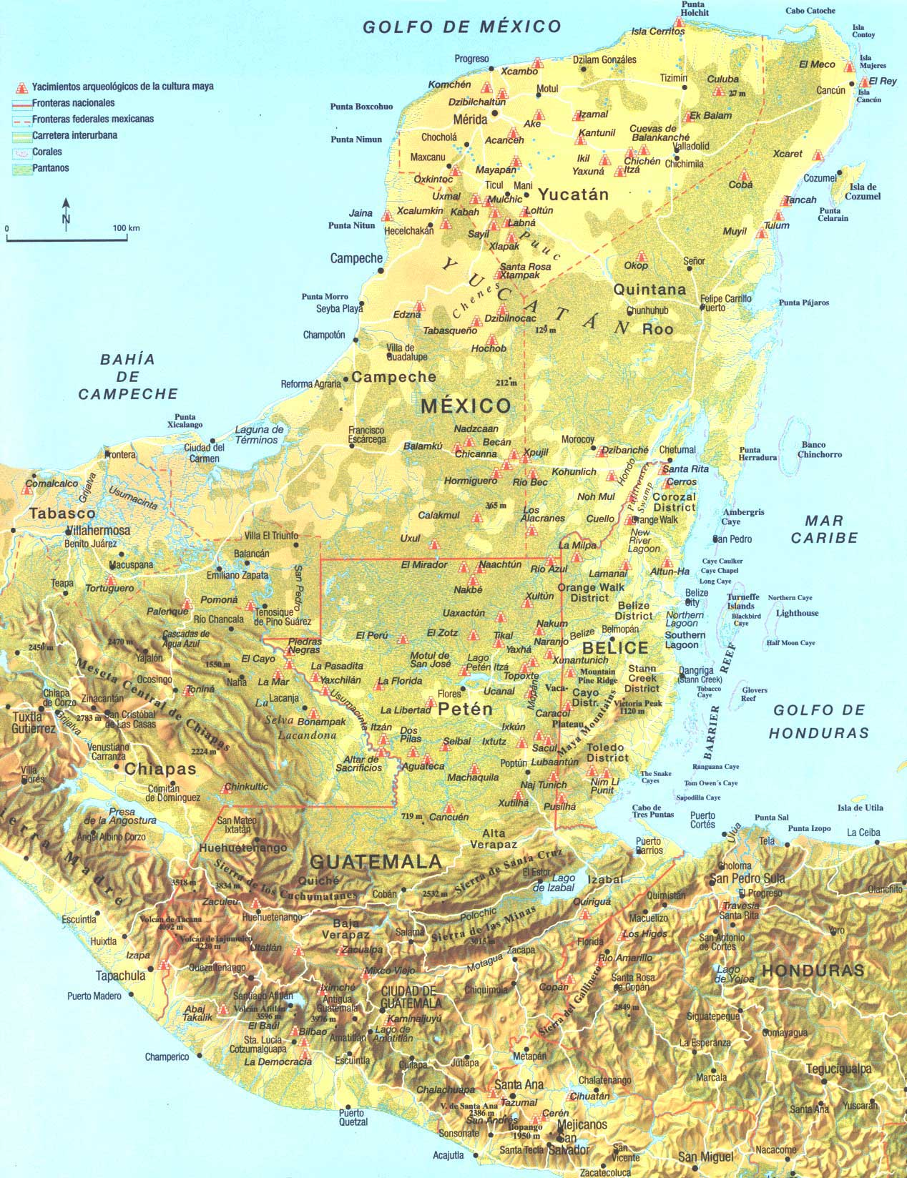
Creating Spanish America: Mesoamerica

Slide 2
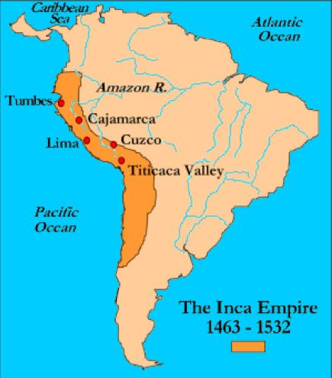
South America

Slide 3
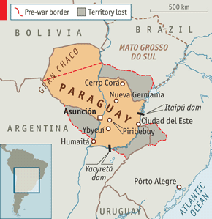
The Guarani territories

Slide 4
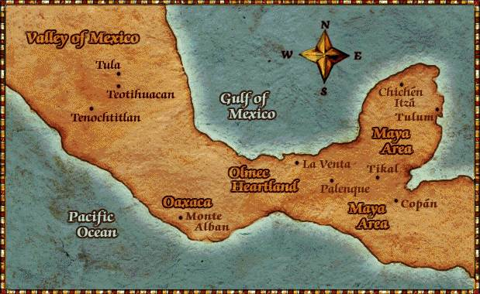
Mesoamerican Cultures Map

Slide 5
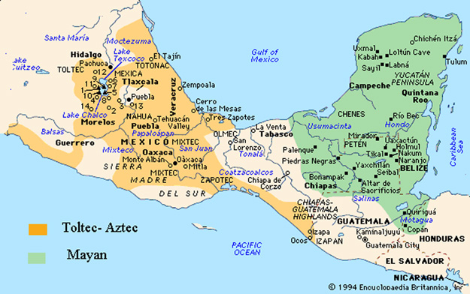
Olmecs, Maya and Aztecs regions

Slide 6
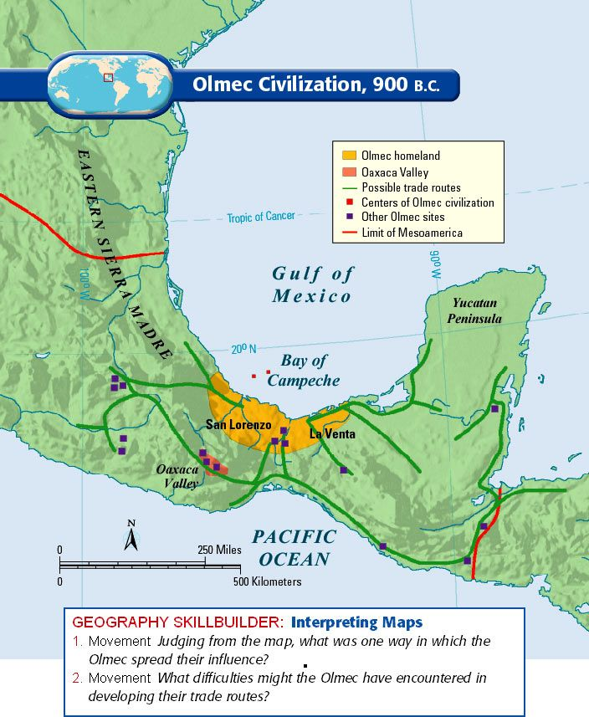
Olmec site

Slide 7
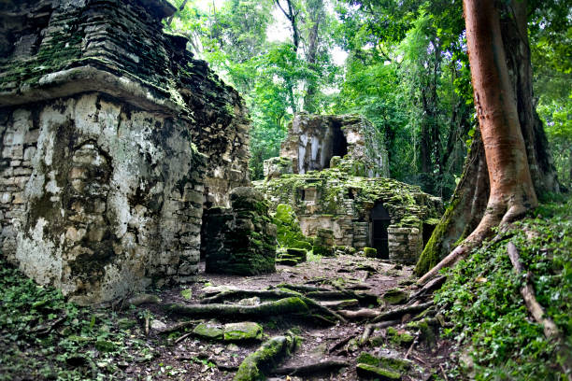
Mesoamerican Jungle: Yaxchilan near Guatemala border

Slide 8
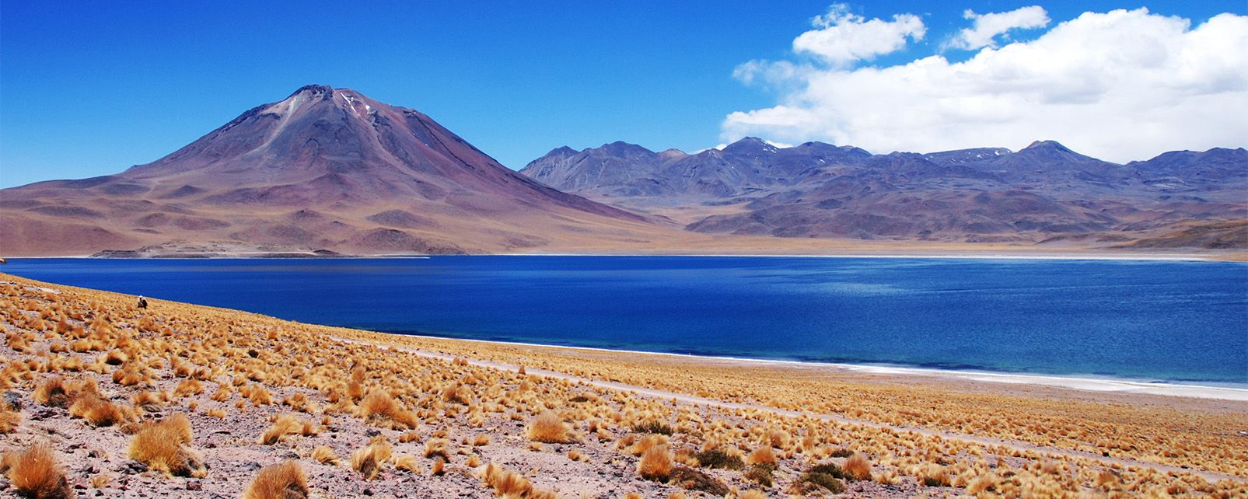
The Altiplano

Slide 9
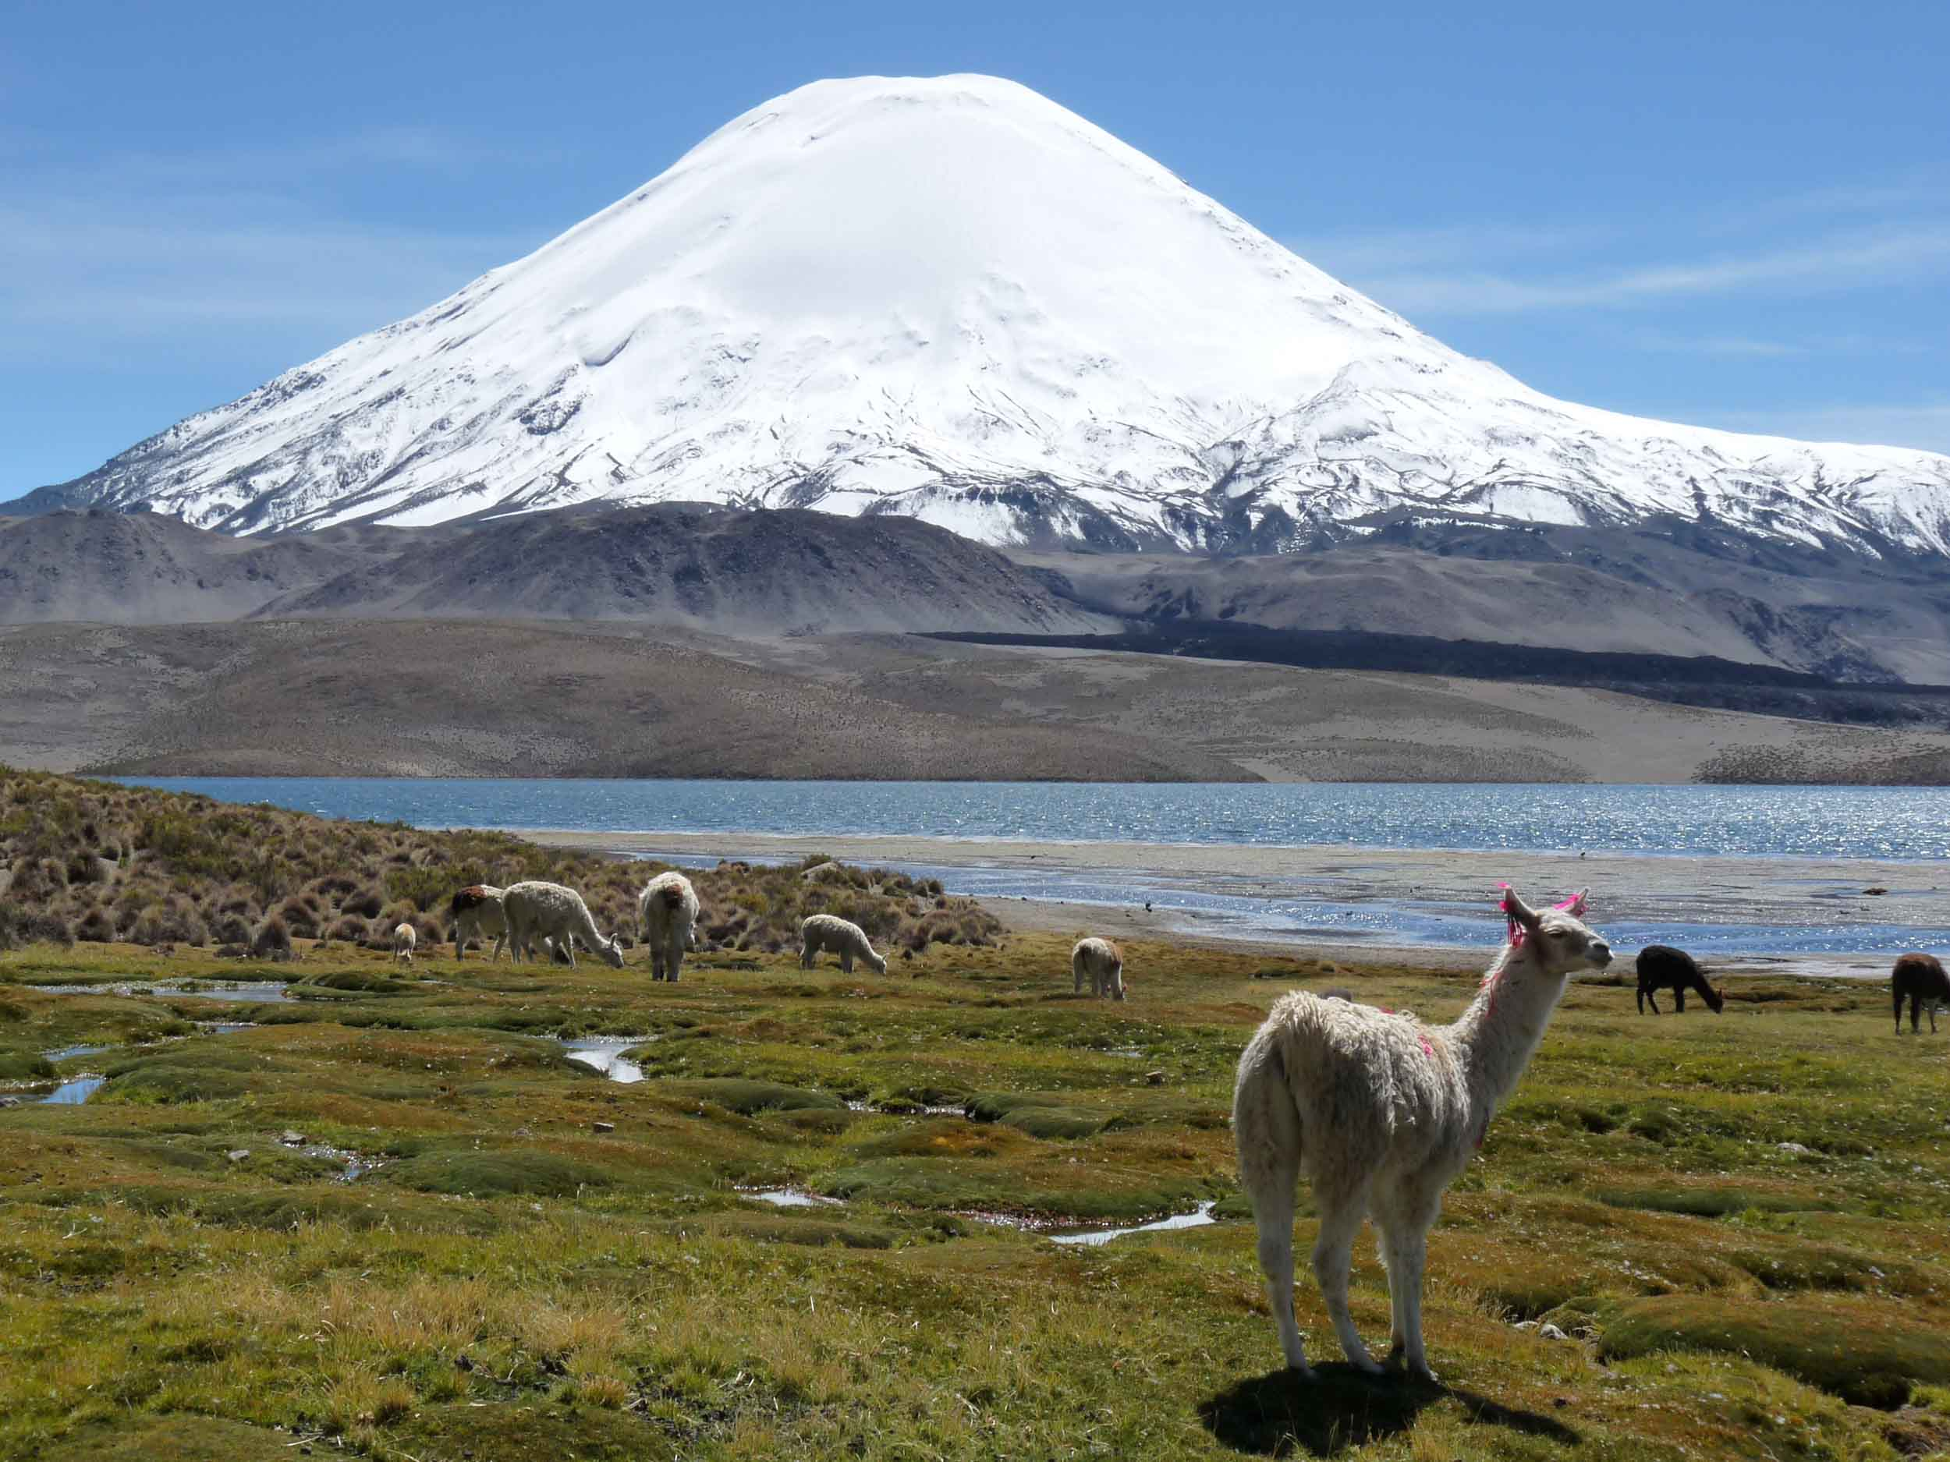
Altiplano

Slide 10
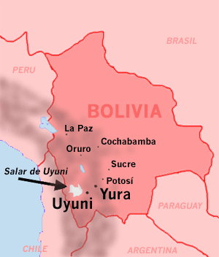
Salar de Uyuni map

Slide 11
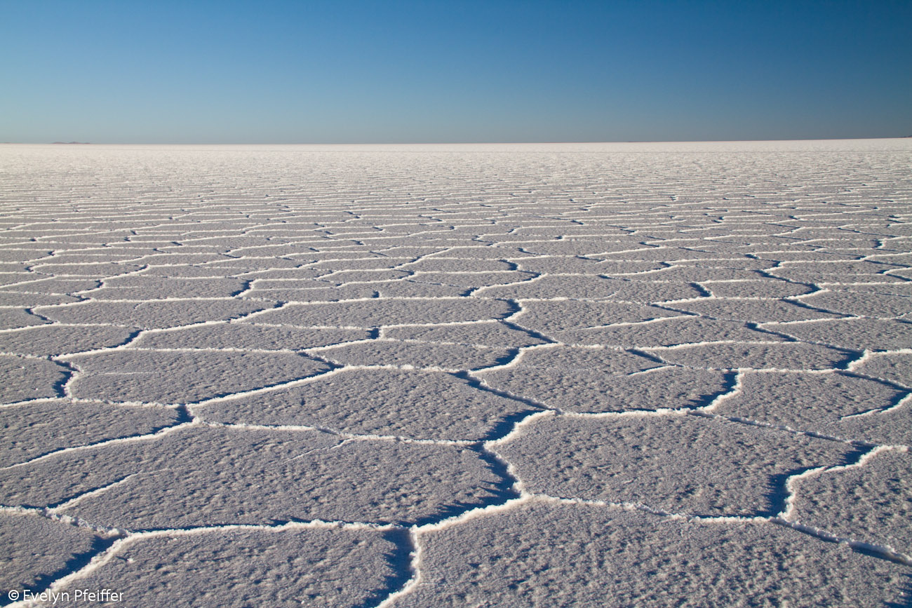
Salar de Uyuni

Slide 12
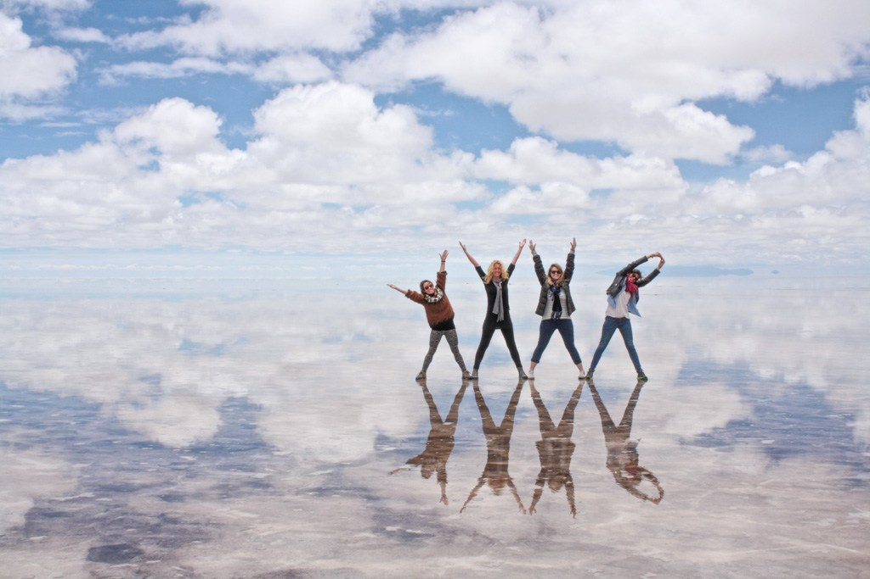

Slide 13
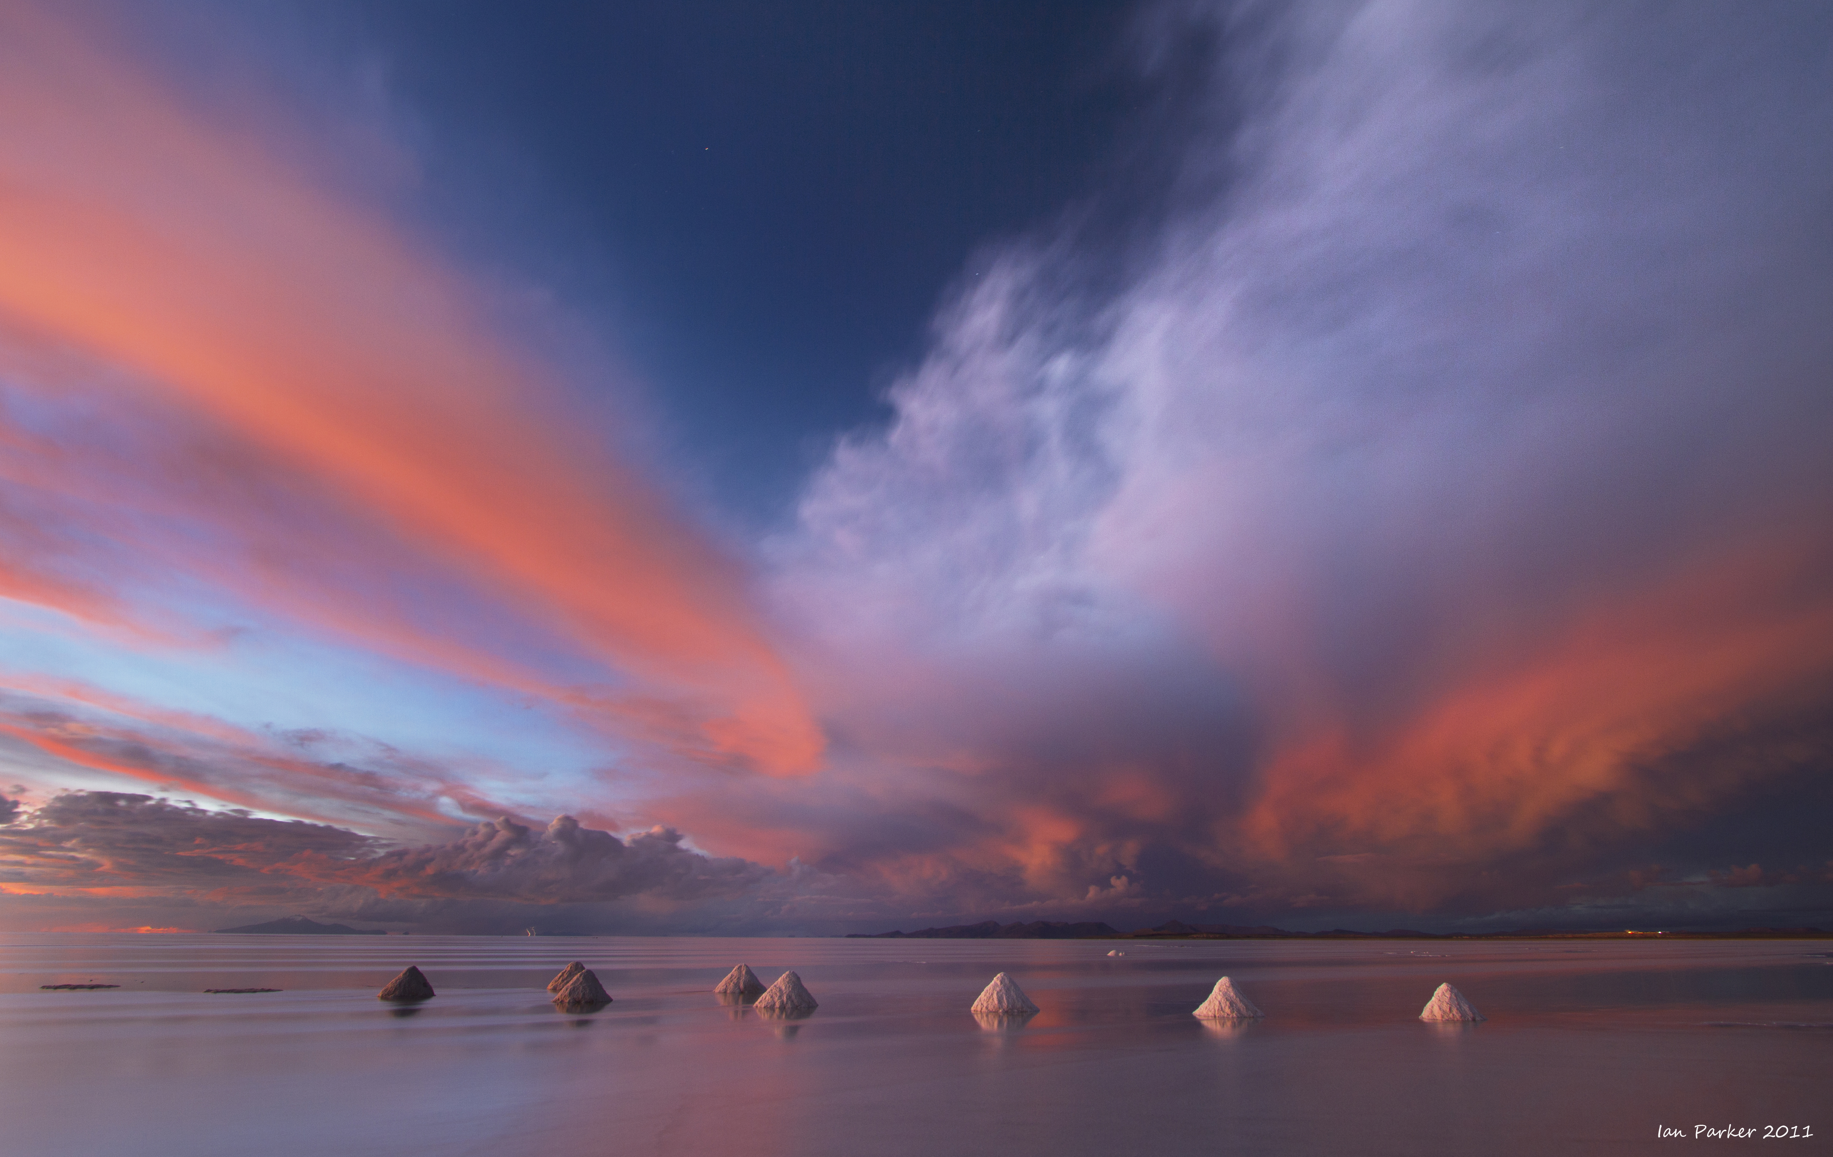

Slide 14
