Slide 1
Solving Logic Problems using Truth Tables

Slide 2
Solving Logic Problems using Truth Tables
Defining a Logic Problem
Selecting and Using an appropriate Truth Table
Using Truth Tables to determine the solution to a Logic Problem
Implementing the solution using hardware (engineering)
Implementing the solution using software (computer science)

Slide 3
Defining a Logic Problem
The assumption for this lesson is that a logic problem consists of
Binary inputs – all inputs are yes/no, on/off, or true/false inputs
Binary outputs – the output(s) are yes/no, on/off, or true/false
The state of the output is based on the state of the inputs
Example: If the burglar alarm is engaged and a window is open or motion is detected, sound the alarm.

Slide 4
Identify the Inputs and Outputs
For each input and output, identify what constitutes on and off (true and false).
Example: If the burglar alarm is turn on and a window is open or motion is detected, sound an audible alarm.
Inputs
Burglar Alarm: 1 – Alarm On, 0 – Alarm Off
Window: 1 – Closed, 0 – Open
Motion Detector: 1 – Motion, 0 – No Motion
Outputs
Alarm: 1 – On, 0 – Off

Slide 5
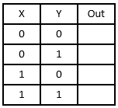
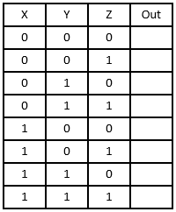
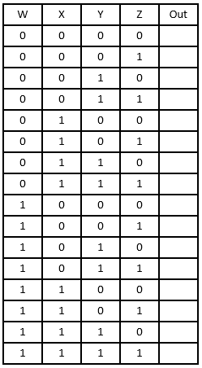
Select an appropriate Truth Table
The appropriate Truth Table is based on the number of inputs
Two Inputs | Three Inputs | Four Inputs

Slide 6
Fill in the Truth Table
X | Y | Z | Out
0 | 0 | 0 | 0
0 | 0 | 1 | 0
0 | 1 | 0 | 0
0 | 1 | 1 | 0
1 | 0 | 0 | 1
1 | 0 | 1 | 1
1 | 1 | 0 | 0
1 | 1 | 1 | 1
X = Burglar Alarm: 1 – Alarm On,
0 – Alarm Off
Y = Window: 1 – Closed, 0 – Open
Z = Motion Detector: 1 – Motion,
0 – No Motion
Out = Alarm: 1 – On, 0 - Off

Slide 7
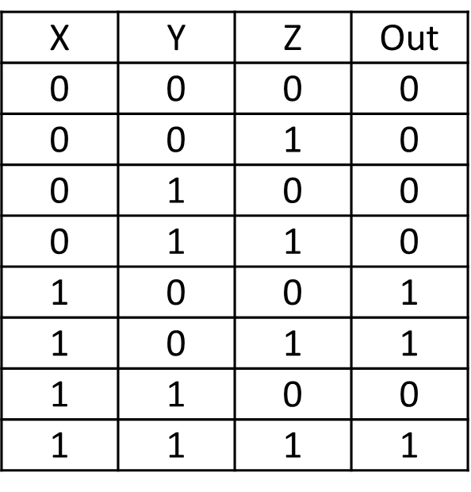
Document the Solution
Identify the inputs that cause the output to be 1. These are the min-terms.
Write the equation for each min-term.
If an input is 1, write the variable name. If the input is 0, write the inverse of the variable name.
If X = 0, use $\overline{X}$
If X = 1, use $X$
Inputs are AND’ed (the first min-term is $X ∗ \overline{Y}∗\overline{Z}$)
Combine min-terms to form the equation
Min-terms are OR’ed
The full solution is $X\overline{Y}\overline{Z}+X\overline{Y}Z+XYZ$

Slide 8
Simplify the Solution
Solutions can be simplified using Boolean Algebra or Karnaugh Mapping.
These topics are beyond the scope this lesson, therefore this lesson will use unsimplified logic expressions.

Slide 9
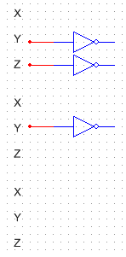
Test the Solution (Hardware)
$$X\overline{Y}\overline{Z}+X\overline{Y}Z+XYZ$$
Invert any inputs that have to be inverted using an Inverter Gate

Slide 10
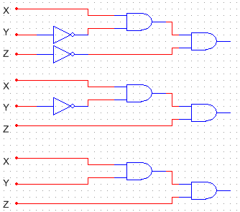
Test the Solution (Hardware)
$$X\overline{Y}\overline{Z}+X\overline{Y}Z+XYZ$$
AND the inputs to form a min-term using an AND Gate

Slide 11
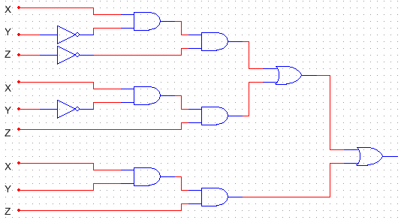
Test the Solution (Hardware)
$$X\overline{Y}\overline{Z}+X\overline{Y}Z+XYZ$$
OR the min-terms to form the solution using an OR Gate

Slide 12
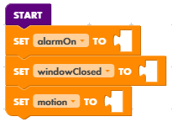
Test the Solution (Software)
$$X\overline{Y}\overline{Z}+X\overline{Y}Z+XYZ$$
Define variables for each input. A common practice is name the variable after the positive (true) state

Slide 13
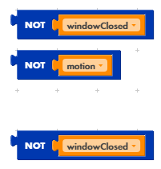
Test the Solution (Software)
$$X\overline{Y}\overline{Z}+X\overline{Y}Z+XYZ$$
Invert any inputs that have to be inverted using the inversion operator

Slide 14
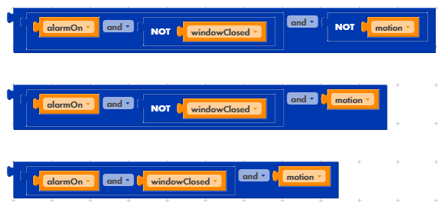
Test the Solution (Hardware)
$$X\overline{Y}\overline{Z}+X\overline{Y}Z+XYZ$$
AND the inputs to form a min-term using AND operators

Slide 15
Test the Solution (Software)
$$X\overline{Y}\overline{Z}+X\overline{Y}Z+XYZ$$
OR the min-terms to form the solution using an OR Gate

Slide 16
References
Digital Logic Circuits created in National Instruments Multisim
Block-Based Code created in littleBits Code Kit
Text-Based Code created in Notepad++

