Slide 1
Safety Organized Practice
Day 2 – Two-day Foundational Institute
Instructor Name
NORTHERN ACADEMY
Notes:
Welcome to Day 2!

Slide 2

Plan for the day
A look back at yesterday: Key takeaways?
Harm and Danger Statements; Safety Goals
Key Mapping Concepts
Mapping/consultation demonstration
Behaviorally based case plans/Action steps
Wrap up
Notes:
Review the plan for the day
Any key takeaways from yesterday?

Slide 3

Harm & Danger Statements
Notes:
Next segment: Harm & Danger Statements
Please refer to handout in participant workbook: Harm & Danger Statements/Safety Goals Quick Guide

Slide 4
How Do We Focus and Have Clarity?
Harm Statements:
Clear and specific statements about the harm or maltreatment that has happened to the child.
Danger Statements: Simple behavioral statements of what we are worried may happen to this child now and in the future, if nothing changes.
Safety Goals: Clear, simple statements about what (not how) the caregiver will DO that will convince everyone the child is safe now and into the future.
Notes:
Talking points
These three gems can profoundly change our practice by keeping us grounded in safety.
They can be touchstones you return to again and again, and how paradoxically hard it can be to be simple.
Discussion Questions
Has anyone already used one or more of these? What worked well about that? What was hard?
What would it be like if every worker and every family and collateral had a clear picture of what would lead us to close a case, or return a child?

Slide 5
Provisional Harm Statements
Harm statements are clear and specific statements about the harm or maltreatment experienced by the child.
Provisional harm statements are often developed at the intake or investigation stage and start with “It was reported”…..as this is prior to final allegation conclusion
Details, not judgment!
It was reported
About what caregiver actions/inactions
With what impact on the child
Notes:
If you remember yesterday, we defined harm as something that has happened in the past that has impacted the child physically, developmentally or emotionally.
Harm statements are “clear and specific statements about the harm or maltreatment that has happened to the child.” This may be the easiest statement in many ways, because it is based on things that already happened.
Provisional harm statements are often developed at the intake or investigation stage and start with “It was reported”…..as this is prior to final allegation conclusion. One easy formula for writing a good provisional harm statement is to think of it in three parts:
Begin with a brief phrase about who is saying that these things happened. Early on, all we may have is that someone called to report. You may not be able to say who is reporting, so you may have to say, “It was reported…”After you’ve gathered some information, you may be able to add some names to this because one or more people you interview may tell you things about what happened and may give you permission to share that with the family.
Next, describe the facts about what the caregiver did, to the best of your knowledge. (We’ll talk about disputes later.)
Finally, describe the impact on the child.
NOTE: It is often not possible to say “who reported.” It’s OK just to let people know they can say “it was reported” - there are many times when we can share “who reported” because they have already told the parent they made the report or shared this information.

Slide 6
Provisional Harm Statement Example
It was reported [or] law enforcement reported that Adam’s dad, Matt, hit Adam last night on the face and back, leaving multiple bruises on both parts of his body and requiring Adam to get medical care at the local emergency room.
It was reported
About what caregiver actions/inactions
With what impact on the child
Notes:
Read example and then discuss (this is a provisional harm statement based on initial referral):
What do people think of this statement?
Is this clear? Concise?
How could you make use of a statement like this?

Slide 7
Harm Statements
Harm statements should always be done in collaboration with the family
Example: Adam’s dad, Matt, hit Adam last night on the face and back, leaving multiple bruises on both parts of his body and requiring Adam to get medical care at the local emergency room.
Caregiver
Impact on the child
Behavior actions/inactions
Notes:
After the Provisional Harm Statement is developed, it is critical that the statement is reviewed and revised with the family.
We no longer use “It was reported” at the beginning of the statement. We simply list the caregiver, their behavior actions/inactions and the impact on the child.
A good, clear mapping is the pre-work that will make it much easier to craft specific, behaviorally detailed harm statements with the family.
It’s surprising how hard it can be to locate a simple statement of harm in a case record, or get to a clear statement of harm in a court report or court testimony.
When you can do this, putting it front and center during conversations with the family, the court, and the safety network (as well as the next worker to be assigned to the family’s case), it can make a huge contribution to staying focused.

Slide 8
Harm Statement for Cheryl
Cheryl turned on the gas in her kitchen while her children were home, flooding the home with toxic fumes, causing both herself and the children to pass out.
Caregiver
Impact on the child
Behavior actions/inactions
Notes:
Read example and discuss:
What do people think of this statement?
What do people appreciate about it?
What are people concerned about?
What would it be like for Cheryl to see this?
Do people have ideas of any ways of making it even better?
NOTE: If people have suggestions take a couple and offer your reflections. Often in these trainings group members do make good upgrades to these examples, but don’t endorse a statement that gets too far away from the formula at this stage.

Slide 9
Danger Statements
Simple behavioral statements of the specific worry we have concerning the child now and in the future.
What might happen if nothing changes?
Details, not judgment!
Who is worried
Potential behavior (actions/inactions) of caregiver
Potential impact on the child
Notes:
REVIEW THESE POINTS:
The easiest place to begin crafting a danger statement is with a harm statement, because we will be most worried that the thing that ALREADY happened will happen AGAIN.
What do you notice about the formula? (The last two elements are the same, except for the word “potential.” The first box is also a “who” but instead of who reported, it is who is worried)
The danger statement bears a strong resemblance to the harm statement, but instead of what already HAS HAPPENED, we convert the information to what we are worried MIGHT HAPPEN if nothing changes.
By anchoring the danger statement in harm, we avoid getting worried about everything! And we build on the notion that the best predictor of future danger is past harm.
There WILL be times when we do not have a harm statement but still have a danger statement.
ASK THE GROUP: Can you think of situations like this? (Examples: Hazardous living environment where there has been no impact on the child to date, a violent incident in the home where the child was sleeping, etc.).
The key here is to ensure that if there is no harm to make sure not all the “complicating factors” creep back into “danger.” Historically, that is what has happened in child welfare. Find some way of prioritizing. Usually the SDM safety assessment is the best way to help this out. Items on the SDM safety assessment include both “harm” and “likely danger.” If you have something that is not “harm” but you are thinking it may be “danger” check it against the SDM safety assessment.

Slide 10
Danger Statement Example
Child welfare, law enforcement, and Adam’s mom, Tonya, are worried that Adam’s dad, Matt, may hit Adam again, leaving him with [more] bruises and even more serious injuries.
Who is worried
Potential behavior (actions/inactions) of caregiver
Potential impact on the child
Notes:
Read statement and discuss:
What do you think about this statement?
What do people appreciate and what are people concerned about?
What do you notice? (It lists a lot of people who are worried and it raises the stakes by saying “even more serious injuries.”)
What happens when a family hears that a lot of people are worried about this? Who could you include in the “people who are worried” section? (Safety network members, the parents, the children, the department, the judge, etc.)
The potential caregiver actions should resemble the actions of the caregiver included in the Harm Statement.
The impact on the child section could include a repeat or continuation of what has already happened, and could raise the stakes by stating worry about things that will cause more harm.
It’s OK to have more than one danger statement per family, but be careful not to make too many. At some point it just becomes noise for the family and the professionals involved.
While we think it is a good idea to try to start with the formula these risk/danger statements have both a piece of ‘art’ as well as ‘science’. What you are trying to do it to things – keep one foot firmly planted in the notion ‘what is the agency most worried could happen if nothing else changes’ and another foot firmly planted in ‘how can we best communicate this clearly to the family”?

Slide 11
Danger Statement for Cheryl
Child welfare and the doctors at the hospital are worried that Cheryl may try to hurt herself again in the future; that she might be seriously injured or die; and that the children could be very frightened, seriously injured, or left motherless.
Who is worried
Potential behavior (actions/inactions) of caregiver
Potential impact on the child
Notes:
Read example and discuss:
What do people think of this statement?
What do people appreciate about it? What are people concerned about?
What would it be like for Cheryl to see this?
Do people have ideas of any ways of making it even better?

Slide 12
Danger Statement: Honoring Good Intentions
Because Elena cares deeply about family, and because it is important to her that her son have a good relationship with his father, Child welfare is worried that she may continue to bring Tomas Jr. to meet his dad alone and that Tomas Sr. may get angry, hit Elena, hit Tomas Jr., and Elena and Tomas Jr. could be seriously hurt.
Who is worried
Potential behavior (actions/inactions) of caregiver
Potential impact on the child
Notes:
Let’s take a look at some different examples and adaptations of danger statements.
In this example, a Latina woman (Elena, not her real name) who held a deep belief that her son should have a relationship with his father (despite the fact that he was regularly violent with both her and her son) took her son to see his father against a stay-away order she had agreed to. Both she and her son were hit and hurt.
While the agency made danger statements related to the father they also felt like it was important to make one for Elena, but did not want to make it “blaming” as it was very clear that she was following strong cultural convictions we could respect.
Read example and discuss:
What do people think of this statement?
What do people appreciate about it? What are people concerned about?
Does it get too “soft” or does it still hold the bottom like?
What would it be like for Elena to see it?
Do people have ideas of any ways of making it even better?

Slide 13
Danger Statement Example: “Denial”
Because baby Anna suffered bleeding in the brain while in mom and dad’s care in October and because no one knows how the injuries happened, Child welfare and hospital doctors are worried that if nothing changes, Anna could be seriously injured again, suffer permanent brain damage, or even die.
Who is worried
Potential behavior (actions/inactions) of caregiver
Potential impact on the child
Notes:
In this example we have a situation that may be familiar to many of you – where there has been an injury to an infant and there is no clear acceptance of responsibility.
These “denial” cases can be the most challenging a child welfare practitioner runs into.
While we won’t be able to spend lots of time talking about how to respond, the first step is clearly being able to communicate the agency’s worry without falling into a circular “denial dispute.”
NOTE: You can playfully act out a denial dispute (“Just tell me you did it!” “I didn’t do it!” “I know you did!”), then discuss:
What do people think of this statement?
What do people appreciate about it? What are people concerned about?
How would a statement like this help set us for forward work with the family? (It circumvent the denial dispute and puts the onus on future safety in situations where parents may never accept responsibility).

Slide 14
Alternate Format for Danger Statements
This alternate format adds context in which the danger could take place:
Adam may be bruised and even more seriously injured if his father Matt gets drunk and hits him.
Child
Could be impacted how?
In what context?
Notes:
Finally we can take the context into account and land that in the statement as well when it is relevant.
What do people think of this statement?
What do people appreciate about it?
What are people concerned about?
How would a statement like this help set us for forward work with the family? (It helps make the context where the safety needs to be grown clear).
NOTE: Sometimes with these kinds of statements trainees worry that the responsibility is being shifted to the drinking. It is not – this would be a situation where the abuse has only happened when Matt is drinking (something that would have to be clarified first in the mapping) and so it could help us get clear what the context is where the safety needs to be created.

Slide 15
Danger Statement Example: Family Reunification
Child welfare, mom (Mary), and grandma, are worried that if Mary continues to use methamphetamine and miss her visits with Lucy, Mary and Lucy will not reunify and Lucy will never be able to return to her home.
Who is worried
Potential behavior (actions/inactions) of caregiver
Potential impact on the child
Notes:
Example of Family Reunification statement.

Slide 16
Danger Statement Example: Youth in a Permanent Plan
Child welfare, the school, and Sarah’s foster parents are worried that if Sarah continues to run away, cut school and smoke marijuana she may not graduate from high school, could get hurt and won’t be able to reach her future goals.
Who is worried
Potential behavior (action/inaction) of youth
Potential impact on youth
Notes:
Example of statement for youth in a permanent plan.

Slide 17
Safety Assessment Can Help Construct Danger Statements
Facts
What facts lead you to consider marking an item on the SDM safety assessment?
Definition
Check the definition. Does it meet the criteria?
Danger Statement
Use the facts that led you to the item and the definition to start constructing your danger statement.
Notes:
The SDM Safety Assessment is also a terrific tool at helping to construct a Danger Statement. Any time you find a situation meets the criteria for a safety threat on the SDM safety assessment you should consider using that to make a danger statement.
Start with the facts (what led me to even think about selecting a safety threat on the safety assessment), move to the definition in the manual (does it meet criteria?) and then use the facts and that definition to construct a Danger Statement the family can understand and make sense of. Let’s look at some examples.

Slide 18
Safety Assessment Can Help Construct Danger Statements
Facts
Father gets drunk to the point of passing out three nights in a row when he is the sole caretaker of his 4-year-old child.
Definition
Caregiver does not meet the child’s immediate needs for supervision, food, clothing and/or medical or mental health care ☑ caregiver complicating behavior: Substance Abuse
Danger Statement
Child welfare is worried that Jim might get drunk again when he is the only one watching Sam, that Jim might black out, and that Sam could become scared or get hurt.
Notes:
Read example and then discuss:
What do people think of this statement and the process for getting there?

Slide 19
Safety Assessment Can Help Construct Danger Statements
Facts
Mother and father have had three police responses to their home for violence in the last week. Children ages 11, 7, and 3 saw their parents strike each other repeatedly and had to flee the home.
Definition
Caregiver caused serious physical harm to the child or made a plausible threat to cause serious physical harm in the current investigation, as indicated by: ☑ Domestic Violence likely to injure child
Risk/Danger Statement
Child welfare is worried that Susan and Bob will continue to physically fight with each other and that Fred, Mike, and Jan will see this and could become very scared or get hurt.
Notes:
Read example and then discuss:
What do people think of this statement and the process for getting there?
Could people imagine using the SDM Safety Assessment to help them do this?

Slide 20

Let’s Practice!
Harm Statements
Caregiver
Impact on the child
Behavior actions/inactions
Danger Statements
Who is worried
Potential behavior (actions/inactions) of caregiver
Potential impact on the child
Notes:
Table group activity: Take the case you have been working on and sort the harm and danger. Then, work together to develop a harm and danger statement.
Refer to handout: Harm & Danger Statement Quick Guide
Instructions:
Ask participants to construct harm and danger statements based on the case, write them down on flip chart paper, and post them around the room.
Use the handout: Harm & Danger Statements Quick Guide for examples
Once completed, have them walk around the room and put stickers or checkmarks next to the statements or parts of statements they most appreciate or think are most effective.
Debrief as a large group
What parts of these statements do you think work the best? Why?
What would it be like to share these with the family?
Trainer notes: When people share their examples, be on alert for:
Labels, jargon, over-professional language;
Whether the person used the general formula;
Whether potential impact to the child is clearly described; and
Whether the events listed in the danger statement make sense or flow reasonably based on real actions the caregiver has taken.
Also offer your feedback as you look around the room. Find parts of a few statements that you appreciate and offer “notes of caution” for those that appear problematic.
Note: If the case you mapped did not have any past harm, do not try to force it in this exercise. Have the group just make danger statements based on the danger that is most likely to occur. If there is more than one pertinent danger, you can split up the group. Each group should work on one danger.

Slide 21

Safety Goals
Notes:
Next segment: Safety Goals
Now we will work on Safety Goals.
These will take us from the future we worry about to the future we want to create.

Slide 22

What are Safety Goals?
The “What” of Enhancing Safety
Every case needs clear, well-formed goals that allow child welfare to believe safety is sufficient to leave a child at home during future work or to close the case.
Too often we do not define these goals, yet we ask parents to engage in services.
Even if follow-through is achieved with the services, we may not be reassured that the dangers have been addressed.
Safety goals could be a part of the family case plan and should be as specific as possible.
Notes:
Refer to handout: Harm & Danger Statements Quick Guide (has safety goal formula and example)
Safety Goals are the “what” of enhancing safety
What would things look like if the danger statement was addressed?
What would tell us that we could close the case?
What would parents be doing differently in their care of their children?
With a safety goal you stay away from a list of services and actually think: What would have to be going on in this family for me to feel like the danger had been addressed?
It can be hard! Sometimes it may feel like you are having to exercise a muscle you haven’t used as much before. We are much more used to thinking about “what services does the family have to complete” then “what actions of protection do I need to see demonstrated?”

Slide 23
Safety Goals…..
DANGER STATEMENT
SAFETY GOAL
Relate directly to the risk statements
Show what protective actions would look like for this family
Identify a time period that the protective actions should be demonstrated
Are crafted collaboratively in the family’s words as much as possible
Are specific, describing what we expect parents to do differently rather than what we expect to stop
Use straightforward language
Notes:
In many ways the danger statement and the safety goal are opposites, or mirror images.
You can’t make a safety goal until you have a danger statement.
Once you have a danger statement, though, you can begin to build—optimally with the family—a vision of what future safety for the child(ren) will look like.
These three statements should work together to tell a coherent story. The harm is what has already happened. The danger is what we worry the harm, or something worse, will happen again. The goal is to replace the worrisome caregiver actions with new behavior that (because we’ve woven the thread throughout) will increase safety.
Be specific. While the details of actions will follow later in the plans and actions steps, it’s important to give enough of a view here of what it will LOOK like when there is safety to ensure that everyone is clear about what we’ll need to see to close the case.
To the greatest extent possible, make these goals with the parent and safety network.
Whenever you can, use family language. When we say “measurable,” we don’t mean, “The mother will love her child 37% more,” but that something people could agree on is or is not there.

Slide 24
Measuring parent progress: “How long”?
High or very high risk
Smaller safety network
Less history of protection in past
More evidence of prior change efforts that did not last
More vulnerable child
Low or moderate risk
Strong safety network
Long history of past protection
History of past successful change efforts
Less vulnerable child
Let the SDM® risk assessment help!
Notes:
The last part of the safety goal is “how long.” This is tricky. In essence we are asking, “For how long does a parent need to demonstrate the speciﬁc actions of protection before we are comfortable walking away with enough conﬁdence that harm will not recur?”
There is no simple formula for this. And there are speciﬁc things worth considering:
SDM risk level. A higher risk level simply means there is a greater chance that some harm will occur in the future. The higher the risk, the longer we’ll want to see acts of protection demonstrated before being persuaded that the harm won’t occur again.
Quality of the safety network. A strong network will have a lot of ongoing contact with the family AND will “blow the whistle” by intervening or even reporting if things start to go badly. A limited or less reliable safety network might mean we need the parent to demonstrate the acts of protection longer so we are more conﬁdent they will continue.
Have the changes the parent made “stuck?” Is there a history of the parent making changes and sticking to them? Or do they start and stop?
Vulnerability of the child, or in other words, the ability of the child to participate in his/her own safety plan. A child with some self\protection capability (including telling another adult, calling police, emotional resilience, having a safe place to go, etc.) may lead me to see enough safety over a shorter demonstration of change by the parent. But for an infant or young child, i.e., a child emotionally unable to self-protect, perhaps as a result of trauma, or a child who is more isolated, I need to see a longer demonstration of acts of protection before I’m convinced these will continue after the authority walks away.
It’s also important to balance the certainty of these statements as you talk about them with the family and network. They are guides, not rules.

Slide 25
Measuring progress: Utilize the Safety Network!
Parent
Relative
Provider
Worker
Supervisor
Child
Ask the people
who know and care about the child!
Notes:
Another way we help determine ‘how long’ is by not doing it all by ourselves.
We ask the people who know and care about the child – how long do you think we should see these new “actions of protection” being demonstrated to know it is enough?
There is likely no easy answer but here is a way you can poll the collective group wisdom.
NOTE: This may continue to be hard for the group and it is OK to harken back to the “agree to disagree” agreement made at the beginning of the training. The other thing to ask the group to think about – how do we handle decisions about time now? It is often very randomly. Is this any worse?

Slide 26
Safety Goal Statements
Clear, simple statements about what the caregiver will DO that will convince everyone the child is safe now and into the future.
Answers the question: “What does the agency need to see the parents doing differently with their children so everyone will know the children are safe?” (specific behaviors, not services)
WHO is Part of the plan/network?
WHAT action must be taken to address the danger?
For How Long?
Actions of protection taken by caregiver that demonstrate safety
Demonstrated over time
Notes:
This is a simple way to begin crafting safety goals.
First, the “who.” We began with “who said” (harm statement) and then shifted to “who is worried” (danger statement). For safety goals statements we will use names of the people who are part of the safety network.
In essence, this establishes that there are people who care about the child’s safety and are committed to helping and watching that the caregiver is doing what needs to be done. The safety network is the “jury” that must be persuaded that the child is safe.
Next, a safety goal describes what action or behavior must be taken to address the danger. Please note that the goal is not a list of specific action steps (that comes later) or expressed as completing services, gaining insight, or having clean drug screens. It’s not expressed as what a parent STOPS doing. It’s extremely important to craft this part of the safety goal in terms of actions/behavior change the parent will demonstrate. Consider: What is the overall behavior change sustained over time to show the child will be safe (tied directly to danger). Anchor what the caregiver needs to do differently in the caregiver’s behaviors that had everyone worried. What could the caregiver do instead? This ties the safety goal to the danger statement.
Note: The traditional way of thinking about safety: Take the case (take a big step), wait a few months (take another big step). If NOTHING BAD HAPPENS, the child is safe! Close the case!
Question: Is this a good measure of child safety? Why not?
The last part is tough. Who remembers the definition of safety? (Make sure the “demonstrated over time” part is mentioned.) For example, with Cheryl’s case, the issue is her depression and everyone is worried that Cheryl could try to kill herself again and her daughters could die with her or find her dead. How long would we need to see that Cheryl is managing her depression? When will we feel safe returning her children to her care?

Slide 27
Safety Goals
______ will work with CWS and their safety network to develop a safety plan that will show everyone that:
CWS will need to see this plan in place and working continuously for at least ____ months so that everyone is confident the safety plan will keep working once CWS withdraws.
WHO is Part of the plan/network?
WHAT action must be taken to address the danger?
For How Long?
Actions of protection taken by caregiver that demonstrate safety
Demonstrated over time
Notes:
This is what the formula looks like

Slide 28
Safety Goal Example for Cheryl
Cheryl will work with child welfare and a network of family, friends, and providers to show everyone that she will always ask for help if sadness or depression start to get in the way of taking care of the girls or if she starts to think about hurting herself again.
Child welfare services will need to see this plan working continuously for six months to begin planning for the girls to come home.
WHO is Part of the plan/network?
WHAT action must be taken to address the danger?
For How Long?
Actions of protection taken by caregiver that demonstrate safety
Demonstrated over time
Notes:
Review example
In the example, the dates are connected to typical court status review timelines (every six months), and “planning for the girls to come home” here would be whatever next steps make sense – moving from no visitation to supervised visitation; supervised visitation to unsupervised visitation; unsupervised to trial home visit; etc.
What stands out for you?
How does making the connection to court timelines help or hurt?
What works well? What worries you about this? (Worries may include that it doesn’t lay out a plan. That’s okay—this is just the goal. We’ll get into the connection to plans in a moment).
How do you think Cheryl would respond to this? What would she appreciate? What would concern her?
What do people think about putting a timeline on our work?
What would be the benefit for us?
For families?
How do we make these decisions now?

Slide 29
Safety Goal Example for Matt
Matt will work with child welfare and a network of family, friends, and providers to show everyone that he will always discipline Adam using non physical forms of discipline such as time outs, loss of privileges and restriction.
Child welfare services will need to see this plan working continuously for six months to begin planning for the Adam to come home.
WHO is Part of the plan/network?
WHAT action must be taken to address the danger?
For How Long?
Actions of protection taken by caregiver that demonstrate safety
Demonstrated over time
Notes:
Review example

Slide 30
Safety Goals and Safety Plans
There will be some overlap between “vision” and “plan.”
Safety Goal
Safety Plan
The safety goal is the vision. It answers: “What will future safety look like?”
The safety plan is the action. It answers: “How will we achieve future safety?”
Neither is a list of services!
Notes:
Safety goals and safety plans are not the same thing. Sometimes people can get confused between the safety goal and the safety plan, and there is some inevitable overlap between them.
One way to think about it: The Safety Goal is a statement, a vision of what the caregiver will be doing diﬀerently to show they are addressing the risk/danger statement. It can change over time, but only if the danger statement changes.
The Safety Plan is a series of steps or guidelines. It is the “how”—how will the caregiver get to the goal? Plans can change more frequently than goals do as they get tested and diﬀerent network members come in and out of the family’s life.
You can think about it like this: When you get into a car and use a GPS what is the ﬁrst thing you need to do? [Put in your destination] What does the GPS then give you? [Turn\by\turn directions]
The Safety Goal is the destination. The plans and action steps we will talk about shortly are turn-by-turn directions.

Slide 31

Let’s Practice!
______ will work with child welfare and their safety network to develop a safety plan that will show everyone that:
Child welfare will need to see this safety plan in place and working continuously for at least ____ months so that everyone is confident that the safety plan will keep working once child welfare withdraws.
WHO is Part of the plan/network?
WHAT action must be taken to address the danger?
For How Long?
Notes:
Table group activity: Take the case you have been working on and work together to sort what’s working well into safety and strengths to develop a Safety Goal
Refer to handout: Harm and Danger Statement Quick Guide
Instructions:
Ask participants to construct safety goals based on the case, write them down on flip chart paper, and post them around the room.
Remind participants that this should NOT include specific action steps, just a simple statement of what behavior the parent/caregiver will be doing differently to demonstrate safety over time.
Once completed, have them walk around the room and look at the safety goals. If the group has the energy, have them again put stickers or checkmarks next to the goals or parts of goals they most appreciate or think are most effective.
Debrief as a large group
What parts of these safety goals do you think work best? Why?
What would it be like to share these with the family?
When people share their examples, be on alert for:
Labels, jargon, over-professional language;
Whether the person used the general formula; and
If the safety goal was achieved, would it respond to the danger statement?
Also offer your feedback as you look around the room. Find parts of a few goals that you appreciate and offer “notes of caution” for those that appear problematic.

Slide 32

Introduction to
Safety Mapping
Notes:
Refer to handout: Safety Mapping Quick Guide
This section introduces the concept of mapping and its connection to the SDM system.
At its core, mapping is a process for bringing people together – it could be a worker and a family, a supervisor and a worker, a case consult or a complex case review – with a process to help organize collective thinking and the information that is known, all in an attempt to move to greater and greater agreement about next steps.
While there are a few different versions of mapping that come out of Signs of Safety practice, you should know that mapping is about the process of coming together to try to reach group agreement.
While this module introduces mapping as something that would aid an individual worker, a case consultation or supervision, where this really takes off is in using it with a family.

Slide 33
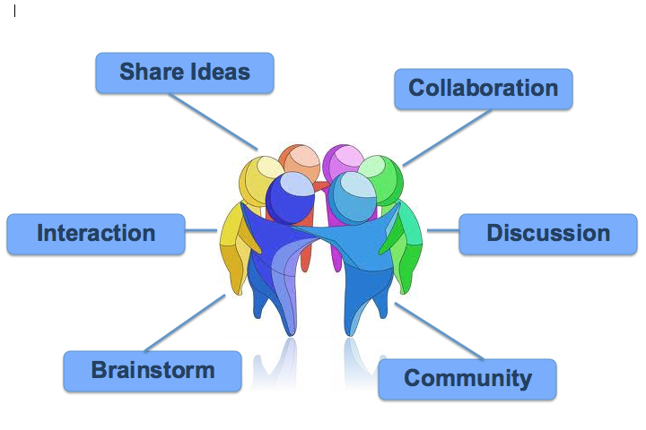
Safety Mapping: The Heart of Collaborative Practice
Developing understanding whereby everyone is clear about why we are here, what we are trying to accomplish, and how we are going to do it
Participation which allows everyone's voices to be heard and allows people to feel a sense of ownership and presence in the process
Creating shared commitments
for action and the outcomes
Notes:
What is mapping?
Mapping is not a form
It’s a facilitated process that helps a group gather information, organize that information, then try to move to group agreements.
It helps institutionalize critical thinking
It allows us to ask three questions and learn the position, or perspective, of all the parties.
Mapping contains a framework that helps us organize the information we receive into some useful categories for anyone participating in a child welfare work to make sense of.
Once that information is organized it may be a little easier – not easy, but just a little easier – to reach group agreement with the people who matter most in the case: the child, his/her family and the personal and professional network around them.

Slide 34
Key Shift: Engagement
Assessment of families
Assessment with families
Empathy
Empowerment
Engagement
Notes:
What is the formula for true engagement? Empathy & Empowerment!
Traditionally in social work and in child welfare we have seen assessment as a fully professional activity. We put something – or someone – under our study, we gather information and analyze that information. It’s a powerful tool and it can still serve us well.
But it is incomplete if we are truly thinking about partnership-based work. In this approach, the people we are working with are no different than us. If you were all of a sudden working with a child welfare professional (or any other helper) would you want the assessment to be something totally done “to” you? You might want the helper’s expertise, but you would also, likely, want to be included, want your best critical thinking and ideas brought into the conversation. We could call this “assessment with” instead of just “assessment on”. That’s what this mapping process tries to do.

Slide 35

What: Safety mapping is a process of gathering and organizing the information to reach joint understanding and agreement.
Why: A regular problem in child welfare is the lack of understanding, participation, and agreement between the family and the organization (and within the organization itself).
How: Can be used with the family to guide an assessment and planning conversation and can be used in supervision or case consultation.
Safety Mapping is the framework used to facilitate a Child and Family Team Meeting
Notes:
Review key points. Make additional point that mapping is a collaborative assessment and planning process that can be used at many points in case work:
Individual Supervision
Group Supervision
Family team meetings
At the kitchen table
Case consultation
Guides discussions at home visits

Slide 36

Core Safety Mapping Values & Beliefs
Relationships are the most significant factor in promoting child safety, permanency, and well-being.
The words we use matter—building a series of shared agreements over time to reach a larger goal requires that we share some common language.
Organizing information about safety and danger to children is not easy—
it can be hard to admit we might be wrong.
The more that information is effectively organized among all the key people involved, the more likely it is that effective decisions can be made.
Notes:
There are some core assumptions or values that underlie this mapping process. Read key points.
Think of your mapping experiences, could one of these elements have made it better?

Slide 37
Dialogue Structure: Facilitating Meetings
Meeting Stage | Key Questions to guide each stage of the meeting
Purpose/Desired Outcome | Why are we meeting today? What do we want to talk about? What do we want to walk away with today (A plan, list, decision, etc.)
Context | Is there anything that might pull our attention away from our focus today?
Group Agreements | How do we want to work with each other?
Network/Child & Family Team | Is everyone here that should be here? If not, what should we do to get everyone here that should be here? (Genogram, ecomap, Safety Circles/Circles of Support, cultural considerations, safety considerations)
Content | What’s working well, What are we worried about? What is the impact on the child(ren)? Gray Areas? (Safety Mapping process)
Next Steps | What steps do we need to take from here? Who does what? By when? Next meeting date?
+/∆ Feedback | What worked? What should we do differently next time?
Notes:
Refer to handout in participant workbook: Facilitated Dialogue Structure
We’re going to start walking through the mapping process. Remember how we talked about relationships matter, the words we use matter, you start developing that in the initial parts of the mapping i.e. developing purpose, connecting, agreements….
Mapping begins by setting the context for the mapping and engaging the family. This is the way social workers can prepare families for the meeting ahead of time.
Refer participants to the “Dialogue Structure for Facilitating a Family Meeting” found in their materials.
Purpose / Desired Outcome: you start by asking about purpose. What does the person seeking the consult or the group attending the consult want to get out of it? Is it a decision, a plan, something else? If it involves a decision of some kind, which SDM assessment can help with that decision?
Context: Check for any distractions that may pull attention away from the focus of the meeting. Does anyone have time constraints?
Group Agreements: How do we want to work with each other? Facilitator charts group agreements on flip chart paper or dry erase board. Please refer to page 14 in the trainers guide for more information and examples of group agreements.
Network / Stakeholders / People and Community: Next move to these questions: Who is in the family? Who cares about the child? Who do we wish could be in this room if at all possible for this conversation? What can we do to get everyone here that should be here? Tools: Genogram, Eco-map, Safety Circles.
Cultural Considerations: What is the race, gender, ethnicity, sexual orientation, etc. of the family and the people who care about the child? What role, if any, do these important parts of identity play in ability to enhance safety for the child?
Content: This is the safety mapping portion of the meeting using the three questions as a guideline: What’s working well? What are we worried about? What’s the impact on the child? Gray Area?
Next Steps: What steps do we need to take from here? This is the time to define the roles of all participants and the timelines for each action step. How will this plan be monitored? Then, schedule a follow-up meeting.
Plus/Delta: What worked well during this meeting? What should we do differently next time?

Slide 38
Safety Mapping Content Starts With the Three Questions
What are we worried about?
What is working well?
What needs to happen next?
Notes:
Mapping begins with the three questions, what are we worried about, what is working well and what needs to happen, and then moves into much more detail.
Please note that the word “worry” is by design. Ask what the difference is for them when you ask what they are worried about vs. telling them that the agency is “concerned” about them. Someone usually says it feels more respectful and human. That’s the point – it is more likely to build engagement.
As we go through this I would like to ask you to think, what parts of this framework feel like it would be helpful in your work? What parts are “value added” to your practice? And what worries might you have? Think about it as we move forward.

Slide 39
Safety Mapping Key Terms
What are we worried about?
What is working well?
Danger
Risk Level
Harm
Complicating Factors
Safety
Strengths
Notes:
Next, we look at two of the three questions and see that they divide up into smaller categories.
When we talk about “what are we worried about” we are talking about harm, Danger and complicating factors. When we talk about ‘what is working well’ we are talking about strengths and safety.
Cover subtle difference in definitions for danger and risk – they a very similar and can cause some confusion due to being used interchangeably depending on what tools & strategies are being used
SOP uses Danger Statements; SDM and Consultation and Information Sharing Framework refers to Risk vs. Danger
The words we use matter and diﬀerent people often say the same words but mean diﬀerent things. This is the common language SOP helps us to develop so that the agency and the family can always be on the same page.
What you can see is that harm is always about the past. Something has happened and has already impacted the child.
Danger is about the future. It is what we are worried about. As some of you may remember from the ﬁrst module, one of the core concepts of Signs of Safety is being able to distinguish “what has gone on in the past” with “what we are worried about happening in the future.” Knowing about the past is particularly helpful in informing “what we are worried about in the future.” Remember, the best predictor of future maltreatment is past maltreatment.
Risk Level here is the same deﬁnition of risk we use when we think of SDM. Risk is about likelihood or probability. Think about a high-risk pregnancy – when someone has been classiﬁed as having a high-risk pregnancy it doesn’t mean something bad will happen, it means that based on the characteristics of the mother or unborn baby, they “look like” other mothers/children that have tough times during birth. That’s how SDM used Risk and what mean when we are using the word here.
Statistically, the best predictor of future harm is past/current harm. It is thankfully not a guarantee but our ability to know what we are worried about happening in the future (the Danger) and how worried we should be (the risk) rest on understanding of what has gone on in the past (the harm). An important thing here thought is going to be our ability to distinguish what is real harm vs. what are things that are “less than optimal” but may not be harm.
One key is distinguishing harm and Danger from other things that may not be impacting the child.
Ask yourself: what questions do I need to ask to understand the impact of the caregiver's actions on the child? Difficult things that are not harm can happen to and within families.
Trainer’s Note: “Risk” and “Danger” are slightly different although they are often used interchangeably in child welfare work (i.e. SDM uses “risk”, SOP has traditionally used “Danger statement”, Consultation Framework uses “risk statement,” etc.); Danger is what we are worried will happen in the future if nothing changes; Risk is about HOW worried we should be about the danger occurring.
Complicating factors are different. They are things that are worrisome and concerning, but in and of themselves are not caregiver actions that are impacting the child. In general, child welfare agencies are good at opening cases because of harm and Danger, but cases often can stay open for years because of complicating factors.
NOTE: You can have brief discussion here about what people think about these deﬁnitions but keep moving through material.
All families have some signs of safety. The best predictor of future protection is past protection.
Without searching for examples of protection, it is difficult to know the extent of the signs of Danger or to determine how protection could be enhanced and measured in the present and future.
Safety: This deﬁnition of safety helps hold the model together – the model is ‘safety organized’ because the work is organized around safety. Notice that safety is a VERB. It is more than the absence of Danger.
The key is to consider the definition: are these actions of protection demonstrated over time? Or are these things good and helpful … but maybe not safety?
DISCUSSION: If this was child welfare’s deﬁnition of safety…and we shared it with families, providers, the courts…and this became ‘north’ on the compass and what we looked for in our work…what, if anything, would change about child welfare services? What would change about your work?
Supporting strengths: Strengths are good, positive things in families, but until they become acts of protection demonstrated over time, they are not the same as safety. This includes skills of living, coping skills, and/or cultural/familial histories of recovery or support that are important but do not directly support the provision of protection.
Just as with harm/Danger, what distinguishes safety and strengths is also that a caregiver has taken an action that has protected the child or mitigated the Danger.
If it is an action that has done this, it is safety. If not, it is a good thing, but it is a strength or a protective capacity, not safety.
Just like the best predictor of future maltreatment is past maltreatment, the best predictor of future “acts of protection” is past actions of protection. All families have some history of being able to keep their children safe, all families have some ‘signs of safety’. If we don’t look for them though we are missing ½ of our “balanced assessment.

Slide 40
SOP Mapping Definitions
Harm
Past or present caregiver actions that resulted in negative impact to the child.
Danger
Worries about future behavior by the caregiver that may cause further harm to the child.
Complicating Factors
Circumstances in or around the family that are worrisome, cause stress, or complicate a family’s ability to ensure safety, but that in themselves are not harm or danger to a child.
Notes:
Refer to handout in participant guide: SOP Glossary

Slide 41
Safety
Acts of protection demonstrated over time by the caregiver that effectively keep the child safe from future harm or danger.
Supporting Strengths
Qualities, circumstances or capacities in a family that are positive or beneficial, but are not, in themselves, acts of protection that result in child safety.
Safety Network
A group of family, friends and professionals who care about the child, are willing to meet with CWS, understand the harm/danger concerns, and are willing to take specific action that supports the family and helps to keep the child safe.
Mapping
A structured process of exploring, with a family, worries (harm, danger, and complicating factors); what’s working well (safety/acts of protection and supporting strengths); and what needs to happen next to ensure child safety, permanency and well-being.
Notes:
Refer to handout in participant guide: SOP Glossary

Slide 42
Danger vs. Risk
Danger
What exactly we are worried about (the danger statement)
Risk
How worried we should be (the risk level)
Danger is about the short term
  Imminent threat of serious harm
  Harm may occur in next week or month
  Danger is related to safety
Risk is about the long term
  Probability that child maltreatment will occur in next one to two years
Notes:
Cover subtle difference in definitions for danger and risk – they a very similar and can cause some confusion due to being used interchangeably depending on what tools & strategies are being used
SOP uses Danger Statements
SDM and Consultation and Information Sharing Framework refers to Risk vs. Danger

Slide 43
Three-Column Mapping
What Are We Worried About? | What Is Working Well? | What Needs to Happen Next?
Harm, danger, and complicating factors: SDM safety threats described here | Safety, protective capacities, and strengths: SDM protective actions described here | Creating and sharing a Danger Statement, enhancing a safety network, planning: SDM risk level: use results to help determine next steps
1
10
On a scale of 0 to 10, with 10 being everyone knows that the children are safe enough to close the case and 0 being things are so bad that the children cannot be at home now, where is this situation rated? (If there are different judgments, place different people's numbers on the continuum.) - Department of Child Protection (2011)
Notes:
This is what is called “three-column” mapping. As you can see, it starts with the three questions as the primary way of organizing the map. This is an excellent tool for having conversations with families, home visits, etc.
While it may seem very simple, this can be a powerful way to begin organizing your thinking. But it would be even more powerful to do this with a family.
Take a piece of paper with you to a home visit, put it on its side, and put the three questions on the top.
Let the family see what you are doing – it helps them understand what our work is about.
You will also notice there is a scale on each of these maps. Just as we heard in Luck’s story, the scale helps with two things – it can help assess really “where does everyone think things are” when it comes to Danger and safety. And once we have a number it can help us think through ‘small steps’ when we ask ourselves and our clients “what would things have to look like for the scale to improve by one number”?
And this where the SDM sections would go: Safety threats are worries, protective capacities are things that are working well. The risk level helps us to determine next steps.

Slide 44
Cheryl’s Three Column Map
What Are We Worried About? | What Is Working Well? | What Needs to Happen Next?
Cheryl turned on the gas stove with her children at home, flooding the home with toxic fumes. Both she and the children passed out. Cheryl lost her job and cannot pay her bills. Cheryl has been diagnosed with clinical depression. Cheryl stopped taking her medication three months ago. Cheryl says her ex-husband hit her a number of years ago. Cheryl's father was physically Dangerous to both her and her mom when she was a child, and she had to grow up outside of her parents’ care. | Cheryl put the children in next room and opened a window before turning on the gas. The girls’ pediatrician and teacher say Cheryl takes good care of the girls. They are medically up to date; she attends parent/teacher conferences and sends the girls to school dressed cleanly with lunches packed. Cheryl took out a restraining order after her husband hit her. Cheryl is proud of her high school diploma. Cheryl's mother made sure she was protected from violence and able to get an education living at Cheryl’s aunt’s house. | Danger statements Safety goals Expanding the safety network Planning Risk level is moderate by score—upgraded to high by policy. There also is an unresolved safety threat.
1
Danger
10
Safety
Notes:
If we were to lay out a basic version of a three-column map with Cheryl’s information, here is what it would look like. There is not a lot of detail here yet, but you can see how a basic sorting of the information starts to look like.
NOTE: Trainers could use this moment to ask a discussion question:
Any thoughts about what it would be like for Cheryl to do this with a worker?
What would you be worried about, if anything, in doing this with Cheryl? Why?
What do you think might be helpful in doing this with Cheryl? Why?

Slide 45
The Child and Family Team
Child and family team meetings are one tool of the CFT engagement and
service delivery process.
Teaming is a process, NOT an event!
The Child and Family Team:
Child/Youth/NMD
Family | Natural Supports
Caregiver (and FFA/STRTP)
Social Worker/Probation Officer
Mental Health | Tribal Partners
Other Professionals | CASA
Skilled & Trained Facilitator
Education Partners
Community Supports
Notes:
Review the slide: What is the CFT? Refer to handout: CFT Meetings Quick Guide
State-mandated practice for one integrated team process for all needs related to a child/youth and family while in foster care
Team of people identified with the family
Supports the team in addressing strengths and needs and coordinating care (using CANS)
CFT meetings (CFTMs) are one component of CFTs
Team meetings are critical opportunities to demonstrate the principles of effective core practice, including empathy, empowerment, and awareness about the impact of trauma.
For more information: ACL 16-89 (CFTs), ACL 18-09 (CANS & CFTs) and ACL 18-23 (CFT FAQ)
CFT Practice https://cdss.ca.gov/inforesources/foster-care/child-and-family-teams
CANS Practice https://cdss.ca.gov/inforesources/foster-care/cans/the-cans-tool/cans-resources
CFT/CANS Toolkit: https://calswec.berkeley.edu/cftcans-implementation-support-toolkit
Refer to handout: CFT Meetings – Quick Guide

Slide 46
CANS: Enhancing and Supporting the CFT
Summarizes the Assessment Process
The CANS is intended to be the process by which the assessment information is organized, summarized, used and communicated after it has been collected.
The Child & Family Team (CFT) is the vehicle for collaboration on assessment, case planning, and placement decisions.
Integrates the Family’s Story
The CANS provides a summary of the family’s story, but it should be done as an integration of multiple story tellers.
Develops a Shared Vision
The consensus-based process of determining action levels on items, and prioritizing relevant needs and strengths to build creates a shared understanding from which a coordinated plan is developed.
Supports Change Management
Mapping the CANS to the plan facilitates outcomes monitoring and management by the team members, allowing for plan adjustment, acknowledgement of accomplishments and celebrating goals that have been met.
Notes:
The CANS is an information integration tool that is used to identify the needs and strengths of children/youth and their families.
Consensus ratings by multiple informants help achieve collaborative, consensus-based assessment – a common language framework that aids understanding of presenting issues, impact, and effectiveness across multiple levels: family, program, system.
The CANS is to be completed as part of a group process with core stakeholders.
Multiple points of view are represented and consensus on the level of action needed to address each identified need and strength leads to a clear, mutually agreeable action plan.

Slide 47
CFT Requirements
Required Timelines:
Required Topics:
Other Meeting Reasons:
Within 60 days of entering foster care (child welfare) or ordered into placement (probation)
Case plan development/ CANS
Safety Planning
At least once every 6 months
Every 90 days (if receiving ICC, IHBS, or TFC)
Placement preservation strategy
Placement disruption
Presumptive transfer
Permanency Planning
Potential Placement Change
Visitation
Return after absent from placement
School of origin
As determined by the team
STRTP Placement
Mental Health Services
Notes:
Review best practices for CFT meetings
CFT meetings must occur:
Within 60 days of the child’s placement in foster care
Every 90 days for youth receiving ICC, IHBS, or TFC
Every six months with case plan development for youth not receiving SMHS
For possible placement changes (includes placement in an STRTP
As frequently as needed to address needs of the child/youth, including need for SMHS (The need for SMHS may also include TFC, hospitalization, medication, changes in medication, etc.)
CFT meetings must include:
Specific discussion regarding the placement, behavioral health, and other needs of the child/youth
A plan to meet those needs
Use of the CANS for communication and case planning
An SOP CFT meeting meets the State mandate when requirements are met for:
Participants
Timing/frequency
Topics covered (including CANS)

Slide 48

Preparing for the meeting:
What does the worker need to know?
    Placement status / Education status
    Child’s mental health/physical health
    CANS strengths and needs for child & caregiver
    Potential safety issues / who will be at the meeting
What does the family need to know?
    Purpose of the meeting
    Who will be at the meeting (required vs. who they would like there, including natural supports)
    Overview of what will be discussed
    Concerns/questions about the meeting
Notes:
Meetings require a lot of planning!
Worker prep:
Placement status
Education
Child’s mental health/physical health
CANS strengths and needs for child & caregiver
Potential safety issues/who will be at the meeting
Preparing the child and family: It is very important that we prepare the family for the CFT!
Imagine you are a parent and your child was brought into care or custody. What would you need to understand?
The following items should be discussed with the family prior to each meeting:
Purpose for the meeting
Who will be at the meeting (required vs. who they would like there, including natural supports)
Overview of what will be discussed
Concerns/questions about the meeting

Slide 49
Overview of Mapping Documents / Handouts
Handout title | Purpose of handout
Safety Mapping Quick Guide | Overview of Safety Mapping
CFT Meetings Quick Guide | Overview of CFT Meetings
ER Meeting Map | CFT meeting map for ER/Safety Planning Meetings
ER Meeting Structure & Content Guide | Instructions for CFT meeting map for ER/Safety Planning Meetings
FM-FR Meeting Map | CFT meeting map for FM/FR Meetings
FM/FR Meeting Structure & Content Guide | Instructions for CFT meeting map for FM/FR Meetings
PP-NMD Meeting Map | CFT meeting map for PP/NMD Meetings
PP/NMD Meeting Structure & Content Guide | Instructions for CFT meeting map for PP/NMD Meetings
CFT Meeting Key Issues & Questions by Meeting Purpose | Overview of key issues/questions to ask by CFT meeting purpose
ER Meeting Map – Cheryl | Sample CFT Meeting Map – ER/Safety Planning for Cheryl’s case
Notes:
Refer participants to their mapping handouts in the participant workbook.
Please note: The structure & content guides are in the participant guide, as they are informational only and are not being used for group activities.
Northern Academy has created some new CFT meeting maps that are based on service component (ER/Safety Planning, FR/FM, and PP/NMD) and adapted from the Consultation and Information Sharing Framework ® Sue Lohrbach, 1999 (primarily used in RED teams and Group Supervision practices).
The SOP CFT meeting maps use the Three Column SOP mapping format and also start to bring in the CANS. They map closely to each other but shift slightly to reflect the priorities of cases as they move through the system.
Give a brief review of the mapping handouts as listed on the slide:
Safety Mapping Quick Guide
CFT Meetings Quick Guide
ER Meeting Map
ER Meeting Structure & Content Guide
FM/FR Meeting Map
FM/FR Meeting Structure & Content Guide
PP/NMD Meeting Map
PP/NMD Meeting Structure & Content Guide
CFT Meeting Key Issues & Questions by Meeting Purpose
CFT ER Meeting Map – Cheryl
Blank versions of all 3 maps for note taking/mapping activity
Please note: Some Counties use the Consultation and Information Sharing Framework, some use the 3 column map some may use the other mapping documents as shown in these slides.

Slide 50
CHILD & FAMILY TEAM (CFT) MEETING MAP – EMERGENCY RESPONSE
Meeting Type: □ Case Consultation □ RED Team □ Safety Mapping w/Parent(s) □ Emergency Removal CFTM □ Risk of Removal CFTM Other: _______ Meeting Purpose/ Focus: What is our intended outcome of today’s meeting? What do we hope to achieve by the end of the meeting?
Complete genogram, ecomap, Circles of Support as appropriate.
What are we worried about/needs? | What’s working well/strengths? | What needs to happen next?
Reason for Referral/Harm | Safety | Shared Vision / Safety Goal
Danger | Supporting Strengths | Gray Area
Complicating Factors | Safety/Support Network | Brainstorming/Ideas
Needs of Child/Youth | Strengths of Child/Youth | Next Steps/Action Plan
Consultation and Information Sharing Framework ® Sue Lohrbach, 1999 – Adapted with permission by the Northern Academy
1 2 3 4 5 6 7 8 9 10
Notes:
The next three slides reflect three different meeting maps that integrate the Consultation and Information Sharing Framework from Sue Lohrbach with the Three Column SOP mapping format and also start to bring in the CANS. There are three different tools, one for ER, one for FM/FR (including VFM), and one for PP/NMD cases. They map closely to each other but shift slightly to reflect the priorities of cases as they move through the system.
The ER CFT Meeting Map can be used for internal referral staffing, RED Teams, kitchen table mappings or formally facilitated CFT meetings at the ER level.
Please note: The meeting maps can be completed electronically during internal case consultations, etc. but should not be typed into during an in-person CFT meetings with the family (charting using flip chart paper is ideal and strongly recommended). However, typing into the electronic form is a useful way to capture the information during virtual CFT meetings

Slide 51
CHILD & FAMILY TEAM (CFT) MEETING MAP – FM/FR
Meeting Type: □ Case Consultation □ Case Planning CFTM □ Placement CFTM □ Transition Home CFTM □ Case Closure CFTM Other: _______
Meeting Purpose/ Focus: What is our intended outcome of today’s meeting? What do we hope to achieve by the end of the meeting?
Meeting Met Statutory Requirements for CFT: □ Yes □ No Complete genogram, ecomap, Circles of Support as appropriate.
What are we worried about/needs? | What’s working well/strengths? | What needs to happen next?
Current Worries that Need to Be Addressed | Safety | Shared Vision/Safety Goal/Well-Being Goal
Harm & Danger | Supporting Strengths | Gray Area
Complicating Factors | Safety/Support Network (Child & Family Team) | Brainstorming/Ideas
Needs & Strengths to Build of Child/Youth (CANS) | Strengths of Child/Youth (CANS) | Next Steps/Action Plans
Consultation and Information Sharing Framework ® Sue Lohrbach, 1999 – Adapted with permission by the Northern Academy
1 2 3 4 5 6 7 8 9 10
Notes:
The FM/FR CFT Meeting Map can be used for internal case consultations, kitchen table mappings or formally facilitated CFT meetings at the FM/FR level.

Slide 52
CHILD & FAMILY TEAM (CFT) MEETING MAP – PP/NMD
Meeting Type: □ Case Consultation □ Case Planning CFTM □ Placement CFTM □ 90-Day Transition CFTM □ Other: _________________
Meeting Purpose/ Focus: What is our intended outcome of today’s meeting? What do we hope to achieve by the end of the meeting?
Meeting Met Statutory Requirements for CFT: □ Yes □ No Complete genogram, ecomap, Circles of Support as appropriate.
What are we worried about/needs? | What’s working well/strengths? | What needs to happen next?
Current Worries that Need to Be Addressed | Permanency/Independence/ Belonging/Safety | Shared Vision / Well-Being Goal
Permanency/Independence/ Belonging/Safety | Supporting Strengths | Gray Area
Complicating Factors | Safety/Support Network (Child & Family Team) | Brainstorming/Ideas
Needs & Strengths to Build of Child/Youth (CANS) | Strengths of Child/Youth (CANS) | Next Steps/Action Plan
Consultation and Information Sharing Framework ® Sue Lohrbach, 1999 – Adapted with permission by the Northern Academy
1 2 3 4 5 6 7 8 9 10
Notes:
The PP/NMD CFT Meeting Map can be used for ILP meetings, 90 day transition plans, placement changes, permanency meetings, formally facilitated CFT meetings at the PP/NMD level.

Slide 53
CHILD & FAMILY TEAM (CFT) MEETING MAP – EMERGENCY RESPONSE (CHERYL’S CASE)
Meeting Type: □ Case Consultation □ RED Team □ Safety Mapping w/Parent(s) Emergency Removal CFTM □ Risk of Removal CFTM Other: _______
Meeting Purpose/ Focus: Make a decision about where the children will live while Cheryl gets help for her depression
Meeting Participants: Cheryl Williams, mom; Trina Evans, family friend; Paul Richards, neighbor; Sarah Moreno, sister; Anna Johnson, social worker; Maria Mendes, supervisor Complete genogram, ecomap, Circles of Support as appropriate.
What are we worried about/needs? | What’s working well/strengths? | What needs to happen next?
Reason for Referral/Harm | Safety | Shared Vision/Safety Goal
Harm Statement: Cheryl turned on the gas stove in her kitchen while the children were at home, flooding the home with toxic fumes, causing both herself and the children to pass out. When Cheryl and Ben were together, Ben got drunk almost daily and was physically violent to Cheryl in front of the children while drinking. He called and texted Cheryl daily after she left, calling her names and threatening her, until she got a restraining order. | Cheryl put the children in next room and opened a window before turning on the gas. Cheryl and the kids are safe and ok. Cheryl left Ben a year ago due to the violence and took out a restraining order nine months ago. She also changed her phone number. Cheryl got the girls in counseling to deal with their trauma of watching their dad hit their mom. | Cheryl will work with CWS and a network of family, friends, and providers to show everyone that she will always ask for help if sadness or depression start to get in the way of taking care of the girls or if she starts to think about hurting herself again. CWS will need to see this plan working continuously for six months to consider returning the girls to Cheryl’s care.
Danger | Supporting Strengths | Gray Area
Danger Statement: Child Welfare Services, the doctors at the hospital, Trina, Sarah and Paul are worried that Cheryl may try to hurt herself again in the future; that she might be seriously injured or die; and that the children could be very frightened, seriously injured, or left motherless. CWS, Trina, Sarah, Paul and Cheryl are worried Ben will continue to drink, be verbally or physically dangerous to Cheryl, and not understand the impact on his children of witnessing their dad hit their mom or call her names. | Cheryl put the children in next room and opened a window before turning on the gas. The girls’ pediatrician and teacher say Cheryl takes good care of the girls. They are medically up to date; she attends parent/teacher conferences and sends the girls to school dressed cleanly with lunches packed. Cheryl took out a restraining order after her husband hit her. Cheryl is proud of her high school diploma. Cheryl's mother made sure she was protected from violence and able to get an education living at Cheryl’s aunt’s house. | What is Ben’s current living situation? What does Ben’s current alcohol use look like? What is Ben’s understanding of the impact of the domestic violence on Cheryl, Rebecca and Akiba?
Notes:
Refer to handout: CFTM Map – ER Cheryl
What do you notice? What might we add to the Gray Area?
What information are we missing?
Please note: Most counties may use a simplified version of this such as the three columns.

Slide 54
Cheryl’s ER meeting framework (continued)
What are we worried about/needs? | What’s working well/strengths? | What needs to happen next?
Complicating Factors | Safety/Support Network | Brainstorming/Ideas
Cheryl lost her job and cannot pay her bills. Cheryl has been diagnosed with clinical depression. Cheryl stopped taking her medication three months ago. Cheryl says her ex-husband hit her a number of years ago. Cheryl's father was physically Dangerous to both her and her mom when she was a child, and she had to grow up outside of her parents care. | Trina Evans, family friend Paul Richards, neighbor Sarah Moreno, sister | Kids home with Cheryl with someone checking in daily, with VFM or Court FM services Kids stay with Trina while Cheryl gets FR services Next Steps/Action Steps Safety Decision: The kids will remain in out-of-home care while Cheryl receives services and supports to address the safety issues caused by her depression. Who What By When Anna Set up visit for Cheryl & Today the kids Trina Facilitate nightly calls for Starting Cheryl & the kids tonight CWS & Trina Complete next step of 12/6/19 RFA approval process Cheryl Make follow-up appt with 12/6/19 psychiatrist Sarah Go with Cheryl to psychiatrist TBD appt when scheduled Team Case planning CFT meeting 1/15/20
Needs of Child/Youth | Strengths of Child/Youth
The girls are separated from their mom. Rebecca is very anxious without her mom, has been crying constantly and hasn’t slept. Akiba has delays in her speech. | Rebecca does great in school and is very smart and responsible. Akiba is funny and social with everyone. The kids are staying in their schools.
Scaling for Current Safety
1 2 3 4 5 6 7 8 9 10
Notes:
Any thoughts about how the information is organized on the map?
Additions?
Questions?
What does this practice look like in your agency?

Slide 55
Why a Map AND an Assessment?
MAP
ASSESSMENT
Use in the field
Family-centered
Formatted to help professionals organize their thinking and judgment
Shared language for professionals, family members, anyone involved with the family
Brings the best of large data sets to practice decisions
Research-based
Consistency
Reliability (definitions)
Equity
Aggregate data
Notes:
Maps are very helpful when organizing information and creating a document the family can see and understand.
But alone, each worker may have different ideas about whether or not something constitutes Danger.
The SDM assessments aren’t usually helpful to have on the kitchen table with the family.
The map can be helpful in that situation.
The SDM assessments also allow information about individual families to be aggregated so the agency has good information about the families served.
Maps can’t provide aggregate data
So you might be asking, why do we need a map and an assessment? How do they work together?
One example is to use the Assessment tools to get clear – what is the critical information we need to acquire to make the decision we are at right now? Then use the map to help gather and organize that information. Together it produces a process that contains both collaboration and a consistent result.
Another example might look like this: I start safety mapping with the family to help build a relationship and gather the information I need. I bring that to the risk assessment which helps me understand that likelihood that this family may maltreat their child again. Together – the relationship I have made with the family and the information I now know about the likelihood of future maltreatment – helps the family and I to make good decisions and good plans.

Slide 56
Safety Mapping
Practice Activity
Notes:
Prepare for mapping demonstration: Assign roles to tables (see next slide)
Remind the class of our group agreements – importance of maintaining safety in the room during this practice activity.

Slide 57

Mapping Demonstration: Activity Instructions
  Social Worker will present basic case details
  Table groups will observe based on assigned roles (see next slide)
  Participants can ask clarifying questions
  Instructor will chart in front of the class to demonstrate a case consultation with a supervisor utilizing the SOP mapping process
Notes:
Please allow at least 1 hour, 30 minutes for this exercise.
Provide an overview of the activity that is about to begin. Please refer to next slide for “Mapping Roles” that will be assigned to each table during the activity.
WHAT: A live demonstration of a consultation utilizing one of the CFT Meeting Maps (based on service component of case presented by social worker / ER, FM/FR, PP/NMD)
WHAT: A live demonstration of a consultation utilizing one of the CFT Meeting Maps (based on service component of case presented by social worker / ER, FM/FR, PP/NMD)
This is a case consultation between the worker and their supervisor, the family is not present. This would be an example of a conversation to gather all information to prepare the worker for next steps, prepare for the next CFT meeting, at a key decision point, etc.
WHY: To let everyone experience the process and let them see it applied to a case from their jurisdiction/county, which can increase their understanding of the process and how useful it can be to their practice.
Applicable Handouts for trainers:
CFT Meeting Maps (for reference)
Laminated Mapping Role cards (hand out mapping role cards to each table…trainers will check in with participants throughout the mapping activity, or at the end…at trainer’s discretion)
Applicable Handouts for participants (participant workbook):
Facilitated Dialogue Structure (for reference)
SOP Definitions (for reference)
CFT Meeting Maps (for reference)
Voice of SDM Assessment handout (to provide more information about the importance of using SDM in the mapping process).
Mapping a case involves the following steps:
Step 1: Selecting a Case
It is important to choose the case for this exercise wisely. Early in the day, tell the group that you will be doing a case consult and ask if anyone is willing to talk about a case that the group can learn from.
Always have at least two examples to choose from before deciding. Look for a case that you can use as an example throughout Day 2 to make harm statements, danger statements, and safety goals. Try to select a case with a clear incident of past harm from which danger statements and safety goals can easily be created. At a minimum, choose a case that will lead to a clear danger statement.
Cases to Avoid
Cases with lengthy histories that will take a long time to write up.
Cases based solely on a child’s actions and the danger in which his/her actions are putting him/herself or others. Mapping will work for those cases, but they are not great training examples.
Cases in which there appears to be no harm or danger, but strong measures have been taken with the family already. These cases put facilitators in the position of displaying poor work and deciding how much or little to comment on it.
Step 2: Board Set Up and Handouts
Set up board with the headings from the appropriate CFT Meeting Map
Suggestion for participants: refer to Facilitated Dialogue Structure handout during the mapping activity.
Step 3: Agreements and Mapping Roles
Create agreements with the group about the consult.
Information. This demonstration is designed to show how the framework helps to organize information. You may not learn everything you wish you could know about the family.
“I don’t know” is okay. Because the worker talking about his/her work has just today agreed to do this, he/she has not reviewed the record and may not be able to answer each question the facilitator asks. It is okay to say “I don’t know.”
The facilitator asks the questions. This is to avoid the phenomenon in case consults where the worker giving information is asked many questions by many people. The facilitator promises to check in with the group at several points for questions he/she is not asking that should be asked, but those questions should be directed at the facilitator, not at the worker.
Watch out for judgments. If anyone finds him/herself in a place of judgment about the worker, either positive (“Wow, what good work”) or negative (“Wow, what terrible work”), recognize that the whole story is not clear. Remember that we do not know everything about the case rather than using judgments or assumptions.

Slide 58
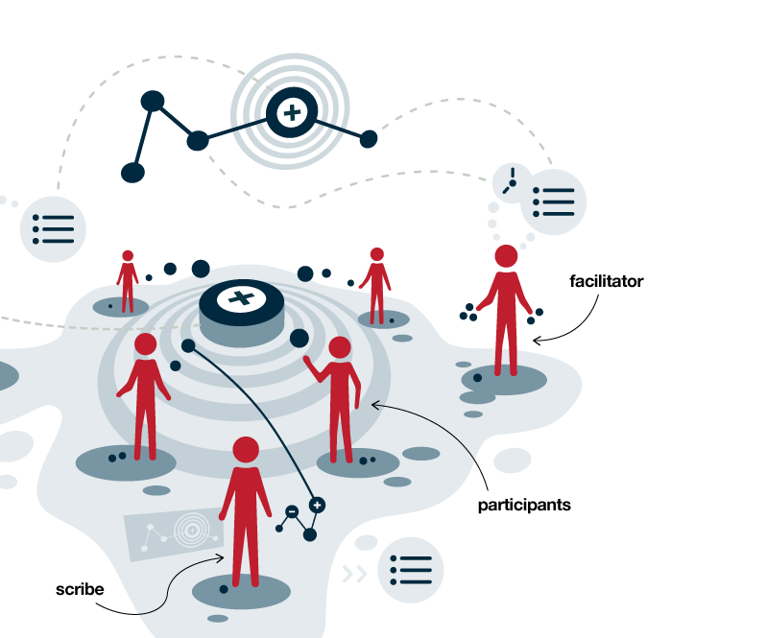
Mapping Roles
Voice of SDM
Trauma Informed Practice
Cultural Humility
Listening for Jargon
Solution Focused Questions
Collaborative Practice
Notes:
Mapping Roles: Each group will be assigned one of the following roles during the mapping activity. The facilitator will check in with each table throughout the activity.
Assign mapping roles for each table/group as outlined on the slide. Place mapping role signs on each table.
Explain each role so that participants know what to listen for during the activity. Encourage them to write down questions and thoughts during the mapping activity.
Please note: There are different options for trainers to consider when checking in with participants in regards to their specific mapping “roles”.
Option 1: You can check in with the various roles throughout the mapping activity as it comes up, although this may take more time.
Option 2: You can go through the entire mapping activity then check in with each table to solicit their thoughts, questions, and feedback regarding their specific role.
Exception: Voice of SDM table will likely be asked to weigh in on what the SDM definitions are during the mapping in regards to the specific case being mapped.
Definitions of roles and things to look for during the mapping:
Mapping Roles: Each group will be assigned one of the following roles during the mapping activity. The facilitator will check in with each table throughout the activity.
Assign mapping roles for each table/group as outlined on the slide. Place mapping role signs on each table.
Explain each role so that participants know what to listen for during the activity. Encourage them to write down questions and thoughts during the mapping activity.
Please note: There are different options for trainers to consider when checking in with participants in regards to their specific mapping “roles”.
Option 1: You can check in with the various roles throughout the mapping activity as it comes up, although this may take more time.
Option 2: You can go through the entire mapping activity then check in with each table to solicit their thoughts, questions, and feedback regarding their specific role.
Exception: Voice of SDM table will likely be asked to weigh in on what the SDM definitions are during the mapping in regards to the specific case being mapped.
Definitions of roles and things to look for during the mapping:
Voice of SDM: The voice of the SDM assessment. If the worker giving the consult is at a key decision point with which an SDM assessment would help, the facilitator will check in with the “voice of the SDM assessment.” This person looks at the SDM assessment to keep the group on track to gather all the information needed for the assessment. For more information, see “The Voice of the SDM Assessment” in the “Introducing Safety- Organized Practice” packet.
Trauma Informed Practice: Listen for any evidence of trauma informed practice in the case consultation. Is the trauma of child welfare involvement considered? Is there a history of trauma for parent or child that may be impacting the current family situation?
Cultural humility: Ask about race, culture, religion, ethnicity, etc., and the role it has played in the work so far. How have any differences between the worker and the family played out in their relationship? Do the recommended services and supports reflect the individual needs and cultural identities of the child and family? Are services and resources fair and equitable?
Listening for Jargon: Listen for any jargon, stereotypes and/or generalizations, he’s an “alcoholic,” she’s “stable,” etc. Listen for opportunities to be more behaviorally specific i.e. what is the actual impact on the child in behavioral terms? Are the action steps in the safety plan and/or case plan behaviorally specific and easy to understand?
Solution Focused Questions: Were any Solution Focused Questions used with the family? What Solution Focused would you have for the family? Any suggestions for SF questions the worker can use with the family being mapped?
Collaborative Practice: Listen for inclusion of child, parent, network, service provider, agency voices. How was child & family voice & choice highlighted and lifted up? Any recommendations for improvement?
Move to next slide to begin the mapping (choose appropriate meeting map based on the case selected for the activity)

Slide 59
CHILD & FAMILY TEAM (CFT) MEETING MAP – EMERGENCY RESPONSE
Meeting Type: □ Case Consultation □ RED Team □ Safety Mapping w/Parent(s) □ Emergency Removal CFTM □ Risk of Removal CFTM Other: _______ Meeting Purpose/ Focus: What is our intended outcome of today’s meeting? What do we hope to achieve by the end of the meeting?
Complete genogram, ecomap, Circles of Support as appropriate.
What are we worried about/needs? | What’s working well/strengths? | What needs to happen next?
Reason for Referral/Harm | Safety | Shared Vision / Safety Goal
Danger | Supporting Strengths | Gray Area
Complicating Factors | Safety/Support Network | Brainstorming/Ideas
Needs of Child/Youth | Strengths of Child/Youth | Next Steps/Action Plan
Consultation and Information Sharing Framework ® Sue Lohrbach, 1999 – Adapted with permission by the Northern Academy
1 2 3 4 5 6 7 8 9 10
Notes:
FOR REFERENCE: Please use applicable meeting map for mapping demonstration
This meeting map has been designed for an ER mapping and incorporates Needs and Strengths of the child/youth that informs the first draft of the CANS

Slide 60
CHILD & FAMILY TEAM (CFT) MEETING MAP – FM/FR
Meeting Type: □ Case Consultation □ Case Planning CFTM □ Placement CFTM □ Transition Home CFTM □ Case Closure CFTM Other: _______
Meeting Purpose/ Focus: What is our intended outcome of today’s meeting? What do we hope to achieve by the end of the meeting?
Meeting Met Statutory Requirements for CFT: □ Yes □ No Complete genogram, ecomap, Circles of Support as appropriate.
What are we worried about/needs? | What’s working well/strengths? | What needs to happen next?
Current Worries that Need to Be Addressed | Safety | Shared Vision/Safety Goal/Well-Being Goal
Harm & Danger | Supporting Strengths | Gray Area
Complicating Factors | Safety/Support Network (Child & Family Team) | Brainstorming/Ideas
Needs & Strengths to Build of Child/Youth (CANS) | Strengths of Child/Youth (CANS) | Next Steps/Action Plans
Consultation and Information Sharing Framework ® Sue Lohrbach, 1999 – Adapted with permission by the Northern Academy
1 2 3 4 5 6 7 8 9 10
Notes:
FOR REFERENCE: Please use applicable framework for mapping demonstration
This meeting map has been designed for an FR or FM mapping and incorporates Needs and Strengths of the child/youth from CANS

Slide 61
CHILD & FAMILY TEAM (CFT) MEETING MAP – PP/NMD
Meeting Type: □ Case Consultation □ Case Planning CFTM □ Placement CFTM □ 90-Day Transition CFTM □ Other: _________________
Meeting Purpose/ Focus: What is our intended outcome of today’s meeting? What do we hope to achieve by the end of the meeting?
Meeting Met Statutory Requirements for CFT: □ Yes □ No Complete genogram, ecomap, Circles of Support as appropriate.
What are we worried about/needs? | What’s working well/strengths? | What needs to happen next?
Current Worries that Need to Be Addressed | Permanency/Independence/ Belonging/Safety | Shared Vision / Well-Being Goal
Permanency/Independence/ Belonging/Safety | Supporting Strengths | Gray Area
Complicating Factors | Safety/Support Network (Child & Family Team) | Brainstorming/Ideas
Needs & Strengths to Build of Child/Youth (CANS) | Strengths of Child/Youth (CANS) | Next Steps/Action Plan
Consultation and Information Sharing Framework ® Sue Lohrbach, 1999 – Adapted with permission by the Northern Academy
1 2 3 4 5 6 7 8 9 10
Notes:
FOR REFERENCE: Please use applicable framework for mapping demonstration
This meeting map has been designed for a PP/NMD mapping and incorporates Needs and Strengths of the child/youth from CANS

Slide 62
Mapping debrief and next steps
+ /
Debrief questions:
What worked well during the mapping?
What are some questions you still have?
Is this similar to what you have seen in your agency?
What upgrades to you have?
What are some personal next steps you have for your practice?
Next steps:
Any additional next steps you would take in this case?
Notes:
Step 13: Plus/Delta on the Process
Debrief the process using questions on the slide
Follow-up with the Social Worker who mapped the case: If possible, leave the mapping on the board for the Social Worker to take a picture of it.

Slide 63

Behaviorally Based
Case Plans & Action Steps
Notes:
Next segment: Behaviorally Based Case Plans & Action Steps
Refer to handout in participant workbook: BBCP Quick Guide
Once we have created Harm and Danger Statements and the well-formed Safety Goals, we can engage the family in the development of behaviorally based case plans that are individualized and include specific action steps to meet their needs and incorporate their strengths. Action steps outline the behavior changes we want to see to ensure safety (acts of protection over time). These plans are not reliant on service compliance, although services are often included to support the behavior changes.
There is no doubt that you are already doing planning in many forms in your work: Case plans, safety plans, etc. What we hope to be able to show is how these SOP practices can help you make plans that are even more rigorous, collaborative, and focused on specific action steps with support from the support network. We will talk about what goes into making these plans and then get a chance to practice.

Slide 64
What type of plan?
Safety Plans (immediate)
Aftercare Plans
Case Plans (ongoing)
How can family life be organized so that ongoing safety can be demonstrated over time?
How will safety continue to be provided once child welfare is no longer working with the family?
How can we work together to ensure the child will be safe during a short period of time?
Notes:
Large group discussion….have participants look at the three types of plans (safety plan, case plan, and aftercare plan) and discuss the following questions: What do you notice? How different is this from what you do now? What comes to mind when you think of planning this way?
You may be asking where do action steps and plans like Cheryl’s go – are they case plans? Safety plans? Something else?
ASK: Do you have any thoughts about that?
These practices and these kinds of actions steps can be incorporated in any and all of our planning work:
Whether it is safety plans related to immediate safety for children, case plans and for more ongoing work or the informal aftercare plans some agencies make when closing a case, we can think about adding danger statements, safety goals and the action steps the family and the network has agreed to take as well.
For example: Some counties and agencies make sure they put danger statements and safety goals on all of their case plans, and make sure that every case plan has an item related to “growing the network”. Some counties make informal aftercare plans, and you can use danger statements there as well saying something like –” if the [Danger Statement] comes back you should…..”
These practices help ensure the parents know what the immediate worry is we are trying to respond to.

Slide 65
All plans should contain…
A network who the parents and the child can access if needed and plans for how that can happen
Agreement on behaviorally specific actions the parents can take to demonstrate safety over time
Agreement on signs that the parents/caregivers are struggling and what the network will do in those instances
If professionals/service providers are involved, what exactly their role will be in enhancing promoting safety
Notes:
Review key elements – all plans should contain these elements!

Slide 66
Effective Safety and Case Plans
Detailed plans of ACTION
made in response
to SPECIFICALLY identified dangers
Behaviorally specific
Action-driven
Notes:
PURPOSE:
To point out that safety plans are detailed and focused on identified dangers.
EXAMPLE:
Safety plans are detailed. We will not settle for vague notions of change.
Safety plans are about ACTIONS. Plans will not be about the absence of, or merely time passing without, an adverse event. Plans will state clearly what caregivers DO.
Safety plans will not require caregivers to take actions, no matter how noble, desirable, or good, unless those actions specifically address the identified danger. By focusing on things that directly respond to the identified danger, we are more likely to protect the child from repeated trauma.
DISCUSSION:
What are some things we often throw into case plans that sound great, and we’d love ALL caregivers to do them, but may have absolutely nothing to do with the danger that brought the family to CPS (e.g., get your children to school, keep house clean, don’t break the law, stay clean and sober)?
There is nothing wrong with these goals IF they directly relate to danger, but we want to keep plans clear of extraneous requirements that may serve only to distract from the real issues, increase defensiveness, and overwhelm families in ways that make hope impossible.

Slide 67
A reminder of Cheryl’s Story
D
E
P
R
E
S
S
I
O
N
O
F
F
M E
D
S
Suicide attempt by gas in the kitchen while the children were home
Her father:
physically abusive,
dangerous
Foster
care
D
V
Poverty
Past
Present
Future
L
E
F
T
HU
S
B
A
N
D.
“My mom
gave custody
of me
to my aunt.”
“My mom and aunt made
sure I got an
education.”
Proper
care of
girls
through
school,
doctor,
therapy
“I'm getting
up at 4:00 a.m.
to meet them
and get them
to school.”
“I took the
girls and put
them in the
next room.”
Notes:
A reminder of Cheryl’s story. (Brief review before we look at Cheryl’s case plan). From our initial assessment we learn…..
Cheryl is an African-American woman in her late 30s with two children (ages 4 and 6).
She made a significant suicide attempt by turning on the gas in her oven while both children were home.
All three of them passed out and it was only through a neighbor smelling the gas and breaking down the door that more serious injuries were averted. Children were placed together in foster care; mother went to a psychiatric facility and was released 10 days later; she is currently not suicidal and is expressing a lot of regret.
You meet with her to do a standard assessment and this is what you learn:
Her father was abusive to her and her mother. He drank and smashed things around the home.
Things got so bad that Cheryl went into foster care herself.
As she got older, Cheryl engaged in relationships with men who were violent, including the father of the girls.
This finally led to Cheryl being diagnosed with depression.
More recently, she has gone off her medication.
Even more recently, Cheryl lost her job as a clerk at a store, leaving the family dangerously close to poverty and not having enough food to eat or money to keep the heat on.
As you ask more about her childhood and earlier history, you learn:
Her father was abusive to her and her mother. He drank and smashed things around the home.
That the foster care arrangement was a familial one. No CPS involvement.
That Cheryl’s mom always stayed in her life, and worked with her aunt—Cheryl’s foster parent—to make sure she got a high school diploma.
That Cheryl reached the point of leaving her husband and took out a restraining order when she saw how violent he could be with the girls watching, saying, “I won’t have my girls go through what I did”.
That there are many examples of appropriate care Cheryl has shown the girls. Pediatrician says she has been terriﬁc, kids all up to date; school says kids come to school dressed appropriately, on time, with work done.
Both are very surprised about what happened. And ﬁnally we learn…
That Cheryl knows the foster mother who is taking care of her kids ('we went to high school together’).
Cheryl has been getting up at 4 a.m., walking more than two miles from her home to the foster mom’s home to get the girls up and oﬀ to school every morning since she got out of the psychiatric hospital.
Given all of this, let’s look at a couple of diﬀerent kinds of plans CPS could make with Cheryl.

Slide 68

What is the difference between these two plans?
Plan # 1
Refer to Handout: Comparing two plans
Cheryl needs to visit the therapist weekly to work on depression, its causes, and its impact on her life.
Cheryl needs to visit the psychiatrist at least monthly to ensure she is taking her medication and it is working properly.
Cheryl needs to attend a therapeutic group weekly for “women facing depression” so she can hear how other women have responded to it.
Cheryl needs to go to a job retraining course.
Cheryl needs to go to parenting classes.
Notes:
Let’s compare and contrast the following two plans for Cheryl
Review Plan #1
Refer to handout in participant workbook: Comparing two plans

Slide 69
Cheryl agrees to present the following to her children and her safety network:
Plan # 2
Neighbor Paul, sister Sarah, foster mother Trina, and outreach worker Betsy agree to be part of Cheryl’s safety network.
Cheryl will ask for help with the children if she is feeling higher than a 7 on a 10-point depression scale.
Cheryl will not be alone if she is thinking about hurting herself again; she will ask for help from someone in the network if this happens.
Cheryl agrees to keep a log of her work in resisting the worst of her depression. She will rate the impact of her depression in the book daily and detail everything that is helping her reduce that impact.
Notes:
Review Plan #2

Slide 70
Plan # 2
Paul, Sarah, and Trina all agree to call or visit once daily (one in the morning, one in the afternoon, one in the evening). They will talk to Cheryl, ask how she is doing, and rate her depression’s impact on her. They will talk to the kids and ask them how they are. When the network visits, they will also write in the log and ensure that the children have their phone numbers.
Betsy will visit the home two to three times a week. Either she or other team members will be available 24 hours a day if Cheryl wants to call. During her visits, Betsy will rate depression’s impact on Cheryl and write in the log. Betsy will work with Cheryl to make sure she goes to the doctor.
Cheryl, the safety network, and CPS will review this plan again in 3 weeks.
Notes:
Discussion on next slide

Slide 71
What Did You Notice?
Plan # 1
Plan # 2
Probably what you usually see
Cookie-cutter
Service-driven
Parent could complete services and we still would not know if safety for the child was achieved
Behaviorally specific
Customized for parent/family
Meaningful engagement with services that address the safety threat
Involves a support network with specific roles
Demonstrates behavior change
Notes:
Discussion: What do you notice about each? What works well in each? What do you worry about in each?
How is Cheryl talked about in each? How is the “philosophy” different in each?
CRITICAL POINTS: We are not going to eliminate services as a part of plans. Sometimes, services are essential stepping stones and the only way for a family to reach their goal. What we do hope to accomplish is to never mistake a list of services for a safety plan.
Also point out the detailed guidelines in Plan 2 and how it does not attempt to “get the depression out” of the family—we cannot do that. It helps create a path to safety, even with depression. The point is not to replace Plan 1 with Plan 2, but to incorporate them together, being sure not to make plans on people but with people.
These action steps are the vehicle that takes the family from the Danger Statement to the Safety Goal.

Slide 72
Danger Statement
Child welfare and the doctors at the hospital are worried that Cheryl may try to hurt herself again in the future; that she might be seriously injured or die; and that the children could be very frightened, seriously injured, or left motherless.
Safety Goal
Cheryl agrees to work with child welfare and a network of family, friends, and providers to show everyone that she will always ask for help if sadness or depression start to get in the way of taking care of the girls or if she starts to think about hurting herself again. Child welfare services will need to see this plan working continuously for six months to begin planning for the girls to come home.
Service Objective #1
Cheryl agrees to have developed a positive support network/CFT with friends and family who will help her address her depression to keep her children safe, and she will have demonstrated how she has used her network every week for 6 months.
Action Steps / Strategies
Paul, Sarah, Gina, Trina, Betsy, Troy, Eugenia and Esther agree to be a part of Cheryl’s safety network.
Cheryl authorizes each member of her network to call the social worker if they suspect she is starting to be overwhelmed by sad feelings again.
Gina will check in with Cheryl at least twice a day – once in the morning and once in the evening. Gina and Cheryl will both write in the logbook.
Paul, Sarah, Gina, Trina Betsy, Troy, Eugenia and Esther agree to call or visit with Cheryl during the daytime on rotation, scale the effects of depression on her, and write in the logbook.
Notes:
Cheryl’s behaviorally based case plan example: How would this look in a CWS/CMS?
What do we need to see to know the safety goals are met?

Slide 73
Service Objective #2
Cheryl agrees to protect Rebecca and Akiba from physical harm.
Cheryl agrees to visit with the girls at Sarah’s house. She will go every morning and call if she cannot make it.
Parent Responsibilities (Services)
Counseling Services: Cheryl agrees to participate in individual therapy with a court-approved therapist, who will help her develop effective coping strategies to help her demonstrate she can always safely parent Rebecca and Akiba.
Action Steps / Strategies
If Cheryl feels overwhelmed during a visit she will let the girls know that the visit needs to end early and make sure someone from the network can watch the girls. That person will also make sure Cheryl has a plan to seek help.
Cheryl, her therapist, and the social worker agree to talk with or write a letter to the girls explaining how she is going to make sure the girls will be safe going forward.
Paul, Sarah, Trina, Troy, Eugenia and Esther will give the girls a code word they can use during visits if they feel scared or upset about something that is happening. If they use that code word during the visit, the person supervising the visit will pause and take that girl to the side to have a conversation about what is scaring her.
If Cheryl can demonstrate this for four weeks, the network will reconvene to help create a plan for unsupervised visits.
Notes:
Cheryl’s case plan example (continued)
What services will help support Cheryl to be successful? Services should be individualized and directly related to the safety goal(s) and objectives!
Are safety network members appropriately included?
Are the objectives and action steps SMART and easy to measure?
Refer to handouts in participant guide for further examples:
BBCP Example with instructions
Cheryl Sample Case Plan

Slide 74


Danger Statements (What we are worried could happen without intervention)
Acts of Protection (Taken by the caregiver that mitigate the danger and are demonstrated over time)
Safety Goal (What we need to see in order to close the case – not services)
The action steps are what get us from the danger statement to the safety goal!
Notes:
Review slide

Slide 75
A New Way to Think About Case Plans
Describe behavior changes caregiver will make that would enhance daily safety for children
Behavior vs. services!!
Inclusive of people beyond just the immediate family
Network
Collaboratively created with family
Participatory case planning process

Slide 76
Specific
Define as much as possible with no labels or jargon
Measurable
Can you track the progress and measure the outcome?
Who, what, where, why?
Achievable
Can the goal be accomplished? How so?
Should be challenging but not out of reach.
Relevant
Does it address the harm and danger?
Time-limited
Your objective should include be time limited.
It will establish a sense of urgency.
Is it consistent with our other goals?
How much, how many, how will I know when my goal is accomplished?
Notes:
A reminder of SMART objectives – briefly review

Slide 77
Guided by these key ideas……
Safety and services are not the same thing.
Insight ≠ Action
Notes:
Safety and services are not the same thing: If safety and services are not the same thing, then what will our plans be composed of? Action-steps. And by the way – there is still a role for services for sure – but it supports this movement toward action and safety, not the other way around. Services are ‘stepping stones’ to actions that can create safety.
Insight does not equal Action: When we think about the kinds of plans we have we can think about our beliefs or orientation to change. Most of us got trained or socialized in this kind of orientation: That individuals, families, children – really anyone – has to have insight before they will take action. That people have to “see” they have a problem before they will be willing to take serious steps to address the problem.
We often feel better if people demonstrate insight into their behavior, but insight does not equal action or behavior change, and people are capable of changing behavior even in the absence of insight. However, behavior change often ultimately leads to insight.
What if we thought about it another way though – that sometimes it is the act of taking a step, taking some kind of action that actually is what produces the insight and desire to maintain the change?
What if we created plans that called for ACTIONS to begin immediately, with the notion that once the actions begin, often, insight will follow?
Many years of research into cognitive behavioral therapy would support this notion, sometimes I need to take action to see the benefit of the change.

Slide 78
Guided by a Critical Question:
The best predictor of future maltreatment is past maltreatment.
The best predictor of future acts of protection are past acts of protection.
The sooner caregivers start demonstrating new protective actions that respond to the danger/worry, the better.
If a danger exists, what are the family and network willing and able to do to show us the children will be safe?
Notes:
What if our bottom line for the plans we made was not about “insight” the parents had or didn’t have (very hard to measure!) and instead was this question: What is the family willing and able to do to show us that their children will be safe?
If the family and the network are not willing to do anything about the risk/danger, that is very important information. However, families and networks are not always asked this question directly when we focus more on services and insight-related ideas.
Read bullet points.
The best predictor of future maltreatment is past maltreatment.
The best predictor of future acts of protection are past acts of protection.
The sooner caregivers start demonstrating new protective actions that respond to the danger/worry, the better.
Ask the group: What possibilities would this paradigm shift open up in working with people? How might it help us in moving forward with people who may not see the problem in the same way as CWS? What concerns would people have?

Slide 79
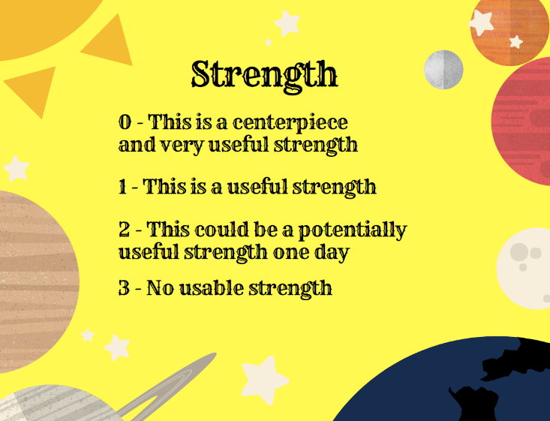
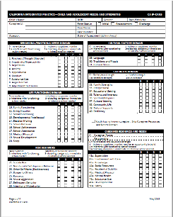
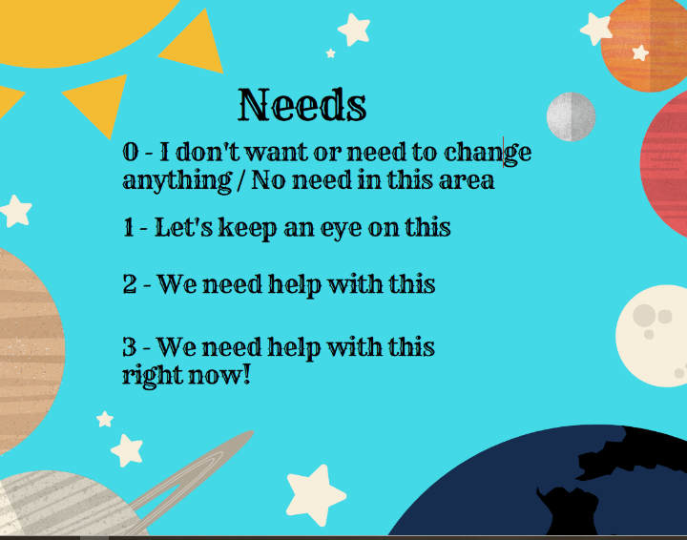
CANS and Case Planning
CANS helps tell the family’s story, supports collaborative decision making and helps guide case planning in a team setting (CFTs, etc.)
  Target strengths/needs of the child & caregiver(s)?
  What should be included in the case plan to utilize strengths and address target needs?
  Is there a trauma history that impacts the child?
  What trauma services should be included to increase child well-being?
  Have the strengths or needs changed over time? How does this impact the case plan?
  Does the plan need to be adapted to current circumstances?
Notes:
A reminder about CANS – important to consider target strengths and needs during CFT Meetings and case planning process!
Target needs are those needs we think that by supporting, we can resolve the need and achieve anticipated outcomes in other areas of need. For example, if a child’s anxiety is causing them to have poor school attendance and poor school achievement, the target need would be anxiety, and anticipated outcomes would include school attendance and achievement.

Slide 80

A reminder for case planning
Parental resilience
Social connections
Knowledge of parenting and child development
Concrete support in times of need
Social and emotional competence of children
Notes:
A reminder – remember our earlier discussion about the Five Protective Factors? How will you utilize these protective factors as part of the case planning process? What types of action steps and strategies can be implemented as part of the case plan objectives to help us reach the safety goal(s)?

Slide 81
How to create meaningful & achievable action steps
On a scale from 1-10 where 1 is “if the children were in their parent’s care the danger statement would be happening all the time,” and 10 is “if the children were if their parent’s care the safety goal would be happening all the time,” where are we?
What would be happening differently if this number went up by 1?
What would the child, parents, and network be doing?
What would the agency be doing?
Up by 2?
Danger
Statement
Safety
Goal
1 2 3 4 5 6 7 8 9 10
Notes:
Creating action steps for any of our plans requires first that everyone is clear about the dangers that need to be addressed (Danger Statements) and what the family needs to do to address the dangers (the Safety Goals). Once we have those, we can use a scaling question to help get clear about next steps.
Think about this scaling question:
On scale from 1-10 where 1 is 'if the children were in their parent's care the danger statement would be happening all the time' and 10 is 'if the children's were if their parent's care the safety goal would be happening all the time' where are we? What would be happening differently if this number went up by 1? What would the child, parents and network be doing? What would the agency be doing? Up by 2?
NOTE: Have some discussion about this scale. It is designed to help create action steps directly related to the Danger Statement and Safety Goal you are working with. What would it be like to try this with a parent and family?

Slide 82

Questions to engage the family in case planning
Remember Solution Focused Questions: Exception, scaling, position, coping, preferred future questions
When your involvement with child welfare is over, what will you be doing differently to parent your children?
What do you think needs to happen to move from the current situation (everyone is worried) up the scale to where your children are always safe (safety goal is met)? Can you think of 2-3 steps you could take to get there?
What would your child list as behaviors they want to see you demonstrate in order for them to feel safe all the time?
Who can support you on this journey? Who cares about you and the kids?
What may get in the way of you achieving these behavior changes? Any worries?
When things were better for you, what helped? Who helped?
If you could find the right kind of service to support you in making these changes, what would it be? Where would it be? Who would it be with?
Notes:
Instructor asks:
Can you think of any other question you could ask?
What services do you think work the best?
What have you seen be the most successful?

Slide 83

In summary, All of our plans should be:
Comprised of DETAILED, SPECIFIC and MEASURABLE (SMART) action steps made in response to identified dangers (relevant to danger statement/safety goal)
A process, not an event – involves ongoing collaboration and teaming with the family and their network
Family, network, child-friendly, culturally relevant and trauma informed!
A method for keeping children safe and a change strategy
An aspiration, not a guarantee – and contain plans for monitoring success
Good safety plans and case plans focus on creating interventions to ensure safety for children at all times.
Real work comes in creating, implementing, monitoring, and adjusting them over time. It is important to expect them to develop and change over time.
“Care and courage.”
Notes:
A few other things we’ll say about plans that may challenge our thinking:
Plans need to be made collaboratively with the family, child, and network. We can come up with the best plans, but if the family doesn’t "own it," all the plan becomes is a protection from liability.
Plans are a process not an event. A plan isn’t something you can set and then set sail--you will need to keep coming back to it time and again.
Plans are a roadmap not a guarantee. The plan provides direction, but we should not fall into naive practice: We are always assessing safety and danger at whatever point in the process we are at.
These are not just a method of keeping children safe--these are an intervention themselves, a way to help people begin to make change.
“Care and courage” is a phrase by Andrew Turnell of what he thinks workers and agencies need that try to make these kinds of plans.

Slide 84

Let’s Practice: Creating action steps
Table groups:
Think about the case you have been mapping at your tables. Based on the danger statement and safety goal created earlier, answer these questions:
Where is the situation on the scale below?
What would be happening differently if this number went up by 1?
What would the child, parents, and network be doing?
What would the agency be doing?
Then - Develop 1 SMART objective and 1 action step you would like to see the family and network take that would make small, but measurable progress toward addressing the danger statement and reaching the safety goal
Danger
Statement
Safety
Goal
1 2 3 4 5 6 7 8 9 10
Notes:
Refer to Behaviorally Based Case Plan Quick Guide – Refer to page 4 of the guide for examples of case plan objectives and behaviorally based action steps
Same table groups: Have groups write down the best versions of the danger statement and of the safety goal created earlier on chart paper. Draw a 1-to-10 scale in between and place the situation on the scale based on the question below.
Table group activity: Think about the case you have been mapping at your tables.
Based on the danger statement and safety goal created earlier, answer these questions:
Where is the situation on the scale (from 1-10)?
What would be happening differently if this number went up by 1?
What would the child, parents, and network be doing?
What would the agency be doing?
Then - Develop 1 SMART objective and 1 action step you would like to see the family and network take that would make small, but measurable progress toward addressing the danger statement and reaching the safety goal
On a scale from 1 to 10 where 1 is the danger statement would be happening all the time if the child was in the parent’s care and 10 is the safety goal would be happening all the time if the child was in the parent’s care, where would you place the situation?
What would be happening differently if this number went up by one? What would the child, parents, and network be doing? What would the agency be doing? Ask groups to use this scaling question to develop one objective and one strategy/action step the parent/family could take that would help to show they are progressing from the danger statement to the safety goal.
After approximately 10 minutes, take ideas from the group (instructor charts the answers)
It is likely that some ideas will be bigger steps than just “up by one.” If that is the case, ask the person giving the idea, “Do you think if the parent did that it would be just ‘up by one,’ or do you think it might be more than one? What would up by one look like?”
Conclude the exercise by asking the worker whose case this is to select which action steps, if any, he/she might take back to the family. Also ask him/her to debrief the day as a whole. Ask: What kind of difference, if any, will it make to have the danger statements, safety goals, and action steps that we created?

Slide 85

Keeping Our Focus: The Golden Thread
Safety Goal
SDM Safety Threat
Danger Statement
Petition & Harm Statement
Case Plan Activities/ Action Steps
Case Plan Objectives
Behavior Change
or not…
Notes:
Refer to handout in Trainee Guide: The Golden Thread; Briefly review the key points – this is how it all fits together.
SDM Safety Threat:
SDM Safety Threat = Harm
SDM Risk identifies complicating factors (or harm, if impact on the child)
CANS should reflect caregiver needs that link to harm/danger and safety
Petition & Harm Statement
Petition ties to the SDM Safety Threat
Harm Statement created with the family and network
Petition uses legal language
Both about the same issues
Danger Statement
Danger Statement ties to SDM Safety Threat, Petition and Harm Statement
Created with the family and network
Safety Goal
Safety Goal ties to SDM Safety Threat, Petition, Harm & Danger Statements
Created with the family and network
Case Plan Objectives
Case Plan Objectives tie to SDM Safety Threat, Petition, Harm & Danger Statements & Safety Goal
Behaviorally-based
SMART
Linked to CANS Target Needs related to Harm/Safety Threat
Case Plan Activities/Action Steps
Case Plan Activities tie to SDM Safety Threat, Petition, Harm & Danger Statements & Safety Goal & Behaviorally-based Objectives
With the support of the Network
Linked to CANS Target Needs and applicable Caregiver Resources
Behavior Change (or not…)
Behavior change measurement is tied to the SDM Safety Threat, Petition, Harm & Danger Statements & Safety Goal & Bx-based Objectives & Activities
SDM Risk Reassessment
FR to FM
FM to closure
If no behavior change, PP

Slide 86
Reminder: Teaming is a process (rolling agenda)
Development / enhancement of Safety Network
Voice of the child (three houses and/or safety house)
Safety planning / case planning with the network
Danger statements / Safety goals
Safety Mapping/CFTs/SDM & CANS assessments
Please note:
It could take three to five meetings, or more, to get through the entire process, depending on the family.
Get as far as you can in each meeting and pick up where you left off next time.
Notes:
This is what using SOP with a family will look like over the life of a case. Not always a linear process, but important to touch on each piece at some point.

Slide 87

Tools & Strategies that
Support SOP
Notes:
Next segment: Tools & strategies that support SOP

Slide 88

Tools that support SOP in Child Welfare Agencies
Additional SOP Training
Coaching
Group Supervision
Review, Evaluate, Direct (RED) Teams
Implementation & Sustainability Tools
Fidelity & Evaluation Tools
Statewide SOP Backbone Committee
Notes:
Review slide (next several slides expand on these)
Additional SOP classes (Northern Academy):
https://humanservices.ucdavis.edu/northern-academy/sop

Slide 89
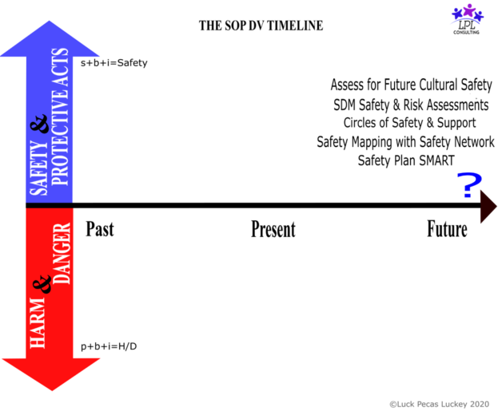
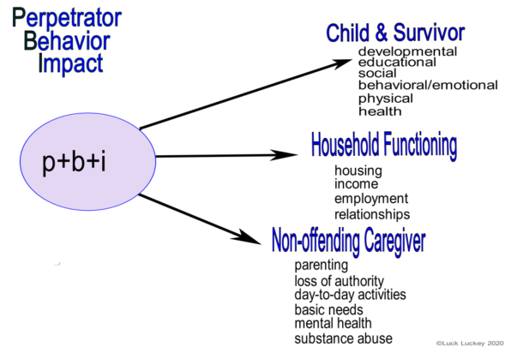
Specialized training around Domestic Violence
Key Shifts:
Partnering with the Survivor
Perpetrator engagement & accountability
Notes:
Please note there are many specialized SOP trainings available, including classes specific to Domestic Violence during which you will learn about the SOP DV Timeline Tool (included in your participant guide).
Please check our website for available offerings

Slide 90

Key Benefits of Coaching
Coaching Benefits
Allows for practice close to the work.
Child Welfare Context
Improving systemic implementation of practice
Supports ongoing transfer of learning.
Based on ideas of appreciative inquiry, facilitation, and dialogue.
Builds up confidence and competence.
Promotes individual and team excellence.
Develops commitment to common goals
Creating positive changes in behavior
Embedding professional development
Improved outcomes for children and families
Notes:
One of the key strategies you should think about as you start any new practice is the use of coaching.
Many of us are used to attending training in this work, and training does serve a purpose [Read key ideas from slide]. But what we have learned from research and our own personal experiences is that training is not enough.
For practices to be sustained, training really needs to be supplemented by coaching and modeled/supported by all levels of the agency. Coaching can greatly impact your ability to deepen your skill level.
Please note: If your County does not utilize a coach, you can still seek out peers or other “SOP Champions” at your workplace to help mentor and coach you.
Coaching is…….[read key ideas from ‘coaching’ box on the slide]. Coaches are not necessarily “experts” in SOP. Often the coach is just a little further out ahead than the trainers! But they are someone who can help an individual or group plan to try something new, then after, help them reflect on what worked well and what was hard about it.
The point here is not that “coaching is better than training”– but that we need both!
Some studies show coaching can increase levels of retention of knowledge, skill level and transfer to practice by up to 95%!!!
Northern Academy Coaching resources: https://humanservices.ucdavis.edu/coaching-human-services

Slide 91
Group Supervision and RED Teams
Group Supervision
Utilizes the mapping process to discuss cases in a team setting
RED Teams
Review: Group staffing of ER referrals
Allows staff to learn from each other’s cases and practice
“Many minds”
Evaluate: All calls that come into the hotline are brought to the team to evaluate
Direct: The team determines response and timeframe
Notes:
Review slide

Slide 92
Implementation, Sustainability & Fidelity
Implementation & Sustainability
SOP Implementation Guide
SOP Snapshot Tool (agency readiness assessment)
SOP Across the Case Continuum
Fidelity & Evaluation
SOP Fidelity Checklists
SOP Documentation Strategies
SOP Glossary
SOP Key Elements
SOP Quick Guides
SOP Practice Profiles
SOP Case Reviews
Parent/Guardian Surveys
Notes:
Review slide: These are some examples of existing tools. Many of these tools are on our SOP Resource page (see next slide). Some tools are still being finalized and will be on the Statewide SOP Toolkit.

Slide 93
SOP Key Elements……and a word about fidelity
SOP Key Elements
Strategies for skills engagement
What is fidelity?
The degree to which a practice as implemented corresponds with the practice as described or intended
Tools that life up voices of children/youth
CFT Meetings/ Safety Mapping
Safety Network
Harm & Danger Statements, Safety Goals
Behaviorally-Based Case Plans
Balanced Assessments (SDM/CANS)
Cultural Humility
Trauma Informed Practice
Fidelity tools for staff and leadership are available for self-reflection, goal setting and coaching
Fidelity tool for organizations are available to determine current practice trends and areas for improvement
Notes:
This slide provides a summary of the Key elements of SOP.
Trainer notes:
These key elements are outlined in the handout: Key elements of SOP (in the participant guide)
Important note about fidelity to the practice: Each of the key elements or components of SOP, implemented to fidelity, is necessary to say SOP is being “implemented” in a given agency. Some counties say they are “using SOP” or consider themselves an “SOP agency”, however, they may only be using one or tool strategies, and may not be using the tools to fidelity (as they are intended to be used).
There are several SOP fidelity tools available through Northern Academy to help your agency assess & evaluate SOP implementation & fidelity

Slide 94

Documentation – Capturing our work
What does SOP documentation look like?
Does your county have an SOP documentation policy?
What are some ideas you have for documenting use of SOP with children
Why is it important to document the tools and strategies we use with families?
Notes:
Please refer to handout in your participant guide: SOP Documentation Strategies
There is increasing interest by Counties and CDSS to assess the use of SOP with families across the state
Use of SOP is often difficult to measure & identify due to the lack of consistent documentation standards and expectations
Large group discussion – consider the questions on the slide:
What does SOP documentation look like?
What are some ideas you have for documenting use of SOP with children and families?
Does your county have an SOP documentation policy?
Why is it important to document the tools and strategies we use with families?
Debrief – possible ideas:
It is important for us to be able to describe the quality of our interactions with children/youth and what tools and strategies are working well to engage the family and what may not work as well – this will help us as we monitor and adapt the case plan, ensuring our services and case plans continue to meet the needs of the child/family, enhance our court reports/status review reports to be more specific, etc.

Slide 95
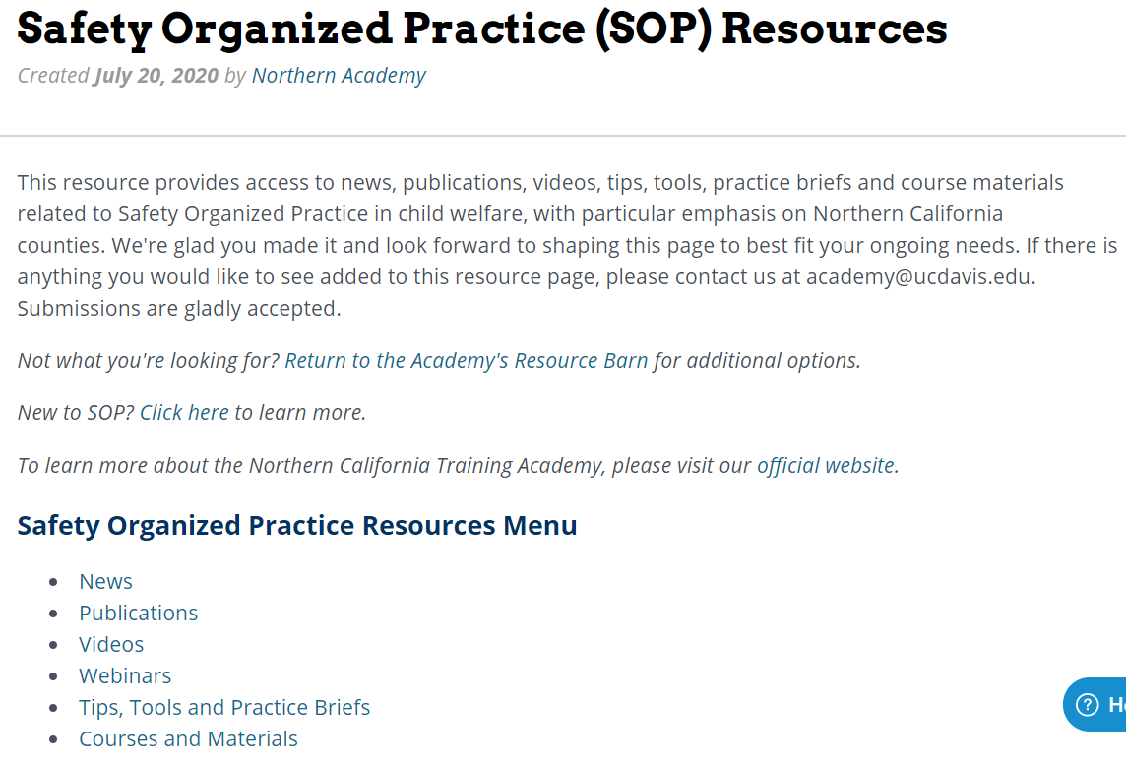
SOP resource page: http://bit.ly/SafetyOrganizedPractice
Notes:
Introduce the SOP Resource Page as an excellent resource for more information! This website includes links to SOP videos, articles, tools, webinars, quick guides, etc.
Optional if you have time: Bring up the website to show participants how to utilize this page. SOP Resource page link: http://bit.ly/SafetyOrganizedPractice

Slide 96







SOP Backbone Committee
SAFETY ORGANIZED PRACTICE BACKBONE COMMITTEE
SOP is a grassroots practice approach, not a mandate
SOP implementation and sustainability is supported by an interagency statewide SOP Backbone Committee
County Partners
Notes:
Counties are not required to use SOP, but choose to do so because of the potential positive impact on outcomes for children, youth and families.
The SOP Backbone Committee is made up of members from the Regional Training Academies (RTAs; Northern, Southern, Bay and Central), California Department of Social Services (CDSS), Casey Family Programs, CalSWEC and county representatives from each region. The Northern Academy has primary responsibility for Committee coordination.

Slide 97
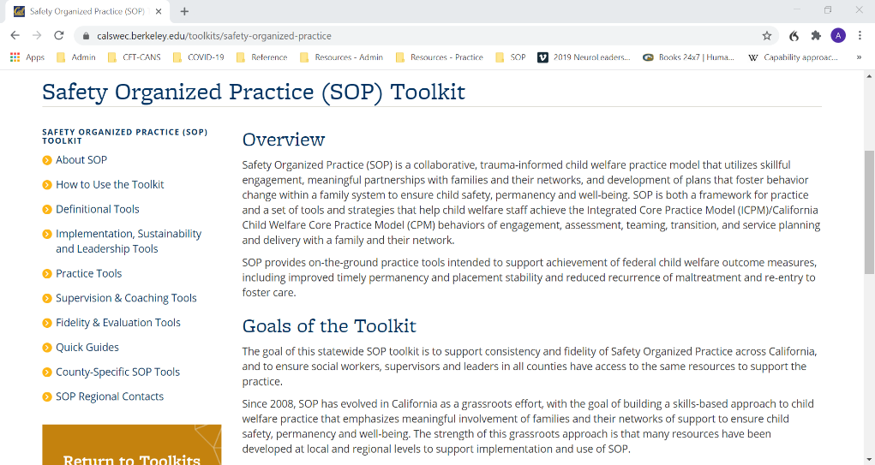
SOP Toolkit
Your complete resource for SOP implementation, leadership and practice supports!
Definitional Tools
Implementation, Sustainability & Leadership Tools
Practice Tools
Supervision & Coaching Tools
Fidelity & Evaluation Tools
Quick Guides
County-Specific Tools
SOP Regional Contacts
Contact your Regional Training Academy for more information
https://calswec.berkeley.edu/toolkits/safety-organized-practice
Notes:
The SOP toolkit contains a comprehensive range of tools to support agencies in implementing SOP and practicing to fidelity.
The toolkit was developed by California’s SOP Backbone Committee, which is made up of members from the Regional Training Academies (RTAs; Northern, Southern, Bay and Central), CDSS, Casey Family Programs, CalSWEC and county representatives from each region. The RTAs provide SOP training, coaching and technical assistance in their geographic areas, including supporting counties in implementing the toolkit. If you would like more information, check out the website at the URL listed here, go to the main CalSWEC website and click on Quick Links – Toolkits – SOP Toolkit, or contact your local RTA.

Slide 98


At least 56 out of 58 counties in California have implemented SOP
  Foundational & specialized training available
Evaluation & Fidelity tools developed
Common language created statewide - Practice expanding to Adult Protective Services
Social workers feel supported with specific strategies and skills to use with families
Coaching has become an accepted practice in CW
Statewide SOP Toolkit developed by the SOP Backbone Committee
Notes:
Review highlights on slide

Slide 99

Wrapping Up
Notes:
Next segment: Wrapping Up

Slide 100
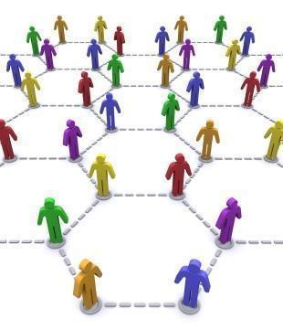
SOP across the case continuum
Hotline/Intake
Emergency Response
Assessment
Voluntary
Case Planning
Family Maintenance
Family Reunification
Permanency Planning/NMDs
Adoption Services
RFA/Placement
Tribal Social Worker
Service Providers
Supervisors / Managers
Others?
Notes:
How will you apply the elements of SOP across the child welfare continuum?
Refer to handout: SOP across the case continuum
Have participants take 5 minutes to review the handout and share with a partner how they would apply these elements based on their role in child welfare

Slide 101

Personal Action Plans
What have you learned about Safety Organized Practice that you value?
What 2-4 tools/strategies are you willing to implement right away in your practice?
What kind of help/support do you need to begin this journey?
What will be your first step?
How do you think use of SOP might change the way families experience the child welfare system and/or change outcomes for children?
Any questions or worries about SOP?
Share with a partner
Notes:
Refer to the handout “My Action Plan” and have participants individually answer the questions.
If there is time, have them share their ideas with a partner.

Slide 102
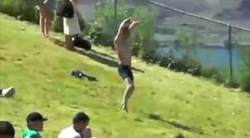
Thoughts on Implementation….From the “Dancing Guy”
https://www.youtube.com/watch?v=fW8amMCVAJQ&list=PLbEpa_1VPxsJsS2GQajL_-RHC5xukj8Gl&index=3
Notes:
Close the workshop with some inspiration and humor - We like to close this workshop with a short video.
We will leave you with a vision of particularly successful implementation, one that takes place quickly and effectively. This closing inspiration for a successful implementation comes…from a dancing guy.
After the video thank them for being willing to be a “lone nut” or to follow one.

Slide 103


Please complete your evaluations!
+/Δ
For questions or to inquire about other trainings:
Visit our website: https://humanservices.ucdavis.edu/northern-academy
Visit our SOP Resources Page: http://bit.ly/SafetyOrganizedPractice
Visit the SOP Foundational Institute Class Materials page:
https://www.oercommons.org/authoring/11911-sop-foundational-institute/view
E-mail the Academy at: academy@ucdavis.edu
Notes:
If time, do a quick plus/delta for feedback
Evaluations

Slide 104
References
Children’s Research Center. (2008). Structured Decision Making®: An evidence-based approach to human services. Retrieved from http://www.nccd-crc.org/crc/pdf/2008_sdm_book.pdf
Children’s Resource Center and Northern California Training Academy (2012). Introducing Safety Organized Practice. Retrieved from Northern California Training Academy archives on private server.
Chin, S., Decter, P., Madsen, W., & Vogel, J. (2010). Enhancing risk assessment through organizational learning: A mid-stream report from Massachusetts. Protecting Children, 25(3), 7–20.
Department of Child Protection. (2011). The signs of safety child protection practice framework. Department of Child Protection, Perth, Australia. Retrieved from http://www.signsofsafety.net/westernaustralia
Essex, S., Gumbleton, J., & Luger, C. (1996). Resolutions: Working with families where responsibilities for abuse is denied. Child Abuse Review, 5(3), 191–201.
Freeman, J., Epston, D., & Lobovits, D. (1997). Playful approaches to serious problems: Narrative therapy with children and their families. New York, NY: Norton.
Lee, M. L., Sebold, J., & Uken, A. (2003). Solution-focused treatment of domestic violence offenders: Accountability for change. New York, NY: Oxford University Press.
Parker, S. (2009). The safety house: A tool for including children in safety planning. Perth, Australia: Aspirations Consultancy. Available from http://www.aspirationsconsultancy.com
Turnell, A., & Edwards, S. (1999). Signs of safety. New York, NY: Norton.
Turnell, A., & Essex, S. (2006). Working with ‘denied’ child abuse: The resolutions approach. Buckingham, UK: Open University Press.
Weld, N. (2009). Making sure children get “HELD” – Ideas and resources to help workers place hope, empathy, love, and dignity at the heart of child protection and support. Dorset, UK: Russell House Publishing.
Weld, N. (2008). The three houses tool: Building safety and positive change in contemporary risk assessment for children. Dorset, UK: Russell House Publishing.

