Slide 1
Safety Organized Practice
Day 1 – Two-day Foundational Institute
Instructor Name
NORTHERN ACADEMY
Notes:
Introductions (Time: 10-15 minutes)
Introduce yourselves as trainers and go over logistics (lunch, breaks, bathrooms, attendance sheets, walk-in forms for those not listed on attendance sheet, etc.)
Share your experience and why you are excited about SOP
Sample intro: Welcome to the Safety Organized Practice (SOP) 2-day Foundational Institute hosted by Northern Academy. This training was originally presented as a 3-day training and was revised in January, 2016 and changed to a 2-day training. The most recent revision was completed in January, 2020. The original version was developed in partnership between Children’s Research Center (CRC/developers of Structured Decision Making), California Department of Social Services (CDSS), and the California Regional Training Academies (RTAs).

Slide 2
Opening Circle
Introduce yourselves:
Name
County
Role
How long?
What do you want to get out of this training?
Notes:
Participant Introductions: OPENING CIRCLE
Ask participants to form an Opening Circle around the room
Intro: Opening Circles provide an opportunity for everyone to share and participate, and also sets the participatory tone for the day.
Once they have formed a circle explain: For this opening circle, please share the following:
Your name, which county you are from, what your role is, how long you have been in your current role, and what do you want to get out of this training? Or what excites you about SOP?
As the trainer, please start the opening circle with your own information, which will be a refresh from the bio above. If there is more than one trainer, please have one go first and the other go last so that it is a smooth transition to the next activity.
Thank them for participating. Allow them to sit down and acknowledge the varying levels of experience in the room.

Slide 3
Training Overview
Day 1 | Day 2
Introduction to Safety Organized Practice (SOP) and the California Integrated Core Practice Model (ICPM) Strategic Conversations about Danger and Safety Safety Networks Interviewing Children | Harm and Danger Statements, Safety Goals Key Mapping Concepts Safety Mapping Demonstration Collaborative Safety/Case Planning Additional SOP Tools/Resources Personal Action Plans & Wrap-up
Link to class materials: https://www.oercommons.org/authoring/11911-sop-foundational-institute/view
Link to SOP Resource Page: http://bit.ly/SafetyOrganizedPractice
Notes:
Provide an overview of training topics that will be covered over the two-day training.
This training is a mandatory pre-requisite to all other SOP trainings & skills labs. Please note: This training is foundational and briefly introduces you to SOP tools and strategies. You are strongly encouraged to attend additional SOP trainings and skills labs to deepen your practice!
Please check our website under “Safety Organized Practice” to see additional SOP offerings: https://humanservices.ucdavis.edu/northern-academy
Briefly review class materials. All materials for this class are on our resource barn and the participant workbook is required as it includes the activities for the class.
Link to class materials: https://www.oercommons.org/authoring/11911-sop-foundational-institute/view
Link to SOP Resource Page (for additional SOP tools, articles, quick guides, etc.): http://bit.ly/SafetyOrganizedPractice

Slide 4
Preparation for Mapping
Can you begin to think about a CWS case that we can use for practice over the next two days (interviewing, assessing, mapping)?
Think of a case you have that is not too complicated.
At least one safety threat (or very high risk).
Be able to provide rich detail about your selected case (please speak to the instructors at break or lunch today).
Notes:
Before continuing with foundational concepts, prepare participants for the mapping activity that will occur the beginning of day two.
Ask them to think of a child welfare case that may be appropriate for the larger group mapping practice (not too complicated with a clear safety threat). Clear purpose, safety threat, genogram
Ensure that each table has an SDM manual.

Slide 5
Group Agreements
What would make this training a good space for learning?
How are we going to work together respectfully and effectively?
Notes:
PLEASE NOTE: If this class is part of Core, please remind the class of their group agreements they previously developed during Module 1. Ask the class – are there any changes or additions you would like to add to your group agreements? If not, move on to next segment.
If this is a standalone class (outside of Core) - See below:
Refer to handout in participant workbook: Facilitated Dialogue Structure
Introduce the Facilitated Dialogue Structure for facilitating meetings. We are modeling this dialogue structure throughout this two – day training as we would use it during a CFT meeting. Group agreements are part of the CFT process to engage the team in how we want to work together.
Group agreements are part of the CFT process to engage the team in how we want to work together. Our practices in our agencies and together should mirror how we work with families (also called a parallel process). We also want to make our own group agreements today to help create relationships and address challenges if they come up. Group Agreements are key to building rapport with families, creating shared language, expectations and staying focused on the purpose of the meeting.
Organically develop a list of agreements that everyone can live with and ensure last agreements is for group to hold everyone accountable to their agreements throughout the 2 days.
If they get stuck pose questions like, should there be a disagreement, should we have an agreement about how we’ll deal with it? Think of a previous group experience or training you have had that was successful and worth your time … what made it so? What has made you feel comfortable in a classroom in the past?
Suggested Talking Points:
Let them know that the process of creating agreements should become one of the tools in their toolbox.
They should be creating agreements with their families and before any meetings they have.
Creating agreements is trauma informed.
One way to successfully work across differences here is to create community agreements. Agreements are somewhere between a promise and a ground rule and they answer the question of how we want to work together throughout the workshop.
Suggestions:
Be open to learning something new and broadening your perspectives
One person talks at a time
Avoid sidebar conversations
Be conscientious with your cell phone use
Be open to others’ opinions, thoughts, feelings, etc. (no judgments)
Being aware of the differences between intent and impact - this acknowledges that I may have the best of intentions when I speak, but my intentions do not guarantee that the impact will be benign. This should be a place of dialogue and group learning, but we need to be aware that what we say may be hard for someone else to hear, without our realizing it. This agreement is about recognizing this can happen and being on the lookout for it.
Everyone always has the right to pass.
Silence is a contribution.
Share airtime and stick to time limits.
Speak personally, for ourselves as individuals.
Allow the trainer to keep us on track and bring us back if we get off track
Maintain confidentiality
Participate and have fun!

Slide 6
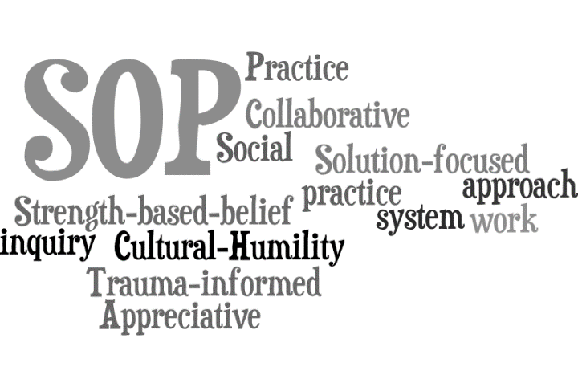
Safety Organized Practice (SOP) Key Elements
Notes:
Next segment: What is SOP and the Integrated Core Practice Model (ICPM)?

Slide 7
SOP is a collaborative, trauma-informed child welfare practice approach that utilizes skillful engagement, meaningful partnerships with families and their networks, and development of plans that foster behavior change within a family system to ensure child safety, permanency and well-being.
Notes:
Animation: Words automatically fade in.
What do we mean when we say “SOP”? SOP is both a framework for practice and a set of tools and strategies that help child welfare staff achieve the Integrated Core Practice Model behaviors of engagement, assessment, teaming and planning with a family and their network.
Refer to handouts in participant guide: Intro to SOP – Quick Guide, SOP Glossary, SOP Key Elements, SOP Contributors
A network is critical, because children and families need people in their lives without expiration dates.
SOP prioritizes prevention – it highlights early intervention with families to avoid trauma caused by unnecessary separation of children from their families whenever possible.
SOP focuses on the social worker as practitioner and change agent

Slide 8
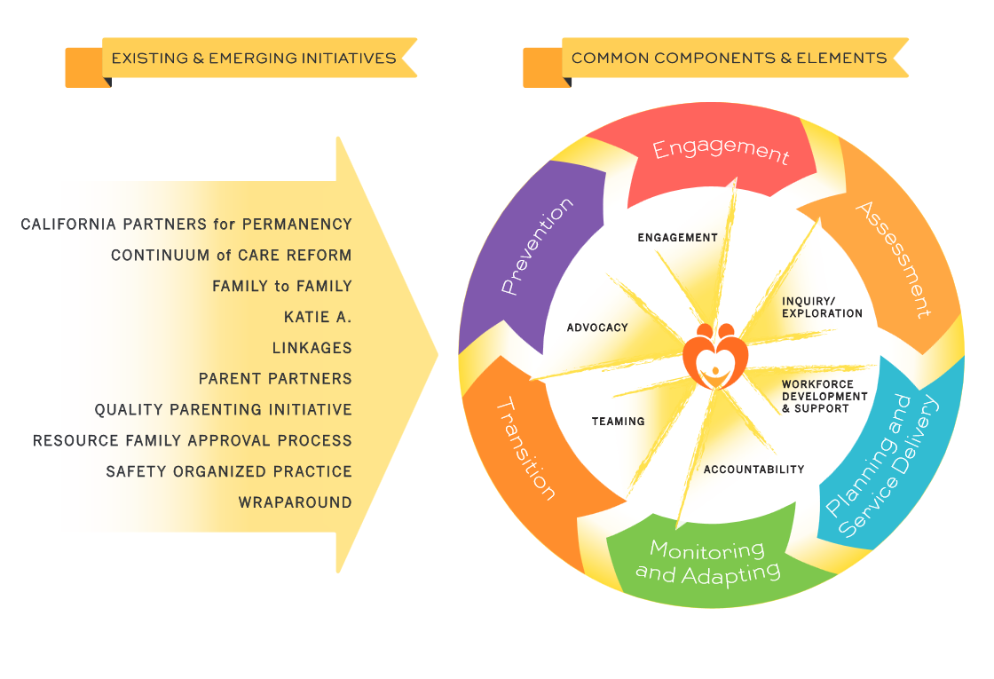
Notes:
The California Child Welfare Core Practice Model, which has now been integrated into the Integrated Core Practice Model, has been in development by the counties since 2012. The intent was to create one unifying framework for California child welfare practice that incorporated the key elements of many other initiatives, such as those listed here. All of these, California counties have tried many promising practices to improve outcomes for children and families
It was observed that many of the new practices had common elements
CAPP and Katie A./Pathways to Well-Being gave the state its first exposure to thinking about the benefit of implementing a comprehensive model
Many practices including SOP, were built upon to create the CPM and subsequently the ICPM.

Slide 9
Shared ICPM/SOP Values…..
Child/Family Voice & Choice
Solution-focused
Collaborative
Appreciative Inquiry
Strength-based
Culturally responsive
Trauma-informed
Notes:
ICPM & SOP share the underlying values of HOW we work with families. With SOP, it is not enough to just focus on engagement, critical thinking and safety, permanency and well-being – these values of collaboration, cultural responsiveness, solution-focused, trauma-informed, have to undergird everything about our approach.
SOP is comprised of what has been found to be important in Child Welfare social work practice.
How do you practice as a social worker? How do you use social work skills to enhance the skills of those around you? What are your values as a social worker and how do you work with families in a respectful and ethical way?
SOP involves taking a humble approach to the work and demonstrating a belief that families have their own answers and that it is our job to help them discover and build on those answers. It involves understanding the impact of trauma and that most everyone involved with child welfare is impacted by trauma. Further, it involves an awareness of the trauma the CW system itself creates for families and children and learning to practice in ways that acknowledge and try to reduce this impact. It involves taking a team approach and using skills to assist and encourage others to build their own supportive network and taking the time to instill hope and focus on what's good and right in people lives.

Slide 10
SOP Tools/Strategies to Support ICPM
Solution-focused questions
The Three Questions
Mapping/meeting frameworks
Facilitated meeting dialogue structure (Super 8)
Safety Circles/Circles of Support
Balanced Assessments – SDM/CANS
Safety House/Three Houses
Harm and Danger Statements
Safety Goals
Safety Networks/Circles of support/Child & Family Team
Safety Plans
Behaviorally-based case plans
RED Teams
Notes:
Here are just some examples of SOP tools/strategies that support ICPM.
For example, this includes things such as solution-focused questions for engagement, assessment and planning; the Three Houses/Safety House to engage the voices of children and youth; facilitated meeting dialogue structure as an engagement strategy for CFT meetings; Safety Circles/Circles of Support to build the network/child and family team; etc.

Slide 11
ICPM Practice Behavior | SOP Tool
Use tools and approaches that amplify the voices of children and youth. | Three Houses, Safety House
Ask the family what is working well and what they see as the solution to the circumstances that brought them to the attention of the child welfare agency. | Three Questions, SFQs
Develop a shared understanding about safety, permanency, and well-being issues to be addressed with the team. | Harm and Danger Statements, Safety Goals
Facilitate critical thinking, discussion, mutual exploration of issues, and consensus building toward the goal of shared decision-making. | Mapping, Meeting Frameworks, Meeting Dialogue Structure
Notes:
This is an example of how the practice behaviors of ICPM align with tools of SOP.

Slide 12
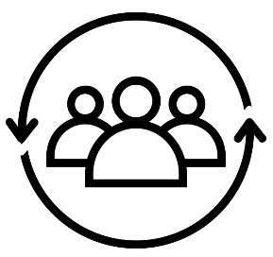
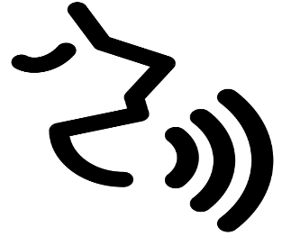
SOP Key Elements & Flow
Build Good relationships
Authentic Collaboration
Skillful Use of Authority
Safety Networks
Safety Circles
Circles of Support
Harm & Danger Statements / Safety Goals
Family’s Language
Shared Understanding
1
3
5
2
4
6
Voice of the child
Three Houses
Safety House
Mapping
Case Staffing | Family & Network
Solution Focused Questions | Rigoous, Balanced Assessment
SDM Safety Assessment
Safety Plans / Case Plans
Behaviorally- Based
Involve Network
Informed by CANS
Notes:
These are the key elements of SOP including strategies used and how they flow together
© Copyright PresentationGo.com – The free PowerPoint template library

Slide 13
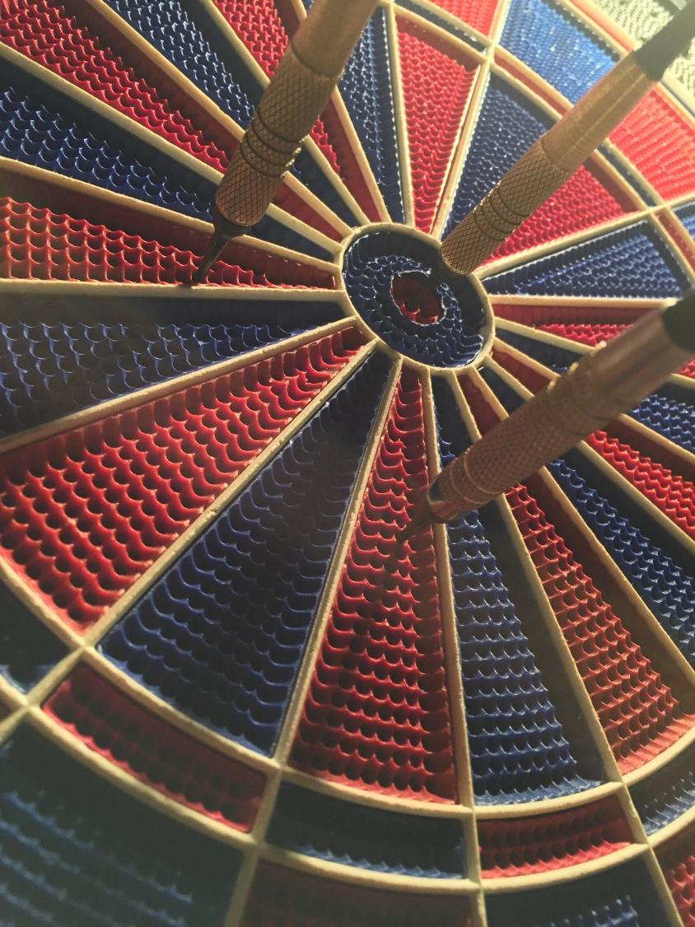
Good working relationships
Critical thinking
Enhanced safety (and permanency, and well-being)
Notes:
The 3 primary goals of SOP:
Good working relationships: Achieved through cultural humility; authentic teaming; appreciative inquiry; and trauma-informed, solution-focused and collaborative practice
Critical thinking: Achieved through mapping worries and what’s working well to develop shared understanding of harm, danger and what needs to happen to ensure safety
Enhanced safety, permanency, well-being: Achieved through meaningful engagement of children/youth, families and their networks of support to achieve the least restrictive safe placement; customized, behaviorally-based plans; and shared accountability

Slide 14
With Safety Organized Practice, Families Can Expect to Be:
Treated as equal members of a team
Included in safety planning / case planning
Asked for their opinion
Respected and valued
Told the truth
Asked to provide detailed information about things that work in their family
Asked to work as a team with all parties
Notes:
Review slide
Goal: A family should expect to receive the same treatment and services regardless of what county they are in. This is what we are striving for.

Slide 15
Intended outcomes of SOP (when used to fidelity).........
Improved:
Agency culture and climate
Teaming and working relationships
Increased:
Collaborative decision-making processes
Increased family engagement in collaborative safety and case planning
Increased understanding of reasons for child welfare involvement
Increased participation in case plan interventions and services
Social worker satisfaction and retention
Notes:
Brief overview: Some of the intended outcomes of SOP when it is used and implemented to fidelity!

Slide 16
Intended outcomes of SOP (Continued).........
Increased……
Safety for children
Increased children's and youth's voice
Behaviorally-focused interventions that meet family needs
Placements with relatives or NREFMs
Placement stability
Lifelong connections for children/youth and families
Natural support systems for children/youth and families
Trauma-informed and culturally relevant practice

Slide 17
Intended outcomes of SOP ......... any others?
Decreased:
Entry to care
Time in foster care
Disproportionality
Recurrence of maltreatment
Re-entry rate
Contested hearings
Ultimate goal: Healthier kids, families and communities!!!
Notes:
Any others missing from the list?

Slide 18
Engagement
Continuously engage with families, their communities and tribes
Listen
Encourage and support
Affirm experiences and create achievable goals
Use solution-focused, trauma-informed engagement practices
Build networks of support
Notes:
Engagement with families is key to achieving positive outcomes!
We listen to families, tribes, caregivers, and communities and respect and value their roles, perspectives, abilities, and solutions in all teaming and casework practice.
We encourage and support families and youth speaking out about their own experiences and taking a leadership role in assessing, finding solutions, planning, and making decisions.
We affirm the family’s experiences and create achievable goals in collaboration with the family.
We use solution-focused, trauma- informed engagement practices and approach all interactions with openness, respect, and honesty. We use understandable language. We describe our concerns clearly.
We connect with families, children, youth, communities, tribes, and service providers to help build networks of formal and informal supports and support connections.

Slide 19
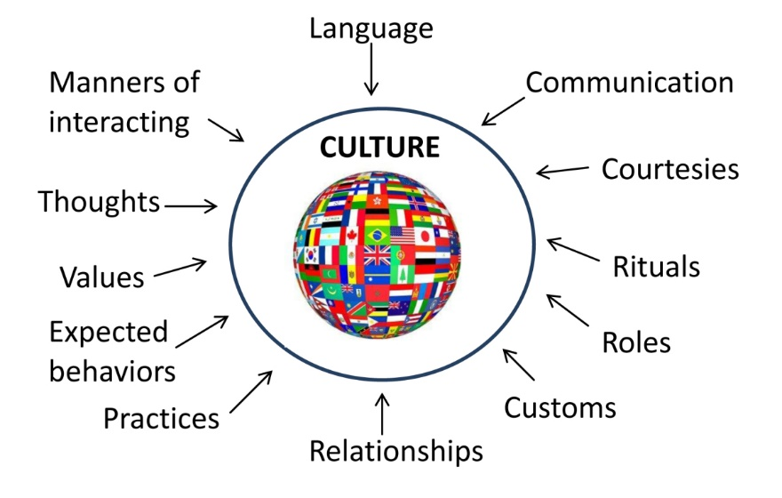
Cultural Humility Defined
Cultural humility is a lifelong process of self-reflection, self-critique and commitment to understanding and respecting different points of view, and engaging with others humbly, authentically and from a place of learning.
Tervalon, M., and Murray-Garcia, J. (1998)
Notes:
One key element of engagement is cultural humility and responsiveness. Humility means teachable - For a lot of years we have discussed cultural competency and we have been trained on this topic … do you feel competent at other people’s cultures? What does this title mean?
The shift to cultural humility is coming from the idea that we cannot and do not need to be experts at someone else’s culture. We do need to be in a space of inquiry so that we can allow each person we encounter to be the expert on their own culture. We do need to use questions and a genuine sense of curiosity about others to invite them to tell their story.
If we remain teachable, we will be able to accomplish these goals. If we practice this type of cultural humility with others – both with our colleagues and with the families we serve … what would be different? How could it support the work we are doing with families?
If we are not practicing this way, what barriers are created?

Slide 20
The Multicultural Process of Change: Table Talk
Cultural differences and similarities affect all relationships and decisions.
Refer to handout: Multicultural Guidelines for Communicating Across Difference
Consider for yourself:
Which one am I best at?
Which one can I work on?
Based on your conversations, do we want to add anything to our agreements?
Notes:
Refer to handout: Multicultural guidelines for Communicating across Difference (participant workbook)
Have participants review handout individually, then have a table talk and share your thoughts.
Consider for yourself:
Which one am I best at?
Which one can I work on?
Debrief with group, then revisit Group Agreements. Is there anything we need to add? Update agreements as needed.

Slide 21
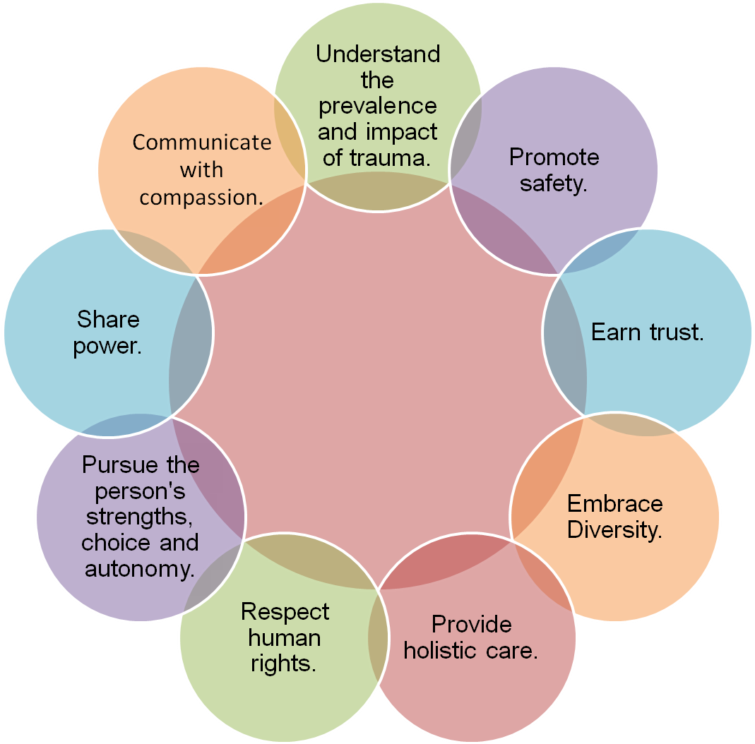
Guiding Values of Trauma-Informed Practice “Healing Happens in Relationship”
Focus on:
Awareness of impact of trauma on behavior and quality of life
Working with children & families in a way that supports engagement, safety, growth & trust
Helping children & families respond to traumatic experiences
Notes:
Healing happens in relationships! Safety-organized practice draws heavily from the National Child Traumatic Stress Network's principles and strategies and from Bruce Perry's work at the National Trauma Academy, which focuses on trauma's impact on brain development and child development.
Most of the children and many of the parents involved in the child welfare system have experienced some form of trauma. Symptoms of trauma can worsen already challenging situations and make the work of engagement and increasing child safety and permanency even more difficult.
Reminder about ACES and correlation to trauma. For more information about ACES, refer participants to the handout in their participant workbook: “Truth about ACES”
Trauma informed practice is a key value of SOP and:
Involves an awareness of trauma and the impact on behavior and quality of life for the entire family.
Assists helping professionals with focusing on the behavior of the person and what might motivate that behavior in the context of trauma.
Focuses on working with children and families in a way that supports engagement, safety, growth and trust.
Helps children and families respond to traumatic experiences
21

Slide 22
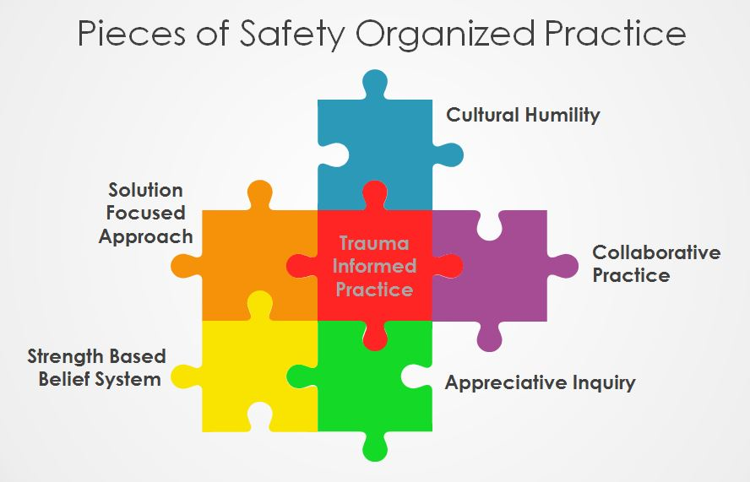
Slide created by Wake County, North Carolina
Notes:
Refer to handout in the participant workbook: SOP SW Practice Definitions
Quick table talk:
Assign each table a different principle on the slide and ask them to brainstorm for 5 minutes:
What ways have you seen or could you imagine this SW practice happening in child welfare?
Quick report out: Have each group share their favorite one

Slide 23
Strategic Conversations about Safety and Danger: A Balanced Assessment
Notes:
Next segment: Strategic Conversations about Safety and Danger: A balanced assessment
Now we will move into talking about the importance of balanced assessments in child welfare

Slide 24
A Rigorous, Balanced Assessment
STRENGTHS
Identifying exceptions to problems and looking for strengths generates cooperation, positive energy and creative solutions, and helps us know how worried we should be.
WORRIES & NEEDS
Regardless of strengths, safety is always paramount; we must look at what is causing harm or danger to a child and what the true needs are of the child and family.
Not talking about worries is unfair to the family and leads to unsuccessful plans.
Notes:
SOP brings forward the importance of a “rigorous and balanced assessment.” If we spend time on the questions of what has worked well, the answer to “next steps” become clearer. There will be solutions that come from what the family already does and therefore what the family is more likely to do again and be successful.
We are trying to build on solutions that the family already uses. In SOP, the focus is on the family’s voice: building from the family’s ideas which helps us develop plans that are aligned with the family’s culture.

Slide 25
Structured Assessment Tools
Structured Decision Making (SDM)
Child Adolescent Needs and Strengths (CANS)
Clinical Judgement
Provides guidance and increases accuracy and consistency for key decision points
Organizes information about child/family strengths & needs to communicate the family’s story
Structured tools provide guidance, however, clinical judgement and team decision making inform final decisions
Notes:
SDM tools, CANS and SOP complement each other to help us develop a rigorous, comprehensive, balanced assessment of the child and family.
The Structured Decision-Making system was designed to identify the key decisions in child welfare practice and then create evidence based assessment tools that could help make those decisions accurately and consistently across even large counties and states. The SDM system is set up to bring the best of research to the important decisions of child welfare.
CANs helps tell the family’s story through prioritizing child and family strengths and needs. Participants are strongly encouraged to attend the CANS overview training to become familiar with the CANS items, how to use CANS in CFT Meetings and in the case planning process with children and families.

Slide 26
safe·ty
[sāftē noun]
Actions of protection taken by the caregiver that address the danger demonstrated over time.
Initial Source: Boffa, J. and Podestra, H (2004). Partnership and risk assessment in child protection practice. Protecting Children, 19(2); 35-49.
Adapted over time by Andrew Turnell and members of the Massachusetts Child Welfare Institute.
Initial Source: Boffa, J. and Podestra, H (2004). Partnership and risk assessment in child protection practice. Protecting Children, 19(2); 35-49. Adapted over time by Andrew Turnell and members of the Massachusetts Child Welfare Institute.
Notes:
This definition of Safety comes from Signs of Safety but helps hold the model together. Notice that safety is a VERB. It is more than the absence of danger.
This is the foundation hand so complicated to see acts over time.
Safety-Organized Practice provides an approach to child protection work that:
Is focused on enhancing child safety
Values working with families
Values reliable and valid assessments
Provides the field with practices and tools to concretely help their day-to-day work
Integrates rigorous, collaborative human judgment with research-built tools
DISCUSSION: If this was the CWS definition of safety…and we shared it with families, providers, the courts…and this became ‘north’ on the compass and what we looked for in our work…what, if anything, would change about CWS? What would change about your work? Facilitate a discussion.

Slide 27
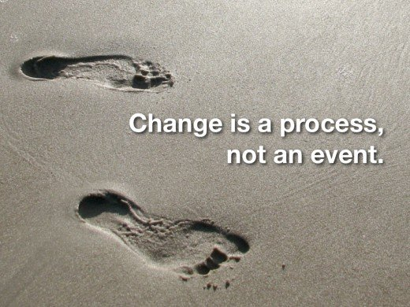
Strategic Conversations about Safety and Danger
A practice of using questions and having conversations that gather rich, detailed, pertinent information about the history of protection and the history of the problem:
Helps key stakeholders (family, workers, providers, supervisors) think through difficult situations together;
Develops a common language, purpose, and goals;
Believes in the possibility of change;
Gathers the information needed for assessments and decision support
Is based on solution-focused interviewing.
Notes:
We will begin by looking at an idea that is central to Safety-Organized Practice: that when we interview families, children and members of the community, we are not just interviewing for history of the Danger but also for a history of the safety that has occurred as well.

Slide 28
Notes:
Take a look at this image. What do you see? Notice how some say two faces looking at each other, others say a vase.

Slide 29
Notes:
How about this image? Some will say pillars others will say people standing facing each other.
Key point: Two people can look at the same situation and see two different things.

Slide 30
A Key Idea…
Safety and services are not the same thing
Notes:
Services do not equal or demonstrate safety!
For years we have used services as a way to measure safety – but does it really tell us parents can keep their children safe? How do we show the court that the parent can keep the child safe?
If a parent does drugs and neglects their child, how do we know that will not happen again?
We have used services – but is that really safety? Is being sober an act of protection? We would argue that it is not. Being sober means you are not doing what put your child in harm’s way but what tells us it will not happen again?

Slide 31
Guided by two critical questions:
What is the impact of the caregiver's action(s) on the child?
If danger exists, what are the family and network willing and able to do to show us the children will be safe?
Notes:
Here is the work of SOP:
Getting clear about the impact of the caregiver’s action(s) on the child
Being transparent with families about the behaviors that will keep the child safe (demonstrated over time, how the agency will measure these behaviors and how the network can support the family to achieve the safety goal(s)

Slide 32
Start by getting a balanced assessment
Past
Present
Future
Notes:
We are going to talk about doing a rigorous and balanced assessment, where the history of ‘safety’ and ‘strengths’ is searched for as rigorously as the history of ‘danger’ and ‘harm’.

Slide 33
Cheryl’s Story
D
E
P
R
E
S
S
I
O
N
OF
F
ME
D
S
Suicide attempt by gas in the kitchen while the children were home
Her father:
physically abusive,
dangerous
Foster
care
D
V
Poverty
Past
Present
Future
Notes:
The next series of slides demonstrates several aspects of what we will be learning, including the importance of a balanced assessment. This story is a compelling ‘hook’ to invite interest in learning how to develop a complete assessment.
Cheryl’s Story:
Cheryl is an African-American woman in her late 30s with two children (ages 4 and 6). She made a significant suicide attempt by turning on the gas in her oven while both children were home.
All three of them passed out and it was only through a neighbor smelling the gas and breaking down the door that more serious injuries were averted. The children were placed together in foster care; mother went to a psychiatric facility and was released 10 days later. Cheryl is currently not suicidal and is expressing a lot of regret.
You meet with her to do a standard assessment and this is what you learn:
Her father was abusive to her and her mother. He drank and smashed things around the home.
Things got so bad that Cheryl went into foster care herself.
As she got older, Cheryl engaged in relationships with men who were violent, including the father of the girls.
This finally led to Cheryl being diagnosed with depression.
More recently, she has gone off her medication.
Even more recently, Cheryl lost her job as a clerk at a store, leaving the family dangerously close to poverty and not having enough food to eat or money to keep the heat on.

Slide 34
Interviewing for Safety and Danger
????
Past
Present
Future
What will Cheryl's future probably look like?
What do we know about risk / danger?
What do we know about safety?
Notes:
PURPOSE: To help participants experience how our conclusions can be very pessimistic when we have only surfaced negatives.
Normally when we hear a story like this we begin to ‘connect the dots’ to make sense of the story. We construct a narrative of events so we can make sense of it and compare it with other experiences, stories, and training.
Given what we know, what would you say about Cheryl’s future?
Are we in a position to make even a good educated guess?
What do we know about Danger? Probably a good deal. Where is your ‘worry meter’ based on what you know so far?
What do we know about safety? Not really anything at all.
Does that get in our way of making a good guess about what Cheryl is likely able to do next to keep her kids safe in the future?
We need to become EQUALLY as rigorous at tracking the history of the parent’s ‘acts of protection’ as we are at the history of the Danger.
TAKE ANOTHER LOOK AT CHERYL’S PAST. HOW MUCH TRAUMA IS PRESENT? HOW MUCH DO YOU THINK THAT IMPACTS HER ABILITY TO PARENT?

Slide 35
Interviewing for Safety and Danger
Suicide attempt by gas
in the kitchen while
the children were home
Past
Present
Future
"I took the
girls and put
them in the
next room."
Notes:
To illustrate that when we begin to ask for details, if we are listening, we may hear positives as well. We need to be equally rigorous in searching for the 'history of protection' as well as the ‘history of the harm’.
When Cheryl tells us about this moment, we can ask for lots of details.
We learn that before turning on the gas, she took the girls to the next room and opened a window. She even put a towel under the door to keep the gas from going into the girls room.
Was that a sufficient act of protection? No. Would it be enough to return her children and/or close the case? No.
But might it be important for Cheryl to know and remember? It may help her as she deals with her sadness, grief and guilt about this event.
Is it important for us as child welfare to know? As part of a longer story of her acts of protection, perhaps. We can use this to ask other questions like, ‘Were there times you were protected by your parents, or things you have done to keep the girls safe’?
And we might learn….

Slide 36
Interviewing for Safety as well as Danger
Past
Present
Future
"My mom
gave custody
of me
to my aunt."
"My mom and aunt made
sure I got an
education."
L
E
F
T
HU
S
B.
Proper
care of
girls through
school,
doctor,
therapy
"I took the
girls and put
them in the
next room."
"I'm getting
up at 4:00 a.m. to meet them and get them
to school."
Notes:
….That the foster care arrangement was a familial one. No CPS involvement.
And that Cheryl’s mom always stayed in her life, and worked with her aunt—Cheryl’s foster parent—to make sure she got a high school diploma.
That Cheryl reached the point of leaving her husband and took out a restraining order when she saw how violent he could be with the girls watching, saying, ‘I won’t have my girls go through what I did’.
That there are many examples of appropriate care Cheryl has shown the girls. Pediatrician says she has been terrific, kids all up to date; school says kids come to school dressed appropriately, on time, with work done. Both are very surprised about what happened. And finally we learn…
That Cheryl knows the foster mother who is taking care of her kids (‘we went to high school together’). Cheryl has been getting up at 4 a.m., walking more than two miles from her home to the foster mom’s home to get the girls up and off to school every morning since she got out of the psychiatric hospital.
Take a look at Cheryl’s strengths. How do you think relationships helped to minimize the impact of her past trauma? How can we build on that?

Slide 37
Interviewing for Safety and Danger
Does looking at what has worked in the past give us a more accurate picture of the family?
Does it tell us more about what they can do?
Are you less worried?
Past
Present
Future
????
History of protection is best predictor of future safety
Notes:
Do we know a little more about safety now?
We would say ‘yes, we do’. Is this important for our work? Why?
Where is your ‘worry meter’ now that you know more? Has it decreased?
Key Point: We can’t know how worried to be if we don’t know both patterns of harm and protection.

Slide 38
"Naïve" Practice
Past
Present
Future
Notes:
If this was all we looked at, would it be enough?
If we did, we think it would be fair to call this ‘naïve practice’

Slide 39
“Problem-saturated” Practice
Past
Present
Future
Notes:
EXAMPLE
But if this was all we looked at, would it be enough?
Family therapist Michael White used to call this a ‘problem-saturated story’, a story that only takes into account the problem and the danger.
In its own way, this would be another kind of…

Slide 40
Goal is to get a full balanced assessment
Past
Present
Future
How?
Notes:
We are talking about doing a full assessment, where the history of ‘safety’ and ‘strengths’ is searched for as rigorously as the history of ‘Danger’ and ‘harm’.
In this training, we will focus on ways to do rigorous and thorough balanced assessments
We will explore ways to engage with families in order to surface important behavioral detail about both worries and safety.
We will learn:
Very specific styles of questions that help families think about things in new ways.
How to use assessment tools and their definitions to shape the most important information to seek at different key decision points.
Ways to gather information from multiple perspectives.
How to use an assessment with a family to create rigorous plans that leads to safety.
Table Group Discussion: Ask people to discuss at their tables:
How is this example like the current practice in your organization?
What is similar?
What is different?
**Then debrief with group

Slide 41
The Three Questions
Notes:
Let’s take a look at some practices for conducting a rigorous balanced assessment. The first practice that will help with that is the Three Questions.

Slide 42
Three Questions That Organize the Conversation
What are we worried about?
What is working well?
What needs to happen next?
Notes:
In thinking about doing a rigorous, balanced assessment there are three basic questions as guides for helping us with our work. At their most basic, both SOP and SDM assessments can be boiled down to these three questions.
Every interview and every stage in the life of a case (ER, FM, FR, PP, etc.) needs to cover these three main issues.
And while they are very simple questions, sometimes in the heat of the moment—in the middle of a complicated assessment or home visit—it can be helpful to have simple maps or guides to remind us where we want to go.
The details of how we ask these questions and what content to focus on will change, but these are the three most central questions. They are valuable at every stage in the life of a child welfare case from screening to adoption.
These can also serve as a way of preparing the caregivers, family members, collaterals, and even the children for the interview. When we tell them, “I’m going to be asking you a lot of questions, but they all boil down to these three…” we help prepare the interviewee for what we are looking for. It starts us off on the right foot for collaboration and better helps them prepare to participate.

Slide 43
How we organize the information we learn
What is working well?
What are we worried about?
Harm
Danger
Complicating Factors
Risk
Safety
Strengths
Notes:
This is how we organize the first two questions:
What is working well?
What are we worried about?

Slide 44
What are we worried about?
Ask questions that…
Raise behavioral descriptions and move past vagueness, generalizations, and jargon
Reveal all the family members' positions on the problem—especially the children’s
Stay connected to the focus of the interview: What is the impact of the caregiver's actions on the child?
Stay connected to the content you need to acquire: What SDM® and/or CANS questions will you need to answer to get the best possible help from the assessments?
Notes:
It is easy to get in the middle of an interview and get carried on waves of information. You may follow up on things that have already been said, latch onto things that seem important at the time, then return to the office with the realization that you have a lot of information, but it may not all be relevant, and you may not have what you need. These prompts can help us plan in advance and create important questions “on the ﬂy” when needed.
First, in all of the vital areas, we need questions that surface behavioral descriptions, not just headlines, jargon, and vague statements full of implications and innuendo. If a topic has been introduced and you realize you are unclear of the who, what, when, where, and how of it, you will need more questions. (More on this in a moment).
Next, remember that any bit of information from one person’s view is only that—one person’s view. For critical areas, we need to know the views of all family members. This includes the very important views of the children, and we will spend almost all of the next module on strategies for doing that. When parents are telling you about their own lives, it is important to bring the conversation around to the impact on the child. Parent information is important to child protection to the extent that it reveals the impact on the child.
Clearly, the points above have a way of expanding the interview. Getting more detail, more points of view, and extending conversa<on about parent behavior to understand impact on the child can substantially increase the scope of the interview. It’s important to stay focused so that we do not collect all of this rich detail on every area of family life.
Know where you are in terms of the key decision at hand, and rely on the relevant SDM assessment and/or CANS to help narrow your interview in useful ways. Determine the right tool to use before you go out and use the items on that assessment to create a frame through which you will look and ask questions. You do not need to limit yourself to the items on the tool—it’s not an interview guide—but it can be an aid in helping to prioritize information.

Slide 45
"What are we worried about?"
Ask questions that reveal …
Caregiver
Impact on the child
Behavior actions/inactions
Notes:
When we are seeking out answers to “What are we worried about?” we need to make sure we don’t have our focus open too wide.
We can worry about a lot of things in families. But we want to use this framework as a way to focus our inquiry where it should be for child protective services.
The key elements should be:
Caregiver. In child protection, if a stranger on the street, a teacher, or even an uncle who doesn't live with the child hurts the child, we may be saddened by it, but it may not require action by a child protection service.
Behavior. The caregiver has done something or failed to do something. It is a specific behavior. Can we get good at naming what that is?
Impact. There must be some significant impact on the child. What is it? Can we describe it? How can we see it? Who can we talk to?
All of our work around figuring out the worries should be organized around this and we should be able to articulate this about any case we have open.
What was the caregiver action?
What was the impact on the child?

Slide 46
Generalizations vs. Behavioral Descriptions / Impact On Child
"She is mentally ill."
How does he/she know?
What caregiver behaviors are associated with it?
When do those behaviors show themselves?
How do those behaviors impact the child?
How do you know? How do you find out?
What does the child know?
What has the child seen?
What are you worried is happening or will happen?
Notes:
To go a bit deeper, we will start with the notion of surfacing behavioral detail. We often rely on headline terms to convey information about a family. “Mom is mentally ill” is one example. It is natural for us to create time-saving devices when certain terms, like “mentally ill,” stand for a fairly rich and detailed set of facts in our heads. The problem is that we each have different, though accurate, notions of this detail. Unfortunately, the standard set of details that come to mind when hearing the term “mentally ill” may not accurately reflect what is going on with this caregiver.
Think: Do we open a case on every parent in our area who has a mental illness? (Actually get them to answer.) Why not? (See if they begin to say that the vast majority of parents with mental illness adequately protect their child. Minimal or no harmful impact.)
Yet we include terms like this all the time in reports and discussions with supervisors, teams, and the courts, and we nod our heads as if we now know something important about this mom. We think we all agree on the meaning.
To avoid falling into traps of headline terms, here are some ideas for questions to ask: (Go over these questions as examples. Ask for other ideas)

Slide 47
Generalizations vs. Behavioral Descriptions / Impact On Child
"He is an alcoholic."
What does he drink? When does he drink? How often?
Where is the child when he drinks?
What caregiver behaviors are associated with it?
When do those behaviors show themselves?
How do those behaviors impact the child?
How do you know? How do you find out?
Notes:
Here is another example: Do we open a case on every parent in our area who is an alcoholic? Why not?
What helps us to distinguish?
Rather than simply stopping with “He’s an alcoholic,” we need to inquire about specific behavioral detail about impact on the child.
Brief discussion: Ask the group:
“What do you think about this?
Do we use language like this?
What is the danger for us as an organization if we use words like this in our supervision, in our court reports, in our conversations with parents?

Slide 48
What’s working well?
There is always a history of protection.
Based in solution-focused questions.
If we do not know "what is working well," we do not know how worried to be.
Ask questions that rigorously surface the history of protection and how that history can be applied in the future for the child's safety.
“Listen for the empty spaces.”
Notes:
This is the second question and we really want to start thinking about that rigorous, balanced assessment.
Remember, if we ask only about the history of the harm and not about the history of protection, we don’t know how worried we should be. If we inquire deeply about the history of protection—times the parent was able to respond to Danger and safety threats…..
…..and we find he/she has not done very much in response that is really important for us to know. And if we inquire deeply about times the parent was able to protect his/her child, and we learn there have been many times, that also is really good for us to know.

Slide 49
Listening for the Empty Spaces
D
E
P
R
E
S
S
I
O
N
OF
F
ME
D
S
Her father:
physically abusive,
dangerous
Suicide attempt by gas in the kitchen while the children were home
Foster
care
D
V
Poverty
Past
Present
Future
Notes:
It is important to seek out what is working well through “listening for the empty spaces”
When we think about Cheryl’s story we can fall into the practice of only asking about and listening for the history of the harm and Danger. It is understandable that we do this—we are listening to “scary” things and we were trained to track those items in our listening. But we can begin to do more.

Slide 50
Listening for the Empty Spaces
D
E
P
R
E
S
S
I
O
N
OF
F
ME
D
S
Suicide attempt by gas in the kitchen while the children were home
Father
physically abusive,
dangerous
LOST
JOB
Foster
care
D
V
Poverty
Past
Present
Future
What is the history of protection?
Notes:
Looking at Cheryl’s story, serious concerns but also lots of “empty spaces” –
where time has passed, and we don’t know what has happened in between.
Those spaces could be filled with more of the concerns…but they may also be filled
with moments of strength and safety.
Even in the list above there is evidence of things that might have worked well
for a while.
Do you see “empty spaces” where may be evidence of Cheryl’s strengths and safety?
She lost her job means she once held a job - Stopped taking medication means
she was once on medication, how did that happen? We learn Cheryl sought therapy
and medication herself – Also, had no prior CPS referrals despite challenges she faced.

Slide 51
"What is working well?"
Ask questions that reveal …
Caregiver
Impact on the child
Behavior actions/inactions
Notes:
Working well, like worries, stays focused on impact.
Just like with the “worries,” we are likely to hear many answers to this question. All of it may be important, but only some of it is relevant to child welfare work. Are we most interested that a child is good at basketball? That a parent is good at crossword puzzles? My personal favorite is: Mom got new curtains. [Fill in the blank here w/ your own].
Those may be things that are “working well” but they are not our focus. We should begin sorting and listening through the “working well” for what the parents are doing that has a positive or protective impact on the child?
NOTE: Depending on time, rather than giving the above examples, you could try to surface examples from the group. “Can you tell me about a ‘working well’ in one of your families that is really making a difference, that you can tell is making an ‘impact on the child’? Can you tell me a ‘working well’ that isn’t having much impact?”

Slide 52
Generalizations vs. Behavioral Descriptions / Impact On Child
"She is stable."
Stable from what?
What caregiver behaviors are associated with stability?
When do those behaviors show themselves?
How do those behaviors impact the child?
How do you know?
How do you find out?
Notes:
Just like in the “worries,” we need to be rigorous about getting behavioral detail regarding what is working well.
In this example, what does “stable” mean?
How is it impacting the child?
Is it protecting the child? Does it have anything to do with the child?

Slide 53
Let’s Practice!
At your tables:
Choose one person to present a case with an SDM safety threat
Please note: this case will be used throughout the two days for various activities so please change names to protect confidentiality
Choose a scribe and a facilitator
Facilitator asks the person presenting the case the first two questions..
What's working well?
What are you worried about?
Scribe: Write down responses on flip chart paper
Group: Work together to make sure there is no Jargon
REMEMBER: Be Behaviorally Specific!!
Notes:
Have the group work at their tables.
For virtual classes: Use handout – Case Planning Worksheet
For in-person classes: They will chart this on chart paper….make sure to tell them to keep the chart papers as we will be going back to these lists throughout the two days.
Trainers walk around the room and help the group eliminate jargon and be behaviorally specific and to keep the focus on the safety/permanency/well-being of the child.

Slide 54
The Third Question: What needs to happen next?
Safety Goals
Collaborative Safety Plans/
Case Plans
Developing a Safety Network
Harm and Danger Statements
Mapping/SDM® Decision Support/CANS
Development of Harm and Danger statements; Safety Goals
Show what protective actions would look like for this family
Identify time period protective actions should be demonstrated
Craft collaboratively in the family’s words as much as possible
Describe what we expect parents to do differently rather than what to stop
Use specific, straightforward language
Notes:
‘What needs to happen next?’ We will consider Mapping and SDM Decision support/CANS (utilizing the mapping demonstration), the development of Safety Networks, Harm and Danger Statements, Safety Goals and how this all relates to Safety Planning and Case Planning.

Slide 55
Solution-Focused Conversations
Notes:
Next segment: Solution-Focused Conversations
Refer to handout in participant workbook: Solution Focused Questions Quick Guide
Solution-Focused Inquiry is a different kind of practice than many of us were socialized in when we went to school.
Developed by Steven DeShazer and Insoo Kim Berg in the 1980’s and 90’s, Solution‐focused questions are a shift away from just looking for problems to a search for what works and helps people keep their children safe.
It’s important to be clear that we are not talking about only using these kinds of questions, but they can be a huge help for people moving out of the problem and into their own best solution building. NOTE: For counties already using Motivational Interviewing please note the alignment here.
These questions also help us move away from being the expert and into a place of shared inquiry, openness and collaboration with family.

Slide 56
Why Solution Focused Conversations?
From multiple research studies:
The best outcomes for children and families occur when constructive working relationships exist between families and professionals and between professionals themselves.
Good working relationships are the best predictor of good outcomes!
Notes:
PURPOSE: Begin to help make a case for why these are important practices to child welfare.
Child welfare is still in many ways a young ﬁeld.
Nursing, for example, has been around since the 1850s.
We are still just beginning to learn what really works in child welfare, what helps and what does not.
One thing that becomes clear in research and common sense is that a good working relationship between family and worker is always one of the biggest predictors of success.
By a good working relationship we do not mean one where workers simply do everything families tell them.
It is one of mutuality, of honesty, of transparency, where we say what we mean, and do what we say we will.\When we can do that, we are taking steps toward a good working relationship, and solution‐focused questions are a tool to help us get there.
They help us have a diﬀerent kind of conversation with families.

Slide 57
"Motivation (for change) may be linked to the degree of hope that change is possible." US National Clearinghouse on Child Abuse and Neglect
At the Heart of Solution-Focused Inquiry:
Notes:
If we had to pick one way to summarize how solution‐focused questions can help or why they are useful, it might be this:
People will not change if they do not feel a sense that change is possible. They need hope.
These kinds of questions, and the good working relationships you will make, will help families ﬁnd that hope.
An example of this is found in Australia’s history: “The stolen generation”: Between 1910 and 1970, many indigenous children were forcibly removed from their families as a result of various government policies and in the name of assimilation into the white society. There was physical, emotional and sexual abuse and they received low levels of education (similar to Native American children). Many children were placed into slavery and were told that there parent either died or abandoned them. Parent saw that other peoples children weren’t being returned and eventually didn’t show up for visits because it literally broke their hearts. Some parents never recovered from the grief.
Trainer note: Signs of Safety was developed as a response to this and was the precursor to Safety Organized Practice. More info about the history of SOP can be found in the participant guide for this class.
One of the things we need to be careful of in child welfare is not to destroy hope for families.

Slide 58
All Wrapped In: Cultural Humility
Cultural Humility
Exception Questions
Scaling
Danger/safety
Progress
Coping
Skill at finding solutions to difficulty
Preferred Future
Past history of protection
Future goals
Position Questions
Seeing through other people's eyes
Cultural Humility
Notes:
These are the five types of solution-focused questions we are going to cover today....wrapped in a spirit of cultural humility and viewed through a multicultural lens.
While Cultural Humility is not a Solution-focused practice, we can make sure that our inquiry stays in that humble place, especially when working across difference, that we can make sure to make our questions account for people’s own unique cultural heritage, background and stories.
Share developmental nature of solution-focused practice – takes time to learn to finesse and make questions natural and your own…
Are any of these familiar? (NOTE: You can take some examples and offer brief feedback and/or do quick introductions of each kind of question).
We are going to briefly walk through each of these in the next few slides

Slide 59
Exception Questions
"Has there ever been a time [the problem] could have happened…maybe almost did…but somehow you were able to do something different?"
Cornerstone solution-focused question.
CRITICAL to get details.
Seeks times when the problem could have occurred as usual, but did not.
No problem is absolute in its effects.
A place to begin looking for safety, strengths, resources, and alternative actions.
People who know they have been able to change are more likely to do it again.
Notes:
Exception questions are the basic building block of all solution‐focused practice. They have at their core a single idea: that no problem is absolute; that if the child is alive there are always some signs of safety—always some history of protection—that we can ﬁnd and seek to grow with the parent. This is the basic form of an exception question.
While the job of the interviewer is to tailor it to the speciﬁc moment and content you are asking about, this gives you a sense of the shape it takes and what you are looking for: times the problem could have happened, maybe almost did happen, but did not.
If time allows, it can be useful to ask the group about the beneﬁts of asking questions like this.
Do you ask these kinds of questions already?
What is the beneﬁt for us as CPS?
What is the beneﬁt for the family?
For relationship building?
For beginning to move toward change?

Slide 60
Scaling Questions
1
Most
10
Least
"On a scale from 1 to 10, with 1 being the most Danger and 10 being the most safety for this child, where do you think this particular situation rates?“
Follow-Up Questions
What exactly did you see or hear that allowed you to give the rating you did and not one above or below?
What do you think would need to happen to increase your rating by one?
Can I tell you what my number is? This is what I think would need to happen for my number to go up by one…
Notes:
Have you ever visited a doctor who asks you to describe your pain level where 10 = the worst pain you can imagine, and 0 = no pain at all? That is a scaling question. Pediatricians use the same scale with children who may not understand numbers very well by showing them an array of faces from a happy smile to a frown to a crying face.
One thing scaling questions do for us is take an abstract or emotionally‐charged idea (like how much pain, or how safe someone feels) and give it a concrete anchor.
They also help us think along a continuum rather than on/oﬀ thinking. They turn light switches into dimmer switches.
Have any of you tried these kinds of questions? How does it work for you? How do you think these can be helpful in our work?
Scaling questions are typically framed using a scale of 0 to 10, where 0 is the least of something and 10 is the most of something.
Traditionally, the 10 is the good thing and the 0 is the not-­‐good thing. Using this pattern helps avoid confusion, i.e., was 10 the good thing or was 0 the good thing?
The numbers on the scale have no 'real' meaning.
Scaling questions answers are not evidence and are not based in research.
TRAINERS: Allow discussion. Look for ideas such as:
We see families as being on a continuum versus all good or all bad;
It creates a way to get incremental change, which is more achievable than moving all the way from on to off.

Slide 61
What Can you Rate Using Scaling Questions?
Willingness
Confidence
Capacity
Progress
Danger/ Safety
Notes:
Introduce various ways scaling questions can be used.
Scaling questions can be used in many ways. Five big categories are shown here.
What’s working well?
Danger and safety questions
Progress questions
What are we worried about?
Danger and safety questions
Progress questions
What should happen next?
Willingness, capacity and conﬁdence questions
Progress questions
The Danger and safety questions, in many ways, are the most important scaling questions we can ask ourselves, our supervisors, managers and most especially, the family. We want them to be thinking this through with us.

Slide 62
Relationship or Position Questions
Questions designed to help someone shift perspective and see through another's eyes:
"If your son was here right now and heard everything we have talked about, what do you think he would be most worried about?“
"When your daughter is older and dating, what would you tell her if she was dating someone who was doing to her what your boyfriend has been doing to you?"
Notes:
Position questions can be very powerful in helping people begin to see their own situations through other people’s eyes.
Has anyone tried anything like this before?

Slide 63
Coping and Preferred Future Questions
Coping
"The things you have been going through are not easy. How do you think you have been able to do as well as you have?"
Preferred Future
"You are pretty clear that this is not how you want things to be. How would you like things to be instead? What needs to happen for things to be like that?“
"Ten years from now when your child is older, what story do you hope he/she has of this time?"
Notes:
When dealing with diﬃcult behaviors or situations, you can ask questions in a way that demonstrates empathy and compassion.
These questions acknowledge your understanding of the pain, fear or frustration that the family member may be experiencing.
It also helps to point the way toward behaviors they may be engaged in that are helping but have not actually been recognized yet.
Have people tried questions like this? Have you been able to get these kinds of details from the follow‐up questions? How does it aﬀect your work when you ask this?
Notice the position question thrown on the bottom of the slide. Are you beginning to see how these might all work together?
The last solution‐focused question we are going to cover today is the preferred future question.
Think about it this way: When things are bad, when you are stuck in a really bad place, it is really important to have a vision of where you want to go instead.
In fact, it is going to be really hard to move anywhere if you do not have a sense of where you are going.
These questions are a vehicle or tool for beginning to imagine where that place would be—where you want to go.

Slide 64
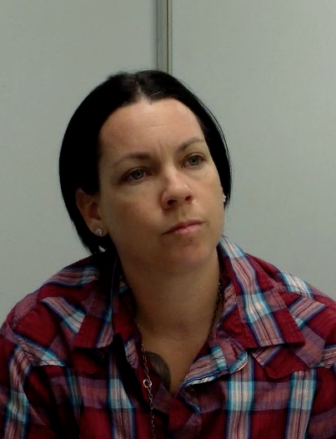
Why Solution-Focused Inquiry?
https://www.youtube.com/watch?v=a4pz_ymwFJ8
Notes:
Luck Luckey (formerly Alison Luckey as she is referred to in the video), when she was a senior social worker from San Diego County who had been learning about SOP for about a year. In the video, she talks about interviewing a mother after an infant has been injured in a car crash following a violent episode between the parents.
Prior to the video, introduce the group to Luck and tell them they will see work she did for an emergency referral. Ask them to watch for three things.
Where do they see her interviewing for safety as well as danger?
Where do they see the Three Questions?
Where do they see solution-focused questions?
PLAY VIDEO
Afterward, have them respond to the above questions and answer the following.
What do they think worked well?
What concerns do they have?
What difference do they think the approach made for this case?
It is useful to emphasize that this case is so serious, the child will likely be removed no matter what Luck discovers. One might legitimately ask, “Why bother?” Luck’s approach lays groundwork for a better working relationship between the mother and CPS that could significantly speed up reunification.
For an advanced group, point out that about nine minutes in, Luck makes a danger statement with the mother just through asking questions.

Slide 65
Let’s Practice!
Exception Questions
Scaling
Danger/safety
Progress
Coping
Skill at finding solutions to difficulty
Preferred Future
Past history of protection
Future goals
Position Questions
Seeing through other people's eyes
In same groups: Pick one idea (worry or what is working) from your list. How would you apply some of these solution-focused questions to this statement?
Write two Solution-Focused questions you could use with your family. Try to ask questions that focus on the impact to the child or behavioral detail.
Notes:
Have groups get back together and look at the list they created using the two questions “what’s working” “what are you worried about” and create two solution focused questions they could use to elicit information from the family.
Refer to handout: Solution Focused Questions Quick Guide for examples
For virtual classes, use handout: Case Planning Worksheet
For in-person classes: Have one member of the group chart on your chart paper

Slide 66
Enhancing the
Safety Network
Notes:
Next segment: Enhancing the Safety Network
Refer to handout in participant workbook: Circles of Support Quick Guide
What are safety networks? Why are they important in child welfare?
A key component and goal of safety mapping is the Safety Network. Plans cannot be made to keep children safe without the involvement of a network.

Slide 67
Safety Network
A group of people (family, friends, community people) committed to keeping a child safe
Notes:
What is a safety network?

Slide 68
What is a Safety Network?
A person that the child/family cares about
A person that cares about the child/family and that is physically and psychologically safe
Know and understand the safety concerns CWS and others have about the youth and family
Is willing and able to do something that supports the child and family to attain a safety outcome. Willing to work closely with CWS
Notes:
What is a safety network?

Slide 69
Building Safety Networks
CWS involvement is TEMPORARY.
A once-a-month home visit IS NOT enough to ensure child safety.
A network of PERMANENT support people is needed to enhance safety.
Families often have more people already involved in caring for their children than we know.
“Services” DO NOT address danger, people do.
Notes:
Why safety networks? They are essential to supporting the family and ensuring long-term sustainable safety for children!
CWS involvement is TEMPORARY.
A once-a-month home visit IS NOT enough to ensure child safety.
A network of PERMANENT support people is needed to enhance safety.
Families often have more people already involved in caring for their children than we know.
We frequently ask people to engage in “services,” even when it does not directly address the danger. We could utilize a similar “push” to bring more people to the work of enhancing daily safety for children.
Identification of Safety Networks should start at intake / initial referrals. Intake workers should be asking about any support people available to support the family and provide safety for the children. This will assist investigative workers to determine if a safety plan can be created and / or identify support people that can be invited to the initial CFT Meeting.
It is easy to believe people don’t have anyone else in their lives to help them. We start believing that for good reasons.
Sometimes that’s what parents tell us because they want to maintain their privacy.
A child welfare intervention is frequently experienced by families as intrusive and embarrassing.
When we start talking about “who else is in your life,” parents can be understandably reluctant to want to include anyone else.
Sometimes, though, parents tell us "I don’t have anyone” because they really believe it. And while it certainly is true that there are times and situations where parents really have “no one” they can turn to, often there are more people in and around a child’s life that would step up if asked than a parent realizes. Our work can be an aid in helping parents begin to see and utilize those people well.

Slide 70
We are working toward this goal:
NO NETWORK…
NO PLAN!
You cannot create safety only with the people you are worried about.
Notes:
No network = No plan

Slide 71
Safety Network Example: Video from Carver County
Julie and her boyfriend moved to Minnesota from Texas. She regularly drinks alcohol while she is the children’s sole caretaker and sometimes blacks out.
Julie
Karl
Video Link
https://www.youtube.com/watch?v=CsqFOJtnGMU&list=PLbEpa_1VPxsJsS2GQajL_-RHC5xukj8Gl&index=7
Julie is told by Sarah (her worker) and others in the system that if she cannot find a network to help her keep the children safe, the children may need to be removed.
Notes:
VIDEO INTRODUCTION:
I will show you a seven-minute video about networks and what it is like to be in one—from the perspective of someone who was in one. This video shows Julie, a mother who worked with Carver County CPS. Carver County is a small county in Minnesota with one of the longest running and strongest Signs of Safety implementations in the United States. Julie and Carver County CPS have graciously allowed us to see a little of their work together.
As background, it is important for you to know that Julie came to Carver, Minnesota from Texas with her children and long-term boyfriend. In Texas, Julie struggled with a significant drinking problem and lost custody of her oldest daughter, who now lives with her father. In Carver, Julie’s drinking has not decreased. She drinks regularly while she is the sole caretaker of the children and has passed out on occasion while caring for the kids.
When Julie starts working with CPS workers in Carver County, they try to help her identify a network to help her and her partner ensure the children will be safe. While the CPS workers would like her to be sober, the focus is not on immediate sobriety; it is on finding a network that ensures her children are safe no matter what. Julie, quite understandably, says, “I just moved here from Texas—I don’t know anyone!” And Sarah, her CPS worker, says, “We know, but none of us like where this is headed. You could lose custody of your children. What you are going to need to do is find some people. It’s non- negotiable.”
This video is of Julie, a year after her Carver County CPS work was completed, being honest and direct with them as she remembers this part of their work together: building a network.
Listen for what she says about the network—how she felt when she was first asked to find a network and what, if anything, has changed over time.
VIDEO DEBRIEF
Trainers can ask about the following areas during the post-video conversation. They might want to pick three or four areas.
What did you notice about Julie’s attitude at the start of the effort to build a network? Did it change? What helped it change? How does she talk about it at the beginning and at the end?
Teaching Point: Clients may start with one opinion about a network and shift over time.
“I had to make myself do things at first; I wasn’t very good at it. There was no beer there; what are we going to do?” What did you think of this line?
Teaching Point: Clients who have used alcohol for many years may have very diminished sober-social skills. By asking them to build a network, we are asking them to do something that can be quite hard, but also very helpful.
“They would make sure that I talked to somebody. ‘If you don’t hear from Julie, you need to call her.’” And then later: “I had people who would just narc me off. If you can get an insider, someone on the inside …
Teaching Point: You can see the beginnings of the safety plan they had in place. There was more than just “if you don’t see her, call her,” but you can see the network was not just about support—it was about safety as well.
Dan from Carver: “What was it like for you to ask these people to be in your network?” Julie: “I hated every minute of it. I didn’t want to do it. My thought at first, ‘I’m not going to stay here … I’m just playing to get along.’
Teaching Point: She was not really embracing a change at the beginning, and, in fact, she was actually out to scam them in some ways (“I’m just playing to get along”). That did not stop her from making a change. Sometimes people start in a “pre-contemplative” place, where they have no insight into a needed change. That does not mean he/she will not take action, gain some insight eventually, or decide he/she wants to make a bigger change in the future. (We will come back to this point about insight in the next module.)
Dan from Carver: “It didn’t seem like Karl always narked you off.” Julie: “Most of the time he narked me off. He would sneak off and go call her. There maybe were times he didn’t, but he was just done. ‘You have to put the kids first. The babies have to come first.’
Teaching Point: It is hard to know without hearing from Karl, but Karl saying “You have to put the kids first” likely demonstrates that he was beginning to understand the importance of child safety, which is what we hope for in our work with families—that they begin to understand safety has to come first.
Ask for other comments/questions as well.
OTHER AREAS TO CONSIDER
Trainers can ask the group what they know about asking someone who has been drinking for years to be sober and using that as a case plan goal. Does that make sense? When would it be the right thing to do? Is sobriety the same thing as safety?
Some workshop participants make the point that this occurred in a rural county, and the situation would be different elsewhere. While all jurisdictions and areas are different, it is likely the county’s rural nature was not the biggest reason for the case’s success—it was the worker’s insistence that a network be formed and Julie’s courage to try new things.

Slide 72
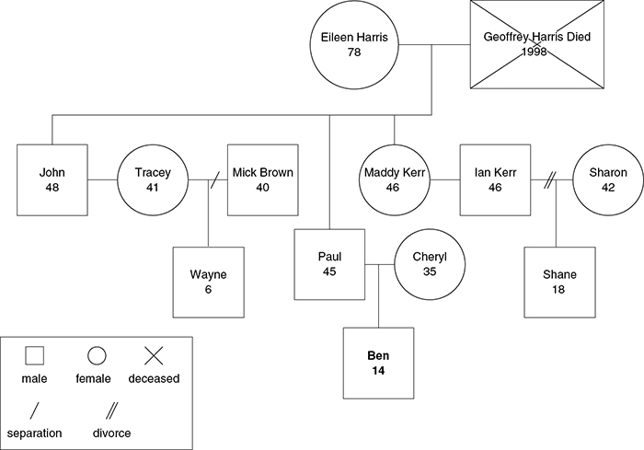
Genogram: A Graphic Representation of the Family Tree
Notes:
Briefly review the genogram as a tool to document safety networks
Used in: RED teams, Child & Family Team meetings, etc.
An example of the genogram is in your participant guide on the class website

Slide 73
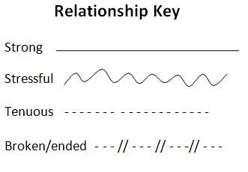
Eco-map: A visual representation of the family as a system
Surrounding Circles Denote Family Connections
Type of Line Indicates Quality of Relationship
School
Faith Community
Neighborhood
Family
Family Member
Organizations
Kin / Extended Family
Activities
Employment
Friends
Notes:
Briefly review the eco-map tool
Can be used in Child & Family Team meetings and case consultations/mappings to determine additional supports for the family
An example of the ecomap tool is in your participant guide on the class website
Creating an ecomap is a graphic and useful way of assessing families in which the families themselves can participate. This method of diagramming depicts the family in their dynamic ecological system. Other important systems that influence the family are included in the ecomap. The ecomap also provides a picture of the important nurturing or conflict-laden connections between the family and the world; demonstrates the flow of resources, or lacks and deprivations; and highlights the nature of the interfaces and points of conflicts to be mediated, bridges to be built, and resources to be explored.
“Who do you care about?” and “Who cares about you?”
Extended family/friends who have cared for you or about you in the past

Slide 74
Enhancing the Safety Network: Circles of Safety and Support
Child/parent
People who know a little
People who know nothing
People who already know
Key question:
Who from this child’s life is interested and able to help to keep the child safe?
Susie Essex
Sonja Parker
Notes:
We are going to introduce a tool that, like genograms and ecomaps, is a way to help workers and families begin to identify members of networks.
The safety circles tool was developed by Susie Essex in England for holding a conversation with a family specifically about building networks.
This is a dynamic process and is supported by inquiry and questions.
Who from the middle circle would you most want to move to the inner circle? Why?
What would tell you someone in your life was ready to move to the inner circle?
If I said you had to move someone to that inner circle for us to take the next step in this case, who would you pick?

Slide 75
Elements of a Safety Circle
Child/parent
People who know a little
People who know nothing
People who already know
A visual tool to help families identify people for the child’s safety network. Draw it with the family and place between you on the table to facilitate conversation.
Initial question: “Who in your life and your child’s life already knows what happened?”
Compliments: “How did you manage/find the strength to be open with those people about that?”
Middle circle: “Who in your life and your child’s life knows a little bit about what happened -- maybe knows that something happened -- but does not know the details?”
Outer circle: “Who knows nothing about what happened?”
Notes:
Read key ideas on slide related to using the safety circles.
Initial question: “Who in your life and your child’s life already knows what happened?”
Compliments: “How did you manage/find the strength to be open with those people about that?”
Middle circle: “Who in your life and your child’s life knows a little bit about what happened -- maybe knows that something happened -- but does not know the details?”
Outer circle: “Who knows nothing about what happened?”
Alternative questions for Transition Age Youth (TAY) (shared with permission, developed by San Luis Obispo County):
People who have had your back or have been there for you
People who can be counted on for something
People who seemed to care but actually did very little
Outside the circle: people you should probably avoid

Slide 76
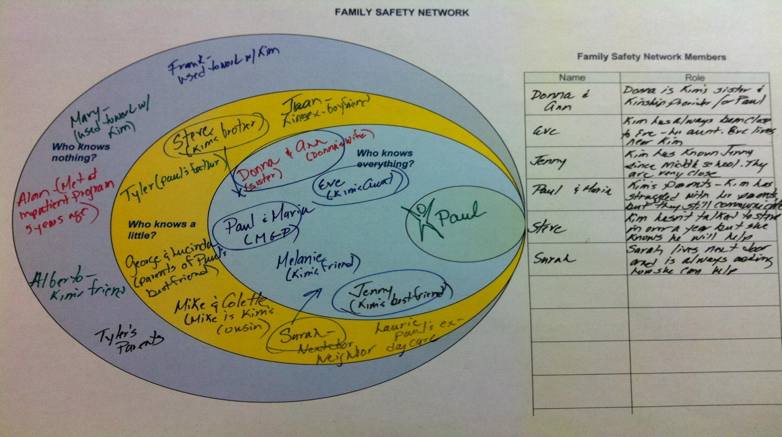
Notes:
This example is based on a real case from Massachusetts that the Safety Circles was used in. Names have been changed and the case has been de-identiﬁed.
This is what their safety circles looked like – with the child Paul at the center, and all the people circled who the parent, Kim, decided were safe.
You can then see arrows that show who Kim is suggesting should move to the inner circle.
One of the components of trauma-informed practice is to oﬀer people choices. Allowing families to circle who they feel best about being in the network is an example of trauma-informed practice.

Slide 77
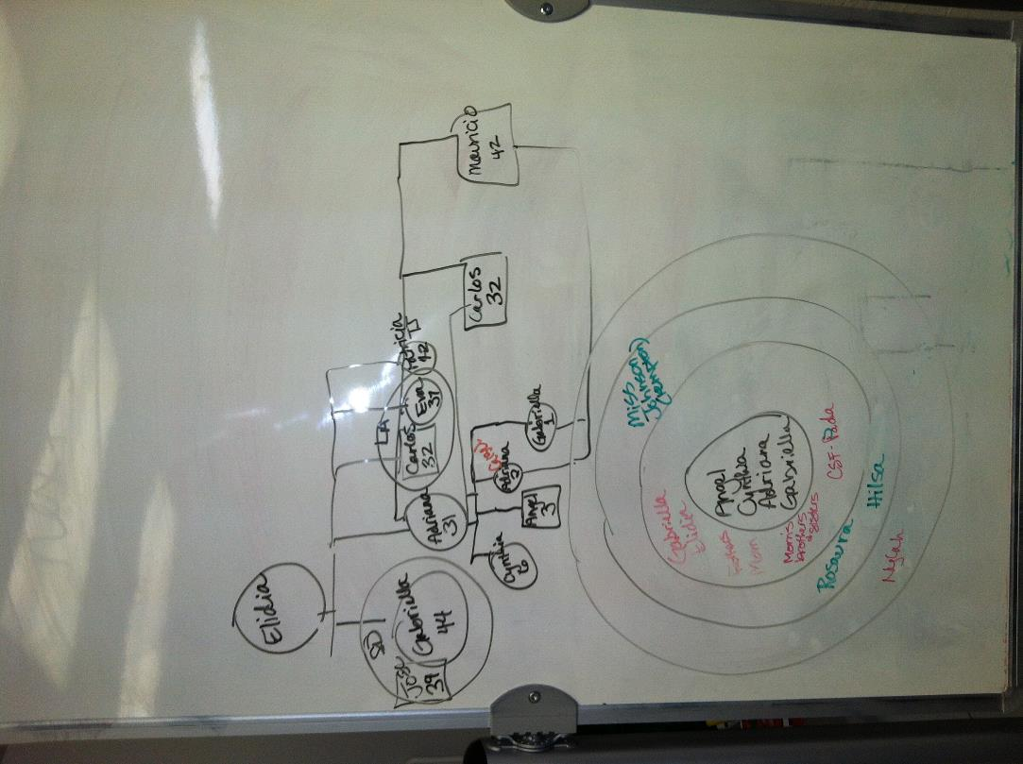
Example from Nicole Kelsay,
San Diego County Child Welfare Supervisor
Notes:
This is another example, this time from San Diego County where before a family team meeting there was both a genogram and a Safety Circles completed.
The genogram helped the family identify family members to the department, but the family reported that the safety circles helped them remember and think about people they would not have considered for a family team meeting.

Slide 78
Cultural Considerations in Forming a Network of Support
Questions to ask:
To whom in their community does the family already reach out?
When others in their community faced similar problems, how did they get support?
Do they prefer to open up to people within their culture? Outside their culture?
Opening up to others in some way may be a bottom line, but with whom and how can be tailored to individual families and cultural groups.
Notes:
Culture is integral to the work of creating networks. Some families from some cultures may have an easier time asking for help – others may be more reluctant or embarrassed to let anyone from their own culture and background know that something is amiss. It’s important to stay open to both possibilities (be in that “culturally humble” place when talking to families.
Having a network may be a “bottom line” – something we tell a family is critical to us feeling like their children are safe. Who is in that network is something we can have some flexibility on – we can ask families if they would want someone from their own cultural background to be in the network, someone different any why.
NOTE: You may want to do some kind of short transition activity here. You can ask participants to get into pairs and think about one family they are working with now or in the recent past they thing could benefit from the safety circles conversation and why

Slide 79
Let’s Practice Safety Circles!
Child/parent
People who know a little
People who know nothing
People who already know
Reminder: You can’t create safety only with the people you are worried about.
NO
Network
Plan
Notes:
Take the same case you have been working on at your tables.
Refer to handouts: Circles of support quick guide; Solution focused questions quick guide
Discuss at your tables (5 minutes):
How would you start the conversation about safety circles with this family?
What questions could you ask to help the family identify natural supports they are willing to bring to the center of the circle?
Debrief with larger group:
What questions did you come up with?
How do you document safety networks in your county?
How do you ensure that networks are ongoing throughout the life of the case? Safety circles are a living document and should be updated regularly!

Slide 80
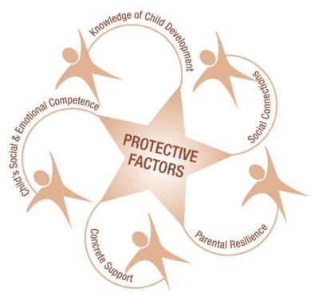
Strengthening Families Five Protective Factors
A research informed approach to increase family strengths, enhance child development, and reduce the likelihood of child abuse and neglect.
The five protective factors are:
Parental resilience
Social connections
Knowledge of parenting and child development
Concrete support in times of need
Social and emotional competence of children
For more information: https://cssp.org/our-work/project/strengthening-families/
Child Welfare tools: https://cssp.org/our-work/projects/practice-tools-for-child-welfare/
Notes:
In addition to the safety network, these five protective factors are shown to be critical to enhancing safety and reducing likelihood of child abuse/neglect.
Refer to handout: 5 protective factors
Protective factors should be considered when workers are developing roles for the safety network.
Additionally, protective factors are an important part of case planning (covered on Day 2).
For example:
Does the parent need support to build resiliency?
How can the network support help increase social connections for the child and family?
How can the network help the parent increase their knowledge of parenting and child development?
Can the network provide some concrete supports for the parent (help with transportation, diapers, clothing, housing, child care, etc.)?
How can the network help build social and emotional competence of children?
Quick table talk: (Please refer to handout: 5 protective factors)
Briefly review the handout at your tables – do you currently do any of these actions in your work? Which ones are you willing to try? How do you see these actions applying to your work with the Child & Family team?

Slide 81
Interviewing Children
Notes:
Next segment: Interviewing Children
The Quick Guides for both the Safety house and 3 houses are in your participant guide for this course.
We have spoken a lot already about the need to think through ‘impact on the child’. What’s the best way to get this information? One of the most important ways is to actually talk to the child and get their perspective. This section of the training talks about some practices that have been developed for doing that.

Slide 82
Think about a time when you interviewed a child and felt really good about it—a time it really made a difference.
Tell your partner this story.
What in particular in your stories do you think each of you did that made the biggest difference?
Notes:
Voices of children/youth are brought forward in SOP because of the belief that they likely witness much of what goes on in their family and can contribute to a comprehensive understanding of what is happening and what they and their caregivers may need, and that they often can and need to collaborate with other stakeholders in their own safety planning.
Allow five to 10 minutes for discussion, then ask for examples. If you want, one person can ask the group for ideas while another person writes down what they say.
Feel free to ask questions to help make their points more concise (You had to slow yourself down to listen. How did you do that?).
Discussion point: Why is it important to interview children? Look for ideas that include the following:
Children have important information. They know what is happening in the family.
Children are aﬀected by what is happening.
Children deserve to have information from us about what is happening to them.
Parents often think that adult problems are hidden from the children, i.e., “The children don’t know that we ﬁght/smoke pot...”
Additional points:
It can be easy to forget that the reason we are involved with a family is because of a child—a child who can oﬀer a lot of information.
Often interviews with children end up focusing on just the incident, or include certain routine questions about disciplinary practices. But if we do that we can miss an opportunity to gain rich and important information from the children’s perspectives.
While there are appropriate boundaries around information, children are part of the process of our intervention, and it will help them to feel less victimized if they are included as much as is developmentally appropriate in conversations about them.
NOTE: Some workers may react against making children responsible for their own safety, or “parentifying” them. We can agree that going that far would be inappropriate. What we are talking about is listening to children about what makes them feel unsafe, what would make them feel safe, and ﬁnding ways they can act to contribute to their safety. The techniques we are going to review in this section can help facilitate these conversations with children.

Slide 83
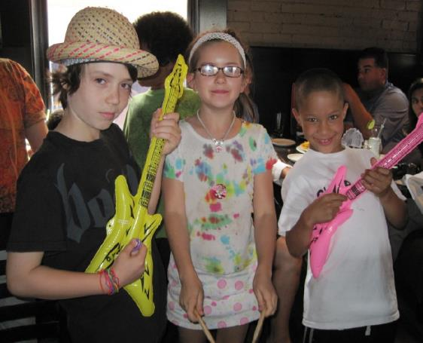
Interviewing Children
Makes children’s voices and perspectives a meaningful part of the process.
Children are likely witnesses to all that goes on in a house, and therefore…
Children’s perspectives are vital to gathering information about what is happening.
Therefore, children need to be our partners in assessment.
Children can be, and often need to be, partners in their own safety planning.
Notes:
Review key points on slide

Slide 84
What Can Children Tell Us About…….
Safety Assessment
Safety threats/Danger
Risk Assessment
Child factors
Child and Adolescent Needs and Strengths (CANS) Assessment
Caregiver characteristics
Child characteristics
Continuing safety planning
Risk Reassessment
Progress on family service plan
Immediate safety planning
Protective capacities
Household factors
Parent factors
Notes:
We may not always think about it, but the conversations we have with children can really help ensure we get the most out of our SDM tools.
Remember, the SDM tools are only as good as the information we get—children can help enhance and verify our information.

Slide 85
Domains of an Interview With a Child
Interviewing children should cover…
School
Culture and Community
Morning/ Evening Routines
Health
Basic Needs
Friend/Peer Relationships
Discipline
Notes:
Trainers: give examples when possible. What else can the child tell us about? Anything and everything!

Slide 86
Stages of an Interview With a Child
Engagement
Orientation
Explain purpose of interview
Connecting with the child
Can be playful
Tolerant of child ways of being
What next steps will occur?
Wrap Up
What are the worries?
What is going well?
Information Exchange
Notes:
If you were to think about all our work with children, you could break it down into four phases: Orientation, engagement, information exchange, and wrap‐up.
The orientation phase is our good-­‐faith contract with the child. We are probably a stranger, and possibly someone he/she has been told to not talk to. We need to honestly, and in developmentally appropriate ways, explain who we are and why we are here. You probably have ways you have found that work for you. Anyone want to share what you use?
The engagement phase gives space for the child to become comfortable with you, and also gives you an opportunity to get familiar with the child’s style and abilities. You have to “read” the child. If he/she is prepped for this interview and is anxious about it, spending too long on engagement can impair his/her willingness to stay with you. Rushing can get into information exchange before the child is ready. There may be some speciﬁc tasks during this stage.
The information exchange can transition fairly gently, but make a clear transition to learning about what is happening in the child’s family. The three questions we covered last Time form the focus in child interviews just as they do in adult interviews. Information exchange is about learning what is going well for the child and what worries he/she has, and you want to be sure you are talking about the family.
The last stage is to thank the child for spending time with you and explore with the child what will happen next. Children do best when they know what to expect. We will come back to this at the end.

Slide 87
Engaging Children
Get down to the child’s level—the floor is your friend!
Break down language into words and questions the child can understand.
Incorporate breaks and check-ins, and view “side trips” as valuable parts of the conversation.
Allow children to look away, fidget, wiggle, face away from you, be under the coffee table, in a different room—anything, as long as you have evidence that they are participating.
Look for what works and do more of it.
Incorporate playfulness as much as possible.
Tools: What objects are in your tool kit?
Setting: How do you make the best of the chaos?
Notes:
Review slide
Are there other ideas you can think of for engaging with children?

Slide 88
Two Child Interviewing Tools
Engage child in Harm/Danger Statement and safety assessment
Safety House
Engage child in safety planning
Three Houses
Notes:
Three Houses is exceptionally good for learning about Danger and safety from the child’s perspective, though you will see that it also has value in beginning safety planning.
The Safety House is exceptional for including the child in safety planning, but you will learn that it can also provide good information about safety and Danger.

Slide 89
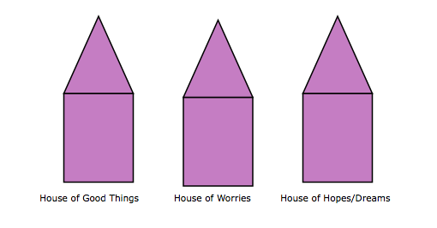
Three Houses Tool
Nicki Weld and Maggie Greening
Notes:
Note: the 3 houses kit is on the class website and the quick guide is in your participant guide.
This practice was developed by Nikki Weld and Maggie Greening, two child protection social workers in New Zealand, as they searched for ways to do assessment and planning.
And while today we are primarily teaching it as a method for engaging children, I hope you will see that there is relevance for lots of populations, including adults.
NOTE: Make connection between Three Houses and Three Questions. Also remind people there is handout and prompt sheets on this material in their packets.

Slide 90
Example from San Diego
DAD
10
8
12
Notes:
This example comes from San Diego County. A single father of 8 and 10 year old boys meets a woman in a bar. They start seeing each other, their relationship gets serious and she moves in with the family.
Initially things go well, but one night she pulls a knife on the dad. The children are home, see this and are terrified. No injuries, but the police are called, CPS responds and dad is told that his girlfriend has to move out. He does this, but 6 months later she moves her back in.
The boys go to school the next day in tears, scared she's back. There is close relationship between school and CPS, they call, and CPS goes right back out. San Diego worker Holly Kohlerich responds, and she was just trained in 3 houses. She does this with the boys, and this is what they draw.

Slide 91
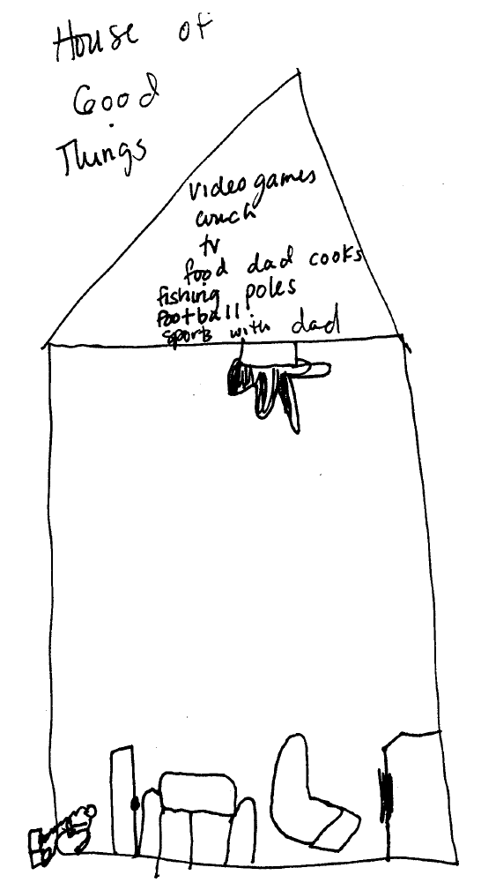
Notes:
This first set of slides is the 8 year old and this is his House of Good Things.
Video games, lunch, TV, dad cooking, etc. The rifle represents shooting/hunting with dad
– A time that they bond.
NOTE: Check in with group on anxiety re: fire arms in the home. In this case, social worker Holly explored gun safety upon first visit with family and was not worried b/c they reported adherence to gun safety practices.

Slide 92
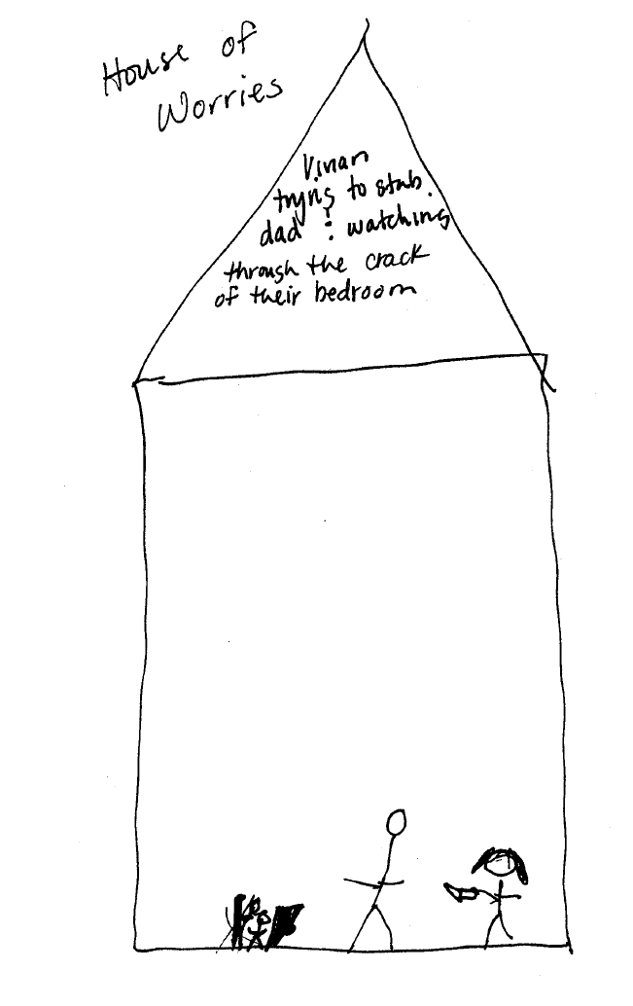
girlfriend
Notes:
This is his House of Worries. Girlfriend tries to stab dad, I watch them through the crack of their bedroom.

Slide 93
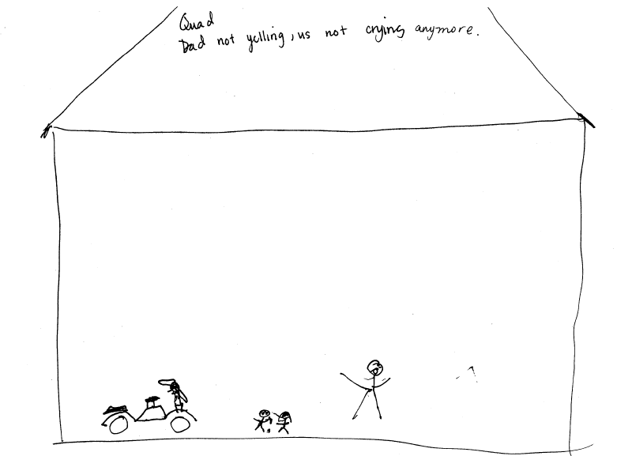
Notes:
This is his House of Wishes and Dreams – the boy wants to own a quad four wheel motor bike but also says he wishes dad would stop yelling.
This was not something that had come up in the assessment process before, and having it come up here allowed the worker to really have a conversation that she would not have been able to have otherwise.

Slide 94
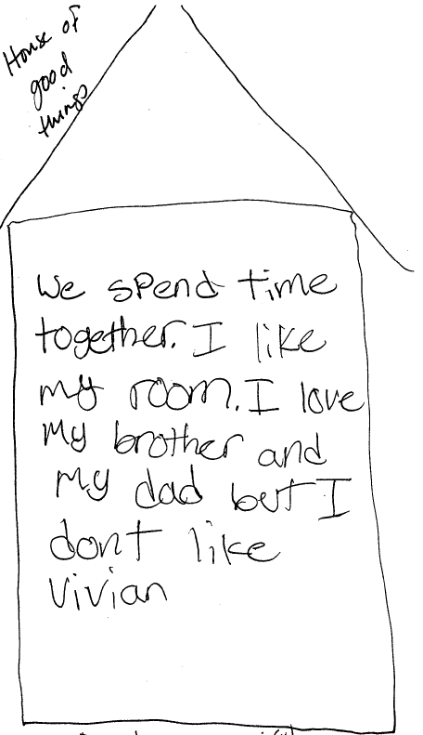
girlfriend
Notes:
These are the Three Houses of the ten-year old. This is his House of Good Things.

Slide 95
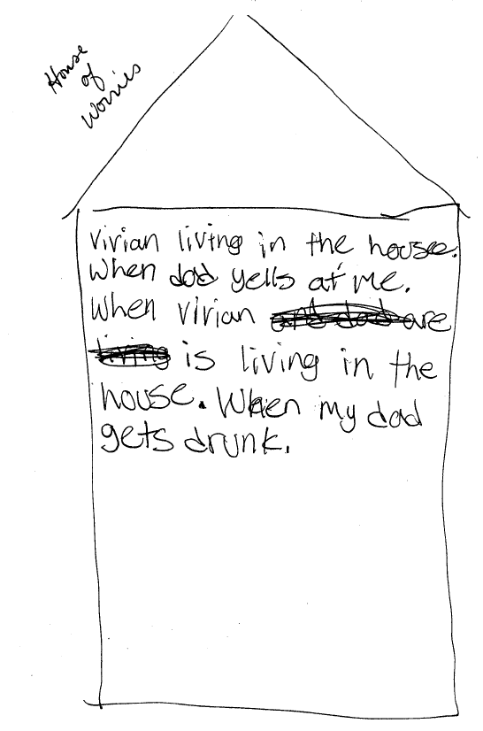
girlfriend
girlfriend
Notes:
This is his house of worries.

Slide 96
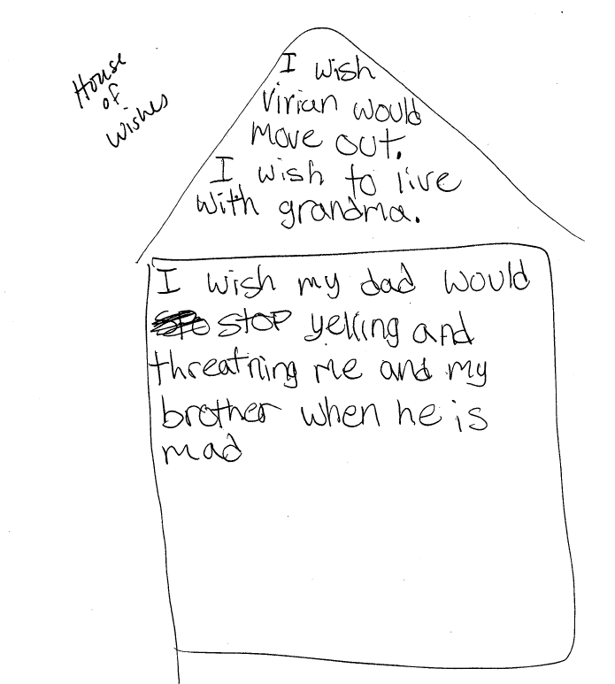
girlfriend
Notes:
This is his House of Wishes and Dreams.
The worker took these houses to the father to show him. We will talk about this in a moment, but that is one of the powerful possibilities of this practice – having parents see their children’s own houses. NOTE: Can ask what kind of difference we think this makes.
When the father saw the drawing he cried, and this time HE kicked his girlfriend. The team soon had a TDM to plan next steps, and dad was able to get members of his network to attend including a local school bus driver. It is a small town, she knows the girl friend’s car, and vouched to call CPS if she spots the car anywhere near dad's house. [TRAINERS can point out safety network]. The case closed successfully a few months later as dad was addressing his yelling, his drinking and, most importantly, was keeping the girlfriend away from the house.
NOTE: It is potentially useful here to have a discussion about what kind of difference having a tool like this makes, if the CPS team from San Diego would have had this same amount of information otherwise, etc.

Slide 97
Before the Child Interview
Obtain permission from parents
IF safe
IF forensic considerations are not compromised
Select a conducive location
Decision: With parents or without?
Have paper and drawing tools with you
Decision: One sibling or more?
Notes:
To do Three Houses is pretty simple, and does not take a lot of preparation. A little planning and consideration is helpful when possible.
First, before interviewing a child, it is good practice to get parent permission.
However, there are times you will interview the child prior to parent involvement: if involving the parent in advance would compromise child safety, if there is worry that the parent will attempt to alter child’s story prior to your interview, or you have to protect against the possibility or perception of interference. (These concerns are likely present when addressing allegations of serious abuse or neglect, or sexual abuse.)
It is a good idea to equip your interview space with paper and crayons, and to carry blank paper and a few crayons or markers with you at all times. Then you are always ready. Find a good space for the interview—as good as is available. Privacy is important, child comfort is important, reducing distractions is important—all the usual considerations.
It is best to interview the child alone whenever possible, but if the child cannot feel comfortable without a parent—as long as the parent is not suspected of sexual abuse or of intimidating the child— it can work with a parent in the room. Provide the parent with clear instructions about not answering for the child or responding to what the child says. It is generally best to interview one child at a time, especially in the early sessions. But again, if a child feels most comfortable with a sibling, you might need to do that. In some instances, interviewing with siblings on occasion can give new perspectives on how the children are doing.
NOTE: If no one in the room can share examples of how they have handled these dilemmas, be prepared with your own examples to share or pose hypotheticals, e.g., How would someone handle a parent who refuses to allow you to do the Three Houses with the children alone? If no one comes up with it, share “ear shot” idea where parent is oﬀered option of being around the corner within earshot, but not in the same room so the child has the sense the conversation is private.

Slide 98
Introducing the Three Houses
Explain to the child:
“In the first house, we will include the things that you like in your life. That is the house of good things.”
“In the second house, we will write or draw your worries. That is the house of worries.”
“In the third house, we will write or draw how things would be if they got better. That is the house of dreams.”
Notes:
NOTE: Read through key points. Point out that they should use a fresh piece of paper for each house whenever possible.
EXAMPLE: We are now in an interview. You have ﬁnished orientation and engagement. You may use Three Houses to transition to information gathering, or you can start with verbal questions and introduce Three Houses later. There is no rule about that. Whenever it happens, these are the ways the developers suggest introducing Three Houses to the child.
After explaining all Three Houses to the child, you can ask the child which one he/she would like to start with, the House of Worries or the House of Good Things. (Leave oﬀ the House of Dreams from this choice—that will be the last one.) Most of the time it’s best to start with House of Good Things (what’s working well) if the child has no preference.
Give the child choices about crayon/marker/pen/pencil. You can even ask if the child wants to draw or wants you to draw. Whichever the child selects, ask him/her to draw a house, and then put in the house all the things that are good about the house in which they live (or that they worry about in their house). Let them know they can use words or pictures to show. Either way ensure that either the child or your writes notes to describe drawings.
It is also appropriate to inform the child in advance of what will happen with this drawing in simple, age‐appropriate ways. Until the drawing begins, you do not know what you will do with it, but it is only fair to make child aware of some basic things and then talk a little more later. The key here is to be honest, but not make a big deal of things that will create needless anxiety. For example, ask the child to make these drawings for you so that child does not expect that he/she can take them when child leaves. (If appropriate, you can oﬀer to make a copy.) Mention that you may need to share the drawings with other people who are working hard to ensure they stay safe.

Slide 99
Introducing the Three Houses
Clarification, details
“And then what happened?”
Awareness of child’s process
“Do you want to take a break?”
Developmental awareness
“Tell me what the word ‘hurt’ means.”
Non-leading
“What else do you think I should know about?”
Above all: It is a conversation!
Notes:
As the child draws, you can (and should!) use classic conversational prompts to help bring additional detail to the surface.
As with any child interview, be aware of terms that may carry diﬀerent meanings for children than we think. For example, if the child draws mom’s boyfriend in the house of worries and says, “He hurt me,” and you happen to be investigating physical abuse, we may assume she has just conﬁrmed physical abuse. But asking what the word hurt means, or how he hurt her, could just as easily reveal that he was combing her very snarled hair and it hurt, or that he hurt her feelings.
As with any child interview, use non‐leading questions that are as broad as possible. If you have to increase the amount of information embedded in the question, step down, giving as much option in the answer as possible, and as soon as the conversation has advanced, go back up to the highest-­‐level question possible. Just because you are drawing Three Houses with the child does not mean that any of the good techniques for child interviewing do not apply.
Be mindful of how the child is doing. If he/she needs a bathroom break, a drink of water, or just a rest from the conversation, take a break!
In the end, this is no diﬀerent from any other interview with a child. It just includes a particularly helpful technique called Three Houses.

Slide 100
Talking to Caregivers
How to share it with parent?
Show whole drawings?
Summarize?
Hold some information that could be incendiary until child safety is secure?
If sharing …
Start with house of good things
Worries presented as things child is worried about (vs. “truth”)
Become partners in thinking through the implications
“CPS must act ‘as if’ until proven otherwise.”
“How do you think I should react if I see this as true?”
“What do you imagine I will need to see happen next?”
Parent reaction IS information
Notes:
If you do share the child’s drawing with the parent, it is usually good to let the parent see the good things ﬁrst. It reduces defensiveness, helps the parent trust that you see the good things too, and adds credibility to the child’s worries.
When you show the House of Worries, describe it in that way. It is things the child worries about. Avoid saying, “Here are the facts I now know about you from what [child] said.”
The reality is that we do not know the truth and even if we did, it may be too charged to go in with truth blazing. Talk about things the child is worried about from his/her perspective and see if this can provide a way to get on a mutually agreeable page about what needs to happen in the future to help the child feel safe without going into power struggles over what has already happened.
However, we cannot let a parent dismiss child’s worries. Unless you are dealing with a demonstrable factual lie (which raises other questions about how the child is doing), you can let the parent know that you will need to act as if this is true until proven otherwise. Ask the parent what reasonable actions would be if this was true—what he/she thinks needs to happen next.
You can get a range of reactions. Some parents are going to be very moved by seeing their children’s Three Houses, and new opportunities for partnership and working together are going to occur as a result. However, these are not all “Hallmark movie moments” where every parent, when confronted by their child’s Three Houses drawing, breaks down, confesses, turns over a new leaf, and becomes parent of the year. Some parents will deny any facts presented, no matter how compelling. As frustrating as that can be, in terms of assessment, it is very useful.
NOTE: Again, elicit examples of times they shared Three Houses with a parent from group and be prepared to share your own.

Slide 101
The Safety House: Safety Planning with Children
A method for including the child’s voice in safety planning
Notes:
Note: The Safety House Quick Guide is in your class participant guide.
We are now going to look at another technique—a wonderful way of surfacing children’s views of what kinds of safety plans they would need to really feel safe.
Again, you may want to pay attention to the way this really allows children’s voices to be connected to all parts of our work.
The Safety House was developed by Sonja Parker, a child protection social worker and now trainer and consultant from Perth, Australia.
This is the Safety House. It is also pretty simple in its form. It has ﬁve sections.
Also remind people there is additional information and prompt sheets in the handout packet.

Slide 102
Rules of the
Safety House
Who
lives in the
house?
Who can visit?
Who should not be allowed in
Safety path
(scaling)
Notes:
Before starting the Safety House interview with the child, it is useful to explain the process to the child. Show him/her the drawing like this. Tell him/her what you want to do. Do the “orientation” we talked about earlier so he/she understands what you are looking for and can participate.
The Safety House interview begins by asking the child a solution­‐focused miracle question. Miracle questions are some of the most well‐known questions from solution‐focused inquiry. This one goes like this: “This is your house, but it is your house if you always feel safe. All the reasons for working with you, all the things that worried you or scared you, have been taken care of.”

Slide 103
The Safety House Elements
Overview: This is your house in the future, when you always feel safe.
Inner circle: Who lives with you in this house?
Outer circle around the house: Who can come visit?
Red circle to the side: Who should not be allowed in?
The roof: What kind of rules does a house like this need to make sure you always feel safe?
The path: If the beginning of the path is where everyone is worried and [known danger is happening] and the end of the path is where this Safety House exists and no one is worried, where are you now? What do adults need to do so you can be one step closer to this house?
Notes:
Review elements of Safety House

Slide 104
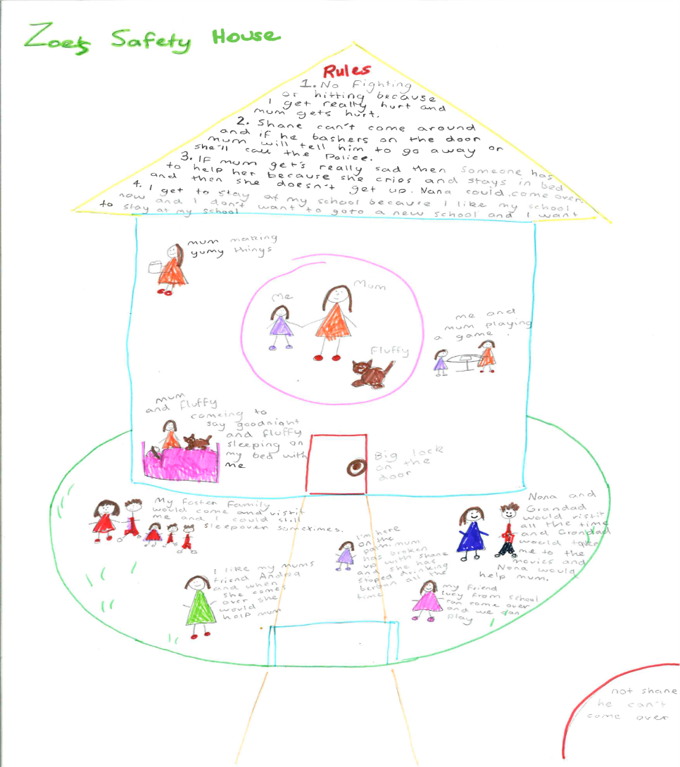
Example
Created with 10-year-old “Zoe” as part of planning for her reunification
(with Sonja Parker)
Notes:
Here you can see an example Sonja Parker made with 10‐year‐old Zoe as she prepared for her reuniﬁcation.
TRAINER NOTE: It can be good to read through each section, or at least some highlights.

Slide 105
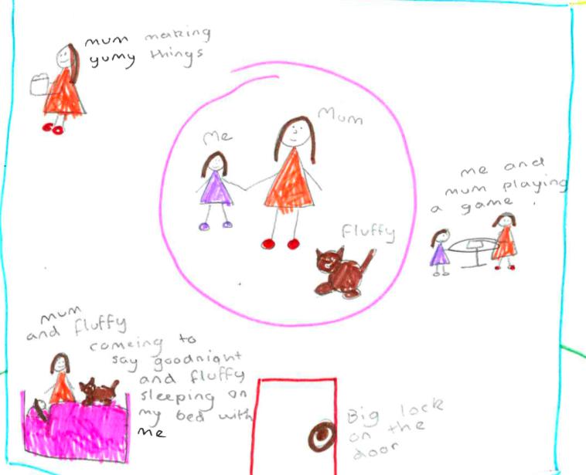
Example: Who lives in the house?
Notes:
A closer look: Who lives in this house?

Slide 106
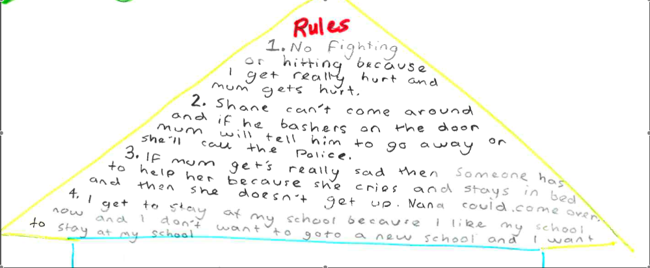
Example: Rules
Notes:
When you get to this part of the Safety House, you say “in this house where you always feel safe, would there need to be any rules, rules to make sure you stayed safe? What would they be?

Slide 107
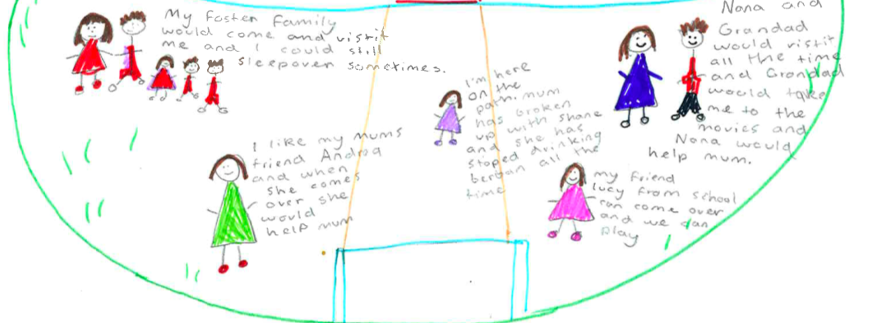
Example: Who can visit?
Notes:
A closer look: Who can visit?

Slide 108
Example: Who cannot come in?
Notes:
A closer look: Who cannot come in?

Slide 109
Reflection and Application
Discuss how you might use the Three Houses and/or Safety House tool in one of these roles:
Intake
Investigation/Assessment
Family Reunification
Family Maintenance
Permanency Planning
Adoptions
RFA / Placement
Community Partners
Notes:
Large group discussion: how they may use the Three Houses and/or Safety House tool in one of these functions.

Slide 110
Reflecting on the Day
What do you worry about?
What do you think might work well about this approach?
What is important for you to hold in your heart & thoughts as we continue training?
What questions do you have?
Notes:
Reflection on the day, ask questions on slide. If your group has energy, put them into pairs or small groups and have them answer these questions.

Slide 111
Plus/Delta – How did today go? See you tomorrow!
+ Δ
For questions or to inquire about other trainings:
Visit our website: http://humanservices.ucdavis.edu/academy
Visit our SOP Resources Page: http://bit.ly/SafetyOrganizedPractice
E-mail the Academy at: academy@ucdavis.edu
Notes:
Do a plus / delta to gain feedback about Day one.
Are there any upgrades for tomorrow?

Slide 112
References
Berg, I. K. & Kelly, S. (2000). Building solutions in child protective services. New York, NY: Norton.
Boffa, J. & Armitage, E. (1999). The Victorian risk framework: Developing a professional judgment approach to risk assessment in child protection work. 7th Australian Conference on Child Abuse and Neglect, Perth, Australia.
Children's Research Center. (2008). Structured Decision Making®: An evidence-based approach to human services. Retrieved from http://www.nccd-crc.org/crc/pdf/2008_sdm_book.pdf
de Shazer, S. (1985). Keys to solution in brief therapy. New York, NY: Norton.
Department of Child Protection. (2011). The signs of safety child protection practice framework. Department of Child Protection, Perth, Australia. Retrieved from http://www.signsofsafety.net/westernaustralia
Johnson, W. (2004). Effectiveness of California's child welfare Structured Decision Making® model: A prospective study of the validity of the California family risk assessment. Sacramento, CA: California Department of Social Services. Retrieved from http://www.nccd-crc.org/crc/pubs/ca_sdm_model_feb04.pdf
Lohrbach, S., & Sawyer, R. (2004). Creating a constructive practice: Family and professional partnership in high-risk child protection case conferences. Protecting Children, 19(2): 26–35.
Turnell, A., & Edwards, S. (1999). Signs of safety. New York, NY: Norton
White, M., & Epston E. (1999). Narrative means to therapeutic ends. New York, NY: Norton

