Slide 1
The American Revolution: Rebel or Hero
by Debra Coram Troxell

Slide 2
SP 78/300/12
http://discovery.nationalarchives.gov.uk/details/r/C7347617
Folio 21: Young to Argout. He cannot believe that he will protect the pirates from the American ship, which attacks British ships. He demands a clear assurance to that effect.
Date and place: 1776 Aug 4 English Harbour Antigua

Slide 3
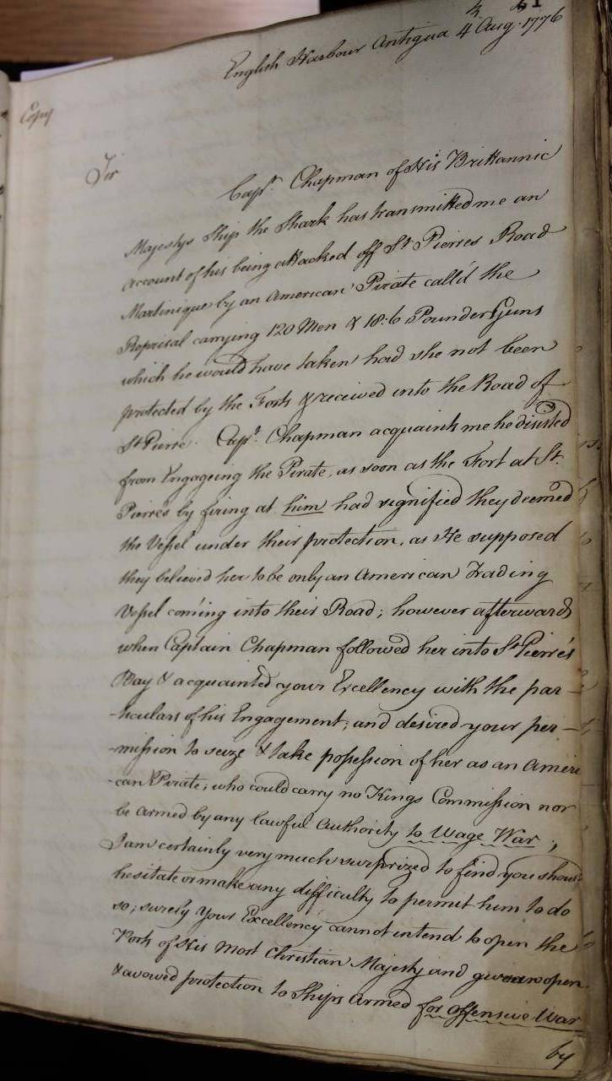

Slide 4
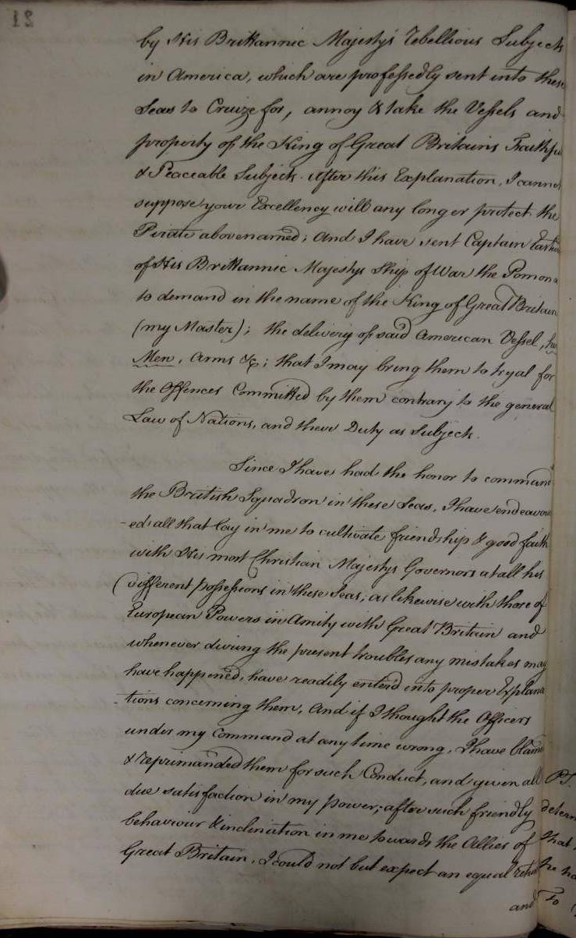

Slide 5
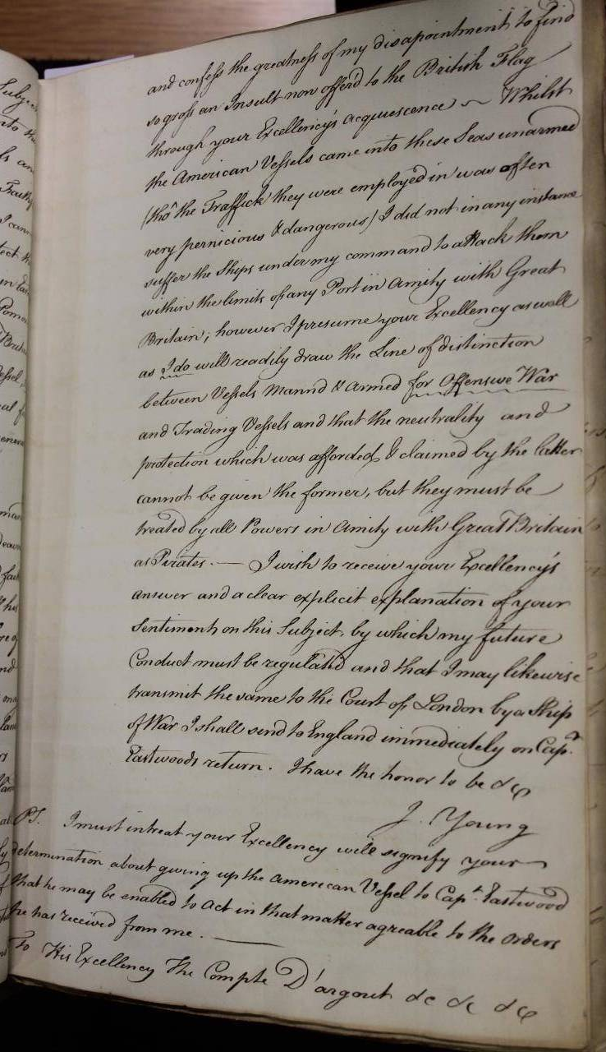

Slide 6
SP 78/300/74
http://discovery.nationalarchives.gov.uk/details/r/C7347679
Folio 173: Charles Hamilton, collector of the customs at Montigo Bay to Sir Basil Keith. He encloses the affidavit of James Stokes about Hispaniola. He is a man of veracity. The pirates are assisted by the French.
Date and place: 1776 Aug 7 Montigo Bay

Slide 7
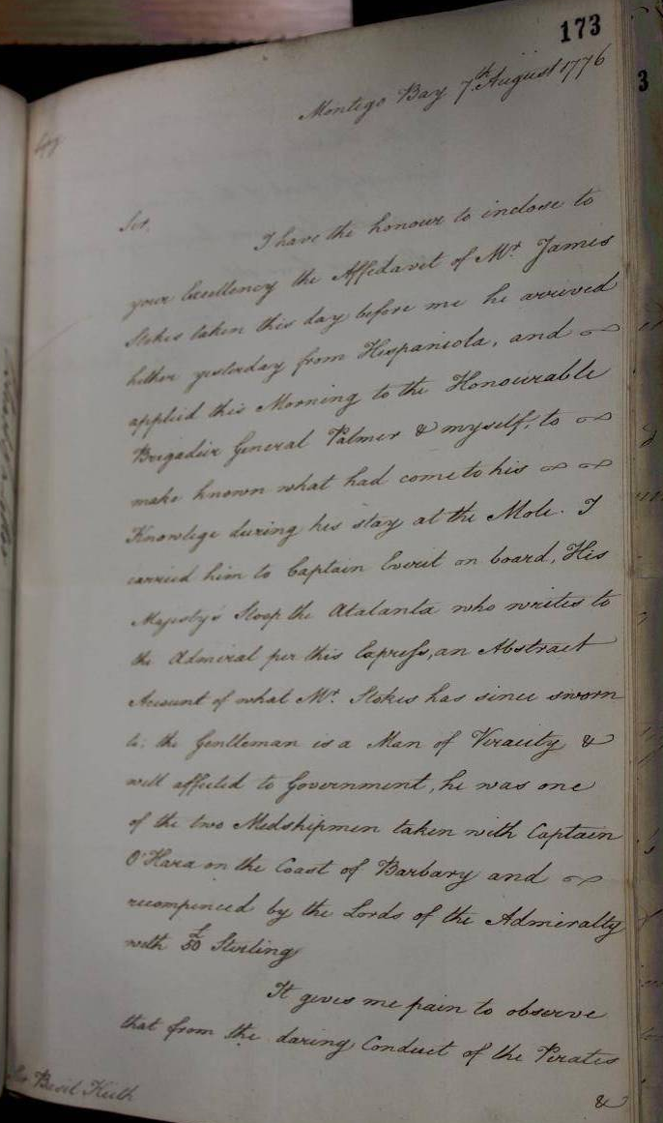

Slide 8
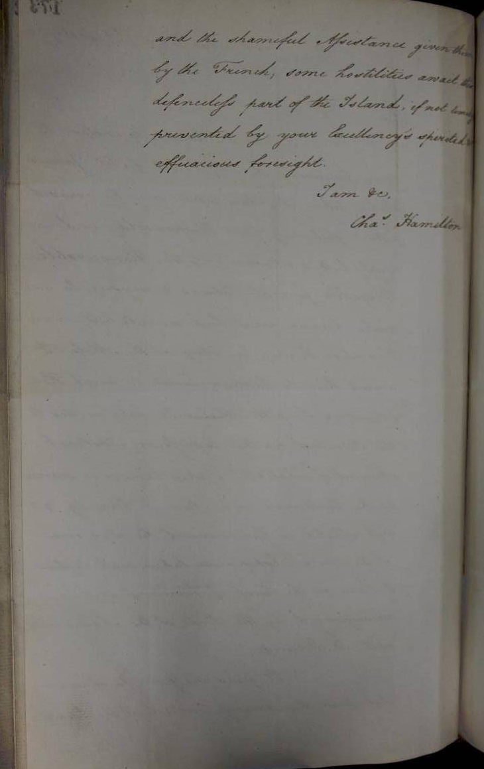

Slide 9
SP 78/305/60
http://discovery.nationalarchives.gov.uk/details/r/C7348549
Folio 128: Governor Morris to lord George Germain. The governors of Martinique and St Lucia have been told by the French government that they can give full support to the American rebels. Bouillé permits them to sell their prizes openly and has given Bingham assurance of his absolute protection for the Americans.
Date and place: 1777 Aug 1, 3 St Vincent.

Slide 10
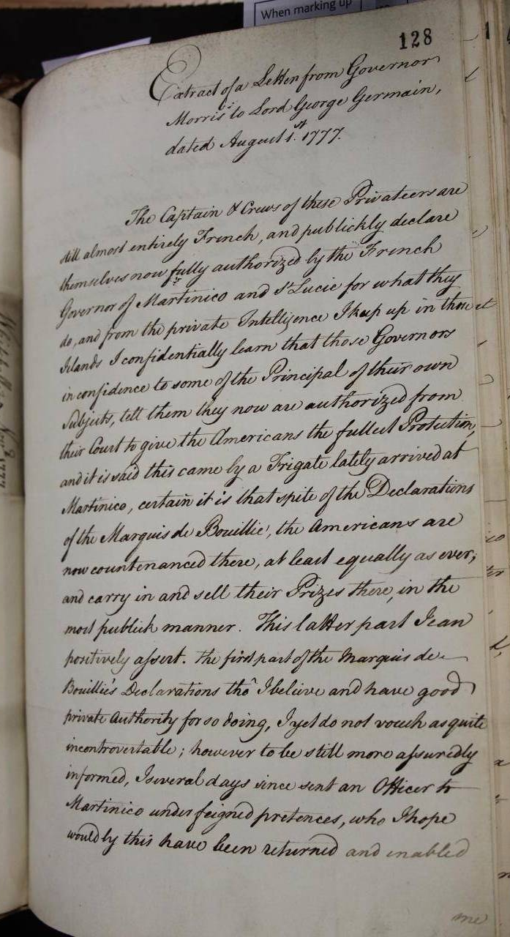

Slide 11
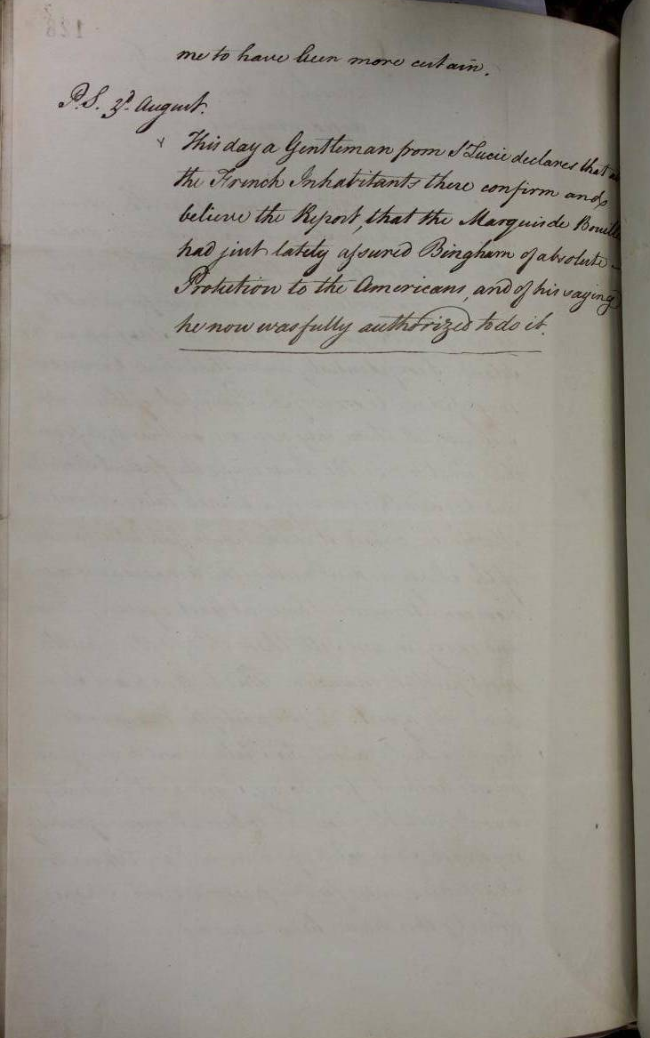

Slide 12
SP 78/306/175
http://discovery.nationalarchives.gov.uk/details/r/C7348802
Folio 383: Burt to lord George Germain. Arbaud promises to punish any French subjects, who help American privateers.
Date and place: 1777 Dec 2 Antigua

Slide 13
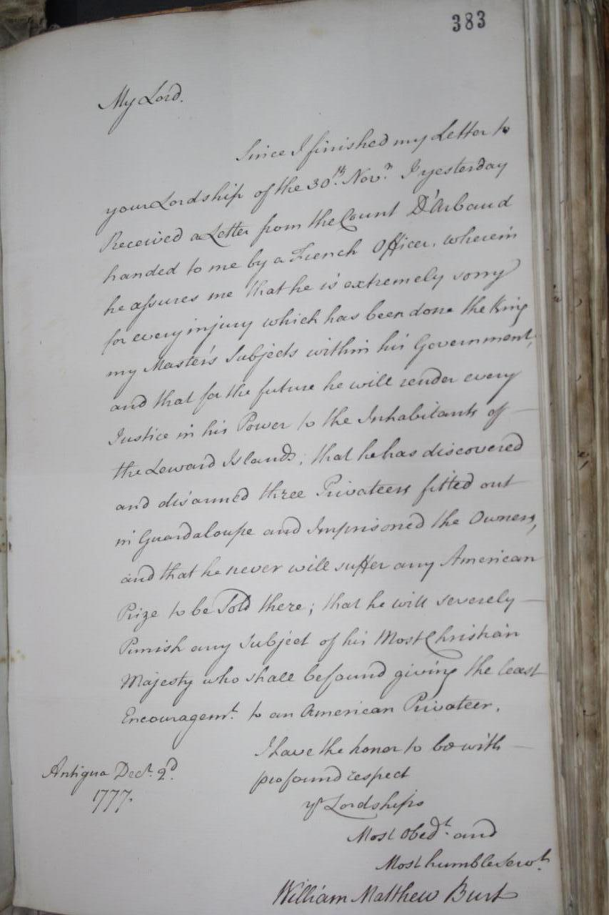

Slide 14
PRO 30/11/74 pg. 9
http://discovery.nationalarchives.gov.uk/details/r/C3214408
A bundle of loose letters, mostly copies or drafts from Cornwallis to Sir Henry Clinton K.B. Commander-in-Chief, unless otherwise noted, numbered as folios 1-145. When two copies of a letter are found in this bundle, one is usually the original draft, and the other is a fair copy of the final version apparently.
1 bdle.
1781 Apr-Dec

Slide 15
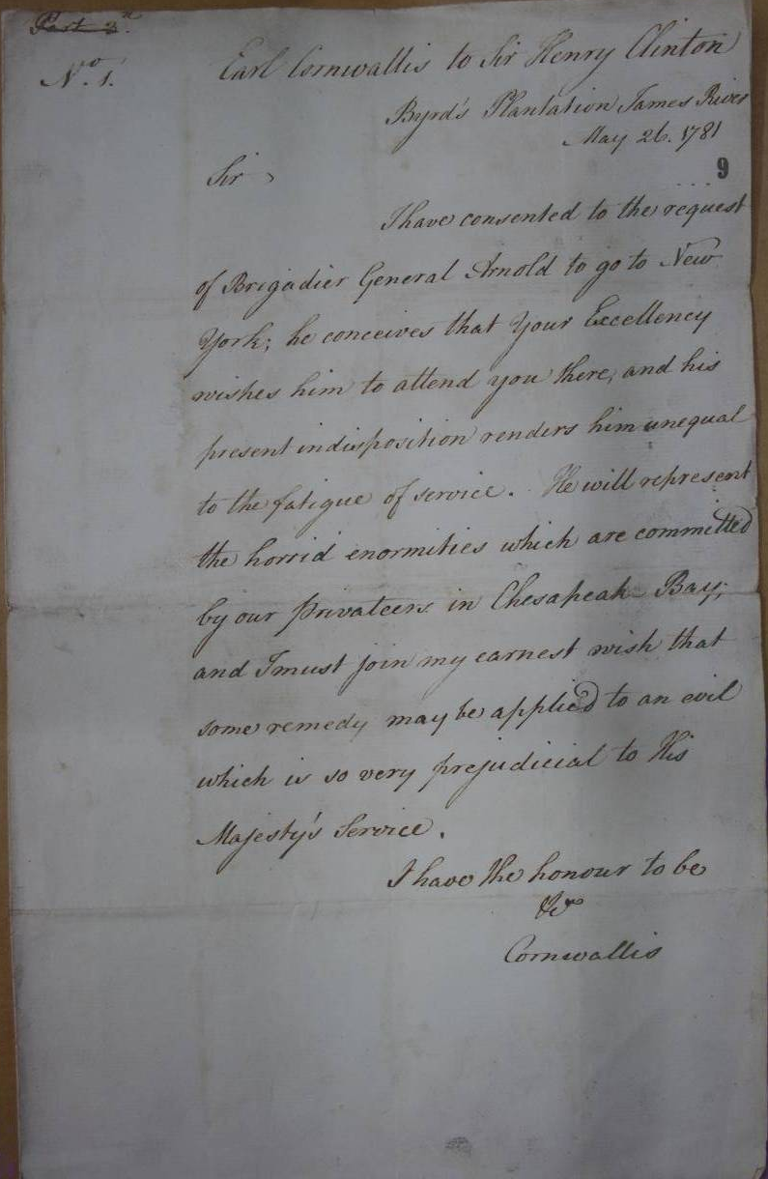

Slide 16
PRO 30/11 folio 101
http://discovery.nationalarchives.gov.uk/details/r/C6672241
Cornwallis to Clinton
11th October 1781

Slide 17
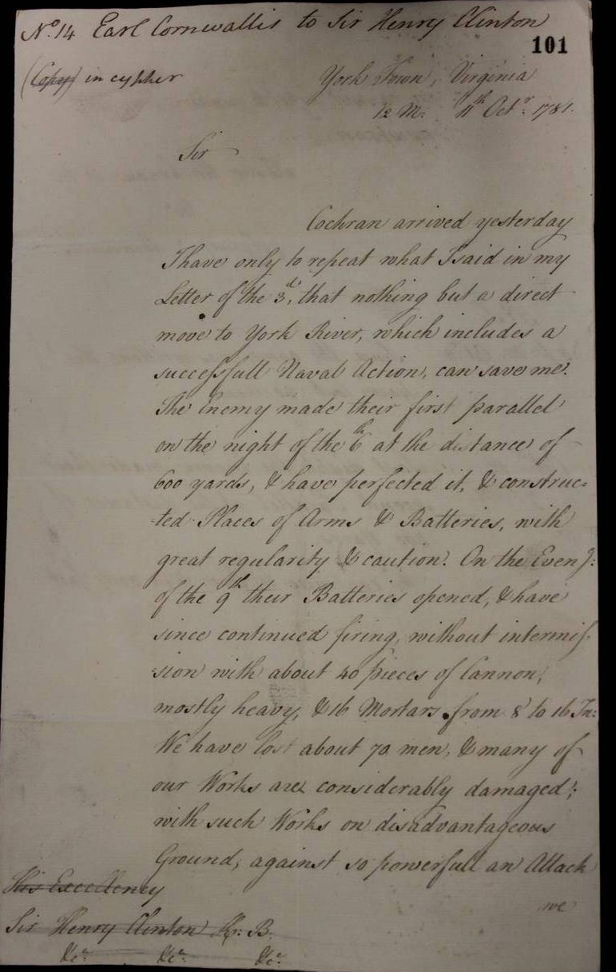

Slide 18
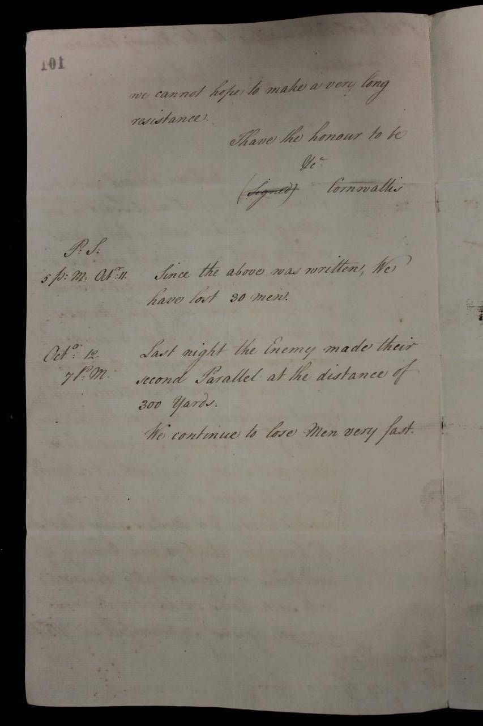

Slide 19
