Slide 1
The American Revolution: Going Dutch, French and Spanish
by Debra Coram Troxell

Slide 2
SP 78/300/75
http://discovery.nationalarchives.gov.uk/details/r/C7347680
Folio 175: Affidavit of James Stokes, master and owner of the Dolphin, taken before and signed by Charles Hamilton. It describes how armed American vessels, with French help, are loading powder, arms and ammunition and threatening British shipping at Molé St. Nicholas.
Date and place: 1776 Aug 7 on brig Dolphin Jamaica

Slide 3
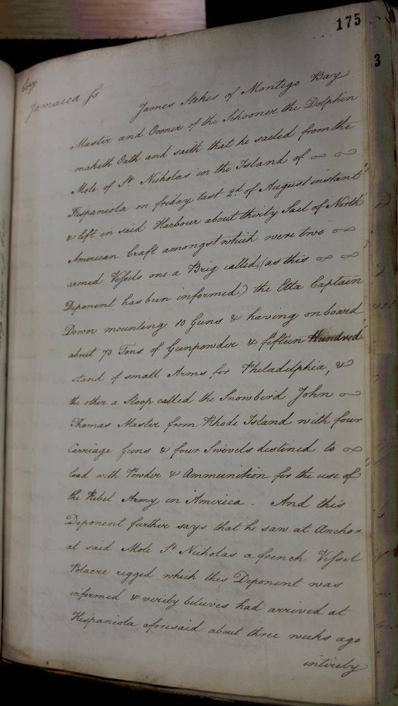

Slide 4
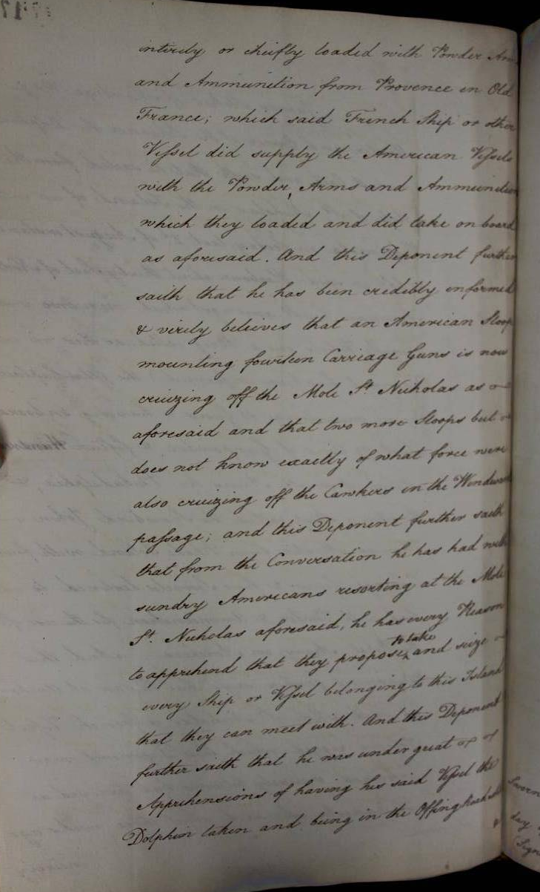

Slide 5
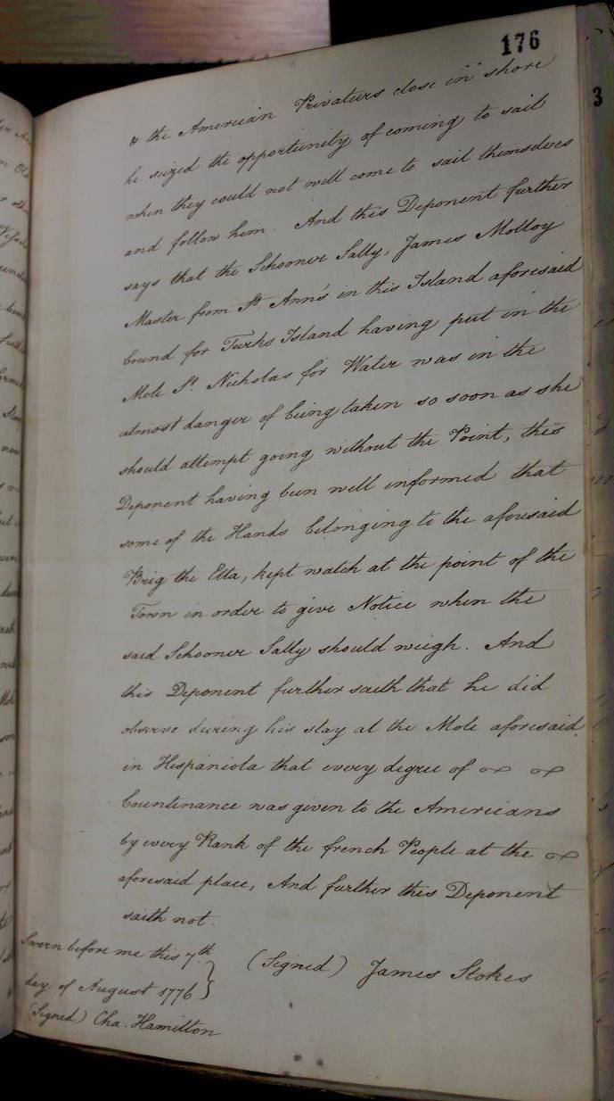

Slide 6
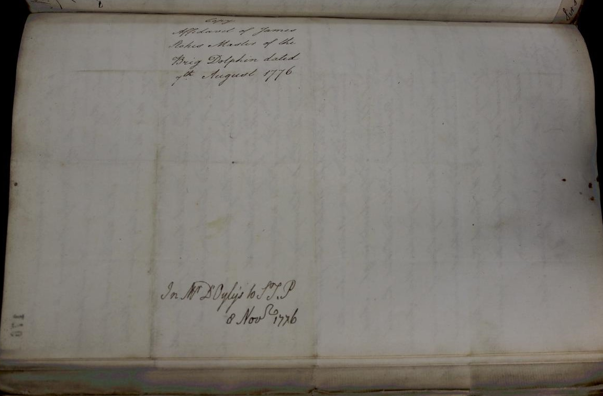

Slide 7
SP 78/300/74
http://discovery.nationalarchives.gov.uk/details/r/C7347679
Folio 173: Charles Hamilton, collector of the customs at Montigo [sic] Bay to Sir Basil Keith. He encloses the affidavit of James Stokes about Hispaniola. He is a man of veracity. The pirates are assisted by the French.
Date and place: 1776 Aug 7 Montigo [sic] Bay

Slide 8
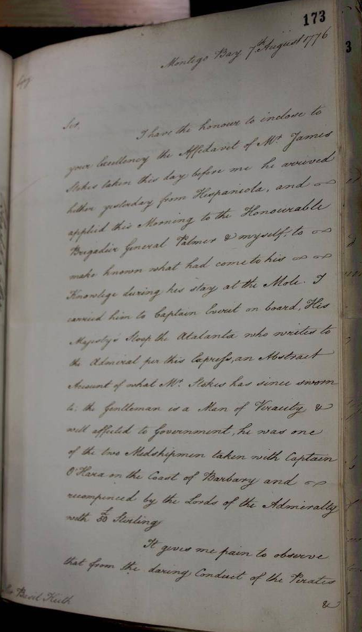

Slide 9
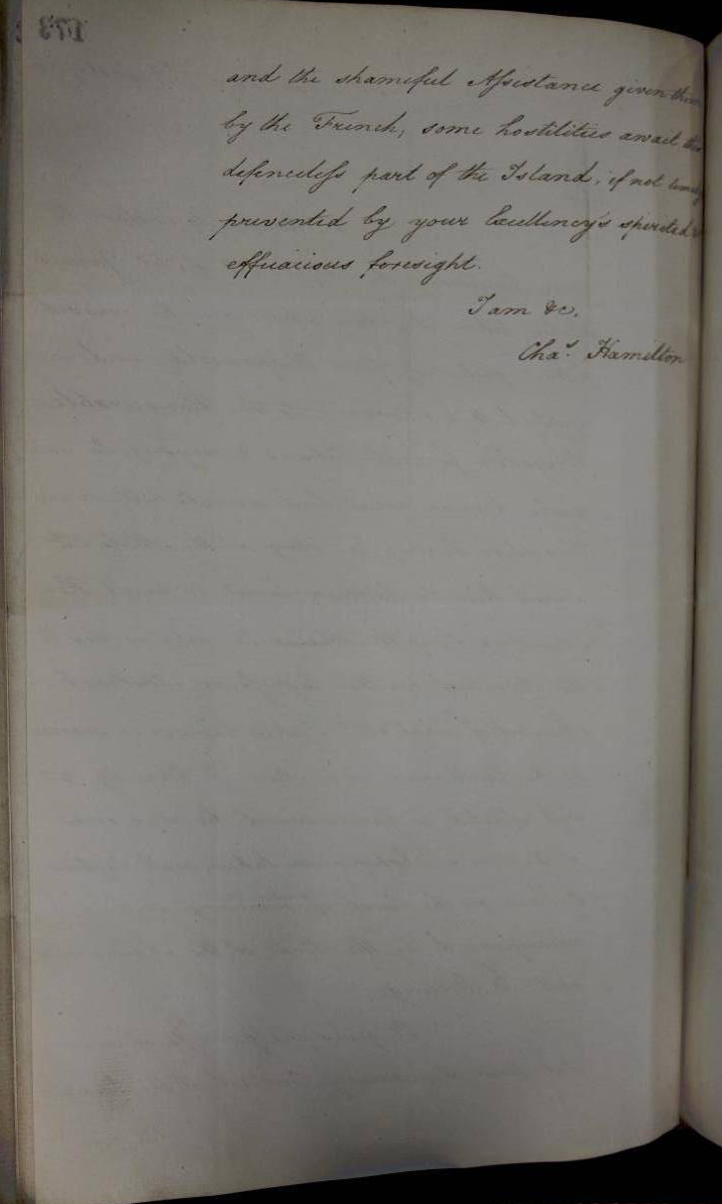

Slide 10
SP 78/300/32
http://discovery.nationalarchives.gov.uk/details/r/C7347637
Folio 72: Frazer to Weymouth. He expresses satisfaction at the defeat of the rebels on Long Island. 2 large Dutch ships have arrived. Their crews have returned to Holland. The ships are to sail for Martinique under French colours, also a French ship Mars. 2 new corvettes have sailed, La Favorite for St. Domingo and La Curieuse for Martinique.
Date and place: 1776 Oct 15 Dunkirk.

Slide 11
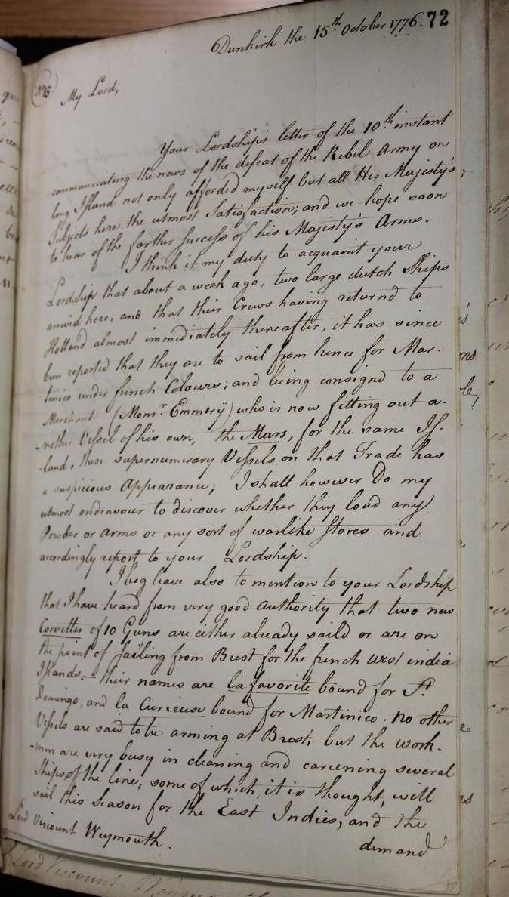

Slide 12
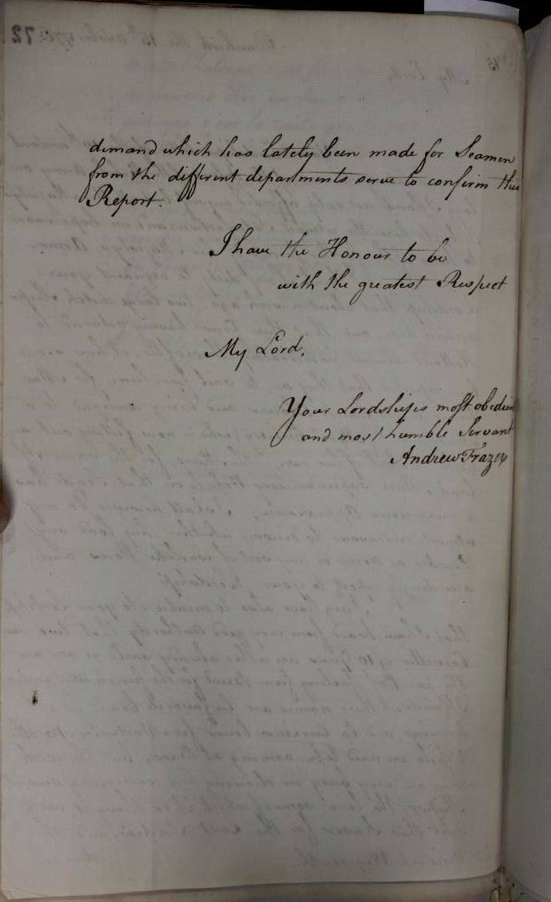

Slide 13
SP 78/300/55
http://discovery.nationalarchives.gov.uk/details/r/C7347660
Folio 131: Frazer to Weymouth. The 2 Dutch ships mentioned in f.72 are almost ready to sail and have loaded powder, which came from Flushing. He hears that France has agreed to take all the powder 2 mills at Middlebourg can produce in a year. He describes both ships - the Marie Rose previously the Doria and the Aimable Reine previously the Maria. He sends information from Brest and Nantes.
Date and place: 1776 Oct 28 Dunkirk.

Slide 14
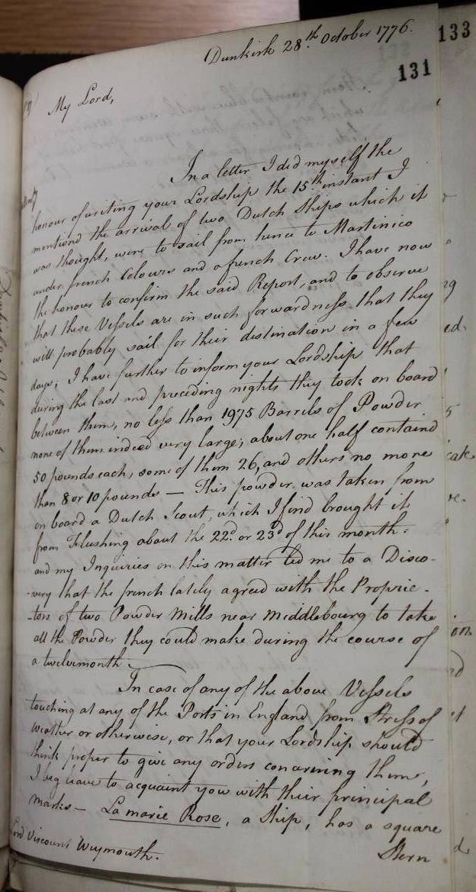

Slide 15
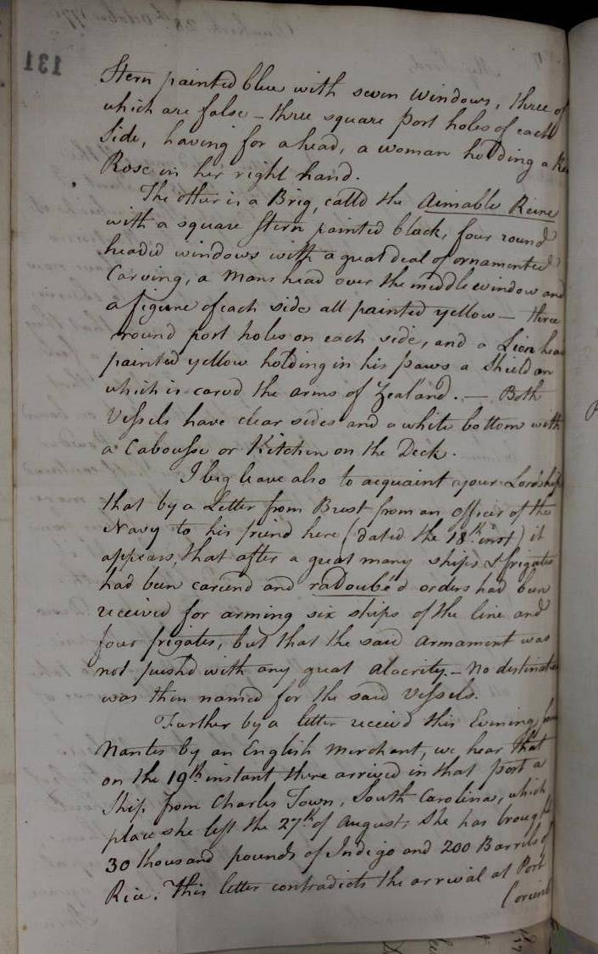

Slide 16
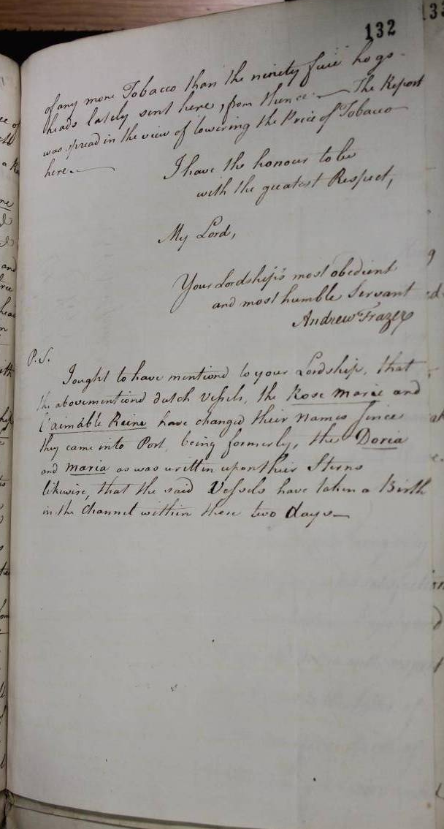

Slide 17
SP 78/305/60
http://discovery.nationalarchives.gov.uk/details/r/C7348549
Folio 128: Governor Morris to lord George Germain. The governors of Martinique and St Lucia have been told by the French government that they can give full support to the American rebels. Bouillé permits them to sell their prizes openly and has given Bingham assurance of his absolute protection for the Americans.
Date and place: 1777 Aug 1, 3 St Vincent.

Slide 18
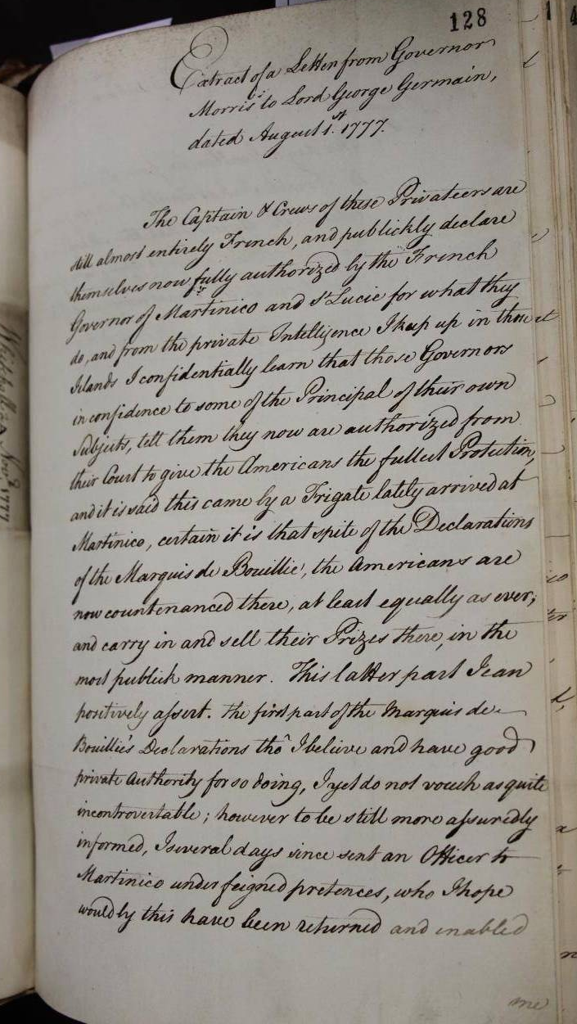

Slide 19
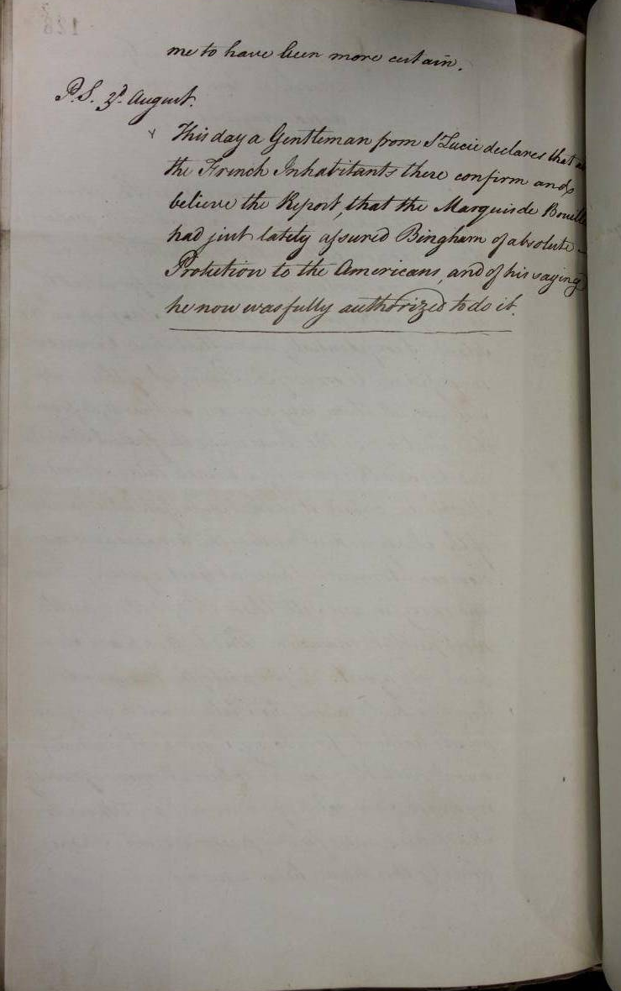

Slide 20
Library of Congress
A letter from Benjamin Franklin and Silas Deane to confirm the signing of a treaty of amity and commerce with France.
http://memory.loc.gov/cgi-bin/ampage?collId=lldc&fileName=002/lldc002.db&recNum=489
8 February 1778

Slide 21
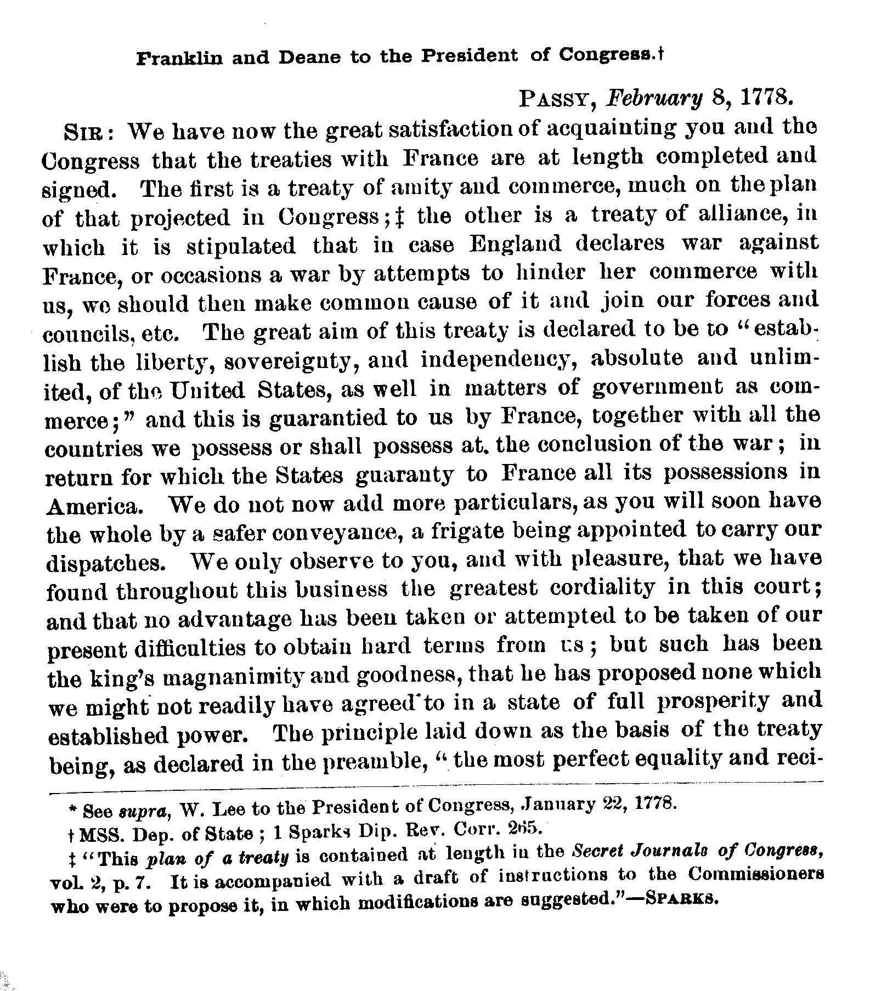

Slide 22
ADM 106/1258/295
http://discovery.nationalarchives.gov.uk/details/r/C10639154
Henry Mills. The timber vessel, the Batchelor, Mark Lee, Master, was taken on a passage from Gatcomb to Plymouth, by the American privateer, Black Prince, west of the Lizard. The American captain demanded £1000 ransom for the ship and cargo, although Mark Lee tried to negotiate a smaller price. The Black Prince had sailed from Dunkirk with a crew comprising 5 Americans, 3 Frenchmen, 1 Dutchman, 2 Portguese and 109 English and Irishmen and had taken 13 prizes in 6 days. As there were 5 timber ships waiting to sail form Gatcomb to Plymouth he pressed for a convoy system to be instituted under the protection of the Mackworth, armed ship
19 July 1780

Slide 23
