Slide 1
Resource Family Approval Training
Day 2: Approval Process
Version 6.0| August 1, 2019

Slide 2
Day 2 Training Overview
Permanency Assessment Written Directives review
Family Evaluation
Interviewing Skills
Written Report
Placement Prior to Approval
CWS/CMS

Slide 3
Learning Objectives
Learning Objective Ice Breaker Activity

Slide 4
Flag Activity: Written Directives
Permanency Assessment
A Resource Family permanency assessment shall include all of the following:
Verification that each applicant completed pre-approval training
A Family Evaluation of each applicant(s)
Verification of the completion of any other activities related to each applicant’s ability to achieve permanency with the child

Slide 5
Focus of Permanency Assessments
Willingness to Maintain Connections
Successful Coping with Challenges
Expectations

Slide 6
Flag Activity: Written Directives
Family Evaluation
Analysis of family structures, values, discipline, practices, parenting style, coping strategies, and current relationships.
Minimum of 2 interviews
If 2 applicants, one separate and one joint

Slide 7
Family Evaluation and the RFA Process
This assessment is one piece of the RFA process.
It is a contributing element to the overall assessment of the applicants.
This assessment will not approve or deny a family solely based on the responses received.
It will be used as a tool to do an overall evaluation of the family to see where additional support may need to be added or to determine if the applicants may not be an appropriate Resource Family.

Slide 8
Why Are They Intrusive?
It’s personal!

Slide 9
Rollercoaster

Slide 10
Solution Focused Inquiry
Solution Focused Inquiry is a practice of using questions and having conversations that strengthen an individual or family’s capacity to achieve their own best judgment in difficult times by surfacing and making visible:
People’s past and present capacities (how they survived trauma).
Achievements, assets, networks of support, resources they bring, unexplored potentials, innovations, strengths, high-point moments.
Expressions of wisdom, values, traditions, stories and visions of valued and possible futures.

Slide 11
Solution Focused Questions
Solution Focused Questions “Try On” handout
Coaching and Supervision Tips

Slide 12
Practice Activity
For each category, individually write a question.
Put them in the center of the table.
Read and discuss as a table group.
Pick the one you would like to “try on.”
Ask your question and see how the person reacts to your question.

Slide 13
Goals of the Family Evaluation
Develop a clear understanding of how an individual’s life experiences have impacted their behavior, belief systems and interpersonal relationships.
Develop a clear understanding of how past experiences affects current functioning and their ability to parent a child in care
The assessment also allows for more appropriate purposeful placement.

Slide 14
Family Evaluation vs. Biography or Psychological Evaluation
Biographies
Family Evaluation
Psychological Evaluation

Slide 15
Family Evaluation Components
Life Experiences
Risk Assessment
Current Relationships
Financial Situation
Employment
Motivation
Background Checks
Parenting Experiences

Slide 16
Assessment Skills
VIDEO
Dr. Beverly Ford on Assessment Skills

Slide 17
The Written Report
A summary and analysis of all information gathered
Copy given to the Resource Family even if the family is denied
WD 4-04

Slide 18
Flag Activity: Written Directives
Written Report:
Beginning the Process
Written Directives Section 6-07

Slide 19
Assessments Take into Account
The interplay between:
Family relationships and functioning
Education, employment, and financial status
Parenting abilities
Physical and mental health status
Interest in permanency

Slide 20
Activity: Written Report
Choose a family that you have worked with in the past to write the practice Written Report.
The important part of this activity is to practice writing the report.

Slide 21
Flag Activity: Written Directives
Placements Prior to Approval
Welfare & Institution Code §309 and §361.45
What is considered a placement prior to approval?
Placement is made with a relative or NREFM on an emergency basis,
OR
There is a compelling reason for the placement based on the needs of the child.

Slide 22
Placement Prior to Approval with a Relative or NREFM
Immediate Steps:
Criminal Records check (CLETS)
Child Abuse Central Index check
Home Environment Inspection for undue risk to the health and safety of the child.
Within 5 business days:
Fingerprint completion within 5 days of an emergency placement or within 10 days of a CLETS being conducted for each adult residing in the home.
Ensure receipt of application and RFA 01B (criminal records statement for all adults residing or regularly present and left alone with the children)
Discuss funding available to a relative or NREFM prior to approval as a Resource Family.
Emergency Caregiver Funding
Initiate a Home Environment Assessment Checklist (RFA-03)

Slide 23
Emergency Placement with a Relative or NREFM (cont’d)
Within 90 calendar days:
Comprehensive assessment
Permanency Assessment
Family Evaluation
Pre-Approval Training
Additional activities related to an applicant’s ability to achieve permanency with a child or nonminor dependent.
Complete written report
The County shall submit to the Department on a monthly basis the number of applications with a placement prior to approval pending 90 days or more and the reason for the delay.

Slide 24
The Critical Communication!
Between ER staff who do Emergency Placements and RFA staff who follow up on the approvals
Get the application referral to the RFA staff as soon as possible
Communicating around approval of other potential relatives
Emergency placement process has not changed. The role of the RFA worker begins at the time of receiving the application.

Slide 25
Placement Based on Compelling Reason
A County may place a child or nonminor dependent with an applicant prior to Resource Family Approval based on a compelling reason, pursuant to Welfare and Institutions Code section 16519.5(e).
A compelling reason may include, but is not limited to the following:
The unique needs of a child or nonminor dependent.
The best interest of a child or nonminor dependent to maintain his or her family or family-like connections with an applicant.

Slide 26
Placement Based on Compelling Reason Cont.
Prior to placement:
Complete background checks on applicants and all adults living or regularly present in the home (including any criminal exemptions)
Complete a Home Health and Safety Assessment using form RFA 03
Within 90 days of placement:
Comprehensive Assessment
Family Evaluation (Permanency and Risk Assessment is included within)
Ensure completion of pre-approval training
Minimum of 12 hours required
Other activities associated with the comprehensive assessment not already complete
Complete a Written Report

Slide 27
Flag Activity: Written Directives
Pre-Approval Training
A minimum of 12 hours of pre-approval training is required
CPR and First-Aid training is now required within 90 days post approval
An individual may begin pre-approval training no more than 60 days prior to submitting an application.
Completed within 90 days of emergency placement or compelling reason.

Slide 28
Engaging Families
Interactions about a Resource Parent’s involvement in the pre-approval training are an excellent way to begin to engage with Resource Families and to assist them through the process.
There are many reasons a family might struggle with their participation in the training, and we cannot assume it is resistance or inability to be a Resource Family.

Slide 29
Listen to the Families
Why?
They may have had negative experiences with training.
They may be afraid that they don’t have the knowledge or skills of others in the training.
They may be afraid of being judged.
They may feel overwhelmed.
They may have fears or reasons for resistance.

Slide 30
Activity: Enhancing Permanency
Can you think of other areas or issues specific to your County that might be included in training?

Slide 31
Approving the Resource Family
Once all necessary requirements have been met, Approval Certificate issued to the applicant(s) shall contain the following:
The name of the County.
The name(s) of the Resource Family and the address of the home.
The date of approval.
The capacity for which the Resource Family is approved.
If applicable, that the approval is for a specific child or nonminor dependent (do not list name(s)).
If applicable, that there are conditions placed on the approval pursuant to.

Slide 32
Evaluation Factors
Evaluate and analyze information
Look at:
The effect on the care provided to children
The effect on permanency
Capacity and ability rather than willingness

Slide 33
Justification of Approval or Denial
Approval decision needs to be based on information received during the assessment process and not the worker’s own personal opinion.
There could be instances where the County disagrees with the recommendation of an outside agency that conducted the Family Evaluation.
If the County is going to go against the recommendation, this needs to be justified and documented in the written report.

Slide 34
Activity: Addressing Barriers
Scenario 1: The Resource Parent has a diagnosed condition of Major Depression.
Scenario 2: The financial statements show that the Resource Family does not have a savings or much discretionary funds after paying bills.
Scenario 3: The Resource Parent has a DUI from 10 years ago.
What do you need to know?
What are the strengths of this family?
Are there any concerns with this family?
What needs to happen next?
With all this information how would you work with this family.

Slide 35
Group Discussion
Mitigating Concerns:
What are available tools to support a worker to address concerns with an applicant?
Chart responses

Slide 36
Data Entry Instructions for Resource Family Applicants and Placements into CWS/CMS
The instructions have been developed to instruct counties on how to enter data into the (CWS) (CMS) (RFA) applicants, placements prior to approval (emergency/compelling reason placements) and placements with an approved Resource Family.

Slide 38
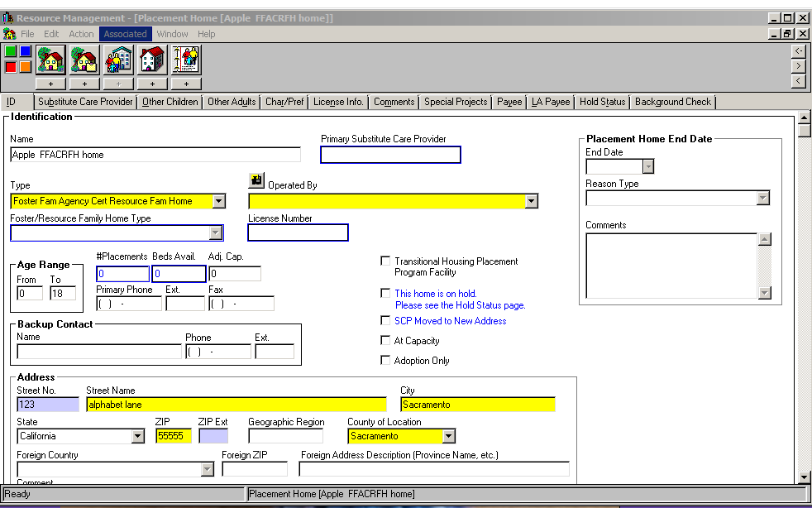

Slide 39
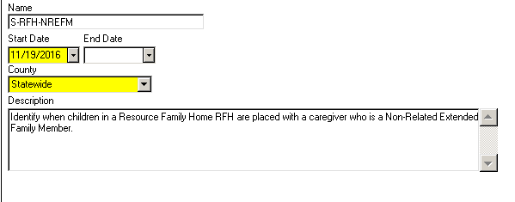

Slide 40
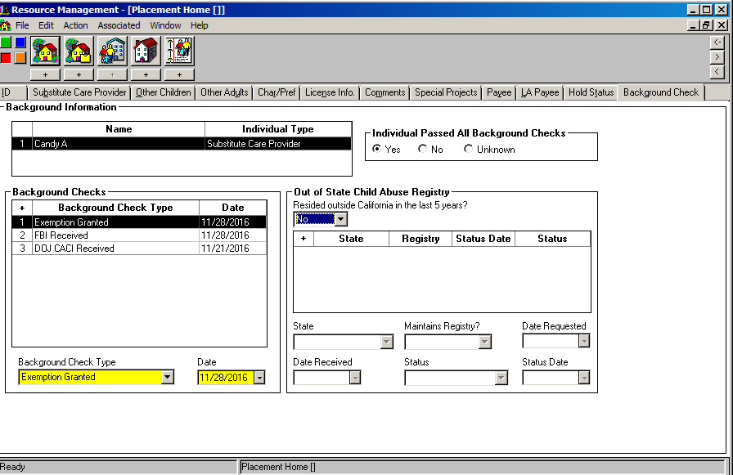

Slide 41
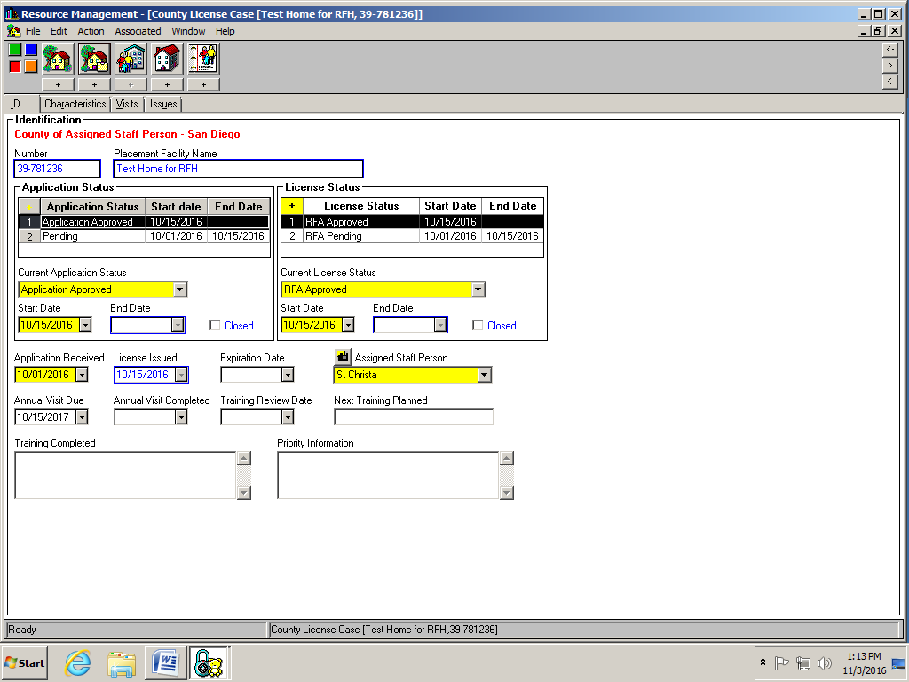

Slide 42
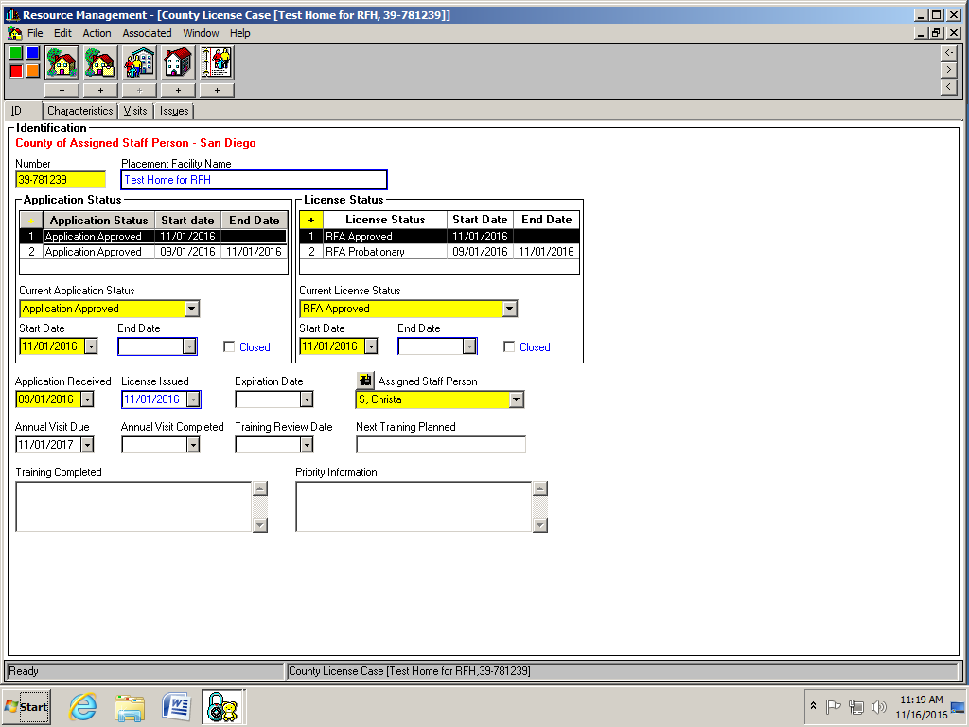

Slide 43
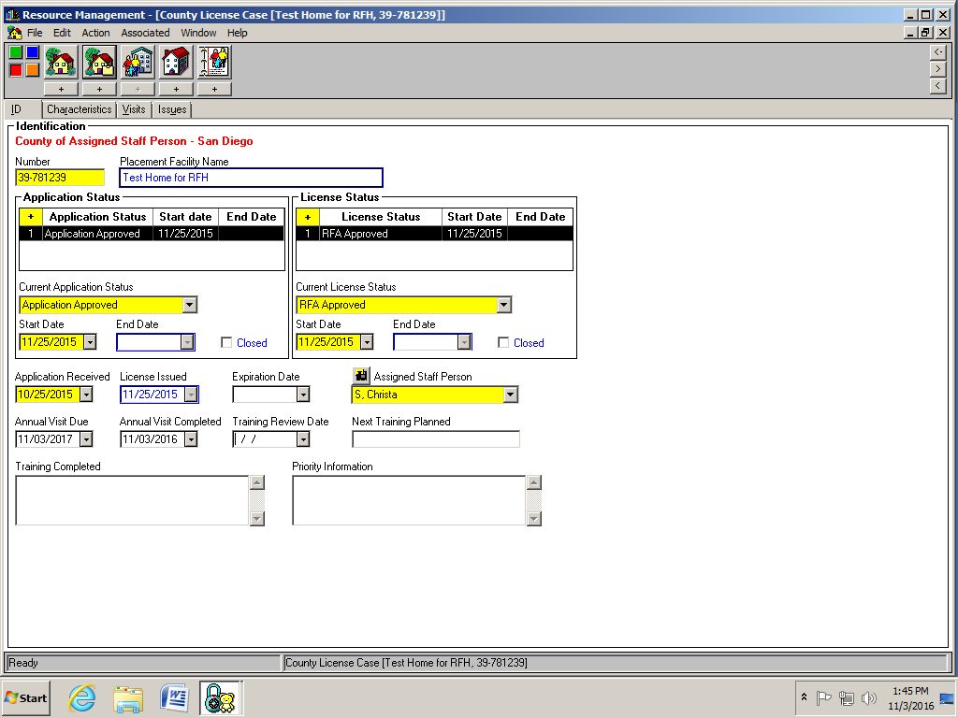

Slide 44
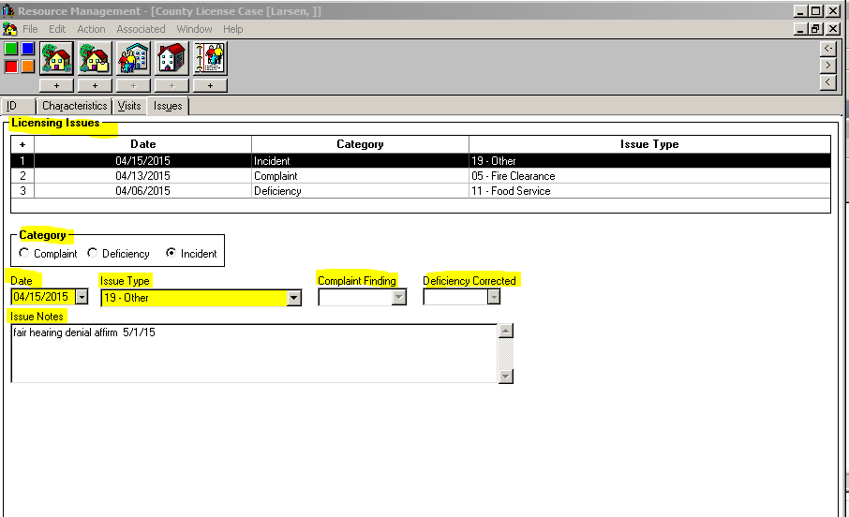

Slide 45
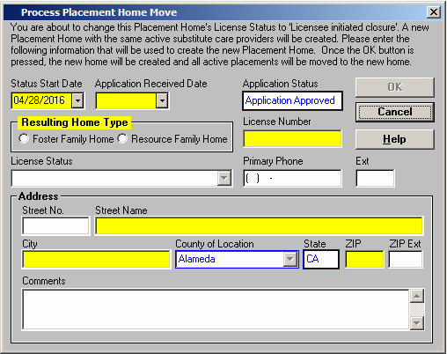

Slide 46
Wrap up
What have you learned?
What questions do you still have?

Slide 47
VIDEO
Let Go of the Day’s Stress
Notes:
https://youtu.be/Eg9hNl_6e5o

