Slide 1
Introduction to Core for Social Workers
Core for Social Workers – Module 1, Day 1
Instructor: Academy Staff
Northern Academy

Slide 2
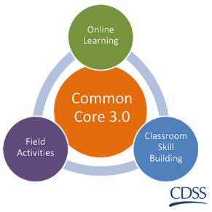
Plan for the Day
Welcome and Introductions
Overview of materials
Demographic Surveys
Classroom expectations / Evaluations
eLearnings
Field Activities
eLearning practice
Q&A/wrap-up

Slide 3
Welcome & Introductions
Name
County
Position
Hopes for Core

Slide 4
Cohort Information
Duration: 8 months (10 modules)
Locations: Please refer to class flyer
Class duration: 9am – 4pm
Strict attendance policy, please be on time!
Welcome packet handouts:
Cohort flyer
Guide to successfully completing Core for Social Workers
Social Worker Passport
Core resources
Field Activity and eLearning information
Notes:
Provide an overview of all handouts in the welcome packet
Provide brief overview of attendance policy and have them sign attendance agreement
Importance of tracking classes on SW Passport – please bring to class each module! (next slide)

Slide 5
Attendance Policy
Strict attendance policy due to training mandates
Please make every effort to attend all classes and arrive timely
If you miss any portion of a class for any reason (illness, court, etc.) you will need to make-up the class
Please note: if you have to miss a class, it could take several months to make it up
For all make-ups, please e-mail academy@ucdavis.edu and request available dates/locations to make up a class
Please complete signature page on page 18 of your welcome packet and return to Academy staff

Slide 6
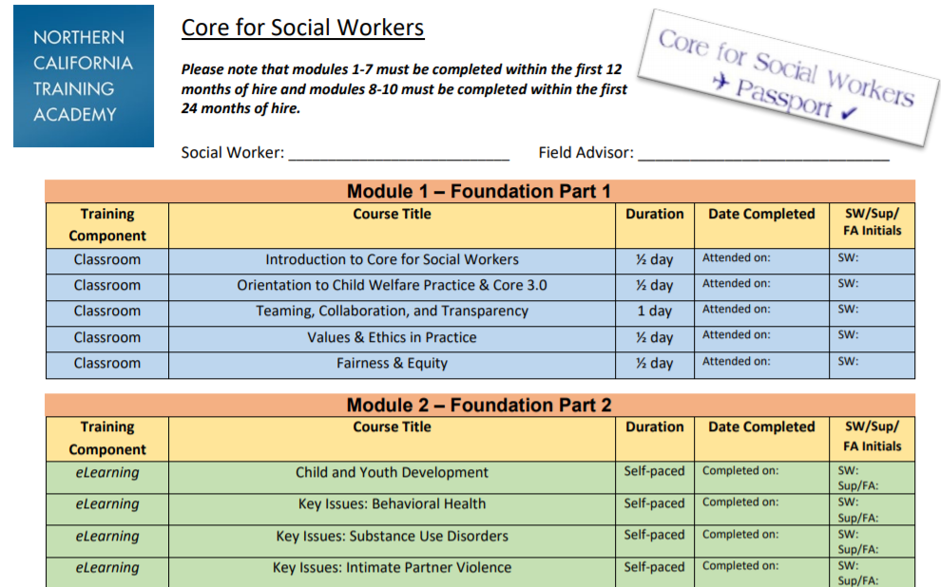
Social Worker Passport
Please keep track of this document – list all completion dates

Slide 7
Northern Academy Website
Link: https://humanservices.ucdavis.edu/northern-academy

Slide 8
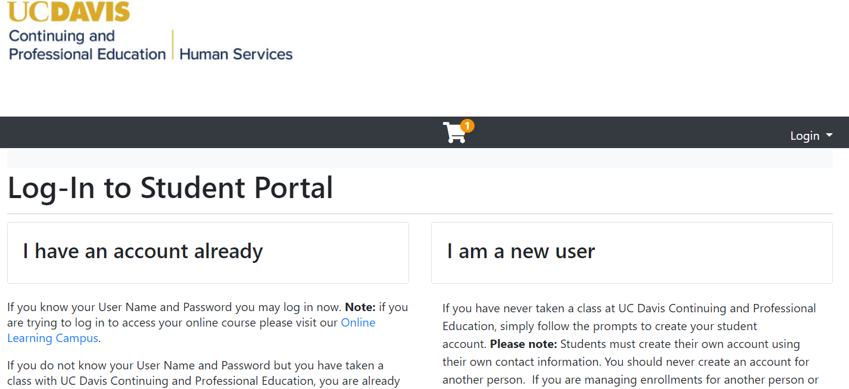
Self Reporting: Student profile

Slide 9
Self Reporting: Student Profile

Slide 10
In-Person Classes
All classes begin at 9am and end at 4pm daily
Please sign in at the beginning of each class TOPIC.
Please note some classes are full day (one sign-in) and some days will consist of two half-day classes (two sign-in sheets)
Please bring all required classroom materials to class
Please be prepared to participate in class discussions – classes are focused on skill development utilizing group activities
Have fun and be open to learning from each other!
Please bring an electronic device if you have one (a few iPads will be available for check-out)

Slide 11
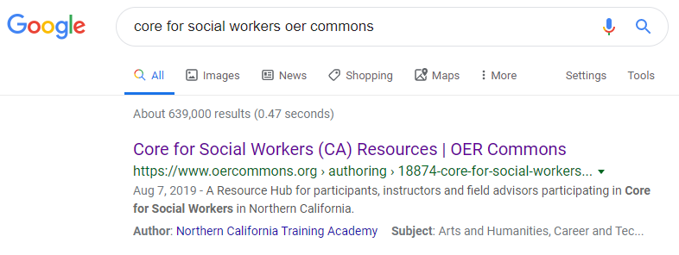
Technology based classes
Welcome to the Center for Human Services Resource Barn!
Core is a technology based program
Go to this link: http://bit.ly/CoreForSW
Or….Google:
Core for Social Workers – OER Commons

Slide 12
Core Academy Resource Page
Notes:
Provide basic overview of where to find class materials. They can google “Core for Social Workers” and select the option that includes “OER Commons” in the search results

Slide 13
All required classroom materials and links to field activities are on this page under “Participant Resources”

Slide 14
Please bring all REQUIRED materials to class!
Notes:
Materials may also be accessed on their iPads/laptops instead of printed

Slide 15
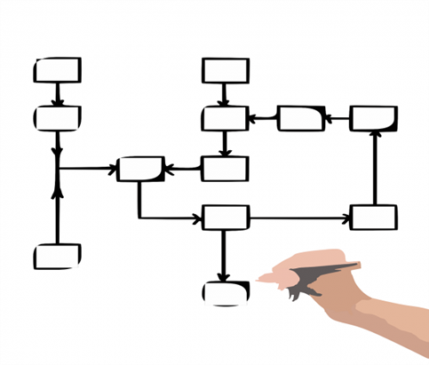
Core for Social Workers at a glance
10 modules - Total duration of 8 months
29 classes
22 E-Learnings
9 Field Activities
Classes are intended to be completed in order as each subsequent module builds on the last.
eLearnings = knowledge & theory
Classroom = skill building & class activities
Field activities = on the job skill application
Notes:
Refer them to their passport for full list of classes

Slide 16
California Integrated Child Welfare Core Practice Model (ICPM)
Existing and Emerging Initiatives
California Partners for Permanency (CAPP)
Continuum of Care Reform (CCR)
Family to Family (F2F)
Katie A.
Linkages
Parent Partners
Quality Parenting Initiative (QPI)
Resource Family Approval (RFA)
Safety Organized Practice (SOP)
Wraparound
Engagement, Inquiry/Exploration, Workforce Development & Support, Accountability, Teaming, Advocacy
Prevention
Engagement
Monitoring and Adapting
Transition
Assessment
Planning and Service Delivery
Notes:
The California Child Welfare Core Practice Model is built on these key components and existing/emerging initiatives and are reflected in CC3.0.
The CPM brings together Casework Components, Practice Elements, and Practice Behaviors that will define how child welfare is practiced in
California. CC3.0 has made use of the casework components by modeling the practice blocks after them. The Practice Elements are interwoven throughout the eLearning, classroom skills-based learning, and field activities.

Slide 17
Core Training Blocks
Engagement, Inquiry/Exploration, Workforce Development & Support, Accountability, Teaming, Advocacy
Prevention
Engagement
Monitoring and Adapting
Transition
Assessment
Planning and Service Delivery
Practice Areas
Foundation
Engagement
Assessment
Case Planning and Service Delivery
Monitoring and Adapting
Transition
Notes:
In Common Core 3.0, the training content is divided into 6 practice area blocks: Foundation, Engagement, Assessment, Service Planning, Monitoring and Adapting, and Transition. These practice blocks mirror the Core Practice Model Casework Components, are congruent with the California Partners for Permanency’s Practice Model, incorporate elements of Safety Organized Practice and allow for a focused exploration of knowledge and skills in key practice areas providing a natural framework for field activities and skill development.
All of the training blocks will include eLearning content, classroom content, and field activities. For additional information about the content contained in each of the training blocks, please refer to the “CC3.0 Content Overview”.

Slide 18
Core Modalities/Sequenced Content
eLearning
Classroom Skills Based Learning
Field
100 Level (Modules 1-7)
On-line knowledge based training
Classroom skills based learning
Field based transfer of knowledge and skills learning
200 Level (Module 8-10)
Notes:
Beyond re-imaging the way social work practice is presented in core, the Common Core 3.0 concept also incorporates a wider range of training modalities, including:
Online knowledge based training
Classroom based learning
Field learning
This involves shifting some knowledge-based content outside the classroom with online learning modules, using classroom time to focus on skill based interactive training, and shifting some skill-based content outside the classroom with field activities. Through these modalities, Common Core 3.0 will provide new social workers with opportunities to focus on skills in the classroom and reinforce skills with application of concepts in the field.

Slide 19
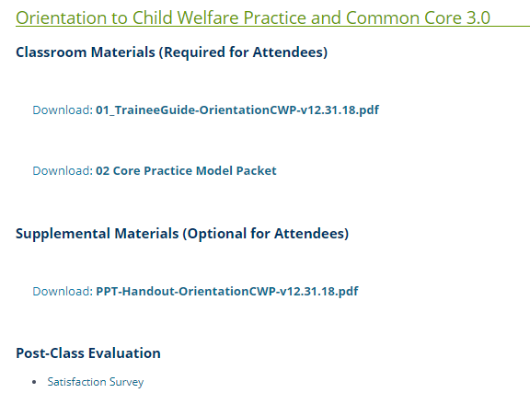
Online Evaluations
All classes have TWO satisfaction surveys
Academy paper survey
CalSWEC online survey
Please bring a laptop, iPad or smart phone to complete online evals
Some classes have additional evals (embedded evals and end-of-block evals)
Bit.ly links are as follows:
Satisfaction Survey (all modules):
bit.ly/c3satisfaction
Embedded Evaluation (Modules 3-6):
bit.ly/c3embedded
End-of-Block Evaluation (Modules 8-10): bit.ly/c3endofblock

Slide 20
Demographic Surveys
Demographic information is gathered to help California gain a broader understanding of its child welfare workforce.
This information will be used to inform workforce development and retention efforts across the state.
Survey completion is voluntary, however we hope you will participate in order to provide us with this valuable information to assist statewide workforce development efforts.
Please take 10 minutes to complete the survey

Slide 21
E-Learnings
eLearnings: Please look out for an e-mail from “Infrastructure Canvas”
Link: https://extensiononline.ucdavis.edu/login/canvas
First eLearning (Child and Youth Development) will be completed during Module 1, Day 1: Introduction to Core for Social Workers
Please complete all eLearnings timely - Classes build on eLearnings!

Slide 22
Northern Academy Website
Link: https://humanservices.ucdavis.edu/northern-academy

Slide 23
First time users
Type in your e-mail address and select “forgot password”
After you update your password, you will be redirected to Canvas to enter your new login information

Slide 24
Self Reporting: Canvas for eLearnings

Slide 25
Self Reporting: Canvas for eLearnings

Slide 26
Notes:
Reminder to look at “Courses” on the left hand menu – not all eLearnings will show up on your dashboard

Slide 27
Summary of 3 Core Websites
OER Commons (Resource Barn): http://bit.ly/CoreForSW
Where you find all Core Curriculum
Where you download/print Trainee Guides
Where your field advisor completes field activity completion survey
Academy Website: https://humanservices.ucdavis.edu/northern-academy
Where you registered for Core
Where you can find all upcoming Core classes if you need to make up
Where you can login to your student portal to view official grades for all classes
Where you can drop classes
Canvas for eLearnings: cpeonline.ucdavis.edu
Where you take your eLearnings
Where you can view unofficial grades for eLearnings

Slide 28
Field Activities
Please complete activities timely so you don’t get behind!
Identify your Field Advisor and start the conversation early!
Field Activity Guides (9 activities total): https://www.oercommons.org/authoring/21058-core-for-social-workers-field-activities/view#h2
Field Activity Completion Survey (to be completed by Field Advisors): http://bit.ly/FieldActivitySurvey
Some ideas/best practices shared from various counties:
Separate eLearning labs for protected time
Group work for field activities: Fairness & Equity; ICWA
Bundling: Interviewing, Exploring family relationships and a teaming activity (i.e. Initial Case Plan, Case Plan update, etc.)

Slide 29
Field activity materials are linked from main Core Resources page under “Participant Resources”

Slide 30
All field activity guides and the completion survey link are found on this page:
Notes:
Brief overview of where field activity guides are located

Slide 31
Example: Interviewing field activity

Slide 32
Field Advisor Training Requirements
Field Advisors may be the social worker’s supervisor or other designated person who will support the worker as they complete their field activities.
All Field Advisors must complete the following training requirements:
Two-day Coaching Institute
One-day Field Advisor and the Field Guide: Understanding the roles and responsibilities

Slide 33
Role of the Core Field Advisor
The field advisor will meet with and support the new social worker before, during, and after identified field activities as follows:
Promote a learning environment and utilize appropriate coaching strategies, tools and techniques to promote desirable and sustainable growth for the worker.
Promote knowledge and skill development that aligns with the desired practice.
Track completion of field activities.
Notes:
Additional responsibilities: Be familiar with Core 3.0 schedule of classes, requirements and where the field activities land on the Core schedule
Become familiar with the field activities and provide feedback about challenges or suggestions you have to improve the activities
Utilize coaching skills and knowledge gained in Field Advisor / Coaching trainings to best support the trainees

Slide 34
Field Activity Guides
Field Activity Guides are provided for each field activity that includes the following information:
Learning objectives for the activity
Description of the activity
Field Advisor and Social Worker tasks:
Before the Activity
During the Activity
After the Activity
Applicable worksheets / resources
Please note: Field activities should be completed using active cases whenever possible.

Slide 35
Field Activities at a glance
Module 3: Engagement Block
Interviewing
Exploring Family, Extended Family, Community, and Tribal Connections
ICWA and working with Native American Tribes
Fairness & Equity
Module 5: Assessment Block (Part 2)
Collaborative Assessment, Planning and Support: Safety & Risk in teams
Completing SDM Assessment tools
Module 6: Case Planning & Service Delivery Block
Collaborative Assessment, Planning and Support: Initial Case Plan
Module 7: Monitoring & Adapting; Transition Block
Collaborative Assessment, Planning and Support: Case Plan Update
Collaborative Assessment, Planning and Support: Transition Plan

Slide 36
Review the Module 3 Field Activities: ICWA Fairness and Equity Exploring Relationships Interviewing

Slide 37
ICWA and Working with Native American Tribes
Description of Activity:
This field activity provides an opportunity for child welfare workers to identify local ICWA resources to support child welfare outcomes and reinforce the value of keeping an Indian child connected to culture and community.
The Field Advisor and worker will review the information together and discuss how this relates to the purpose of ICWA and the value of keeping a child connected to their culture and community

Slide 38
Fairness & Equity
Description of Activity:
This field activity provides an opportunity for child welfare workers to explore data related to disparity, practices that promote fair and equitable treatment with individuals interacting with the child welfare system, and ways that bias can be discussed and addressed in day-to-day practice to improve outcomes for children and families.
Please note: If the Social Worker has an active caseload they MUST use one of their cases for this activity.

Slide 39
Interviewing
Description of Activity:
This field activity provides an opportunity for child welfare workers to prepare for and complete an interview with a family member, caregiver, youth, or stakeholder.
The trainee will prepare for this activity by:
Identifying interview participants, information to be collected, and goals of the interview
Following the interview, the trainee will reflect on what worked well, any challenges or opportunities for upgrade during the interview, and next steps.

Slide 40
Exploring Family, Extended Family, Community, Tribal Connections, and Relationships
Description of Activity:
This field activity provides an opportunity for child welfare workers to develop a genogram, eco-map, or safety circle to help identify family, extended family, community, and tribal connections that may provide support and permanent connections for children, youth, young adults and families.

Slide 41
Review the Module 5 Field Activities: Completing SDM Tools Safety & Risk in Teams

Slide 42
Completing SDM Assessment Tools
Description of Activity:
The Social Worker will complete one of the following safety tools:
Hotline Assessment Tool
Safety Assessment Tool
Substitute Care Provider Safety Assessment Tool
Reunification Reassessment Tool
AND
The Social Worker will complete one of the following risk tools:
Family Risk Assessment Tool
Family Risk Reassessment for In-home Cases Tool (Family Maintenance)
Reunification Reassessment Tool (Family Reunification)
Please note: If the Social Worker has an active caseload they MUST use one of their cases for this activity.

Slide 43
Collaborative Assessment, Planning and Support: Safety & Risk in teams
Description of Activity:
The social worker will participate in OR observe a team meeting where safety and safety planning are discussed with a family
At the conclusion of the meeting, the trainee will have participated in a developing a plan that ensures safety for the child/youth
Please note: If the Social Worker has an active caseload they MUST use one of their cases for this activity.

Slide 44
Review the Modules 6 & 7 Field Activities: Initial Case Plan Case Plan Update Transition Case Plan Update

Slide 45
Collaborative Assessment, Planning and Support: Initial Case Plan
Description of Activity:
During this field activity, the child welfare worker participates in or observes a case planning meeting with a family to develop the initial case plan.
Examples:
Safety planning meeting
Safety mappings
TILP meetings
Child & Family Team meetings
Please note: If the Social Worker has an active caseload they MUST use one of their cases for this activity.

Slide 46
Collaborative Assessment, Planning and Support: Case Plan Update
Description of Activity:
During this field activity, the child welfare worker participates in or observes a case planning meeting with a family to develop an updated case plan.
Please note: If the Social Worker has an active caseload they MUST use one of their cases for this activity.

Slide 47
Collaborative Assessment, Planning and Support: Transition Plan
Description of Activity:
During this field activity, the child welfare worker participates in or observes a case planning meeting with a family to develop a transition case plan.
Please note: If the Social Worker has an active caseload they MUST use one of their cases for this activity.

Slide 48
Field Activity Tracking

Slide 49
Field Activity Tracking
Field Activities are tracked using a survey that is completed by the Field Advisor after each field activity is completed
Field Advisors are encouraged to complete the survey after each activity is completed vs. waiting until all activities are completed (this ensures up to date records)
Link to the survey on the Field Activity web page and in the Social Worker Guide to Completing Core
Questions?

Slide 50
Example: Interviewing field activity

Slide 51
Field Activity Survey: http://bit.ly/FieldActivitySurvey

Slide 52
Core Participants…
If you need help, please ask your instructor or reach out to the Academy! We want to help you be successful and ensure a positive learning experience!

Slide 53
Lessons Learned
Social Workers often come to Core not knowing who their field advisor is.
Field Advisors and Social Workers should have a conversation at the beginning of Core to develop agreements, roles, and start planning for field activities.
Counties should have a plan for who will be Field Advisors ahead of time BEFORE Social Workers begin Core.
Social Worker Passport and Guide have field activities listed and a link to the field activity completion survey
Field activities may sound overwhelming but they aren’t such a big deal – they are OK!

Slide 54
Core Contacts
Tami McCalip, MSW, Academic Coordinator
tmccalip@ucdavis.edu
(530) 520-9253
Kaitlyn Ash, Public Education Specialist
kash@ucdavis.edu
(530) 757- 8672
General inquiries about scheduling, make-ups, etc.:
academy@ucdavis.edu

