Slide 1
Northern California Training Academy Fundamentals in Evidence‐based Decision‐Making
Session 3: Developing Implementation Supports
January 21, 2020
Anita Barbee
The Center for Family and Community Well-Being, Kent School of Social Work, University of Louisville

Slide 2
Today’s Agenda
9:00-9:30 Welcome back
9:30-10:30 Present strategies from homework
10:30-10:45 Break
10:45-12:00 Implementation Science overview
12:00-12:45 Lunch
12:45-2:45 Implementation supports and Fidelity
2:45-3:00 Break
3:00-3:45 Identify needed supports and potential fidelity measures
3:45-4:00 Review of homework assignment

Slide 3
The CQI Cycle
PLAN
Define problem & outcome
Develop theory of change
Design/select intervention
Process of care investments
ACT
DO
Adjust intervention as needed
Implement intervention
Monitor implementation
Quality of care investments
Measure outcomes
Provide feedback
Investments in capacity
STUDY

Slide 4
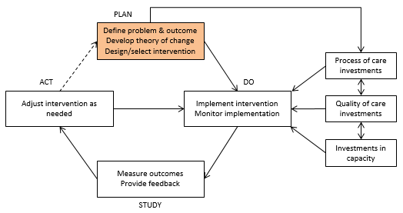
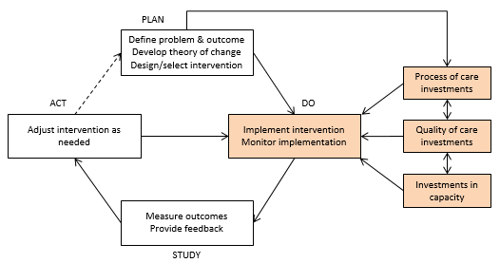
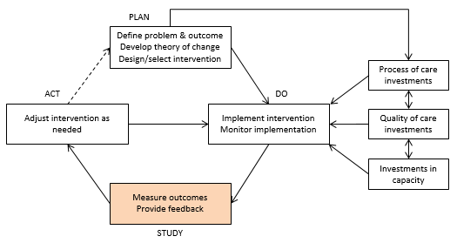
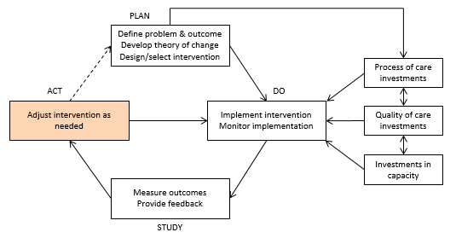
CQI Phase | Hypothesis development/testing | Evidence use
Plan | Define the problem. (“I observe that…”) | What evidence supports this observation?
 | Hypothesize as to the cause of the problem. (“I think it’s because…”) | What evidence supports this hypothesis?
 | Identify a solution. (“So I plan to…”) | What evidence supports the hypothesis that the proposed dose of the intervention will lead to this specific degree of improvement? Taken together, what evidence supports the theory of change—i.e., the claim about how this intervention will have the intended effect on the target population?
 | Set a performance target. (“….which I think will result in…”)
Do | Implement the intervention. | Collect data required for an analysis of intervention effectiveness and analysis of implementation fidelity.
 | Monitor implementation. | What evidence is there that the intervention was (or was not) implemented with fidelity?
Study | Measure progress toward the target outcome. | What evidence is there that the intervention was effective (or not effective)?
 | Provide feedback to relevant stakeholders and decision makers. | Transmit evidence regarding outcomes and fidelity to those who will interpret the findings and make decisions accordingly.
Act | Determine the extent to which the problem still exists. | What evidence supports this observation?
 | Confirm or refute the theory of change. | What evidence supports this claim?
 | Adjust the intervention as needed. | What evidence supports the decision to continue, modify, or discontinue the intervention?
© The Center for State Child Welfare Data

Slide 5
Report Outs
Butte
Lake
Contra Costa
Trinity
Sierra

Slide 6
Learning goals regarding implementation science
Gain an understanding of implementation science
Be able to identify what is needed to implement innovations with
fidelity
Be able to articulate what implementation science is AND be able to communicate it to others
Be able to identify key Implementation Drivers

Slide 7
Formula for Success
Formula for Success
Fixsen, Blase, Metz, & Van Dyke (2015)

Slide 8
Formula for Success
Formula for Success
Fixsen, Blase, Metz, & Van Dyke (2015)

Slide 9
Think, Pair, Share: Strengths and Opportunities for Change
Think, Share, Pair
Take 2 minutes to self-reflect upon the strengths and opportunities for change in your current work based on the Formula for Success
Take 4 minutes to share your thoughts with a partner
Share with the large group.
Fixsen, Blase, Metz, & Van Dyke (2015)

Slide 10
Active Implementation
Active Implementation
Effective Practices
Effective Implementation
Enabling Context
Improved Outcomes
Usable Practices
Teams
Drivers
Stages
Data & Communication
Implementation Defined. (n.d.). Retrieved
November 22, 2016, from http://nirn.fpg.unc.edu/learn- implementation/implementation-defined

Slide 11
Implementation Stages
Implementation Stages
Identify
Plan Get Started Get Better
Exploration
Installation
Initial Implementation
Full Implementation
Assess need
Examine fit and feasibility
Assure resources
Develop supports
Initiate practice
Use data to improve supports
Practice is consistent
Positive outcomes are expected if practices used with fidelity
Adapted from Metz, Naoom, Halle, & Bartley (2015)

Slide 12
Implementation Drivers
Implementation Drivers

Slide 13
Most Critical Drivers
Do the people delivering services have the knowledge, skills and supports to execute the innovation with fidelity?
What tools need to be created to execute the innovation?
What training do staff or partners need to utilize the tools and execute the innovation with fidelity?
What coaching or technical assistance do staff or partners need to utilize the tools and execute the innovation with fidelity?
What data do staff or partners need to know if they are executing the innovation with fidelity and if not where corrective action needs to take place (CQI process)?

Slide 14
Training Best Practices
Training
Acquire knowledge
New skill development
Continue ‘buy-in’
Build community
Skill-based training
Use best practices for adult learning
Training data are used to develop competency and improve training

Slide 15
Coaching Best Practices
Technical Assistance and Coaching
Ensure Implementation
Generalize skills in setting
Includes direct observation
and feedback
Competency development
Coaching service delivery plan
Assessments of coaching effectiveness

Slide 16
Fidelity Best Practices
Fidelity
Motivates implementation
Reinforces staff and build on strengths
Interprets Outcome Data
Use a consistent fidelity system
Follow a protocol for fidelity assessments
Use fidelity assessment data to improve outcomes and implementation supports
Provide a proactive staff overview/introduction

Slide 17
Decision Support Data Systems Best Practices
Decision Support- Data Systems
Monitor and improve outcomes
Engage in continuous quality improvement
Celebrate success
Data are useful and usable
Access to relevant data for making decisions
Process for using data for decision-making

Slide 18
Systems Intervention Best Practices
System Intervention
Identify and “lift up” systemic barriers and facilitators to the next level
Develop key partnerships to ensure resources to support implementation
Leaders and Managers:
Engage with the system to create improved regulatory and funding environment
Engage with key stakeholders and partners to support effective practice
Learned Helplessness

Slide 19
Your Roles as Leaders in the Process of Change
Your Role as Leaders in the Change Process
CURRENT SYSTEM/ PROCESS
TRANSITION SYSTEM/PROCESS
VISION OF FUTURE SYSTEM/PROCESS
Act Plan
Act Plan
Act Plan
Study Do
Study Do
Study Do
Rubin (1994); Nielsen (2000); Akin et al. (2013)

Slide 20
Evaluating the Integrity and Quality of Implementation
Notes:
Transition slide to introduce the topic

Slide 21
Why is Measuring Fidelity Important?
Aids in interpreting findings
Provides CQI feedback to correct program drift or indicate where program changes or additional supports are needed
Helps us understand the importance of different program components
Helps us understand the effects of deviations from the model
Greater fidelity is related to amount of positive change
Notes:
Footnote with JBA brief for last bullet

Slide 22
What are the Dimensions of Fidelity?
Fidelity
Adherence
Exposure
Program Differentiation
Participant Responsiveness
Quality of Delivery
James Bell Associates (2009, October) Evaluation Brief: Measuring Implementation Fidelity
Notes:
Explain that fidelity is a multidimensional concept and briefly describe each of these. These components all need to be measured to get a full picture of what is contributing to or detracting from implementation fidelity. Some dimensions are also interconnected. For example, adherence is the bottom line but it can be affected by things like quality of delivery or participants responsiveness

Slide 23
Adherence
Examples
Do teams review all OOHC cases 1 month before the 6 month court date?
If the case continues is this step repeated at the 11 month mark?
Did meeting with court attorneys, judges and other critical court personnel occur? Was all pertinent information shared?
Are managers and supervisors reminded of the importance of visits with children in BOTH types of foster homes on a monthly basis across the 6 month period?
Are the program components being delivered or taking place as prescribed?
Notes:
How do we measure these aspects of fidelity? Briefly describe using examples from the sites.

Slide 24
Exposure
Examples
What percentage of cases did teams review OOHC cases 1 month before the 6 month court date?
In those cases that continued, what percentage of cases did teams review at the 11 month mark?
How many meetings with court attorneys, judges and other critical court personnel occurred? What information was shared?
What percentage of managers and supervisors were reminded of the importance of visits with children in BOTH types of foster homes each month across the 6 month period?
Is the program delivered in the amount prescribed by the developer (e.g. number of contacts or sessions, frequency, duration)?
Notes:
Uptake fits here too

Slide 25
Quality of Delivery
Examples
Is there evidence that any of the reviews followed a high quality protocol at the reviews?
What was the quality of communication in the meetings with court personnel?
Was the rationale for visiting both types of foster homes included in the communication with managers and supervisors?
How well is the intervention delivered?
Includes:
provider knowledge and experience,
preparedness,
enthusiasm,
respectfulness
communication skills
Intervention strategies
Notes:
Where clear criteria for delivery exist, its part of fidelity. I not it can be thought of as a moderator
Put intervention strategies here- things like training, manuals, COP groups

Slide 26
Participant Responsiveness
Examples
Did staff, court personnel or leaders seem interested in the information shared with them?
Did staff, court personnel or leaders see the information as useful and relevant to their work?
Were staff, court personnel or leaders willing to engage in the activities being promoted?
How do participants react to the intervention?
Includes:
Interest
Perceptions of usefulness or relevance
Willingness to engage in activities
Notes:
Could also be a moderator

Slide 27
Program Differentiation
Examples
Was other information shared with these audiences at the same time or close in time to your communication?
Was the other information aligned with your message?
Was there a difference in outcomes after the intervention was installed, compared to the previous time period?
Are the critical components distinguishable from each other and from components of other interventions or business as usual?
Notes:
What are the unique features of the intervention that must be present to distinguish it from other interventions?
In Louisiana a time study will document the how much time workers in the experimental group are doing “out-of-level” tasks (e.g. preparing and mailing forms, compiling referral packets for service providers and obtaining signed consent forms) in contrast to time spent by workers in the comparison group on these tasks.

Slide 28
Class Exercise
Examine the table with potential implementation drivers/supports listed
Note the definitions of each driver/support are on pages 2-3 of the handout
Determine which drivers/supports you think are most critical for your intervention/strategy roll out
Jot down what steps you think you will need to take to ensure this support is in place for the intervention implementation
Jot down what you may need to document that the support is in place and continuing

Slide 29
Homework: Complete Hypothesis
I observe [some outcome that I want to improve].
I think it’s because of [this reason].
So I plan to [implement this intervention],
which I think will result in [an improved outcome].

Slide 30
Homework: Complete Implementation Support Plan
Jumping off from the class exercise, and perhaps after consulting with your team back in the office, complete the table you began in class

Slide 31
Next Class
During the next class we will review your implementation plans and will begin to think more deeply about how to ensure fidelity to the intervention
We will also focus on how to measure the short and long term outcomes you think your intervention will affect for the evaluation portion of your project.

