Slide 1
Being a Digital Citizen & Social Media

Slide 2
What’s Your Digital Footprint?
https://www.youtube.com/watch?v=eg3gSNgaBm0

Slide 3
Social media lets the world hear your voice
When you interact online you leave a digital trail
Think how it would appear to potential colleges, employers, friends, and family
Show your best side and share what you care about with the world

Slide 4
Examples
Comment on articles
Share thoughts on the Facebook pages
Tweet insights during news events
Comment on the videos that inspire you

Slide 5
New Word: Pseudonym
pseu·do·nym
So͞odnim
Meaning: a fictitious name, especially one used by an author.

Slide 6
Remember This
While you may choose to use a pseudonym online, it isn’t a bullet proof method that prevents what you say from being traced back to you.
Remember even if you don't use your real name, you are still legally responsible for your actions and the same consequences exist.

Slide 7
College admissions officers use Facebook or other social networking pages to research an applicant.

Slide 8
35% of those who Googled candidates discovered something that negatively impacted their application

Slide 9
What were you doing/posting in 2012? 2017?

Slide 10
In 2012 - 37% of companies use social networks to research potential job candidates
In 2017 - 70% of companies use social networks to research potential job candidates

Slide 11
Why are they searching me?

Slide 12
So what did the employers find when searching applicants?

Slide 13
How can I be a good digital citizen?
Do This:
Treat others the way you want to be treated - This sounds pretty basic, but it’s probably the one piece of digital etiquette advice that is broken the most. Keep your comments positive; be truthful, and polite.
Be safe - It’s crucial not divulge any personal information, passwords, addresses, etc. with someone you don’t know.
Know the rules - Whether you’re using classroom forums, Twitter, Facebook, or other sites, know the site’s rules and guidelines—and follow them.
Be Aware - If you see something online that may be harmful to someone else, report it to the site’s authorities or an adult you trust

Slide 14
Digital Don’ts
Don’t say anything online you wouldn’t say to someone’s face
Don’t share anything you don’t own, without permission (Give Credit)
Don’t believe everything you read
Don’t post anything that you don’t want to last forever
ask yourself, “Am I ok if this is never deleted?”

Slide 15
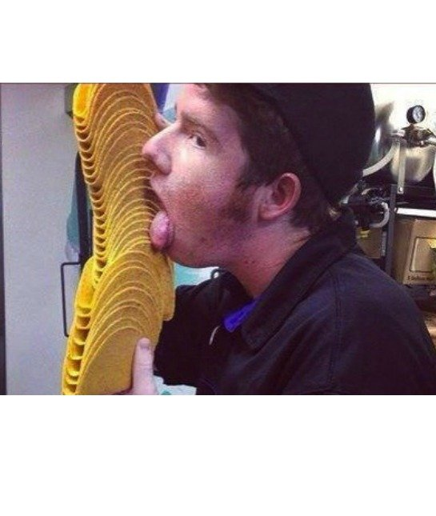
Please don’t lick the tacos..
Taco Bell employee who goes by "Jj O'Brien Nolan" was terminated from the food chain when his taco-shell-licking pic incited disgusted reactions on social media. Don't worry, they weren't served to customers as they were meant to be thrown out.

Slide 16
Careful what you tweet..
22 year old Conner, a recent college graduate who tweeted how much she hated her new job
"Cisco just offered me a job! Now I have to weigh the utility of a fatty paycheck against the daily commute to San Jose and hating the work."
A huge response on Twitter -- including from a Cisco associate who responded he’d be happy to pass her sentiments on to HR. Suffice it to say, her job offer disappeared.

Slide 17
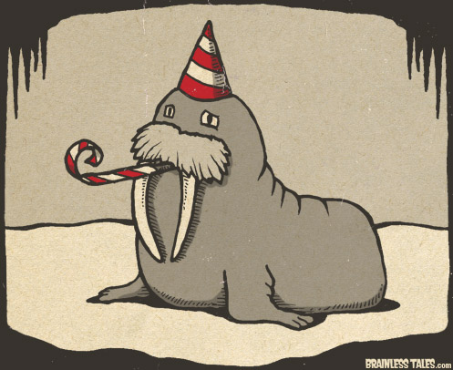
I can’t make it to work today
Kevin Colvin thought he could pull a fast one on his manager while interning at Anglo Irish Bank. Colvin told his supervisor, Paul Davis, that he was going to miss work due to a "family emergency." Turns out that was just a front to hit up a Halloween party. Davis soon discovered as much after Colvin posted this questionable image on his Facebook page. Not only was he fired, but Davis attached the image to his reply and CC'd the entire office.

Slide 18
Other Posts
"first day at work. omg (oh my God)!! So dull!!". The message found its way to upper management three weeks later and the employee was cut loose.
Philadelphia Eagles stadium operations worker Dan Leone took it personal when the team let Brian Dawkins pursue the free agent market "Dan is [expletive] devastated about Dawkins signing with Denver ... Dam Eagles R Retarted!!" The Eagles called and fired him.

Slide 19
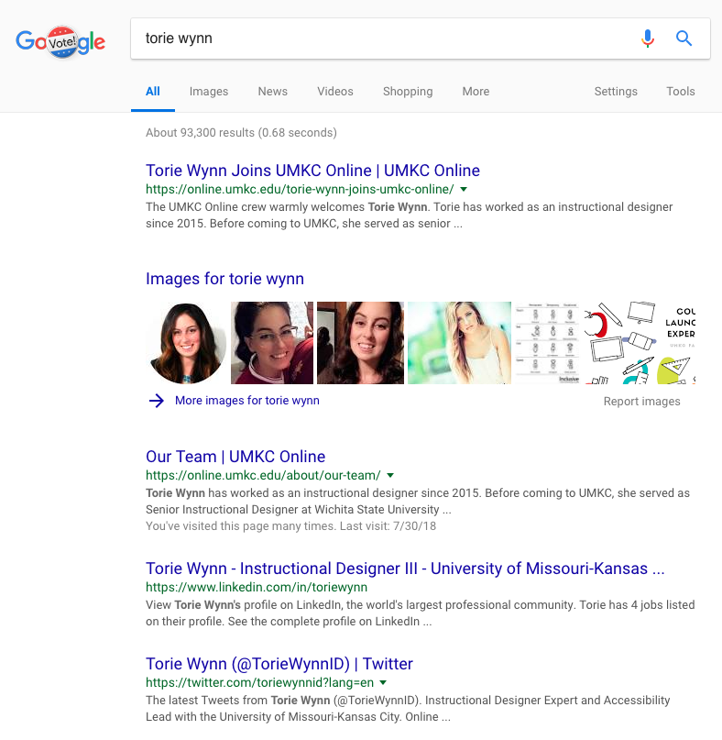
Google Yourself
Use an incognito window or private browsing option
Look at first and last name as well as nicknames
Torie, Torie Wynn, Torie L. Wynn, Victoria Wynn, Victoria L. Wynn
Enter into any social media accounts and review what you can and cannot see
Google on Mobile and PC
Make changes accordingly

