Slide 1
Application Number- 927ab278e45211e9928e018d7b218432 Name- Prathamesh U Tawade Affiliation- Assistant Professor Email Id- Prathamesh@somaiya.edu

Slide 2
Future Of Banking In India- Opportunities and Challenges
Notes:
To change the image on this slide, select the picture and delete it. Then click the Pictures icon in the placeholder to insert your own image.

Slide 3
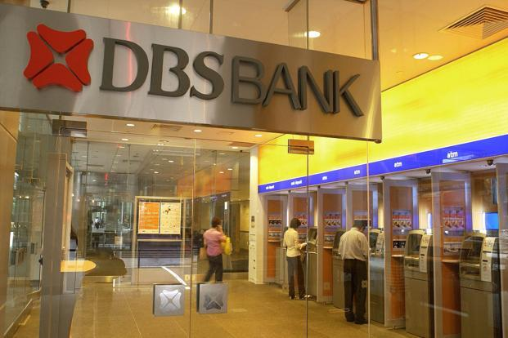
From Paper to Paperless, Presence to Presence-less

Slide 4
The Connectors
1.23 Billion- Aadhaar Cards Generated in India (AS on February, 2019)
1.01 Billion- Number of Cell phone users in India (AS on April 2018)
More than 500 Million- Internet users in India

Slide 5
The Future Of Banking Is Here…..
Bank is becoming more convenient thanks to Internet
Future of the banking sector is growing increasingly digital
Today’s age is digital and hyper connected environment
Future of banking in India will revolve around – Digital, IoT and Cognitive technologies

Slide 6
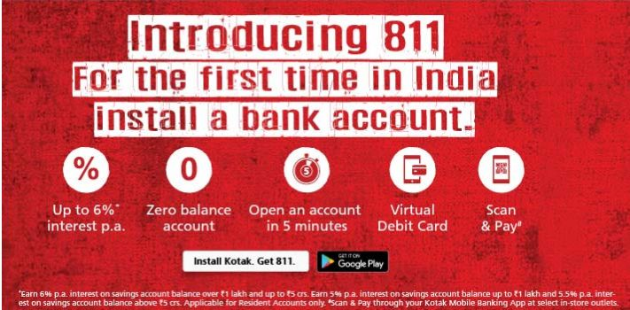
Digital Banks
Changing customer expectations in the digital age is forcing banks to rethink their strategies
Customers are expecting more flexibility and interactivity through digital platforms
Expectations of the digital natives are of instant and 24/7 contacts through digital channels

Slide 7
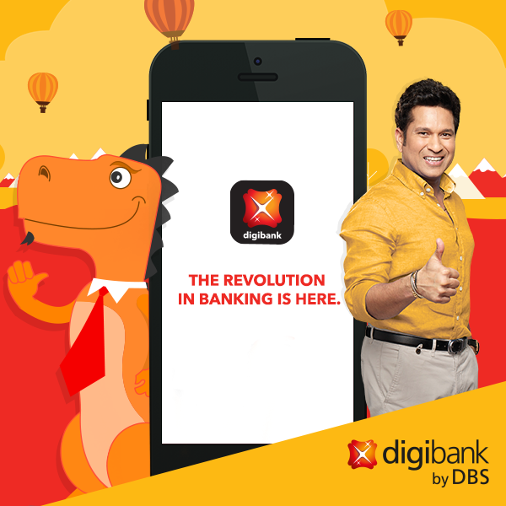
Digital Banks- Indian Examples

Slide 8
IoT (Internet Of Things)
There will be 25 billion smartphones, smartwatches, wearable, connected cars and other connected devices by 2020
ATM is an early prototype of IoT
Banks are turning towards new IoT technologies to enhance the user experience and reduce cost
Use of Beacons in banks for sending customized offers to the customers smartphone as soon as they enter the branch
RFID enabled banking cards issued by Dena Bank

Slide 9
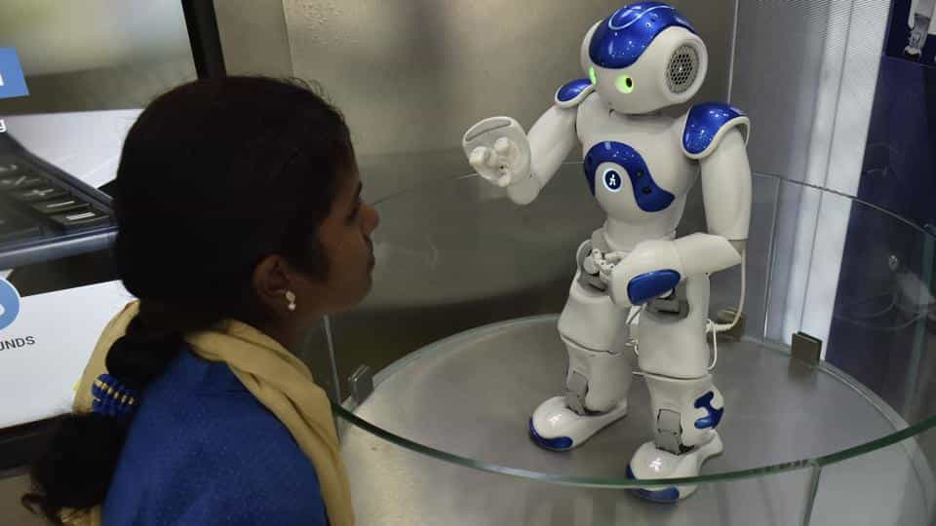
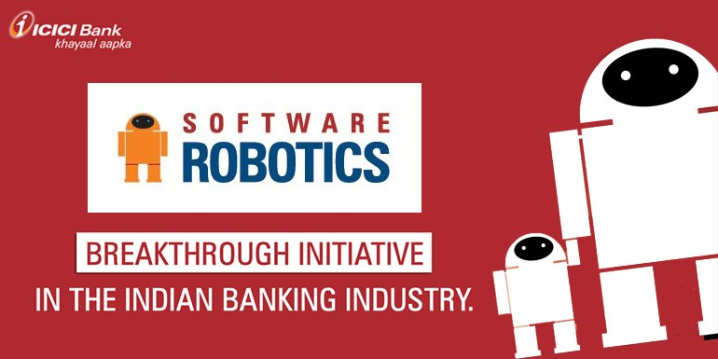
Artificial Intelligence and Cognitive Technologies
AI and Cognitive technologies can transform both front and back office
ICICI has deployed more than 200 software robots across 200 business process functions, reducing the response time to customers by 60%
Canara Bank has introduced two robots for customer care at two of its offices in Bengaluru

Slide 10
Artificial Intelligence and Cognitive Technologies
ICICI Bank has launched Voice Recognition Services where voice will act as a password
CITI Bank is using Voice Recognition System for Locker operations
The Chatbot combines the benefits of virtual and human assistance and provides a differentiated customer experience.
Kotak Mahindra Bank (Kotak) has launched Keya - India's first AI-powered voicebot in the banking sector. Integrated with Kotak's phone-banking helpline, it augments the traditional interactive voice response (IVR) system.

Slide 11
What It Has Or Will Offer?
Customer Service
24/7 Connectivity
Online Bill Payments
Lower Overheads

Slide 12
Can You, Me and We will be replaced?
When it comes to money, sometimes we still talk to the trained professionals
ATMS were developed in 1960’s and popularized in 1970’s and 8o’s and was likely to replaced human tellers, but 2019 still most banks have tellers
Problems resolutions must be done “neatly”
Still we require human touch (For example Senior Citizens, Customers in Rural areas etc.)

Slide 13
Men And Machine Will Work Together

Slide 14
References
Sanat Rao, 2018, How banks can ride the artificial intelligence wave, Mint Newspaper Dated 19th January 2018
https://www.techemergence.com/ai-applications-in-the-top-4-indian-banks/
https://www.newgenapps.com/blog/applications-artificial-intelligence-machine-learning-in-banking-finance
https://www.icicibank.com/aboutus/article.page?identifier=news-icici-bank-introduces-software-robotics-to-power-banking-operations-20160809103646464

Slide 15
Acknowledgment
SWAYAM Course Academic Writing
S K Somaiya Degree College Library
S K Somaiya Degree College, Banking & Insurance Department

Slide 16
Feedback on Academic Writing Course
Changed the mind set and the way I started looking at academic writing
Helped me in my PhD Preparation
Given a new way of thinking for writing books

Slide 17
Thank You

