Slide 1
Cultural end ethical perspectives on medicine
Complex migrant patients Clinical Cultural Competences
Interpretation
Christian Wejse, MD PhD, Dept. of Infectious Diseases, AUH
Assoc.Prof. Center for Global Health

Slide 2
Solutions
Migrant-friendly hospitals:
www.mfh-eu.net

Slide 3
Recommendations
Individually oriented solutions
Communication and care practice adapted to ethnic minorities.
Avoid stereotyping on the basis of ethnicity, cultural background and religion
Developing partnerships with local community organisations to facilitate the development of a more culturally and lin- guistically appropriate service delivery system.

Slide 4
49 yo woman from Somalia Headache, Stomach pain, Muscle‐ and joint‐pain
Elevated ESR and C‐reactive protein
D‐vitamin‐ and iron‐ deficiency
Seen by many specialists…
Emergency room visits
125 departments
Previous hepatitis B, mantoux posititve

Slide 5
Emergency room visits
Resent loss
Seen in 125 departments
Seen by many specialists
Afraid of no secrecy using interpreter
Not able to exercise as previously
No or family translation
High ESR and C‐ reactive protein
Interpreter (anonymous)
Divorce
Economic problems
Somatic investigation
D‐vitamin and iron deficiency,
Headache, Stomach pain
Bronchiectasis
‐ Recurrent pneumonia
Violent ex‐ husband
Muscle‐ and joint‐pain _{Inter}
respir
mittent fever and
PTSD
Not able to learn Danish
atory symptoms
Problems disturbing the picture
6 children, worries
about 18 yo.
War refugee
Dizzy when
driving by bus
from Som
1992
Explanation of symptoms
alia
Rape, torture
Prison in Somalia
Previous hepatitis B Mantoux positive

Slide 6
The basic conditions of exile
Culture
PTSD
Illiteracy
Rare/endemic
disease
Language
Residence permit
Overlooked common disease
Health literacy
Compliance
Economy
Known disease
Family/ marriage
Municipality!
Stigma/ Loneliness

Slide 7
In a new country your health literacy will be low..
Health literacy: ”the degree to which an individual has the capacity to obtain, communicate, process, and understand basic health information and services to make appropriate health decisions”
CDC
Where to go
When to go
With what
Prescribed medicine
Aso, aso
I can´t read what it says

Slide 8
Patients are misunderstood
Doctors misinterpret
”ethnic pain” – eg. rheumatoid arthritis, multiple myeloma and ALS
Ordinary symptoms are expressed in unexpected ways
Delayed diagnosis
Medication errors
Adverse events and complications
Sodemann M, et al. Tak fordi I lavede en bedre version af mig. Erfaringer fra Indvandrermedicinsk Klinik, 2008‐2013
Sodemann M. Kronik: For syg til sygehus. Jyllandsposten; 11 A.D. Oct 10. Windsor, medical‐student‐cultural‐competence, IMJE 2016
Johansen ES. Indvandrermedicinsk klinik baner vej for lighed i behandlingen. Odense Universitets Hospital; 2012.

Slide 10
Psychotic vapors
(or wrong cultural filter?)
Hot air squeezed out through the side of the neck like knives. There is someone choking me at night =
asthma
There is a flow of current from the legs through the stomach to the chest and afterwards warm fumes on the left side that make me powerless =
constipation

Slide 11
A migrant´s sensation of symptoms from of the body
Hard to interpret body signals in a Danish context (move the mindset!)
Same symptom will have different meaning in different context

Slide 12
”How will I know when to give birth in Denmark?”

Slide 13
Den vulnerable patient
The difficult patient
The strange patient
The heavy patient

Slide 14
The nice and competent The nice and incompetent
Get most help and support
The annoying but competent
The annoying and incompetent
Get least help and support

Slide 15
Patientology
Says yes to get away – but means no
Afraid to get scolded
Rather do nothing than risk accidents
Don´t know where they are
Don´t know what disease they have
Only trust: Empathy, respect, and eye contact
You only get one chance – take it!

Slide 16
”It is more important to know what sort of person has a disease, than to know what sort of disease a person has”
William Osler
Perhaps the greatest physician in the 20th century

Slide 17
When we meet the unexpected, we become frustrated or denying…
46 year old African woman with 6 kids
Lived from milking and selling goats
“mysterious symptoms”
→Mononucleosis

Slide 18
Case from the Emergency Room
49 year old male admitted with acute dizziness, dyspnea, chest pain.
Passed out in cantina at language school
Wakes up after cardiac massage
Tentative considerations on diagnosis and treatment?

Slide 19
Relapsing pain
3. admission this month with same presentation.
Previous admission have shown normal ECG, coronary markers and biochemistry.
Investigations: CTC, CT thorax, CT urography, Holtermonitored, no focale findings
In which direction do your considerations now move?

Slide 20
Communication
From patient file:
”Syrian refugee, does not speak Danish, family member interprets via patient telephone”
”Difficult to achieve a proper history”
”Has sick daughter in Syria, pain increases when he thinks of her”

Slide 21
The story behind
An interpreter is requested, history:
Kurdish refugee from Iraq close to the border of Iran. The area was controlled by ISIS
Has left wife and daughter aged 15
Fled with son 27, has a sister-in-law in DK, she has been here one year (used as interpreter…)
Fled via Turkey and Greece, the boat ticked, was 9 hours in cold water, people around him drowned

Slide 22
The real problem
The family was told he was dead, since then, the daughter has had psychological problems
Has always been physically well, worked as a mechanic.
Knows that he does not have a physical disease
Haunted by flash-backs and worries about the family. When he thinks of them or sees girls same age, he feels bad

Slide 23
Good questions to ask
How do you sleep at night?
Why did you leave your home country? How was that?
Anything you miss?
Many people from XX country have experienced violence, imprisonment etc, have you?
Have you ever experienced things which are hard to think or talk about?
How old do you feel inside?

Slide 24
Post traumatic stress disorder (PTSD)
Nightmare/flashbacks, sleeping problems, avoidance behavior, hypervigilance, anxiety/depression, concentration/memory problems
Physical symptoms of PTSD
Headache, neck/shoulder/chest pain, sweating, digestive problems
PTSD screening
Experienced something that was so awful so it's hard to think about?
If yes:
1) Avoidance behavior
2) Being alert
3) Numbness / feeling of isolation
4) Sleep problems
traume.dk

Slide 25
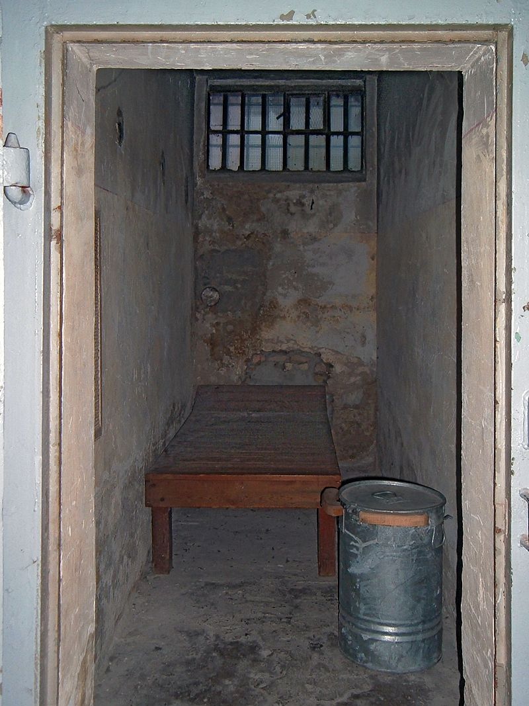
Notes:
Undgå yderligere ulykker → spare menneskelige og økonomiske ressourcer..

Slide 26
Past experience creates mutual negative expectations…
Patient does not expect to be understood..
Doctor does not expect the patient will understand and search for the fastest way to get the patient out of the consultation

Slide 27
How much do we have in common?
Doctor
Patient

Slide 28
Patient language
Medical language
Lægen
Patienten
Common language

Slide 29
Everybody is bad at something
– you just need to figure out what..
What is it the doctor did not understand?
What is it the patient did not understand?
What is it the municipality did not understand?
What should we do about it?

Slide 30
”Course coordination” ”Forløbskoordination”
Clean up
Academic priority
Find out what´s happening elsewhere
Coordinate efforts
Brige-building / Dialogue
Avoid more accidents
Meetings with interested parties
Making sure the patient feels understood
Test compliance
Help to self-help
Create understanding
Practical coordination
Notes:
Der er ikke noget vi ikke gør!
Empati, tålmodighed, helhedsorinteret

Slide 31
3 tools: The problem list The life story Genogram (family history)

Slide 32
How to become clinical cultural competent?
Taboos
Urogenital/gastrointestinal problems
Handicap
Skin marks ‐ , infection, ritual or torture ..
Static vs dynamic cultural understanding

Slide 33
How to investigate migrant patients with multiple complains
Meet a person/patient in stead of focusing on what is cultural different
Time, empathy, listen to the story
Nielsen D, “Livshistorien er i centrum i Indvandrermedicinsk Klinik”, Sygeplejersken, 2011

Slide 34
Key lessons
If we guess and dare not ask we lose our professionalism
No medicine will help, if we don´t communicate well with the patient

Slide 35
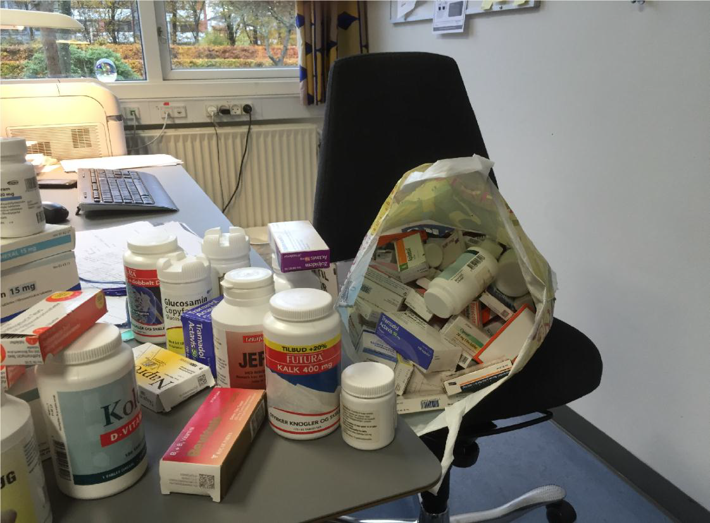
Non- compliance among patients with different ethnic background
1/3 of patients did not adhere to the doctors recommendations
38% took medicine which was not prescribed to themselves
‘> 50% take medicine bought in country of origin
50% do not know that they are taking their medicine wrongly
Afsaneh Ahmadi, pharmaceut, IMK, Odense

Slide 36
Interpretation
Interpretation

Slide 37
Exercise
Work together 2 students
1 student (patient) explains a disease to the other student (doctor)
without speaking!
2 minutes

Slide 38
When the language disappears…
”I need an interpreter even though I do speak Danish.
I can´t concentrate on telling about the ugly experiences when searching for the words
I get so tired, and then the thoughts break and my words disappear…”

Slide 39
Evidence for the effect of using interpreters
Reduce risk of wrong diagnosis
Reduce risk and severity of complications
Communication problems is the most important in caring for patients of other ethnic origin
Sodemann M, et al. Tak fordi I lavede en bedre version af mig. Erfaringer fra Indvandrermedicinsk Klinik, 2008‐2013
Lou S, Tre er et umage par, Center for Folkesundhed, 2008

Slide 40
Cases
A patient referred for gastroscopy with epigastric pain
No interpreter, the patient could not cooperate
Conclusion: Examination not possible, no further follow‐up
A patient seen in emergency
The patient has diffuse pain, no obvious acute illness, patient discharged without further explanation (patient thinks she has cancer and treatment not possible)
Patient referred for MR scan
Not possible (no written or verbal information,
patient previously in small isolation room in prison)

Slide 41
Considerations using interpretation..
Missing words concerning health and disease even when the patient speak reasonable Danish
In case of illness, the learned language is lost
Family for interpretation?
Generally not, and never for serious messages
For simple messages (family does not translate everything!)
Do not use children (<18år)
24‐hour telephone interpretation available!

Slide 42
Interpretation ‐ considerations
Inform about confidentiality
Check understanding (conflicts)
Double consultation time
Speak directly to the patient
Short, clear and meaningful sentences
Avoid medical terms, slang and metaphors
Sum up and check understanding
Evaluation with interpreter
Good interpretations includes cultural interpretation
e‐dok.rm.dk

Slide 43
Video interpretation

Slide 44
When to use an interpreter?
Always consider with migrant patients
For all outpatient contacts, ward rounds, information about results, further investigations, diagnoses aso..
The medical history is one of the most important tools
We do not accept in other aspects of medicine not to be able to access information

Slide 45
New legislation on interpretation
Bekendtgørelse om tolkebistand efter sundhedsloven (I medfør af § 50, stk. 4, i sundhedsloven, jf. lovbekendtgørelse nr. 191 af 28. februar 2018, som ændret ved lov nr. xx af xx 2018) §2 stk. 3 pkt 1):
Patienter, der som følge af nedsat fysisk eller psykisk funktionsevne midlertidigt eller varigt har mistet evnen til at tilegne sig henholdsvis oppebære og anvende tilegnede danskkundskaber.

Slide 46
Even the best medicine do not work on the wrong story
Creative writing as a medical instrument.
Baruch JM. J Med Humanit. 2013. http://www.ncbi.nlm.nih.gov/m/pubmed/24006190/

Slide 47
Guessing is not a good substitute for professionalism and curiosity

Slide 48
In Denmark we appreciate
Free and open access to health care for all
We do not pay to see the doctor
… unless of course you are a migrant and do not speak Danish!

Slide 50
Ethical dilemma
Discuss how you would handle this situation:
A patient has been in Denmark 3 years and speaks no Danish. He has no money for an interpreter but is clearly very ill.
Try to balance current rules, patient safety matters and the Hippocratical oath

Slide 51
Ethical dilemmas

Slide 52
Take home messages
Use interpreter for equal contact & common frame
native language is key for understanding
All people are rational on their own terms
find the premise before the solution
If you do not take your time for the patient, the patient will take your time
Take time for trust
You never win a cultural guess competition
ask and win respect instead

Slide 53
Thank you for your attention

