Slide 1
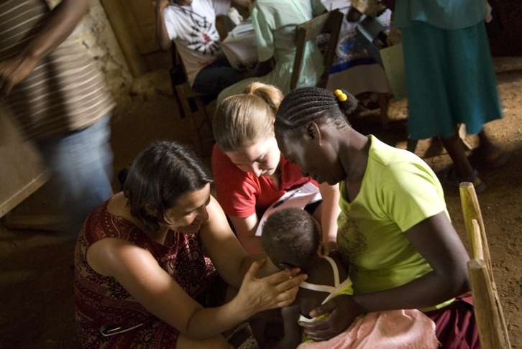
Perspectives on culture and global health
Christian Wejse
Dept of Infectious Disease
Center for Global Health
Aarhus University

Slide 2
Agenda
Global health and perspectives on culture.
- Christian Wejse 11.00-11.45
Clinical cultural comptences. Complex migrant patients. Interpretation
Christian Wejse 12.15-13.00
Global health in practice, sustainable development goals
Per Kallestrup 13.15-14.00
Notes:
Ulighed i sundhed, etiske problemer med pt der ikke bliver ordentligt behandlet, patientsikkerhed, nye tolkelov

Slide 3
Purpose of seminar
Create an understanding of causalities of diseases in a global context
Introduce basic concepts of clinical cultural perspectives in patient management
Present challenges and ethical dilemmas in cross-cultural clinical practice

Slide 4
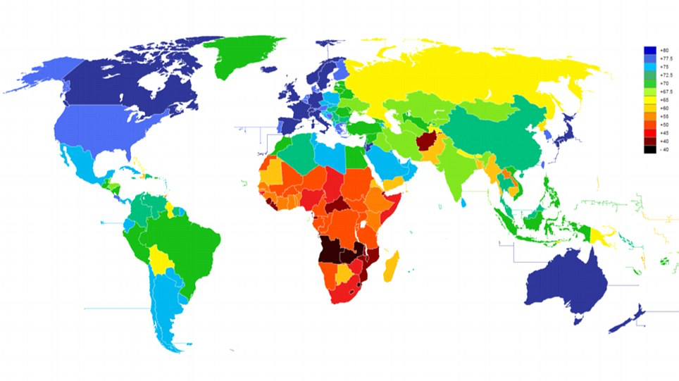

Slide 6
The importance of Global Health
Diseases do not respect boundaries
Health disparities has an ethical dimension
Health is linked with economic development in an interdependent world
Health has implications for global security and freedom
wjse@ph.au.dk Christian Wejse, Department of Infectious Diseases

Slide 7
Global health is – answers given to questions such as:
What are the key diseases and health conditions that cause death and disability in the world?
What are the theories and methods that allow us to study population health?
What can be done to create a healthier population?

Slide 8
Important global health issues
66 mio refugees in the world + internally displaced
The enduring wealth gap
Health system management
Climate change
Emerging health threats (eg Ebola, Zika)
Air pollution
Health worker shortage
Mental health for trauma survivors
Drug-resistant bacteria
Gun violence

Slide 9
The failure of Global Health
Failure to deliver on the Alma-Ata declaration: "Health For All by 2000” - nearly half the world's population lacks access to essential health services.
A roaring HIV epidemic with +30 mill infected, 2 mill new infected per year and 1 mill deaths
6 mill children die every year, 3-4 mill die from preventable diseases (90% in dev countries)

Slide 10
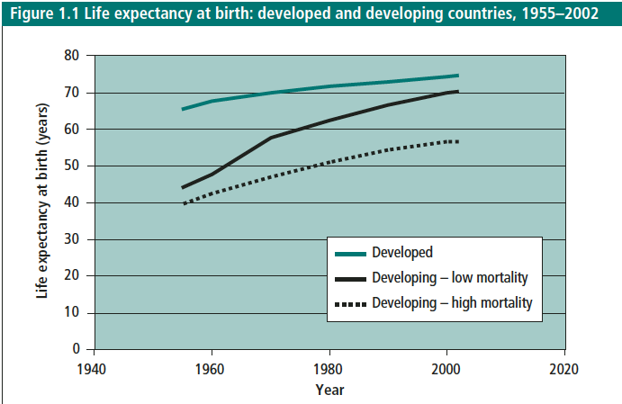
The succes of Global Health
Life expectancy around 80 yrs in many countries and increasing
Life expectancy in developing countries increased from 40 to 70 in the past 50 years
Elimination of smallpox
Eradication of polio and measles within range
Decline in child mortality from 18% in 1960 to 4% in 2015

Slide 11
What is the leading cause of global mortality?
https://www.mentimeter.com/p/f577f4c68236

Slide 12
Source: World Health Organisation 2018

Slide 13
Source: World Health Organisation 2018

Slide 14
What is the leading cause of death in low income countries?
https://www.mentimeter.com/s/c80929a61e6565103195fddb5010f12e/982658ec3a38

Slide 15
Source: WHO Statistics 2018

Slide 16
Global health local health
Travelling brings diseases which are common elsewhere but rare here
Migrants will reflect disease patterns in country of origin
You need to know something about the geography of medicine

Slide 17
Meet Oliver

Slide 18
27 year old man working for an Italian construction company at DNU
Originaly from Burkina Faso.
No residence permit
Brought to your dept. by co-worker who worries about him
Speaks only French
Lost weight, febrile, coughs
Gradually weaker over weeks, walks bad
Ethical dilemmas
Universal right to health care for everyone?

Slide 19
Tentative diagnoses?
Common diseases in Burkina Faso?
Migration route?
Life before migration
History
Vaccinations
Exposures
Family illnesses
Ethical dilemmas
Stigma
Missed screening opportunities?

Slide 20
Let’s go back to where it started
Terror militia killed his family
‘Evil eyes’ from neighbour
Since then ”dead blood under my skin”
Smugglers through Sahara, warehouse in Libya
Ethical issues
Right to life, food, education
Access to primary care

Slide 21
Wild, IJTLD 2017

Slide 22
Outcome for Oliver
All have right to acute medical care
Admission for TB investigation
Diagnosed with severe TB spondylitis
Outpatient follow-up not possible for non-residents (except for TB)
Additional health care provided by Red Cross

Slide 24
Ethical dilemmas
An undocumented migrant patient is diagnosed with TB. He is homeless and has a severy substance abuse problem (self-treatment for PTSD). He has no access to health care in Denmark.
He does not take any TB treatment and is highly contagious.
Discuss solutions with your neighbour
Try to balance public health concerns and patient autonomy

Slide 25
Migrant
Person with residence in another country than country of birth
Globally 200 mio, 3% of populati
1/3 south to north
Denmark 10% (½ non‐western)
on

Slide 26
Migrants in Denmark
Migrants represent an increasing part of the Danish population (10%)
Incl descendants it is 13%
58% are from non-Western countries
Large regional variation (Ishøj 35%, Mors 4%)
Immigrants in DK, Danmarks statistik 2018

Slide 27
Immigrants in Denmark (DK statistics 2014)

Slide 28
Importance of considering migrant health
Socioeconomic
Diverse population ‐ clinical cultural skills are needed
Human rights

Slide 29
Migrant health
Premigration health factors
Famine, War, Trauma, Health care access
Postmigration access to health care
Legal (asylum seekers, undocumented migrants)
Informal barriers: Language, culture, newness to the health care system, health care professional´s cultural competences

Slide 30
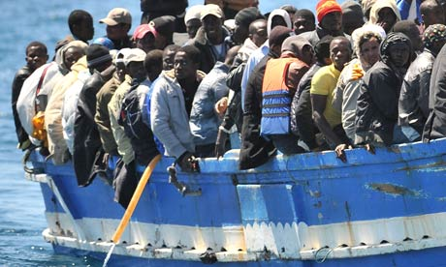
Is there a need for special attention on migrants in DK?
Infectious diseases more common
tb, hepatitis, syphilis and parasites
Udlændinge, Integrations og boligministeriet. Tal på udlændingeområdet pr. 31. mar 2016. www.nyidanmark.dk (25. apr 2016).
Bozorgmehr K, Mohsenpour A, Saure D et al. Systematic review and evidence mapping of empirical studies on health status and medical care among refugees and asylum seekers in Germany (1990‐2014). Bundesgesundheitsblatt Gesundheitsforschung Gesundheitsschutz 2016;59:599‐620.
More often diabetes and PTSD
Higher mortality from infectious diseases (*2‐4)
Norredam M, Olsbjerg M, Petersen JH et al. Mortality from infectious diseases among refugees and immigrants compared to native Danes: a historical prospective cohort study. Trop Med Int Health 2012;17:223‐30
≥3 long‐term illnesses
25‐48% (11% in ethnic Danes)
Despite healthy migrant effect
Do not use health care more
Etniske minoriteters sundhed, CENTER FOR FOLKESUNDHED, REGION MIDTJYLLAND, juni 2008

Slide 31
Self-assessed health
Ethnic minorities in health care.
SST 2010

Slide 32
High proportion with numerous diseases
Etniske minoriteter i sundhedsvæsenet.
SST 2010

Slide 33
Discrimination in access to health
Barrier in access
Delayed treatment
Information problems
More complications and less rehabilitation
Metersky ML et al. Racial disparities in the frequency of patient safety events: results from the National Medicare Patient Safety Monitoring System. Med Care 2011 May;49(5):504‐10.
Hempler NF et al. Do immigrants from Turkey, Pakistan and Yugoslavia receive adequate medical treatment with beta‐blockers and statins after acute myocardial infarction compared with Danish‐born residents? A register‐based follow‐up study. Eur J Clin Pharmacol 2010 Jul;66(7):735‐42.
Sanchez‐Ramirez DC et al. Do immigrants from Turkey, Pakistan and Ex‐Yugoslavia with newly diagnosed type 2 diabetes initiate recommended statin therapy to the same extent as Danish‐born residents? A nationwide register study. Eur J Clin Pharmacol 2013 Jan;69(1):87‐95.
Kristensen JK et al. Diabetes prevalence and quality of diabetes care among Lebanese or Turkish immigrants compared to a native Danish population. Prim Care Diabetes 2007 Sep;1(3):159‐65.
Michaelsen J. Forstærkning af sociale problemer? Livsstilsfokuseret sundhedspædagogik overfor immigrantmænd i hjerterehabilitering. Norsk Tidsskrift for Migrasjonsforskning 2008;1:63‐80.
Vandenheede H et al. Migrant mortality from diabetes mellitus across Europe: the importance of socio‐economic change. Eur J Epidemiol 2012 Feb;27(2):109‐17.

Slide 36
The iceberg of culture
Languages
(verbal & non-verbal)
Explicit
Conscious
Explicit behaviours
Habits & traditions
(food, housing, clothing, health…)
Know-how
(communication codes, tools..)
Institutions
(collective organizations modes:
family, education
Norms
(Do’s & don'ts)
Implicit
Values
Unconscious
Mental state & cognitive processes
(perception, learning, knowledge, memory…)
Notes:
EXPLICIT:
IMPLICIT:

Slide 37
Cultural competence, definition
“Cultural competence is having the knowledge, understanding and skills about a diverse cultural group that allows the health care provider to provide acceptable cultural care”
“Competence is an ongoing process that involves accepting and respecting differences and not letting one´s personal beliefs have an undue influence on those whose worldview is different from one´s own”
“Cultural competence includes having general cultural as well as cultural-specific information so the health care provider knows what questions to ask”
Giger J, American Academy of Nursing Expert Panel Report: Developing Cultural Competence to Eliminate Health Disparities in Ethnic Minorities and Other Vulnerable Populations; Journal of Transcultural Nursing, Vol. 18 No. 2, April 2007 95-102
Notes:
2 concepts before speaking of something more close to patient treatment
Concept 1: Define Cultural competence
Various definitions – this is one of them
Learning clinical cultural competence is a process - a different process than most learning studying at a university!
(as learning all common bacteria that causes pneumonia by heart)
I will show you that in order to use your cultural competence you need basic communication skills (time, empathy, listening..)

Slide 38
Cultural aspects of importance in assessment of health issues
3 days with cough = 1 week, months, or chronically
Blood sampling takes your strength and should not be done when you are sick
Weight gain is always a sign of health
Genetic disease blamed on the mother
A doctor without a white coat asking what the patient believes is not a real doctor
Decision on treatment taken by the family and not by the patient

Slide 39
Questions…
Discuss with your neighbour:
Do you have experience that cross-cultural communication can be difficult?
Are you aware of blind spots or ways you stereotype patients?
Source: CCL, 2002

