Slide 1
Online Learning
Common Core 3.0
Field Activities
Classroom Skill Building

Slide 2
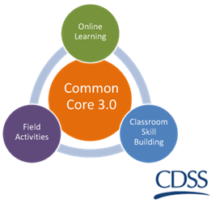
ICWA: Working with Native American Families and Tribes
California Common Core April 30, 2019
2
Notes:
2

Slide 3
ICWA: Working with Native American Families and Tribes
Opening
Introductions
Housekeeping
3

Slide 4
Why ICWA?
“[S]hould Indian children be treated differently than other children? Given the history of Indian children in the United States and the trust relationship promised to them by the United States government, the answer is Yes.”
--Hon. Leonard Edwards
Santa Clara Superior Court (Ret.)
4

Slide 5
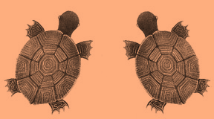
Learning Objectives
Participants will understand the relationship between US history and ICWA and will be able to identify three events that led to the passage of ICWA.
Participants will understand regional differences of California Indian history and will identify two regional historic events that resulted in historical trauma.
Participants will identify two examples of the effects of historical trauma that affect engaging and working with Indian children, families and Tribes.
Participants will recognize that Tribes are sovereign nations and that being American Indian/Alaska Native is both a political and cultural distinction.
5

Slide 6
Learning Objectives
Participants will be able to identify five basic provisions of the Indian Child Welfare Act.
Participants will be able to identify engagement and teaming with Tribes as a part of the new practice model.
Participants will understand the difference between reasonable and active efforts, that active efforts begin immediately when there is reason to know a child is American Indian or Alaska Native and will be able to change a reasonable effort into an active effort.
Participants will understand ICWA placement preferences and that they are important to one of ICWA’s purposes.
6
Notes:
6

Slide 7
Learning Objectives
Participants will recognize Tribal Customary Adoption and guardianship as concurrent planning options for American Indian and Alaska Native children.
Participants will be able to describe two positive child welfare outcomes from a Tribal perspective and will be able to identify legal consequences to non-compliance with ICWA.
Participants will recognize the legal ramifications related to non-compliance with ICWA.
Participants will demonstrate and awareness of culturally appropriate engagement for the purpose of identifying American Indian/Alaska Native children.
7

Slide 8
Learning Objectives
Participants will demonstrate the ability to change reasonable efforts into active efforts.
Participants will value engaging and teaming with Tribes, Tribal service providers and designated ICWA agents and advocates as resources for decision making, ICWA compliance, and implementation of the CA Child Welfare Core Practice Model.
Participants will value keeping an American Indian/Alaska Native child connected to their community, culture and Tribe to ensure positive child welfare outcomes and ICWA compliance.
8

Slide 9
Training Overview
eLearning Review
ICWA Historical Context
ICWA Basics
Historical Trauma
Tribal Sovereignty
Remedying Bias
ICWA Requirements and Social Work Practice
9

Slide 10
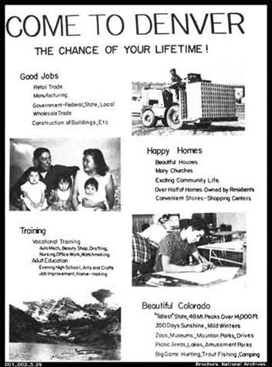
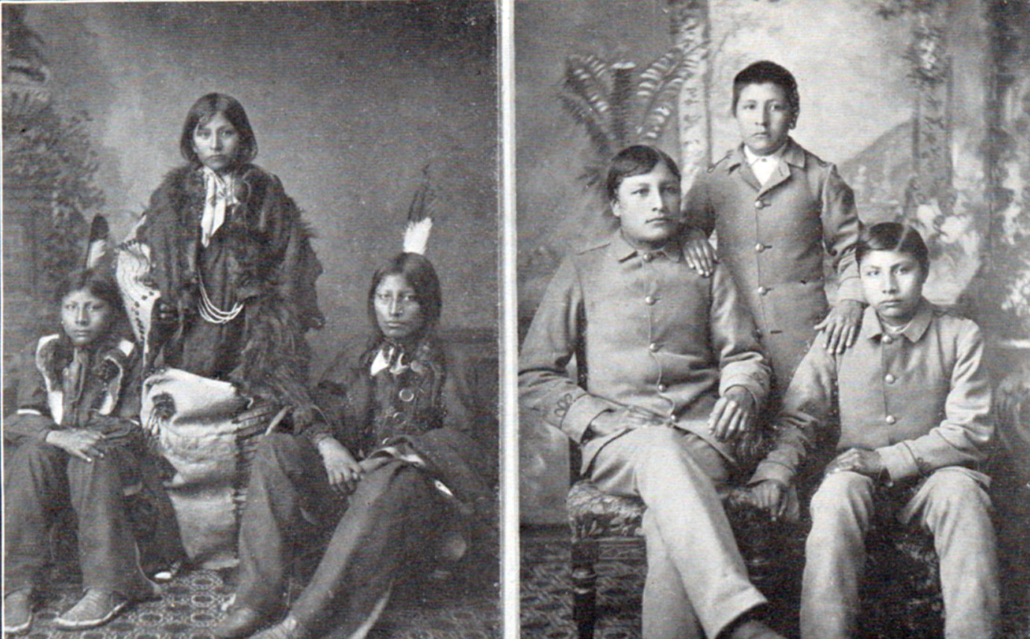
eLearning Review/ICWA Historical Context
What do you remember about…
Removal
Boarding Schools
Relocation
Indian Adoption Project
Photo Credit: National Archives
10

Slide 11
The Two Apologies: What is the significance?
In 2000 Kevin Gover(Pawnee), Assistant Secretary for Indian Affairs, delivered an apology for the conduct of the Bureau of Indian Affairs and their collusion in helping to break up Indian families.
Mr. Shay Bilchik, Executive Director of the Child Welfare League of America, issued an apology in 2001 for their role in the Indian Adoption Project, stating the project was developed to remove Indian children, mostly infants, and place them in adoptive homes with non-Indian parents.
11

Slide 12
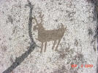
ICWA Basics
Who is an Indian child?
Who determines who is an Indian child?
How may a Tribe participate in an ICWA case?
When does ICWA apply?
deer petroglyph
ancient “writing” on the wall
12
Notes:
12

Slide 13
What do we hope to get out of today?
Ancient Wall Art
13

Slide 14
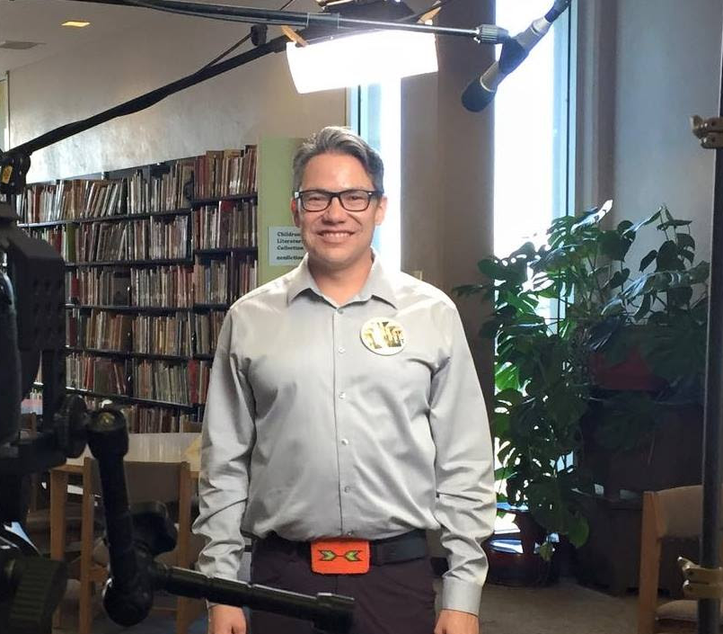
15-Minute Break
Cmdr. John Harrington, Chickasaw
Retired Naval pilot and Naval test pilot; first Native American NASA astronaut; flew on the Space Shuttle Endeavor’s 16th mission to the International Space Station.
Corey Gray, Siksika (Northern Blackfoot)
Lead operator of the laboratory that directly observed black holes for the first time; detected gravitational waves and confirmed aspects of Einstein’s Theory of Relativity.
14

Slide 15
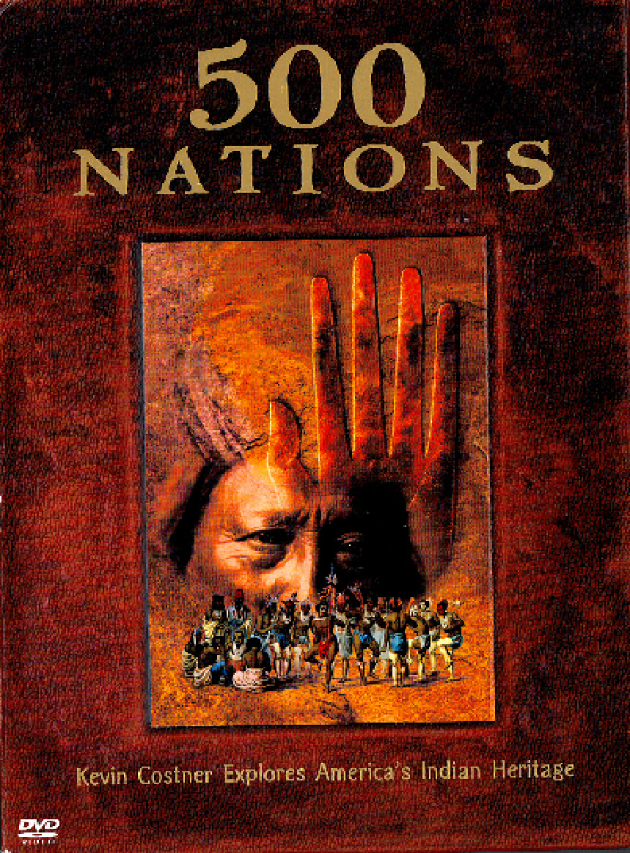
California Indians
500 Nations: California Coast
15

Slide 16
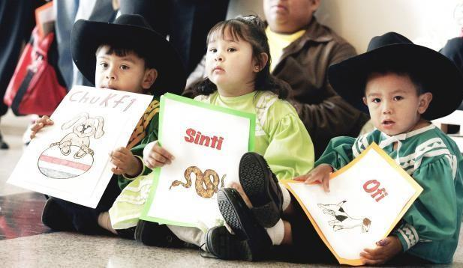
Indian Child Welfare Act
History, Purpose, and Provisions
Photo Credit:Jaconna Aguirre, Oklahoman archives
16
Notes:
16

Slide 17
American Indian Policy Review Commission Findings
Decisions made about Indian children were biased when made by non-Indian authorities.
25% to 35% of all Indian children were removed and raised at some time in non-Indian homes and institutions.
States failed to recognize the Tribal, social, and cultural standards prevailing in Indian communities and families.
The Indian Child Welfare Act was passed to remedy these issues!
17

Slide 18
ICWA: Purpose
In adopting ICWA, Congress declared that the U.S. policy is to:
Protect the best interests of Indian children;
Promote the stability and security of Indian Tribes and families.
Purpose accomplished through:
Minimum federal standards for the removal of Indian children from their families and their placement in foster or adoptive homes that honor the unique values of Indian culture
Assistance to Indian Tribes for operating child and family service programs
18
Notes:
18

Slide 19
Spirit of ICWA
Maintaining connections to culture and community increases protective factors. Spirit of ICWA means treating the case as an ICWA case:
When the child’s Tribe is not a federally recognized Indian Tribe
When the child is a descendent of a federally recognized Tribe but is not eligible for enrollment
When the family is a Native American family but not a member of a Tribe
California law gives a court discretion to allow non-federally recognized Tribes to participate in proceedings and make recommendations.
19
Notes:
19

Slide 20
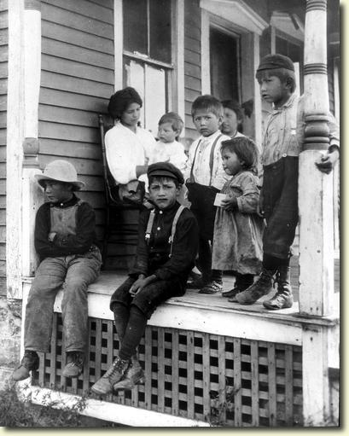
Compassion Activity
20

Slide 21
Historic Trauma
Historical Trauma is the collective emotional and psychological injury both over the life span and across generations, resulting from a cataclysmic history of genocide.
Cultural Trauma is an attack on the fabric of a society, affecting the essence of the community and its members.
Intergenerational Trauma occurs when trauma is not resolved, subsequently internalized, and passed from one generation to the next.
21

Slide 22
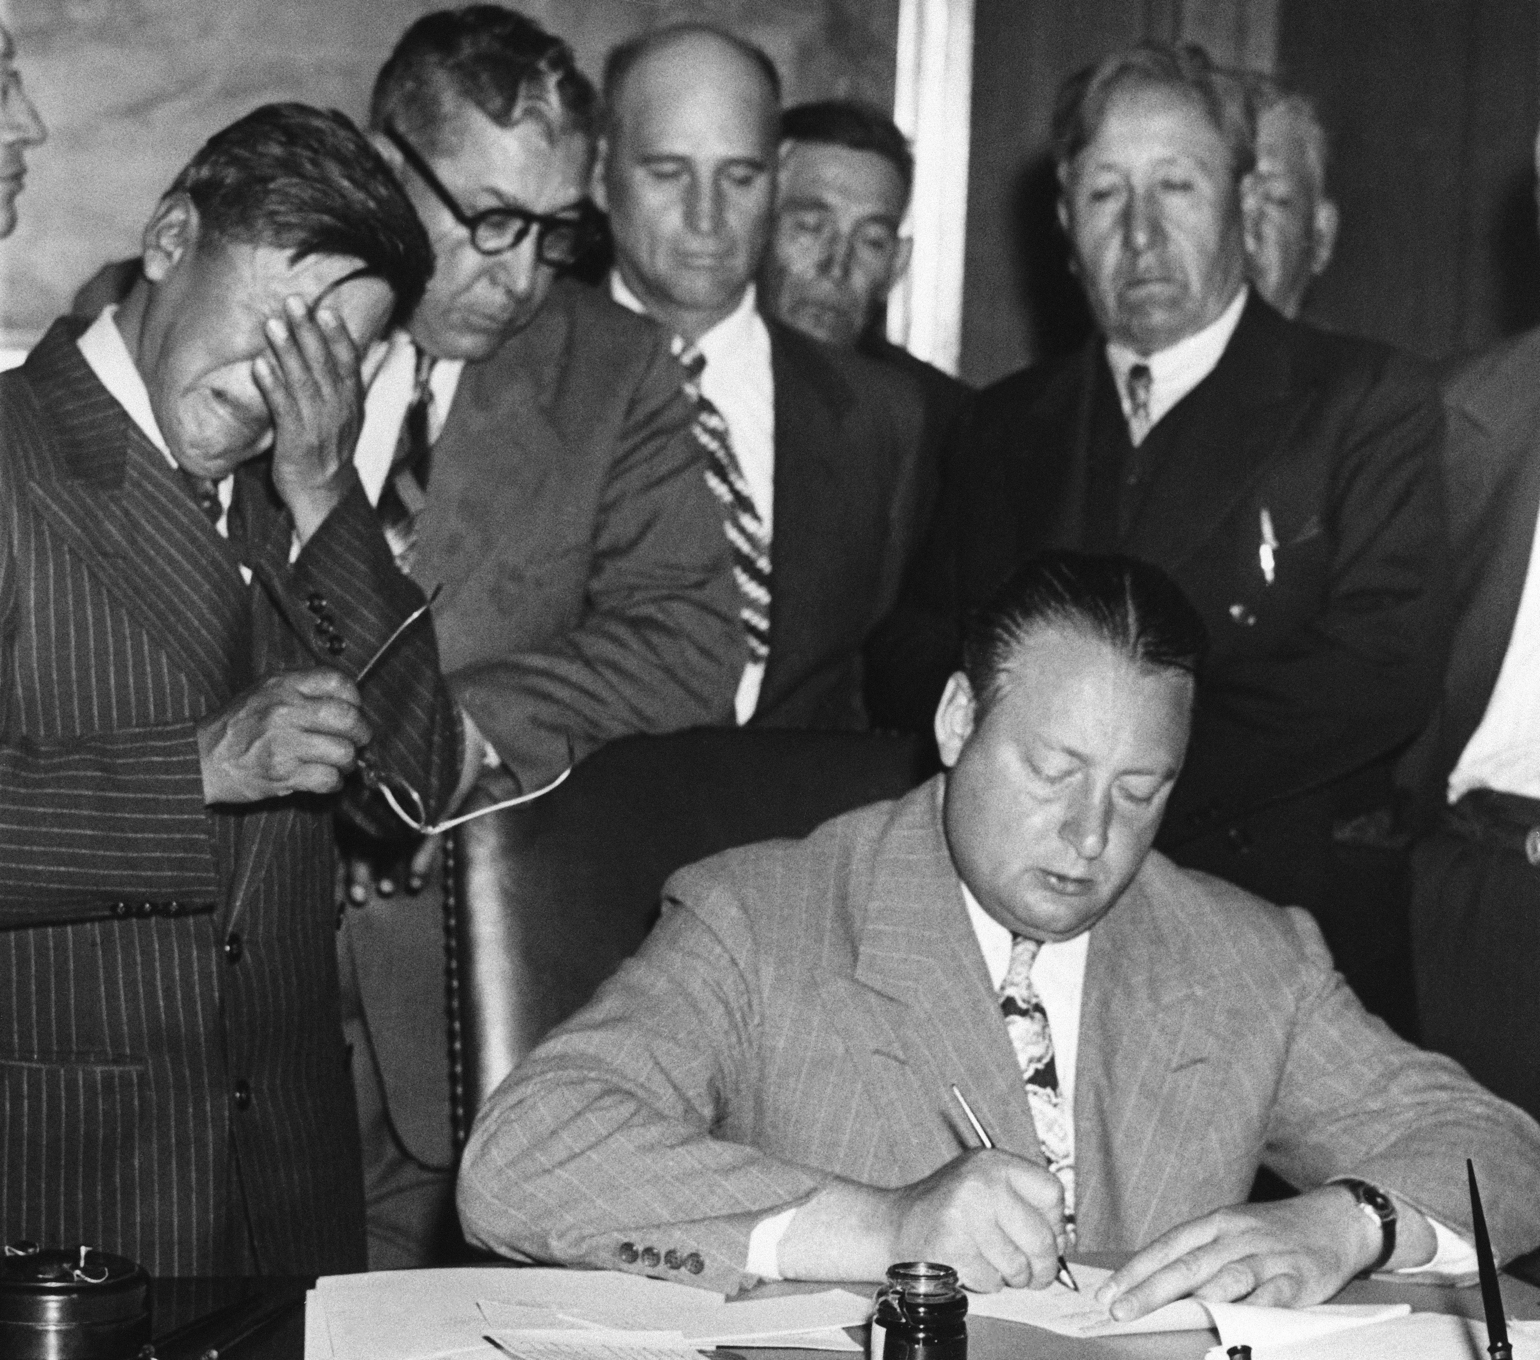
Historic Trauma (cont’d)
Characteristics of unresolved grief and loss:
being quick to anger
low self-esteem/shame of identity
history of depression
shame about loss of culture
suicidal ideation
substance abuse
violence
Photo Credit: Associated Press
22
Notes:
22

Slide 23
Historic Trauma: What a Social Worker May See
Lack of parenting skills
Emotional remoteness and “going through the motions” of the process
Apathy and resistance toward following through with case plans or contacting other government agencies
Parents may “disappear”
23

Slide 24
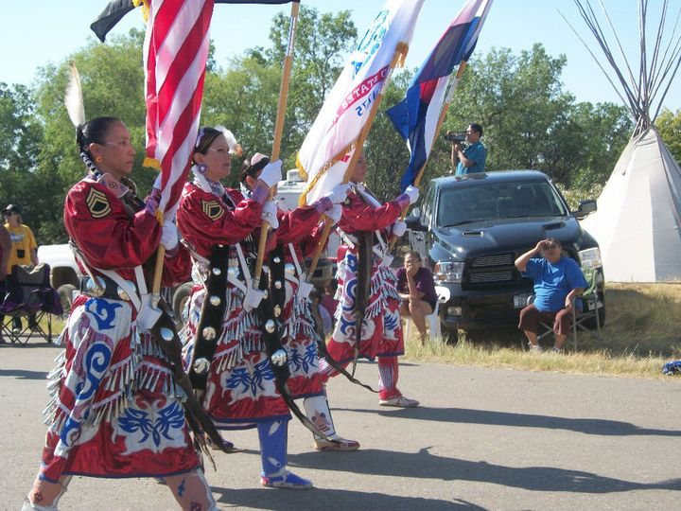
Contributions
What have American Indian/Alaska Natives contributed to contemporary society?
Photo Credit: PowWows.com
24

Slide 25
Agriculture
Corn, Beans, Squash:
The Three Sisters
Vanilla Bean
Cocoa Beans
25

Slide 26
Pharmocopeia
Products Used as Medicine from The “New World” Cultivated by American Indians
White Sage
Tobacco
Aspirin (White Willow)
Echinacea
Quinine (Cinchona Tree)
Coca Leaves
26

Slide 27
Code Talkers
Choctaw Code Talkers‐WWI
Navajo Code Talkers‐WWII
27

Slide 28
Law and Policy
The Haudenosaunee Wampum Belt Commemorating
the Great Laws of Peace of the Iroquois Confederacy
The Seneca
(Keepers of the Western Door)
The Mohawk (Keepers of the Eastern Door)
The Cayuga
The Oneida
The Onondaga (Keepers of the Central Fire)
28

Slide 29
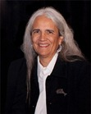
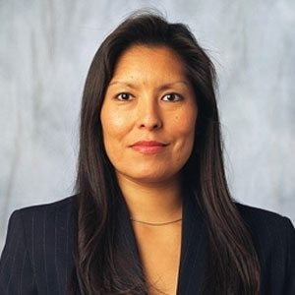
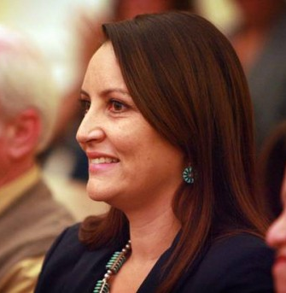
Judicial
The Honorable Abby Abinanti (Yurok)
First California Native admitted to California Bar
Superior Court of California- San Francisco Unified Family Court (retired)
Chief Justice, Yurok Tribal Court (2007- Present)
The Honorable Diane Humetewa (Hopi)
U.S. District Court for the District of Arizona
May 14, 2014- Present
The Honorable Sunshine Sykes (Navajo)
Riverside County Superior Court
December 2013-- Present
29

Slide 30
Social Work
Historical Trauma
Maria Yellowhorse Braveheart, Ph.D. (Hunkpapa, Oglala Lakota)
Dolores (Dee) Subia Bigfoot, Ph.D. (Caddo Nation of Oklahoma)
30

Slide 31
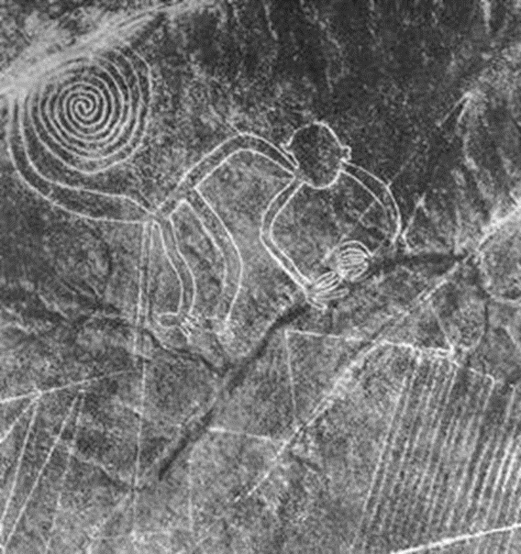
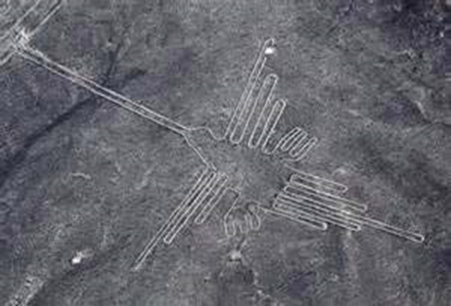
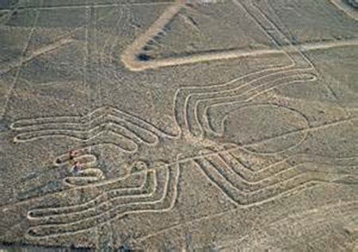
Lunch Break - 60 minutes
The Nazca Lines—Southern Peru A UNESCO World Heritage Site
The Nazca Lines, a UNESCO World Heritage Site, s are a series of ancient geoglyphs in the Nazca Desert in
southern Peru. Scholars believe the Nazca Lines were created by the Nazca culture between 400 and 650 AD.
The hundreds of individual figures range in complexity from simple lines to stylized hummingbirds, spiders,
monkeys, fish, sharks, orcas, and lizards. The designs are shallow lines made in the ground by removing the
reddish pebbles and uncovering the whitish/grayish ground beneath. Scholars differ in interpreting the
purpose of the designs, but in general, they ascribe spiritual significance them.
31

Slide 32
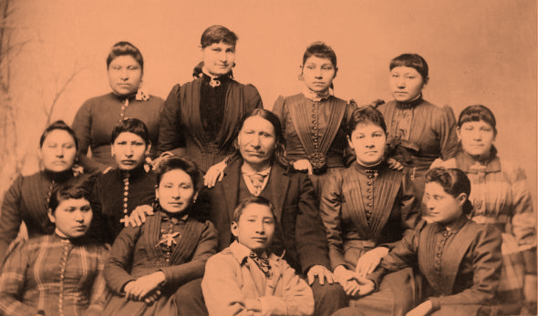
ICWA Requirements and Social Work Practice
American Horse with children in boarding school
32
Notes:
32

Slide 33
ICWA’s Five Provisions
Inquiry & Notice
Active Efforts
Placement
Concurrent Planning
Qualified Expert Witness
33
Notes:
33

Slide 34
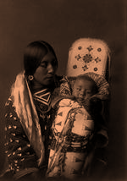
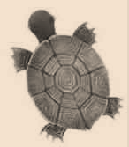
Inquiry
Anyone seeking foster care placement, guardianship, Tribal customary adoption or adoption has an ongoing duty to inquire about whether a child is an Indian child.
Ask if the child may be of American Indian heritage:
At initial intake
If the child is being placed in foster care
If the child’s permanent plan is adoption
34

Slide 35
Inquiry (cont’d)
Anyone seeking foster care placement, guardianship, Tribal customary adoption or adoption must seek additional information when reason to know exists that the child is an Indian child.
Reason to know exists when:
Any participant in the proceeding (including the child) or Officer of the Court, Indian Tribe, organization, or agency states the child is an Indian child or has information indicating the child is an Indian child.
The residence or domicile of the child, parents or Indian custodian is on a reservation or in an Alaska Native village.
The child is or has been a ward of a Tribal Court.
Either parent or child has an identification card indicating membership in a Tribe.
35
Notes:
35

Slide 36
Best Practice
ICWA requires that when there is reason to know, the child must be treated as an Indian child until is it determined on the records that this not an Indian child under the ICWA definition.
36

Slide 37
Inquiry: Who/What to Ask
Anyone who reasonably could be expected to have information regarding the child’s membership or eligibility; parents, Indian custodian, extended family, child, Tribe, etc.
Is the child a member of an Indian Tribe or may be eligible for membership and name(s) of Tribe(s), enrollment numbers, contact information
Questions from ICWA 030 form
37

Slide 38
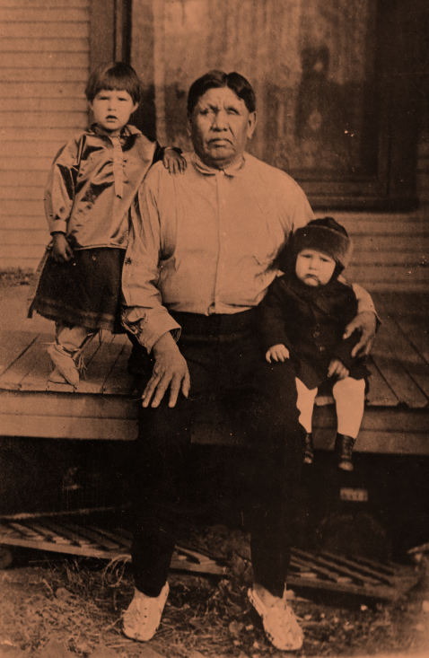
Best Practice: Inquiry
If a child is moving into permanency on the adoption track and the records do not show if the child is Indian or may be Indian, ask the question before proceeding with the adoption.
The Brolier Family (Osage)Grandpa, Frannie & Freddie
Permission , the Brolier family
38
Notes:
38

Slide 39
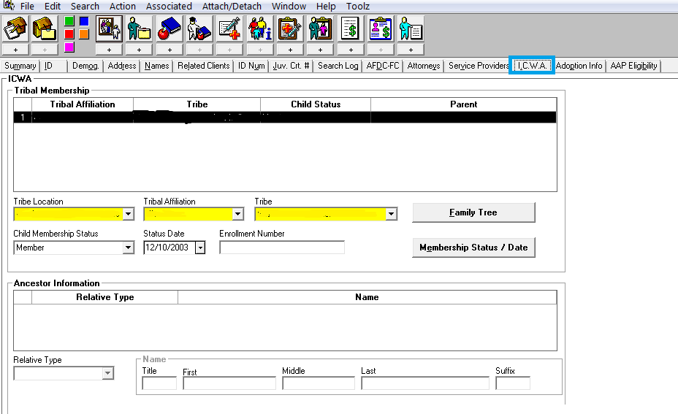
Inquiry
39
Notes:
39

Slide 40
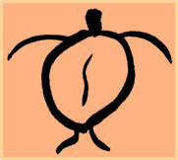
Inquiry Resources
“Reasons Why People Don’t Claim Indian Heritage” Participant’s Workbook and on Judicial Council website.
Genogram or family tree
The child’s Tribe or Tribes
ICWA 030 form
40
Notes:
40

Slide 41
Inquiry at a Glance
Disproportionality cannot be reduced if we do
not identify each Indian child in our care.
It’s better to state rather than ask “If you are
American Indian/Alaska Native there may
additional services available to you.”
Continue to ask throughout the life of the case.
41

Slide 42
Notice: Its Importance
Allows a Tribe to determine whether a child is an Indian child
Advises the Tribe of the pending proceedings and ensures the Tribe an opportunity to assume jurisdiction or intervene in the proceedings
Without notice to the Tribe, the intent and underlying policy of ICWA are undermined
42
Notes:
42

Slide 43
Notice: Who Receives What
Notice must be provided when there is reason to know a child is an Indian child.
Sent to parent, guardian, Indian custodian; all Tribes to which the child is a member or eligible for membership (see Federal Register and CDSS listing); Bureau of Indian Affairs (Sacramento, CA) and Secretary of the Interior, Washington, D.C.
Includes a copy of the petition (including, as a matter of practice, completed ICWA 010 form) and completed ICWA 030 form
43
Notes:
43

Slide 44
Notice
Sent registered or certified mail, return receipt requested
Must be received at least 10 days prior to the hearing (except for detention hearings)
Must be sent again if information is received that was not previously provided
44
Notes:
44

Slide 45
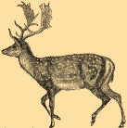
Best Practice
Complete every section of the ICWA 030 form. If, after asking, you are unable to obtain information, write “information unavailable” on the form.
45

Slide 46
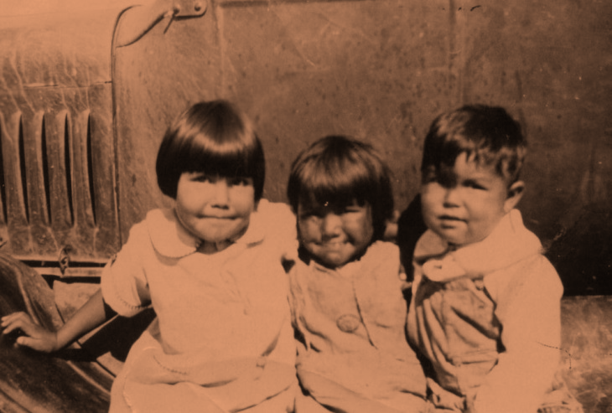
Notice at a Glance
Required when there is reason to know an Indian child is involved
Must notice all Tribes in which a child is a member or may be eligible for membership
Soboba Children, Courtesy Soboba Band of Luiseno Indians Cultural Center
46

Slide 47
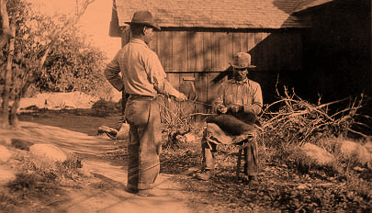
Skill-Building Activity: Inquiry and Notice
Maintaining the culture. Two Indian men making rope.
47
Notes:
47

Slide 48
Active Efforts
ICWA requires any party seeking to effect foster care or the termination of parental rights to satisfy the court that active efforts have been made to provide remedial services and rehabilitative programs designed to prevent the breakup of the Indian family and that these efforts were unsuccessful.
48
Notes:
48

Slide 49
What Are Active Efforts?
Affirmative, thorough, active and timely efforts intended to maintain or reunite an Indian child with his or her family.
Should be conducted in partnership with the Indian child, the child’s parents, extended family, Indian custodians, and the Tribe.
Should be provided to the maximum extent possible in a manner consistent with the prevailing social and cultural conditions and way of life of the Indian child’s Tribe.
49
Notes:
49

Slide 50
What Are Active Efforts? (cont’d)
Must involve assisting the parent(s) or Indian custodian through the steps of a case plan.
Must involve the parent(s) or Indian custodian with developing or accessing the resources necessary to satisfy the case plan.
Tailored to the facts and circumstances of the case.
50
Notes:
50

Slide 51
Examples of Active Efforts
Inviting representatives of Indian child’s Tribe to participate in providing support and services, participate in family team meetings, safety mapping, permanency planning, and resolving placement issues.
Offering and employing all available and culturally appropriate family preservation strategies and using remedial and rehabilitative services offered by Tribe.
Considering alternative ways to address the parents’/family’s needs if the optimum services do not exist or are not available.
51
Notes:
51

Slide 52
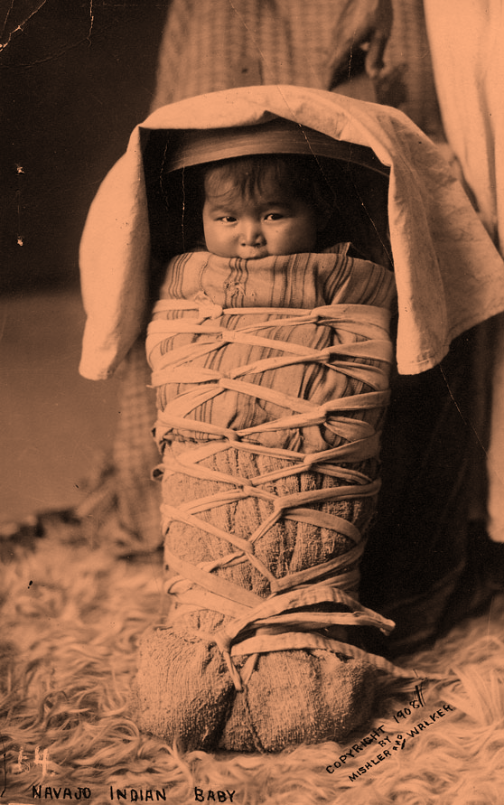
Skill-Building Activity: Active Efforts
52

Slide 53
Active Efforts at a Glance
Active efforts are intended to eliminate the need for removal.
Active efforts begin immediately if you have reason to believe this is an Indian child.
Active efforts is meant to help families believe in the process rather than become dependent.
53

Slide 54
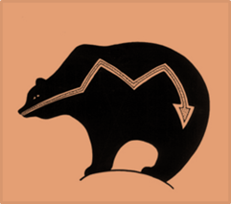
Emergency Removal
ICWA does not prevent the emergency removal of an Indian child to prevent physical damage or harm to the child.
The removal or emergency placement must terminate immediately when it no longer is necessary to prevent imminent physical damage or harm to the child.
54
Notes:
54

Slide 55
Placement
Who is extended family?
“Extended family member” shall be defined by the law or custom of the Indian child’s Tribe or, in the absence of such a law or custom, shall be a person who has reached the age of 18 and who is the Indian child’s grandparent, aunt, uncle, brother or sister, brother-in-law or sister-in-law, niece or nephew, first or second cousin or stepparent.
55
Notes:
55

Slide 56
Placement Preferences
To ensure compliance with ICWA placement
preference requirements, the prevailing social
and cultural standards of the Indian community
where the parent or extended family lives or
with which the parent or extended family
maintains social and cultural ties must be
applied.
56
Notes:
56

Slide 57
Placement Preferences: Foster Care/Pre-Adoptive
Child must be placed in:
Least restrictive setting that is most like a family setting, taking into consideration sibling attachment and allows the child’s special needs to be met, if any.
Within reasonable proximity to his or her home, extended family, or siblings.
56
57
Notes:
57

Slide 58
Placement Preferences: Foster Care/Pre-Adoptive
Extended Family
Foster care licensed, approved, or specified by Tribe
Indian foster home licensed by non-Indian licensing authority
Institution approved by Tribe or operated by an Indian organization
58

Slide 59
Placement Preferences for Adoptive (Permanent) Placements
Extended family
Tribal Member
Other Indian family
Note: There is no fourth item in the order of preference that allows for adoption of Indian children by non-Indians.
59
Notes:
59

Slide 60
Placement Preferences: Tribe
If the child’s Tribe establishes a different order of preference, the preference must be followed so long as the placement is the least restrictive setting appropriate to the needs of the child.
The court may determine if good cause exists
to deviate from the placement preferences.
60

Slide 61
Placement Preferences
Also apply whenever an Indian child is being removed from a placement for the purpose of further foster care or because they are being placed in a preadoptive or adoptive placement.
Do not apply when the Indian child is being removed from a placement to be returned to the parent or Indian custodian from whose custody the child was originally removed.
61
Notes:
61

Slide 62
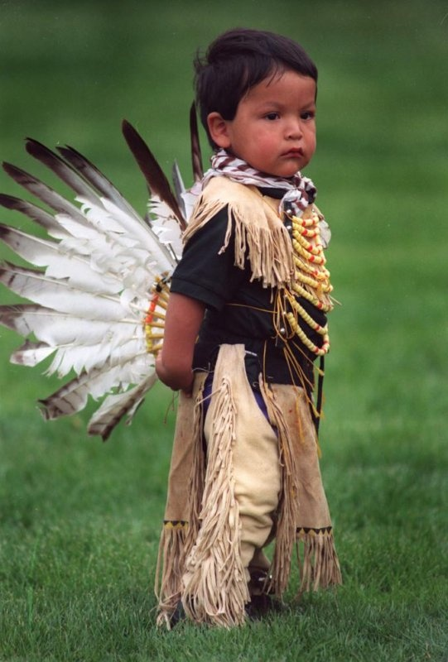
Skill-Building Activity: Placement
62

Slide 63
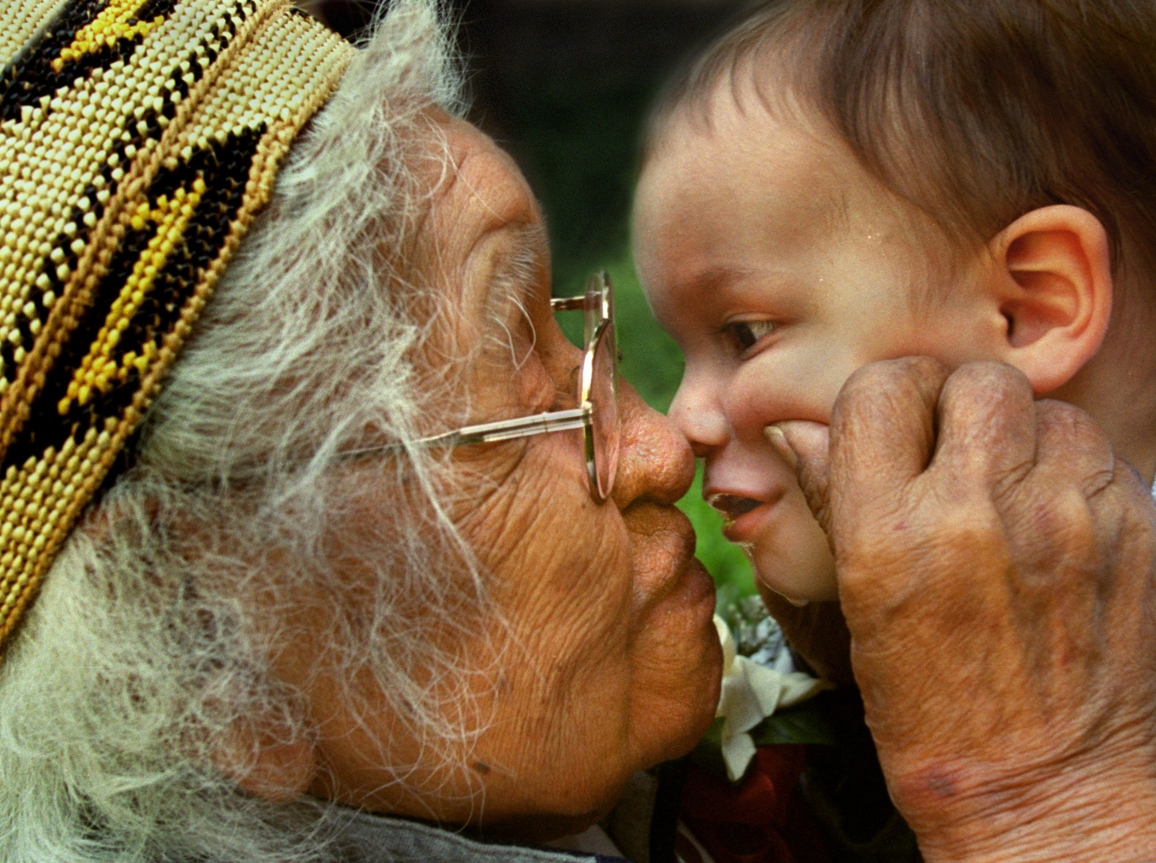
Placement at a Glance
Place with family/extended family
Work with Tribal ICWA worker to identify placement options
Photo Credit: California State Indian Museum
63

Slide 64
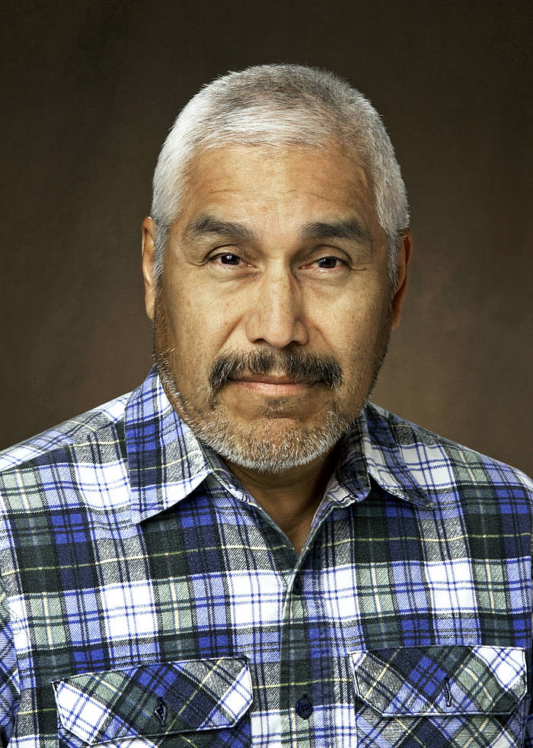
15-Minute Break
Dr. Michael Yellow Bird (Mandan, Hidatsa, Arikara)
Dr. YellowBird is recognized for his work on Indigenous Peoples’ health, leadership, and cultural rights; the effects of colonization and methods of decolonization; decolonizing social work approaches; decolonizing war and military service; neurodecolonization and mind-body approaches; neuroscience and Indigenous Peoples; traditional mindfulness and contemplative practices; ancestral and paleo eating and lifestyle; and the Rights of Mother Earth.
64

Slide 65
Indian Tribes in the U.S.
Federally recognized: The U.S. government formally recognizes the Tribal government; the federal government has legally enforceable obligations to these Tribes (567 federally-recognized Tribes)
Non-recognized or unrecognized: The U.S. government does not recognize the Tribal government; the federal government does not have legally enforceable obligations to these Tribes(approximately 400 non-recognized Tribes)
State-recognized Tribes: U.S. government does not recognize the Tribal government, but the state government does
Relationship with the federal and state governments is a government-to-government relationship, in the same way the United States relates to Mexico, or Arizona to California
Diverse structure, government process, and revenue sources through which government services are provided
65

Slide 66
Tribal Sovereignty: Child Welfare
Designate ICWA social worker or advocate as primary contact for a child dependency case
Designate ICWA representatives to receive notice of dependency proceedings involving Indian children
Complete background checks and approve foster homes for children in dependency
Define expert witness criteria
Order Tribal Customary Adoption
66

Slide 67
Engagement and Teaming with Tribes
When working and communicating with Tribes, show the same level of respect and professionalism as you would to a governor of a neighboring state. Tribal representatives are representatives of a sovereign government.
As soon as you are aware your case is or may be an ICWA case, contact the appropriate Tribal ICWA social worker or advocate. Develop and maintain a relationship with the ICWA social worker or advocate before you need them.
If it is necessary to visit the reservation, contact the social worker to ask permission and for the appropriate protocol for a visit. It is not advised to visit the reservation unannounced.
Meaningfully consider the Tribe’s input in the same way you would any other collaborative partner. You and the Tribe want the best outcome for the child.
Attempt to resolve the case informally before bringing the case before the court. Collaborative efforts result in better outcomes for the child and family, and fewer wasted resources.
67

Slide 68
Concurrent Planning
Tribes hold legal rights under ICWA and can influence many aspects of a dependency case.
Partnership with Tribes is key to effective child welfare practice and ICWA compliance.
Successful partnerships begin with early engagement and meaningful consultation.
Consultation required as soon as concurrent planning begins (which is as soon as child is removed).
68

Slide 69
Concurrent Planning (cont’d)
Under California law, permanency options for an Indian child include guardianship, adoption and, under California ICWA, Tribal customary adoption.
Tribal customary adoption (TCA) is adoption by and through Tribal custom, traditions, or law of an Indian child’s Tribe.
69

Slide 70
Tribal Customary Adoption (TCA)
Available as an option as soon as the child is confirmed to be an Indian child.
Termination of parental rights is not required under TCA.
Only the Tribe may choose TCA; Tribes are not required to choose TCA.
Tribes do not have to commit to TCA until the 366.26 hearing.
The Tribe issues the TCA order, not the state court.
70

Slide 71
TCA: General Process
TCA selected, state court orders TCA as preferred plan, Tribe takes the lead on the next steps.
Tribe has 120 days to complete TCA home study, background checks and issuing and filing TCA order (a continuance can be requested).
State court recognizes TCA order (affords full faith and credit).
71

Slide 72
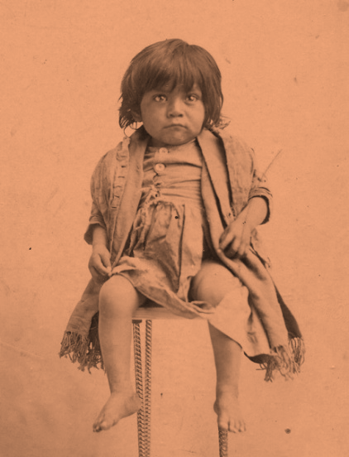
TCA: General Process (cont’d)
TCA placement
Adoption petition filed
Finalization hearing set
Adoption/Dependency terminated
72

Slide 73
TCA: Practice Reminders
Must consult with the Tribe about an appropriate permanent plan as soon as concurrent planning begins.
Must inform the court at disposition TCA was discussed and the Tribe’s choice if one has been made.
Must consult with the Tribe and report to the court at every hearing from disposition until 366.26 that consultation has occurred and the Tribe’s permanent plan choice, if one has been made.
Must work in consultation with the Tribe to minimize unnecessary placement disruptions.
Facilitate placement, and supporting the adoptive parents through the adoption assistance agreement.
Submit a final report to the court regarding the TCA for the finalization hearing.
73

Slide 74
Best Practice: Concurrent Planning
Make sure to consult with the Tribe when preparing each court report to confirm their choice of permanent plan has not changed.
The Brolier Family (Osage)Grandpa, Frannie & Freddie
Permission , the Brolier family
74
Notes:
74

Slide 75
Concurrent Planning at a Glance
Early and meaningful consultation is the key to successful partnerships with Tribes.
Remember to inform family and Tribe of Tribal customary adoption as an option early in the case.
TCA may only be chosen by the Tribe; the TCA order is issued only by the Tribe.
75

Slide 76
Qualified Expert Witness
Diminishes risk of bias in decision-making
Testifies when a child must be removed or when parental rights must be terminated:
Testifies as to whether the continued custody is likely to result in serious emotional or physical harm to the child
Testifies about the Tribe’s culture
May also testify on placement and active efforts
76

Slide 77
Qualified Expert Witness
Must be qualified to testify regarding whether the continued custody by parent or Indian custodian is likely to result in serious emotional or physical damage to the child
Should have knowledge of prevailing social and cultural standards of the Indian child’s Tribe
Cannot be an employee of the person/agency recommending foster care placement or termination of parental rights
77

Slide 78
Who Is a Qualified Expert Witness?
A member of the child’s Tribe who is recognized by the Tribal community as knowledgeable in Tribal customs as they pertain to family organization and child-rearing practices
Any person having substantial experience in the delivery of child and family services to Indians, and extensive knowledge of prevailing social and cultural standards and child-rearing practices with the child’s Tribe
A professional person with substantial education and experiences in the area of his or her specialty
May include: social worker, sociologist, doctor, psychologist, traditional Tribal therapist and healer, Tribal spiritual leaders, Tribal historian, or Tribal elder
78

Slide 79
When to Contact Qualified Expert Witness?
At the outset of the case in consultation with the Tribe
The court or agency may request help of the Tribe or BIA in locating witness
Link to list of expert witnesses statewide:
http://www.courtinfo.ca.gov/programs/cfcc/programs/description/jrta-ICWAExpertWitness.htm
79

Slide 80
Qualified Expert Witness at a Glance
Document all your efforts related to inquiry, notice, active efforts, and placement.
Work with the child’s Tribe to identify a qualified expert witness at the outset of the case.
Look for qualified expert witnesses that have extensive knowledge and understanding of Tribal culture, in particular child-rearing practices and family and Tribal structure.
80

Slide 81
ICWA’s Five Provisions
Inquiry & Notice
Active Efforts
Placement
Concurrent Planning
Qualified Expert Witness
81
Notes:
81

Slide 82
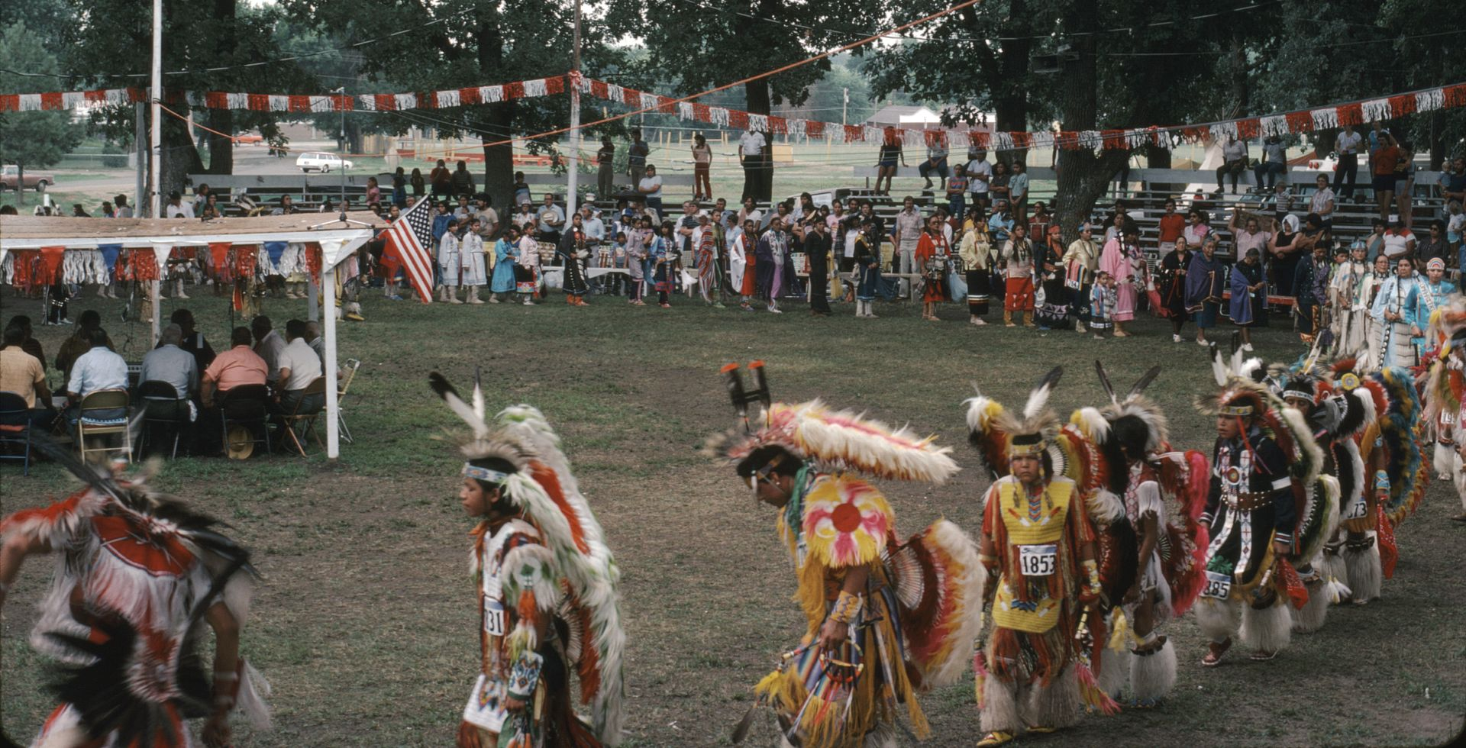
What stands out from today?
82

Slide 83
Best Practice
Assume that the child is an Indian child unless and until there is information indicating otherwise.
83
Notes:
83

Slide 84
Best Practice
Document clearly and objectively all of your efforts, but especially those related to inquiry, notice, active efforts, and placement.
84
Notes:
84

Slide 85
Best Practice
If a child must be enrolled in order to be considered a member, the social worker should assist the family and child in completing required paperwork and engaging in the enrollment process.
85
Notes:
85

Slide 86
Best Practice
Follow the Spirit of ICWA. Ensure access to culturally appropriate services and facilitate ties between the child, extended family and Tribe when the child is not eligible for membership in a federally recognized Tribe or when the child’s Tribe is an unrecognized Tribe.
86
Notes:
86

Slide 87
Best Practice
Complete every section of ICWA 010 and 030 forms. If, after asking, you are unable to obtain information, write “information unavailable” on the form.
87

Slide 88
Best Practice
Make sure to consult with the Tribe when preparing each court report to confirm their choice of permanent plan has not changed.
The Brolier Family (Osage)Grandpa, Frannie & Freddie
Permission , the Brolier family
88
Notes:
88

Slide 89
Best Practice
As soon as possible, engage with Tribal social workers, ICWA agents and advocates and develop relationships that support appropriate decision-making to ensure ICWA compliance.
89

Slide 90
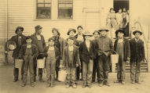
Post-Evaluation and Closing
90

Slide 91
Thank you for working towards improved outcomes
for Native American
foster youth!
91

