Slide 1
One big party?
CC BY Puyallup School District, adapted from iCivics content

Slide 2
It’s a party…
Political Party: an organized group of people who share similar views and seek to influence government
Political views: How someone thinks the government should run and how problems should be solved
Fight for political power by supporting candidates
Influence all levels of government
Gives people more power to influence government than by acting alone

Slide 3
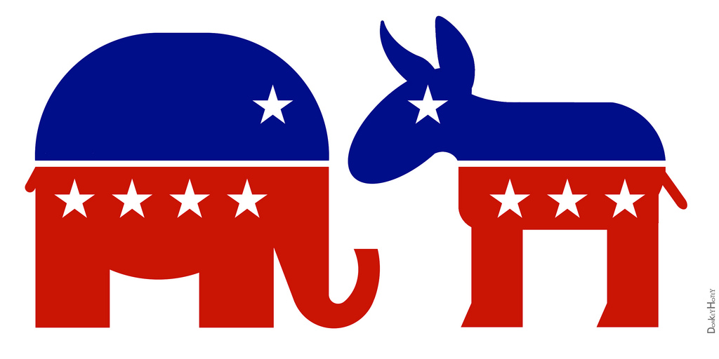
The big two
Two dominate parties: Republicans and Democrats
Technically a multi-party system
R + D so powerful that most elected officials belong to one or the other
Most Americans identify as R or D
Politically independent: not affiliating with any political party
40% of Americans identify as such
Most end up learning Republican or Democrat
More likely to support candidates from either/both party
Republican Elephant and Democratic Donkey, by DonkeyHotey; Flickr

Slide 4
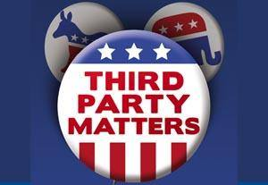
Third Parties
Ballot Access: the process of getting on the ballot in each state differs
Often need a certain number of signatures of voters
Minor parties have less support and have a harder time getting on the ballot
R + D have ballot access in every state
Libertarians (largest minor party) is usually able to get ballot access in 30+ states
2015: Green Party ballot access in 20 states, Constitution Party in over 10
Public Domain American Party of South Carolina 10649622 190538471116490 6910021203168239049 n.jpg
Created: 31 December 2013

Slide 5
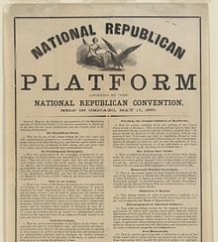
The party platform
Platform: a document that describes the party’s views on all the major issues facing the nation
Set of beliefs that the party “stands” on
Republicans and Democrats tend to have simple platforms to attract as many voters as possible
“Better Education” or “More Jobs” – but platform explains how they want to do this
The party website explains their platform
National republican platform. Adopted by the National Republican Convention, held in Chicago, May 17, 1860.jpg Created: 17 May 1860

Slide 6
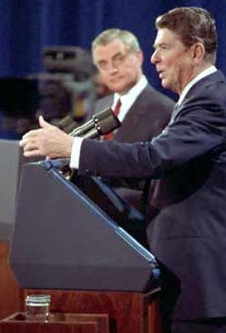
Political parties support candidates
Candidates: people running for political office
Almost always declare themselves member of a party
Gains support from the party
Easier for voters to figure out where they stand on issues
Parties help candidates run get elected
Raising money, campaigning, educating voters, urging members to vote
First General Election Debate, 1984; on Wikicommons

Slide 7
Political parties work inside government
Each official has their own views, the laws, and solutions they support align with their political party’s platform
At the national level and most states the balance between R + D determines which laws get passed
Majority party: the one of the most elected members
can most easily influence laws
Minority party: the party with less elected members
Tries to influence by forcing compromise
America First Party, Libertarian Party, Green Party logos; from Wikicommons

Slide 8
Political parties work inside government
WA Gov. Inslee
The executive (President, Governor, etc) also belongs to a party
Policies usually align with their party and works to advance the party goals
Doesn’t make policies but helps develop and shape them for their party
Public Policy: the way the government will handle issues
If the executive and legislative branch are in different parties they may work against each other (vetos, overriding vetos, etc)
Rep. DelBene
Sen. Murray
Snohomish County, Wash., April 6, 2014 -- Regional Administrator Ken Murphy, Senator Patty Murray, Governor Jay Inslee, Congresswoman DelBene, Senator Maria Cantwell, Department of Homeland Security Secretary Jay Johnson, and County Executive John Lovick are briefed on the details of the SR530 Slide and current recovery operations; on Wikicommons

Slide 9
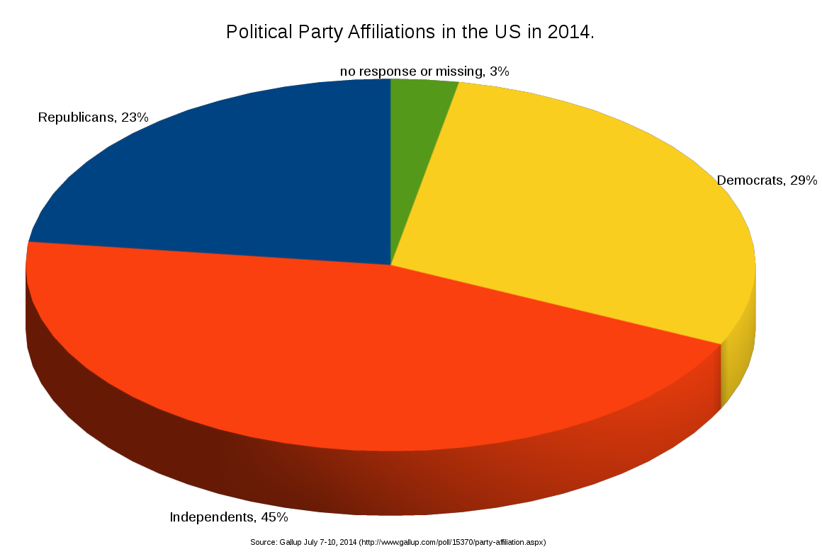
Political parties and you
During elections parties work to influence voters by distributing information about candidates and issues
Look at fine print on TV and print ads; some are paid for by parties
All information they produce is biased towards their candidates
You can join a political party, but don’t have to
Can still vote for any candidate you want
Some states won’t let you participate in primary elections or caucuses if you are not a member of the party
Political Party Affiliations in the US, 2014; on Wikicommons

Slide 10
Attributions
Adapted from the One Big Party? Lesson and reading
Statement from iCivics:
iCivics does not take issue with instructional, non-profit use of our materials as it pertains to our product copyright. You are free to copy, distribute, and transmit iCivics materials so long as you credit the work to iCivics, Inc. and include our website: www.icivics.org.

