Slide 1
The Electoral Process
CC BY Puyallup School District, adapted from content by iCivics

Slide 2
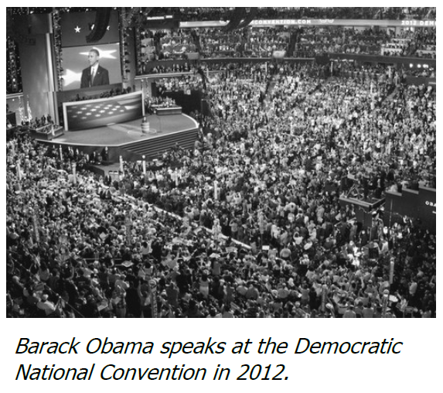
It’s Election Time!
Presidential Election every 4 years
Debates between candidates
Road trips talking to voters
Ads on TV, Radio, and in the mail
Step one: declare that you are running
Need support, $$, and attention from voters

Slide 3
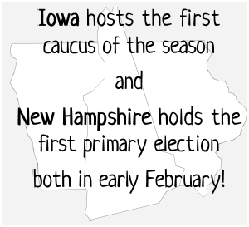
Narrowing the Field
Conventions: Political parties meet to decide who their candidates will be
Local, state, and national levels
Two ways to select delegates
Caucus system: people meet in groups to discuss and reach a consensus on the nominee
Primary election: people use a ballot to vote for the person they want to be the nominee
Delegates: representatives selected to represent a group
Pledged to vote for the candidate selected by their state political period

Slide 4
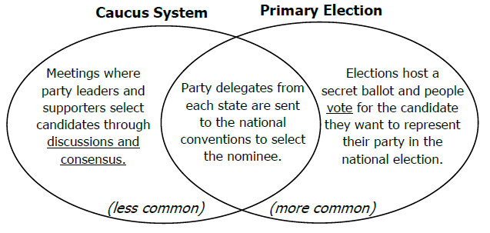
Narrowing the Field

Slide 5
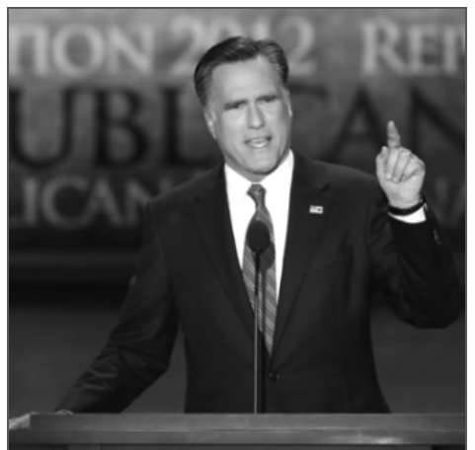
And the Nominee is…
Conventions are held in large arenas with balloons, confetti, funny looking hats, lots of media coverage
Delegates discuss candidates, listen to speeches, create party platform
Votes are cast to select nominee
Nominee: the person selected to run in the national election
Acceptance speech: nominee official accepts support, outlines goals, tries to unit party

Slide 6
On the Campaign Trail
Time between official nomination and general election is 4-5 months
Fundraising becomes more important
Need to get their message out to voters
Parties help with these activities and paying for some

Slide 7
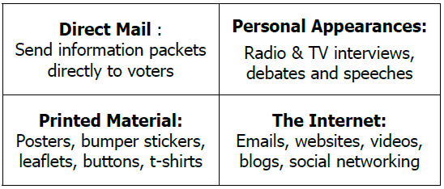
Get the Word Out!
Campaign: process of gathering public opinion and support for an issue or candidate
Several ways to connect with voters

Slide 8
Election Day!
Election day is in November
Media reports results as polls close
Popular Vote: the person who gets the most votes in a contest
many positions selected this way – not the president

Slide 9
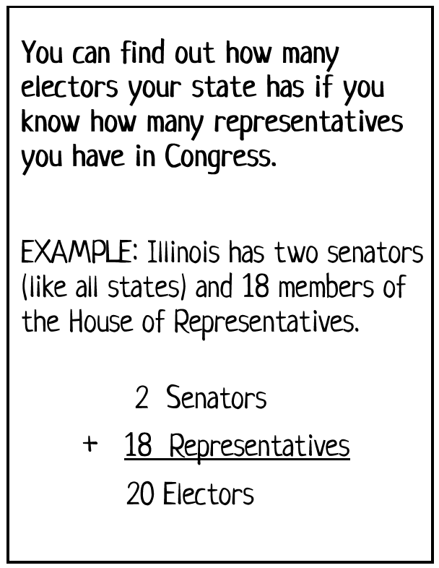
The Electoral College
Electoral College: each state select electors who cast a ballot for the president
Elector: selected representatives; often selected by party that wins the popular vote
Electors meet in state capitols in December
Cast 2 ballots; one for President and one for Vice President
President of the Senate counts votes
538 electors total; need 270 votes to win
Absolute majority: more than half
Jan 20 is when President/Vice Presidents take oath of office

Slide 10
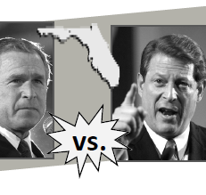
The Electoral College
Tie? No one gets 270?
House of Representatives decides President
Senate decides the Vice President
If no decision by inauguration day – Speaker of the House!
Elections of 1800 and 1824 were resolved by Congress

Slide 11
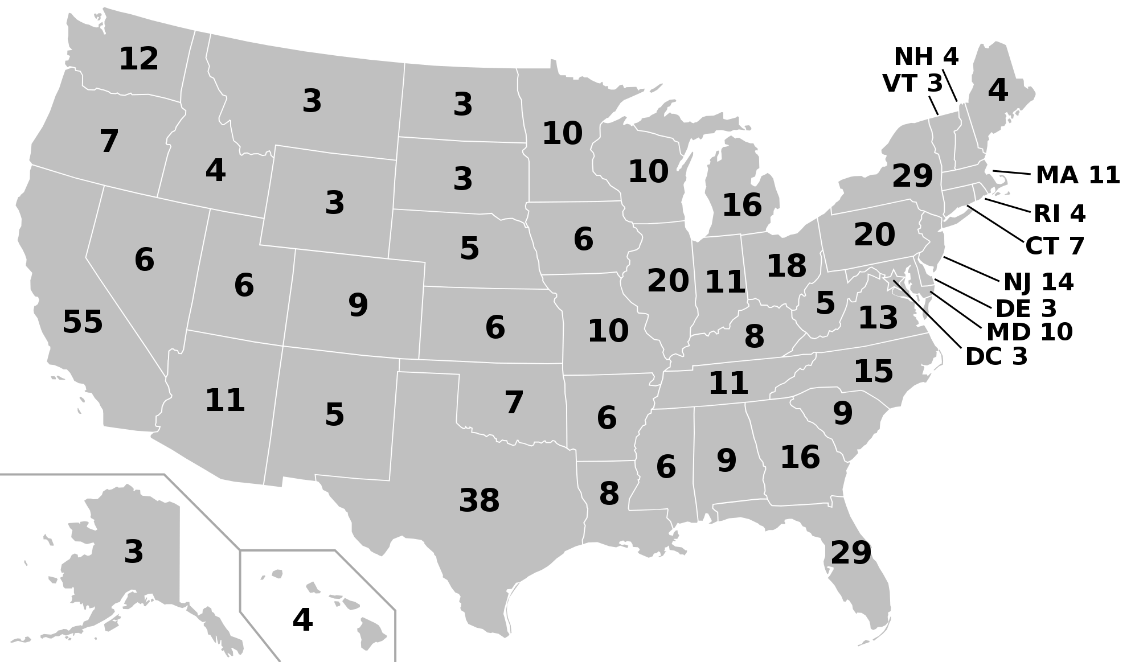
MB298, Public Domain, Wikicommons

Slide 12
Attributions
Adapted from the Electoral Process Lesson and reading
Statement from iCivics:
iCivics does not take issue with instructional, non-profit use of our materials as it pertains to our product copyright. You are free to copy, distribute, and transmit iCivics materials so long as you credit the work to iCivics, Inc. and include our website: www.icivics.org.

