Slide 1
Safe Guarding Civil Liberties

Slide 2
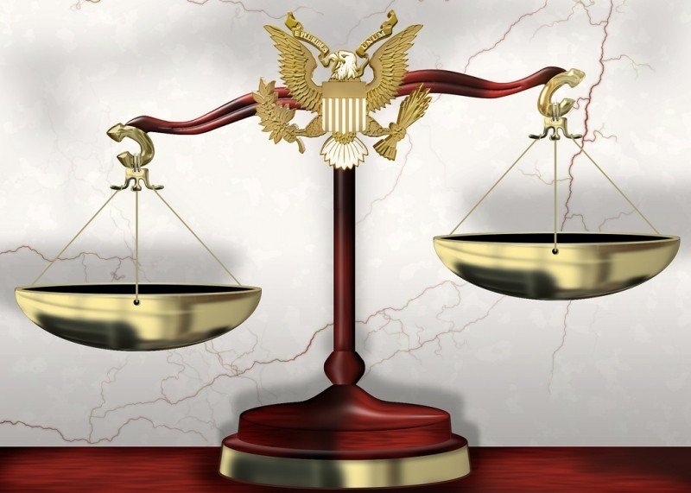
Introduction
Civil Liberties and Civil Rights are different
Most come from Bill of Rights
Civil Liberties often conflict with other Civil Liberties
Balance between liberties and order
Photo by DonkeyHotey on TrendHype / CC BY

Slide 3
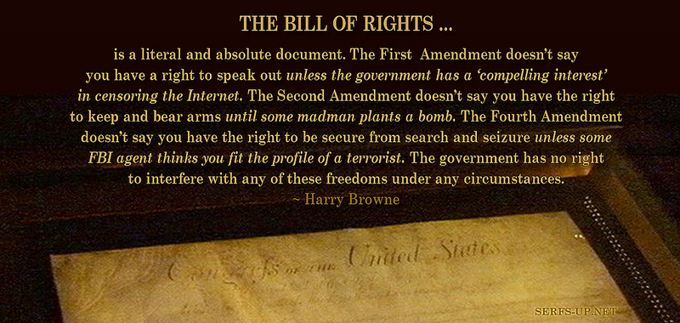
Bill of Rights
1st 10 Amendments
1st lists several rights that protect civil liberties
Freedom of speech, press, association, practice one’s own religion
Protected against government restriction and interference of others
Balance conflicting rights for the public good of all citizens
Photo by Serfs UP ! Roger Sayles on Trend Hype / CC BY-ND

Slide 4
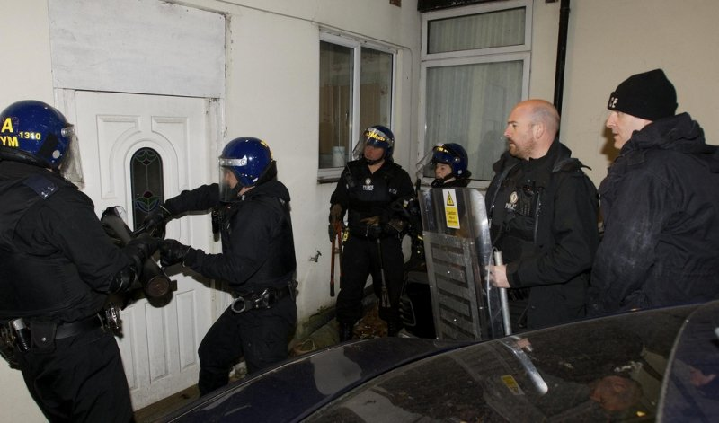
Bill of rights
Designed to protect from government, even when popular majorities at the local, state, or national level vote to restrict them
4th – stops unreasonable search and seizure and requires warrant
1st – freedom of speech, press, peaceful assembly, petition for a redress of grievances, individual/group exercise of religion, prohibits promotion of any religion
Photo by West Midlands Police on TrendHype / CC BY-SA

Slide 5
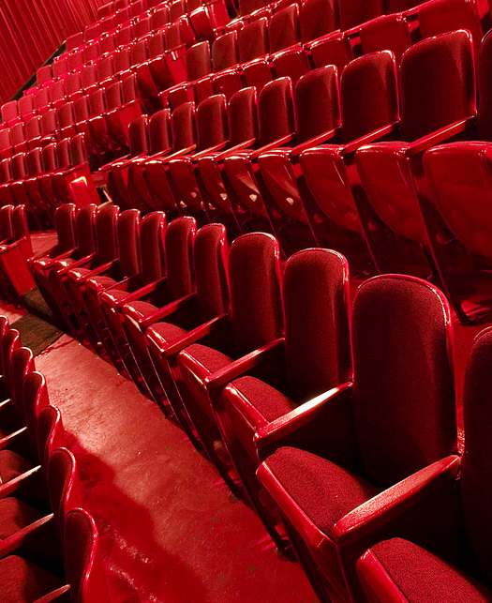
First amendment
Rights are not considered absolute; must be weighed against other rights or issues
Can limit someone’s right to shout “fire” in a crowded theater and cause a stampede, or “bomb” in an airport
Photo by JSmith Photo on Trend hype / CC BY-ND

Slide 6
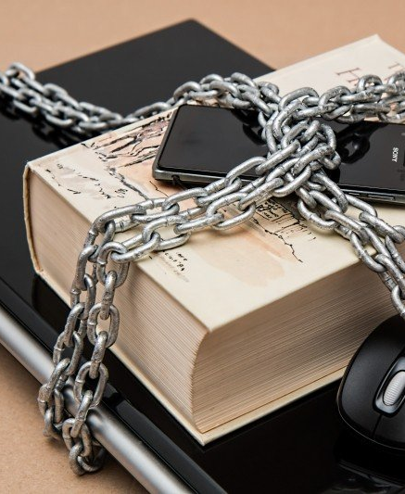
First Amendment
Weighing speech vs. public safety has led to several tests
“clear and present danger” speech may be restricted
“bad tendency” speech that could cause indirect and future danger may be restricted
Media may be prevented names of accused from being released to ensure right to a fair trial is kept intact
Photo on Foter.com

Slide 7
Fourth through sixth amendments
Relate to the rights of the accused and criminal procedures
4th – explores what is a “reasonable” search, proper warrants, “probable cause” that a crime was committed, what is appropriated to be searched
Photo by West Midlands Police on TrendHype / CC BY-SA

Slide 8
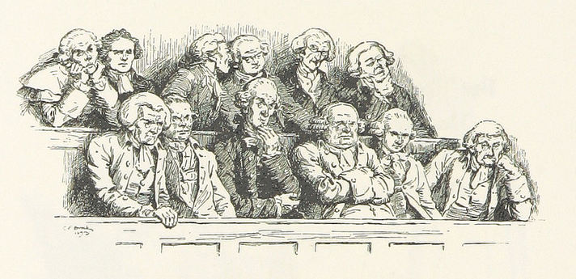
Fourth through sixth amendments
6th – accused have right to “speedy and public trial, by an impartial jury”
Often have to decide what information can be made public, what evidence can be used, who will be on a jury, sentencing guidelines
Photo by The British Library on Trendhype / No known copyright restrictions

Slide 9
Attributions
Images – see captions for sources
Content: based on content from Annenberg Learning, Annenberg Foundation http://www.learner.org/courses/democracyinamerica/dia_4/dia_4_ct.html

