Slide 1
American Government
Unit 2: Civil Rights & liberties
This work is adapted from The Independence Hall Association is licensed under a Creative Commons Attribution 4.0 International License.
From <http://www.ushistory.org/gov/1b.asp>

Slide 2
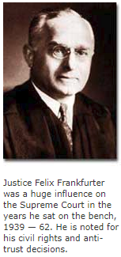
Introduction
Protection of civil liberties and civil rights most fundamental political value
Tested in our courts, often by less than ideal citizens

Slide 3
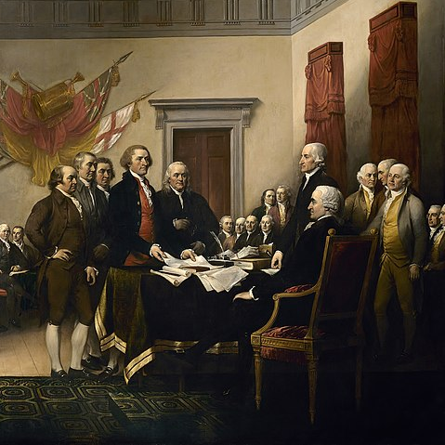
Liberties or rights?
Both appear in the Declaration of Independence and the Bill of Rights
Often used interchangeably
Civil Liberties: protections against government action
Civil Rights: actions the government should take to ensure equal conditions
Signing of the Declaration of Independence; Wikicommons

Slide 4
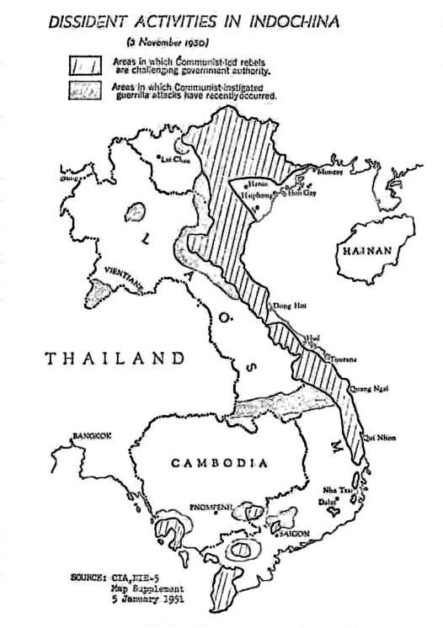
Right vs. Right
Rights are not absolute – often rights are in conflict
1971 Pentagon Paper
New York Times published negative actions of the US government
Government sued, claimed national security violation
NYT claimed freedom of the press
Supreme court upheld the rights of the press
Map of dissident activities in Indochina published by the New York Times; WikiCommons

Slide 5
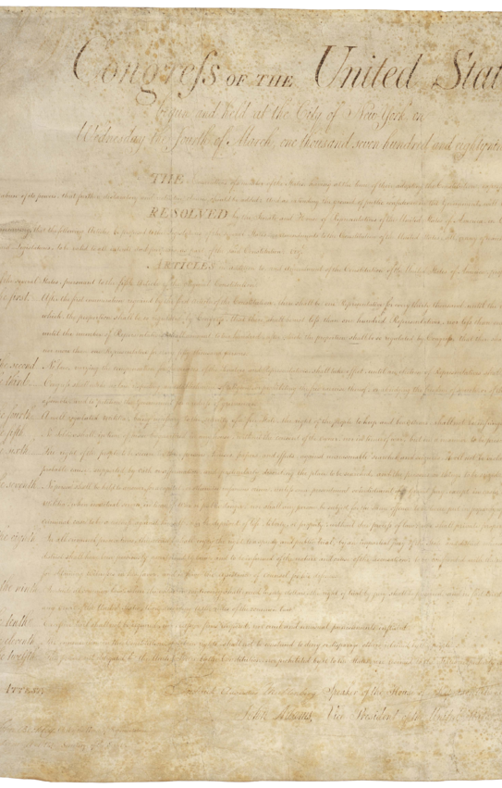
The Bill of Rights and the 14th Amendment
Most cases about civil rights are based on Bill of Rights
Two broad areas
First Amendment: religion, speech, press, assembly, and petition
Liberties and Rights associated with crime and due process
Bill of Rights; Wikicommons

Slide 6
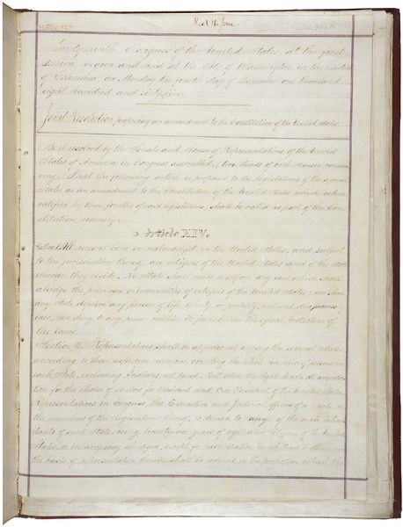
The Bill of Rights and the 14th Amendment
14 Amendment protects against violation of rights and liberties by state governments
Protection of civil liberties and civil rights is basic American political value
Protecting one right may involve violating the right of another
Court cases and decisions continually redefine where these lines are
14th Amendment; Wikicommons

Slide 7
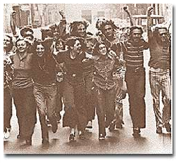
Rights and Responsibilities of citizens
“Equality” is not mentioned in the Constitution or Bill of Rights
Goals of early US government more centered on liberty
Stonewall Riot, 1969

Slide 8
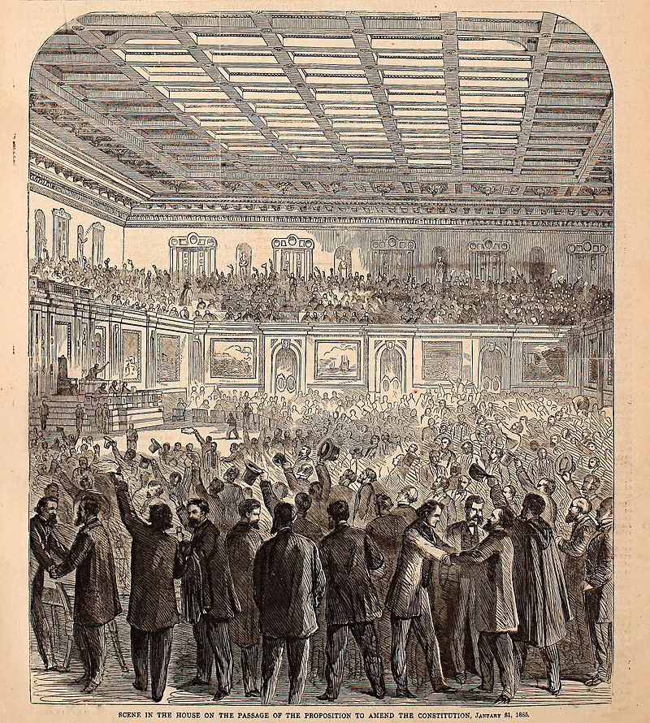
Civil Rights in early national history
In early history most civil rights (voting, owning property) reserved for white males
Constitution counted African Americans slaves as 3/5th of a person until 13th Amendment
15th Amendment gave African American men the right to vote
Harper’s Weekly cartoon showing celebration in the House after the 13th Amendment; Wikicommons

Slide 9
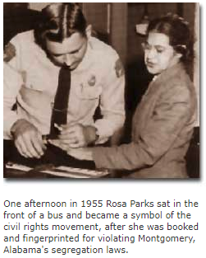
Civil Rights in early national history
14th Amendment "No State shall ... deny to any person within its jurisdiction the equal protection of the laws.“
Jim Crow laws enacted in the South legalized and enforced segregation
Plessy v. Ferguson – challenged and lost; said that separate was ok as long as facilities were equal
Amendment was not applied for more than 50 years

Slide 10
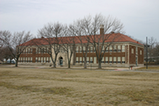
Modern Civil Rights Movement
1954 – Brown v. Board of Education of Topeka
Overturned separate by equal doctrine
NAACP argued the case
Monroe Elementary School; Wikicommons

Slide 11
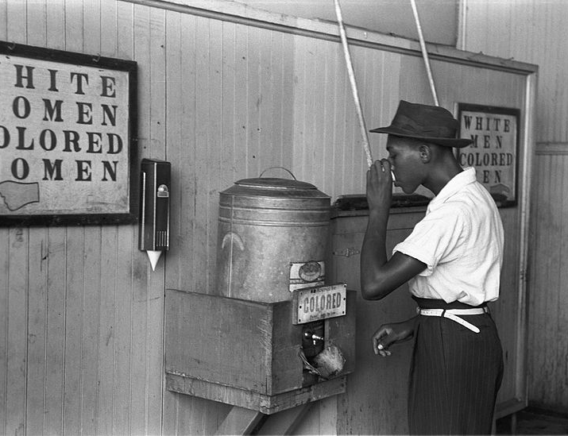
Modern Civil Rights Movement
Early Civil Rights movement was focused on African Americans
MLK Jr’s leadership helped bring issues to forefront
Nonviolent protests, demonstrations, sit-ins, boycotts spurred Government to act
Civil Rights Act of 1964
Voting Rights Act of 1965
End of de jure segregation (legally enforced segregation)
De facto segregation is still remained
“Colored” drinking fountain from mide-20th century; Wikipedia

Slide 12
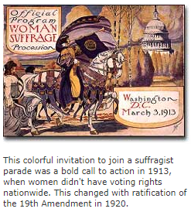
Civil Rights for Women
Won the right to vote in 1920 (19th Amendment)
1848 – Seneca Falls Convention
1960s focus on ‘women’s liberation’
National Organization for Women (NOW) focused on eliminating gender discrimination in work and school
Demanding equal rights for owning property, divorce, equal pay for equal work, access to male dominated professions
Equal Rights Amendment failed to get added to the Constitution

Slide 13
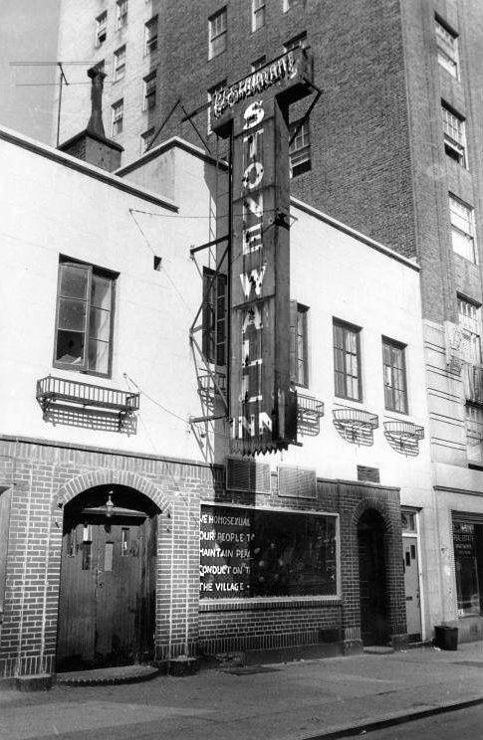
Equal rights for all Americans
Inspired by the success of movements for African Americans and women, others also sought increased civil rights
Latinos, the elderly, the disabled, homosexuals
14th Amendment guaranteed “equal protection of the law” more than 130 years ago
Took all 3 branches, active interest groups, and concerned citizens
Stonewall Inn, site of 1969 riots; Wikicommons

Slide 14
"Congress shall make no law respecting an establishment of religion, or prohibiting the free exercise thereof; or abridging the freedom of speech, or of the press; or the right of the people peaceably to assemble, and to petition the government for a redress of grievances."
-First Amendment to the Constitution

Slide 15
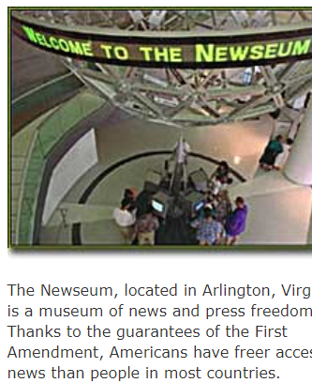
First amendment rights
Several basic liberties
Freedom of religion, speech, press, petition, and assembly
Court case after court case have redefined its interpretation

Slide 16
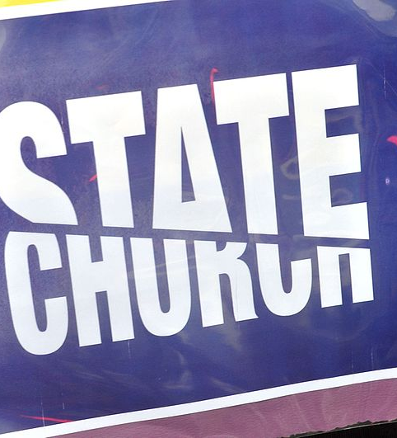
Freedom of Religion
Two clauses
Establishment clause – prohibits the government from having an official religion
Free exercise clause – allows people to worship as they please
“separation of church and state” – not in the Constitution
Coined by Thomas Jefferson in 1802
Sign from NWomen’s March 2017; Wikicommons

Slide 17
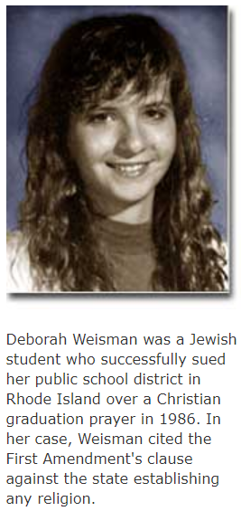
Freedom of Religion
Precedent: cases have addressed both parts of the 1st amendment
Rejecting prayer in public schools
Denying governmental aid to parochial schools
Banning polygamy
Restricting poisonous snakes and drugs in religious rites
Limiting the right to decline medical care for religious purposes

Slide 18
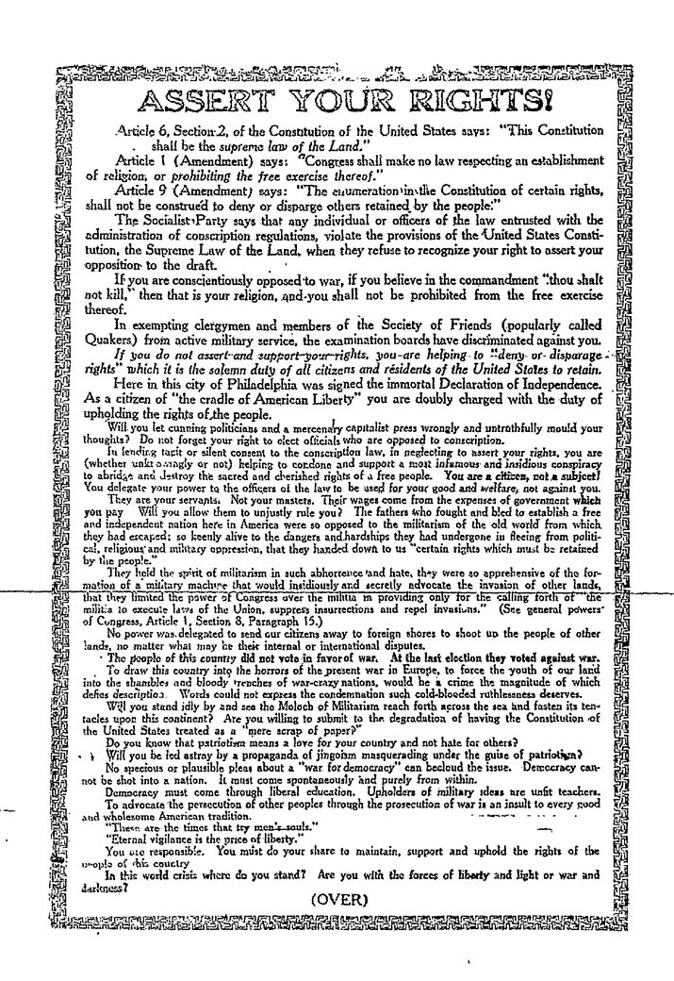
Freedoms of speech and of the press
Freedom of speech often conflicts with other rights and liberties
Courts have tried to answer “what are the limits of free speech?”
Schenck v. the United States – Clear and Present Danger Test
Speech could be limited if it poses a clear and present danger to United States Security
Leaflet passed out by Schenck; Wikicommons

Slide 19
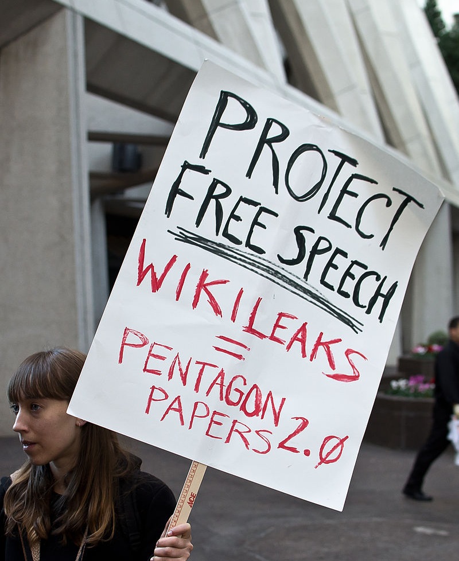
Freedoms of speech and of the press
Three types of free speech:
Pure speech – verbal expression of thoughts and opinions before a voluntary audience
Strongly protected by the Supreme Court
Speech-plus – involves actions such as demonstrating or protesting in addition to words
Not as protected; actions can be dangerous
Limits on protesters obstructing traffic, endangering public safety, or trespassing illegally
Wikileaks Protester; Wikicommons

Slide 20
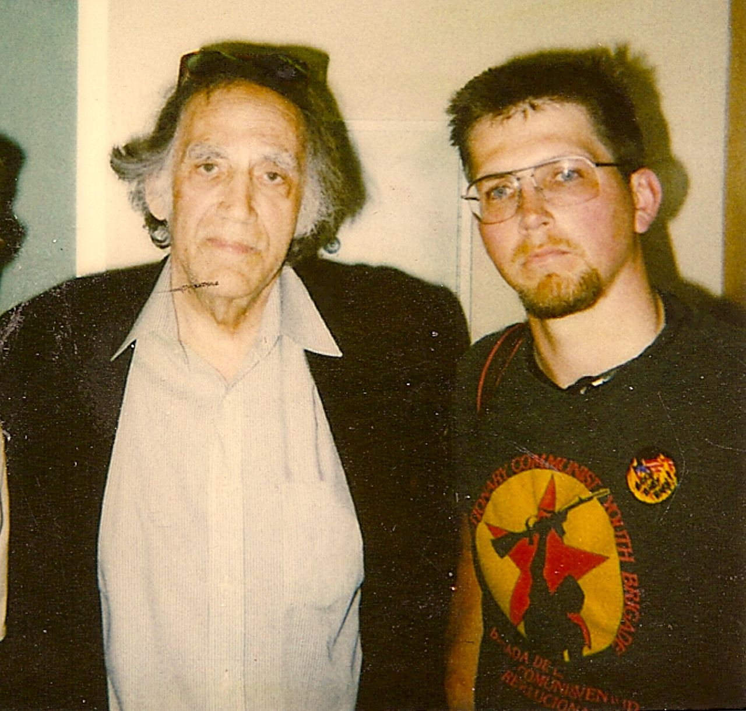
Freedoms of speech and of the press
Symbolic speech – symbols the courts determined to be forms of free expression
Tinker v. Des Moines – students wore black arm bands to school to protest war; upheld
Texas v. Johnson – burned the American Flag in protest of presidential politics; upheld
Similar protections for the press
Prior restraint – the government cannot censor information before its written/published
Except in most extreme cases of national security
Gregory Lee Johnson (right) and his lawyer; Wikicommons

Slide 21
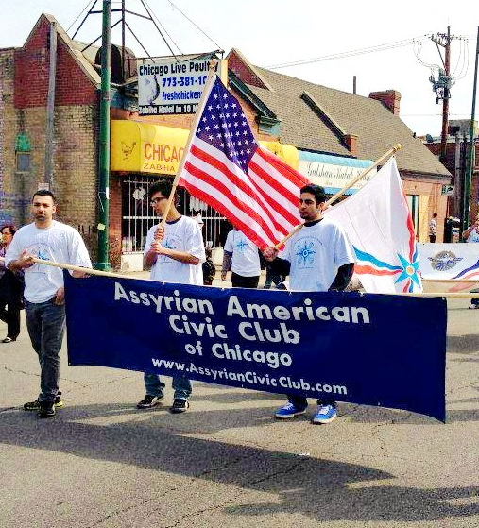
Freedom of assembly and petition
Freedom of Assembly and petition are similar to freedom of speech and have had similar protections
Former Chief Justice Charles Evans Hughes wrote, "Peaceable assembly for lawful discussion cannot be made a crime.“
Balanced with others rights if it disrupts public order, traffic flow, ability to go about normal business
Must apply for permit, must be granted if the government has the means to prevent major disruptions
Assyrian American Civic Club of Chicago; Wikicommons

Slide 22
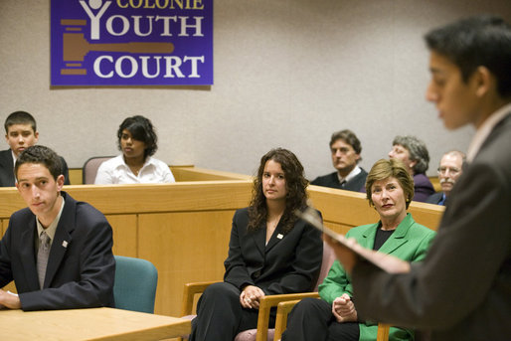
Crime and Due process
Americans are often interested in trials; the crime, the arrest, the verdict
Constitutional Basis for those accused of crimes
4th, 5th, 6th, and 8th amendments
Former First Lady Laura Bush observing a mock trial; Wikicommons

Slide 23
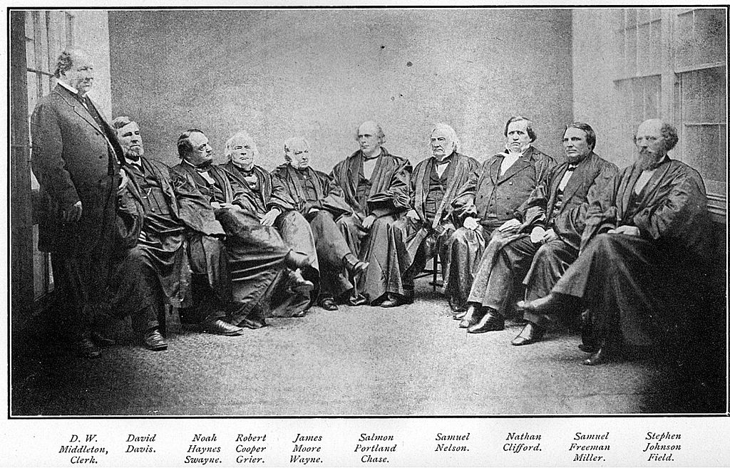
The principle of due process
Laws should be applied fairly and equally to all people
5th Amendment stops the federal government from depriving anyone of “life, liberty, or property, without due process of law”
14th Amendment stops the state government from doing the same
Supreme Court of US, circa 1866; Wikicommons

Slide 24
Searches and seizures
4th Amendments prevents “unreasonable” searches and seizures
Police may search:
Persons arrested
Things in plain view of the accused person
Places or things that the arrested person could touch, reach,, or in the person’s “immediate control”
Property where there is a strong suspicion of immediate danger
San Francisco police searching a car; Wikicommons

Slide 25
The Fifth Amendment
Citizens accused of a serious crime must be indicted by a grand jury
Forbids double jeopardy
Protects from self-incrimination
Right to remain silent
Due Process of law before depriving of life, liberty, property
Exclusionary Rule – evidence that is obtained illegally cannot be used in trial
Photo by Elvert Barnes on TrendHype / CC BY

Slide 26
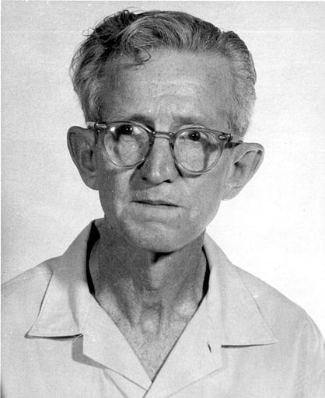
The 6th amendment and right to a counsel
Right to have the assistance of counsel for … defense
Gideon v. Wainwright; Clarence Gideon couldn’t afford counsel when convicted
After years in prison researching, the court ruled in his favor
Right to counsel in state and federal court
Clarence Earl Gideon circa 1961; Wikicommons

Slide 27
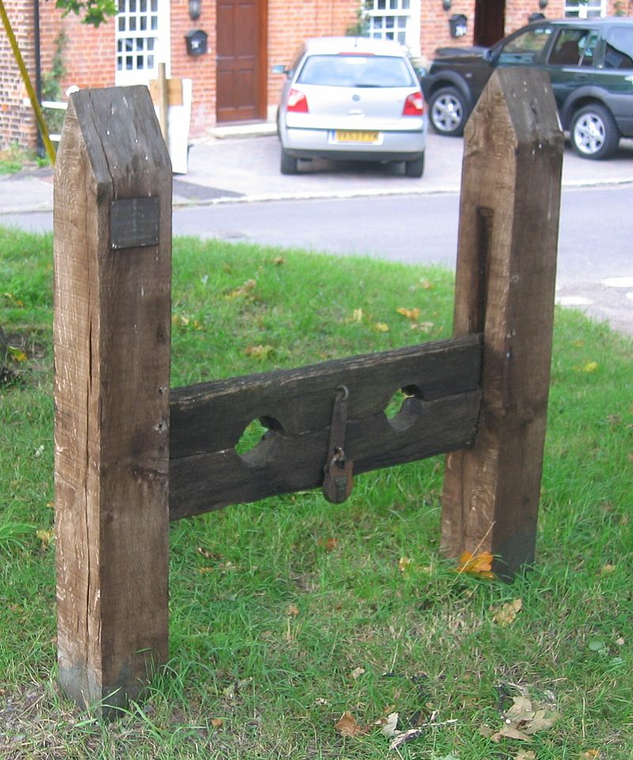
The 8th amendment and cruel and unusual punishment
Prohibits “cruel and unusual punishments”
Concepts not clear, reinterpreted
Controversy – capital punishment (death sentences)
States generally make own laws/policies
1972 Furman v. Georgia – death penalties have to be carried out in a fair and consistent manner
Stocks, Keevil, Wiltshire; Wikicommons

Slide 28
Other protections
Article 1 – habeas corpus; a judge has to have reason to issue an order to keep a person in jail
Photo by wdroops on Trend hype / CC BY-NC-SA

Slide 29
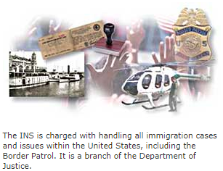
Citizenship Rights
Each countries sets their own rules of citizenship
14th Amendment gives Constitutional protection of citizenship for all born in the United States

Slide 30
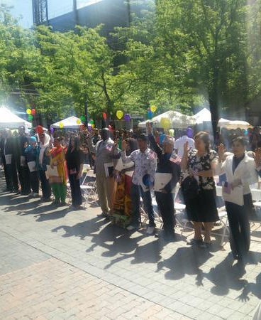
Native-born citizens
Birthright Citizenship
Any child born in the US is a citizen
Children of US citizens born abroad are citizens
Dual Citizenship if born to parents living outside the US (depends on other government) OR if born to non-citizens while in the US
Must be a natural-born citizen to become President
Photo by Kencf0618 on Wikicommons / CC BY-NC-SA

Slide 31
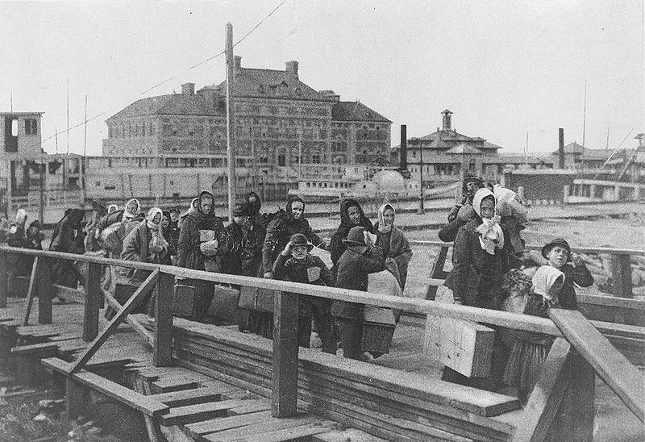
Citizenship by naturalization
Naturalization: the process of an alien becoming a citizen
Must be 18
Read, write, and speak English
Lived in the US for 5 continuous years; 3 if married to a citizen
File a petition for citizenship
Hearing to ask about background and character
Answer questions about US government and history (Citizenship Test)
Final hearing – Oath of Allegiance
Emigrants coming onto Ellis Island; US Library of Congress via Wikicommons

Slide 32
Loss of citizenship
3 ways:
Expatriation (giving up citizenship to live in/become a citizen of another country)
Punishment for a federal crime (ex. Treason)
Fraud in the naturalization process
Photo by BayuMahardika on flickr

Slide 33
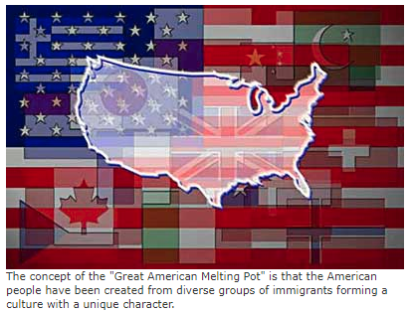
Admission to the united states
Long debate about citizenship
Open boarders, allow immigration (nation of immigrants, healthy economy)
Closing the boarders, protect American traditions and values (too many people)
Congress has power to regulate by setting restrictions
No limitations until late 19th century; eventually quotas for country of origin
1960s eliminated quotes, but set a cap at 675,000 total per year

Slide 34
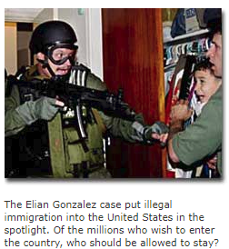
Rights of Aliens
The wording of the Constitution often refers to ‘persons’ rather than citizens; assumed to be anyone in the United States
Property ownership Enrollment in Public Schools
Business ownership First Amendment freedoms
Due process rights
Responsibilities of residents:
Pay taxes, emergency medical care, disaster relief, some nutrition programs
Cannot vote, hold public office, can be deported
1996 Immigration Act – permitted states to deny most welfare benefits

Slide 35
Attributions
This work is adapted from The Independence Hall Association is licensed under a Creative Commons Attribution 4.0 International License. ​
From <http://www.ushistory.org/gov/1b.asp> ​
Unit 10: Civil Liberties and Civil Rights
All images not otherwise attributed from www.ushistory.org

