Slide 1
Government & the Economy
CC BY Puyallup School District, based on content from iCivics

Slide 2
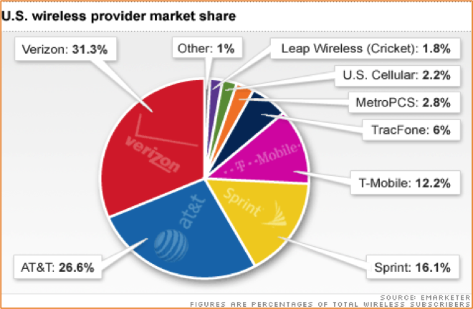
Gov & the Econ
Market Economy: most goods and services are offered by private companies
Companies compete for business

Slide 3
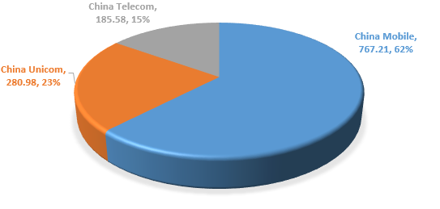
Gov & the Econ
Command Economy: government owns and offers all goods/services
No competition for business
The 3 cell providers in China are all owned and operated by the government

Slide 4
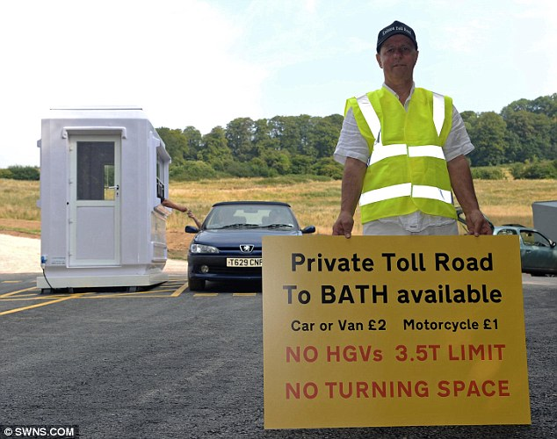
Gov & the Econ
“Free Market” – there is no government interference at all
Everything would be privately owned (police, space program, nuclear waste storage, roads, schools)
No regulations on working conditions/production (minimum wage, overtime, safety standards, monopolies, etc)

Slide 5
Gov & the Econ
Mixed economy: government owns some property, offers some services, others are available from private companies
Ex. Public schools, roads, libraries, postal system
Ex. Grocery stores, law firms, dentists, club sports

Slide 6
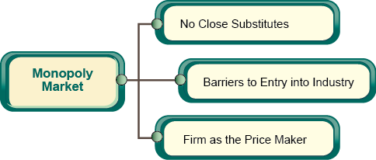
Gov & the Econ
Competition could result in only one provider (one business out performs or buys up competitors)
Monopoly – when one business controls the entire industry
Anti-trust laws – designed to stop companies from controlling
Es. AT&T tried to buy T-Mobile

Slide 7
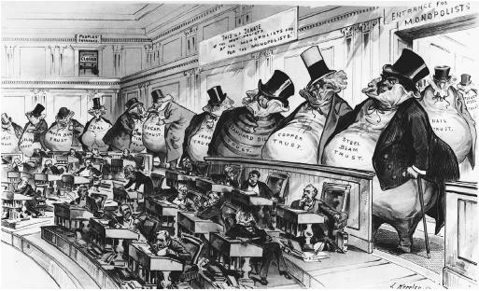
Gov & The Econ
Sherman Anti-Trust Act of 1890 – companies not allowed to do anything that would ‘restrain trade’
Clayton Antitrust Act of 1914 – government can prevent mergers that would reduce competition
Federal Trade Commission – government agency designed to prevent unfair competition

Slide 8
Gov & The Econ
Tariffs – taxes on goods from other countries
Increases price on foreign good, encourages domestic businesses
Government tries to help reduce tariffs on US goods in other countries
Free trade – neither country will impose tariffs on goods coming into the country

Slide 9
Gov & The Econ
Consumer Protection – the government investigates private businesses
Ex. Stopping unauthorized charges to phone bills, limits on how powerful cell phone towers are (adverse health risks), etc

Slide 10
Attributions
Adapted from Government and the Economy lesson and reading
Statement from iCivics:
iCivics does not take issue with instructional, non-profit use of our materials as it pertains to our product copyright. You are free to copy, distribute, and transmit iCivics materials so long as you credit the work to iCivics, Inc. and include our website: www.icivics.org.

