Slide 1
Who Rules?
Adapted from icivics; www.icivics.org

Slide 2
Who Rules?
Governments all have one thing in common:
Someone is in power
Sometimes a single person, sometimes a group, sometimes the people

Slide 3
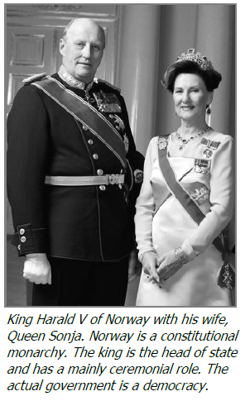
Who Rules?
Autocracy: one person holds all power
Monarchy – king or queen, usually inherited
Modern times – share power with other parts of government
Dictatorship – absolute control over citizens and the government

Slide 4
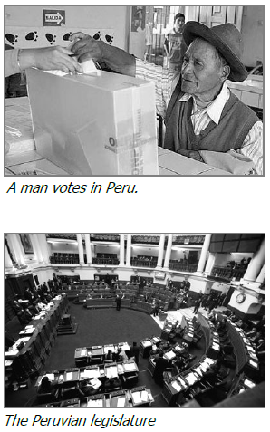
Who Rules?
Democracy – citizens hold political power
Representative democracy – elect leaders to represent their interests in government
Representatives carry out day-to-day decisions, held accountable via elections
Direct democracy – all citizens directly participate in day-to-day work of the country
Best example: Ancient Athens – and only males were citizens

Slide 5
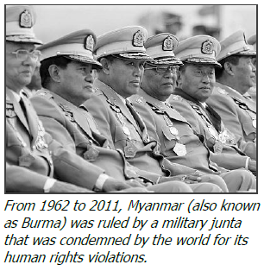
Who rules?
Oligarchy – small group has the power
Could be a single political party, noble families, land owners
Junta – military officers rule after taking over by force

Slide 6
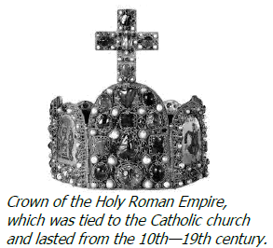
Who Rules?
Theocracy – god(s) or a divine being is seen as the ultimate authority
Can be a democracy or a dictatorship
Often religious leaders rule the country
Ex. Vatican City, Iran, ancient Egypt

Slide 7
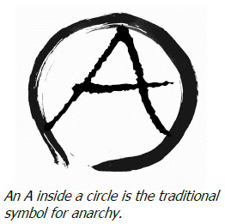
Who rules?
Anarchy – no one is in control, absence of government
anarchists often believe they should not be subject to the rules or laws of any government
Groups claiming to be anarchists may attempt to create chaos and capitalize on protests to riot

Slide 8
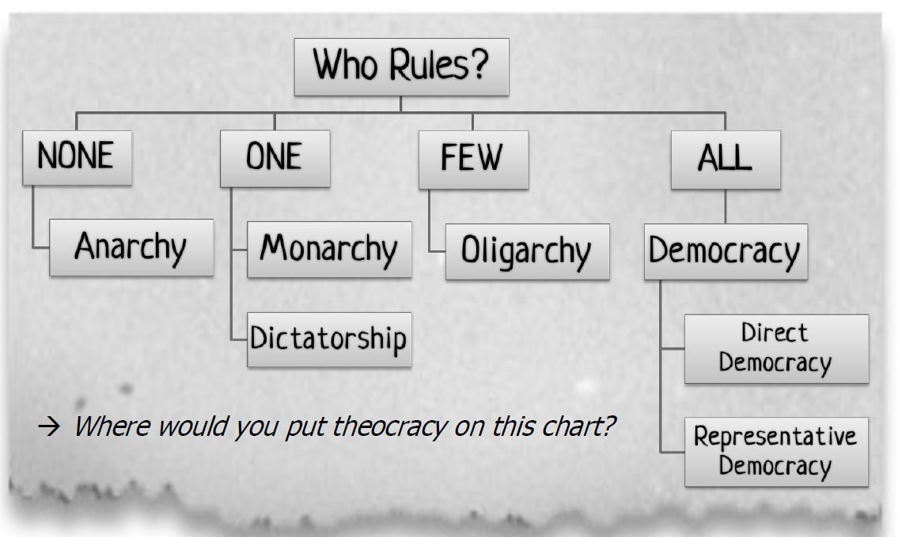

Slide 9
attributions
Adapted from Who Rules? Lesson and reading
Statement from iCivics:
iCivics does not take issue with instructional, non-profit use of our materials as it pertains to our product copyright. You are free to copy, distribute, and transmit iCivics materials so long as you credit the work to iCivics, Inc. and include our website: www.icivics.org.

