Slide 1
Why government?
CC BY Puyallup School District, adapted from content from iCivics

Slide 2
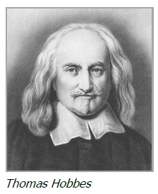
Why Government?
Thomas Hobbes – English scholar & philosopher
In Paris during English civil war
Humans naturally selfish
State of Nature – everyone has right to everything, conflict and fighting
Governments helped end war/chaos, allow inventions, art, crops, tools

Slide 3
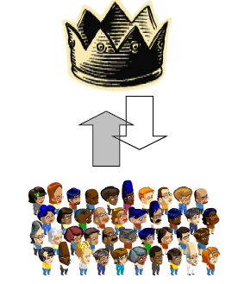
Why Government?
Social Contract – agreement between people and their government
Hobbes: people give up some rights/power in exchange for protection
Believed giving over power means giving up the right to overthrow or even question the government

Slide 4
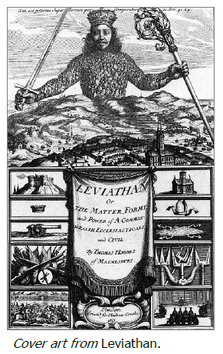
Why Government?
Leviathan – Hobbes’ book about government
Strong central authority was the only way to avoid war
Believed single sovereign should have total authority over the people (specifically a king)
John Locke & Jacques Rousseau
Democracy for government; people have the power
Believed that people had rights that had to be protected from the government

Slide 5
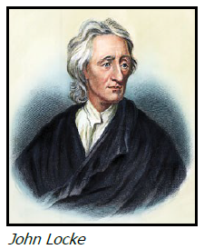
Why Government?
Thomas Jefferson studied Locke’s work
Tabula Rasa (blank slate) – life/experience filled us
Natural Rights – born with them
Life: Live and will right to survive
Liberty: Be as free as possible and make own decisions
Property: Own things (land, food, tools)

Slide 6
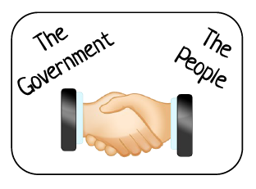
Why Government?
State of Nature: no rules, no one in charge, no way to protect natural rights
Government ends the state of nature and allows protections
Government should protect natural rights
Social Contract – relationship between people and government
People give up some freedoms IF the government protect everyone’s rights
If the government doesn’t hold up it’s end of the barging, the people have the right to revolt

Slide 7
Attributions
Adapted from Why Government? Lesson and reading
•Statement from iCivics:
iCivics does not take issue with instructional, non-profit use of our materials as it pertains to our product copyright. You are free to copy, distribute, and transmit iCivics materials so long as you credit the work to iCivics, Inc. and include our website: www.icivics.org.

