Slide 1
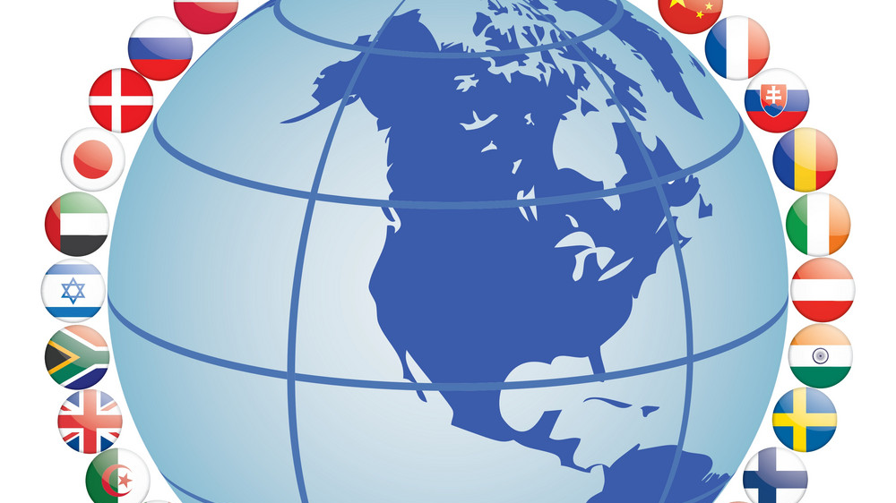
The sovereign State

Slide 2
The state
No, not Washington, Oregon, or Wyoming
State:
Body of people
Living in defined space
Power to make/enforce laws
Organization to carry out laws
The US State Department is responsible for interactions with other States (ex. Russia,, Canada)

Slide 3
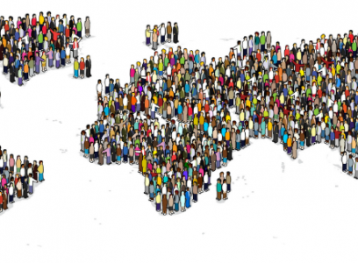
Population
Population: a group of people who are the members or citizens of a state
Can be big or small
China has more than 1.3 million
Fiji has just over 860,000
Variety of features:
Rural or urban
Economic distribution (poor, wealthy, etc)
Levels of education
Cultural traditions
Language(s) spoken

Slide 4
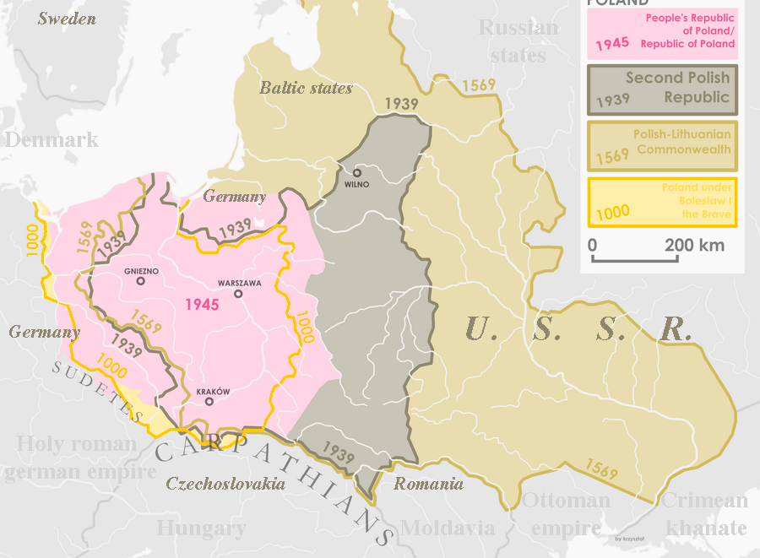
territory
Territory – area in which the state is in control (the land)
Must have set boundaries (sometimes states dispute the boundaries)
Boundaries can change over time
War, negotiation, purchase
US bought Alaska from Russia for $7.2 million

Slide 5
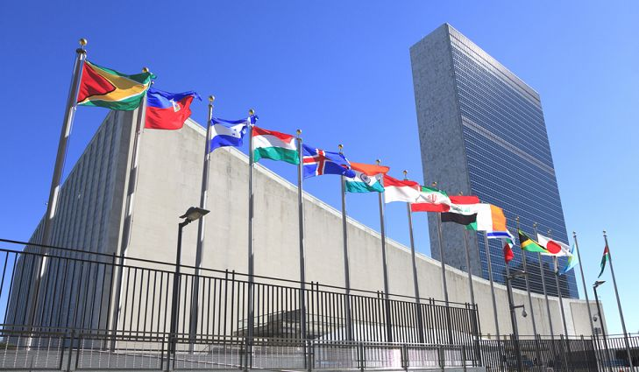
Sovereignty
Sovereignty – ability to rule absolutely within a territory
States are equal to each other and cannot interfere in another’s affairs
United Nations – members states willing agree to follow the UN’s rules (still sovereign)
Sometimes the UN will violate a state’s sovereignty if they are unable to keep their people safe
Foreign Policy – each state develops relationships/ways of interacting with other states

Slide 6
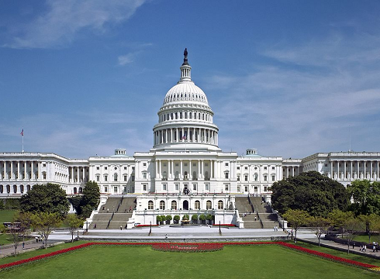
Government
Government: the organization inside a state that controls the actions and policies of the state
Makes laws
Rules for how things run
Responsible for protecting the state
Military, other protection agencies
Keeps order
Law enforcement agencies
Providing services
Post offices, paving streets, health care, unemployment

Slide 7
Government’s roles
Place each example next to the role of the government that you think best fits:
Highway Patrol | Freedom of Speech | Navy
Kids under 14 can’t work | Veteran’s hospital | Air Force
Army | FBI | Schools
Voting age is 18 | Retirement Benefits | Minimum wage
Marines | Highway System | Maintain Roads
Police | Sheriff

