Slide 1
The Nature of Government
Unit 1: Foundations of Government
CC BY Puyallup School District, adapted from material from ushistory.org

Slide 2
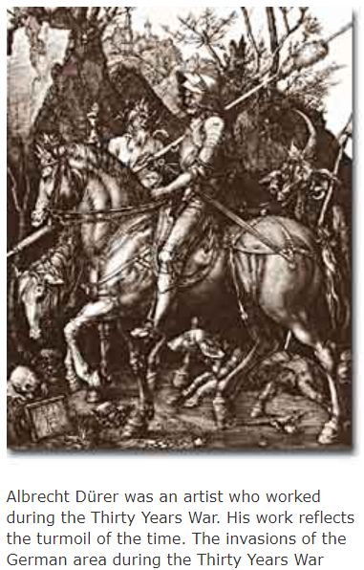
The Purposes of Government
Government creates rules
Protection from conflict, law and order
Karl Marx – result of conflict over property (selfish)
Groups make protection easier
Now also responsible for regulating economy
Federal Reserve Person, New Deal programs
Provide social programs
Education, target poverty, health care

Slide 3
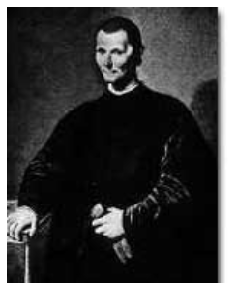
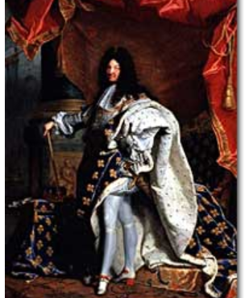
Types of Government
Louis XIV, King of France (1643-1715): “I am the State”
Legitimacy – accepted rule of those in power
Rule by Man
Citizens – the people subject to the government’s power
Absolute ruler – power is unchecked and unlimited
Divine right – God(s) gave power to rule
Monarchy – power is hereditary
Oligarchy – rule by a small group
Plutocracy – group in power due to wealth, social status
Aristocracy – rule by upper class
Niccolò Machiavelli, The Prince: “It is better to be feared than loved”

Slide 4
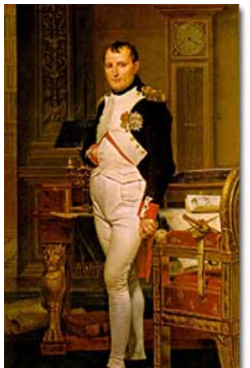
Types of Government
Rule by Law
Code of Law – government has set rules (ex. Justinian’s or Napoleon’s codes)
Many have written constitutions
Great Britain doesn’t have a single document
Nigeria has ignored theirs)

Slide 5
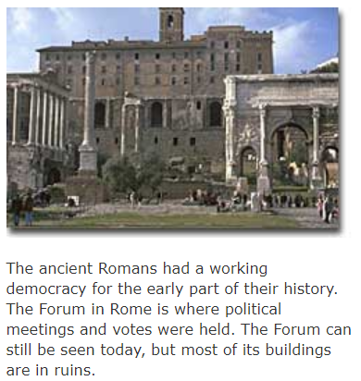
What is a Democracy?
James Madison, Fed. #10 said that democratic rule lead to “… instability, injustice, and confusion” – but was still preferable to monarchies of Europe
Greek – demos (the people) + kratia (power or authority)
Aristotle – Natural Law (ethical principles found in nature)
Direct democracy – citizens meet, discuss and make decisions
Representative Democracy – chosen by the people to make decisions for them
Smaller size easier for decisions
Republic – idea that more knowledgeable citizens represented general citizenry
Democratic Centralism – Lenin
No private ownership, everyone was equal
Small “vanguard of the revolution” made decisions for all

Slide 6
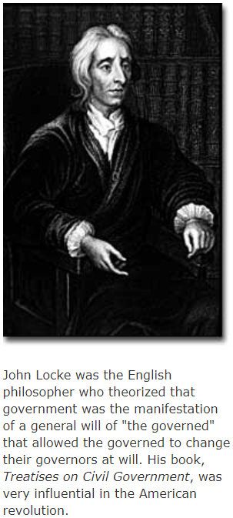
Democratic Values – Liberty, Equality, Justice
Absolute monarchs may have brought peace and order, but at the cost of personal freedoms
Enlightenment – questioned traditional authority of monarchy to rule
Acknowledged the importance of bring order to chaos, strong-man rule
medieval times – centralized government brought widespread death and destruction
John Locke – consent of the governed
Montesquieu – three “branches” with checks
Jacques Rousseau – “general will” or majority rule

Slide 7
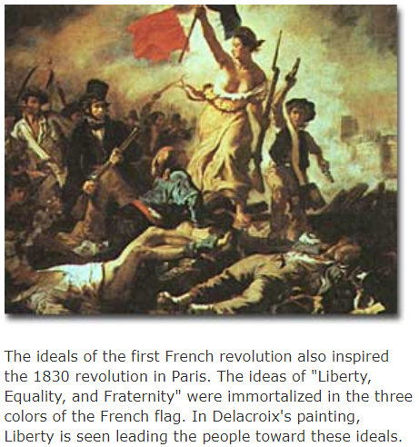
Democratic Values – Liberty, Equality, Justice
Two Kinds of Balance:
Balance order & liberty
No repressive laws, individual freedom cherished
Balance liberty & equality
Allow freedom to pursue/succeed, prevent consolidation of power or restricting liberty of others
relates to taxation, promote equality without restricting individual freedom for economic success

Slide 8
Attributions
This work is adapted from The Independence Hall Association is licensed under a Creative Commons Attribution 4.0 International License.
From <http://www.ushistory.org/gov/1b.asp>
Unit 1: The Nature of Government

