Slide 1
PARAPHRASING
Strategies to analyze complex text and increase comprehension
Gear Up Episode 3
Vicki Estrem, Minneapolis Adult Education
Minnesota GED Advisory Team
January 27, 2015

Slide 2
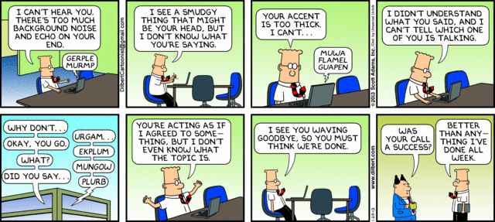
Hoping this doesn’t happen!

Slide 3



LOGISTICS
Technical challenges – Heather Indelicato
Heather.Indelicato@mpls.k12.mn.us
Sound
Asking questions and participation or use Chat
Viewing later
Materials
Other?

Slide 4

Welcome!
Adult Education instructor for Minneapolis Adult Education – ELL and GED
MindQuest Academy
STAR
MN GED Advisory Committee
Language and Literacy Team
DCS GED Prep Online
Learning Express Library
OBJECTIVES FOR TODAY
Differentiate between paraphrasing and summarizing.
Understand instructional strategies for paraphrasing at the word, phrase, sentence, and paragraph level.
Recognize the components of the RAP strategy to assimilate into classroom.
Outline paraphrasing strategies to use in classroom setting.

Slide 5
Overview
Rational for Paraphrasing Instruction
Strategies for scaffolding instruction of paraphrasing text
Investigate RAP paraphrasing strategy
Resources for the
Classroom

Slide 6
Pre -Work Responses

Slide 7
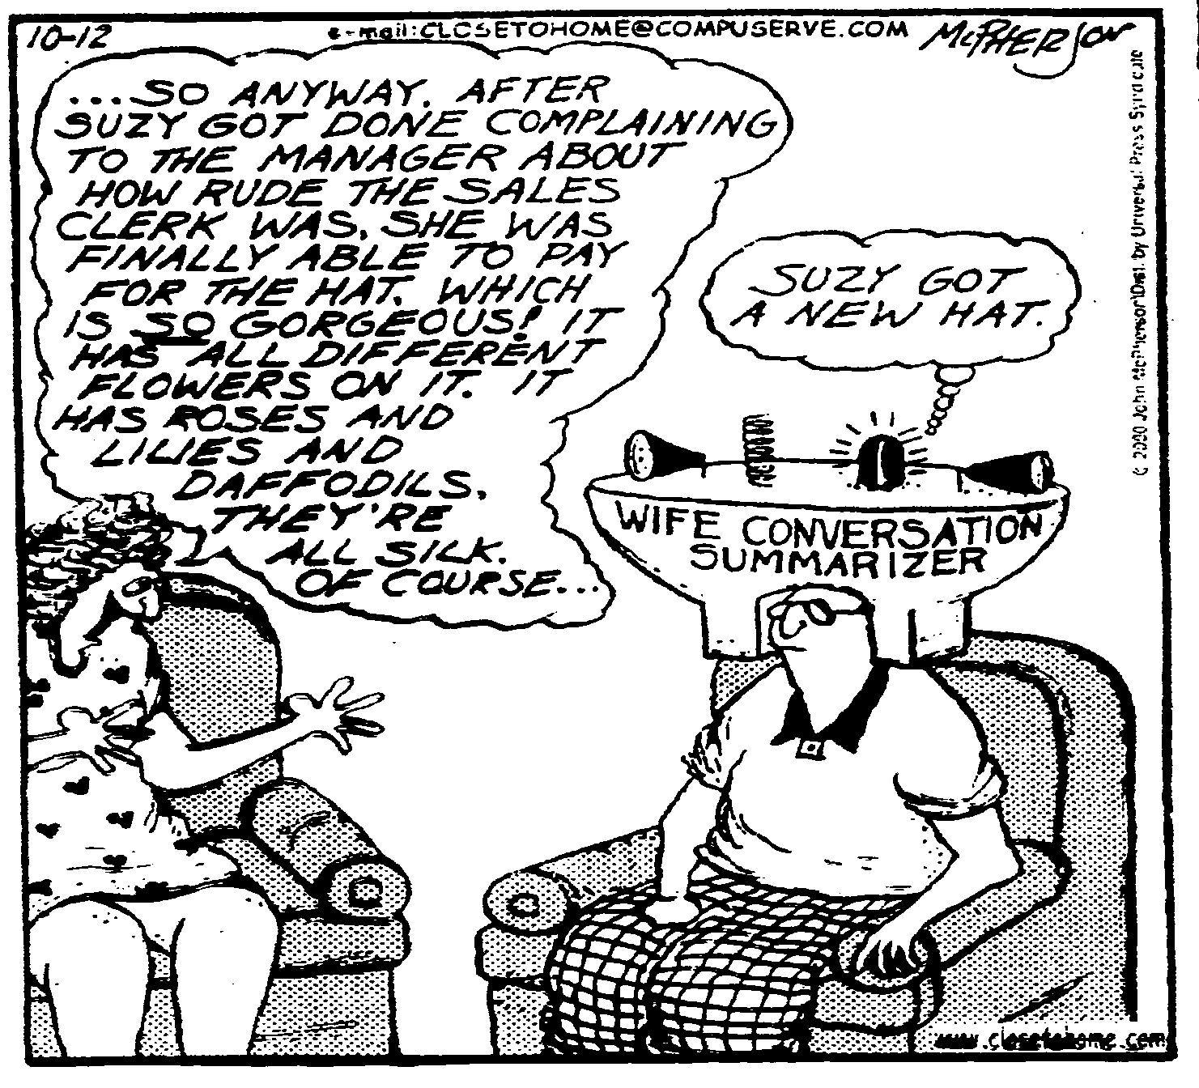
Paraphrase or Summarizing??

Slide 8
Paraphrasing vs. Summarizing
Paraphrasing
does not match the source word for word
involves putting a passage from a source into your own words
changes the words or phrasing of a passage, but retains and fully communicates the original meaning
must be attributed to the original source
Source: Purdue Online Writing Lab https://owl.english.purdue.edu/owl
Summarizing
does not match the source word for word
involves putting the main idea(s) into your own words, but including only the main point(s)
presents a broad overview, so is usually much shorter than the original text
must be attributed to the original source

Slide 9
What does the research say?
“Student’s comprehension and retention scores increase in proportion to the quality and quantity of the paraphrase statements they make while reading a passage. Specific research conducted on paraphrasing strategies has shown gains in reading comprehension on grade level materials to average 35 percentage points.”
- Schumaker, Deshler, and McBride, University of Kansas, 1984.

Slide 10
What Does the Research Say?
“Comprehending a text involves actively creating meaning by building relationships among ideas in text, and between the text and one’s knowledge, beliefs, and experiences (Wittrock, 1990).” – from Writing to Read, 2010
“Having students write about a text should enhance reading comprehension because it affords greater opportunities to think about ideas in a text, requires them to organize and integrate those ideas into a coherent whole, fosters explicitness, facilitates reﬂection, encourages personal involvement with texts, and involves students transforming ideas into their own words (Applebee, 1984; Emig, 1977; Klein, 1999; Smith, 1988; Stotsky, 1982)” – from Writing to Read (2010)

Slide 11
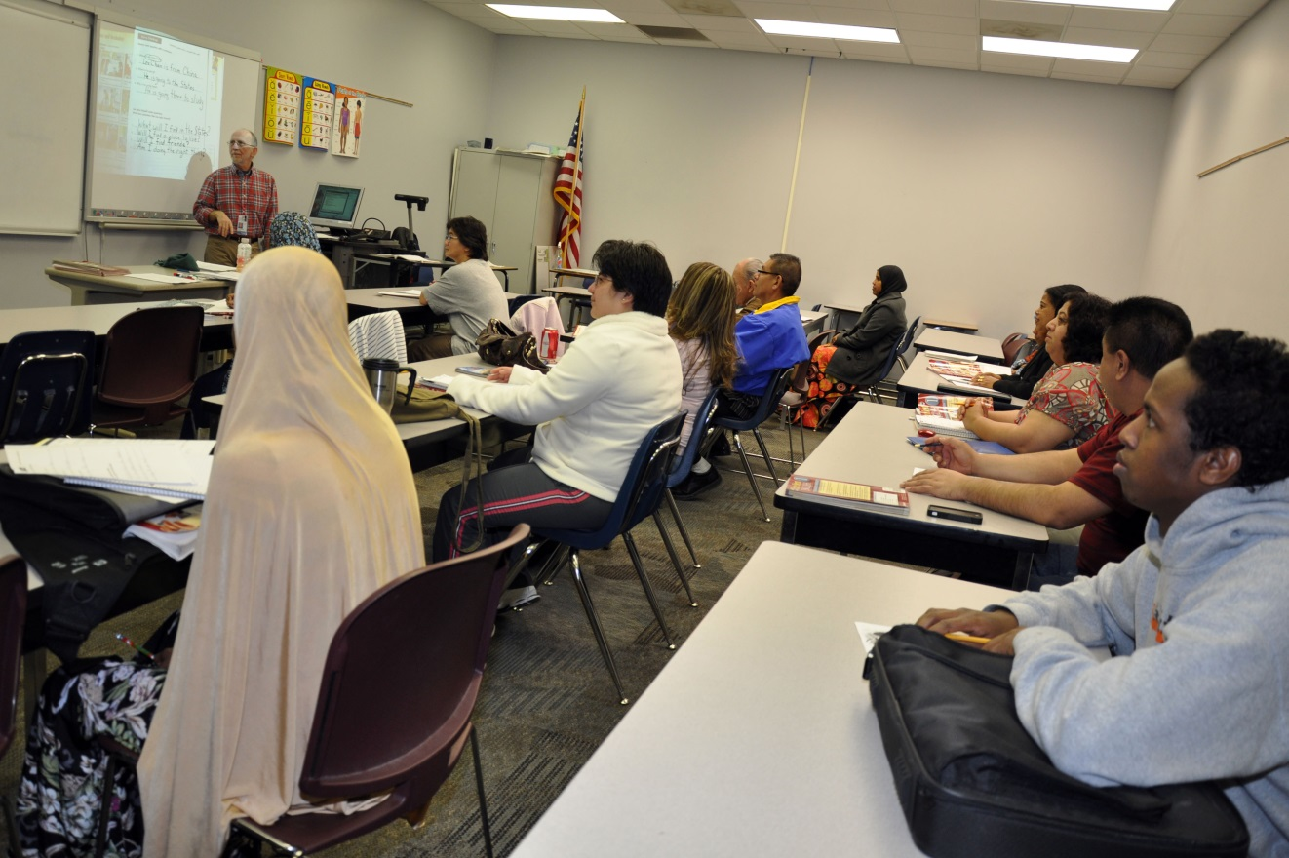
Systematic Paraphrasing instruction
Helps students deal more effectively with complex texts.
Requires students actively interact with material
Is a strategy designed to improve recall of main ideas and supporting details.
Can help learners improve test-taking skills

Slide 12
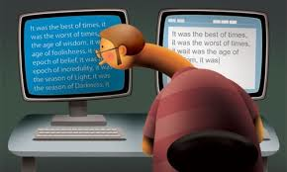
Plagiarism!
Is uncredited use of someone else's words or ideas.

Slide 13
Discrete or in Context?
Brief
Resort
The attorney prepared a written brief for the judge.
The soldiers had to resort to hiding in the mountains to stay safe.

Slide 14
General instructional methods
PARAPHRASE WORDS, PHRASES, SENTENCES, and PARAGRAPHS
Describe Explicitly state purpose
Modeling Learn by watching
Practice Learn by sharing
Application Independent work / Generalization
PROVIDE FEEDBACK!
Adapted from SIM (Strategic Instruction Model), University of Kansas, KU Center for Research and Learning

Slide 15
Characteristics of good paraphrasing
Communicates the original idea
Does not add your opinion
Uses about the same number of words
Uses a combination of writing skills including different words and sentence structures
Blends the original idea into your own writing using your own words
References the original source – GED 2014 Extended Response

Slide 16

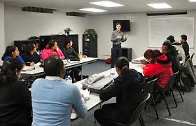

General Instructional Method for Each Activity
Learn by watching – Observe
Learn by sharing – Working Together
Learn by practicing – On Your Own

Slide 17
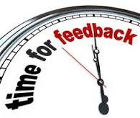
Giving Feedback
Based on whether an item is correct, written in student’s own words, and makes sense.
“Correct” means that an item has same or similar meaning as the original word, phrase, or sentence.
Place a checkmark in the “C” box.
“Written in the student’s own words” means that the original word phrase or sentence has been changed into the student’s own words as much as possible.
Place a checkmark in the “W” box.
“Makes Sense” means that an item is clearly understood and communicates the original meaning of the word, phrase, or sentence.
Place a checkmark in the “M” box.
- See Handout

Slide 18
Start with Words (Synonyms) – Activity #1
Purpose of lesson
Define paraphrasing
and synonym
Explain characteristics of good paraphrase
Explain feedback

Slide 19
Let’s look at this document together

Slide 20
Activity 2 – Paraphrase a phrase
A phrase is a small group of words that has meaning.
wandering around town
painted a hateful picture
doesn’t own wheels
It must be correct, include one’s own words, and must make sense.

Slide 21
Give Explicit Directions
Purpose
Define phrase
Characteristics of good paraphrase
Explain Feedback

Slide 22
Let’s look at this document together
file://localhost/Users/vickiestrem/Documents/Paraphrasing Webinar/Activity2.docx

Slide 23
Activity #3 – Paraphrasing sentences
Give Explicit Directions
Define the components of a sentence
  (subject/verb/object)
Paraphrase single sentences
  Break long sentences into shorter ones
  Make abstract ideas more concrete
Key Questions:
Does the sentence mean the same as the original?
Is the meaning clear?
Does the altered sentence read smoothly?

Slide 24
Let’s look at this activity together!
file://localhost/Users/vickiestrem/Documents/Paraphrasing Webinar/Swim Safely.docx

Slide 25
Activity 4 – Paraphrasing Paragraphs
A paragraph
Contains sentences that are all related to each other.
Contain a topic, a main idea, and some details supporting the main idea.
Is usually indented

Slide 26
TOPIC
MAIN IDEA
One or two words that tell what the paragraph is about.
Frequently located in the first or second sentence.
Is sometimes repeated or “relative word” is repeated.
To find the topic, ask:
“What is this paragraph mostly about?”
The big idea that the paragraph is about.
A general statement that summarizes all the information in the paragraph.
To find the main idea, ask:
“What does this paragraph
tell me about
_____(the topic)______

Slide 27
Supporting Details
A piece of information that is related to the main idea.
A statement that provides specific information about the main idea and topic.
To find supporting details, ask:
“What specific information is related to
the main idea?”

Slide 28
Repeat this process – Working Together and On Your Own

Slide 29
Paraphrasing Paragraphs
ORIGINAL
In The Sopranos, the mob is besieged as much by inner infidelity as it is by the federal government. Early in the series, the greatest threat to Tony's Family is his own biological family. One of his closest associates turns witness for the FBI, his mother colludes with his uncle to contract a hit on Tony, and his kids click through Web sites that track the federal crackdown in Tony's gangland.
From Duke University Library: http://library.duke.edu/research/plagiarism/cite/paraphrase.html
PARAPHRASED
In the first season of The Sopranos, Tony Soprano’s mobster activities are more threatened by members of his biological family than by agents of the federal government. This familial betrayal is multi-pronged. Tony’s closest friend and associate is an FBI informant, his mother and uncle are conspiring to have him killed, and his children are surfing the Web for information about his activities.

Slide 30

Application in your classroom
How would you use these strategies in your classroom?
What materials do you already have that you could adapt for these strategies?
Challenges? Questions?

Slide 31
Activity – Evaluate the paraphrase
Original Passage
Paraphrase
Students frequently overuse direct quotation in taking notes, and as a result they overuse quotations in the final [research] paper. Probably only about 10% of your final manuscript should appear as directly quoted matter. Therefore, you should strive to limit the amount of exact transcribing of source materials while taking notes. Lester, James D. Writing Research Papers. 2nd ed. (1976): 46-47.
Students often use too many direct quotations when they take notes, resulting in too many of them in the final research paper. In fact, probably only about 10% of the final copy should consist of directly quoted material. So it is important to limit the amount of source material copied while taking notes.
FROM:https://owl.english.purdue.edu/

Slide 32
Legitimate Paraphrase
Original Passage
Paraphrase
Students frequently overuse direct quotation in taking notes, and as a result they overuse quotations in the final [research] paper. Probably only about 10% of your final manuscript should appear as directly quoted matter. Therefore, you should strive to limit the amount of exact transcribing of source materials while taking notes. Lester, James D. Writing Research Papers. 2nd ed. (1976): 46-47.
In research papers students often quote excessively, failing to keep quoted material down to a desirable level. Since the problem usually originates during note taking, it is essential to minimize the material recorded verbatim.
FROM:https://owl.english.purdue.edu/

Slide 33
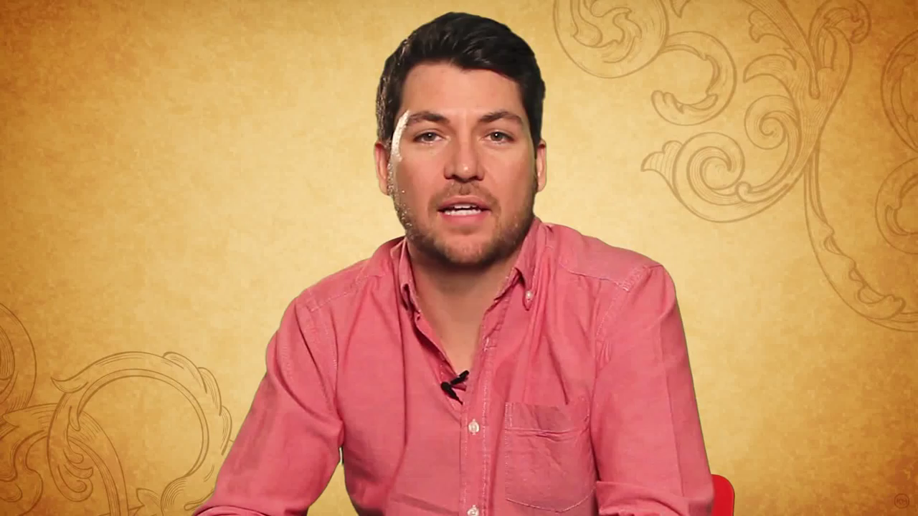
Do Your Students do This?
What did you hear in the video clip that is similar to the things your students might do when asked to restate, retell, or paraphrase?

Slide 34
RAP Paraphrasing Strategy
- adapted from Learning Strategies Curriculum
University of Kansas
Designed to help students manage complex reading demands of complex texts.
Requires students to actively interact with material.
Divides passage into small units – “chunking”
Alternation of activities requires high level of attention during reading activity.
IT IS A VERBAL STRATEGY

Slide 35
Instructional Methods
Pretest and Goal Setting – Student Commitment
Describe – Model
Verbal Practice
Guided Practice and Feedback
Independent Practice and Feedback
Posttest – Generalization

Slide 36
Pretest and Goal Setting directions
Is is necessary??
Materials:
A passage containing 3-5 paragraphs at student’s reading level.
Explicit Directions
Silent reading
Restate after each paragraph
Comprehension assessment
Feedback
Set Goals – student commitment

Slide 37
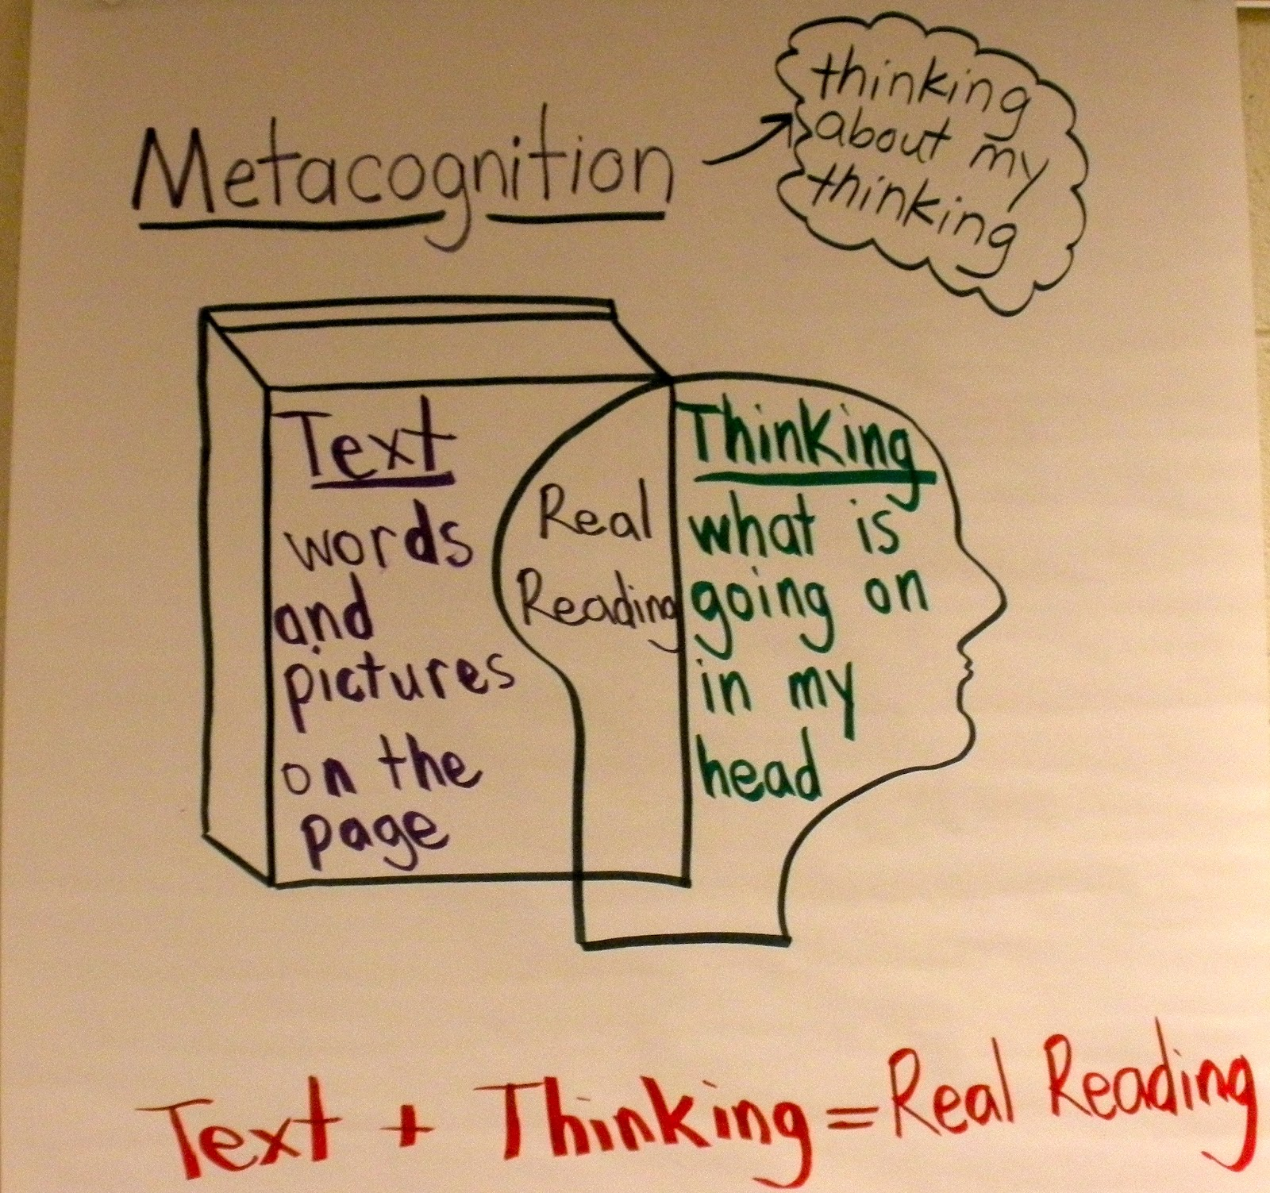
Describe and Model
DESCRIBE
What is paraphrasing?
file://localhost/Users/vickiestrem/Documents/Paraphrasing Webinar/Requirements for a Paraphrase.docx
Three Step - RAP
Read - silently
Ask - self-questioning
Main idea
Details
Put – main idea and details in own words
file://localhost/Users/vickiestrem/Documents/Paraphrasing Webinar/RAP STRATEGY.docx
MODEL
Review RAP strategy
Explicit direction
Demonstrate each step
file://localhost/Users/vickiestrem/Documents/Paraphrasing Webinar/Finding the Topic and Main Idea.docx

Slide 38
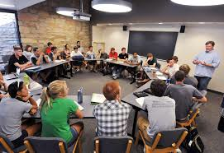
Verbal Practice of RAP
Goal is to insure students memorize the RAP process
Review strategy – give explicit instruction
Ask questions

Slide 39
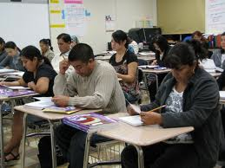
Guided Practice and Feedback
Goal – working to student mastery of the Paraphrasing Strategy in controlled materials using materials at their reading level.
Review strategy
Explicit instructions
Practice
Evaluate
Feedback

Slide 40
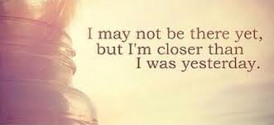
Advanced Practice and Feedback
Goal – students will be able to RAP method at their instructional level and apply across content.
Materials
Longer passages
Content specific
Review strategy
Explicit instructions
Practice
Evaluate
Feedback

Slide 41
Evaluating
Student’s response
Must be a complete thought
Must contain entirely correct information
No repeat information
Make sense within the context of statements previously made
Must not be all generalities
Is substantially different from any sentence in written paragraph. Must put information in own words!
file://localhost/Users/vickiestrem/Documents/Paraphrasing Webinar/Paraphrase Evaluation.docx

Slide 42

Let’s Look at an Example
Model Passage

Slide 43
Giving Feedback
Did the student:
Articulate the main idea and supporting detail of the paragraph?
Complete thought
Accurate
New thought – not repetitive
Make sense within the context
Is relevant and useful for comprehension
Not multiple global thoughts
Information is in students own words
file://localhost/Users/vickiestrem/Documents/Paraphrasing Webinar/Paraphrase Scored Evaluation.docx

Slide 44
Assessing progress
Post tests
Reading passage that is 3 – 5 paragraphs in length with corresponding comprehension questions.
At student’s current reading level or instructional level?
Provide feedback

Slide 45
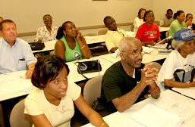
Classroom Application
Time to Share ideas!
Beginning
Intermediate
High
Mixed Level Classroom

Slide 46
Resources
The Gilder Lehrman Institute of American History
https://www.gilderlehrman.org/history-by-era/early-republic/resources/our-constitution-bill-rights-grades-7–9
https://www.gilderlehrman.org/history-by-era/government-and-civics/resources/preamble-us-constitution-pledge-allegiance-and-declar
ReadWriteThink
http://www.readwritethink.org/classroom-resources/lesson-plans/used-words-paraphrasing-informational-1177.html?tab=4 - session1
Prudue OWL
https://owl.english.purdue.edu/owl/owlprint/930/
https://owl.english.purdue.edu/owl/resource/619/02/
Kelly Gallagher Article of the Week
http://www.kellygallagher.org/article-of-the-week/
See Handout for this and more!

Slide 47

Questions and Comments?
Thank you for your participation!
Vicki Estrem
victoria.estrem@mpls.k12.mn.us

