Slide 1
Polyploids in plant breeding

Slide 2
Haploid: An individual carrying gametic chromosome number n
Monoploid: Basic chromosome number (or) haploid of a diploid sps
Heteroploids: Individuals carrying chromosome number other than the diploid number

Slide 3
Polyploids
Organism with multiple sets of chromosomes (excess than diploid organism)
Polyplods is common in nature and provides a major mechanism for adaptation and speciation
50 – 70 % of angiosperms, including many crop plants have undergone polyploidy during their evolution process

Slide 12
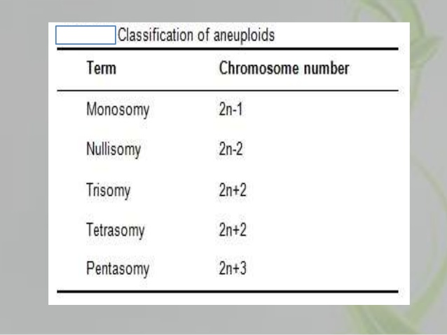

Slide 13
Application in crop improvement
Monoploids and haploids are weaker than diploid and are of little agriculture value directly
These are used for the development of homozygous diploid lines by direct doubling in two years
It is used in certain interspecific crosses eg. H.bulbosum x h.vulgare , T.aestivum x H.bulbosum

Slide 14
Origin and production of Autopolyploids
Spontaneous: Chromosome doubling occures occasionally in somatic tissues and unreduced gamete formation
Production of adventitious buds: Decapitation in some plants leads to development of callus in at the cut end of stem. Such callus having polyploid cells. The shoot buds regenerated from the callus may be polyploid. Common in solanaceae
Physical agents: Cold treatment, x rays and gamma rays irradiation. Datura cold treatment produce tetraploids. Heat treatment successfully used in barley, wheat, rye and other crops
Regeneration invitro – Nicotiana and Datura
Colchicine treatment : C₂₂H₂₅O₆N
Other chemical agents: 8-hydroxy quinoline and nitrous oxide

Slide 15
Morphological and cytological features of autopolypolids
Larger cell size than diploids, No. of stomata per unit area is lower in polyploids
Larger pollen grains
Slower in growth and later in flowering
Larger and thicker leaves
Reduced fertility due to irregularity during meiosis
Increase in general vigour and vegetative growth
Different sps have different levels of optimum ploidy
Lower dry matter content

Slide 16
Cytological features
Triploids produce various types of aneuploids eg. Trisomics and double trisomics
Autotriploids are highly sterile
Autotetraploids show variable fertility level
Segregation is more complex than diploids

Slide 17
Role in evolution (Autopolyploids)
Forage and ornamental are autopolyploids
GISH (Genome insitu hybridization) powerful tool In genome organization and evolutionary relationship

Slide 18
Application in crop improvement
Triploids (tetraploid x diploid) useful in production of seedless seedless watermelon
Triploid sugarbeets produce larger root and more sugar per unit area
Triploid clone tea – more cured tea per unit area
Tetraploids: Improving quality, overcome self in compatability, making distant crosses and used directly as variety

Slide 19
Tetraploid maize: 43 % more carotenoid pigment and vit A
Tetraploid banana more disease resistant than triploids
White clover and petunia – over come self incompatability
Tetraploid – rye grass, red clover are superior than diploids
Pusa giant berseem first autopolyploid variety released form India for general cultivation

Slide 23
Limitations
More water content does not produce more dry matter
Poor seed quality
Complex segregation - progress under selection is slow
Maintenance of triploid is difficult (only through vegetative propagation)
Effect of autopolyploids cannot be predicted

Slide 24
Allopolyploids - origin
Useful to create new species
Interspecific cross follow by chro# doubling leads to production of allopolyploids
Artificial doubling by colchicine is called synthetic allopolyploids
Allopolyploid - first production of F1 followed by doubling chro#

Slide 25
Morphological features
Combine the morphological and physiological characteristics of parental sps
Difficult to predict precise combination of parental characters
eg Raphanobrassica (Radish x Cabbage) – popularly known as rabbage
Triticale – Rye x wheat
Allopolyploids differ in their adaptability from their parental sps

Slide 26
Cytological features
Homeologous chromosomes: Chro# of related sps partially similar to each other
Amphidiploids: After doubling would have homologous chro# for each chro# present. It behave like a diploid sps this is called Amphidiploids

Slide 27
Role of Allopolyploids
Important in evolution
One third of angiosperm are allopolyploids
Evolution of bread wheat (T.aestivum)
Nicotiana tobacum
Gossypium hirsutum
Brassica sps

Slide 28
A.speltoides

Slide 29
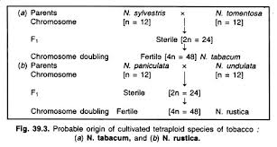

Slide 30
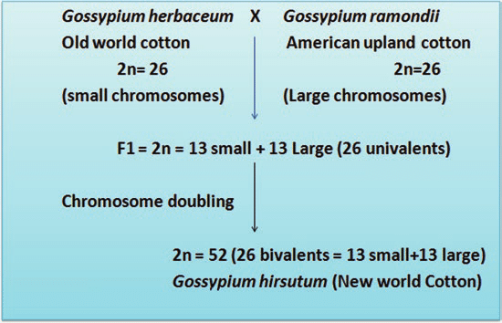

Slide 31
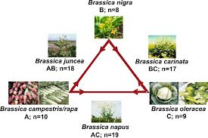
Evolution of Brassica sps

Slide 32
Application of allopolyploids in crop improvement
Utilization as a bridging sps
Creation of new crop sps
Widening the genetic base of existing allopolyploids

Slide 34
N,tigluta used as a bridging sps for transfer of tobacco mosaic virus form N.sylvestris to N.tabacum

Slide 35
Creation of new sps
Triticale
Raparadish – R.sativa x B.rapa
Raphanabrassica

Slide 36
Widening the genetic base of existing allopolyploids
Resynthesization of bread wheat by crossing present day durum wheat with Ae.tauschii
Limitation:
The effects of allopolyploids cannot be predicted
Newly synthesized allopolypolids have many defects
Only small portion of allopolyploids are promising

