Slide 1
Exploring Climate Science with Virtual Reality
Follow-up #4
Teacher/Scientist Partnership
PNNL Campus – 3820 Voltage Room
May 15, 2019
Georgia Boatman, Regional Science Coordinator, ESD 123
Peggy Harris Willcuts, Sr. STEM Education Consultant, PNNL
Notes:
8:30-8:40 a.m. Welcome and Introductions (all teachers and all facilitators) (Peggy)

Slide 2
Welcome Back!
Restrooms and refreshments
Be sure to sign the SIGN IN sheet.
Use your table boxes at will and as needed.
Be sure to compete your travel and timesheet before you leave today.
Notes:
8:30-8:45 a.m. Reminders

Slide 3
Lunch!
Be Back in 30 minutes!
Image by Kamil Szeląg from Pixabay
Notes:
12:00-12:30

Slide 4
The Planning Flow
Engagement:
Standards &
Big Ideas
Phenomena
Gapless Explanation
Eliciting Student Ideas:
Adapting Further Instruction
Represent Ideas Publicly
Eliciting Student Ideas
Supporting Changes to Ongoing Student Thinking:
Pressing for Evidence Based Explanations
Notes:
Slides 4-11 12:30-1:30 ( one hour)
The Planning Flow
Slide 4 3 min.
A brief reminder of where we are in the process
Then using the Planning for Engagement tool section 4
revisit where you were at and continue this part as needed.
click to bring up the next blocks: Eliciting Student Ideas go through the next section of blocks under eliciting student ideas

Slide 5
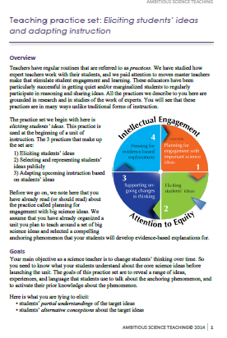
Eliciting Student Ideas and
Adapting Instruction
Notes:
Slides 4-11 12:30-1:30 ( one hour)
Slide 5 2 min.
Pass out document

Slide 6
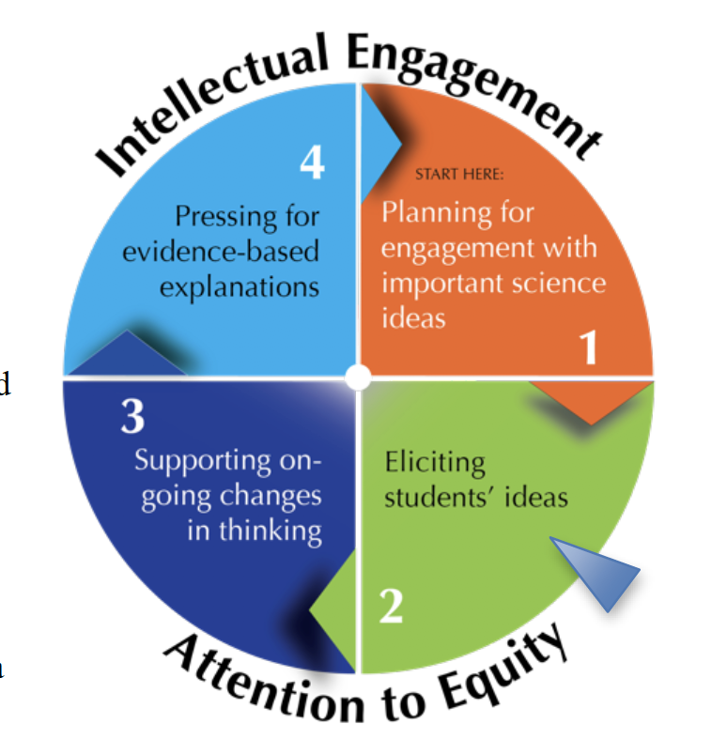
Eliciting Student Ideas: Regular Routines = Practices
Successful in getting quiet and/or marginalized students to participate and share ideas
Grounded in research
They are unlike many traditional forms of instruction
Practices include:
Eliciting students’ ideas
Selecting and representing students’ ideas publicly
Adapting upcoming instruction based on students’ ideas
Notes:
Slides 4-11 12:30-1:30 ( one hour)
Slide 6 4 min.
We will be engaging in guided reading through the Primer for Eliciting Student Ideas
Let me summarize the big ideas of Overview section in a brief talk through. These bullet points are from that section. See if you can find them and underline or highlight them. Share that there are regular routines or practices that we can engage in that master teachers engage in that can be very Successful in getting quiet and/or marginalized students to participate and share ideas
They are Grounded in research and They are unlike many traditional forms of instruction
We have been thinking about the first two really all year and will touch on them today. We are going to dig a bit deeper into adapting instruction. The so now I know what they are understanding or not….what can I do about it?

Slide 7
Eliciting Student Ideas: Goals
Your main objective as a science teacher is to change students’ thinking over time.
Here is what you are trying to elicit:
• students’ partial understandings of the target ideas
• students’ alternative conceptions about the target ideas
• students’ everyday language that can be leveraged to help them understand scientific ideas
• students’ everyday experiences related to the core science idea that can be leveraged in later instruction
Notes:
Slides 4-11 12:30-1:30 ( one hour)
Slide 7 3 min.
Student learning is on a continuum. Students don’t just learn x part about a concept and then stop acquiring understanding of the concept. If we know that our part in student learning is to push on their ideas, help them change and advance their thinking over time then we need to reveal what their ideas or conceptions are, what their experiences are and how they might influence student conceptions what kind of prior knowledge in other words and the language they use to express their ideas.
Here’s what we want to elicit: read the list and explain a bit

Slide 8
Planning for Eliciting Student Ideas
Identify an anchoring phenomena
Develop rich tasks for students about that phenomena
Make it relatable and relevant for students
A rich task has two characteristics:
• Accessibility
• Power to reveal consequential ideas
Read the last paragraph on page 2 and T-Chart of Rich Tasks.
Stop and discuss with partner(s).
Notes:
Slides 4-11 12:30-1:30 ( one hour)
planning for eliciting student ideas
Slide 8 3 min.
We have talked about the use of phenomena a lot and its role in being engaging and giving students a real world question or problem to develop their science learning around. But it is not as easy as giving students a puzzling phenomena and saying “go get ‘em”. We need to develop rich tasks around the phenomena that can really do that pushing on students’ thinking.
Two Characteristics that are key to a rich task
Accessibility and Power to Reveal Consequential Ideas
• Accessibility. Accessibility means that students can be expected to know enough
about the task or question to reasonably speculate or hypothesize about it.
• Power to reveal consequential ideas. This means the task or question can get
students talking about facets of understanding that will be crucial in developing the
core ideas of the unit (i.e. reveals partial understandings, alternative conceptions,
everyday language, everyday experiences related to the target idea).
Read over the scenarios and core ideas….
Think about your team’s idea. Is it headed down the right track? Have a brief conversation with an elbow partner.

Slide 9
How to Enact Eliciting Student Ideas
1. Introducing the puzzling event and eliciting (only) observations
2. Eliciting hypotheses about “what might be going on”
3. Pressing for possible explanations
Notes:
Slides 4-11 12:30-1:30 ( one hour)
Slide 9 10 min.
Guided reading through the Primer for Eliciting Student Ideas
There are three phases that are part of eliciting student ideas. Don’t skip any of them! Each accomplishes an important goal finguring out what students understandings are and extending their thinking.
You should flow through the phases in this order.
Read the Student Teacher ideas tables for each one at a time of 1, 2, 3 after little blurb
The 1st one introducing a puzzling event and eliciting only student observations is a way to engage all students and make them feel safe contributing, perhaps in a turn and talk style. Read the table For how this might look…. Note the guiding questions above the table to push on our thinking.
#2 is Eliciting hypotheses: This is different from just observations. Now we are asking kids to say “what if” or “what might be…” about the phenomena to reveal more of their thinking. We should have them be more public about their ideas, maybe in small group settings. Read the table for examples of how this conversation might go.
The 3rd part of this is pressing for explanations. How you are asking for causal hypotheses...what’s going on that we cannot see and then perhaps engaging in an initial model. Read the table.

Slide 10
Eliciting Student Ideas: Representing Student Ideas Publicly
Small group models
Whole class list of hypotheses
Whole class consensus model
Read this section at the bottom of page 6 and into page 7.
Notes:
Slides 4-11 12:30-1:30 ( one hour)
Slide 10 15 min.
Guided reading through the Primer for Eliciting Student Ideas
Read this section, stop at the end of the section, discuss with a partner. Quickly review ways that we can do this in bullets

Slide 11
Eliciting Student Ideas: Adapting Further Instruction
Use what you learn from students’ to adapt further instruction
Read this section at the bottom of page 7.
Notes:
Slides 4-11 12:30-1:30 ( one hour)
Slide 10 15 min.
Guided reading through the Primer for Eliciting Student Ideas
Read this section, stop at the end of the section, discuss with a partner
Read, stop, discuss
If there is any time left: stop and jot, whole group discussion

Slide 12
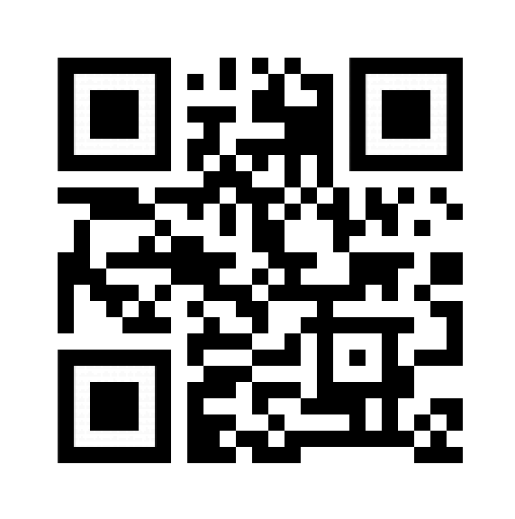
AESD Survey/ Cell – Biology Break!
Complete the survey.
When you are done please take
a break.
https://pdfor.us/s/af60f9
Be back in 15!
Notes:
1:30-1:45 Cell - Biology Break (Peggy)

Slide 13
Problems of Practice...Sharing Out
Notes:
1:45 -2:30
Partner talk and decision about how they will engage in the practice of representing student ideas publicly. choices are CER, Models and Explanations

Slide 14
Collaborative Feedback….
In pairs or trios complete the chart to provide us with collaborative feedback.
Be ready to share out important tidbits.

Slide 15
….and Fond Farewell!
Please complete the AESD Final Survey if you haven’t already.
Thank you, thank you, thank you! We so appreciate your “all in” participation in this learning experiences.
Have a great end to school and keep us posted on the Climate Science work you are doing with your students!
Notes:
2:30-3:00

