Slide 1
Exploring Climate Science with Virtual Reality
Follow-up #3
Teacher/Scientist Partnership
PNNL Campus – Mural Room BSF/CSF
February 7, 2019
Georgia Boatman, Regional Science Coordinator, ESD 123
Peggy Harris Willcuts, Sr. STEM Education Consultant, PNNL
Notes:
Slide 1 10 minutes
Welcome and Introductions

Slide 2
Ambitious Science Teaching
4 CORE SETS OF TEACHING PRACTICES
30 years of research - NSF
Anchoring teaching in complex natural events
Using a variety of discourse strategies - student involvement
Notes:
Slides 2-3 5 minutes
Quick Introduction to / Reminder of Ambitious Science Teaching

Slide 3
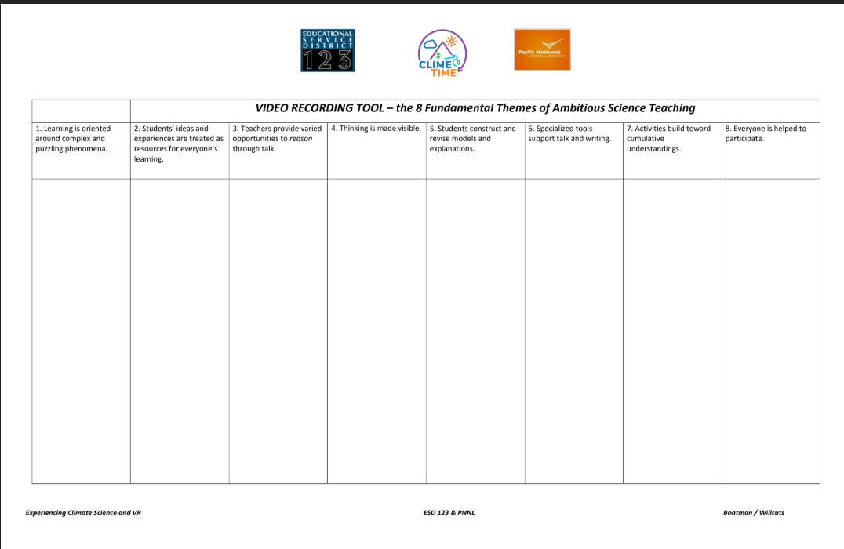
8 Fundamental Themes of Ambitious Science Teaching Video Recording Tool
Get to know the
Video Recording Tool!
Highlight key words...
Notes:
Slides 2-3 5 minutes
Hand out Recording Tool.
Look in each column at the 8 Fundamental Themes of AST. Take a moment to highlight the key words in each columns title.

Slide 4
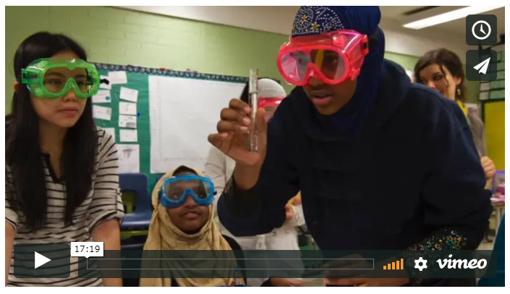
8 Fundamental Themes of
Ambitious Science Teaching
Let’s take a look into a classroom to see what this looks like. Take notes using the scaffold provided!
Notes:
Slide 4-10 45 minutes
https://vimeo.com/106398654

Slide 5
8 Fundamental Themes of
Ambitious Science Teaching (1-2)
Theme 1: Learning is oriented around complex and puzzling phenomena.
Theme 2: Students’ ideas and experiences are treated as resources for everyone’s learning.
Notes:
Slide 4-10 45 minutes
The ambitious teacher is someone who “works with students’ ideas” over time. What would you experience in classrooms where ambitious teaching was the focus? You would see and hear each of the 8 fundamental themes of AST. Go through each slide 5-8 to see the themes. Give people time to finish recording their ideas. Ask for places in the video where they spotted various themes.

Slide 6
8 Fundamental Themes of
Ambitious Science Teaching (3-4)
Theme 3: Teachers provide varied opportunities to reason through talk..
Theme 4: Thinking is made visible.
Notes:
Slide 4-10 45 minutes
The ambitious teacher is someone who “works with students’ ideas” over time. What would you experience in classrooms where ambitious teaching was the focus? You would see and hear each of the 8 fundamental themes of AST. Go through each slide 5-8 to see the themes. Give people time to finish recording their ideas. Ask for places in the video where they spotted various themes.

Slide 7
8 Fundamental Themes of
Ambitious Science Teaching (5-6)
Theme 5: Students construct and revise models and explanations..
Theme 6: Specialized tools support talk and writing..
Notes:
Slide 4-10 45 minutes
The ambitious teacher is someone who “works with students’ ideas” over time. What would you experience in classrooms where ambitious teaching was the focus? You would see and hear each of the 8 fundamental themes of AST. Go through each slide 5-8 to see the themes. Give people time to finish recording their ideas. Ask for places in the video where they spotted various themes.

Slide 8
8 Fundamental Themes of
Ambitious Science Teaching (7-8)
Theme 7: Activities build toward cumulative understandings..
Theme 8: Everyone is helped to participate..
Notes:
Slide 4-10 45 minutes
The ambitious teacher is someone who “works with students’ ideas” over time. What would you experience in classrooms where ambitious teaching was the focus? You would see and hear each of the 8 fundamental themes of AST. Go through each slide 5-8 to see the themes. Give people time to finish recording their ideas. Ask for places in the video where they spotted various themes.

Slide 9
AST Scavenger Hunt Get Ready
Count off by 4:
1. Planning for engagement with important science ideas
2. Eliciting student ideas
3. Supporting ongoing changes in thinking
4. Pressing for evidence-based explanations
Notes:
Slide 4-10 45 minutes
Read from slide

Slide 10
AST Scavenger Hunt Go!
Be prepared to share out your findings.
What are the three best tips/resources you found?
Notes:
Slide 4-10 45 minutes
Four minute reporting out for each group.

Slide 11
Lifted
Watch the video of Erik Roner.
Question: How is Erik Roner able to successfully fly and safely land using helium balloons attached to a lawn chair?
Directions:
Draw your initial model of what is happening that you can’t see that causes Erik to move at each point in time. Use dotted arrows to show motion and solid arrows to show forces in the picture.
Draw and label all of the forces acting on Erik.
Write an explanation about what is happening at each point in time.
Notes:
Slides 11-21 15 minutes
Last time we watch the Erik Roner video to see an engaging phenomena

Slide 12
Modeling + Explanation are “Keystone” Science Practices
Questions
Design of investigations
Argument
Explanation
Models
Seeking & communicating info
Data analysis
Engineering solutions
Models either motivate the other science practices (like asking questions, deciding what to test via investigations), or they change as a result of other science practices (data analysis, argument) —and they are tightly coupled with explanations.
Notes:
Slides 11-21 15 minutes
We learned about models and explanations as key to all of the practices

Slide 13
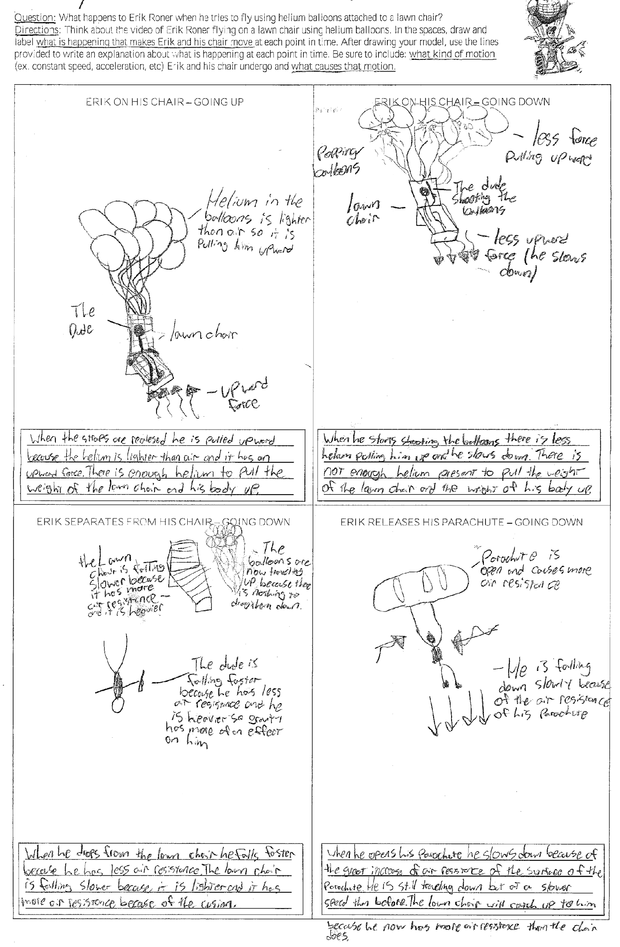
Before and after template for 9th grade unit on forces
Notes:
Slides 11-21 15 minutes
We examined some student samples of initial and final models

Slide 14
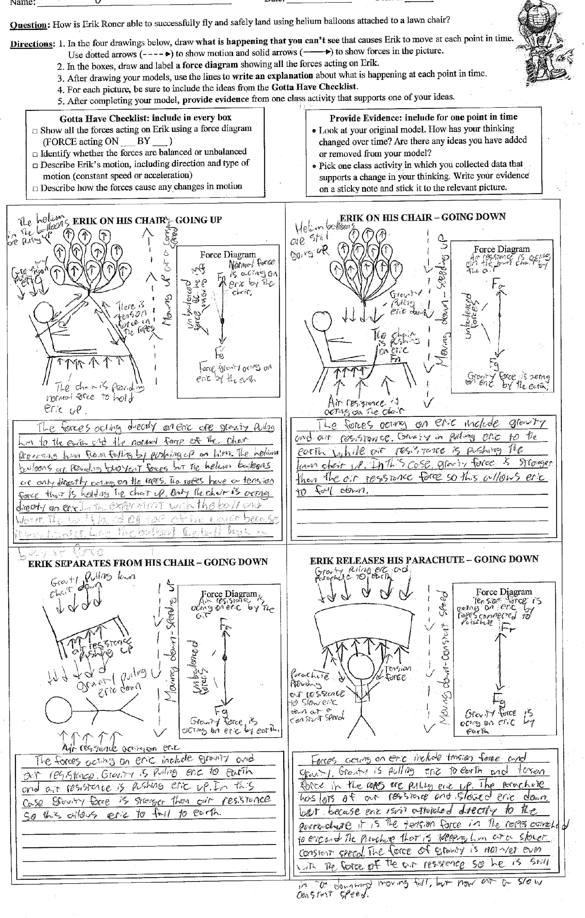
Scaffolding
What kinds of scaffolds did the teacher provide for the students on the model template?
If you did not include this kind of scaffolding, would you likely have students showing you this kind of work? What does this scaffolding do to support them?
Notes:
Slides 11-21 15 minutes
We learned how to scaffold for models to help students capture ALL of their thinking

Slide 15
Gotta Have Checklist:
Ideas that have to be in the model, or in the explanation, or both
Notes:
Slides 11-21 15 minutes
One of those scaffolds was the Gotta Have It Checklist

Slide 16
Carbon Dioxide Levels in the Atmosphere
Arguing from Evidence
Argument-Driven Inquiry in Earth and Space Science: Lab Investigations for Grades 6–10 - --Victor Sampson Resource
Notes:
Slides 11-21 15 minutes
In our first follow-up meeting we engaged in argument driven inquiry using a unit from the Victor Sampson book to help understand arguing from evidence

Slide 17
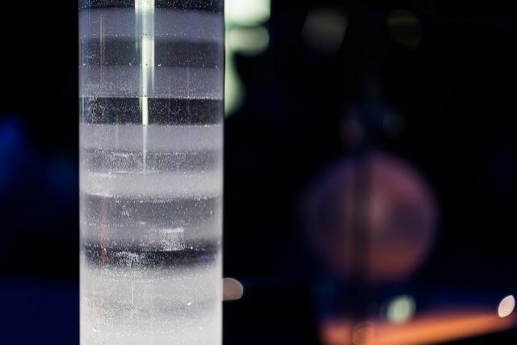
Obtaining Information
Note the text features
Predict what you think the text will be about
With a partner read through the Introduction and Getting Started page 439-top part of 440
Paul Hudson
https://creativecommons.org/licenses/by/2.0/
No changes made
Notes:
Slides 11-21 15 minutes
We used the Carbon Dioxide Levels in the Atmosphere lessons and claims, evidence, reasoning strategies to steep ourselves in this type of classroom task.

Slide 18
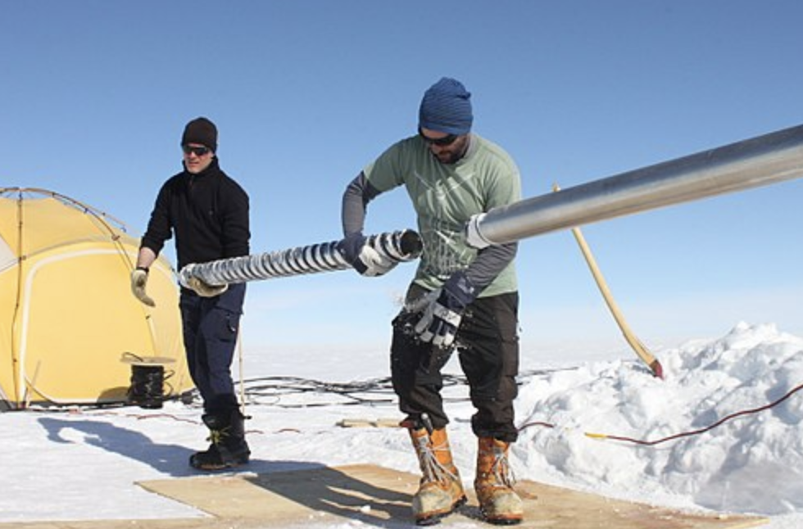
Analyze and Interpret the Data-1
Strategy to look at data…
Highlights, Comments, and Captions
Highlight what I see:
Look for changes, trends, or differences.
Write what you see. A different description for each observation.
Be concise - write only the essence, or highlights, of what you see.
Helle Astrid Kjaer
Wikipedia Commons
https://creativecommons.org/licenses/by/4.0/
No changes made
Notes:
Slides 11-21 15 minutes
One strategy was highlighting important data

Slide 19
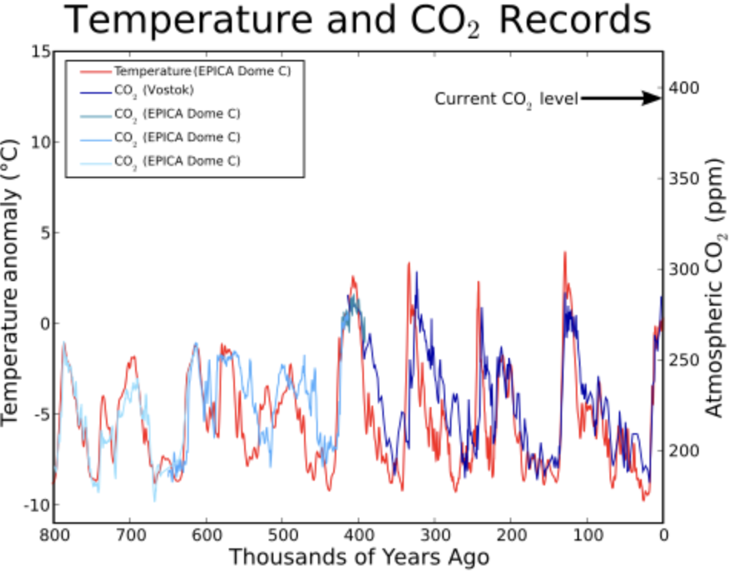
Analyze and Interpret the Data-2
Strategy to look at data…
Highlights, Comments and Captions
Comment on what it means:
Interpret what you see.
Write what each observation means.
Don’t tackle all of the data at once, just one observation at a time
Leland McInnes at the English language Wikipedia
Attribution-Share Alike 3.0 Unported
Notes:
Slides 11-21 15 minutes
Next we commented and interpreted that data.

Slide 20
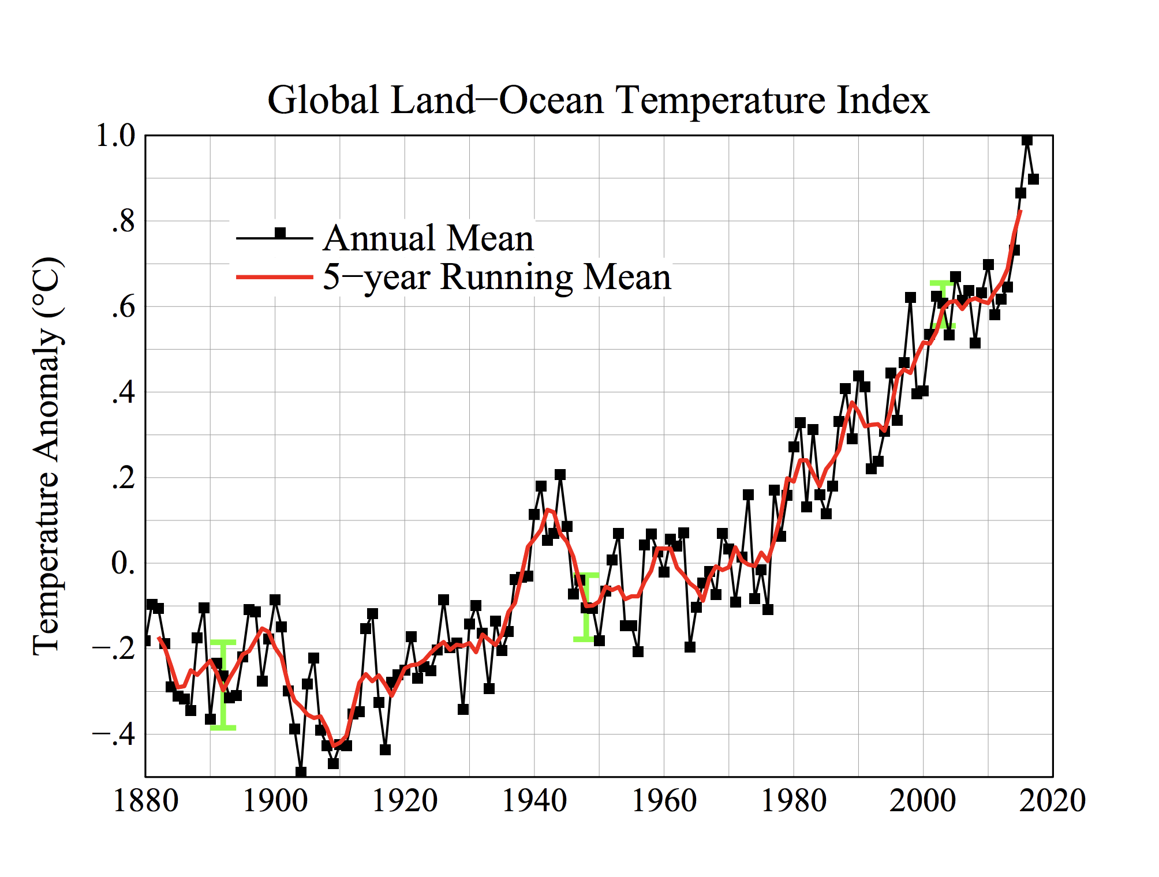
Analyze and Interpret the Data-3
Strategy to look at data…
Highlights, Comments and Captions
Create a Caption:
Think of the caption as a summary.
Begin your caption with a topic sentence describing the overview of the figure.
Join each “What I see” to its “What it means” to form a sentence.
Build a coherent description in 2 to 3 sentences.
Public Domain
Wikipedia Commons
Notes:
Slides 11-21 15 minutes
Finally we summarized that data in a 2-3 sentence ”caption”

Slide 21
Argue from Evidence Gallery Walk
Visit each team as a group.
Listen to their argument.
Give feedback and be ready to take back ideas to discuss with your group.
Notes:
Slides 11-21 15 minutes
We saw the value of making your argument to each other

Slide 22
Representing Student Ideas Publicly Teachers’ Choice
Time to decide…...
Pixabay License Free for commercial use
Notes:
Slide 22 45-60 minutes or as time allows
Talk with your partner(s). Make a decision about how you will engage in the practice of representing student ideas publicly. Remember your choices are CER, Models and Explanations. This is the time to begin to develop an actual plan for how they will Represent Student Ideas Publicly as part of eliciting student ideas.
Given you a couple of ways think about this work
Given you a way to think about phenomena the students can do this work around
Talked about public representations over time to build on and refine
We want you to think about the phenomena you think you might use and about and the work you do in your classroom, how do you embed a formative classroom task. This is your new work. Embedding not adding on.
a very brief reminder of the 4 elements of AST and where we are in the process
Time to translate their phenomena thinking into planning using the AST Planning for Engagement Tool section 4

Slide 23
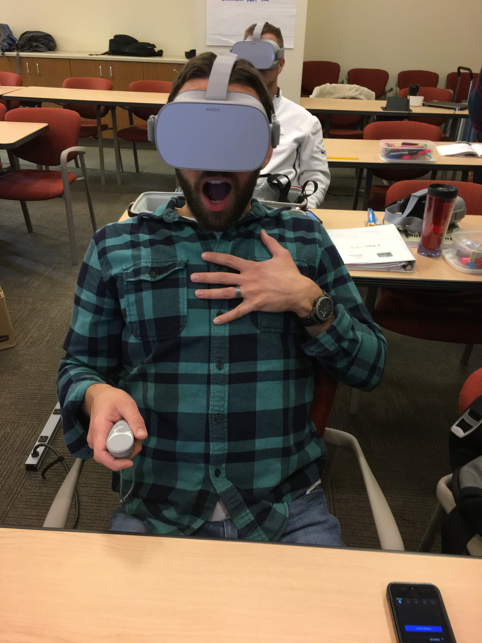
Climate Science & VR
Picture by P. Willcutts
Notes:
Slide 23 60 minutes to 90 minutes Climate Science App
Teachers engaged with VR scientists to:
Audio and Video casting,
Screenshot and video capture
Downloading to a computer screen
Learn about the Feedback Google Form
Teacher Feedback:
https://drive.google.com/open?id=1Hp-v9OM2BJPlaUsFb1x8SnkR5WXtnVnD7TjM-tMSqlU
Student Feedback:
https://drive.google.com/open?id=1FsuyMw_LpjCWyvXj9dLbkTn_CoDgR_aiZSB5OMofgwE

Slide 24
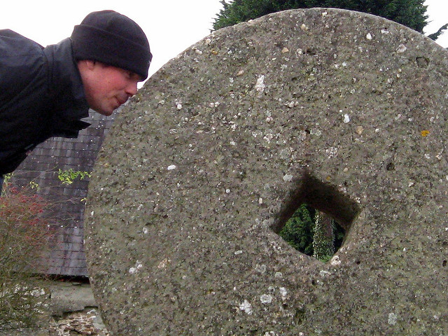
Nose to the Grindstone!
https://creativecommons.org/licenses/by/2.0/
Notes:
Slide 33 Whatever time is left
A brief reminder of where we are in the process
Given you a couple of ways think about this work
Given you a way to think about phenomena the students can do this work around
Talked about public representations over time to build on and refine
We want you to think about the phen. you think you might use and about and the work you do in your classroom, how do you embed a formative classroom task. This is your new work. Embedding not adding on.
a very brief reminder of the 4 elements of AST and where we are in the process
Time to translate their phenomena thinking into planning using the AST Planning for Engagement Tool section 4
Then using the Planning for Engagement tool Step 4
Be prepared to have something in writing that gets uploaded to the folder on Google Drive. Make the case for why a large variety of documents can be helpful to other teachers. We want products to share. A platform will be created by which these products will be shared.

Slide 25
Creative Commons Licensing
License:
Creative Commons Attribution 4.0
Georgia Boatman
Regional Science Coordinator
Educational Service District 123
Peggy Willcuts
Senior STEM Consultant
Pacific Northwest National Laboratory
Notes:
Creative Commons Licensing information

