Slide 1
Exploring Climate Science with Virtual Reality
Follow-up #1
Teacher/Scientist Partnership
PNNL Campus – Mural Room BSF/CSF
October 2, 2018
Georgia Boatman, Regional Science Coordinator, ESD 123
Peggy Willcuts, Sr. STEM Education Consultant, PNNL
Notes:
Slide 1 Welcome and Introductions (all teachers and all facilitators)
Restrooms / Evacuation Site / Escorted Badges

Slide 2
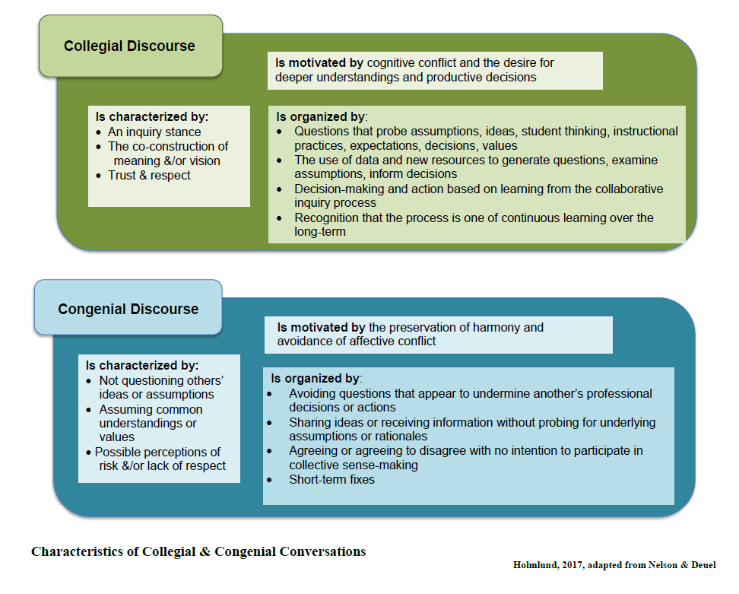
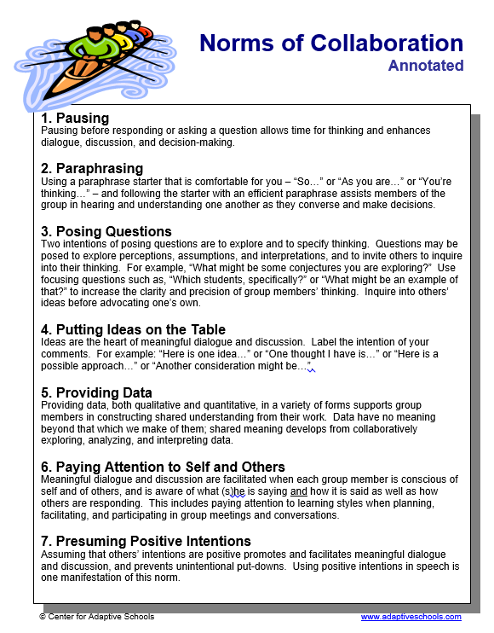
Refresh - Take a Quick Glance
Notes:
Slide 2-3 30 minutes
Welcome to Exploring Climate Science Follow-up
Our norms
Just a reminder of these two documents and an invitation to revisit them as needed

Slide 3
Updates on What You are Doing
Report out to the group about any Climate Science work you have done so far…
Planning
Lessons
Research
Etc.
Notes:
Slide 2-3 30 minutes
Report Out
25 minutes
Report out on what you have been doing (planning, research, teaching, use of resources)

Slide 4
Is it a Phenomena?
Qualities of a Good Anchor Phenomena
Read through the one page document
Discuss with a partner
Get back into the phenomena charts - go through the whole cycle
Notes:
Slides 4-7
90 min
Grounding: Qualities of a Good Phenomena
Hand out of one-pager of Phenomena Graphic
To brainstorm a phenomena, read through each of the elements on the handout
Move to your wall chart and continue brainstorming

Slide 5
Phenomena Brainstorming Tool
Notes:
Slides 4-7
90 min
Grounding: Qualities of a Good Phenomena
Hand out of one-pager of Phenomena Graphic
To brainstorm a phenomena, read through each of the elements on the handout
Move to your wall chart and continue brainstorming

Slide 6
Transitioning to Classroom Implementation
Finish thinking on Phenomena Development Chart
Think about lessons/units that you teach or may teach where this phenomena would be employed
Continue to develop a classroom experience around this phenomena and the ecology and human impact learning
Be ready to share to the group
Notes:
Slides 4-7
90 min
Grounding: Qualities of a Good Phenomena
Hand out of one-pager of Phenomena Graphic
To brainstorm a phenomena, read through each of the elements on the handout
Move to your wall chart and continue brainstorming

Slide 7
Share Out Your Ideas
Share out your initial thinking about a phenomena
What is the phenomena?
How do you think you would introduce it?
Any thoughts on lessons to illuminate the phenomena?
Notes:
Slides 4-7
90 minutes
Share out of initial thinking: choice of phenomena
How to introduce it to your students
Activities you might do with students

Slide 8
Probing For Understanding
Parts Per Million Card Sort:
First Sort: signs of global warming and not clear signs of global warming
Second Sort: Direct measurement of global warming of the earth and inferences from data
Notes:
Slide 8
. Page Keeley Card Sort “What are the Signs of Global Warming?”
30 minutes
Regroup and hand out card sets
The purpose of this assessment probe, made into a card sort, is to elicit students’ ideas about the signs of global warming.
The probe is designed to determine whether students think a statement is:
Accurate or complete enough to see direct patterns or draw inferences from data that can be used to support the claim that our planet is warming, 0r
Whether more long-term data is needed to decide whether the effect is a sign of global warming.
First sort: Using the above criteria, sort the cards into those that could be considered signs of global warming and those that are not clear signs of global warming
Second sort: Sort the cards into direct measurement of global warming of the earth and inferences from data (over long period of time, types of data)
Debrief the facilitation: Supportive of English Language Learners? How would you facilitate this with your students?
Share NOAA’s Ten Signs of a Warming World

Slide 9
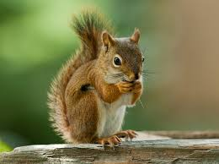
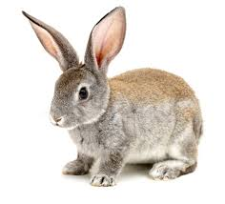
Probing For Understanding Yale Map
2018 Map from Yale
https://bit.ly/2GFDUiJ
This is two years ago.
Individually, squirrel down as many rabbit holes as you can.
What do you predict the situation would look like now?
Notes:
Slides 9-11
Probing for Understanding Part 2 45 minutes
Show map from Yale with 2016 data. This is the situation two years ago,
Individually squirrel down as many rabbit holes as you can.
What do you predict things would look like now?

Slide 10
Probing For Understanding Controversial Topics
How should you engage students in controversial topics?
Read article.
How might you use this to engage students in discourse around this topic?
Notes:
Slides 9-11
Probing for Understanding Part 2 (Peggy)
45 minutes
Handout article: How to engage students in controversial topics.
Read and React to Four Tips to Teaching Climate Science
How would you use this to engage in student discourse?
Get up, find someone in the room you do not work with. Share out your answer to this question.

Slide 11
Probing For Understanding Share Ideas
Stand up.
Find someone in the room you do not work with.
Share your thinking on how you would use this to engage students in discourse?
Notes:
Slides 9-11
Probing for Understanding Part 2 (Peggy)
45 minutes
Handout article: How to engage students in controversial topics.
Read and React to Four Tips to Teaching Climate Science
How would you use this to engage in student discourse?
Get up, find someone in the room you do not work with. Share out your answer to this question.

Slide 12
Carbon Dioxide Levels in the Atmosphere Resource
Arguing from Evidence
Argument-Driven Inquiry in Earth and Space Science: Lab Investigations for Grades 6–10 - --Victor Sampson Resource
Notes:
Slides 12-22 Claims, Evidence, and Reasoning – Argument Driven Inquiry Resource
75 minutes
We will be engaging in an activity from a Victor Sampson resource called Argument - Driven Inquiry in Earth and Space Science.
I am choosing to share one on Carbon Dioxide Levels in the Atmosphere as it directly ties to our Climate Science work.

Slide 13
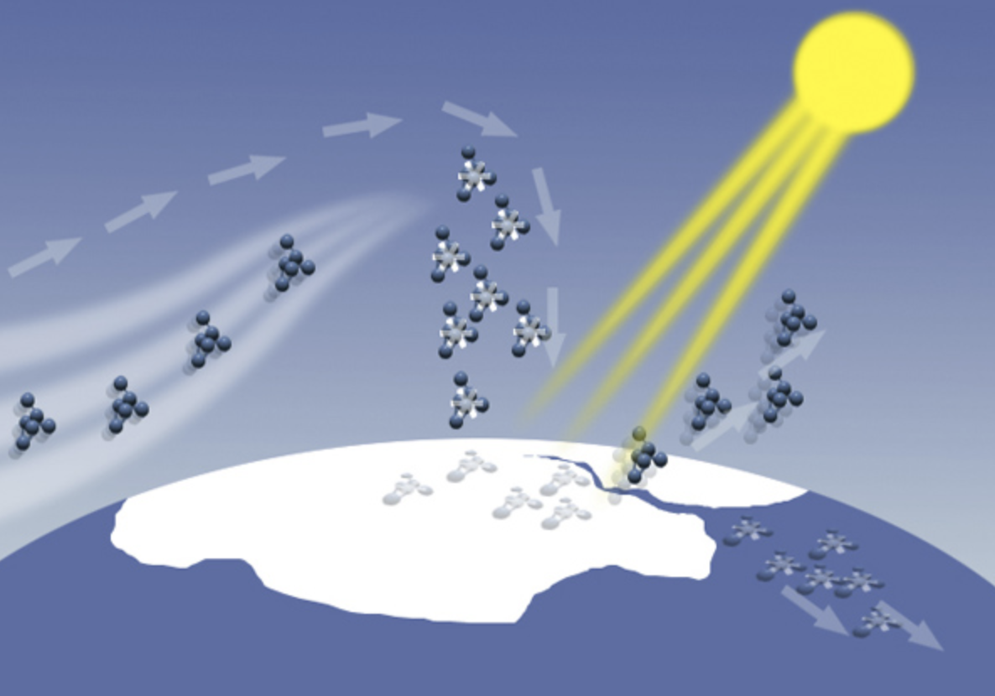
Carbon Dioxide Levels in the Atmosphere
Question: How has the concentration of atmospheric
carbon dioxide changed over time?
Quick write your first thinking
Share with a neighbor
https://creativecommons.org/licenses/by/2.0/
Notes:
Slides 12-22 Claims, Evidence, and Reasoning – Argument Driven Inquiry Resource
75 minutes
How has the concentration of atmospheric carbon dioxide changed over time?
Quick write your initial thinking
Share with a neighbor

Slide 14
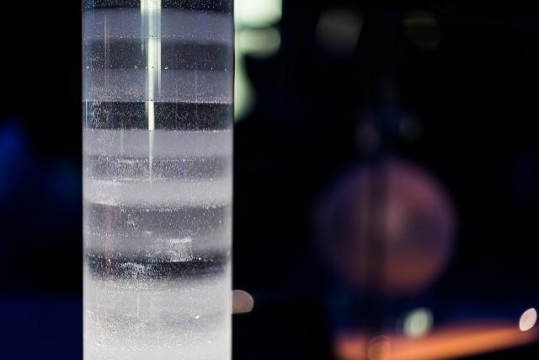
Obtaining Information
Note the text features
Predict what you think the text will be about
With a partner read through the Introduction and Getting Started page 439-top part of 440
Paul Hudson
Flickrudson
https://creativecommons.org/licenses/by/2.0/
No changes made
Notes:
Slides 12-22 Claims, Evidence, and Reasoning – Argument Driven Inquiry Resource
75 minutes
Examine the handout. Note the text features
Predict what you think the text will be about
Read pages 439-440 with a partner - the Introduction and Getting Started

Slide 15
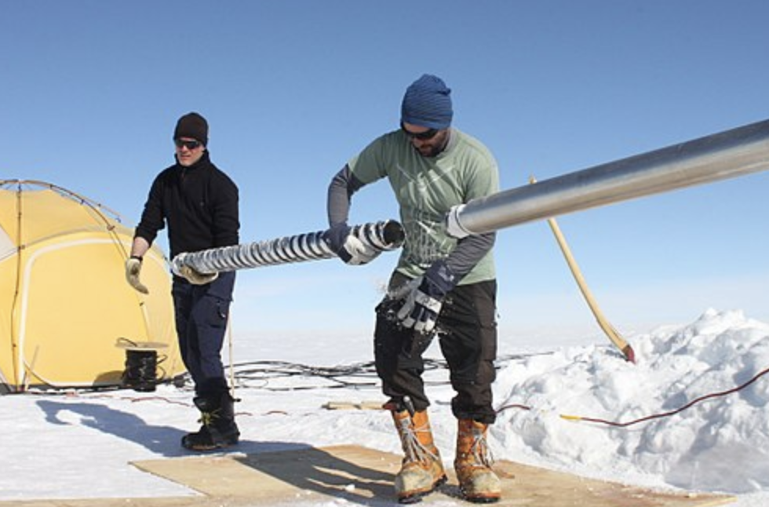
Analyze and Interpret the Data-1
Strategy to look at data…
Highlights, Comments, and Captions
Highlight what I see:
Look for changes, trends, or differences.
Write what you see. A different description for each observation.
Be concise - write only the essence, or highlights, of what you see.
Helle Astrid Kjaer
Wikipedia Commons
https://creativecommons.org/licenses/by/4.0/
No changes made
Notes:
Slides 12-22 Claims, Evidence, and Reasoning – Argument Driven Inquiry Resource
75 minutes
Let’s engage in a strategy to look at data
Highlights, Comments, and Captions
HIGHLIGHT: what I see
Look for changes, trends or differences
Write what you see - a different description for each observation
Be concise - write on the essence, or highlights of what you see.

Slide 16
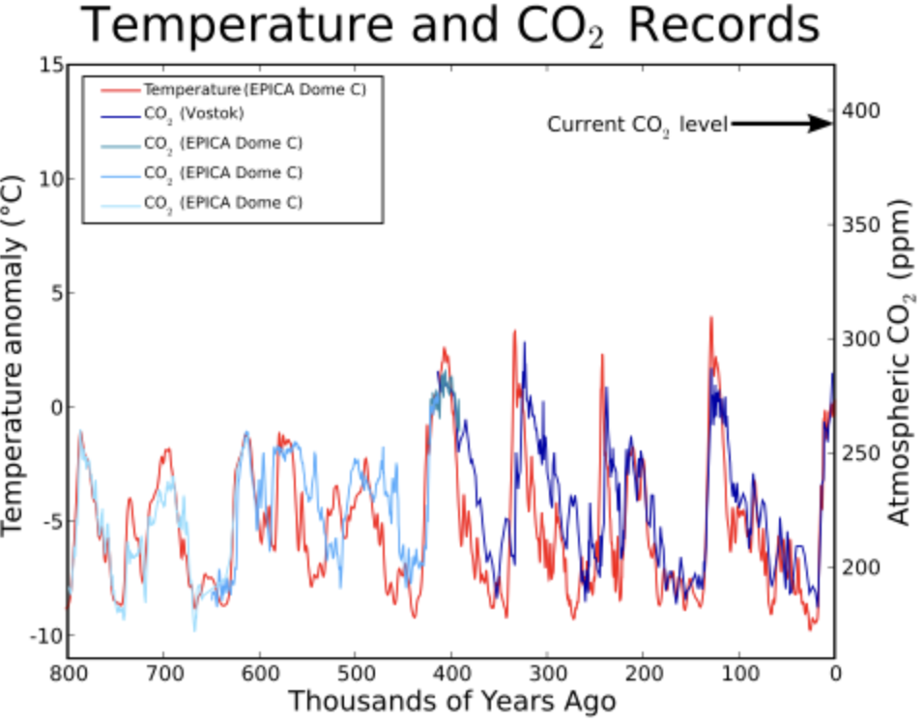
Analyze and Interpret the Data-2
Strategy to look at data…
Highlights, Comments and Captions
Comment on what it means:
Interpret what you see.
Write what each observation means.
Don’t tackle all of the data at once, just one observation at a time
Leland McInnes at the English language Wikipedia
Attribution-Share Alike 3.0 Unported
Notes:
Slides 12-22 Claims, Evidence, and Reasoning – Argument Driven Inquiry Resource
75 minutes
For Comments: comment on what it means
Interpret what you see.
Write what each observation means.
Don’t tackle all the data at once - just one observation at a time.

Slide 17
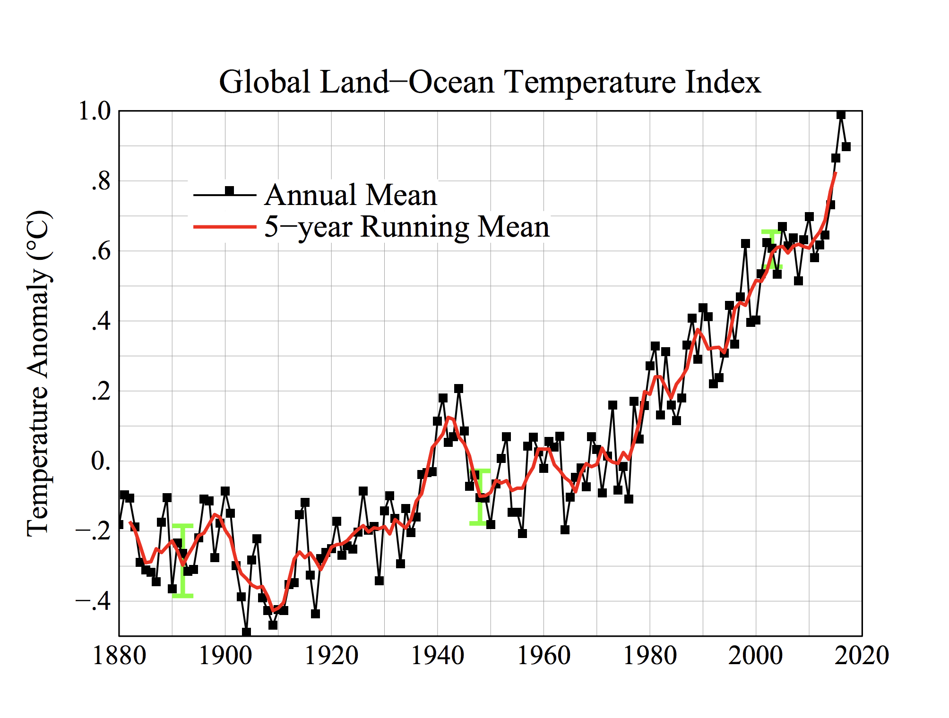
Analyze and Interpret the Data-3
Strategy to look at data…
Highlights, Comments and Captions
Create a Caption:
Think of the caption as a summary.
Begin your caption with a topic sentence describing the overview of the figure.
Join each “What I see” to its “What it means” to form a sentence.
Build a coherent description in 2 to 3 sentences.
Public Domain
Wikipedia Commons
Notes:
Slides 12-22 Claims, Evidence, and Reasoning – Argument Driven Inquiry Resource
75 minutes
For Create a Caption:
Think of the caption as a summary.
Begin your caption with a topic sentence describing the overview of the figure.
Join each “What I see” to its “What it means” to form a sentence.
Build a coherent description in 2-3 sentences.

Slide 18
Argue from Evidence
Using evidence, talk through your best argument for answering the question: How has the concentration of
atmospheric carbon dioxide changed over time?
Be sure to:
-state the claim you are trying to support
-include genuine evidence (data+analysis+interpretation)
-provide a justification of your evidence that explains why the evidence is relevant and why it supports the claim
-organize your argument in a way that enhances listener understanding
-use a broad range of words including science vocabulary
you have learned
Notes:
Slides 12-22 Claims, Evidence, and Reasoning – Argument Driven Inquiry Resource
75 minutes
Using evidence, talk through your best argument for answering the question: How has the concentration of Atmospheric carbon dioxide changed over time?
Be sure to:
State the claim you are trying to support
Include genuine evidence (data + analysis + interpretation)
Provide a justification of your evidence that explains why the evidence is relevant and why it supports the claim
Organize your argument in a way that enhances listener understanding
Use a broad range of words including science vocabulary you have now learned.

Slide 19
Construct an Explanation-Prepare to Argue from your Evidence: How has the concentration of
Atmospheric carbon dioxide changed over time?
Summarize your evidence to construct an explanation
Analyze the evidence
Look for trends and patterns.
Think about your oral arguments.
Record your Claim, Evidence and Explanation/Justification to answer the question (see template on page 442).
Notes:
Slides 12-22 Claims, Evidence, and Reasoning – Argument Driven Inquiry Resource
75 minutes
Construct an Explanation - Prepare to Argue from Your Evidence
How has the concentration of atmospheric carbon dioxide changed over time?
Summarize your evidence to construct an explanation
Analyze the evidence
Look for trends and patterns
Think about your oral arguments.
Record your Claim, Evidence and Explanation/Justification to answer the question (see template on page 442)

Slide 20
Argue from Evidence Report Out
Report Out
What question were you trying to answer and why?
What did you do to answer your question and why?
What is your argument?
Your report should answer
these questions in two pages
or less.
Notes:
Slides 12-22 Claims, Evidence, and Reasoning – Argument Driven Inquiry Resource
75 minutes
Report Out:
What question were you trying to answer and why?
What did you do to answer your question and why?
What is your argument?
Your report should answer these questions in two pages or less.

Slide 21
Argue from Evidence Gallery Walk
Visit each team as a group.
Listen to their argument.
Give feedback and be ready to take back ideas to discuss with your group.
Notes:
Slides 12-22 Claims, Evidence, and Reasoning – Argument Driven Inquiry Resource
75 minutes
Visit each team as a group.
Listen to their argument.
Give feedback and be ready to take back ideas to discuss with your group.

Slide 22
Be Ready to Report
1. What question were you trying to answer and why?
2. What did you do to answer your question and why?
3. What is your argument?
Notes:
Slides 12-22 Claims, Evidence, and Reasoning – Argument Driven Inquiry Resource
75 minutes
What question were you trying to answer and why?
What did you do to answer your question and why?
What is your argument?

Slide 23
Return to Phenomena Chart
Return to Phenomena Chart
How might your thinking change in light of the Argument from Evidence work?
Continue your planning with the chart
Notes:
Slide 27
. Return to Phenomena Chart
30 minutes

Slide 24
Creative Commons Licensing
License:
Creative Commons Attribution 4.0
Georgia Boatman
Regional Science Coordinator
Educational Service District 123
Peggy Willcuts
Senior STEM Consultant
Pacific Northwest National Laboratory
Notes:
Creative Commons Licensing information

