Slide 1
Open Educational Resources (OER)
OER Commons

Slide 2
Goals
Provide a brief explanation OER in general
Provide a brief overview and explanation of OER Commons specifically
Notes:
Added this slide to explain the brevity of the presentation

Slide 3
What are Open Educational Resources (OER)?
Open Educational Resources (OER) are teaching and learning materials that reside in the public domain or have been released under an open license. These resources may be used free of charge, distributed without restriction, and modified without permission. (OSPI Digital Learning Department)
http://digitallearning.k12.wa.us/oer/

Slide 4
OER Collections
Numerous OER collections available at OSPI DLD
http://digitallearning.k12.wa.us/oer/collections.php
Notes:
These collections are suggested at the OSPI DLD web page.

Slide 5
OER Commons
The Institute for the Study of Knowledge Management in Education (ISKME) created OER Commons to provide support for and build a knowledge base around the use and reuse of open educational resources (OER). As a network for teaching and learning materials, the web site offers engagement with resources in the form of social bookmarking, tagging, rating, and reviewing.
https://www.oercommons.org/
Notes:
Register for free account.
Benefits – Access lesson plans, units, and teaching resources.
Create materials, share materials and/or collaborate
Click on login.

Slide 6
Register
Notes:
Click upper right hand corner

Slide 7
https://www.oercommons.org/registration

Slide 8
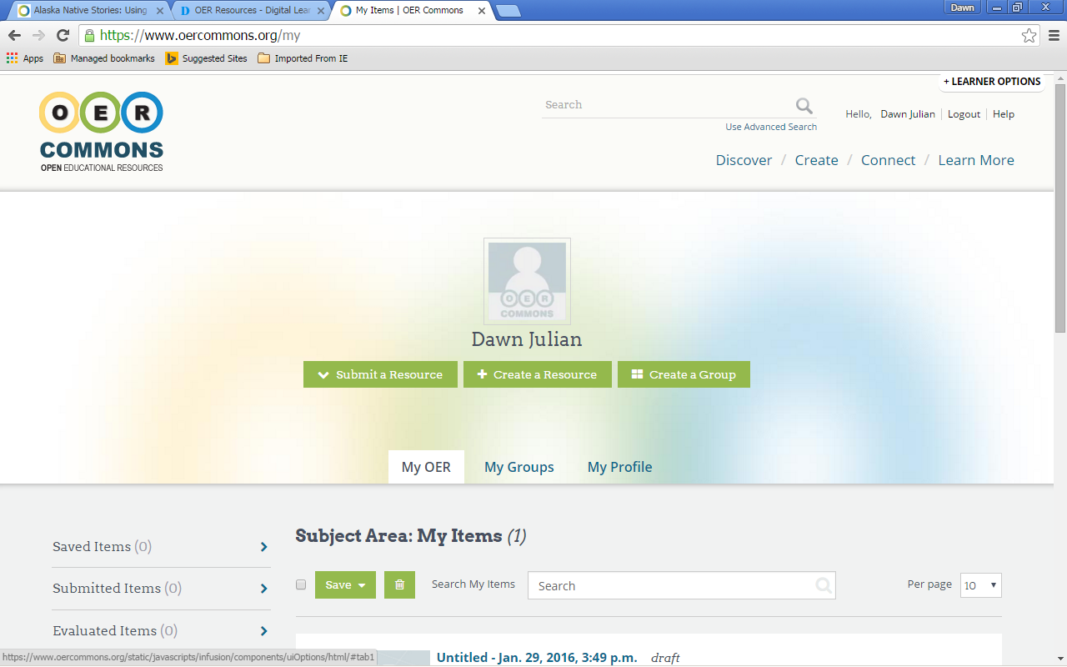
https://www.oercommons.org/my
Notes:
Click on name

Slide 9
Discover
Click “Discover” on home page https://www.oercommons.org/
Subject Areas
Grade Levels
Materials Types
Notes:
Add

Slide 10
Create
Click “Create” on home page https://www.oercommons.org/
Open Author
Open Author Features
Tools and How-to’s
Why use Open Author?
Help & Tutorials
Notes:
Added this slide because there are additional supports, how-to’s and tutorials for authoring materials. The bullets on this page are the subdivisions on the webpage.

Slide 11
Started Authoring
Created a PowerPoint for sharing OER Commons
Created group and co-authors
Notes:
I added this slide just a s reminder to explain our product that we will post at some point. The OER Commons webpage has a button that says, “Start Authoring” so I titled this slide because we had “started authoring.” We can remove these notes when we post but I thought it might be important to explain—this slide may not be necessary

Slide 12
Connect
Click on “Connect” on home page https://www.oercommons.org/
Connect with all OER Common Groups
Hubs
Notes:
I added this because it is the last of the buttons on the home page and explains the connections to other OER Common groups and Hubs.

Slide 13
Practice
Go forth and create!
Notes:
This is the closing which can be the end of a brief presentation or time to practice in a longer presentation.

