Slide 1
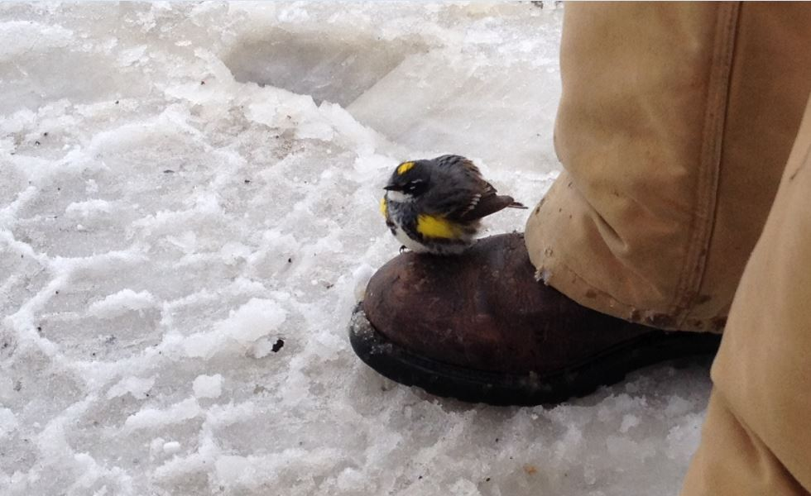
Climate Science for High School Teachers
August 12 - 15, 2018
John Hubbe PNNL

Slide 2
Disciplinary Core Ideas
Disciplinary Core Idea
ESS2.D: Weather and Climate
The foundation for Earth's global climate systems is the electromagnetic radiation from the sun, as well as its reflection, absorption, storage, and redistribution among the atmosphere, ocean, and land systems, and this energy's re-radiation into space. (HS-ESS2-4)
Changes in the atmosphere due to human activity have increased carbon dioxide concentrations and thus affect climate. (HS-ESS2-6)
Approach
- a lot of science is creating models/analogies
to help us 'see' things we can't 'see'
- graphs tell stories (If "a picture is worth a thousand words",
a graph is worth a thousand numbers)
- build on what we know (make new connections)

Slide 3
What is Climate
What is climate?
...
- statistics of weather (averages, ranges, frequencies)
- patterns of weather (over time, over space,
connected to earth features)
...
We can see patterns of weather in satellite images
- visible-wavelength images
- infrared-wavelength images

Slide 4
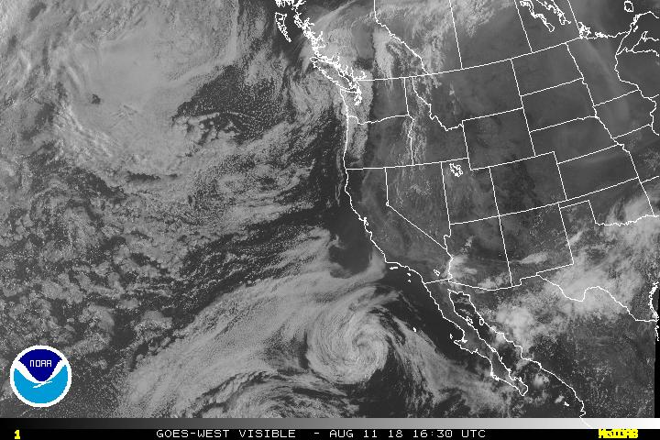
NOAA Satellite Image
https://www.wrh.noaa.gov/satellite/?wfo=pdt
http://www.ssd.noaa.gov/goes/west/weus/vis.jpg

Slide 5
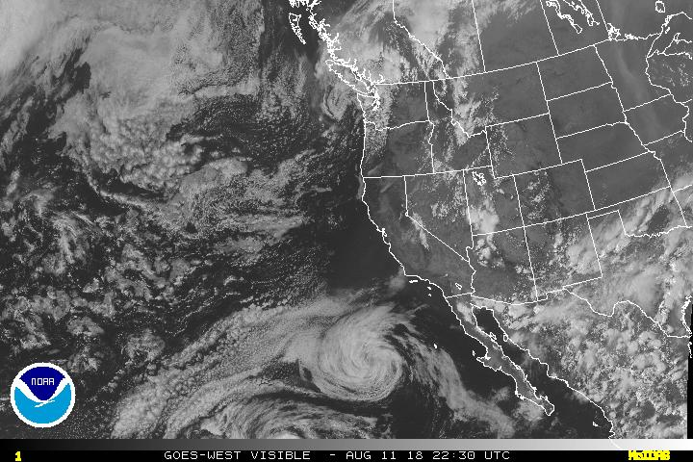
NOAA Satellite Image Reflected Radiation
https://www.wrh.noaa.gov/satellite/?wfo=pdt
http://www.ssd.noaa.gov/goes/west/weus/vis.jpg
Reflected

Slide 6
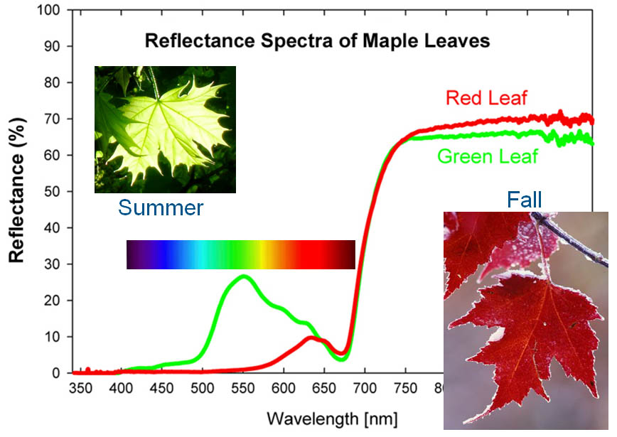
Reflectance Spectra of Maple Leaves
[planetarygeolog.blogspot.com]

Slide 7
Electromagnetic Spectrum
Electromagnetic energy has properties of...
- waves (wavelengths, velocities, and frequencies)
- particles (the smallest packet of electromagnetic energy is the photon;
photons carry energy from one place to another;
photons interact with matter/atoms/molecules)

Slide 8
Electromagnetic Spectrum Inset
[]

Slide 9
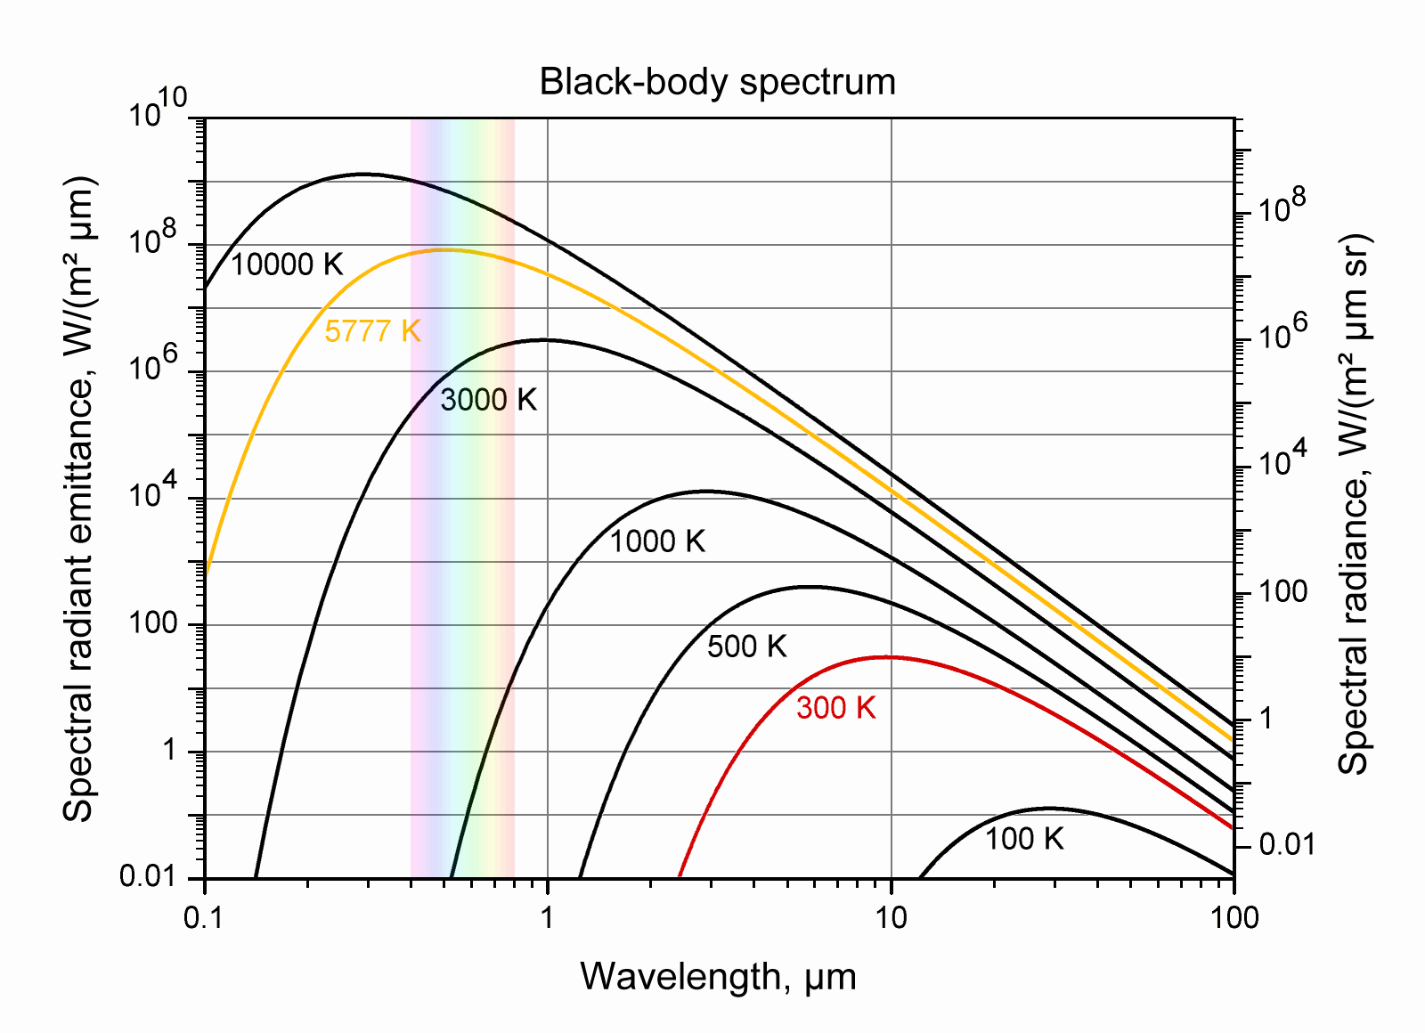
Black Body Spectrum

Slide 10
NOAA Satellite Image Reflected Radiation
https://www.wrh.noaa.gov/satellite/?wfo=pdt
http://www.ssd.noaa.gov/goes/west/weus/vis.jpg
Reflected

Slide 11
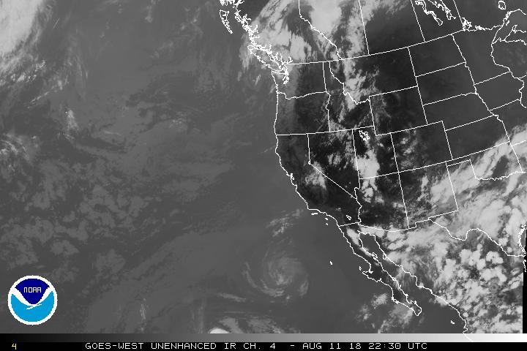
NOAA Satellite Image Emitted Radiation from Earth
https://www.wrh.noaa.gov/satellite/?wfo=pdt
http://www.ssd.noaa.gov/goes/west/weus/ir4.jpg
Emitted

Slide 12
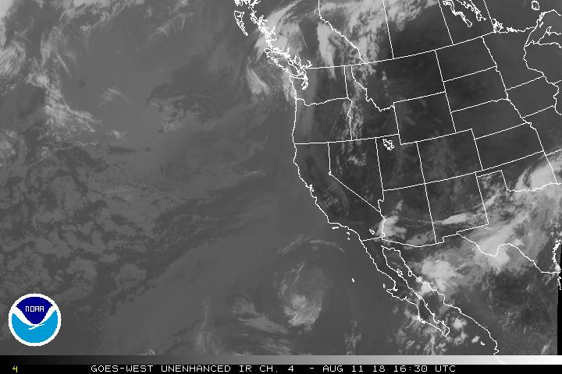
NOAA Satellite Image Emitted Radiation from Earth
https://www.wrh.noaa.gov/satellite/?wfo=pdt
http://www.ssd.noaa.gov/goes/west/weus/ir4.jpg
Emitted

Slide 13
Earth's energy budget
345 W/m^2
~5(10)^16 W
Visible radiation
From Sun
Absorbed by Earth
Infrared radiation
Emitted by Earth

Slide 14
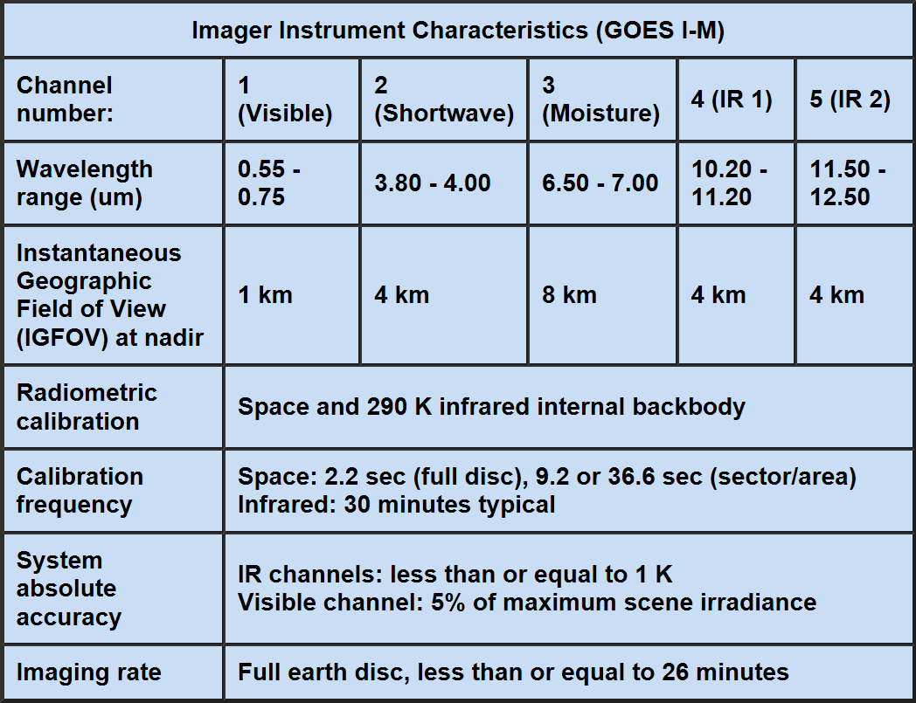
Imager Instrument Characteistics

Slide 15
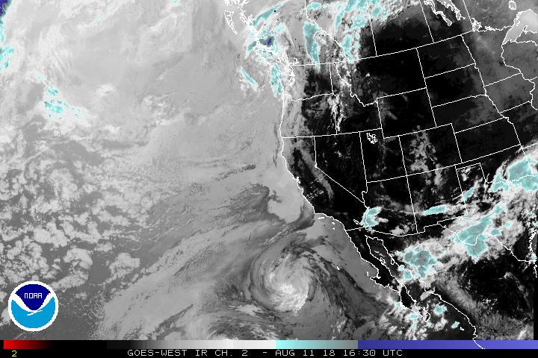
NOAA Satellite Image Emitted Radiation from Earth
https://www.wrh.noaa.gov/satellite/?wfo=pdt
http://www.ssd.noaa.gov/goes/west/weus/ir2.jpg
Emitted

Slide 16
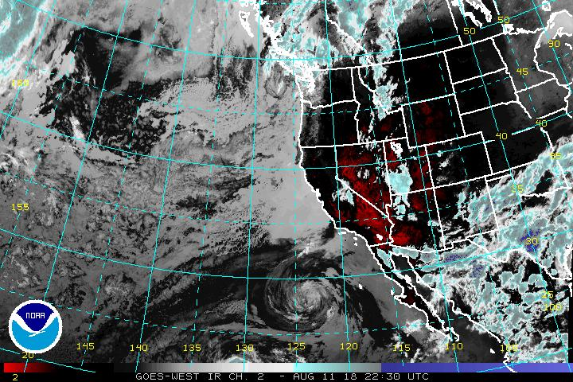
NOAA Satellite Image Emitted Radiation from Earth
https://www.wrh.noaa.gov/satellite/?wfo=pdt
http://www.ssd.noaa.gov/goes/west/weus/ir2.jpg
Emitted

Slide 17
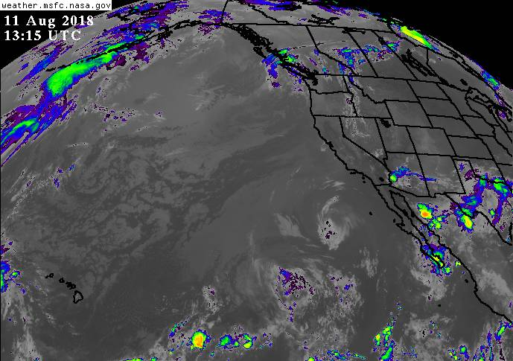
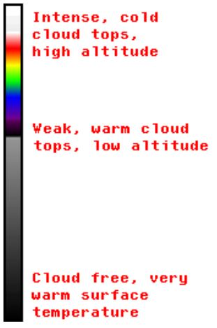
NOAA Satellite Image Emitted Radiation from Earth

