Slide 1
Energy Balance
Laura Riihimaki

Slide 2
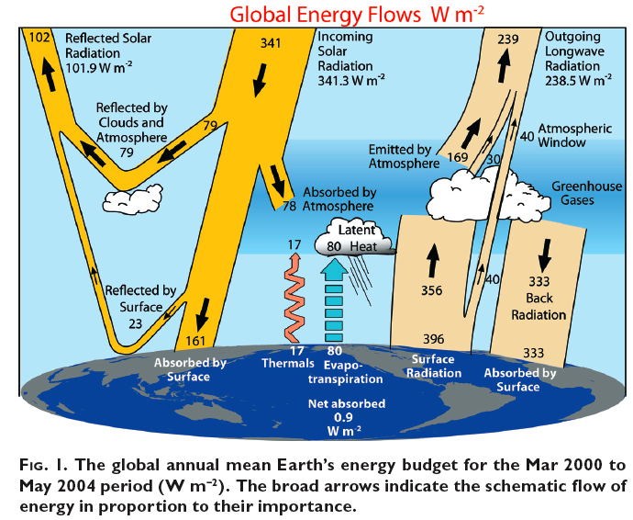
Earth’s energy balance
Source: Trenberth et al., 2009

Slide 3
Global Energy Flow Model-2013

Slide 4
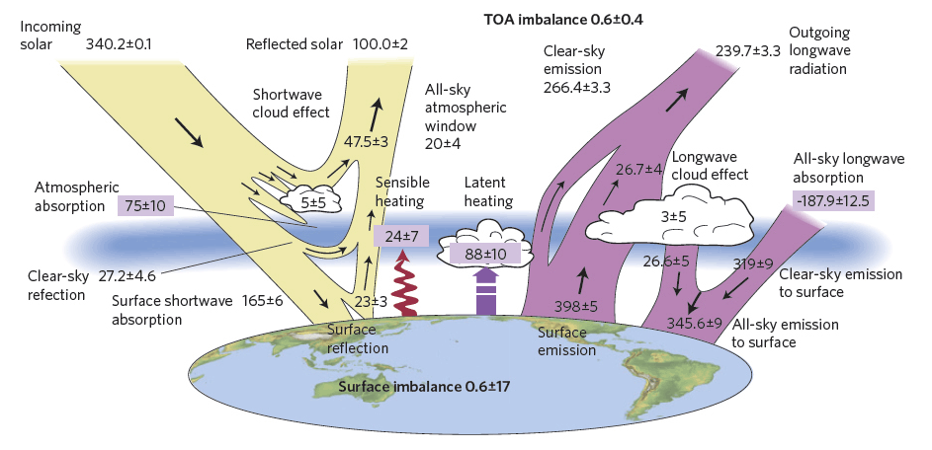
Global Energy Flow Model-Stephens
Based on Stephens et al. (2012) for period from 2000-2010

Slide 5
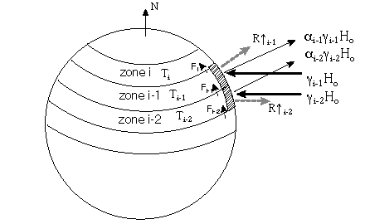
Energy Balance Model
https://www.shodor.org/master/environmental/general/energy/energy.html
At what fraction of the solar constant does the hemisphere "ice over", that is, the surface temperatures in all the zones fall to or below the critical temperature? How sensitive is the model to changes in the solar constant fraction?
A variety of values for the transport constant have been reported:
  C=3.81 W m⁻² C⁻¹
  C=3.74 W m⁻² C⁻¹
  How sensitive is the model to changes in this constant?
Holding A constant, vary B slightly and investigate the effect on the climate. What does a variation in B correspond to physically?

Slide 6
Increasing CO₂ and Global Climate Modeling

Slide 7
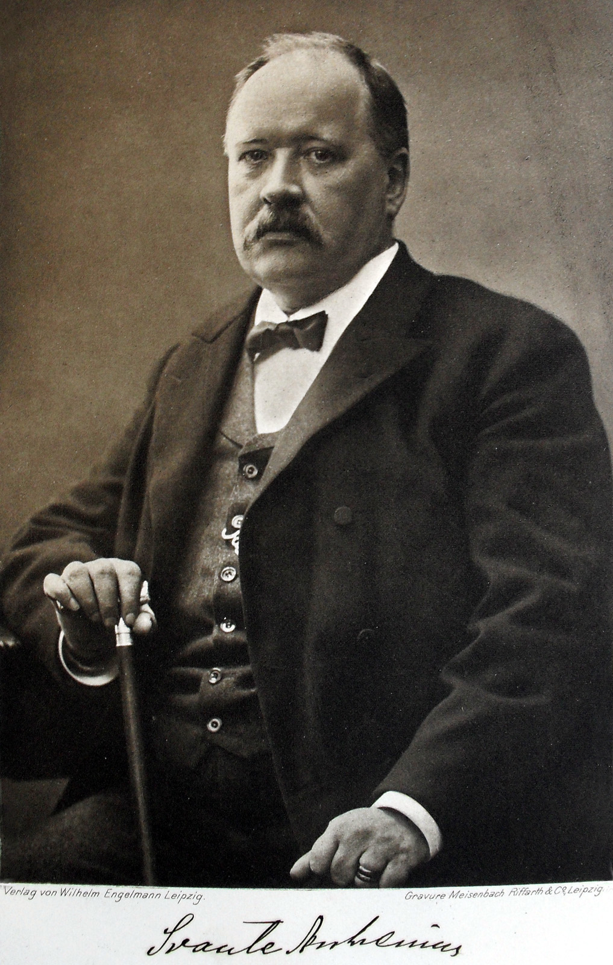
Svante Arrhenius (1859-1927)
“if the quantity of [CO₂] increases in geometric progression, the augmentation of the temperature will increase nearly in arithmetic progression”
(1896)
Arrhenius was the first to predict that increasing atmospheric CO₂ would warm the planet!

Slide 8
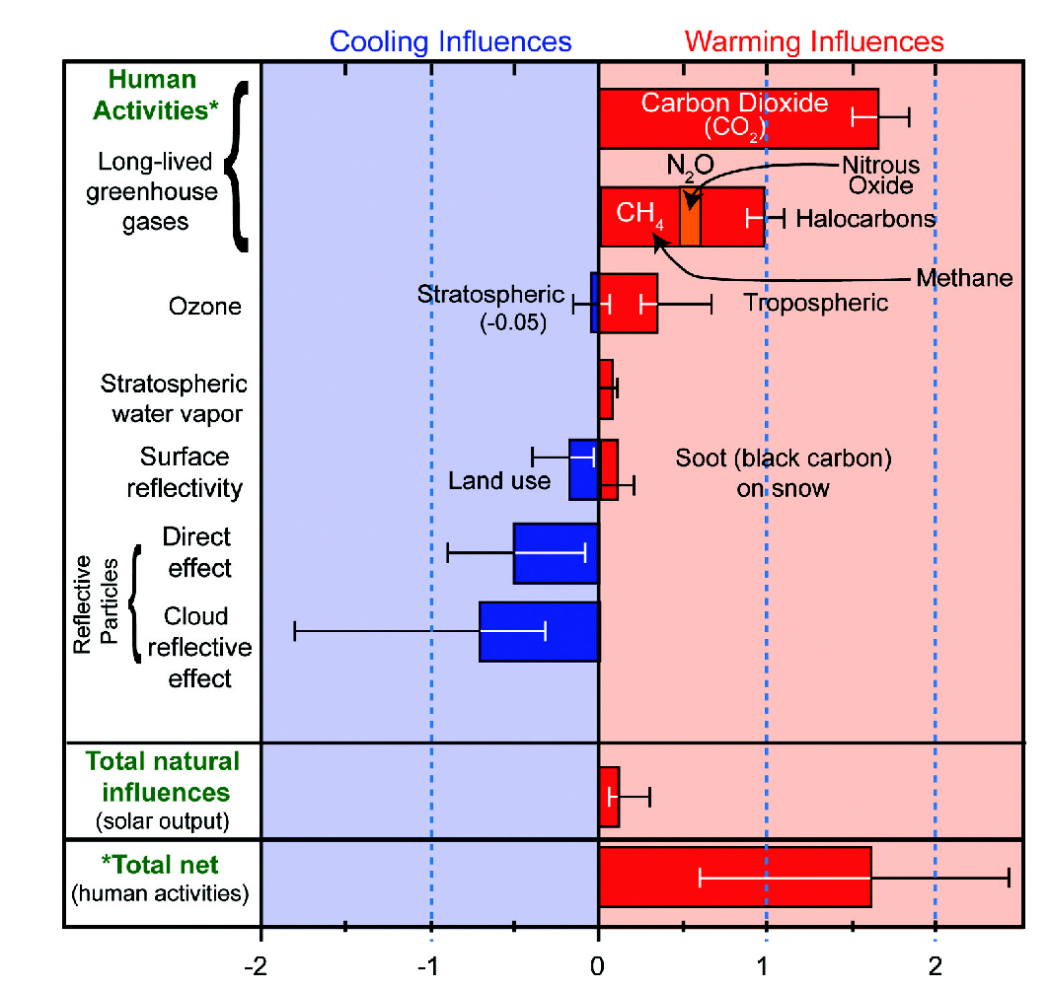
Climate Forcings
Source: National Research Council, 2010a (Depiction courtesy U.S. Global Climate Research Program) from Forster et al. (2007)

Slide 9
Climate Sensivity & Feedbacks
The good
  Infrared emission, CO₂ fertilization
The bad
  Water vapor, Snow/ice cover, Methane clathrate, CO₂ solubility.
The uncertain
  Low cloud cover, High cloud cover

Slide 10
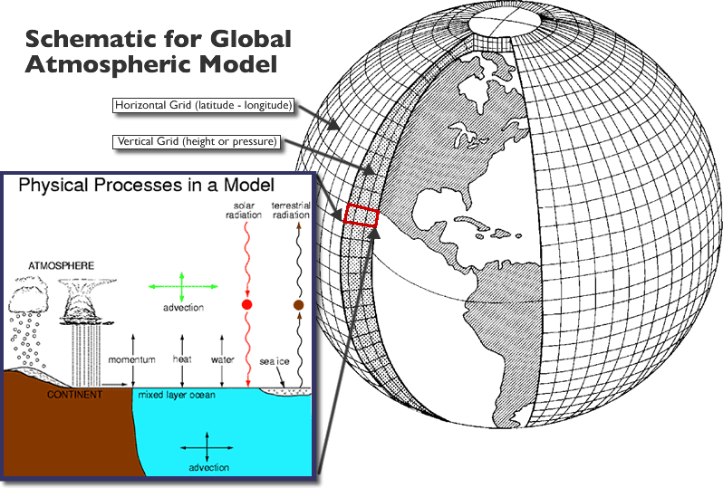
Resolution requires us to parameterize cloud processes in Global Climate Models.
Slide courtesy of Steve Ghan

Slide 11
Global Temperature Change Graphs
From IPCC AR5 WGII report
Notes:
Before I get into what it even means to measure clouds, or how we might go about such a thing, I want to start with the question of why do we measure clouds. And the answer that I am going to give to that is in the title as well—climate research. It is not an exhaustive answer to the question but it is certainly an important one. And climate research is of course motivated by climate change.

Slide 12
Extra Slides

Slide 13
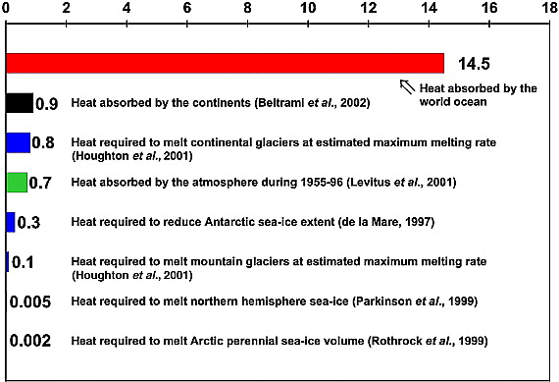
80-90% of the heat from global warming absorbed by oceans
Figure 3. Estimates of Earth's heat balance components (10²² J) for the 1955–1998 period. from Levitas et al. (2005) GRL

Slide 14
Black Body Curves and Wavelengths
Absorption (%)
Based on Goody & Yung

Slide 15
Compare Black Body Curves, Wavelength and Tropopause

