Slide 1
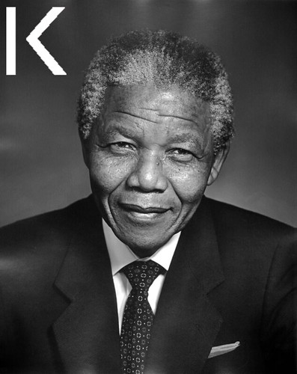
Who is he? Where is he from? What do you know about him?

Slide 2
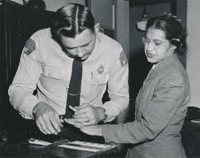
Who is she? Where is she from? Wha else do you know about her?

Slide 3
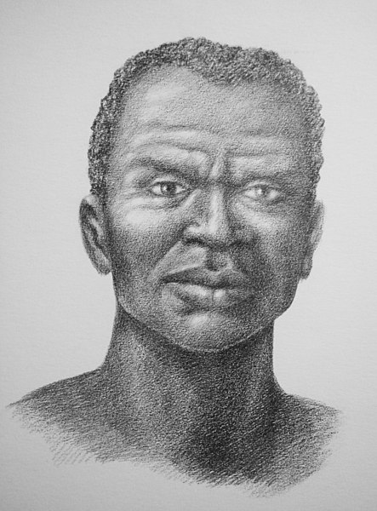
Who is he? Where is he from? What do you know about him?

Slide 4
Who is she? Where is she from? What do you know from?

