Slide 1
Exploring Climate Science with Virtual Reality
Teacher/Scientist
Partnership
Day 1
Georgia Boatman, Regional Science Coordinator, ESD 123
Peggy Willcuts, Sr. STEM Education Consultant, PNNL
Notes:
Restrooms / Evacuation Site / Escorted Badges
Slide 1 5 minutes
Welcome to Exploring Climate Science With Virtual Reality(Georgia)
Review Agenda
Wear two Hats (label binder tabs)
Adult Learner Hat
Teacher Hat

Slide 2
Graphic Representation of Value of Teacher Scientist Partnership Programs
Peggy Willcuts, Sr. STEM Consultant PNNL, 2019
Notes:
Slides 2-4 10 to 12 minutes
Review the graphic of the importance for our future STEM Professionals of engaging in Teacher Scientist Partnerships

Slide 3
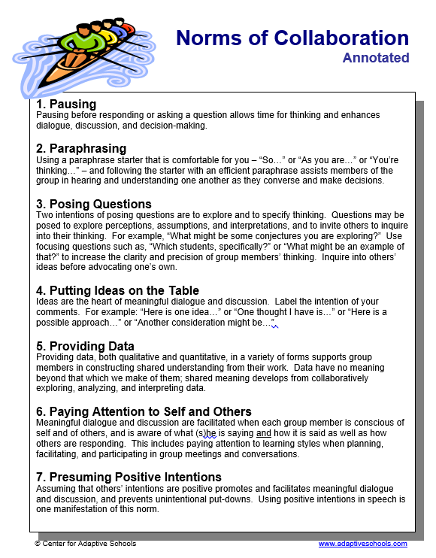
Norms of Collaboration
Notes:
Slides 2-4 10 to 12 minutes
Pass out Norms of Collaboration from Center for Adaptive Schools
Read over the document
identify one norm you will work on this week and share with a colleague

Slide 4
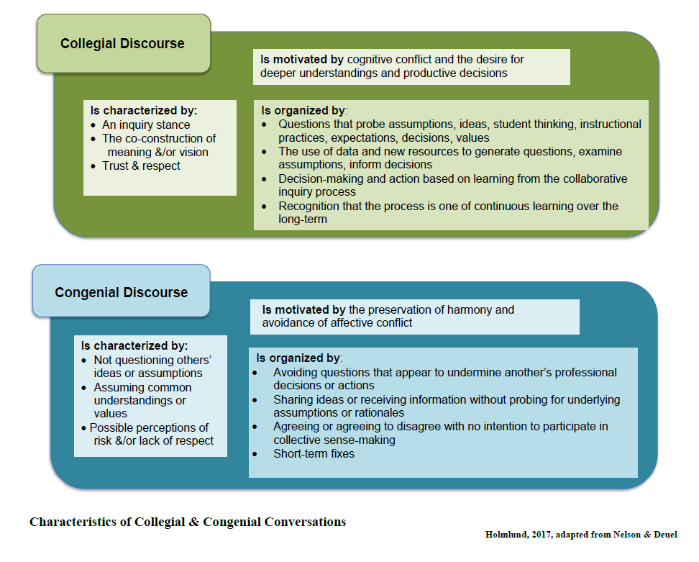
Collegial vs Congenial Teams
Notes:
Slides 2-4 10 to 12 minutes
Review Collegial VS Congenial Teams and point out we strive to be collegial in order to move learning forward
Skim the document
Discuss the notion of these two things

Slide 5
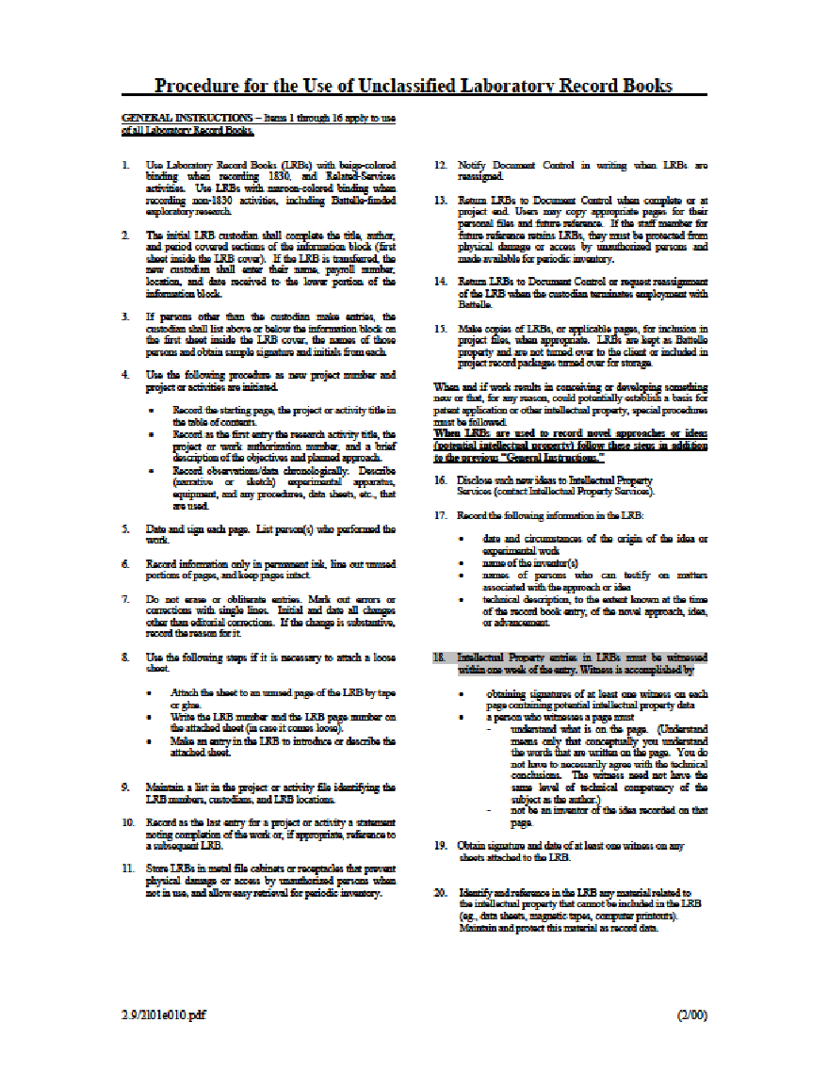
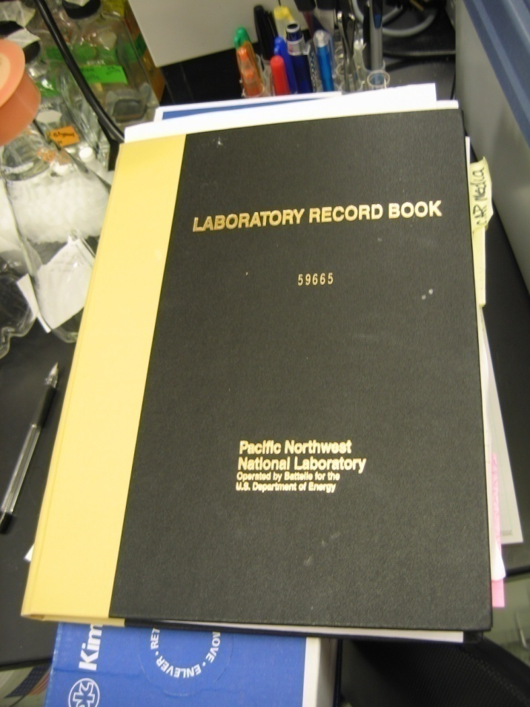
Laboratory Record Book
Notes:
Slides 5-9 15 to 20 minutes
Hand out LRBs and Ribbons
Hand out Unclassified LRBs
Share slides of scientists and Frannie’s notebooks in the field.
Think about the types of data and the level of detail you desire

Slide 6
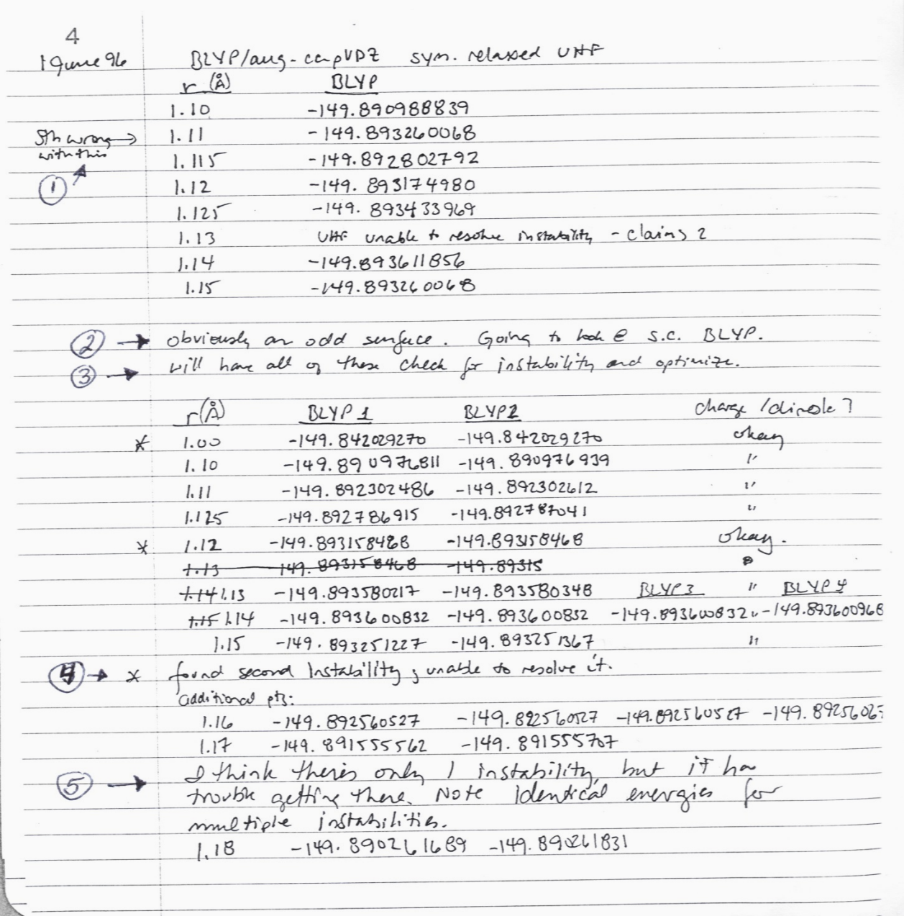
Computational Chemist
“Something wrong with this”
“will have all of these checked for instability and optimize”
Notes:
Slides 5-9 15 to 20 minutes

Slide 7
ECOLOGIST
Describing the problem – the purpose of the study
Identifying the site including selection criteria and sketching the elk enclosures.
Notes:
Slides 5-9 15 to 20 minutes

Slide 8
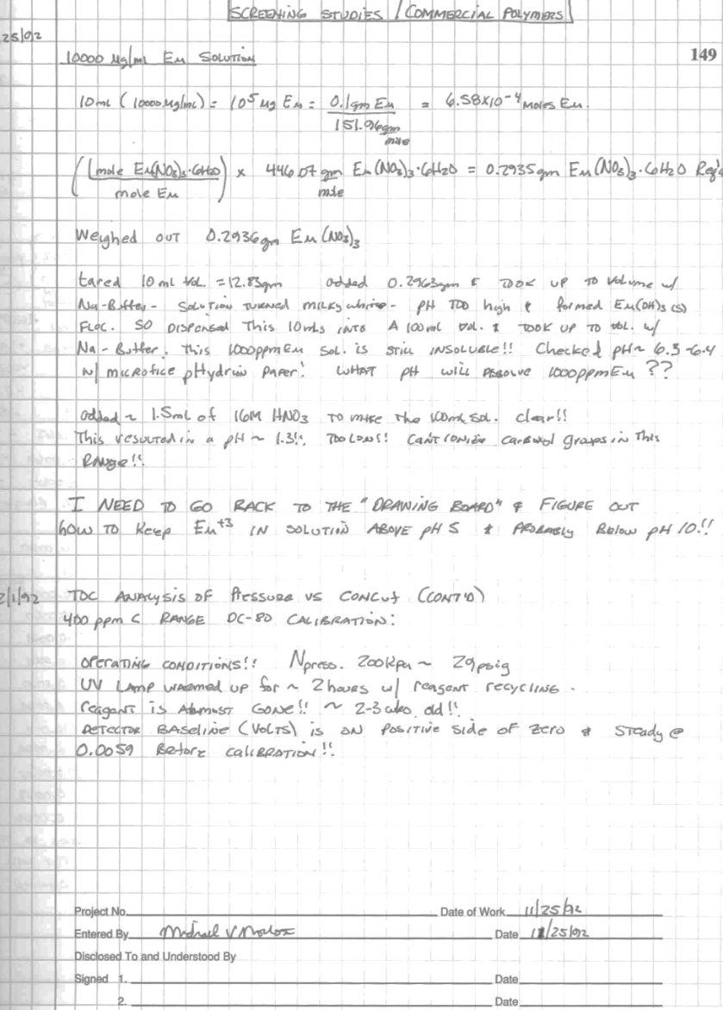
PERSISTANCE OF A BIOFUELS INTERN …
This solution is still insoluble. This resulted in a pH of 1.3 which is still too low!
I need to go back to the
drawing board to figure
out…
Note signature and date…
Notes:
Slides 5-9 15 to 20 minutes

Slide 9
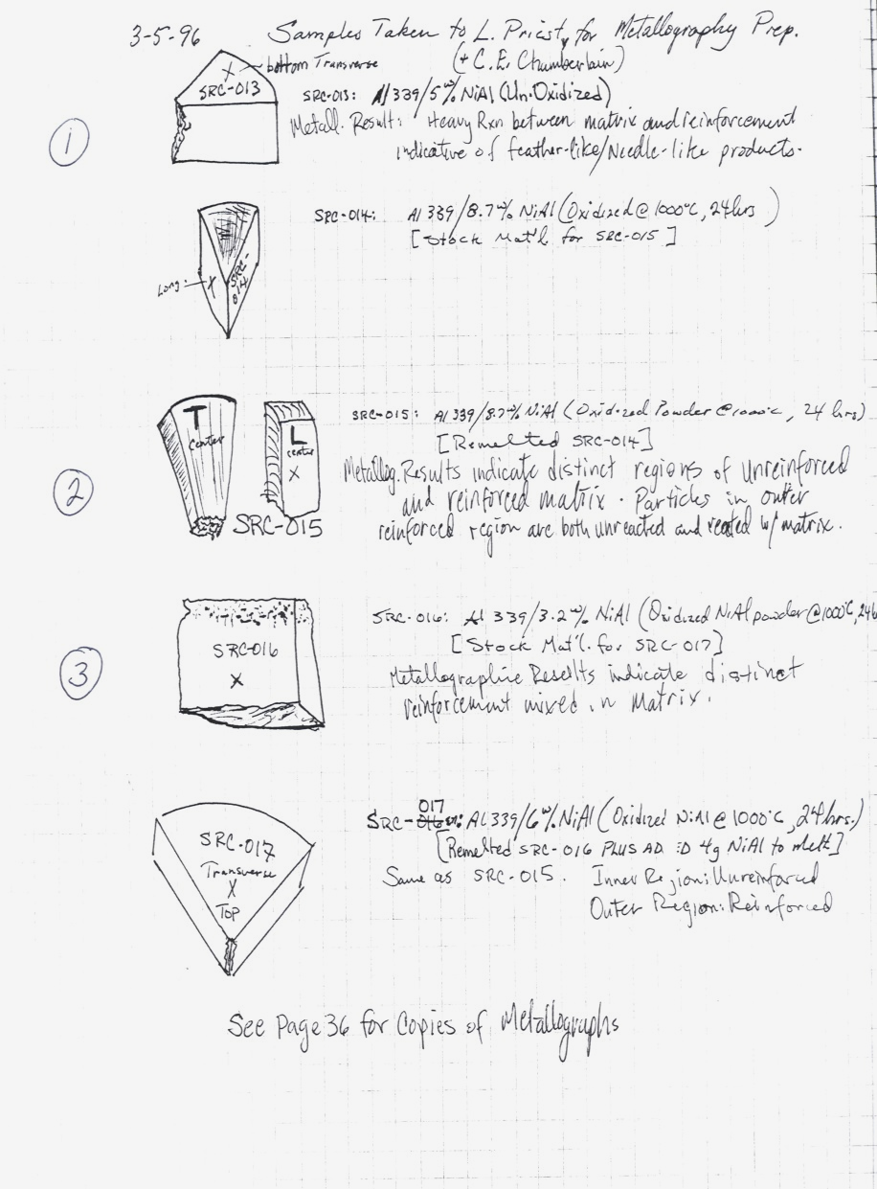
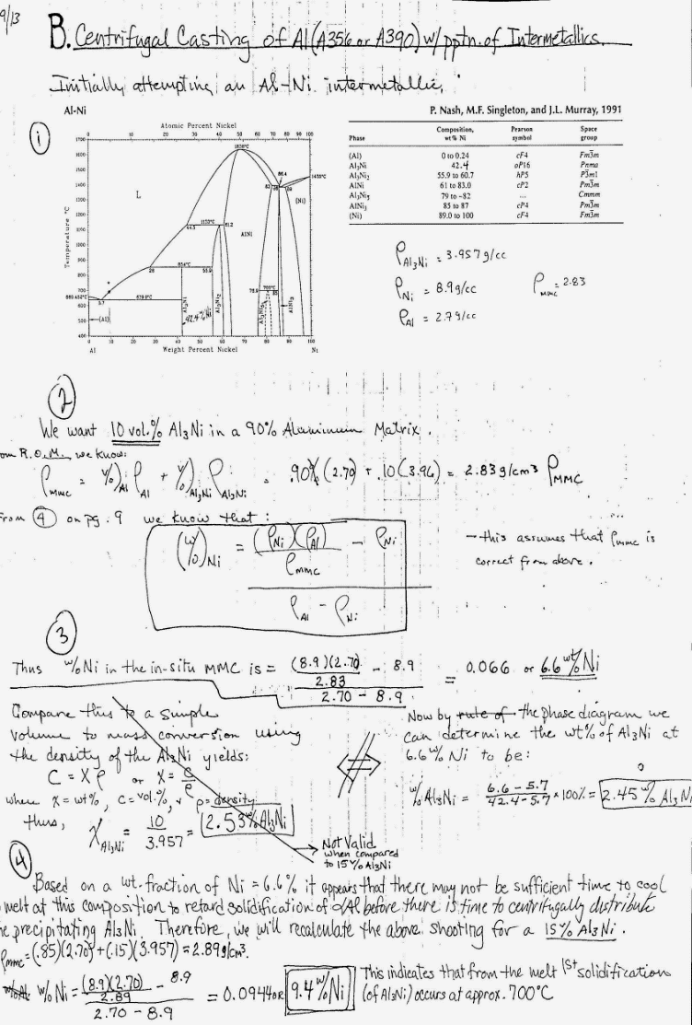
MATERIALS SCIENTIST
Reference graphs
and tables
pasted into notebook
Sample
sketch
Results (crossed out)
Notes:
Slides 5-9 15 to 20 minutes
Now time to work with Climate Scientists for the next day and a half.

Slide 10
Exploring Climate Science with Virtual Reality
Teacher/Scientist
Partnership
Day 3
Georgia Boatman, Regional Science Coordinator, ESD 123
Peggy Willcuts, Sr. STEM Education Consultant, PNNL
Notes:
Slide 10
Marker for Teacher Hat day

Slide 11
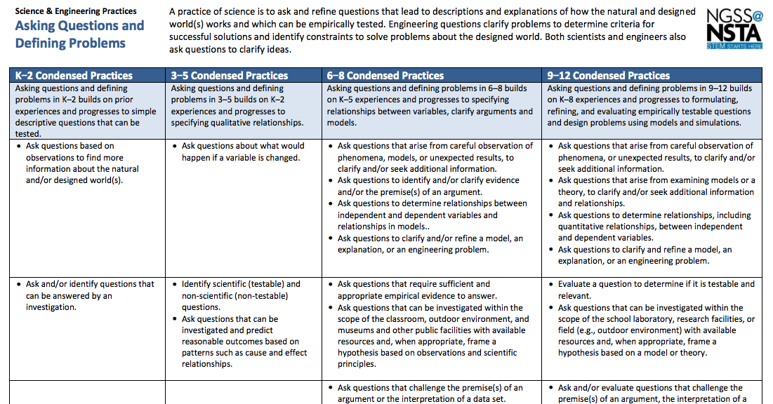
The Science and
Engineering
Practices
Notes:
Slides 11-17 30 minutes
Hand out and examine all SEPs
Show Bethany video and have participants identify the SEPs they see in the video
Whole Group Share Out
Make a claim about what you saw and provide evidence

Slide 12
The Science and Engineering Practices
Notes:
Slides 11-17 30 minutes
Pass out SEPs
Explain Matrices
Walk through the parts

Slide 13
The Science and Engineering Practices
Notes:
Slides 11-17 30 minutes
Pass out SEPs
Explain Matrices
Walk through the parts

Slide 14
The Science and Engineering Practices
Notes:
Slides 11-17 30 minutes
Pass out SEPs
Explain Matrices
Walk through the parts

Slide 15
The Science and Engineering Practices
C O M P L E X I T Y
Notes:
Slides 11-17 30 minutes
Pass out SEPs
Explain Matrices
Walk through the parts

Slide 16
Science and Engineering Practices
Read about your SEP in the SEP Matrix
look at the 9-12 grade level progressions for each SEP
What are the 3-5 most important ideas to remember about this SEP?
What is the level of rigor for this SEP at the 6-8 grade level
Share out to your group, summarizing the SEP and thoughts about the rigor at this grade level
Notes:
Slides 11-17 30 minutes
Directions for them to jigsaw the 8 Science and Engineering Practices in teams of 8

Slide 17
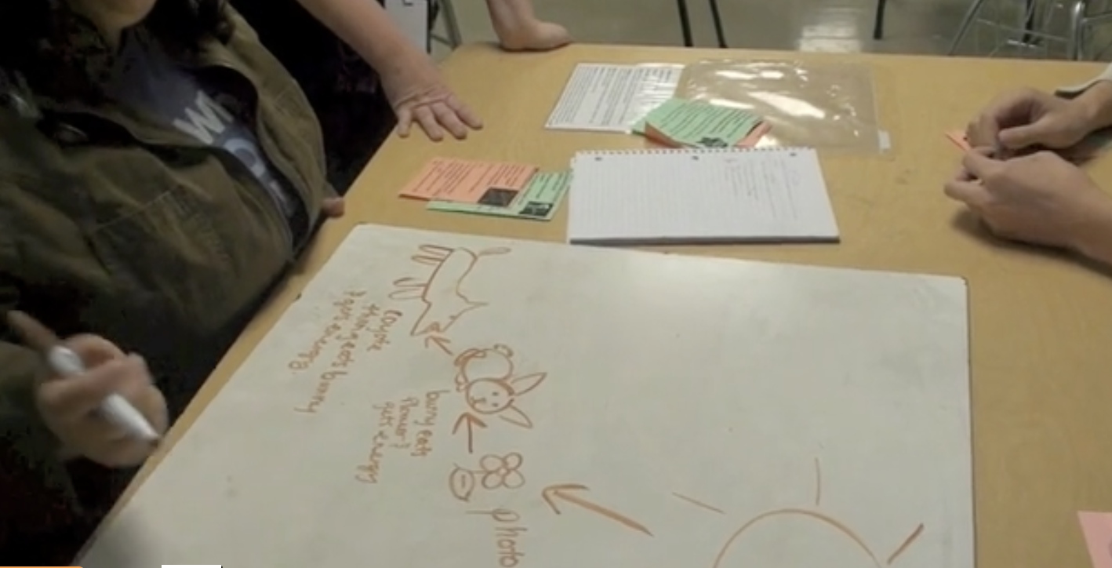
Science and Engineering Practices
Watch the video
Make note of any SEPs you see students engaging in
Ambitious Science T eaching Bethany’s class
https://ambitiousscienceteaching.org/high-school-series-%E2%80%A2-ecosystem-dynamics/#1479376606316-a25bc7d0-9145
Notes:
Slides 11-17 30 minutes
AST Bethany’s class
https://ambitiousscienceteaching.org/high-school-series-%E2%80%A2-ecosystem-dynamics/#1479376606316-a25bc7d0-9145
Start at about 1:56 and go to 8:55 about 7 minutes
Pass out the recording sheet
Each take an SEP, make notes on recording sheet
read the general descriptor section of SEPs and then study the 9-12 column
Discuss what you saw on the video ...which SEPs, how strong, how integrated

Slide 18
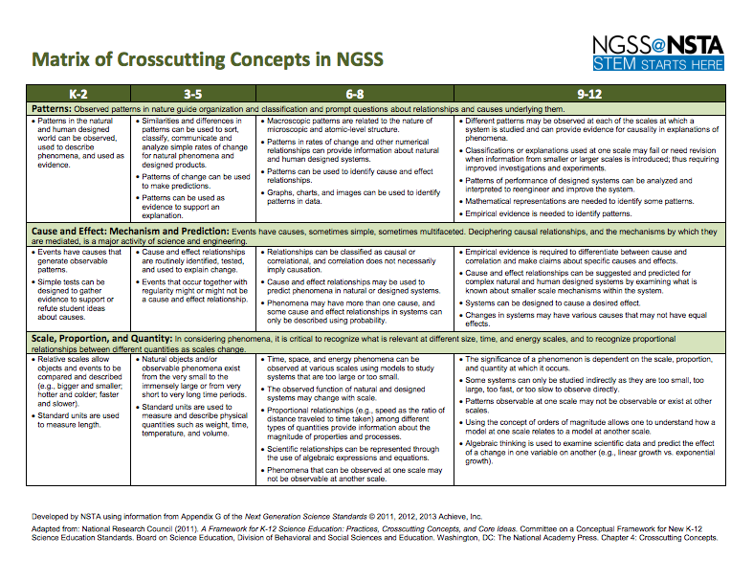
The
Crosscutting
Concepts
Notes:
Slides 18-23 20 25 minutes
Hand out and examine all Crosscutting Concepts Matrix
Talk through each part of the Matrix
Show How Whales Change Climate video
Have people spot where they see CC connections that could be exploited
Stand and share or Walk and Talk

Slide 19
Matrix of Crosscutting Concepts
Notes:
Slides 18-23 25 minutes
Hand out and examine all Crosscutting Concepts Matrix
There are 7 Crosscutting concepts and a little general description is given for each
Show How Whales Change Climate video
Have people spot where they see CC connections that could be exploited
Stand and share or Walk and Talk

Slide 20
Matrix of Crosscutting Concepts
Notes:
Slides 18-23 25 minutes
Hand out and examine all Crosscutting Concepts Matrix
Each Crosscutting Concept is broken down by grade band and described with specificity for that grade band
Show How Whales Change Climate video
Have people spot where they see CC connections that could be exploited
Stand and share or Walk and Talk

Slide 21
Matrix of Crosscutting Concepts
C O M P L E X I T Y
Notes:
Slides 18-23 25 minutes
Hand out and examine all Crosscutting Concepts Matrix
The idea is that complexity in the Crosscutting Concepts increases as you move from K to 12
Show How Whales Change Climate video
Have people spot where they see CC connections that could be exploited
Stand and share or Walk and Talk

Slide 22
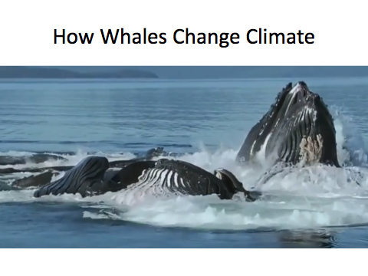
Thinking About Crosscutting Concepts
First – just read through the CC matrix focusing on your grade level bullets
Watch “How Whales Change Climate”
Identify CCs that could potentially be met with this type of field study
Notes:
Slides 18-23 25 minutes
Hand out and examine all Crosscutting Concepts Matrix
Show How Whales Change Climate video-the picture is linked
Have people spot where they see CC connections that could be exploited
Shand and share or Walk and Talk
https://www.youtube.com/watch?v=rwZR28su0FU

Slide 23
Debriefing the Video
Crosscutting Concept | Possible Evidence from Whales Video
Patterns | Behavior whales or plankton
Cause and Effect | * Overt theme in video- whales caused a cascade of effects in the system
Scale, Proportion, & Quantity | The quantity of whales affects the quantity of plankton and impacts the system; Increase in proportion of whales and plankton decrease amount of CO2 in system.
Systems & Systems Models | * Clear theme in the video- living and nonliving parts of the system are interconnected
Energy and Matter | * Food web shows the flow of energy and matter through the parts of the system
Structure and Function | Whales contribute to a change in the structure of the ecosystem which affects ocean organisms, oceans, climate
Stability and Change | Decrease in whale populations change the system that was stable and a new stability
Notes:
Slides 18-23 25 minutes
Hand out and examine all Crosscutting Concepts Matrix
Show How Whales Change Climate video
Have people spot where they see CC connections that could be exploited
Shand and share or Walk and Talk
Share possible connections on table

Slide 24
Is it a Phenomena?
Notes:
Slides 24-27 30-45 minutes depending on time
Watch the video https://www.ngssphenomena.com/phenomena/#/deer-migration/
(https://www.youtube.com/watch?v=Jyiv1Lc0dng&feature=youtu.be) This is an additional video from Brian Reiser on the NextGenScience.org site
Start the Heuristic
What did you do in your classroom right now… the top box
Read short Heuristic STEM Teaching Tool
Handout Phenomena Development Tool and tape into notebook and use it to take “notes to self” in the field.

Slide 25
“Phenomenal” Brainstorming
Think about current science units/lessons you do
Brainstorm a possible phenomena that could “anchor” this unit or some of its lessons
Share the unit context and your brainstorm ideas with table mates
https://creativecommons.org/licenses/by-sa/2.0/
Notes:
Slides 24-27 30-45 minutes depending on time
Read the slide
Start the Heuristic
What did you do in your classroom right now… the top box
Watch the video (https://www.youtube.com/watch?v=Jyiv1Lc0dng&feature=youtu.be)
Read short Heuristic STEM Teaching Tool
Handout Phenomena Development Tool and tape into notebook and use it to take “notes to self” in the field.

Slide 26
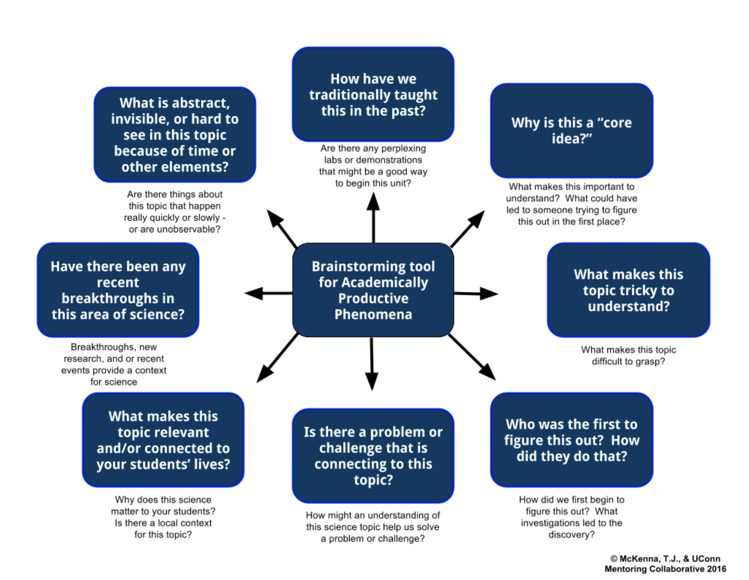
Identifying and Developing Academically Productive Phenomena
Notes:
Slides 24-27 30-45 minutes depending on time
Start the Heuristic
What did you do in your classroom right now… the top box
Read short Heuristic STEM Teaching Tool linked from STEM Teaching Tools from University of Connecticut
Handout Phenomena Development Tool and tape into notebook and use it to take “notes to self” in the field.

Slide 27
Transitioning to Classroom Implementation
Finish thinking on Phenomena Development Chart
Think about lessons/units that you teach or may teach where this phenomena would be employed
Begin to develop a classroom experience around this phenomena and the ecology and human impact learning
Be ready to share to the group
Notes:
Slides 24-27 30-45 minutes depending on time
Start the Heuristic
What did you do in your classroom right now… the top box
Read short Heuristic STEM Teaching Tool linked from STEM Teaching Tools from University of Connecticut
Handout Phenomena Development Tool and tape into notebook and use it to take “notes to self” in the field.

Slide 28
Addressing DCIs
Look at the identified DCIs
Number off by 3 and work with your team of 4 or 5 people
Site evidence on Post-Its of how that DCI was addressed during the week
Notes:
Slides 28-30 15 minutes
Disciplinary Core Ideas that were identified at the beginning of the Summer session on posters on the wall
Write down evidence from teacher experience this week that addressed these DCIs
Post them on the DCI posters

Slide 29
Reflection and Sense Making
Share out to the group your ideas and progress on incorporating this work into classroom experiences
Reflection on Working With Scientists
Thank you posters for scientists
Notes:
Slides 28-30 15 minutes
Follow directions on Slide

Slide 30
What Will You Share With Students
Stand and talk to someone you haven’t worked with today:
What will you tell your students you did at PNNL this summer?
Notes:
Slides 28-30 15 minutes
Follow directions on Slide

Slide 31
Creative Commons Licensing
License:
Creative Commons Attribution 4.0
Georgia Boatman
Regional Science Coordinator
Educational Service District 123
Peggy Willcuts
Senior STEM Consultant
Pacific Northwest National Laboratory
Notes:
Creative Commons Licensing information

