Slide 1
Field Advisor and the Field guide: Getting to know the roles and responsibilities
July 23, 2019 – Sacramento, CA
Instructor: Tami McCalip, MSW
Northern California Training Academy

Slide 2
Plan for the day
Overview of Core for Social Workers
Exploring the role of Field Advisor
Review of coaching skills
Overview of Core field activities
Web Resources
Data Collection
Wrap-up

Slide 3
Introductions
Introduce yourself
If you attended the 2-day Coaching Institute, what is one thing you remember?
What is one thing you hope to learn in this training?
What is one thing you are looking forward to about being a field advisor?

Slide 4
Understand broader context of Core 3.0
Become familiar with the role of the field advisor.
Understand the structure of the field activities and the field guide

Slide 5
Learning Objectives
Trainee Guide: Page 4

Slide 6
Context and Group Agreements
Is there anything that may pull our attention away from our focus today?
How do we want to work together?
Guidelines for communicating across differences…
Speaking of Field Activities….
Notes:
Communicating Across Differences

Slide 7
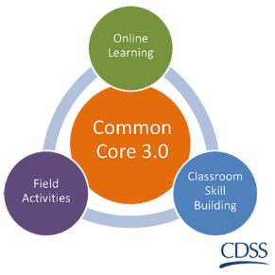
Overview of Core for Social Workers (Version 3.0)

Slide 8
The California Integrated Child Welfare Core Practice Model (ICPM)
Existing and Emerging Initiatives
California Partners for Permanency (CAPP)
Continuum of Care Reform (CCR)
Family to Family (F2F)
Katie A.
Linkages
Parent Partners
Quality Parenting Initiative (QPI)
Resource Family Approval (RFA)
Safety Organized Practice (SOP)
Wraparound
Engagement, Inquiry/Exploration, Workforce Development & Support, Accountability, Teaming, Advocacy
Prevention
Engagement
Monitoring and Adapting
Transition
Assessment
Planning and Service Delivery
Notes:
The California Child Welfare Core Practice Model is built on these key components and existing/emerging initiatives and are reflected in CC3.0.
The CPM brings together Casework Components, Practice Elements, and Practice Behaviors that will define how child welfare is practiced in
California. CC3.0 has made use of the casework components by modeling the practice blocks after them. The Practice Elements are interwoven throughout the eLearning, classroom skills-based learning, and field activities.

Slide 9
ICPM Practice Behaviors
Turn to page 7 in your trainee guide (Practice Behaviors).
Review the 13 practice behaviors and circle one behavior that resonates most with you
In Pairs:
3-5 minutes: Introduce yourselves and share what practice behavior you chose and why

Slide 10
Core 3.0 Training Blocks
Engagement, Inquiry/Exploration, Workforce Development & Support, Accountability, Teaming, Advocacy
Prevention
Engagement
Monitoring and Adapting
Transition
Assessment
Planning and Service Delivery
Practice Areas
Foundation
Engagement
Assessment
Case Planning and Service Delivery
Monitoring and Adapting
Transition
Notes:
In Common Core 3.0, the training content is divided into 6 practice area blocks: Foundation, Engagement, Assessment, Service Planning, Monitoring and Adapting, and Transition. These practice blocks mirror the Core Practice Model Casework Components, are congruent with the California Partners for Permanency’s Practice Model, incorporate elements of Safety Organized Practice and allow for a focused exploration of knowledge and skills in key practice areas providing a natural framework for field activities and skill development.
All of the training blocks will include eLearning content, classroom content, and field activities. For additional information about the content contained in each of the training blocks, please refer to the “CC3.0 Content Overview”.

Slide 11
Core 3.0 Modalities/Sequenced Content
100 Level
On-line knowledge based training
Classroom skills based learning
Field based transfer of knowledge and skills learning
200 Level
Notes:
Beyond re-imaging the way social work practice is presented in core, the Common Core 3.0 concept also incorporates a wider range of training modalities, including:
Online knowledge based training
Classroom based learning
Field learning
This involves shifting some knowledge-based content outside the classroom with online learning modules, using classroom time to focus on skill based interactive training, and shifting some skill-based content outside the classroom with field activities. Through these modalities, Common Core 3.0 will provide new social workers with opportunities to focus on skills in the classroom and reinforce skills with application of concepts in the field.

Slide 12
Technology based classes
Welcome to the Center for Human Services Resource Barn!
Core is a technology based program
Go to this link: http://bit.ly/CoreForSW

Slide 13
Core Academy Resource Page

Slide 14
All required classroom materials and links to field activities are on this page under “Participant Resources”

Slide 15
All field activity guides and the completion survey link are found on this page:

Slide 16
Core Participants…

Slide 17
Lessons Learned
Social Workers often come to Core not knowing who their field advisor is.
Field Advisors and Social Workers should have a conversation at the beginning of Core to develop agreements, roles, and start planning for field activities.
Counties should have a plan for who will be Field Advisors ahead of time BEFORE Social Workers begin Core.
Instructors/Academy will give several reminders through e-mails and in the classroom about field activities
Social Worker Passport and Guide will have field activities listed and a link to the field activity completion survey
Field activities may sound overwhelming but they aren’t such a big deal – they are OK!

Slide 18
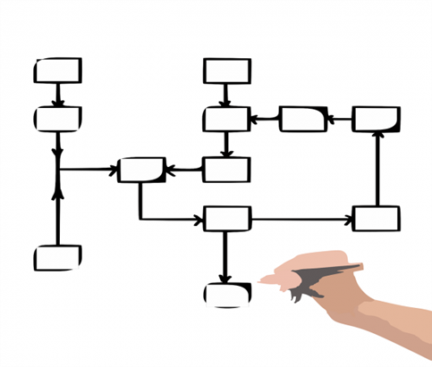
Core 3.0 at a glance
10 modules with a total duration of 10 months
29 classes
22 E-Learnings
9 Field Activities
Make-ups: Please e-mail the Academy to determine upcoming classes / locations available for make-ups: academy@ucdavis.edu

Slide 19
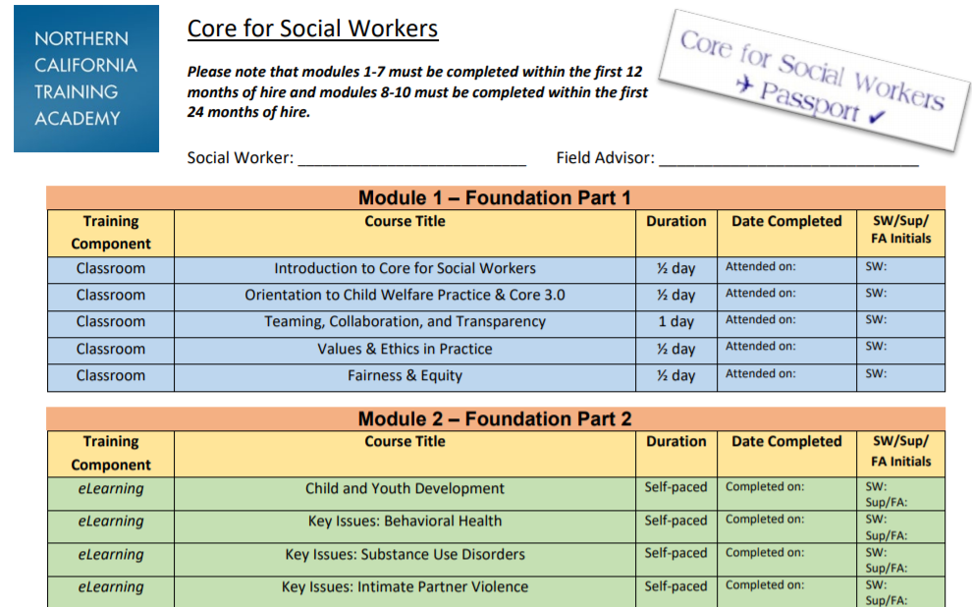
Social Worker Passport
Please keep track of this document – list all completion dates

Slide 20
Module 1 - Foundation Part 1

Slide 21
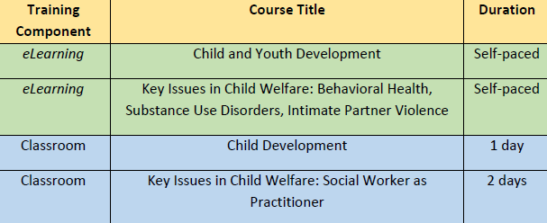
Module 2 - Foundation Part 2

Slide 22
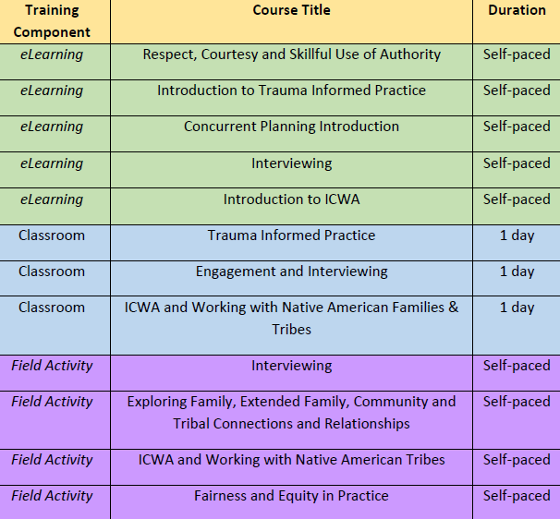
Module 3 - Engagement

Slide 23
Module 4 - Assessment Part 1

Slide 24
Module 5 - Assessment Part 2

Slide 25
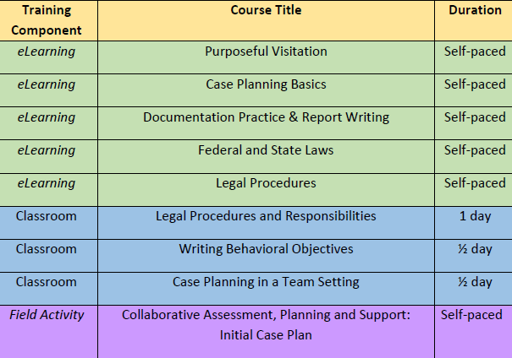
Module 6 – Case Planning & Service Delivery

Slide 26
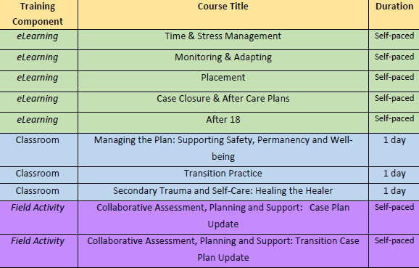
Module 7 – Monitoring & Adapting; Transition

Slide 27
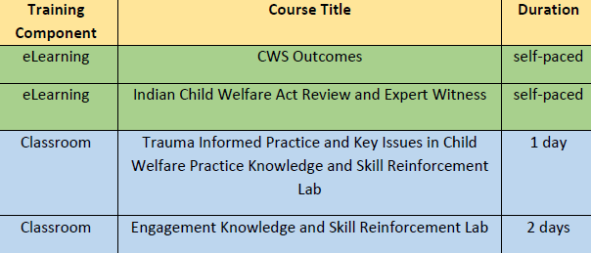
Module 8 –Trauma/Engagement (200 Level)

Slide 28
Module 9 – Managing Case Plans (200 Level)
Module 10 – Managing Change (200 Level)

Slide 29
Field Advisor Roles & Responsibilities

Slide 30
Role of the CC 3.0 Field Advisor
The field advisor will meet with and support the new social worker before, during, and after identified field activities as follows:
Promote a learning environment and utilize appropriate coaching strategies, tools and techniques to promote desirable and sustainable growth for the worker.
Promote knowledge and skill development that aligns with the desired practice.
Track completion of field activities.

Slide 31
Additional Responsibilities
Be familiar with Core 3.0 schedule of classes, requirements and where the field activities land on the Core schedule
Become familiar with the field activities and provide feedback about challenges or suggestions you have to improve the activities
Utilize coaching skills and knowledge gained in Field Advisor / Coaching trainings to best support the trainees

Slide 32
Field Advisor Training Requirements
Field Advisors may be the social worker’s supervisor or other designated person who will support the worker as they complete their field activities.
All Field Advisors must complete the following training requirements:
Attend the two-day Coaching Institute
Attend the Field Advisor and the Field Guide Course AND pre-requisite eLearning course (link to this eLearning course is provided in your confirmation letter for the classroom course)

Slide 33
Making the connection
eLearning
Classroom Skills Based Learning
Field
Notes:
Instructor to facilitate a discussion about the connection between
online, classroom, and field content. Some things to highlight are:
o Adult Learning
§ Spaced learning – shown to be a more effective way
for people to learn, practice, and transfer what they
have learned
§ Blended learning (multiple modalities)
§ Coaching
§ Skill-based, interactive, in-person training
§ Skill practice
CC3.0 seeks to enhance the transfer of learning for new social workers
by incorporating coaching and feedback opportunities related to
practice application and aligning the training that new social workers
receive with the values of the organization and state child system.
p Ask trainees to describe the meaning of “transfer of Learning”. Remind
trainees about reviewing this information in the field advisor eLearning.
o Transfer of learning is the degree to which the trainees
apply the knowledge, skills, and attitudes learned in training
when they return to the job and the degree to which the
new learning is maintained over time (Baldwine and Ford,
1988).
p Facilitate a discussion regarding the transfer of learning and how the
trainees see their role in supporting new social workers. This can be
done in small groups with a large group report out, or it can be done all
together as a large group, depending on the time available. This activity
is an introduction to the field advisor role and responsibilities.

Slide 34
Skill-Based Coaching Model

Slide 35
What is coaching?
Coaching is defined as the process by which the coach creates structured, focused interaction and uses appropriate strategies, tools and techniques to promote desirable and sustainable change for the benefit of the learner, in turn making a positive impact on the organization.
In the child welfare context, professional development coaching leads to improvements in practice, quality of work, and the agency’s success in working with children and families in the following ways:
Improving systemic implementation of practice
Creating positive changes in behavior
Embedding professional development
~ Adapted from Mink, Owen and Mink, (1993) and from Cox Bachkirova and Clutterbuck (2010)

Slide 36
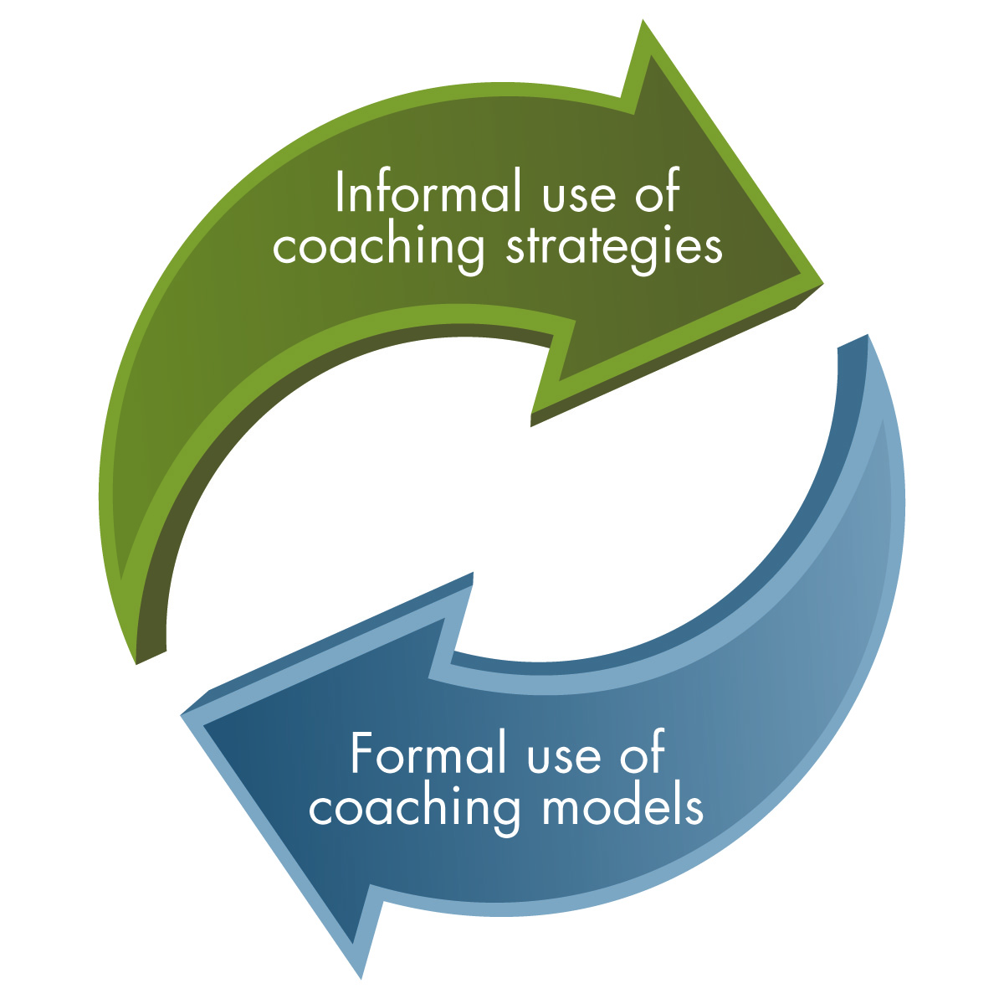
Supervisors Dance of Coaching
On the spot – informal coaching
Planned – formal coaching

Slide 37
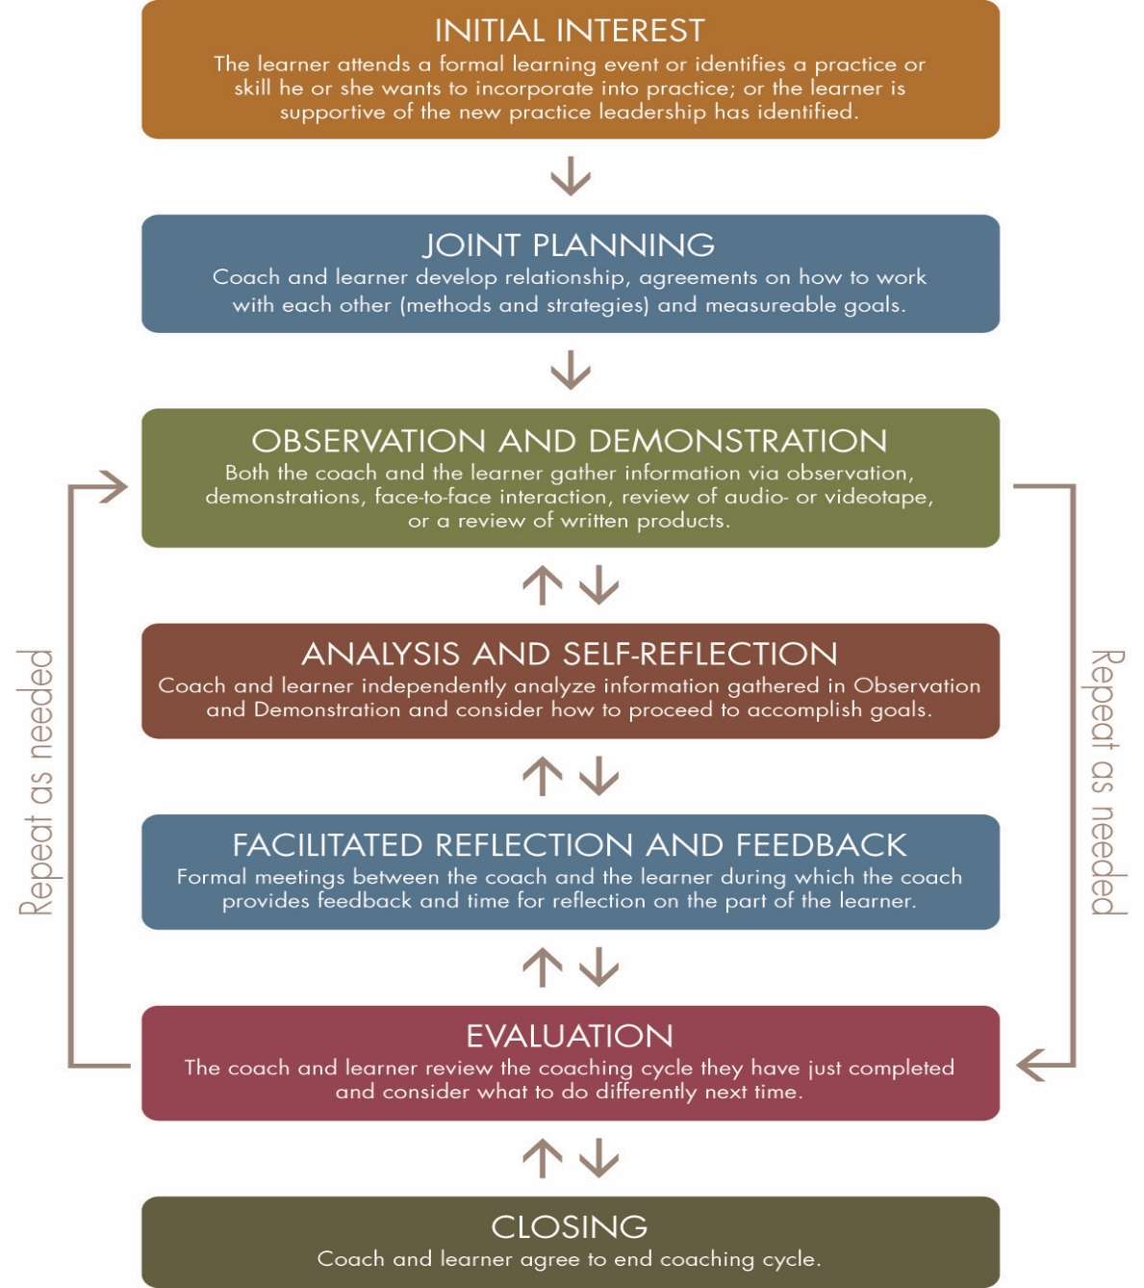
UC Davis
Child Welfare
Skills-Based Model
Trainee Guide: Pages 14-15
Notes:
Discussion: How are the steps of the skills based model similar to (parallel process) good casework practice?
Need to have a clear goal developed with clients.
Have a case plan = contract
Listening is key social work skill
Must explore not only the evidence of maltreatment but also the underlying conditions and the family’s strengths
The case plan must have explicit action steps for everyone
Need to review the plan on a regular basis to determine progress towards goals and change plan if progress is not timely

Slide 38
Skill-Based Coaching Model for Field Advisors
Joint Planning
Next Steps
Field Advisor
& Social Worker
Field Activity Skill
Development
Observation/
Demonstration
Facilitated Feedback
Analysis and Self-Reflection
Notes:
Pages 14-15 in Trainee Guide

Slide 39
Joint Planning
Field Advisor:
Set foundation for effective working relationship
Create learning environment
Establish rapport
Discuss field advisor role and boundaries
Create agreements for providing feedback and establishing goals for learning
Review field activity learning objectives

Slide 40
Observation and Demonstration
Field Advisor gathers information through:
Observation
Modeling
Demonstration
Face-to-face interaction
Review of written documentation related to field activity

Slide 41
Analysis and Self-Reflection
Field Advisor
Engage in self-reflection by asking purposeful and powerful questions
Engage in co-creating behavioral changes that explore the social worker’s perceptions about what can be done to master the skill and field activity

Slide 42
Facilitated Reflection and Feedback
Field advisor and social worker engage in reflective dialogue to create a positive environment that facilitates continued learning and skill development

Slide 43
Next Steps / Field Activity Feedback
Field advisor and Social Worker:
Plan next steps related to deepening the learning and social work practice.
Discuss what worked during the field activity and what could be done differently for future field activities.
Field advisor completes field activity completion survey

Slide 44
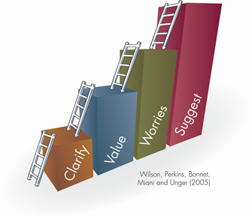
Additional Coaching Tools & Resources
Multicultural Guidelines
Reflective Que Prompts
Useful Coaching Questions
The Feedback Ladder
Implicit Bias Tests
WOOP it up!
SCARF Model
https://www.oercommons.org/authoring/12021-field-advisor-and-the-field-guide-getting-to-know-/view

Slide 45
Reflective Cue Prompts
Facilitate Learning | Reflection | Influencing Factors | Continued Learning
Describe the experience. Describe the phenomenon (observable occurrence). What are the key issues to pay attention to? | What were you trying to achieve? Why did you intervene or react as you did? What were the consequences (for me, my clients, and the people with whom I work?) How did you feel about this experience when it was happening? How did the other person or people feel? How do you know how the other person or people felt? | What internal factors and external factors influenced your reactions? What sources of knowledge did or should have influenced my reaction? | What other choices did you have and what would be the consequences of these choices? How do you feel about the experience now? How has this experience changed my ways of knowing: How have my skills or contextual knowledge been affected? How has my understanding of appropriate responses been changed? Has there been any internal conflict or negotiation of my values? Has my self-awareness or self-esteem been altered? What data have I seen or been given?

Slide 46
WOOP! There it is…
1. Wish
2. Outcome
3. Obstacle
4. Plan!
Oettinger, Gabriele (2014), Rethinking Positive Thinking, New York, NY; Penquin

Slide 47
Landing on the Goal
What excites you about this goal?
How do you want to feel? (not successful, the feeling is about what feelings you are wanting to experience – not about the things… but about the feeling)
How will you know if you reach this goal?
What will be different about your life if you reach this goal? What will success look like?
Notes:
Generally this takes some time! This is not easy. It’s generally rather messy. And it’s generally not SMART

Slide 48
HARD Goals
Heartfelt — My goals will enrich the lives of somebody besides me— customers, the community, etc.
Animated — I can vividly picture how great it will feel when I achieve my goals.
Required — My goals are absolutely necessary to help this company.
Difficult — I will have to learn new skills and leave my comfort zone to achieve my assigned goals for this year.
Leadership IQ, Murphy, Mark; HARD Goals, The Secret of Getting from where you are to where you want to be.
Notes:
HARD GOALS
The Secret of Getting From Where
You Are to Where You Want To Be
MARK MURPHY

Slide 49
SCARF model by David Rock, 2008

Slide 50
Field Activity Overview

Slide 51
Field Activities at a glance
Module 3: Engagement Block
Interviewing
Exploring Family, Extended Family, Community, and Tribal Connections
ICWA and working with Native American Tribes
Fairness & Equity
Module 5: Assessment Block (Part 2)
Collaborative Assessment, Planning and Support: Safety & Risk in teams
Completing SDM Assessment tools
Module 6: Case Planning & Service Delivery Block
Collaborative Assessment, Planning and Support: Initial Case Plan
Module 7: Monitoring & Adapting; Transition Block
Collaborative Assessment, Planning and Support: Case Plan Update
Collaborative Assessment, Planning and Support: Transition Plan

Slide 52
Field Activity Guides
Field Activity Guides are provided for each field activity that includes the following information:
Learning objectives for the activity
Description of the activity
Field Advisor and Social Worker tasks:
Before the Activity
During the Activity
After the Activity
Applicable worksheets / resources
Please note: Field activities should be completed using active cases whenever possible.

Slide 53
Field Guide Introduction
Review the Field Guide Introduction – Page 3
Glance through the Field Activity Guide
Get familiar with the layout and roles (before, during, after the activity)
And then…. We’ll review together!

Slide 54
Let’s Practice!
In dyads or triads: Discuss what conversation you need to have with social workers about the field activities:
Context and group agreements (shift from supervisor to field advisor)
Roles and responsibilities (for the trainee and the field advisor)
Purpose of the field activities
Notes:
Facilitate a large group brainstorm. Ask the trainees what they are
worried about, specifically worries about their ability to meet their
responsibilities as a field advisor? The trainer will chart all of the worries
identified by the group.
p Have group identify top 4 or 6 (depending on the group size) of their
worries that they would like to examine more closely. These should be
the worries that they feel like they will need the most help in how to
handle. The trainer can do this by group poll or have the participants get
up and mark their 4-6 choices to allow them to stretch.

Slide 55
Review the Module 3 Field Activities: ICWA Fairness and Equity Exploring Relationships Interviewing

Slide 56
ICWA and Working with Native American Tribes
Description of Activity:
This field activity provides an opportunity for child welfare workers to identify local ICWA resources to support child welfare outcomes and reinforce the value of keeping an Indian child connected to culture and community.
The Field Advisor and worker will review the information together and discuss how this relates to the purpose of ICWA and the value of keeping a child connected to their culture and community

Slide 57
Fairness & Equity
Description of Activity:
This field activity provides an opportunity for child welfare workers to explore data related to disparity, practices that promote fair and equitable treatment with individuals interacting with the child welfare system, and ways that bias can be discussed and addressed in day-to-day practice to improve outcomes for children and families.
Please note: If the Social Worker has an active caseload they MUST use one of their cases for this activity.

Slide 58
Fairness & Equity Activity
1. Read through the activity.
2. In pairs or at your tables, discuss the following:
How have you seen bias show up in practice?
What (if anything) did you do when you encountered the bias?
What are some of your “hot button” issues that could possibly impact your work with a social worker as a field advisor?
How will you guard against bias in your role as field advisor?
3. Report out to the larger group

Slide 59
Interviewing
Description of Activity:
This field activity provides an opportunity for child welfare workers to prepare for and complete an interview with a family member, caregiver, youth, or stakeholder.
The trainee will prepare for this activity by:
Identifying interview participants, information to be collected, and goals of the interview
Following the interview, the trainee will reflect on what worked well, any challenges or opportunities for upgrade during the interview, and next steps.

Slide 60
Interviewing Activity
Read through the activity.
2. In pairs or at your tables:
List some tips you have for interviewing children, youth and adults
Share with your table
Pick the top tip for each age group
3. Share with the large group
4. Any questions about this field activity?

Slide 61
Exploring Family, Extended Family, Community, Tribal Connections, and Relationships
Description of Activity:
This field activity provides an opportunity for child welfare workers to develop a genogram, eco-map, or safety circle to help identify family, extended family, community, and tribal connections that may provide support and permanent connections for children, youth, young adults and families.

Slide 62
Exploring Family Relationships
Read through the activity.
2. In pairs or at your tables:
Discuss the tools you use in your counties for identifying and exploring family support networks (i.e. genograms, ecomaps, safety circles, etc.)
3. Share with the large group
4. Any questions about this field activity?

Slide 63
Review the Module 5 Field Activities: Completing SDM Tools Safety & Risk in Teams

Slide 64
Completing SDM Assessment Tools
Description of Activity:
The Social Worker will complete one of the following safety tools:
Hotline Assessment Tool
Safety Assessment Tool
Substitute Care Provider Safety Assessment Tool
Reunification Reassessment Tool
AND
The Social Worker will complete one of the following risk tools:
Family Risk Assessment Tool
Family Risk Reassessment for In-home Cases Tool (Family Maintenance)
Reunification Reassessment Tool (Family Reunification)
Please note: If the Social Worker has an active caseload they MUST use one of their cases for this activity.

Slide 65
Collaborative Assessment, Planning and Support: Safety & Risk in teams
Description of Activity:
The social worker will participate in OR observe a team meeting where safety and safety planning are discussed with a family
At the conclusion of the meeting, the trainee will have participated in a developing a plan that ensures safety for the child/youth
Please note: If the Social Worker has an active caseload they MUST use one of their cases for this activity.

Slide 66
Read the Collaborative Assessment, Planning, and Support: Safety and Risk in Teams
Only read the sections identified as “Active Case”,
Page 16 (Trainee Guide) - Read the Conseco/Velasquez Observation Scenario
Dyads: Social Worker and Field Advisor – Take turns in each role (5 minutes each)
Field Advisors: practice providing feedback on the observation and helping the new social worker identify next steps
Notes:
Dyads or triads:
Dyads: Social worker and field advisor
Triads: social worker, field advisor, observer
p Following review of the Field Activity: Collaborative Assessment,
Planning, and Support: Safety and Risk in Teams, ask the trainees to
read Trainee Handout: Conseco/Velasquez Observation Scenario.
o Social worker
o Field advisor
p Ask the trainees to role play using the scenario and the field guide. The
person in the field advisor role will practice providing feedback on the
observation and helping the new social worker to identify next steps.
After about 10 minutes, ask the trainees to switch roles so that each
person has an opportunity to practice as the field advisor.
p Facilitate a discussion with the trainees about how this was for them.
What are some things that the field advisor did well? What were some
challenges? What were some opportunities for upgrade? The trainer
should add any questions or use appreciative inquiry to help the
trainees process the practice experience.

Slide 67
Review the Modules 6 & 7 Field Activities: Initial Case Plan Case Plan Update Transition Case Plan Update

Slide 68
Collaborative Assessment, Planning and Support: Initial Case Plan
Description of Activity:
During this field activity, the child welfare worker participates in or observes a case planning meeting with a family to develop the initial case plan.
Examples:
Safety planning meeting
Safety mappings
TILP meetings
Child & Family Team meetings
Please note: If the Social Worker has an active caseload they MUST use one of their cases for this activity.

Slide 69
Collaborative Assessment, Planning and Support: Case Plan Update
Description of Activity:
During this field activity, the child welfare worker participates in or observes a case planning meeting with a family to develop an updated case plan.
Please note: If the Social Worker has an active caseload they MUST use one of their cases for this activity.

Slide 70
Collaborative Assessment, Planning and Support: Transition Plan
Description of Activity:
During this field activity, the child welfare worker participates in or observes a case planning meeting with a family to develop a transition case plan.
Please note: If the Social Worker has an active caseload they MUST use one of their cases for this activity.

Slide 71
Table discussion: Case planning in teams
1. Each table group is assigned a different activity to review:
Initial Case Plan
Case Plan Update
Transition Case Plan Update
2. In pairs or at your tables, discuss the following:
How can you best help prepare the worker for the teaming activity?
What questions can you ask the worker to help them prepare the family for the meeting?
What are some questions you can ask to help debrief the activity with the worker?
3. Report out to the larger group

Slide 72
Courageous Conversations
Page 12-13 in your trainee guide
In pairs or table groups:
Read your assigned scenario
Discuss how you would respond to the Social Worker
Report out to larger group

Slide 73
Field Activity Tracking

Slide 74
Field Activity Tracking
Field Activities are tracked using a survey that is completed by the Field Advisor after each field activity is completed
Field Advisors are encouraged to complete the survey after each activity is completed vs. waiting until all activities are completed (this ensures up to date records)
Link to the survey on the Field Activity web page and in the Social Worker Guide to Completing Core
Questions?

Slide 75
Example: Interviewing field activity

Slide 76
Field Activity Survey: http://bit.ly/FieldActivitySurvey

Slide 77
Journal
Page 19, Trainee Guide
Journal about one thing you are willing to try with a trainee or something you will do to prepare yourself for completing field activities with a new social worker.

Slide 78
At your table…
Discuss:
Is there anything you still have questions about regarding the content of CC 3.0?
On a scale of 1-10, how comfortable are you with supporting field activities based on your experience/knowledge of the topics in the practice blocks (Foundation, Engagement, Assessment, Service Planning, Monitoring and Adapting, and Transition) and the field activities?
1 | 2 | 3 | 4 | 5 | 6 | 7 | 8 | 9 | 10
Not at all comfortable |  |  |  |  |  |  |  |  | Extremely comfortable
Notes:
Display the next slide. Ask the trainees if there are any questions that
they have about the content of CC3.0. If there are questions about the
structure or training modalities, let the trainees know that this will be
covered in more detail shortly. Ask the trainees to rate themselves on a
scale from 1-10 of how comfortable they are with supporting field
activities for the topics in the practice blocks.
o OPTIONAL: Rather than discussing in a large group, ask the
trainees to discuss in their dyads/triads. Bring back to the
large group and ask if anyone would like to share.
p Ask people to share how they rated themselves and why: What got you
to a ___? Why only a ___? What are some of your worries about
supporting field activities in these areas? Try to stay focused on the
blocks and the information contained in the blocks, rather than any
concerns they may have about being a field advisor. Let them know we
are going to explore the role of field advisor in more detail later in the
training.

Slide 79
Wrap-Up
What did you learn?
Any questions?
Next Steps?
Notes:
Transition the training to the final slide to wrap-up and elicit questions. Ask them what they learned and summarize the contents of the training. Ask them about next steps for the information received today.

Slide 80
Questions?
Core Contacts:
Tami McCalip, MSW, Academic Coordinator
tmccalip@ucdavis.edu
(530) 520-9253
Kaitlyn Ash, Public Education Specialist
kash@ucdavis.edu
(530) 757- 8672
General inquiries about scheduling, make-ups, etc.:
academy@ucdavis.edu

Slide 81
Thank you!
Please complete the participant satisfaction survey.

