Slide 1
Analyizing Photos

Slide 2
Here is a Pulitzer-Prize Winning Photo. Imagine using the design elements presented in previous Powerpoint and Khan Academy texts are asked to try to write an analysis of the photo.
(This is just an example - you don’t have to do
This one)

Slide 3
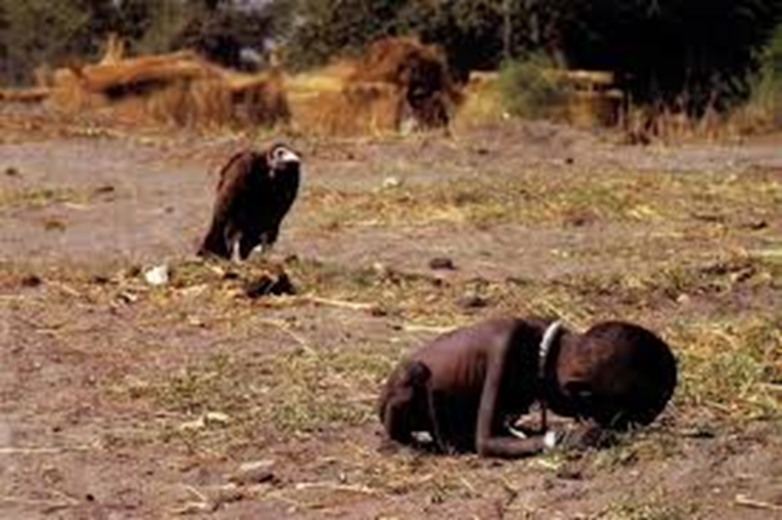

Slide 4
This seems a daunting task, but following this is an example student paper on their feelings about the photos

Slide 5
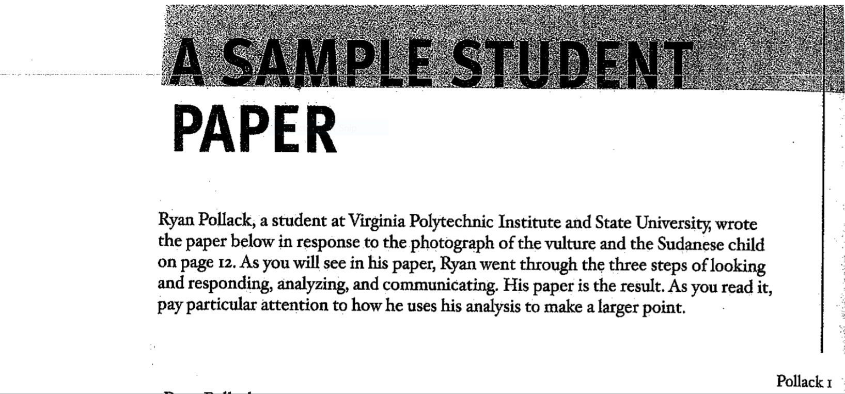

Slide 6
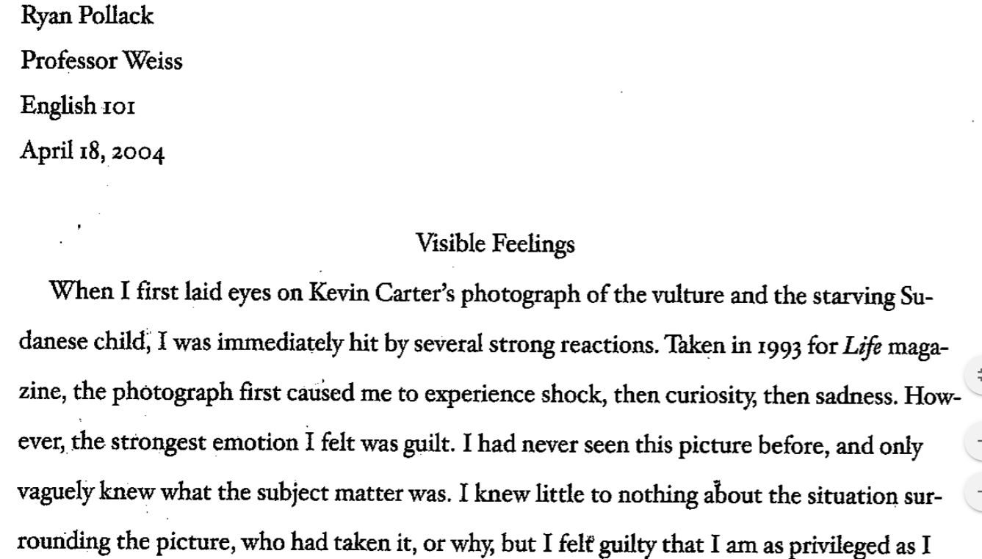

Slide 7
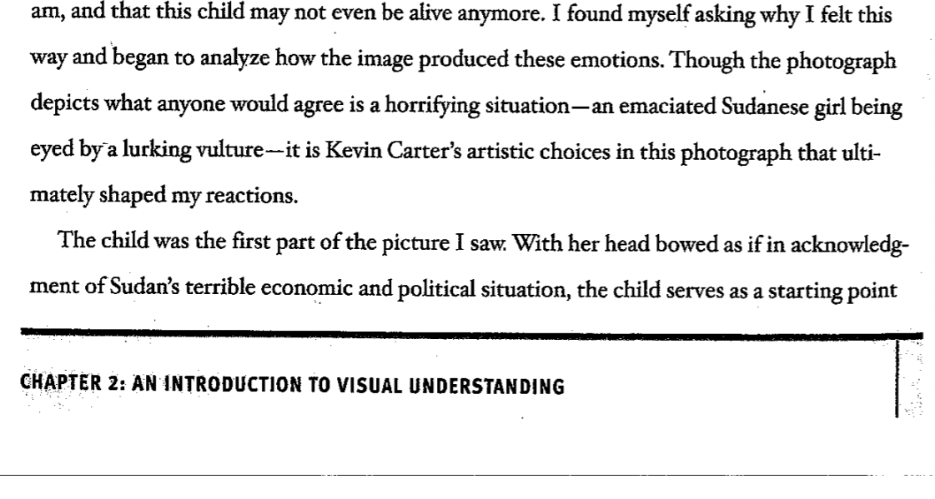

Slide 8
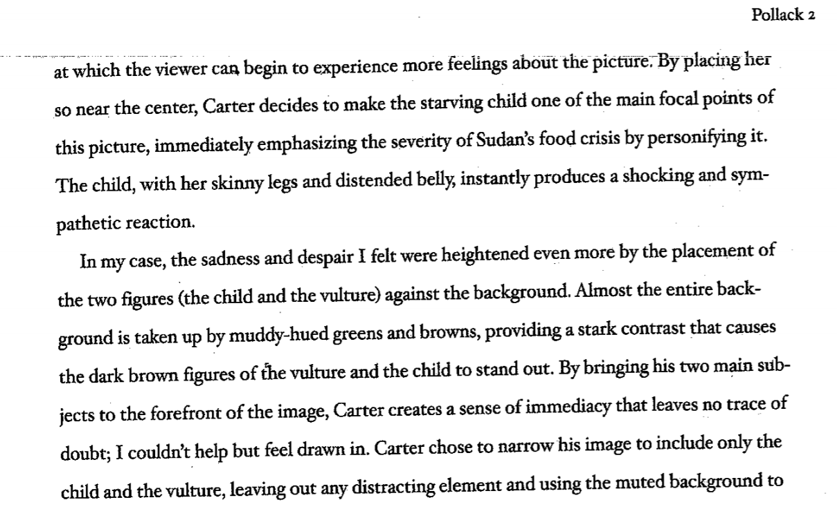

Slide 9
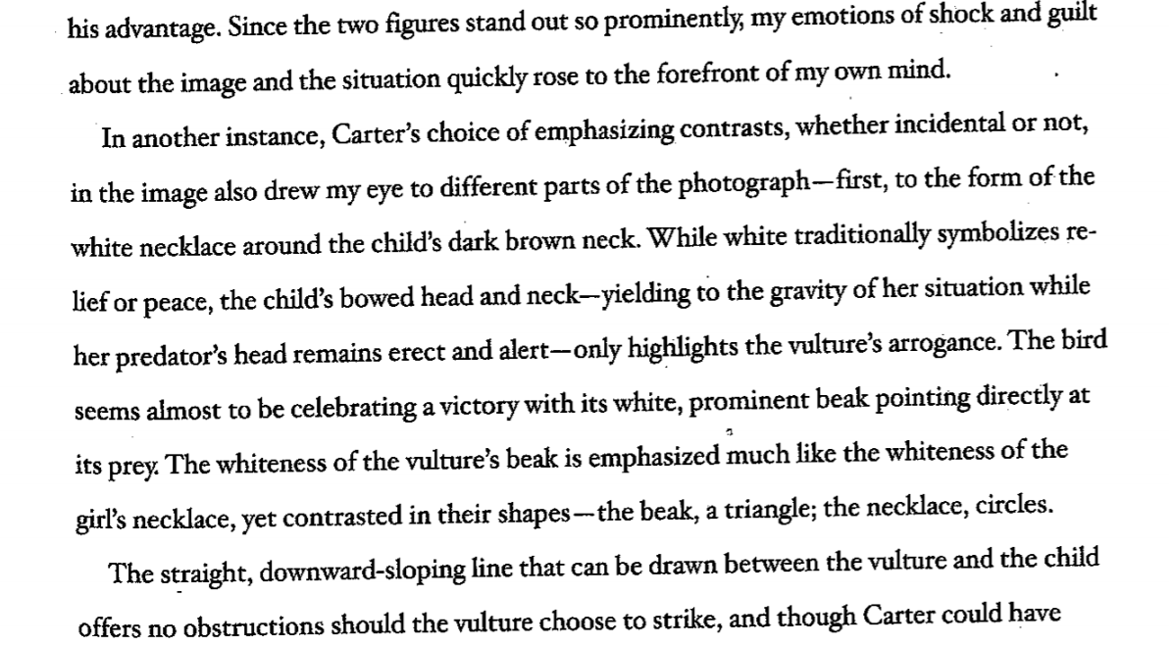

Slide 10
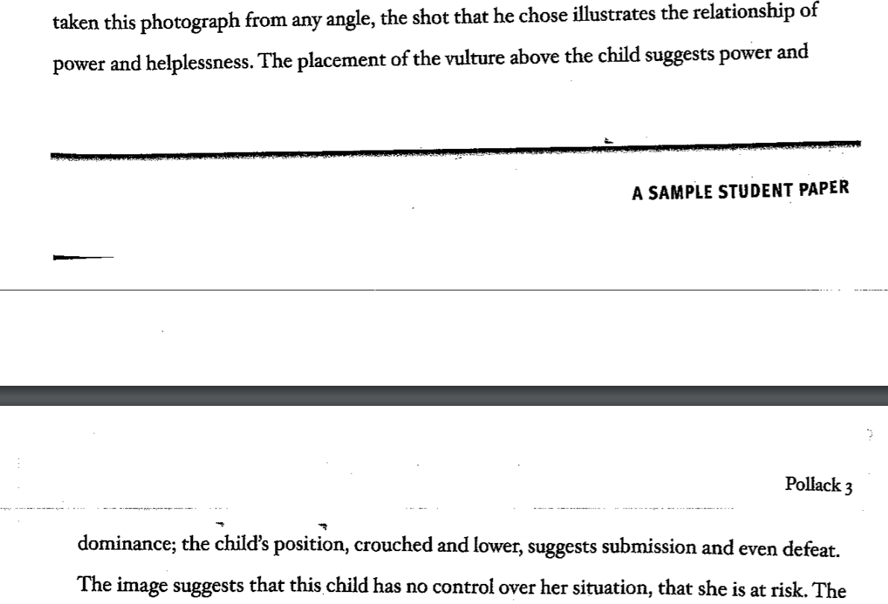

Slide 11
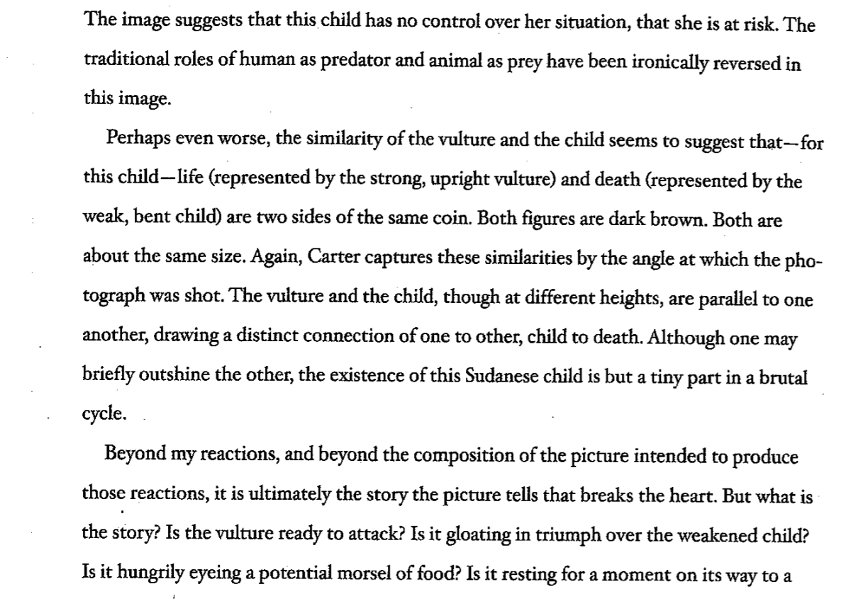

Slide 12
