Slide 1
Chapter 8 confidence intervals
introduction

Slide 2
Confidence intervals
We use sample data to make generalizations about an unknown population. This part of statistics is called inferential statistics.
The sample data help us to make an estimate of a population parameter.
The sample mean, $\overline{x}$, is the point estimate for the population mean, μ. Remember, $\overline{x}$ is called a statistic.
The point estimate is not the exact value of the population parameter, but close to it.
After calculating point estimates, we construct interval estimates, called confidence intervals. The interval of numbers is a range of values calculated from a given set of sample data. The confidence interval is likely to include an unknown population parameter.

Slide 3
Chapter 8 confidence intervals
Section 8.1 - A Single Population Mean using the Normal
Distribution

Slide 4
Section 8.1 Learning Objectives
In this section students will:
Determine the best point estimates for population parameters
Find the critical value corresponding to a given confidence level for a z-intervals
Calculate margins of error for confidence intervals for μ when σ is known.
Construct confidence intervals for μ when σ is known.
Interpret the results of confidence intervals for μ when σ is known.
Compute the sample size to be used for estimating mean μ.

Slide 5
Calculating the Confidence Interval
To construct a confidence interval for a single unknown population mean μ, where the population standard deviation, σ, is known, we need $\overline{x}$ as an estimate for μ and we need the margin of error.
Here, the margin of error (EBM) is called the error bound for a population mean (abbreviated EBM). The sample mean $\overline{x}$ is the point estimate of the unknown population mean μ.
The margin of error (EBM) depends on the confidence level (abbreviated CL).
The confidence interval estimate will have the form:
(point estimate - error bound, point estimate + error bound)
or, in symbols, ($\overline{x}$ – EBM, $\overline{x}$ +EBM )

Slide 6
Calculating the Confidence Interval example
Example 8.1
Suppose we have collected data from a sample. We know the sample mean but we do not know the mean for the entire population.
The sample mean is seven, and the error bound for the mean is 2.5.
$\overline{x}=7$ and EBM = 2.5
The confidence interval is (7 – 2.5, 7 + 2.5), and calculating the values gives (4.5, 9.5).
If the confidence level (CL) is 95%, then we say that, "We estimate with 95% confidence that the true value of the population mean is between 4.5 and 9.5."
Try It 8.1
Suppose we have data from a sample. The sample mean is 15, and the error bound for the mean is 3.2.
What is the confidence interval estimate for the population mean?

Slide 7
Calculating the Confidence Interval (cont.)
So what if we aren’t just given $\overline{x}$ and the EBM?
How do we form ($\overline{x}$ – EBM, $\overline{x}$ +EBM )?
We have many ways (preferably using the calculator) to find the sample mean, $\overline{x}$, if it’s not given to us.
The error bound formula for an unknown population mean μ when the population standard deviation σ is known is:
EBM = (z_{α/2})(σ/$\sqrt{n}$)
Since σ is known, the part that is challenging is finding z_{α/2}

Slide 8
Finding the z-score for the Stated Confidence Level
Remember, the margin of error (EBM) depends on the confidence level (abbreviated CL).
The confidence level, CL, is the area in the middle of the standard normal distribution. CL = 1 – α, so α is the area that is split equally between the two tails. Each of the tails contains an area equal to α/2.
The z-score that has an area to the right of α/2 is denoted by z_{α/2}.
For example, when CL = 0.95, α = 0.05 and α/2 = 0.025; we write z_{α/2} = z_{0.025}.
The area to the right of z_{0.025} is 0.025 and the area to the left of z_{0.025} is 1 – 0.025 = 0.975.
Using a calculator can actually find the z-score.

Slide 9
Finding the z-score for the Stated Confidence Level Calculator
When we know the population standard deviation σ, we use a standard normal distribution to calculate the error bound EBM and construct the confidence interval.
Remember, this distribution is: Z ~ N(0, 1).
Using the TI-83, 83+, 84, 84+ Calculator
invNorm(area to left, 0, 1)
Note
Remember to use the area to the LEFT of z_{α/2} ; in this chapter the last two inputs in the invNorm command are 0, 1, because you are using a standard normal distribution Z ~ N(0, 1).

Slide 10
Calculating the Confidence Interval (cont. 2)
The other part of the error bound formula:
EBM = (z_{α/2})(σ/$\sqrt{n}$)
σ/$\sqrt{n}$ is not difficult because once again, σ is known, and we should know the sample size.
But because of that piece, we do need to remember the central limit theorem:
$\overline{X}$ is normally distributed, that is, $\overline{X}$ ~ N(μ_{X}, σ_{X}/$\sqrt{n}$)
Remember, either the X distribution is normal or there must be 30 in the sample size.

Slide 11
Calculating the Confidence Interval (Cont. 3)
Writing the Interpretation
The interpretation should clearly state the confidence level (CL), explain what population parameter is being estimated (here, a population mean), and state the confidence interval (both endpoints).
"We estimate with ___% confidence that the true population mean (include the context of the problem) is between ___ and ___ (include appropriate units)."

Slide 12
Calculating the Confidence Interval (Cont. 4)
As a recap, the steps to construct a confidence interval estimate for an unknown population mean when σ is known:
• Calculate the sample mean $\overline{x}$ from the sample data, if necessary.
• Find the z-score that corresponds to the confidence level.
• Calculate the error bound EBM.
• Construct the confidence interval ($\overline{x}$ – EBM, $\overline{x}$ + EBM)
• Interpret the estimate in the context of the situation in the problem. (Explain what the confidence interval means, in the words of the problem.)

Slide 13
Calculating the Confidence Interval example 2
Example 8.2
Suppose scores on exams in statistics are normally distributed with an unknown population mean and a population standard deviation of three points. A random sample of 36 scores is taken and gives a sample mean (sample mean score) of 68. Find a confidence interval estimate for the population mean exam score (the mean score on all exams).
Find a 90% confidence interval for the true (population) mean of statistics exam scores.

Slide 14
Calculating the Confidence Interval try it
Try It 8.2
Suppose average pizza delivery times are normally distributed with an unknown population mean and a population standard deviation of six minutes. A random sample of 28 pizza delivery restaurants is taken and has a sample mean delivery time of 36 minutes.
Find a 90% confidence interval estimate for the population mean delivery time.

Slide 15
Calculating the Confidence Interval using the calculator

Slide 16
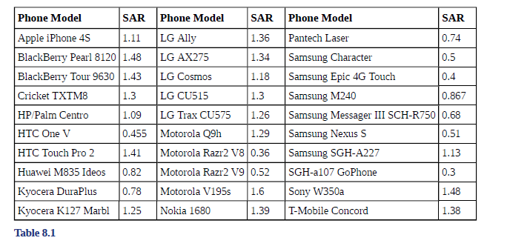
Calculating the Confidence Interval using the calculator example
Example 8.3
The Specific Absorption Rate (SAR) for a cell phone measures the amount of radio frequency (RF) energy absorbed by the user’s body when using the handset. Every cell phone emits RF energy. Different phone models have different SAR measures. To receive certification from the Federal Communications Commission (FCC) for sale in the United States, the SAR level for a cell phone must be no more than 1.6 watts per kilogram. Table 8.1 shows the highest SAR level for a random selection of cell phone models as measured by the FCC.
Find a 98% confidence interval for the true (population) mean of the Specific Absorption Rates (SARs) for cell phones. Assume that the population standard deviation is σ = 0.337.

Slide 17
Calculating the Confidence Interval using the calculator try it
Try It 8.3
Table 8.2 shows a different random sampling of 20 cell phone models. Use this data to calculate a 93% confidence interval for the true mean SAR for cell phones certified for use in the United States. As previously, assume that the population standard deviation is σ = 0.337.

Slide 18
Calculating the Sample Size n
If researchers desire a specific margin of error, then they can use the error bound formula to calculate the required sample size.
Remember, the error bound formula for a population mean when the population standard deviation is known is: EBM = (z_{α/2})(σ/$\sqrt{n}$)
The formula for sample size is n = (z²σ²)/EBM², found by solving the error bound formula for n.
In this formula, z is z_{α/2}, corresponding to the desired confidence level.

Slide 19
Calculating the Sample Size n Example
Example 8.7
The population standard deviation for the age of Foothill College students is 15 years. If we want to be 95% confident that the sample mean age is within two years of the true population mean age of Foothill College students, how many randomly selected Foothill College students must be surveyed?

Slide 20
Calculating the Sample Size n Try it
Try It 8.7
The population standard deviation for the height of high school basketball players is three inches. If we want to be 95% confident that the sample mean height is within one inch of the true population mean height, how many randomly selected students must be surveyed?

Slide 21
Chapter 8 confidence intervals
Section 8.2 - A Single Population Mean using the Student t
Distribution

Slide 22
Section 8.2 Learning Objectives
In this section students will:
Learn about degrees of freedom and Student's t-Distribution
Find the critical values using degrees of freedom corresponding to a given confidence level for a t-interval.
Construct confidence intervals for μ when σ is unknown
Interpret the results of confidence intervals for μ when σ is unknown.

Slide 23
A Single Population Mean using the Student t Distribution
In practice, we rarely know the population standard deviation, σ.
When the population standard deviation is unknown, we do not use the standard normal distribution. Rather we use the Student's t-distribution.
The one big difference is the calculation of the number n – 1, which is called the degrees of freedom (df).
The notation for the Student's t-distribution (using T as the random variable) is:
• T ~ t_{df} where df = n – 1.
• For example, if we have a sample of size n = 20 items, then we calculate the degrees of freedom as df = n - 1 = 20 – 1 = 19 and we write the distribution as T ~ t₁₉.

Slide 24
A Single Population Mean using the Student t Distribution (Cont.)
With the Student's t-distribution, there is a t-score which has the same interpretation as the z-score.
A probability table for the Student's t-distribution is used to find the t-score.
A Student's t table (See Appendix H) gives t-scores given the degrees of freedom and the right-tailed probability. The table is very limited.
Images from the table is shown on the next page and are found at http://www.itl.nist.gov/div898/handbook/eda/section3/eda3672.htm

Slide 25
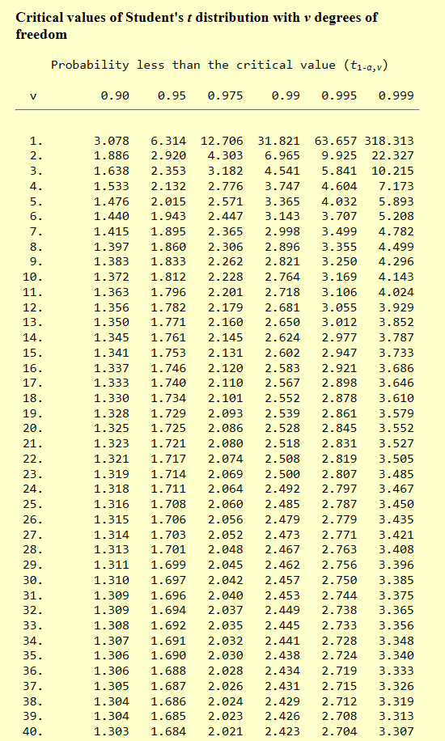
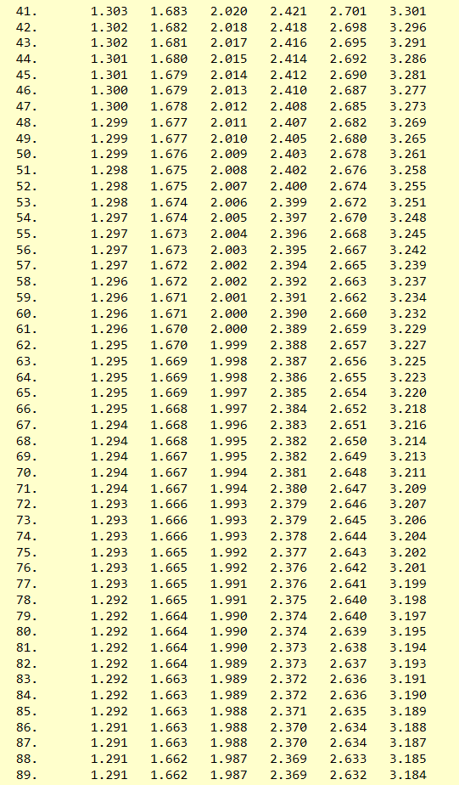
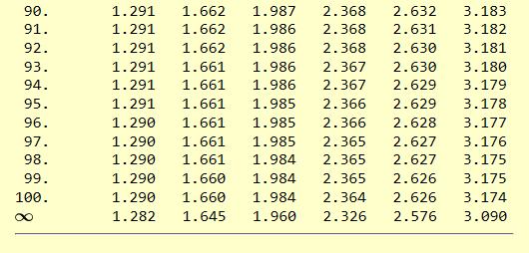
A Single Population Mean using the Student t Distribution Table

Slide 26
A Single Population Mean using the Student t Distribution (Cont. 2)
If the population standard deviation is not known, the error bound for a population mean is: EBM = (t_{α/2})(s/$\sqrt{n}$)
• t_{α/2} is the t-score with area to the right equal to α/2
• use df = n – 1 degrees of freedom, and
• s = sample standard deviation.
The format for the confidence interval is:
($\overline{x}$ – EBM, $\overline{x}$ + EBM)

Slide 27
A Single Population Mean using the Student t Distribution example
Example 8.8
Suppose you do a study of acupuncture to determine how effective it is in relieving pain. You measure sensory rates for 15 subjects with the results given. Use the sample data to construct a 95% confidence interval for the mean sensory rate for the population (assumed normal) from which you took the data.
8.6; 9.4; 7.9; 6.8; 8.3; 7.3; 9.2; 9.6; 8.7; 11.4; 10.3; 5.4; 8.1; 5.5; 6.9

Slide 28
A Single Population Mean using the Student t Distribution try it
Try It 8.8
You do a study of hypnotherapy to determine how effective it is in increasing the number of hours of sleep subjects get each night. You measure hours of sleep for 12 subjects with the following results.
Construct a 95% confidence interval for the mean number of hours slept for the population (assumed normal) from which you took the data.
8.2; 9.1; 7.7; 8.6; 6.9; 11.2; 10.1; 9.9; 8.9; 9.2; 7.5; 10.5

Slide 29
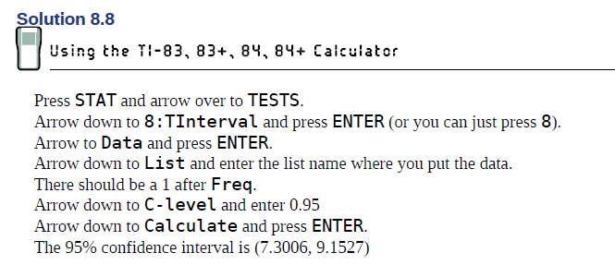
A Single Population Mean using the Student t Distribution calculator

Slide 30
A Single Population Mean using the Student t Distribution example 2
Example 8.9
The Human Toxome Project (HTP) is working to understand the scope of industrial pollution in the human body. Industrial chemicals may enter the body through pollution or as ingredients in consumer products. In October 2008, the scientists at HTP tested cord blood samples for 20 newborn infants in the United States. The cord blood of the "In utero/newborn" group was tested for 430 industrial compounds, pollutants, and other chemicals, including chemicals linked to brain and nervous system toxicity, immune system toxicity, and reproductive toxicity, and fertility problems. There are health concerns about the effects of some chemicals on the brain and nervous system. Table 8.3 shows how many of the targeted chemicals were found in each infant’s cord blood.
Use this sample data to construct a 90% confidence interval for the mean number of targeted industrial chemicals to be found in an in infant’s blood.

Slide 31
A Single Population Mean using the Student t Distribution try it 2
Try It 8.9
A random sample of statistics students were asked to estimate the total number of hours they spend watching television in an average week. The responses are recorded in Table 8.4. Use this sample data to construct a 98% confidence interval for the mean number of hours statistics students will spend watching television in one week.

Slide 32
Chapter 8 confidence intervals
Section 8.3 - A population proportion

Slide 33
Section 8.3 Learning Objectives
In this section students will:
Compute the margin of error for proportion using a given level of confidence.
Construct confidence intervals for proportions.
Interpret the results of confidence intervals for proportions
Compute the sample size to be used for estimating a proportion p when we have an estimate for proportions
Compute the sample size to be used for estimating a proportion p when we have no estimate for proportions.

Slide 34
A POPULATION PROPORTION
Example
During an election year, we see articles in the newspaper that state confidence intervals in terms of proportions or percentages. For example, a poll for a particular candidate running for president might show that the candidate has 40% of the vote within three percentage points (if the sample is large enough). Often, election polls are calculated with 95% confidence, so, the pollsters would be 95% confident that the true proportion of voters who favored the candidate would be between 0.37 and 0.43: (0.40 – 0.03,0.40 + 0.03).
The procedure to find the confidence interval, the sample size, the error bound, and the confidence level for a proportion is similar to that for the population mean, but the formulas are different.

Slide 35
POPULATION PROPORTION PROBLEM
How do you know you are dealing with a proportion problem?
First, the underlying distribution is a binomial distribution. (There is no mention of a mean or average.) If X is a binomial random variable, then X ~ B(n, p) where n is the number of trials and p is the probability of a success.
To form a proportion, take X, the random variable for the number of successes and divide it by n, the number of trials (or the sample size). The random variable p′ (read “p prime") is that proportion, p′ = x/n
(Sometimes the random variable is denoted as , $\hat{p}$, read “p hat".)

Slide 36
FROM BINOMIAL TO NORMAL
When n is large and p is not close to zero or one, we can use the normal distribution to approximate the binomial.
$$X \sim N\left(np, \sqrt{npq}\right)$$
If we divide the random variable, the mean, and the standard deviation by n, we get a normal distribution of proportions with P′, called the estimated proportion, as the random variable. (Recall that a proportion as the number of successes divided by n.)
$$\frac{X}{n}=P^{′}\sim N\left(\frac{np}{n}, \frac{\sqrt{npq}}{n}\right)$$
Below is the algebraic simplified form
P′ follows a normal distribution for proportions:
$$\frac{X}{n}=P^{′}\sim N\left(p,\sqrt{\frac{pq}{n}}\right)$$

Slide 37
CONFIDENCE INTERVALS FOR PROPORTIONS
The confidence interval has the form (p′ – EBP, p′ + EBP). EBP is error bound for the proportion.
p′ = x/n p′ = the estimated proportion of successes (p′ is a point estimate for p, the true proportion.) x = the number of successes n = the size of the sample
The error bound for a proportion is
$EBP=\left(z_{α/2}\right)\left(\frac{\sqrt{p′q′}}{n}\right)$
where q’ = 1 – p’

Slide 38
ERROR BOUND FORMULA AND STANDARD DEVIATION
This formula is similar to the error bound formula for a mean, except that the "appropriate standard deviation" is different. For a mean, when the population standard deviation is known, the appropriate standard deviation that we use is
For a proportion, the appropriate standard deviation is $\sqrt{\frac{pq}{n}}$. However, in the error bound formula, we use $\sqrt{\frac{p′q′}{n}}$ as the standard deviation, instead of $\sqrt{\frac{pq}{n}}$
In the error bound formula, the sample proportions p′ and q′ are estimates of the unknown population proportions p and q. The estimated proportions p′ and q′ are used because p and q are not known. The sample proportions p′ and q′ are calculated from the data: p′ is the estimated proportion of successes, and q′ is the estimated proportion of failures.
The confidence interval can be used only if the number of successes np′ and the number of failures nq′ are both greater than five.

Slide 39
A POPULATION PROPORTION
EXAMPLE
Suppose that a market research firm is hired to estimate the percent of adults living in a large city who have cell phones. Five hundred randomly selected adult residents in this city are surveyed to determine whether they have cell phones. Of the 500 people surveyed, 421 responded yes - they own cell phones. Using a 95% confidence level, compute a confidence interval estimate for the true proportion of adult residents of this city who have cell phones.

Slide 40
A POPULATION PROPORTION ON THE CALCULATOR
USING THE TI-83, 83+, 84, 84+ CALCULATOR
Press STAT and arrow over to TESTS.
Arrow down to A:1-PropZint. Press ENTER.
Arrow down to x and enter the value.
Arrow down to n and enter the sample size.
Arrow down to C-Level and enter the level of confidence as a decimal.
Arrow down to Calculate and press ENTER.

Slide 41
A POPULATION PROPORTION
TRY IT
Suppose 250 randomly selected people are surveyed to determine if they own a tablet. Of the 250 surveyed, 98 reported owning a tablet. Using a 95% confidence level, compute a confidence interval estimate for the true proportion of people who own tablets.

Slide 42
CALCULATING THE SAMPLE SIZE N
If researchers desire a specific margin of error, then they can use the error bound formula to calculate the required sample size.
The error bound formula for a population proportion is $EBP=\left(z_{α/2}\right)\left(\frac{\sqrt{p′q′}}{n}\right)$
Solving for n gives you an equation for the sample size.
$$n=\frac{{\left(z_{\frac{α}{2}}\right)}^{2}(p^{′}q^{′})}{{EBP}^{2}}$$

Slide 43
CALCULATING THE SAMPLE SIZE N
EXAMPLE
Suppose a mobile phone company wants to determine the current percentage of customers aged 50+ who use text messaging on their cell phones. How many customers aged 50+ should the company survey in order to be 90% confident that the estimated (sample) proportion is within three percentage points of the true population proportion of customers aged 50+ who use text messaging on their cell phones.

Slide 44
Acknowledgments
The original PowerPoint file is copyright 2011-2015, Rice University. All Rights Reserved.
This work is a derivative of a text by OpenStax, which is licensed under a Creative Commons Attribution License 4.0 license.
Material on this PowerPoint was adapted from Illowsky, Barbara and Dean, Susan. “Chapter 8. Confidence Intervals.” Introductory Statistics. OpenStax, Introductory Statistics. OpenStax CNX. May 13, 2019 http://cnx.org/contents/30189442-6998-4686-ac05-ed152b91b9de@23.30.
This document has been reviewed for accessibility.

