Slide 1
Chapter 2 descriptive statistics
Section 2.1 – Stem-and-Leaf Graphs (Stemplots), Line Graphs, and
Bar Graphs

Slide 2
Section 2.1 Learning Objectives
In this section students will:
Construct a frequency distribution
Construct bar graphs
Construct stem-and-leaf display and visualize data distribution
Interpret information displayed in all types of graphs

Slide 3
Stem-and-Leaf Graphs (Stemplots)
One simple graph, the stem-and-leaf graph or stemplot, comes from the field of exploratory data analysis. It is a good choice when the data sets are small.
To create the plot, divide each observation of data into a stem and a leaf. The leaf consists of a final significant digit.
For example, 23 has stem two and leaf three. The number 432 has stem 43 and leaf two. Likewise, the number 5,432 has stem 543 and leaf two. The decimal 9.3 has stem nine and leaf three.
Write the stems in a vertical line from smallest to largest. Draw a vertical line to the right of the stems. Then write the leaves in increasing order next to their corresponding stem.

Slide 4
Stem-and-Leaf Graphs (Stemplots) Cont.
The stemplot is a quick way to graph data and gives an exact picture of the data.
You want to look for an overall pattern and any outliers. An outlier is an observation of data that does not fit the rest of the data. It is sometimes called an extreme value.
When you graph an outlier, it will appear not to fit the pattern of the graph.
Some outliers are due to mistakes (for example, writing down 50 instead of 500) while others may indicate that something unusual is happening. It takes some background information to explain outliers, so we will cover them in more detail later.

Slide 5
Stem-and-Leaf Graphs (Stemplots) Example 2.1
Example 2.1
For Susan Dean's spring pre-calculus class, scores for the first exam were as follows (smallest to largest):
33; 42; 49; 49; 53; 55; 55; 61; 63; 67; 68; 68; 69; 69; 72; 73; 74; 78; 80; 83; 88; 88; 88; 90; 92; 94; 94; 94; 94; 96; 100
The stemplot shows that most scores fell in the 60s, 70s, 80s, and 90s.
Eight out of the 31 scores or approximately 26% (8/31)
were in the 90s or 100, a fairly high number of As.

Slide 6
Stem-and-Leaf Graphs (Stemplots) Example 2.3
A side-by-side stem-and-leaf plot allows a comparison of the two data sets in two columns. In a side-by-side stem-and-leaf plot, two sets of leaves share the same stem. The leaves are to the left and the right of the stems. Table 2.4 and Table 2.5 show the ages of presidents at their inauguration and at their death. Construct a side-by-side stem-and-leaf plot using this data.
Data for this example is on the next slide.

Slide 7
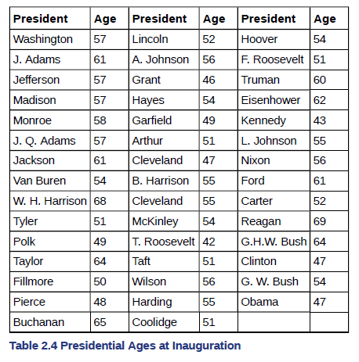
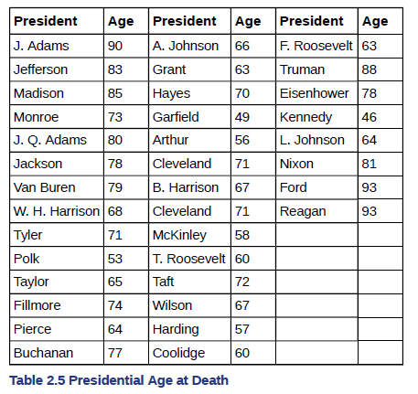
Data for Example

Slide 8
Stem-and-Leaf Graphs (Stemplots) try it
Try It 2.1
For the Park City basketball team, scores for the last 30 games were as follows (smallest to largest):
32; 32; 33; 34; 38; 40; 42; 42; 43; 44; 46; 47; 47; 48; 48; 48; 49; 50; 50; 51; 52; 52; 52; 53; 54; 56; 57; 57; 60; 61
Construct a stem plot for the data.

Slide 9
Stem-and-Leaf Graphs (Stemplots) Try it 2
Try It 2.2
The following data show the distances (in miles) from the homes of off-campus statistics students to the college. Create a stem plot using the data and identify any outliers:
0.5; 0.7; 1.1; 1.2; 1.2; 1.3; 1.3; 1.5; 1.5; 1.7; 1.7; 1.8; 1.9; 2.0; 2.2; 2.5; 2.6; 2.8; 2.8; 2.8; 3.5; 3.8; 4.4; 4.8; 4.9; 5.2; 5.5; 5.7; 5.8; 8.0

Slide 10
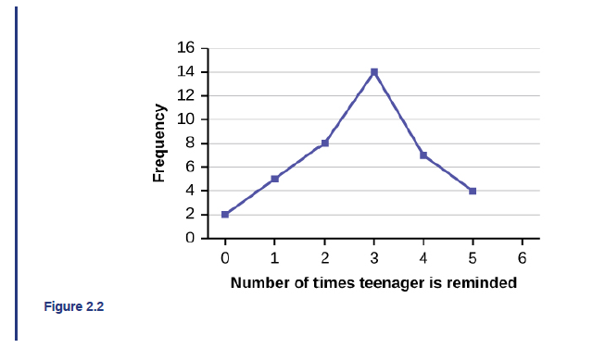
Line graphs
Another type of graph that is useful for specific data values is a line graph.
The x-axis (horizontal axis) consists of data values and the y-axis (vertical axis) consists of frequency points.
The frequency points are connected using line segments.
Example 2.4
In a survey, 40 mothers were asked how many times per week a teenager must be reminded to do his or her chores. The results are shown in Table 2.7 and in Figure 2.2.

Slide 11
Line graphs try it
Try It 2.4
In a survey, 40 people were asked how many times per year they had their car in the shop for repairs. The results are shown in Table 2.8. Construct a line graph.

Slide 12
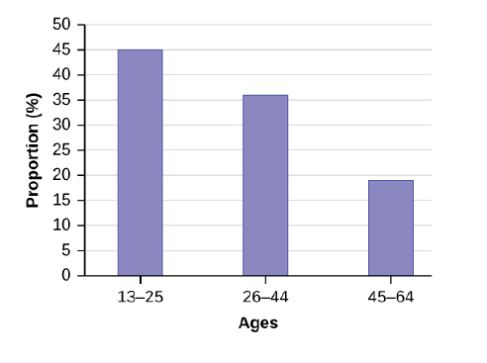
bar graphs
Bar graphs consist of bars that are separated from each other.
The bars can be rectangles or they can be rectangular boxes (used in three-dimensional plots), and they can be vertical or horizontal.
Example 2.5
By the end of 2011, Facebook had over 146 million users in the United States. Table 2.9 shows three age groups, the number of users in each age group, and the proportion (%) of users in each age group. A bar graph of this data is shown below.

Slide 13
bar graphs try it
Try It 2.5
The population in Park City is made up of children, working-age adults, and retirees. Table 2.10 shows the three age groups, the number of people in the town from each age group, and the proportion (%) of people in each age group. Construct a bar graph showing the proportions.

Slide 14
Chapter 2 descriptive statistics
Section 2.2 – Histograms, Frequency Polygons, and Time Series
Graphs

Slide 15
Section 2.2 Learning Objectives
In this section students will:
Determine types of graphs appropriate for specific data
Construct histograms, relative frequency histograms
Construct time-series graphs

Slide 16
histograms
A histogram consists of contiguous (adjoining) boxes. It has both a horizontal axis and a vertical axis.
The horizontal axis is labeled with what the data represents (for instance, distance from your home to school).
The vertical axis is labeled either frequency or relative frequency (or percent frequency or probability).
The graph will have the same shape with either label.
The histogram (like the stemplot) can give you the shape of the data, the center, and the spread of the data.

Slide 17
Histograms (cont.)
To construct a histogram, first decide how many bars or intervals, also called classes, represent the data. Many histograms consist of five to 15 bars or classes for clarity.
Choose a starting point for the first interval to be less than the smallest data value. A convenient starting point is a lower value carried out to one more decimal place than the value with the most decimal places.
For example, if the value with the most decimal places is 6.1 and this is the smallest value, a convenient starting point is 6.05 (6.1 – 0.05 = 6.05). If all the data happen to be integers and the smallest value is two, then a convenient starting point is 1.5 (2 – 0.5 = 1.5).
Also, when the starting point and other boundaries are carried to one additional decimal place, no data value will fall on a boundary.
Next, calculate the width of each bar or class interval. To calculate this width, subtract the starting point from the ending value and divide by the number of bars (you must choose the number of bars you desire).

Slide 18
Histograms example
Example 2.7
The following data are the heights (in inches to the nearest half inch) of 100 male semiprofessional soccer players. The heights are continuous data, since height is measured.
60; 60.5; 61; 61; 61.5 63.5; 63.5; 63.5 64; 64; 64; 64; 64; 64; 64; 64.5; 64.5; 64.5; 64.5; 64.5; 64.5; 64.5; 64.5 66; 66; 66; 66; 66; 66; 66; 66; 66; 66; 66.5; 66.5; 66.5; 66.5; 66.5; 66.5; 66.5; 66.5; 66.5; 66.5; 66.5; 67; 67; 67; 67; 67; 67; 67; 67; 67; 67; 67; 67; 67.5; 67.5; 67.5; 67.5; 67.5; 67.5; 67.5 68; 68; 69; 69; 69; 69; 69; 69; 69; 69; 69; 69; 69.5; 69.5; 69.5; 69.5; 69.5 70; 70; 70; 70; 70; 70; 70.5; 70.5; 70.5; 71; 71; 71 72; 72; 72; 72.5; 72.5; 73; 73.5 74
The smallest data value is 60. Since the data with the most decimal places has one decimal (for instance, 61.5), we want our starting point to have two decimal places. Since the numbers 0.5, 0.05, 0.005, etc. are convenient numbers, use 0.05 and subtract it from 60, the smallest value, for the convenient starting point.
60 – 0.05 = 59.95 which is more precise than, say, 61.5 by one decimal place. The starting point is, then, 59.95.
The largest value is 74, so 74 + 0.05 = 74.05 is the ending value.
Next, calculate the width of each bar or class interval. To calculate this width, subtract the starting point from the ending value and divide by the number of bars (you must choose the number of bars you desire). Suppose you choose eight bars.

Slide 19
Histograms example (cont.)
NOTE
We will round up to two and make each bar or class interval two units wide. Rounding up to two is one way to prevent a value from falling on a boundary. Rounding to the next number is often necessary even if it goes against the standard rules of rounding. For this example, using 1.76 as the width would also work. A guideline that is followed by some for the number of bars or class intervals is to take the square root of the number of data values and then round to the nearest whole number, if necessary. For example, if there are 150 values of data, take the square root of 150 and round to 12 bars or intervals.
Create the boundaries by adding the width to the starting point and so on to create the total number of classes needed.
The boundaries are:
59.95
59.95 + 2 = 61.95
61.95 + 2 = 63.95
63.95 + 2 = 65.95
65.95 + 2 = 67.95
67.95 + 2 = 69.95
69.95 + 2 = 71.95
71.95 + 2 = 73.95
73.95 + 2 = 75.95
Count the frequency in each class to draw your histogram.

Slide 20
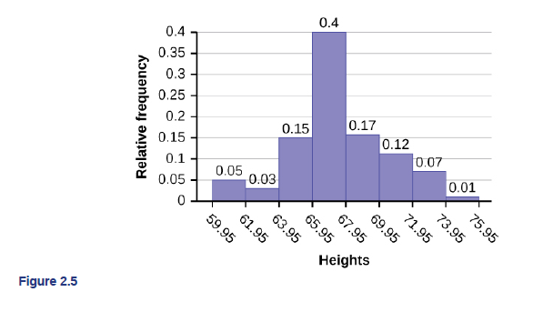
Histograms example (cont. 2)
The heights 60 through 61.5 inches are in the interval 59.95–61.95. The heights that are 63.5 are in the interval 61.95–63.95. The heights that are 64 through 64.5 are in the interval 63.95–65.95. The heights 66 through 67.5 are in the interval 65.95–67.95. The heights 68 through 69.5 are in the interval 67.95–69.95. The heights 70 through 71 are in the interval 69.95–71.95. The heights 72 through 73.5 are in the interval 71.95–73.95. The height 74 is in the interval 73.95–75.95.
The following histogram displays the heights on the x-axis and relative frequency on the y-axis.

Slide 21
Histograms try it
Try It 2.7
The following data are the shoe sizes of 50 male students. The sizes are discrete data since shoe size is measured in whole and half units only. Construct a histogram and calculate the width of each bar or class interval. Suppose you choose six bars.
9; 9; 9.5; 9.5; 10; 10; 10; 10; 10; 10; 10.5; 10.5; 10.5; 10.5; 10.5; 10.5; 10.5; 10.5; 11; 11; 11; 11; 11; 11; 11; 11; 11; 11; 11; 11; 11; 11.5; 11.5; 11.5; 11.5; 11.5; 11.5; 11.5; 12; 12; 12; 12; 12; 12; 12; 12.5; 12.5; 12.5; 12.5; 14

Slide 22
Histograms example 2
Example 2.8
Create a histogram for the following data: the number of books bought by 50 part-time college students at ABC College.the number of books bought by 50 part-time college students at ABC College. The number of books is discrete data, since books are counted.
1; 1; 1; 1; 1; 1; 1; 1; 1; 1; 1 2; 2; 2; 2; 2; 2; 2; 2; 2; 2 3; 3; 3; 3; 3; 3; 3; 3; 3; 3; 3; 3; 3; 3; 3; 3 4; 4; 4; 4; 4; 4 5; 5; 5; 5; 5 6; 6
Eleven students buy one book. Ten students buy two books. Sixteen students buy three books. Six students buy four books. Five students buy five books. Two students buy six books.
Because the data are integers, subtract 0.5 from 1, the smallest data value and add 0.5 to 6, the largest data value. Then the starting point is 0.5 and the ending value is 6.5.
Next, calculate the width of each bar or class interval. If the data are discrete and there are not too many different values, a width that places the data values in the middle of the bar or class interval is the most convenient. Since the data consist of the numbers 1, 2, 3, 4, 5, 6, and the starting point is 0.5, a width of one places the 1 in the middle of the interval from 0.5 to 1.5, the 2 in the middle of the interval from 1.5 to 2.5, the 3 in the middle of the interval from 2.5 to 3.5, and so on.

Slide 23
Histograms example 2 (cont.)

Slide 24
Histograms on the Calculator
Using the TI-83, 83+, 84, 84+ Calculator
Go to Table F2. There are calculator instructions for entering data and for creating a customized histogram. Create the histogram for Example 2.8.
Press Y=. Press CLEAR to delete any equations.
Press STAT 1:EDIT. If L1 has data in it, arrow up into the name L1, press CLEAR and then arrow down. If necessary, do the same for L2.
Into L1, enter 1, 2, 3, 4, 5, 6.
Into L2, enter 11, 10, 16, 6, 5, 2.
Press WINDOW. Set Xmin = .5, Xmax = 6.5, Xscl = (6.5 – .5)/6, Ymin = –1, Ymax = 20, Yscl = 1, Xres = 1.
Press 2nd Y=. Start by pressing 4:Plotsoff ENTER.
Press 2nd Y=. Press 1:Plot1. Press ENTER. Arrow down to TYPE. Arrow to the 3rd picture (histogram). Press ENTER.
Arrow down to Xlist: Enter L1 (2nd 1). Arrow down to Freq. Enter L2 (2nd 2).
Press GRAPH.
Use the TRACE key and the arrow keys to examine the histogram.

Slide 25
Histograms on the Calculator try it
Try It 2.8
The following data are the number of sports played by 50 student athletes. The number of sports is discrete data since sports are counted.
1; 1; 1; 1; 1; 1; 1; 1; 1; 1; 1; 1; 1; 1; 1; 1; 1; 1; 1; 1 2; 2; 2; 2; 2; 2; 2; 2; 2; 2; 2; 2; 2; 2; 2; 2; 2; 2; 2; 2; 2; 2 3; 3; 3; 3; 3; 3; 3; 3
20 student athletes play one sport. 22 student athletes play two sports. Eight student athletes play three sports.
Using this data, create a histogram.

Slide 26
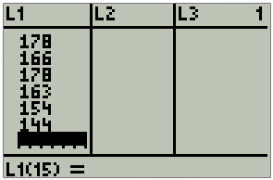
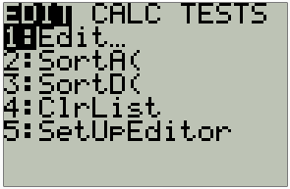
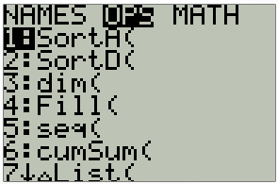
Sorting data in the calculator
If you type your data into a List in the calculator, you can SORT the data and it will help you to count the data values that fall into each class.
Open a List by pressing the STAT button, and then select 1: EDIT by pressing ENTER. If there is something in the List, highlight the L# and press CLEAR.
Type the data set into L1. Now press 2nd STAT (to get to List). Scroll over to OPS and select 1: SortA(.

Slide 27
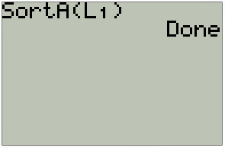
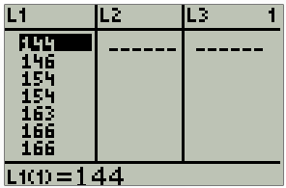
Sorting data in the calculator (cont.)
With SortA( on the home screen, type in L1 (press 2nd 1).
Close out the parenthesis and press Enter. You will the command “Done.”
Now, when you go back to the data (STAT, 1:Edit), you will see your data in descending order.

Slide 28
Histograms try it 2
Try It 2.9
The following data represent the number of employees at various restaurants in New York City. Using this data, create a histogram.
22; 35; 15; 26; 40; 28; 18; 20; 25; 34; 39; 42; 24; 22; 19; 27; 22; 34; 40; 20; 38; and 28
Use 10–19 as the first interval.

Slide 29
Frequency Polygons
Frequency polygons are analogous to line graphs, and just as line graphs make continuous data visually easy to interpret, so too do frequency polygons.
To construct a frequency polygon, first examine the data and decide on the number of intervals, or class intervals, to use on the x-axis and y-axis.
After choosing the appropriate ranges, begin plotting the data points.
After all the points are plotted, draw line segments to connect them.

Slide 30
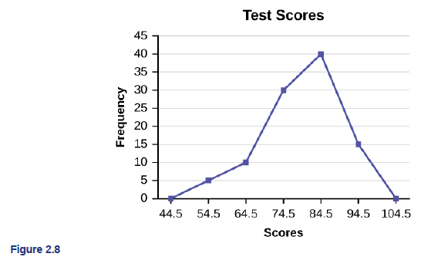
Frequency Polygons example
Example 2.10
A frequency polygon was constructed from the frequency table below.

Slide 31
Frequency Polygons try it
Try It 2.10
Construct a frequency polygon of U.S. Presidents’ ages at inauguration shown in Table 2.15.

Slide 32
Time Series Graph
To construct a time series graph, we must look at both pieces of our paired data set. We start with a standard Cartesian coordinate system.
The horizontal axis is used to plot the date or time increments, and the vertical axis is used to plot the values of the variable that we are measuring. By doing this, we make each point on the graph correspond to a date and a measured quantity.
The points on the graph are typically connected by straight lines in the order in which they occur.

Slide 33
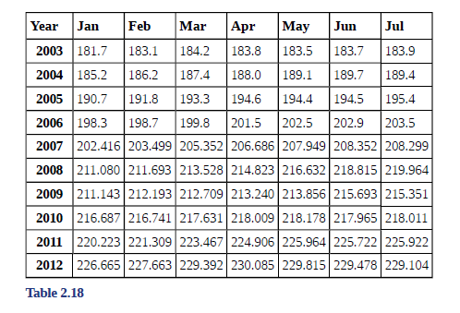
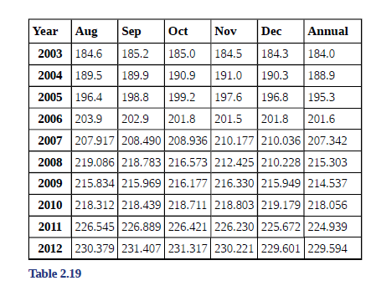
Time Series Graph example
Example 2.12
The following data shows the Annual Consumer Price Index, each month, for ten years. Construct a time series graph for the Annual Consumer Price Index data only.

Slide 34
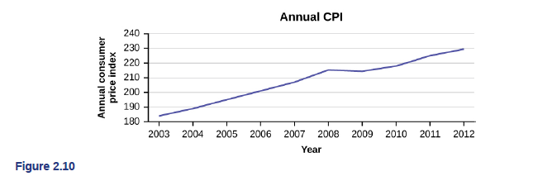
Time Series Graph example
Time series graphs are important tools in various applications of statistics.
When recording values of the same variable over an extended period of time, sometimes it is difficult to discern any trend or pattern.
However, once the same data points are displayed graphically, some features jump out. Time series graphs make trends easy to spot.

Slide 35
Time Series Graph try it
Try It 2.12
The following table is a portion of a data set from www.worldbank.org. Use the table to construct a time series graph for CO₂ emissions for the United States.

Slide 36
Chapter 2 descriptive statistics
Section 2.3 – Measures of the Location of the Data

Slide 37
Section 2.3 Learning Objectives
In this section students will:
Define measure of position and determine most appropriate measure.
Compute the median from raw data
Compute percentiles from raw data
Compute quartiles from raw data
Compute the five-number summary from raw data

Slide 38
Measures of the Location of the Data
The median is a number that measures the "center" of the data.
You can think of the median as the "middle value," but it does not actually have to be one of the observed values.
It is a number that separates ordered data into halves. Half the values are the same number or smaller than the median, and half the values are the same number or larger.
The median, M, is called both the second quartile and the 50th percentile.

Slide 39
Measures of the Location of the Data (cont.)
The common measures of location are quartiles and percentiles.
Percentiles divide ordered data into hundredths.
To score in the 90th percentile of an exam does not mean, necessarily, that you received 90% on a test. It means that 90% of test scores are the same or less than your score and 10% of the test scores are the same or greater than your test score.
To calculate percentiles, the data must be ordered from smallest to largest.

Slide 40
Measures of the Location of the Data (cont. 2)
Quartiles divide ordered data into quarters.
The first quartile, Q1, is the middle value of the lower half of the data, and the third quartile, Q3, is the middle value of the upper half of the data.
The first quartile, Q1, is the same as the 25th percentile, and the third quartile, Q3, is the same as the 75th percentile.
Quartiles may or may not be part of the data.
To calculate quartiles, the data must be ordered from smallest to largest.

Slide 41
A Formula for Finding the kth Percentile
k = the kth percentile. It may or may not be part of the data.
i = the index (ranking or position of a data value)
n = the total number of data
Order the data from smallest to largest.
Calculate $i=\frac{k}{100}(n+1)$
If i is an integer, then the kth percentile is the data value in the ith position in the ordered set of data.
If i is not an integer, then round i up and round i down to the nearest integers. Average the two data values in these two positions in the ordered data set.

Slide 42
Finding the kth Percentile example
Example 2.17
Listed are 29 ages for Academy Award winning best actors in order from smallest to largest.
18; 21; 22; 25; 26; 27; 29; 30; 31; 33; 36; 37; 41; 42; 47; 52; 55; 57; 58; 62; 64; 67; 69; 71; 72; 73; 74; 76; 77
Find the 70th percentile.
Find the 83rd percentile.

Slide 43
Finding the kth Percentile try it
Try It 2.17
Listed are 29 ages for Academy Award winning best actors in order from smallest to largest.
18; 21; 22; 25; 26; 27; 29; 30; 31; 33; 36; 37; 41; 42; 47; 52; 55; 57; 58; 62; 64; 67; 69; 71; 72; 73; 74; 76; 77
Calculate the 20th percentile and the 55th percentile.

Slide 44
A Formula for Finding the Percentile of a Value in a Data Set
Order the data from smallest to largest.
x = the number of data values counting from the bottom of the data list up to but not including the data value for which you want to find the percentile.
y = the number of data values equal to the data value for which you want to find the percentile.
n = the total number of data.
Calculate $\frac{x+0.5y}{n}(100)$
Then round to the nearest integer.

Slide 45
Finding the Percentile of a Value in a Data Set example
Example 2.18
Listed are 29 ages for Academy Award winning best actors in order from smallest to largest.
18; 21; 22; 25; 26; 27; 29; 30; 31; 33; 36; 37; 41; 42; 47; 52; 55; 57; 58; 62; 64; 67; 69; 71; 72; 73; 74; 76; 77
Find the percentile for 58.
Find the percentile for 25.

Slide 46
Finding the Percentile of a Value in a Data Set try it
Try It 2.18
Listed are 30 ages for Academy Award winning best actors in order from smallest to largest.
18; 21; 22; 25; 26; 27; 29; 30; 31, 31; 33; 36; 37; 41; 42; 47; 52; 55; 57; 58; 62; 64; 67; 69; 71; 72; 73; 74; 76; 77
Find the percentiles for 47 and 31.

Slide 47
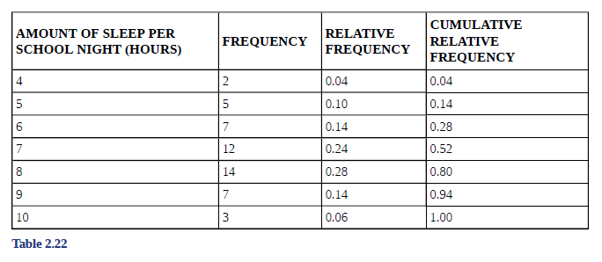
Measures of the Location of the Data example
Example 2.15
Fifty statistics students were asked how much sleep they get per school night (rounded to the nearest hour). The results are below.
Using Table 2.22:
Find the 80th percentile.
Find the 90th percentile.
Find the first quartile. What is another name for the first quartile?

Slide 48
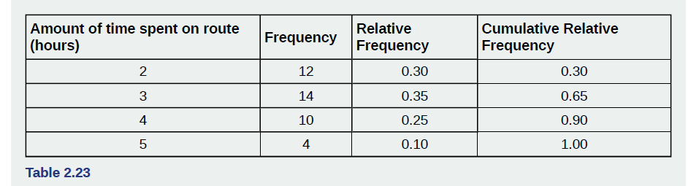
Measures of the Location of the Data try it
Try It 2.15
Forty bus drivers were asked how many hours they spend each day running their routes (rounded to the nearest hour). Find the 65th percentile.
Try It 2.16
Refer to the Table 2.23. Find the third quartile. What is another name for the third quartile?

Slide 49
Interpreting Percentiles, Quartiles, and Median
NOTE
When writing the interpretation of a percentile in the context of the given data, the sentence should contain the following information.
information about the context of the situation being considered
the data value (value of the variable) that represents the percentile
the percent of individuals or items with data values below the percentile
the percent of individuals or items with data values above the percentile.

Slide 50
Interpreting Percentiles, Quartiles, and Median examples
Example 2.19
On a timed math test, the first quartile for time it took to finish the exam was 35 minutes. Interpret the first quartile in the context of this situation.
Solution 2.19
Twenty-five percent of students finished the exam in 35 minutes or less.
Seventy-five percent of students finished the exam in 35 minutes or more.
A low percentile could be considered good, as finishing more quickly on a timed exam is desirable. (If you take too long, you might not be able to finish.)

Slide 51
Interpreting Percentiles, Quartiles, and Median try it 1
Try It 2.19
For the 100-meter dash, the third quartile for times for finishing the race was 11.5 seconds. Interpret the third quartile in the context of the situation.

Slide 52
Interpreting Percentiles, Quartiles, and Median try it 2
Try It 2.20
On a 60 point written assignment, the 80th percentile for the number of points earned was 49. Interpret the 80th percentile in the context of this situation.

Slide 53
Interquartile range
The interquartile range is a number that indicates the spread of the middle half or the middle 50% of the data.
It is the difference between the third quartile (Q3) and the first quartile (Q1).
IQR = Q3 – Q1
The IQR can help to determine potential outliers.
A value is suspected to be a potential outlier if it is less than (1.5)(IQR) below the first quartile or more than (1.5)(IQR) above the third quartile. Potential outliers always require further investigation.
NOTE
A potential outlier is a data point that is significantly different from the other data points. These special data points may be errors or some kind of abnormality or they may be a key to understanding the data.

Slide 54
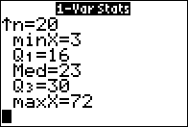
Finding the Five-Number Summary on the calculator
Type the data set into L1.
Press the STAT button, scroll to CALC, then highlight 1: 1-Var Stats and press ENTER.
(If using the TI-84, make sure the FreqList does not have a value listed)
To get to the five-number summary data, you need to scroll down the screen.
You will see minX, Q1, Median (which is Q2), Q3 and maxX.

Slide 55
Iqr try it
Try It 2.13
For the following 11 salaries, calculate the IQR and determine if any salaries are outliers. The salaries are in dollars.
$33,000; $64,500; $28,000; $54,000; $72,000; $68,500; $69,000; $42,000; $54,000; $120,000; $40,500

Slide 56
Chapter 2 descriptive statistics
Section 2.4 – box plots

Slide 57
Section 2.4 Learning Objectives
In this section students will:
Construct a box-and-whisker plot
Interpret the meaning of a box-and-whisker plot

Slide 58
Box plots
Box plots (also called box-and-whisker plots or box-whisker plots) give a good graphical image of the concentration of the data.
They also show how far the extreme values are from most of the data.
A box plot is constructed from five values: the minimum value, the first quartile, the median, the third quartile, and the maximum value.

Slide 59
Box plots (cont.)
To construct a box plot, use a horizontal or vertical number line and a rectangular box.
The smallest and largest data values label the endpoints of the axis. The first quartile marks one end of the box and the third quartile marks the other end of the box. Approximately the middle 50 percent of the data fall inside the box. The "whiskers" extend from the ends of the box to the smallest and largest data values.
The median or second quartile can be between the first and third quartiles, or it can be one, or the other, or both. The box plot gives a good, quick picture of the data.
NOTE
You may encounter box-and-whisker plots that have dots marking outlier values. In those cases, the whiskers are not extending to the minimum and maximum values.

Slide 60
Box plots (cont. 2)
The two whiskers extend from the first quartile to the smallest value and from the third quartile to the largest value. The median is shown with a dashed line.
NOTE
It is important to start a box plot with a scaled number line. Otherwise the box plot may not be useful.

Slide 61
Box Plots example
The following data are the heights of 40 students in a statistics class.
59; 60; 61; 62; 62; 63; 63; 64; 64; 64; 65; 65; 65; 65; 65; 65; 65; 65; 65; 66; 66; 67; 67; 68; 68; 69; 70; 70; 70; 70; 70; 71; 71; 72; 72; 73; 74; 74; 75; 77
Construct a box plot.
Minimum value = 59
Maximum value = 77
Q1: First quartile = 64.5
Q2: Second quartile or median= 66
Q3: Third quartile = 70
NOTE
Each quarter has approximately 25% of the data.
The spreads of the four quarters are 64.5 – 59 = 5.5 (first quarter), 66 – 64.5 = 1.5 (second quarter), 70 – 66 = 4 (third quarter), and 77 – 70 = 7 (fourth quarter). So, the second quarter has the smallest spread and the fourth quarter has the largest spread.
Range = maximum value – the minimum value = 77 – 59 = 18
Interquartile Range: IQR = Q3 – Q1 = 70 – 64.5 = 5.5.
The interval 59–65 has more than 25% of the data so it has more data in it than the interval 66 through 70 which has 25% of the data.
The middle 50% (middle half) of the data has a range of 5.5 inches.

Slide 62
Box Plots try it
Try It 2.25
Follow the steps you used to graph a box-and-whisker plot for the data values shown.
0; 5; 5; 15; 30; 30; 45; 50; 50; 60; 75; 110; 140; 240; 330

Slide 63
Box Plots on the calculator
Using the TI-83, 83+, 84, 84+ Calculator
To find the minimum, maximum, and quartiles:
Enter data into the list editor (Pres STAT 1:EDIT). If you need to clear the list, arrow up to the name L1, press CLEAR, and then arrow down.
Put the data values into the list L1.
Press STAT and arrow to CALC. Press 1:1-VarStats. Enter L1.
Press ENTER.
Use the down and up arrow keys to scroll.
Smallest value = 59.
Largest value = 77.
Q₁: First quartile = 64.5.
Q₂: Second quartile or median = 66.
Q₃: Third quartile = 70.
To construct the box plot:
Press 4:Plotsoff. Press ENTER.
Arrow down and then use the right arrow key to go to the fifth picture, which is the box plot. Press ENTER.
Arrow down to Xlist: Press 2nd 1 for L1
Arrow down to Freq: Press ALPHA. Press 1.
Press Zoom. Press 9: ZoomStat.
Press TRACE, and use the arrow keys to examine the box plot.

Slide 64
Box Plots calculator try it
Try It 2.23
The following data are the number of pages in 40 books on a shelf. Construct a box plot using a graphing calculator, and state the interquartile range.
136; 140; 178; 190; 205; 215; 217; 218; 232; 234; 240; 255; 270; 275; 290; 301; 303; 315; 317; 318; 326; 333; 343; 349; 360; 369; 377; 388; 391; 392; 398; 400; 402; 405; 408; 422; 429; 450; 475; 512

Slide 65
Chapter 2 descriptive statistics
Section 2.5 – Measures of the Center of the Data

Slide 66
Section 2.5 Learning Objectives
In this section students will:
Define measures of center and determine most appropriate measure.
Compute the mean, median, and mode from raw data
Compute a weighted average.

Slide 67
Measures of the Center
The "center" of a data set is also a way of describing location. The two most widely used measures of the "center" of the data are the mean (average) and the median.
To calculate the mean weight of 50 people, add the 50 weights together and divide by 50.
To find the median weight of the 50 people, order the data and find the number that splits the data into two equal parts.
NOTE
The words “mean” and “average” are often used interchangeably. The substitution of one word for the other is common practice. The technical term is “arithmetic mean” and “average” is technically a center location. However, in practice among non-statisticians, “average" is commonly accepted for “arithmetic mean.”

Slide 68
Measures of the Center (cont.)
The letter used to represent the sample mean is an x with a bar over it (pronounced “x bar”): $\overline{x}$.
The Greek letter μ (pronounced "mew") represents the population mean.
One of the requirements for the sample mean to be a good estimate of the population mean is for the sample taken to be truly random.

Slide 69
Measures of the Center (cont. 2)
If the total number of data values in the sample is an odd number, the median is the middle value of the ordered data (ordered smallest to largest).
If the total number of data values in the sample is an even number, the median is equal to the two middle values added together and divided by two after the data has been ordered.
The location of the median and the value of the median are not the same.
The upper case letter M is often used to represent the median.

Slide 70
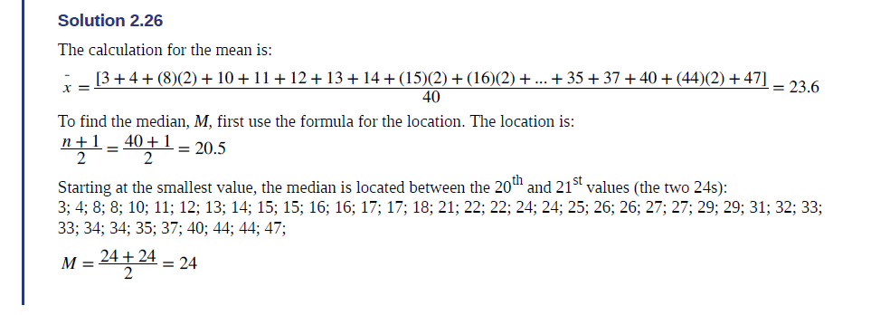
Measures of the Center example
Example 2.26
AIDS data indicating the number of months a patient with AIDS lives after taking a new antibody drug are as follows (smallest to largest):
3; 4; 8; 8; 10; 11; 12; 13; 14; 15; 15; 16; 16; 17; 17; 18; 21; 22; 22; 24; 24; 25; 26; 26; 27; 27; 29; 29; 31; 32; 33; 33; 34; 34; 35; 37; 40; 44; 44; 47;
Calculate the mean and the median.

Slide 71
Measures of the Center on the calculator
Using the TI-83, 83+, 84, 84+ Calculator
To find the mean and the median:
Clear list L1. Pres STAT 4:ClrList. Enter 2nd 1 for list L1. Press ENTER.
Enter data into the list editor. Press STAT 1:EDIT.
Put the data values into list L1.
Press STAT and arrow to CALC. Press 1:1-VarStats. Press 2nd 1 for L1 and then ENTER.
Press the down and up arrow keys to scroll.

Slide 72
Measures of the Center try it
Try It 2.26
The following data show the number of months patients typically wait on a transplant list before getting surgery. The data are ordered from smallest to largest. Calculate the mean and median.
3; 4; 5; 7; 7; 7; 7; 8; 8; 9; 9; 10; 10; 10; 10; 10; 11; 12; 12; 13; 14; 14; 15; 15; 17; 17; 18; 19; 19; 19; 21; 21; 22; 22; 23; 24; 24; 24; 24

Slide 73
Measures of the Center
Another measure of the center is the mode. The mode is the most frequent value.
There can be more than one mode in a data set as long as those values have the same frequency and that frequency is the highest. A data set with two modes is called bimodal.
Example 2.29
Five real estate exam scores are 430, 430, 480, 480, 495. The data set is bimodal because the scores 430 and 480 each occur twice.
NOTE
The mode can be calculated for qualitative data as well as for quantitative data. For example, if the data set is: red, red, red, green, green, yellow, purple, black, blue, the mode is red.

Slide 74
Measures of the Center try it
Try It 2.28
The number of books checked out from the library from 25 students are as follows:
0; 0; 0; 1; 2; 3; 3; 4; 4; 5; 5; 7; 7; 7; 7; 8; 8; 8; 9; 10; 10; 11; 11; 12; 12 Find the mode.

Slide 75
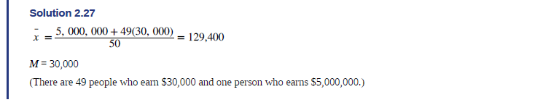
Measures of the Center example
Example 2.27
Suppose that in a small town of 50 people, one person earns $5,000,000 per year and the other 49 each earn $30,000. Which is the better measure of the "center": the mean or the median?
The median is a better measure of the "center" than the mean because 49 of the values are 30,000 and one is 5,000,000. The 5,000,000 is an outlier. The 30,000 gives us a better sense of the middle of the data.

Slide 76
Measures of the Center try its
Try It 2.27
In a sample of 60 households, one house is worth $2,500,000. Half of the rest are worth $280,000, and all the others are worth $315,000. Which is the better measure of the “center”: the mean or the median?
Try It 2.29
Five credit scores are 680, 680, 700, 720, 720. The data set is bimodal because the scores 680 and 720 each occur twice. Consider the annual earnings of workers at a factory. The mode is $25,000 and occurs 150 times out of 301. The median is $50,000 and the mean is $47,500. What would be the best measure of the “center”?

Slide 77
Calculating the Mean of Grouped Frequency Tables
When only grouped data is available, you do not know the individual data values (we only know intervals and interval frequencies); therefore, you cannot compute an exact mean for the data set.
What we must do is estimate the actual mean by calculating the mean of a frequency table.
Remember, the frequency table is a data representation in which grouped data is displayed along with the corresponding frequencies.
We simply need to modify the definition to fit within the restrictions of a frequency table. Since we do not know the individual data values we can instead find the midpoint of each interval.
The midpoint is (lower boundary + upper boundary)/2

Slide 78
Calculating the Mean of Grouped Frequency Tables (cont.)
We can do this in the calculator.
First, press the STAT key and select 1:Edit
Input the midpoint values into L1 and the frequencies into L2
Select STAT, CALC, and 1: 1-Var Stats
Select 2nd then 1 then, 2nd then 2 Enter
You will see displayed the sample mean $\overline{x}$

Slide 79
Calculating the Mean of Grouped Frequency Tables try it
Try It 2.30
Maris conducted a study on the effect that playing video games has on memory recall. As part of her study, she compiled the following data. What is the best estimate for the mean number of hours spent playing video games?

Slide 80
Chapter 2 descriptive statistics
Section 2.6 – Skewness and the Mean, Median, and Mode

Slide 81
Section 2.6 Learning Objectives
In this section students will:
Determine the most appropriate measures of center, measure of variation, and measure of position.
Interpret the meanings of each measure of center, measure of variation, and measure of position.
Recognize basic distribution shapes: uniform, symmetrical, skewed, and bimodal.

Slide 82
Skewness and the Mean, Median, and Mode
The histogram displays a symmetrical distribution of data.
A distribution is symmetrical if a vertical line can be drawn at some point in the histogram such that the shape to the left and the right of the vertical line are mirror images of each other.
In a perfectly symmetrical distribution, the mean and the median are the same.
This example has one mode (unimodal), and the mode is the same as the mean and median.
In a symmetrical distribution that has two modes (bimodal), the two modes would be different from the mean and median.

Slide 83
Skewness and the Mean, Median, and Mode (cont.)
The right-hand side seems "chopped off" compared to the left side.
A distribution of this type is called skewed to the left because it is pulled out to the left.
Notice that the mean is less than the median, and they are both less than the mode. The mean and the median both reflect the skewing, but the mean reflects it more so.
To summarize, generally if the distribution of data is skewed to the left, the mean is less than the median, which is often less than the mode.

Slide 84
Skewness and the Mean, Median, and Mode (cont. 2)
A distribution of this type is called skewed to the right because it is pulled out to the right.
Of the three statistics, the mean is the largest, while the mode is the smallest. Again, the mean reflects the skewing the most.
To summarize, if the distribution of data is skewed to the right, the mode is often less than the median, which is less than the mean.

Slide 85
Skewness and the Mean, Median, and Mode try it
Try It 2.31
Discuss the mean, median, and mode for each of the following problems. Is there a pattern between the shape and measure of the center?

Slide 86
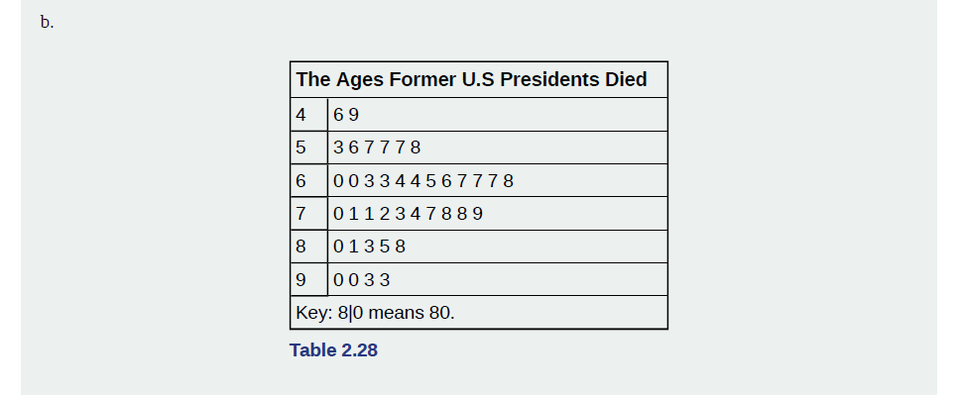
Skewness and the Mean, Median, and Mode try it 2
Try It 2.31
Discuss the mean, median, and mode for each of the following problems. Is there a pattern between the shape and measure of the center?

Slide 87
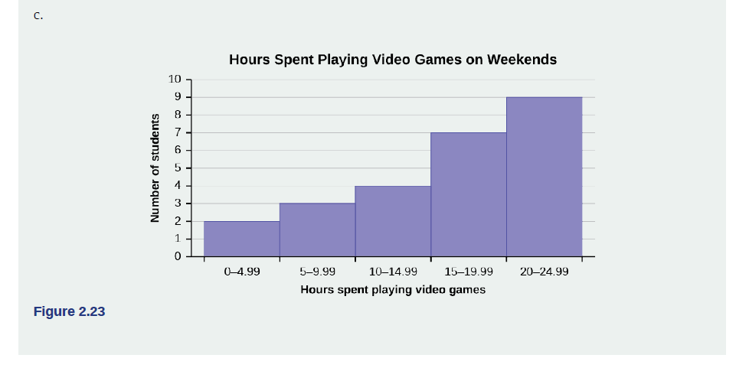
Skewness and the Mean, Median, and Mode try it 3
Try It 2.31
Discuss the mean, median, and mode for each of the following problems. Is there a pattern between the shape and measure of the center?

Slide 88
Chapter 2 descriptive statistics
Section 2.7 – Measures of the Spread of the Data

Slide 89
Section 2.7 Learning Objectives
In this section students will:
Define measures of variation and determine most appropriate measure.
Compute the range, variance, and standard deviation

Slide 90
Measures of the Spread of the Data
An important characteristic of any set of data is the variation in the data.
In some data sets, the data values are concentrated closely near the mean; in other data sets, the data values are more widely spread out from the mean.
The most common measure of variation, or spread, is the standard deviation. The standard deviation is a number that measures how far data values are from their mean.

Slide 91
Measures of the Spread of the Data (cont.)
The standard deviation provides a measure of the overall variation in a data set
The standard deviation is always positive or zero.
The standard deviation is small when the data are all concentrated close to the mean, exhibiting little variation or spread.
The standard deviation is larger when the data values are more spread out from the mean, exhibiting more variation.

Slide 92
Measures of the Spread of the Data (cont. 2)
The standard deviation can be used to determine whether a data value is close to or far from the mean.
A data value that is two standard deviations from the average is just on the borderline for what many statisticians would consider to be far from the average.
Considering data to be far from the mean if it is more than two standard deviations away is more of an approximate "rule of thumb" than a rigid rule.
In general, the shape of the distribution of the data affects how much of the data is further away than two standard deviations. (You will learn more about this in later chapters.)

Slide 93
Calculating the standard deviation
The procedure to calculate the standard deviation depends on whether the numbers are the entire population or are data from a sample.
The calculations are similar, but not identical. Therefore the symbol used to represent the standard deviation depends on whether it is calculated from a population or a sample.
The lower case letter s represents the sample standard deviation and the Greek letter σ (sigma, lower case) represents the population standard deviation.
If the sample has the same characteristics as the population, then s should be a good estimate of σ.

Slide 94
Calculating the standard deviation (cont.)
To calculate the standard deviation, we need to calculate the variance first.
The variance is the average of the squares of the deviations
(the x – $\overline{x}$ values for a sample, or the x – μ values for a population)
The symbol σ² represents the population variance; the population standard deviation σ is the square root of the population variance.
The symbol s² represents the sample variance; the sample standard deviation s is the square root of the sample variance.
You can think of the standard deviation as a special average of the deviations.

Slide 95
formulas
Formulas for the Sample Standard Deviation
$$s=\sqrt{\frac{\sum{{f(x−\overline{x})}^{2}}}{n−1}}$$
Formulas for the Population Standard Deviation
$$σ=\sqrt{\frac{\sum{f{(x−μ)}^{2}}}{N}}$$
In these formulas, f represents the frequency with which a value appears.

Slide 96
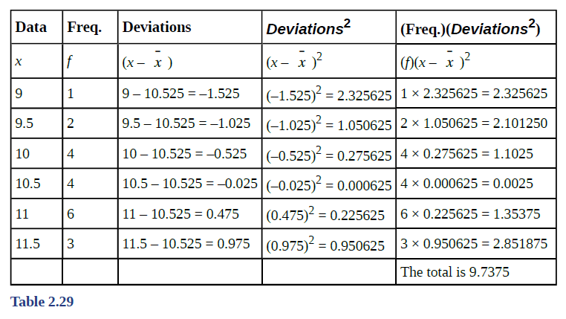
Measures of the Spread of the Data example
Example 2.32
In a fifth grade class, the teacher was interested in the average age and the sample standard deviation of the ages
of her students. The following data are the ages for a SAMPLE of n = 20 fifth grade students.
The ages are rounded to the nearest half year:
9; 9.5; 9.5; 10; 10; 10; 10; 10.5; 10.5; 10.5; 10.5; 11; 11; 11; 11; 11; 11; 11.5; 11.5; 11.5;
The average age is 10.53 years, rounded to two places. The variance may be calculated by using a table.
Then the standard deviation is calculated by taking the square root of the variance.
We will explain the parts of the table after calculating s.
The sample variance, s²,
is equal to the sum of the last column (9.7375)
divided by the total number of data values
minus one (20 – 1):
s² = 9.7375/(20−1) = 0.5125
The sample standard deviation s is equal to the
square root of the sample variance:
s =√0.5125 = 0.715891,
which is rounded to two decimal places, s = 0.72.

Slide 97
Measures of the Spread of the Data in the calculator
NOTE
In practice, USE A CALCULATOR OR COMPUTER SOFTWARE TO CALCULATE THE STANDARD DEVIATION. If you are using a TI-83, 83+, 84+ calculator, you need to select the appropriate standard deviation σ_{x} or s_{x} from the summary statistics.
We will concentrate on using and interpreting the information that the standard deviation gives us. However you should study the following step-by-step example to help you understand how the standard deviation measures variation from the mean. (The calculator instructions appear at the end of this example.)

Slide 98
Measures of the Spread of the Data on the calculator
Using the TI-83, 83+, 84, 84+ Calculator
Clear lists L1 and L2. Press STAT 4:ClrList.
Enter 2nd 1 for L1, the comma (,), and 2nd 2 for L2.
Enter data into the list editor.
Press STAT 1:EDIT. If necessary, clear the lists by arrowing up into the name.
Press CLEAR and arrow down.
Put the data values (9, 9.5, 10, 10.5, 11, 11.5) into list L1
and the frequencies (1, 2, 4, 4, 6, 3) into list L2. Use the arrow keys to move around.
Press STAT and arrow to CALC. Press 1:1-VarStats and enter L1 (2nd 1), L2 (2nd 2).
Do not forget the comma. Press ENTER.
Use Sx because this is sample data (not a population)
NOTE
Your concentration should be on what the standard deviation tells us about the data.
The standard deviation is a number which measures how far the data are spread from
the mean. Let a calculator or computer do the arithmetic.

Slide 99
Measures of the Spread of the Data calculator try it
Try It 2.32
On a baseball team, the ages of each of the players are as follows:
21; 21; 22; 23; 24; 24; 25; 25; 28; 29; 29; 31; 32; 33; 33; 34; 35; 36; 36; 36; 36; 38; 38; 38; 40
Use your calculator or computer to find the mean and standard deviation. Then find the value that is two standard deviations above the mean.
Try It 2.33
The following data show the different types of pet food stores in the area carry.: 6; 6; 6; 6; 7; 7; 7; 7; 7; 8; 9; 9; 9; 9; 10; 10; 10; 10; 10; 11; 11; 11; 11; 12; 12; 12; 12; 12; 12;
Calculate the sample mean and the sample standard deviation to one decimal place using a TI-83+ or TI-84 calculator.

Slide 100
Standard deviation of Grouped Frequency Tables
Recall that for grouped data we do not know individual data values, so we cannot describe the typical value of the data with precision. In other words, we cannot find the exact standard deviation. What we must do is estimate the actual standard deviation by calculating the standard deviation of a frequency table.
First, press the STAT key and select 1:Edit
Input the midpoint values into L1 and the frequencies into L2
Select STAT, CALC, and 1: 1-Var Stats
Select 2nd then 1 then, 2nd then 2 Enter
You will see displayed both a population standard deviation, σx, and the sample standard deviation, Sx.

Slide 101
Standard deviation of Grouped Frequency Tables try it
Try It 2.34
Find the standard deviation for the data in the table.

Slide 102
Comparing Values from Different Data Sets
The standard deviation is useful when comparing data values that come from different data sets. If the data sets have different means and standard deviations, then comparing the data values directly can be misleading.
Using the formula: x = $\overline{x}$ + (# of STDEV)(s) (or x = μ + (# of STDEV)(σ)) and solving for #ofSTDEVs, we get the #ofSTDEVs that is often called a "z-score.” We can use the symbol z.
In symbols, the formulas become:
Sample
x = $\overline{x}$ + zs z = (x - $\overline{x}$)/s
Population
x = μ + zσ z = (x − μ)/σ

Slide 103
Comparing Values from Different Data Sets example
Example 2.35
Two students, John and Ali, from different high schools, wanted to find out who had the highest GPA when compared to his school. Which student had the highest GPA when compared to his school?

Slide 104
Comparing Values from Different Data Sets try it
Try It 2.35
Two swimmers, Angie and Beth, from different teams, wanted to find out who had the fastest time for the 50 meter freestyle when compared to her team. Which swimmer had the fastest time when compared to her team?

Slide 105
Chebyshev's Rule
For ANY data set, no matter what the distribution of the data is:
• At least 75% of the data is within two standard deviations of the mean.
• At least 89% of the data is within three standard deviations of the mean.
• At least 95% of the data is within 4.5 standard deviations of the mean.
This is known as Chebyshev's Rule.

Slide 106
Empirical Rule
For data having a distribution that is BELL-SHAPED and SYMMETRIC:
• Approximately 68% of the data is within one standard deviation of the mean.
• Approximately 95% of the data is within two standard deviations of the mean.
• More than 99% of the data is within three standard deviations of the mean.
This is known as the Empirical Rule.

Slide 107
Acknowledgments
The original PowerPoint file is copyright 2011-2015, Rice University. All Rights Reserved.
This work is a derivative of a text by OpenStax, which is licensed under a Creative Commons Attribution License 4.0 license.
Material on this PowerPoint was adapted from Illowsky, Barbara and Dean, Susan. “Chapter 2. Descriptive Statistics.” Introductory Statistics. OpenStax, Introductory Statistics. OpenStax CNX. May 13, 2019 http://cnx.org/contents/30189442-6998-4686-ac05-ed152b91b9de@23.30.
This document has been reviewed for accessibility.

