Slide 1
Chapter 10 FURTHER APPLICATIONS OF TRIGONOMETRY
Section 10.1 – Non-right Triangles: Law of Sines

Slide 2
Section 10.1 Learning Objectives
In this section students will:
Use the Law of Sines to solve oblique triangles.
Find the area of an oblique triangle using the sine function.
Solve applied problems using the Law of Sines.

Slide 3
Using the Law of Sines to Solve Oblique Triangles
It would be preferable, to have methods that we can apply directly to non-right triangles without first having to create right triangles.
Any triangle that is not a right triangle is an oblique triangle.
Solving an oblique triangle means finding the measurements of all three angles and all three sides.
To do so, we need to start with at least three of these values, including at least one of the sides.
We will investigate three possible oblique triangle problem situations

Slide 4
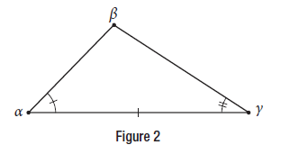
Using the Law of Sines to Solve Oblique Triangles (cont.)
ASA (angle-side-angle) We know the measurements of two angles and the included side. See Figure 2.

Slide 5
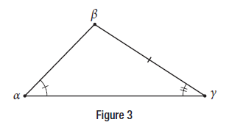
Using the Law of Sines to Solve Oblique Triangles (cont.2)
AAS (angle-angle-side) We know the measurements of two angles and a side that is not between the known angles. See Figure 3.

Slide 6
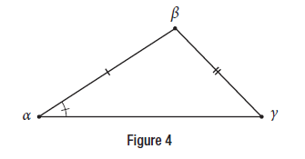
Using the Law of Sines to Solve Oblique Triangles (cont.3)
SSA (side-side-angle) We know the measurements of two sides and an angle that is not between the known sides. See Figure 4.

Slide 7
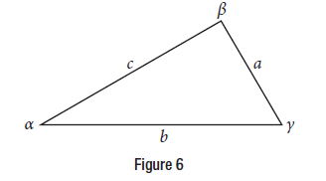
Using the Law of Sines to Solve Oblique Triangles (cont.4)
Note the standard way of labeling triangles: angle α (alpha) is opposite side a; angle β (beta) is opposite side b; and angle γ (gamma) is opposite side c. See Figure 6.
While calculating angles and sides, be sure to carry the exact values through to the final answer. Generally, final answers are rounded to the nearest tenth, unless otherwise specified.

Slide 8
Using the Law of Sines to Solve Oblique Triangles formula
LAW OF SINES
Given a triangle with angles and opposite sides labeled as in Figure, the ratio of the measurement of an angle to the length of its opposite side will be equal to the other two ratios of angle measure to opposite side. All proportions will be equal. The Law of Sines is based on proportions and is presented symbolically two ways.
$$\frac{\text{sin} \text{α}}{\text{α}}=\frac{\text{sin} \text{β}}{\text{b}}= \frac{\text{sin} \text{γ}}{\text{c}}$$
$$\frac{\text{α}}{\text{sin} \text{α}}=\frac{\text{b}}{\text{sin} \text{β} }= \frac{\text{c}}{\text{sin} \text{γ} }$$
To solve an oblique triangle, use any pair of applicable ratios.

Slide 9
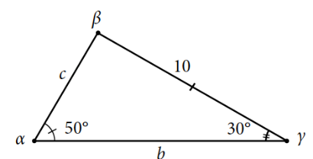
Using the Law of Sines to Solve Oblique Triangles example
Example Solving for Two Unknown Sides and Angle of an AAS Triangle
Solve the triangle shown in Figure 7 to the nearest tenth.

Slide 10
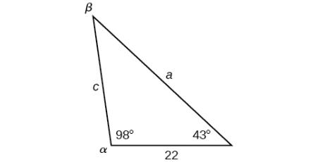
Using the Law of Sines to Solve Oblique Triangles try it
Try It: Solve the triangle shown in Figure to the nearest tenth

Slide 11
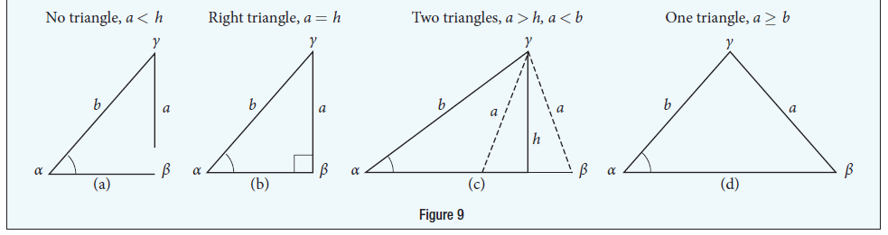
Using The Law of Sines to Solve SSA Triangles
We can use the Law of Sines to solve any oblique triangle, but some solutions may not be straightforward. In some cases, more than one triangle may satisfy the given criteria, which we describe as an ambiguous case.
Triangles classified as SSA, those in which we know the lengths of two sides and the measurement of the angle opposite one of the given sides, may result in one or two solutions, or even no solution.
POSSIBLE OUTCOMES FOR SSA TRIANGLES
Oblique triangles in the category SSA may have four different outcomes. Figure illustrates the solutions with the known sides a and b and known angle α.

Slide 12
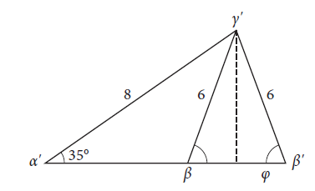
Using The Law of Sines to Solve SSA Triangles example
Example Solving an Oblique SSA Triangle
Given α = 35°, a = 6, and b = 8, find the missing side and angles. If there is more than one possible solution, show both.

Slide 13
Using The Law of Sines to Solve SSA Triangles try it
Try It: Given α = 80°, a = 120, and b = 121, find the missing side and angles. If there is more than one possible solution, show both.

Slide 14
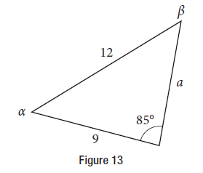
Using The Law of Sines to Solve SSA Triangles example 2
Example Solving an Oblique SSA Triangle
In the triangle shown in Figure 13, solve for the unknown side and angles. Round your answers to the nearest tenth.

Slide 15
Using The Law of Sines to Solve SSA Triangles try it 2
Try It: Given α = 80°, a = 100, b = 10, find the missing side and angles. If there is more than one possible solution, show both. Round your answers to the nearest tenth.

Slide 16
Using The Law of Sines to Solve SSA Triangles example 3
Example Finding the Triangles That Meet the Given Criteria
Find all possible triangles if one side has length 4 opposite an angle of 50°, and a second side has length 10.

Slide 17
Using The Law of Sines to Solve SSA Triangles try it 3
Try It: Determine the number of triangles possible given a = 31, b = 26, β = 48°.

Slide 18
Finding the Area of an Oblique Triangle Using the Sine Function
AREA OF AN OBLIQUE TRIANGLE
The formula for the area of an oblique triangle is given by
Area = ½ bcsin α
= ½ acsin β
= ½ absin γ
This is equivalent to one-half of the product of two sides and the sine of their included angle.

Slide 19
Finding the Area of an Oblique Triangle Using the Sine Function example
Example Finding the Area of an Oblique Triangle
Find the area of a triangle with sides a = 90, b = 52, and angle γ = 102°. Round the area to the nearest integer.

Slide 20
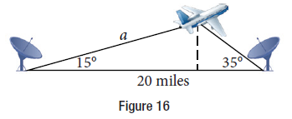
Solving Applied Problems Using the Law of Sines
Example Finding an Altitude
Find the altitude of the aircraft in the problem introduced at the beginning of this section, shown in Figure 16. Round the altitude to the nearest tenth of a mile.

Slide 21
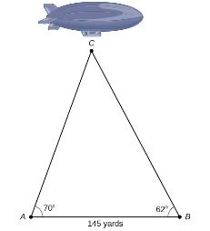
Solving Applied Problems Using the Law of Sines try it
Try It: The diagram shown in Figure represents the height of a blimp flying over a football stadium. Find the height of the blimp if the angle of elevation at the southern end zone, point A, is 70°, the angle of elevation from the northern end zone, point B, is 62°, and the distance between the viewing points of the two end zones is 145 yards.

Slide 22
Chapter 10 FURTHER APPLICATIONS OF TRIGONOMETRY
Section 10.2 – Non-right Triangles: Law of Cosines

Slide 23
Section 10.2 Learning Objectives
In this section students will:
Use the Law of Cosines to solve oblique triangles.
Solve applied problems using the Law of Cosines.
Use Heron’s formula to ﬁnd the area of a triangle.

Slide 24
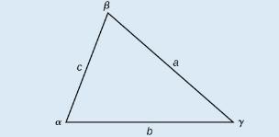
Using the Law of Cosines to Solve Oblique Triangles
LAW OF COSINES
The Law of Cosines states that the square of any side of a triangle is equal to the sum of the squares of the other two sides minus twice the product of the other two sides and the cosine of the included angle. For triangles labeled as in Figure, with angles α, β, and γ, and opposite corresponding sides a, b, and c, respectively, the Law of Cosines is given as three equations.
a² = b² + c² − 2bc cos α
b² = a² + c² − 2ac cos β
c² = a² + b² − 2ab cos γ
To solve for a missing side measurement, the corresponding opposite angle measure is needed.
When solving for an angle, the corresponding opposite side measure is needed. We can use another version of the Law of Cosines to solve for an angle.
cos α = $\frac{\text{b}\text{2 }\text{+ }\text{c}\text{2 }\text{− }\text{a}\text{2}}{\text{2}\text{bc}}$ cos β= $\frac{\text{a}\text{2 }\text{+ }\text{c}\text{2 }\text{− }\text{b}\text{2}}{\text{2}\text{ac}}$ cos γ = $\frac{\text{a}\text{2 }\text{+ }\text{b}\text{2 }\text{− }\text{c}\text{2}}{\text{2}\text{ab} }$

Slide 25
Using the Law of Cosines to Solve Oblique Triangles (Cont.)
How To:
Given two sides and the angle between them (SAS), find the measures of the remaining side and angles of a triangle.
Sketch the triangle. Identify the measures of the known sides and angles. Use variables to represent the measures of the unknown sides and angles.
Apply the Law of Cosines to find the length of the unknown side or angle.
Apply the Law of Sines or Cosines to find the measure of a second angle.
Compute the measure of the remaining angle.

Slide 26
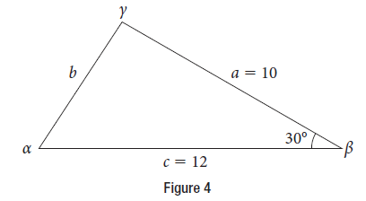
Using the Law of Cosines to Solve Oblique Triangles example
Example Finding the Unknown Side and Angles of a SAS Triangle
Find the unknown side and angles of the triangle in Figure 4.

Slide 27
Using the Law of Cosines to Solve Oblique Triangles try it
Try It: Find the missing side and angles of the given triangle: α = 30°, b = 12, c = 24.

Slide 28
Using the Law of Cosines to Solve Oblique Triangles try it 2
Try It: Given a = 5, b = 7, c = 10, find the missing angles.

Slide 29
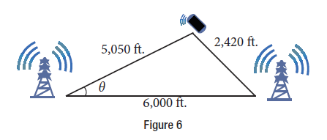
Solving Applied Problems Using the Law of Cosines
Example Using the Law of Cosines to Solve a Communication Problem
Suppose there are two cell phone towers within range of a cell phone. The two towers are located 6,000 feet apart along a straight highway, running east to west, and the cell phone is north of the highway. Based on the signal delay, it can be determined that the signal is 5,050 feet from the first tower and 2,420 feet from the second tower. Determine the position of the cell phone north and east of the first tower, and determine how far it is from the highway.

Slide 30
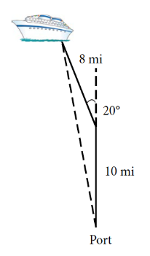
Solving Applied Problems Using the Law of Cosines example
Example Calculating Distance Traveled Using a SAS Triangle
Suppose a boat leaves port, travels 10 miles, turns 20 degrees, and travels another 8 miles. How far from port is the boat? The diagram is repeated here in Figure 8.

Slide 31
Using Heron’s Formula to Find the Area of a Triangle
HERON’S FORMULA
Heron’s formula finds the area of oblique triangles in which sides a, b, and c are known.
Area = $\sqrt{\text{s}\text{(}\text{s}\text{−}\text{a}\text{)(}\text{s}\text{−}\text{b}\text{)(}\text{s}\text{−}\text{c}\text{)}}$
where s = $\frac{\text{(}\text{a}\text{+}\text{b}\text{+}\text{c}\text{)}}{\text{2}}$ is one half of the perimeter of the triangle, sometimes called the semi-perimeter.

Slide 32
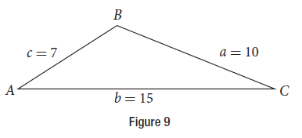
Using Heron’s Formula to Find the Area of a Triangle example
Example Using Heron’s Formula to Find the Area of a Given Triangle
Find the area of the triangle in Figure 9 using Heron’s formula.

Slide 33
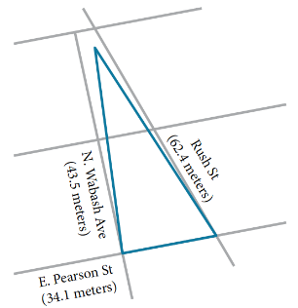
Using Heron’s Formula to Find the Area of a Triangle example 2
Example Applying Heron’s Formula to a Real-World Problem
A Chicago city developer wants to construct a building consisting of artist’s lofts on a triangular lot bordered by Rush Street, Wabash Avenue, and Pearson Street. The frontage along Rush Street is approximately 62.4 meters, along Wabash Avenue it is approximately 43.5 meters, and along Pearson Street it is approximately 34.1 meters. How many square meters are available to the developer? See Figure 10 for a view of the city property.

Slide 34
Chapter 10 FURTHER APPLICATIONS OF TRIGONOMETRY
Section 10.3 – Polar Coordinates

Slide 35
Section 10.3 Learning Objectives
In this section students will:
Plot points using polar coordinates.
Convert from polar coordinates to rectangular coordinates.
Convert from rectangular coordinates to polar coordinates.
Transform equations between polar and rectangular forms.
Identify and graph polar equations by converting to rectangular equations.

Slide 36
Plotting Points Using Polar Coordinates
When we think about plotting points in the plane, we usually think of rectangular coordinates (x, y) in the Cartesian coordinate plane.
However, there are other ways of writing a coordinate pair and other types of grid systems.
In this section, we introduce to polar coordinates, which are points labeled (r, θ) and plotted on a polar grid.
The polar grid is represented as a series of concentric circles radiating out from the pole, or the origin of the coordinate plane.

Slide 37
Plotting Points Using Polar Coordinates (Cont.)
The polar grid is scaled as the unit circle with the positive x-axis now viewed as the polar axis and the origin as the pole.
The first coordinate r is the radius or length of the directed line segment from the pole.
The angle θ, measured in radians, indicates the direction of r.
We move counterclockwise from the polar axis by an angle of θ, and measure a directed line segment the length of r in the direction of θ.
Even though we measure θ first and then r, the polar point is written with the r-coordinate first.

Slide 38
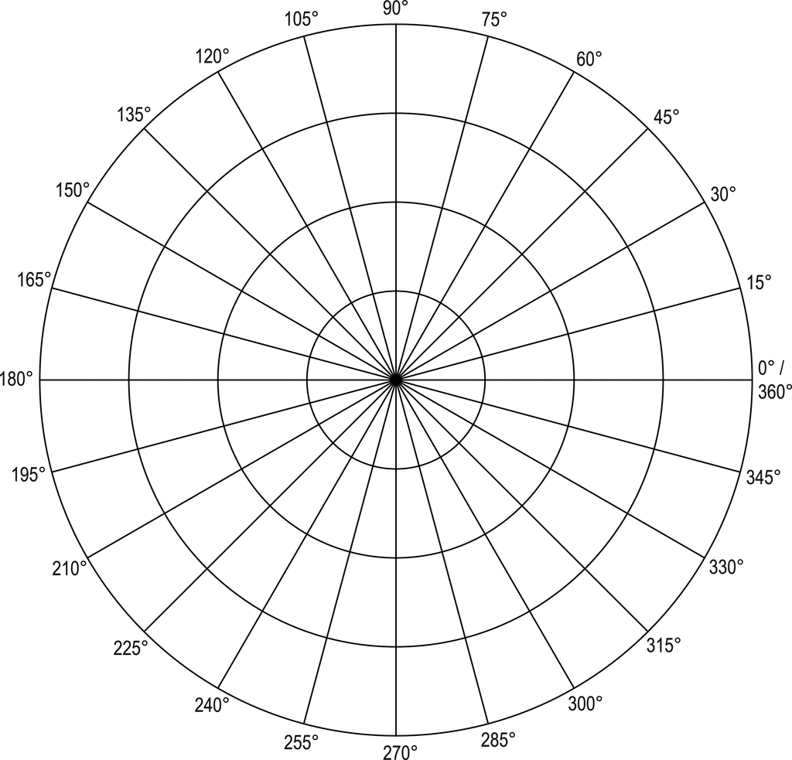
Plotting Points Using Polar Coordinates try it
Try It: Plot the point $\left(\text{2}, \frac{\text{π}}{\text{3}}\right)$ in the polar grid.

Slide 39
Plotting Points Using Polar Coordinates example
Example Plotting a Point in the Polar Coordinate System with a Negative Component
Plot the point (−2, π/6) on the polar grid.

Slide 40
Plotting Points Using Polar Coordinates example 2
Example Plotting a Point on the Polar Grid
Plot the point (-3, -π/2) on the polar grid.

Slide 41
Plotting Points Using Polar Coordinates try it 2
Try It: Plot the points $\left(\text{3},\text{−}\frac{\text{π}}{\text{6}}\right)$and $\left(\text{2}, \frac{\text{9}\text{π}}{\text{4}}\right)$ on the same polar grid.

Slide 42
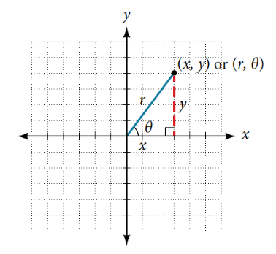
Converting from Polar Coordinates to Rectangular Coordinates
CONVERTING FROM POLAR COORDINATES TO RECTANGULAR COORDINATES
To convert polar coordinates (r,θ) to rectangular coordinates (x,y), let
cosθ = $\frac{\text{x}}{\text{r}}$→ x = rcos θ
sinθ = $\frac{\text{y}}{\text{r}}$→ y = rsin θ

Slide 43
Converting from Polar Coordinates to Rectangular Coordinates (Cont.)
How To:
Given polar coordinates, convert to rectangular coordinates.
Given the polar coordinate (r,θ), write x = rcos θ and y = rsin θ.
Evaluate cos θ and sin θ.
Multiply cos θ by r to find the x-coordinate of the rectangular form.
Multiply sin θ by r to find the y-coordinate of the rectangular form.

Slide 44
Converting from Polar Coordinates to Rectangular Coordinates example
Example Writing Polar Coordinates as Rectangular Coordinates
Write the polar coordinates (3, π/2) as rectangular coordinates.

Slide 45
Converting from Polar Coordinates to Rectangular Coordinates try it
Try It: Write the polar coordinates $\left(\text{−1}, \frac{\text{2}\text{π}}{\text{3}}\right)$ as rectangular coordinates.

Slide 46
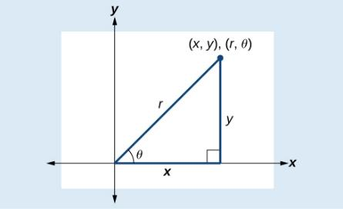
Converting from Rectangular Coordinates to Polar Coordinates
CONVERTING FROM RECTANGULAR COORDINATES TO POLAR COORDINATES
Converting from rectangular coordinates to polar coordinates requires the use of one or more of the relationships illustrated in Figure.
cosθ = $\frac{\text{x}}{\text{r}} or$ x = rcos θ
sinθ = $\frac{\text{y}}{\text{r}}$ or y = rsin θ
r² = x² + y²
tan θ = $\frac{\text{y}}{\text{x} }$

Slide 47
Converting from Rectangular Coordinates to Polar Coordinates example
Example Writing Rectangular Coordinates as Polar Coordinates
Convert the rectangular coordinates (3, 3) to polar coordinates.

Slide 48
Converting from Rectangular Coordinates to Polar Coordinates example
Example Writing Rectangular Coordinates as Polar Coordinates
Convert the rectangular coordinates (-2, 0) to polar coordinates.

Slide 49
Transforming Equations between Polar and Rectangular Forms
We can now convert coordinates between polar and rectangular form.
Converting equations can be more difficult, but it can be beneficial to be able to convert between the two forms.
Since there are a number of polar equations that cannot be expressed clearly in Cartesian form, and vice versa, we can use the same procedures we used to convert points between the coordinate systems.

Slide 50
Transforming Equations between Polar and Rectangular Forms example
Example Rewriting a Cartesian Equation as a Polar Equation
Rewrite the Cartesian equation x² + y² = 9 as a polar equation.

Slide 51
Transforming Equations between Polar and Rectangular Forms example 2
Example Rewriting a Cartesian Equation as a Polar Equation
Rewrite the Cartesian equation x² + y² = 6y as a polar equation.

Slide 52
Transforming Equations between Polar and Rectangular Forms example 3
Example Rewriting a Cartesian Equation as a Polar Equation
Rewrite the Cartesian equation y = 3x + 2 as a polar equation.

Slide 53
Transforming Equations between Polar and Rectangular Forms try it
Try It: Rewrite the Cartesian equation y² = 3 − x² in polar form.

Slide 54
Transforming Equations between Polar and Rectangular Forms example 4
Example Rewriting a Polar Equation in Cartesian Form
Rewrite the polar equation r = 2secθ to a rectangular equation.

Slide 55
Transforming Equations between Polar and Rectangular Forms example 5
Example Rewriting a Polar Equation in Cartesian Form
Rewrite the polar equation r = 3/(1 − 2cosθ) as a Cartesian equation.

Slide 56
Transforming Equations between Polar and Rectangular Forms try it 2
Try It: Rewrite the polar equation r = 2 sin θ in Cartesian form.

Slide 57
Transforming Equations between Polar and Rectangular Forms example 6
Example Rewriting a Polar Equation in Cartesian Form
Rewrite the polar equation r = sin(2θ) as a Cartesian equation.

Slide 58
Acknowledgments
The original PowerPoint file is copyright 2015, Rice University. All Rights Reserved.
This work is a derivative of a text by OpenStax, which is licensed under a Creative Commons Attribution License 4.0 license.
Material on this PowerPoint was adapted from Abramson, Jay. “Chapter 10. Further Applications of Trigonometry.” Algebra and Trigonometry. OpenStax CAT, Algebra and Trigonometry. OpenStax CNX. May 30, 2019 http://cnx.org/contents/13ac107a-f15f-49d2-97e8-60ab2e3b519c@13.63.
This document has been reviewed for accessibility.

