Slide 1
Chapter 8 periodic functions
Section 8.1 – Graphs of the sine and cosine functions

Slide 2
Section 8.1 Learning Objectives
In this section students will:
Graph variations of y=sin(x) and y=cos(x).
Use phase shifts of sine and cosine curves.

Slide 3
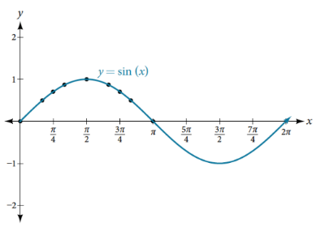
Graphing Sine Functions
Recall that the sine and cosine functions relate real number values to the x- and y-coordinates of a point on the unit circle. We can create a table of values and use them to sketch a graph. Table 1 lists some of the values for the sine function on a unit circle.
Plotting the points from the table and continuing along the x-axis gives the shape of the sine function. See Figure 2.

Slide 4
Graphing cosine Functions
Now let’s take a similar look at the cosine function. Again, we can create a table of values and use them to sketch a graph.
Table 2 lists some of the values for the cosine function on a unit circle.
As with the sine function, we can plots points to create a graph of the cosine function as in Figure 4.

Slide 5
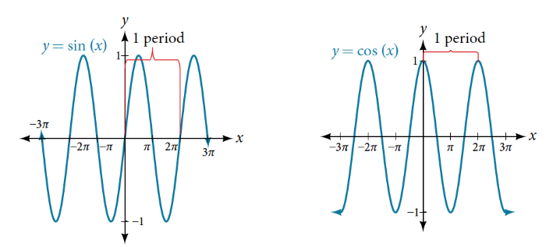
Graphing Sine and Cosine Functions
In both graphs, the shape of the graph repeats after 2π, which means the functions are periodic with a period of 2π.
A periodic function is a function for which a specific horizontal shift, P, results in a function equal to the original function: f (x + P) = f (x) for all values of x in the domain of f .
When this occurs, we call the smallest such horizontal shift with P > 0 the period of the function. Figure 5 shows several periods of the sine and cosine functions.

Slide 6
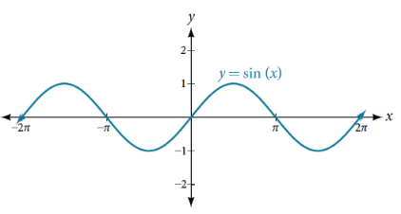
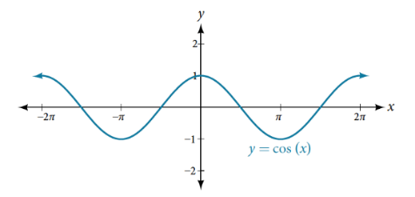
Graphing Sine and Cosine Functions (2)
As we can see in Figure 6, the sine function is symmetric about the origin.
We determined from the unit circle that the sine function is an odd function because sin(−x) = −sin x.
Now we can clearly see this property from the graph.
Figure 7 shows that the cosine function is symmetric about the y-axis.
Again, we determined that the cosine function is an even function.
Now we can see from the graph that cos(−x) = cos x.

Slide 7
Graphing Sine and Cosine Functions (3)
CHARACTERISTICS OF SINE AND COSINE FUNCTIONS
The sine and cosine functions have several distinct characteristics:
They are periodic functions with a period of 2π.
The domain of each function is (−∞,∞) and the range is [−1,1].
The graph of y = sin x is symmetric about the origin, because it is an odd function.
The graph of y = cos x is symmetric about they- y-axis, because it is an even function.

Slide 8
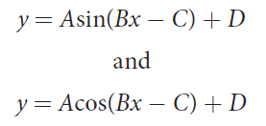
Investigating Sinusoidal Functions
A function that has the same general shape as a sine or cosine function is known as a
sinusoidal function.
The general forms of sinusoidal functions are:

Slide 9
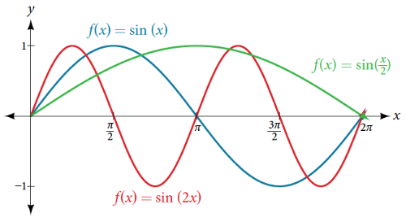
Determining the Period of Sinusoidal Functions
PERIOD OF SINUSOIDAL FUNCTIONS
If we let C = 0 and D = 0 in the general form equations of the sine and cosine functions, we obtain the forms
y = A sin (Bx)
y = A cos (Bx)
The period is $\frac{\text{2}\text{π}}{\text{|}\text{B}\text{|}\text{.}}$

Slide 10
Determining the Period of Sinusoidal Functions examples
Example Identifying the Period of a Sine or Cosine Function
Determine the period of the function $f\left(x\right)=sin\left(\frac{1}{6}x\right)$.
Try It: Determine the period of the function g(x)=cos($\frac{x}{3}$).

Slide 11
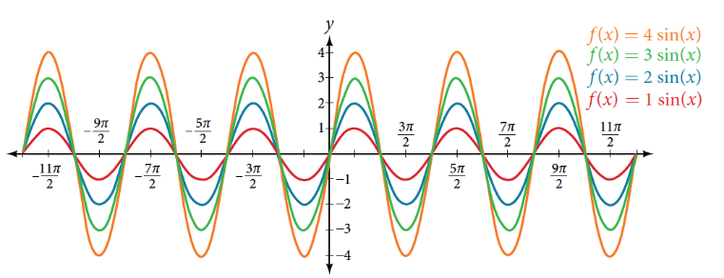
Determining Amplitude
AMPLITUDE OF SINUSOIDAL FUNCTIONS
If we let C = 0 and D = 0 in the general form equations of the sine and cosine functions, we obtain the forms
y = A sin (Bx) and y = A cos(Bx)
The amplitude is A, and the vertical height from the midline is | A |. In addition, notice in the example that
|A| = amplitude = ½|maximum − minimum|

Slide 12
Determining Amplitude examples
Example Identifying the Amplitude of a Sine or Cosine Function
What is the amplitude of the sinusoidal function f (x) = 2cos(x)? Is the function stretched or compressed vertically?
Try It: What is the amplitude of the sinusoidal function f(x) = ½ sin(x)? Is the function stretched or compressed vertically?
Example Identifying the Amplitude of a Sine or Cosine Function
What is the amplitude of the sinusoidal function f (x) = -4sin(x)? Is the function stretched or compressed vertically?
Analysis
The negative value of A results in a reflection across the x-axis of the sine function.

Slide 13
Analyzing Graphs of Variations of y = sin x and y = cos x
Now that we understand how A and B relate to the general form equation for the sine and cosine functions, we will explore the variables C and D.
Recall the general form:
VARIATIONS OF SINE AND COSINE FUNCTIONS
Given an equation in the form f(x) = A sin (Bx − C) + D or f(x) = A cos (Bx − C) + D, $\frac{\text{C}}{\text{B}}$ is the phase shift and D is the vertical shift.

Slide 14
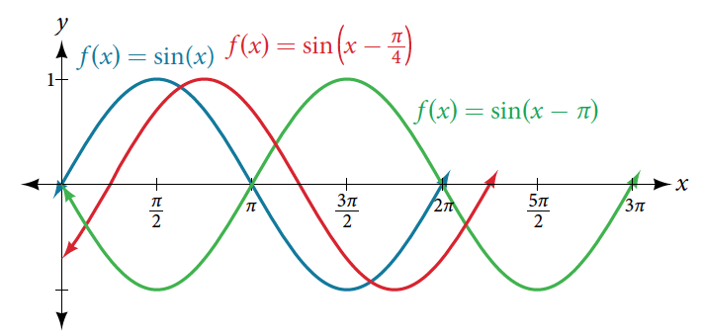
Analyzing Graphs of Variations of y = sin x and y = cos x (cont.)
Figure 11 shows that the graph of f (x) = sin(x − π) shifts to the right by π units, which
is more than we see in the graph of f (x) = sin(x − π/4), which shifts to the right by π/4 units.

Slide 15
Analyzing Graphs of Variations of y = sin x and y = cos x examples
Example Identifying the Phase Shift of a Function
Determine the direction and magnitude of the phase shift for $f\left(x\right)=sin\left(x+\frac{π}{6}\right)$.
Example Identifying the Phase Shift of a Function
Determine the direction and magnitude of the phase shift for $f\left(x\right)=sin\left(3x−\frac{3π}{2}\right)$.
Try It: Determine the direction and magnitude of the phase shift for f(x) = 3cos(x−$\frac{π}{2}$).

Slide 16
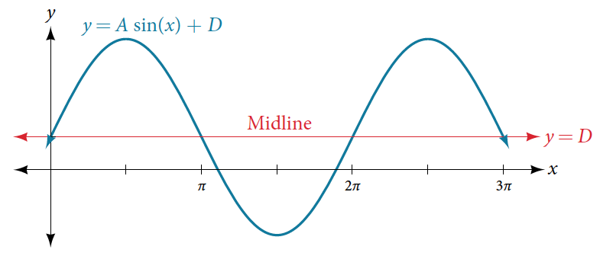
Analyzing Graphs of Variations of y = sin x and y = cos x (cont.2)
While C relates to the horizontal shift, D indicates the vertical shift from the midline in the general formula for a sinusoidal function.
See Figure 12. The function y = cos(x) + D has its midline at y = D.

Slide 17
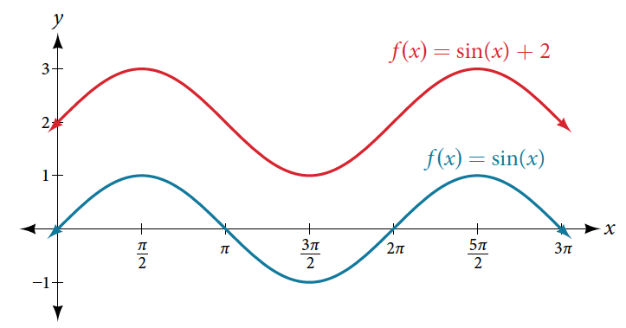
Analyzing Graphs of Variations of y = sin x and y = cos x (cont. 3)
Any value of D other than zero shifts the graph up or down.
Figure 13 compares f (x) = sin x with f (x) = sin x + 2, which is shifted 2 units up on a graph.

Slide 18
Analyzing Graphs of Variations of y = sin x and y = cos x examples 2
Example Identifying the Vertical Shift of a Function
Determine the direction and magnitude of the vertical shift for $f\left(x\right)=cos\left(x\right)−3$. Graph the original function and the new function to compare.
Try It: Determine the direction and magnitude of the vertical shift for f(x) = 3sin(x) + 2.

Slide 19
Analyzing Graphs of Variations of y = sin x and y = cos x (cont.3)
How To:
Given a sinusoidal function in the form f(x) = A sin(Bx − C) + D, identify the midline, amplitude, period, and phase shift.
Determine the amplitude as |A|.
Determine the period as P = $\frac{\text{2}\text{π}}{\text{|}\text{B}\text{|}\text{.}}$
Determine the phase shift as $\frac{\text{C}}{\text{B}}$.
Determine the midline as y = D.

Slide 20
Analyzing Graphs of Variations of y = sin x and y = cos x example
Example Identifying the Variations of a Sinusoidal Function from an Equation
Determine the midline, amplitude, period, and phase shift of the function $y=3sin\left(2x\right)+1$.

Slide 21
Analyzing Graphs of Variations of y = sin x and y = cos x try it
Try It: Determine the midline, amplitude, period, and phase shift of the function y = ½ cos($\frac{\text{x}}{3}$ − $\frac{π}{3}$).

Slide 22
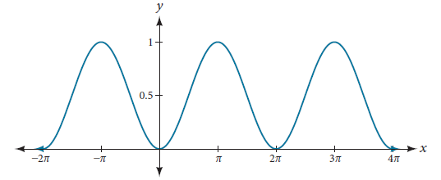
Analyzing Graphs of Variations of y = sin x and y = cos x example 2
Example Identifying the Equation for a Sinusoidal Function from a Graph
Determine the formula for the cosine function.

Slide 23
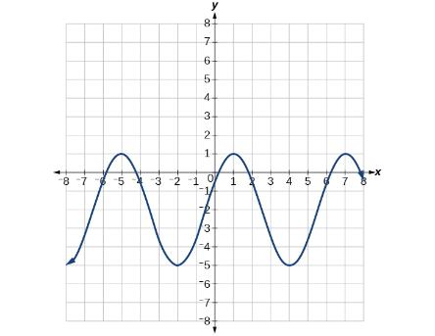
Analyzing Graphs of Variations of y = sin x and y = cos x Example 3
Example Identifying the Equation for a Sinusoidal Function from a Graph
Determine the formula for the sine function.

Slide 24
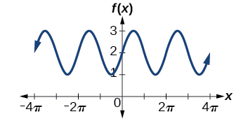
Analyzing Graphs of Variations of y = sin x and y = cos x Try It 2
Try It: Determine the formula for the sine function in Figure.

Slide 25
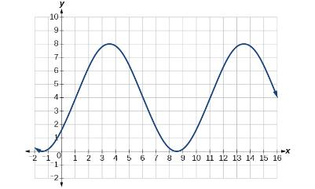
Analyzing Graphs of Variations of y = sin x and y = cos x Try IT 3
Try It: Write a formula for the function graphed in Figure.

Slide 26
Graphing Variations of y = sin x and y = cos x
How To:
Given the function y = A sin (Bx), sketch its graph.
Identify the amplitude, |A |.
Identify the period, P = $\frac{\text{2}\text{π}}{\text{|}\text{B}\text{|}\text{.}}$
Start at the origin, with the function increasing to the right if A is positive or decreasing if A is negative.
At x = $\frac{\text{π}}{\text{2}\text{|}\text{B}\text{|}\text{.}}$ there is a local maximum for A > 0 or a minimum for A < 0, with y = A.
The curve returns to the x-axis at x =$\frac{\text{π}}{\text{|}\text{B}\text{|}\text{.}}$
There is a local minimum for A > 0 (maximum for A < 0 ) at x = $\frac{\text{3}\text{π}}{\text{2}\text{|}\text{B}\text{|}\text{.}}$ with y = –A.
The curve returns again to the x-axis at x = $\frac{\text{π}}{\text{2}\text{|}\text{B}\text{|}\text{.}}$

Slide 27
Graphing Variations of y = sin x and y = cos x Example
Example Graphing a Function
Sketch a graph of $f\left(x\right)=−2sin\left(\frac{π}{2}x\right)$. Determine the midline, amplitude, period, and phase shift.

Slide 28
Graphing Variations of y = sin x and y = cos x try it
Try It: Sketch a graph of g(x) = −0.8cos(2x). Determine the midline, amplitude, period, and phase shift.

Slide 29
Graphing Variations of y = sin x and y = cos x (cont.)
How To:
Given a sinusoidal function with a phase shift and a vertical shift, sketch its graph.
Express the function in the general form y = A sin(Bx − C) + D or y = A cos(Bx − C) + D.
Identify the amplitude, | A |.
Identify the period, P= = $\frac{\text{2}\text{π}}{\text{|}\text{B}\text{|}\text{.}}$
Identify the phase shift, = $\frac{\text{C}}{\text{B}}$.
Draw the graph of f(x) = A sin(Bx) shifted to the right or left by $\frac{\text{C}}{\text{B}}$ and up or down by D.

Slide 30
Graphing Variations of y = sin x and y = cos x example 2
Example Graphing a Function
Sketch a graph of $f\left(x\right)=3sin\left(\frac{π}{4}x−\frac{π}{4}\right)$. Determine the midline, amplitude, period, and phase shift

Slide 31
Graphing Variations of y = sin x and y = cos x try it 2
Try It: Draw a graph of g(x) = −2cos($\frac{π}{3}$x+$\frac{π}{6}$). Determine the midline, amplitude, period, and phase shift.

Slide 32
Graphing Variations of y = sin x and y = cos x example 3
Example Identifying the Properties of a Sinusoidal Function
Given y = −2cos($\frac{π}{2}$x + $π$) + 3, determine the amplitude, period, phase shift, and horizontal shift. Then graph the function.

Slide 33
Using Transformations of Sine and Cosine Functions
Example Finding the Vertical Component of Circular Motion
A point rotates around a circle of radius 3 centered at the origin. Sketch a graph of the y-coordinate of the point as a function of the angle of rotation.

Slide 34
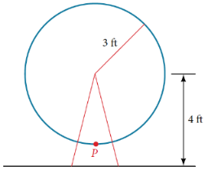
Using Transformations of Sine and Cosine Functions example
Example Finding the Vertical Component of Circular Motion
A circle with radius 3 ft is mounted with its center 4 ft off the ground. The point closest to the ground is labeled P, as shown in Figure 23. Sketch a graph of the height above the ground of the point P as the circle is rotated; then find a function that gives the height in terms of the angle of rotation.

Slide 35
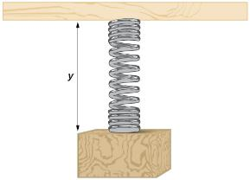
Using Transformations of Sine and Cosine Functions try it
Try It: A weight is attached to a spring that is then hung from a board, as shown in Figure. As the spring oscillates up and down, the position y of the weight relative to the board ranges from –1 in. (at time x = 0) to –7 in. (at time x = π) below the board. Assume the position of y is given as a sinusoidal function of x. Sketch a graph of the function, and then find a cosine function that gives the position y in terms of x.

Slide 36
Using Transformations of Sine and Cosine Functions example 2
Example Determining a Rider’s Height on a Ferris Wheel
The London Eye is a huge Ferris wheel with a diameter of 135 meters (443 feet). It completes one rotation every 30 minutes. Riders board from a platform 2 meters above the ground. Express a rider’s height above ground as a function of time in minutes.

Slide 37
Chapter 8 periodic functions
Section 8.2 – Graphs of the other trigonometric functions

Slide 38
Section 8.2 Learning Objectives
In this section students will:
Analyze the graph of y=tan x.
Graph variations of y=tan x.
Analyze the graphs of y=sec x and y=csc x.
Graph variations of y=sec x and y=csc x.
Analyze the graph of y=cot x.
Graph variations of y=cot x.

Slide 39
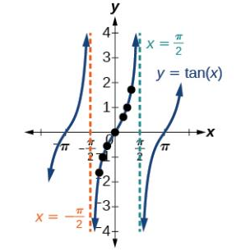
Analyzing the Graph of y = tan x
We will begin with the graph of the tangent function, plotting points as we did for the sine and cosine functions.
We can further analyze the graphical behavior of the tangent function by looking at values for some of the special angles, as listed in Table 1.
As x approaches π/2, the outputs of the function get larger and larger.
We can see that, as x approaches − π/2, the outputs get smaller and smaller.
At these values, the graph of the tangent has vertical asymptotes. Figure 1 represents the graph of y = tan(x).

Slide 40
Graphing Variations of y = tan x
As with the sine and cosine functions, the tangent function can be described by a general equation.
Because there are no maximum or minimum values of a tangent function, the term amplitude cannot be interpreted as it is for the sine and cosine functions.
Instead, we will use the phrase stretching/compressing factor when referring
to the constant A.
FEATURES OF THE GRAPH OF Y = ATAN(BX)
The stretching factor is | A |.
The period is P = $\frac{π}{\text{|}\text{B}\text{|}\text{.}}$
The domain is all real numbers x, where x ≠ $\frac{π}{\text{2}\text{|}\text{B}\text{|}}$+ $\frac{π}{\text{|}\text{B}\text{|}}$k such that k is an integer.
The range is(−∞,∞).
The asymptotes occur at x = π2|B|+π|B| k, where k is an integer.
y = A tan (Bx) is an odd function.

Slide 41
Graphing One Period of a Stretched or Compressed Tangent Function
How To:
Given the function f(x) = Atan(Bx), graph one period.
Identify the stretching factor, |A|.
Identify B and determine the period, P = $\frac{π}{\text{|}\text{B}\text{|}}.$
Draw vertical asymptotes at x = − $\frac{\text{P}}{\text{2}}$ and x = $\frac{\text{P}}{\text{2}}$ .
For A > 0, the graph approaches the left asymptote at negative output values and the right asymptote at positive output values (reverse for A < 0 ).
Plot reference points at($\frac{\text{P}}{\text{4}}$, A), (0,0), and (− $\frac{\text{P}}{\text{4}}$, −A), and draw the graph through these points.

Slide 42
Graphing One Period of a Stretched or Compressed Tangent Function example
Example Sketching a Compressed Tangent
Sketch a graph of one period of the function $f\left(x\right)=0.5tan\left(\frac{π}{2}x\right)$.

Slide 43
Graphing One Period of a Stretched or Compressed Tangent Function try it
Try It: Sketch a graph of f(x) = 3tan($\frac{π}{\text{6}}$x).

Slide 44
Graphing One Period of a Shifted Tangent Function
Now that we can graph a tangent function that is stretched or compressed, we will add a vertical and/or horizontal (or phase) shift. In this case, we add C and D to the general form of the tangent function.
FEATURES OF THE GRAPH OF Y = ATAN(BX−C)+D
The stretching factor is |A|.
The period is $\frac{π}{\text{|}\text{B}\text{|}}$.
The domain is x ≠ $\frac{\text{C}}{\text{B}}$+ $\frac{π}{\text{|}\text{B}\text{|}}$k, where k is an integer.
The range is(−∞,∞).
The vertical asymptotes occur at x = $\frac{\text{C}}{\text{B}}$+ $\frac{π}{\text{2}\text{|}\text{B}\text{|}}$k, where k is an odd integer.
There is no amplitude.
y = A tan(Bx−C) + D is an odd function because it is the quotient of odd and even functions (sine and cosine respectively).

Slide 45
Graphing One Period of a Shifted Tangent Function (Cont.)
How To:
Given the function y = Atan(Bx − C) + D, sketch the graph of one period.
Express the function given in the form y = Atan(Bx − C) + D.
Identify the stretching/compressing factor, |A|.
Identify B and determine the period, P= $\frac{π}{\text{|}\text{B}\text{|}}$
Identify C and determine the phase shift, $\frac{\text{C}}{\text{B}}$.
Draw the graph of y = Atan(Bx) shifted to the right by $\frac{\text{C}}{\text{B}}$ and up by D.
Sketch the vertical asymptotes, which occur at x = $\frac{\text{C}}{\text{B}}$+ $\frac{π}{\text{2}\text{|}\text{B}\text{|}}$k, where k is an odd integer.
Plot any three reference points and draw the graph through these points.

Slide 46
Graphing One Period of a Shifted Tangent Function example
Example Graphing One Period of a Shifted Tangent Function
Graph one period of the function y = −2tan(πx + π) − 1.

Slide 47
Graphing One Period of a Shifted Tangent Function (cont.2)
How To:
Given the graph of a tangent function, identify horizontal and vertical stretches.
Find the period P from the spacing between successive vertical asymptotes or x-intercepts.
Write f(x)=Atan($\frac{π}{\text{P}}$x).
Determine a convenient point(x,f(x)) on the given graph and use it to determine A.

Slide 48
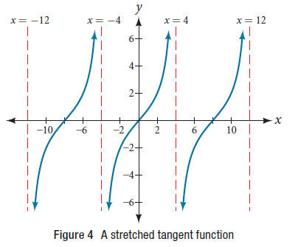
Graphing One Period of a Shifted Tangent Function example 2
Example Identifying the Graph of a Stretched Tangent
Find a formula for the function graphed in Figure 4

Slide 49
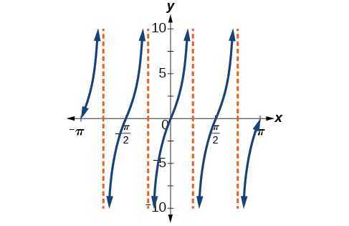
Graphing One Period of a Shifted Tangent Function try it
Try It: Find a formula for the function in Figure

Slide 50
Using the Graphs of Trigonometric Functions to Solve Real-World Problems
Example Using Trigonometric Functions to Solve Real-World Scenarios
Suppose the function y = 5tan($\frac{π}{4}$t) marks the distance in the movement of a light beam from the top of a police car across a wall where t is the time in seconds and y is the distance in feet from a point on the wall directly across from the police car.
a. Find and interpret the stretching factor and period.
b. Graph on the interval [0, 5].
c. Evaluate f (1) and discuss the function’s value at that input.

Slide 51
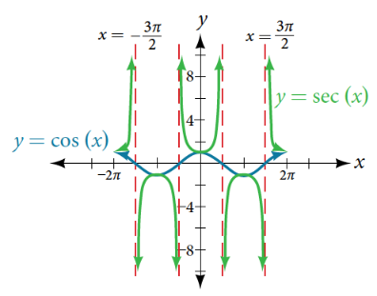
Analyzing the Graphs of y = sec x and y = csc x
We can graph y = sec x by observing the graph of the cosine function because these two functions are reciprocals of one another. See Figure 6.
The graph of the cosine is shown as a blue wave so we can see the relationship.
Where the graph of the cosine function decreases, the graph of the secant function increases. Where the graph of the cosine function increases, the graph of the secant function decreases.
When the cosine function is zero, the secant is undefined.
The secant graph has vertical asymptotes at each value of x where the cosine graph crosses the x-axis.
We show these in the graph below with dashed vertical lines, but will not show all the asymptotes explicitly on all later graphs involving the secant and cosecant.

Slide 52
Analyzing the Graphs of y = sec x and y = csc x (cont.)
FEATURES OF THE GRAPH OF Y = ASEC(BX)
The stretching factor is |A|.
The period is $\frac{\text{2}\text{π}}{\text{|}\text{B}\text{|}\text{.}}$
The domain is x ≠ $\frac{\text{π}}{\text{2}\text{|}\text{B}\text{|}\text{.}}$k where k is an odd integer.
The range is(−∞, −|A|] ∪ [ |A|,∞ ).
The vertical asymptotes occur at x = $\frac{\text{π}}{\text{2}\text{|}\text{B}\text{|}}$k, where k is an odd integer.
There is no amplitude.
y = Asec(Bx) is an even function because cosine is an even function.

Slide 53
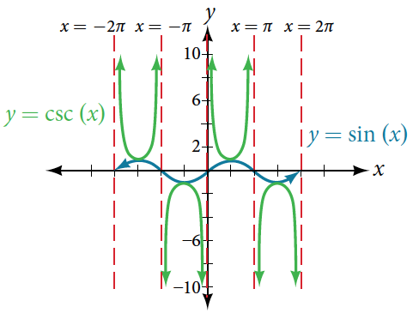
Analyzing the Graphs of y = sec x and y = csc x (cont.2)
We can graph y = csc x by observing the graph of the sine function because these two functions are reciprocals of one another. See Figure 7.
The graph of sine is shown as a blue wave so we can see the relationship.
Where the graph of the sine function decreases, the graph of the cosecant function increases. Where the graph of the sine function increases, the graph of the cosecant function decreases.
The cosecant graph has vertical asymptotes at each value of x where the sine graph crosses the x-axis.
We show these in the graph below with dashed vertical lines.

Slide 54
Analyzing the Graphs of y = sec x and y = csc x (cont.3)
FEATURES OF THE GRAPH OF Y = ACSC(BX)
The stretching factor is |A|.
The period is $\frac{\text{2}\text{π}}{\text{|}\text{B}\text{|}\text{.}}$
The domain is x ≠ $\frac{\text{π}}{\text{|}\text{B}\text{|}}$k, where k is an integer.
The range is (−∞,−|A| ] ∪ [ |A|, ∞ ).
The asymptotes occur at x = $\frac{\text{π}}{\text{|}\text{B}\text{|}}$k, where k is an integer.
y = Acsc(Bx) is an odd function because sine is an odd function.

Slide 55
Graphing Variations of y = sec x and y = csc x
For shifted, compressed, and/or stretched versions of the secant and cosecant functions, we can follow similar methods to those we used for tangent and cotangent.
The equations become the following:

Slide 56
Graphing Variations of y = sec x and y = csc x (cont.)
FEATURES OF THE GRAPH OF Y = ASEC(BX-C)+D
The stretching factor is |A|.
The period is $\frac{\text{2}\text{π}}{\text{|}\text{B}\text{|}\text{.}}$
The domain is x ≠ $\frac{C}{B}+ \frac{\text{π}}{\text{2}\text{|}\text{B}\text{|}}$k, where k is an odd integer.
The range is (−∞, −|A| + D ] ∪ [ |A| + D, ∞ ).
The asymptotes occur at x = $\frac{C}{B}+ \frac{\text{π}}{\text{2}\text{|}\text{B}\text{|}}$, where k is an odd integer.
There is no amplitude.
y = Asec(Bx) is an even function because cosine is an even function.

Slide 57
Graphing Variations of y = sec x and y = csc x (cont.2)
FEATURES OF THE GRAPH OF Y = Acsc(BX-C)+D
The stretching factor is |A|.
The period is $\frac{\text{2}\text{π}}{\text{|}\text{B}\text{|}}.$
The domain is x ≠ $\frac{C}{B}+ \frac{\text{π}}{\text{|}\text{B}\text{|}}$k, where k is an integer.
The range is (−∞, −|A| + D ] ∪ [ |A| + D, ∞ ).
The asymptotes occur at x = $\frac{C}{B}+ \frac{\text{π}}{\text{|}\text{B}\text{|}}$, where k is an integer.
There is no amplitude.
y = Acsc(Bx) is an odd function because sine is an odd function.

Slide 58
Graphing Variations of y = sec x and y = csc x (cont.3)
How To:
Given a function of the form y = Asec(Bx), graph one period.
Express the function given in the form y = Asec(Bx).
Identify the stretching/compressing factor, |A|.
Identify B and determine the period, P = $\frac{\text{2}\text{π}}{\text{|}\text{B}\text{|}}$.
Sketch the graph of y = Acos(Bx).
Use the reciprocal relationship between y = cos x and y = sec x to draw the graph of y = Asec(Bx).
Sketch the asymptotes.
Plot any two reference points and draw the graph through these points.
Q & A..
Do the vertical shift and stretch/compression affect the secant’s range?
Yes. The range of f(x) = Asec(Bx − C) + D is ( −∞, −|A| + D] ∪ [ |A| + D, ∞ ).

Slide 59
Graphing Variations of y = sec x and y = csc x example
Example Graphing a Variation of the Secant Function
Sketch a graph of one period of the function $f\left(x\right)=2.5sec\left(0.4x\right)$.

Slide 60
Graphing Variations of y = sec x and y = csc x (cont.4)
How To:
Given a function of the form f(x) = A sec(Bx−C)+D, graph one period.
Express the function given in the form y = A sec(Bx − C) + D.
Identify the stretching/compressing factor, |A|.
Identify B and determine the period, $\frac{\text{2}\text{π}}{\text{|}\text{B}\text{|}}$.
Identify C and determine the phase shift, $\frac{\text{C}}{\text{B}}$.
Draw the graph of y = A sec(Bx) , but shift it to the right by $\frac{\text{C}}{\text{B}}$ and up by D.
Sketch the vertical asymptotes, which occur at x = $\frac{\text{C}}{\text{B}}$+ $\frac{\text{π}}{\text{2}\text{|}\text{B}\text{|}}$k, where k is an odd integer.
" "

Slide 61
Graphing Variations of y = sec x and y = csc x example 2
Example Graphing a Variation of the Secant Function
Sketch a graph of one period of the function $f\left(x\right)=4sec\left(\frac{π}{3}x−\frac{π}{2}\right)+1$.

Slide 62
Graphing Variations of y = sec x and y = csc x (cont.5)
How To:
Given a function of the form y = A csc(Bx), graph one period.
Express the function given in the form y = A csc(Bx).
Identify the stretching/compressing factor, |A|.
Identify B and determine the period, $\frac{\text{2}\text{π}}{\text{|}\text{B}\text{|}}$.
Draw the graph of y = A sin(Bx).
Use the reciprocal relationship between y = sin x and y = csc x to draw the graph of y = A csc(Bx).
Sketch the asymptotes.
Plot any two reference points and draw the graph through these points.
Q & A….
The domain of csc x was given to be all x such that x ≠ kπ for any integer k. Would the domain of y = A csc(Bx−C) + D be x ≠ $\frac{\text{C} \text{+ }\text{k}\text{π}}{\text{B}}$?
Yes. The excluded points of the domain follow the vertical asymptotes. Their locations show the horizontal shift and compression or expansion implied by the transformation to the original function’s input.

Slide 63
Graphing Variations of y = sec x and y = csc x example 3
Example Graphing a Variation of the Cosecant Function
Sketch a graph of one period of the function $f\left(x\right)=−3csc\left(4x\right)$.

Slide 64
Graphing Variations of y = sec x and y = csc x (cont.6)
How To:
Given a function of the form f(x) = A csc(Bx − C) + D, graph one period.
Express the function given in the form y = A csc(Bx − C) + D.
Identify the stretching/compressing factor, |A|
Identify B and determine the period, $\frac{\text{2}\text{π}}{\text{|}\text{B}\text{|}}$.
Identify C and determine the phase shift, $\frac{\text{C}}{\text{B}}$.
Draw the graph of y = A csc(Bx) but shift it to the right by $\frac{\text{C}}{\text{B}}$ and up by D.
Sketch the vertical asymptotes, which occur at x = $\frac{\text{C}}{\text{B}}$+ $\frac{\text{π}}{\text{|}\text{B}\text{|}}$k, where k is an integer.

Slide 65
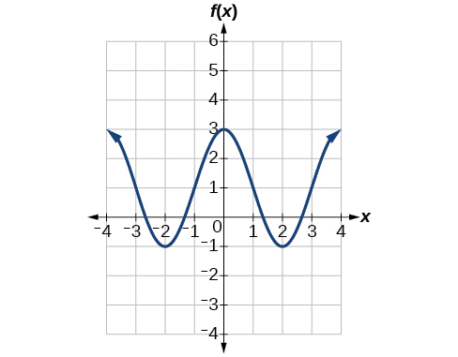
Graphing Variations of y = sec x and y = csc x try it
Try It: Given the graph of f(x) = 2cos($\frac{π}{2}$x)+1 shown in Figure, sketch the graph of g(x) = 2sec($\frac{π}{2}$x)+1 on the same axes.

Slide 66
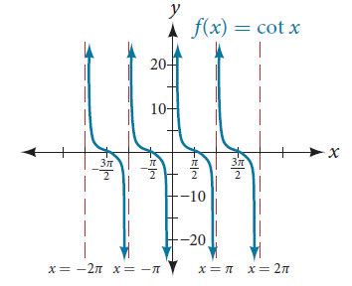
Analyzing the Graph of y = cot x
The last trigonometric function we need to explore is cotangent.
Notice that the function is undefined when the tangent function is 0, leading to a vertical asymptote in the graph at 0, π, etc. Since the output of the tangent function is all real numbers, the output of the cotangent function is also all real numbers.
We can graph y = cot x by observing the graph of the tangent function because these two functions are reciprocals of one another. See Figure 13. Where the graph of the tangent function decreases, the graph of the cotangent function increases. Where the graph of the tangent function increases, the graph of the cotangent function decreases.
The cotangent graph has vertical asymptotes at each value of x where tan x = 0.
We show these in the graph below with dashed lines. Since the cotangent is the reciprocal of the tangent, cot x has vertical asymptotes at all values of x where tan x = 0, and cot x = 0 at all values of x where tan x has its vertical asymptotes.

Slide 67
Analyzing the Graph of y = cot x (cont.)
FEATURES OF THE GRAPH OF Y = ACOT(BX)
The stretching factor is |A|.
The period is P = $\frac{\text{π}}{\text{|}\text{B}\text{|}}$.
The domain is x ≠ $\frac{\text{π}}{\text{|}\text{B}\text{|}}$k, where k is an integer.
The range is (−∞,∞).
The asymptotes occur at x = $\frac{\text{π}}{\text{|}\text{B}\text{|}}$k, where k is an integer.
y = A cot(Bx) is an odd function.

Slide 68
Graphing Variations of y = cot x
PROPERTIES OF THE GRAPH OF Y = ACOT(BX−C)+D
The stretching factor is |A|.
The period is $\frac{\text{π}}{\text{|}\text{B}\text{|}}$
The domain is x ≠ $\frac{\text{C}}{\text{B}}$+ $\frac{\text{π}}{\text{|}\text{B}\text{|}}$k, ,where k is an integer.
The range is (−∞,∞).
The vertical asymptotes occur at x = $\frac{\text{C}}{\text{B}}$+ $\frac{\text{π}}{\text{|}\text{B}\text{|}}$k, where k is an integer.
There is no amplitude.
y = Acot (Bx) is an odd function because it is the quotient of even and odd functions (cosine and sine, respectively)

Slide 69
Graphing Variations of y = cot x (cont.)
How To:
Given a modified cotangent function of the form f(x) = A cot (Bx), graph one period.
Express the function in the form f(x) = A cot(Bx).
Identify the stretching factor, |A|.
Identify the period, P = $\frac{\text{π}}{\text{|}\text{B}\text{|}}$.
Draw the graph of y = A tan(Bx).
Plot any two reference points.
Use the reciprocal relationship between tangent and cotangent to draw the graph of y = A cot (Bx).
Sketch the asymptotes.

Slide 70
Graphing Variations of y = cot x Example
Example Graphing Variations of the Cotangent Function
Determine the stretching factor, period, and phase shift of y = 3cot(4x), and then sketch a graph.

Slide 71
Graphing Variations of y = cot x (Cont.2)
How To:
Given a modified cotangent function of the form f(x) = A cot (Bx−C)+D, graph one period.
Express the function in the form f(x) = A cot (Bx − C) + D.
Identify the stretching factor, |A|.
Identify the period, P = $\frac{\text{π}}{\text{|}\text{B}\text{|}}$
Identify the phase shift, $\frac{\text{C}}{\text{B}}$.
Draw the graph of y = A tan (Bx) shifted to the right by $\frac{\text{C}}{\text{B}}$ and up by D.
Sketch the asymptotes x = $\frac{\text{C}}{\text{B}}$ + $\frac{\text{π}}{\text{|}\text{B}\text{|}}$k, where k is an integer.
Plot any three reference points and draw the graph through these points.

Slide 72
Graphing Variations of y = cot x Example 2
Example Graphing a Modified Cotangent
Sketch a graph of one period of the function f (x) = 4cot($\frac{π}{8}$x − $\frac{π}{2}$) − 2.

Slide 73
Chapter 8 periodic functions
Section 8.3 – inverse trigonometric functions

Slide 74
Section 8.3 Learning Objectives
In this section students will:
Understand and use the inverse sine, cosine, and tangent functions.
Find the exact value of expressions involving the inverse sine, cosine, and tangent functions.
Use a calculator to evaluate inverse trigonometric functions.
Find exact values of composite functions with inverse trigonometric functions.

Slide 75
Understanding and Using the Inverse Sine, Cosine, and Tangent Functions
In order to use inverse trigonometric functions, we need to understand that an inverse trigonometric function “undoes” what the original trigonometric function “does,” as is the case with any other function and its inverse.
In other words the domain of the inverse function is the range of the original function, and vice versa, as summarized in Figure 1.

Slide 76
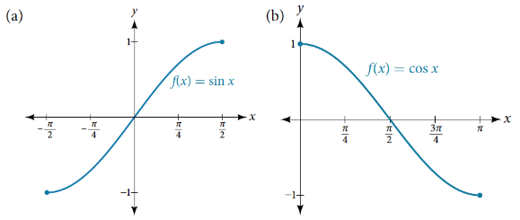
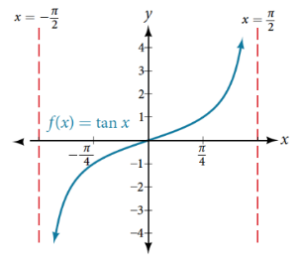
Understanding and Using the Inverse Sine, Cosine, and Tangent Functions (cont.)
Bear in mind that the sine, cosine, and tangent functions are not one-to-one functions. As with other functions that are not one-to-one, we will need to restrict the domain of each function to yield a new function that is one-to-one.
Sine function on a restricted domain of $\left[−\frac{π}{2}, \frac{π}{2}\right]$;
Cosine function on a restricted domain of $[0, π]$
Tangent function on a restricted domain of $\left(−\frac{π}{2}, \frac{π}{2}\right)$

Slide 77
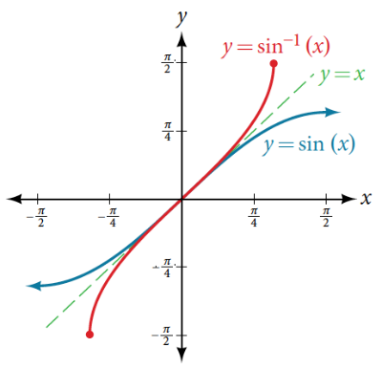
Understanding and Using the Inverse Sine function
The inverse sine function y = sin⁻¹x means x = sin y. The inverse sine function is sometimes called the arcsine function, and notated arcsinx.

Slide 78
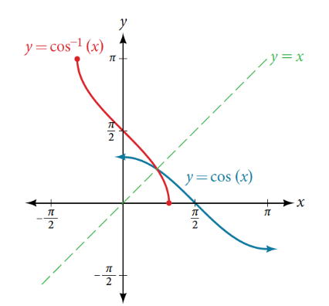
Understanding and Using the Inverse Cosine Function
The inverse cosine function y = cos⁻¹x means x = cos y. The inverse cosine function is sometimes called the arccosine function, and notated arccos x.

Slide 79
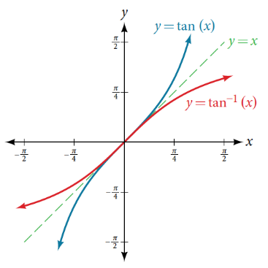
Understanding and Using the Inverse Tangent Function
The inverse tangent function y = tan⁻¹x means x = tan y. The inverse tangent function is sometimes called the arctangent function, and notated arctan x.

Slide 80
Understanding and Using the Inverse Sine, Cosine, and Tangent Functions (cont.2)
RELATIONS FOR INVERSE SINE, COSINE, AND TANGENT FUNCTIONS
For angles in the interval [−$\frac{π }{2}$, $\frac{π }{2}$], if sin y = x, then sin⁻¹x = y.
For angles in the interval [0, π], if cos y = x, then cos⁻¹ x = y.
For angles in the interval(−$\frac{π }{2}$, $\frac{π }{2}$), if tan y = x, then tan⁻¹ x = y.

Slide 81
Understanding and Using the Inverse Sine, Cosine, and Tangent Functions examples
Example Writing a Relation for an Inverse Function
Given $sin\left(\frac{5π}{12}\right)≈0.96593$, write a relation involving the inverse sine.
Try It: Given cos (0.5) ≈ 0.8776, write a relation involving the inverse cosine.

Slide 82
Finding the Exact Value of Expressions Involving the Inverse Sine, Cosine, and Tangent Functions
How To:
Given a “special” input value, evaluate an inverse trigonometric function.
Find angle x for which the original trigonometric function has an output equal to the given input for the inverse trigonometric function.
If x is not in the defined range of the inverse, find another angle y that is in the defined range and has the same sine, cosine, or tangent as x, depending on which corresponds to the given inverse function.

Slide 83
Finding the Exact Value of Expressions Involving the Inverse Sine, Cosine, and Tangent Functions examples
Example Evaluating Inverse Trigonometric Functions for Special Input Values
Evaluate each of the following:
a. $\sin^{−1}\left(\frac{1}{2}\right)$ b. $\sin^{−1}\left(−\frac{\sqrt{2}}{2}\right)$ c. $\cos^{−1}\left(−\frac{\sqrt{3}}{2}\right)$ d. $\tan^{−1}\left(1\right)$

Slide 84
Finding the Exact Value of Expressions Involving the Inverse Sine, Cosine, and Tangent Functions try it
Try It: Evaluate each of the following.
sin⁻¹(−1)
tan⁻¹(−1)
cos⁻¹(−1)
cos⁻¹(½)

Slide 85
Using a Calculator to Evaluate Inverse Trigonometric Functions
To evaluate inverse trigonometric functions that do not involve the special angles discussed previously, we will need to use a calculator or other type of technology.
Most scientific calculators and calculator-emulating applications have specific keys or buttons for the inverse sine, cosine, and tangent functions. These may be labeled, for example, SIN⁻¹, ARCSIN, or ASIN.
In the previous chapter, we worked with trigonometry on a right triangle to solve for the sides of a triangle given one side and an additional angle.
Using the inverse trigonometric functions, we can solve for the angles of a right triangle given two sides, and we can use a calculator to find the values to several decimal places.

Slide 86
Using a Calculator to Evaluate Inverse Trigonometric Functions examples
Example Evaluating the Inverse Sine on a Calculator
Evaluate sin⁻¹(0.97) using a calculator.
Try It: Evaluate cos⁻¹ (−0.4) using a calculator.

Slide 87
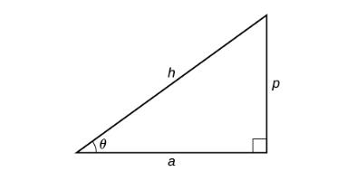
Using a Calculator to Evaluate Inverse Trigonometric Functions (2)
How To:
Given two sides of a right triangle like the one shown in Figure, find an angle.
If one given side is the hypotenuse of length h and the side of length a adjacent to the desired angle is given, use the equation θ = cos⁻¹($\frac{a}{h}$).
If one given side is the hypotenuse of length h and the side of length p opposite to the desired angle is given, use the equation θ = sin⁻¹($\frac{\text{p}}{h}$).
If the two legs (the sides adjacent to the right angle) are given, then use the equation θ = tan⁻¹($\frac{\text{p}}{\text{a}}$).

Slide 88
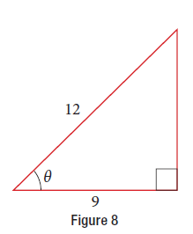
Using a Calculator to Evaluate Inverse Trigonometric Functions example 2
Example Applying the Inverse Cosine to a Right Triangle
Solve the triangle in Figure 8 for the angle θ

Slide 89
Using a Calculator to Evaluate Inverse Trigonometric Functions try it
Try It: Solve the triangle in Figure for the angle θ.

Slide 90
Evaluating Compositions of the Form f (f ⁻¹(y )) and f ⁻¹(f (x ))
COMPOSITIONS OF A TRIGONOMETRIC FUNCTION AND ITS INVERSE
sin(sin⁻¹ x) = x for −1 ≤ x ≤ 1
cos(cos⁻¹ x) = x for −1 ≤ x ≤ 1
tan(tan⁻¹ x) = x for −∞ < x < ∞
sin⁻¹(sin x) = x only for −$\frac{π}{ 2}$ ≤ x ≤ $\frac{π}{ 2}$
cos⁻¹(cos x) = x only for 0 ≤ x ≤ π
tan⁻¹(tan x) = x only for − $\frac{π}{ 2}$< x < $\frac{π}{ 2}$

Slide 91
Evaluating Compositions of the Form f (f ⁻¹(y )) and f ⁻¹(f (x )) (cont.)
Q & A…
Is it correct that sin⁻¹(sin x) = x?
No. This equation is correct if x belongs to the restricted domain[− $\frac{π}{2}$, $\frac{π}{2}$], but sine is defined for all real input values, and for x outside the restricted interval, the equation is not correct because its inverse always returns a value in[− $\frac{π}{2}$, $\frac{π}{2}$]. The situation is similar for cosine and tangent and their inverses. For example, sin⁻¹(sin($\frac{3π}{4}$))= $\frac{π}{4}$.
How To:
Given an expression of the form f⁻¹(f(θ)) where f(θ) = sin θ, cosθ, or tanθ, evaluate.
If θ is in the restricted domain of f, then f⁻¹(f(θ)) = θ.
If not, then find an angle ϕ within the restricted domain of f such that f(ϕ) = f(θ). Then f⁻¹(f(θ)) = ϕ.

Slide 92
Evaluating Compositions of the Form f (f ⁻¹(y )) and f ⁻¹(f (x )) example
Example Using Inverse Trigonometric Functions
Evaluate the following:
a. sin⁻¹(sin$\left(\frac{π}{3}\right)$) b. cos⁻¹(cos$\left(\frac{2π}{3}\right)$)

Slide 93
Evaluating Compositions of the Form f (f ⁻¹(y )) and f ⁻¹(f (x )) examples
Example Using Inverse Trigonometric Functions
Evaluate the following:
a. sin⁻¹(sin$\left(\frac{2π}{3}\right)$) b. cos⁻¹(cos$\left(−\frac{π}{3}\right)$)

Slide 94
Evaluating Compositions of the Form f (f ⁻¹(y )) and f ⁻¹(f (x )) try it
Try It: Evaluate tan⁻¹(tan($\frac{π}{8}$))and tan⁻¹(tan($\frac{11π}{9}$)).

Slide 95
Evaluating Compositions of the Form f ⁻¹(g (x )) example
Example Evaluating the Composition of an Inverse Sine with a Cosine
Evaluate sin⁻¹(cos$\left(\frac{13π}{6}\right)$)

Slide 96
Evaluating Compositions of the Form f ⁻¹(g (x )) example 2
Try It: Evaluate cos⁻¹(sin(− $\frac{\text{11}\text{π}}{\text{4}}$)).

Slide 97
Evaluating Compositions of the Form f (g ⁻¹(x ))
Example Evaluating the Composition of an Inverse Sine with a Cosine
Find an exact value for sin(cos ⁻¹$\left(\frac{4}{5}\right)$)

Slide 98
Evaluating Compositions of the Form f (g ⁻¹(x )) example
Example Evaluating the Composition of an Inverse Sine with a Tangent
Find an exact value for sin(tan ⁻¹$\left(\frac{7}{4}\right)$)

Slide 99
Evaluating Compositions of the Form f (g ⁻¹(x )) try it
Try It: Evaluate cos(tan⁻¹($\frac{\text{5}}{\text{12}}$)).

Slide 100
Evaluating Compositions of the Form f (g ⁻¹(x )) try it 2
Try It: Evaluate cos(sin⁻¹($\frac{\text{7}}{\text{9}}$)).

Slide 101
Evaluating Compositions of the Form f (g ⁻¹(x )) example 2
Example Finding the Cosine of the Inverse Sine of an Algebraic Expression
Find s simplified expression for cos(sin ⁻¹$\left(\frac{x}{3}\right)$) for -3 ≤ x ≤ 3

Slide 102
Evaluating Compositions of the Form f (g ⁻¹(x )) try it 3
Try It: Find a simplified expression for sin(tan⁻¹(4x)) for − $\frac{\text{1}}{\text{4}}$ ≤ x ≤ $\frac{\text{1}}{\text{4}}$.

Slide 103
Acknowledgments
The original PowerPoint file is copyright 2015, Rice University. All Rights Reserved.
This work is a derivative of a text by OpenStax, which is licensed under a Creative Commons Attribution License 4.0 license.
Material on this PowerPoint was adapted from Abramson, Jay. “Chapter 8. Periodic Functions.” Algebra and Trigonometry. OpenStax CAT, Algebra and Trigonometry. OpenStax CNX. May 30, 2019 http://cnx.org/contents/13ac107a-f15f-49d2-97e8-60ab2e3b519c@13.63.
This document has been reviewed for accessibility.

