Slide 1
Chapter 5 polynomial and rational functions
Section 5.1 – Quadratic Functions

Slide 2
Section 5.1 Learning Objectives
In this section students will:
Recognize characteristics of parabolas.
Understand how the graph of a parabola is related to its quadratic function.
Determine a quadratic function’s minimum or maximum value.
Solve problems involving a quadratic function’s minimum or maximum value.

Slide 3
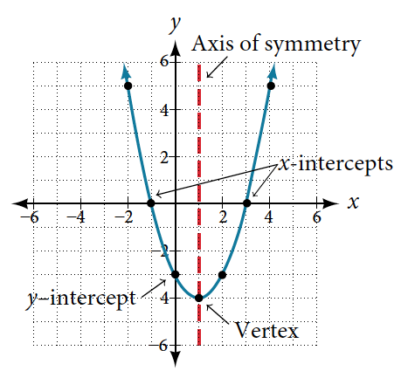
5.1 Quadratic Functions Recognizing Characteristics of Parabolas
The graph of a quadratic function is a U-shaped curve called a parabola.
The vertex is a turning point on the graph.
If the parabola opens up, the vertex represents the minimum value of the quadratic function.
If the parabola opens down, the vertex represents the maximum value.
The graph is also symmetric with a vertical line drawn through the vertex, called the axis of symmetry.

Slide 4
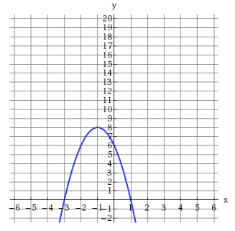
Recognizing Characteristics of Parabolas
Example Identifying the Characteristics of a Parabola
Determine the vertex, axis of symmetry, zeros, and y-intercept of the parabola shown

Slide 5
Understanding How the Graphs of Parabolas are Related to Their Quadratic Functions
FORMS OF QUADRATIC FUNCTIONS
A quadratic function is a polynomial function of degree two. The graph of a quadratic function is a parabola.
The general form of a quadratic function is f(x) = ax² + bx + c where a, b, and c are real numbers and a ≠ 0.
The standard form of a quadratic function is f(x) = a(x − h)² + k where a ≠ 0.
The vertex (h, k) is located at
$$h=–\frac{b}{2a} , k=f(h)=f(–\frac{b}{2a}a)$$

Slide 6
Understanding How the Graphs of Parabolas are Related to Their Quadratic Functions (2)
How To:
Given a graph of a quadratic function, write the equation of the function in general form.
Identify the horizontal shift of the parabola; this value is h. Identify the vertical shift of the parabola; this value is k.
Substitute the values of the horizontal and vertical shift for h and k. in the function f(x) = a(x – h)² + k.
Substitute the values of any point, other than the vertex, on the graph of the parabola for x and f(x).
Solve for the stretch factor, |a|.
Expand and simplify to write in general form.

Slide 7
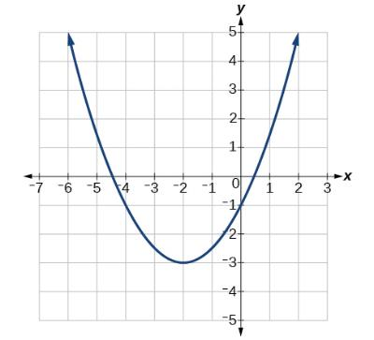
Understanding How the Graphs of Parabolas are Related to Their Quadratic Functions example
Example: Writing the Equation of a Quadratic Function from the Graph
Write an equation for the quadratic function g in Figure as a transformation of f(x) = x², and then expand the formula, and simplify terms to write the equation in general form.

Slide 8
Understanding How the Graphs of Parabolas are Related to Their Quadratic Functions
How To:
Given a quadratic function in general form, find the vertex of the parabola.
Identify a, b, and c.
Find h, the x-coordinate of the vertex, by substituting a and b into $h=–\frac{b}{2a}$
Find k, the y-coordinate of the vertex, by evaluating k = f(h) = f ($–\frac{b}{2a}$).

Slide 9
Understanding How the Graphs of Parabolas are Related to Their Quadratic Functions example 2
Example Finding the Vertex of a Quadratic Function
Find the vertex of the quadratic function $f\left(x\right)=3x^{2} −5x −1$. Rewrite the quadratic in standard form (vertex form).

Slide 10
Understanding How the Graphs of Parabolas are Related to Their Quadratic Functions try it
Try It: Given the equation g(x) = 13 + x² − 6x, write the equation in general form and then in standard form.

Slide 11
Finding the Domain and Range of a Quadratic Function
DOMAIN AND RANGE OF A QUADRATIC FUNCTION
The domain of any quadratic function is all real numbers unless the context of the function presents some restrictions.
The range of a quadratic function written in general form f(x) = ax² + bx + c with a positive a value is f(x) ≥ f ($–\frac{b}{2a}$), or [f($–\frac{b}{2a}$),∞); the range of a quadratic function written in general form with a negative a value is f(x) ≤ f ($–\frac{b}{2a}$), or (−∞, f($–\frac{b}{2a}$)].
The range of a quadratic function written in standard form f(x) = a(x − h)² + k with a positive a value is f(x) ≥ k; the range of a quadratic function written in standard form with a negative a value is f(x) ≤ k.

Slide 12
Finding the Domain and Range of a Quadratic Function (2)
How To:
Given a quadratic function, find the domain and range.
Identify the domain of any quadratic function as all real numbers.
Determine whether a is positive or negative. If a is positive, the parabola has a minimum. If a is negative, the parabola has a maximum.
Determine the maximum or minimum value of the parabola, k.
If the parabola has a minimum, the range is given by f(x) ≥ k, or [k,∞). If the parabola has a maximum, the range is given by f(x) ≤ k, or (−∞,k].

Slide 13
Finding the Domain and Range of a Quadratic Function example
Example Finding the Domain and Range of a Quadratic Function
Find the domain and range of $f\left(x\right)= −x^{2} +4x+3$.

Slide 14
Finding the Domain and Range of a Quadratic Function try it
Try It: Find the domain and range of $f(x) = 2{\left(x − \frac{4}{7}\right)}^{2}+ \frac{8}{11}$.

Slide 15
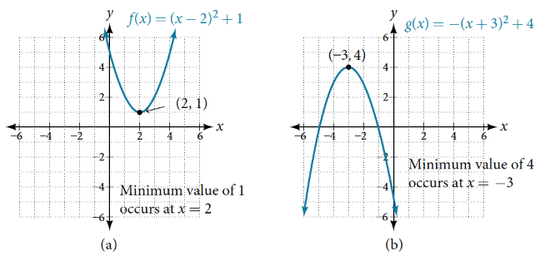
Determining the Maximum and Minimum Values of Quadratic Functions

Slide 16
Determining the Maximum and Minimum Values of Quadratic Functions example
Example Finding the Maximum Value of a Quadratic Function
Find the dimensions of the rectangular corral producing the greatest enclosed area given 200 feet of fencing.

Slide 17
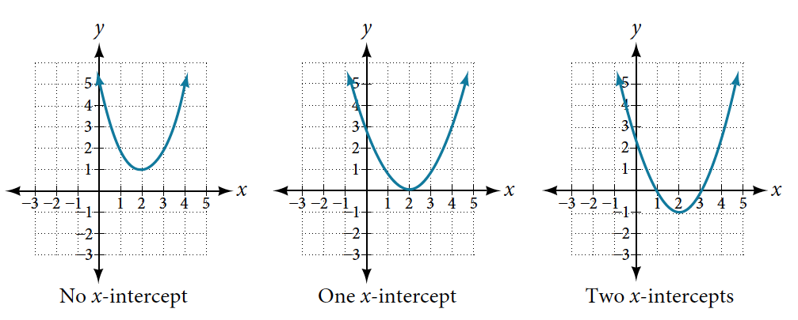
Finding the x- and y-Intercepts of a Quadratic Function

Slide 18
Finding the x- and y-Intercepts of a Quadratic Function example
How To:
Given a quadratic function f(x), find the y- and x-intercepts.
Evaluate f(0) to find the y-intercept.
Solve the quadratic equation f(x) = 0 to find the x-intercepts.
Example Finding the y- and x-Intercepts of a Parabola
Find the y- and x-intercepts of the quadratic $f\left(x\right)= x^{2} − 5x+6$.

Slide 19
Finding the x- and y-Intercepts of a Quadratic Function
Example Finding the x-Intercepts of a Parabola
Find the y- and x-intercepts of the quadratic function $f \left(x\right)=4x^{2} −12x −3$.

Slide 20
Finding the x- and y-Intercepts of a Quadratic Function try it
Try It: In a Try It, we found the standard and general form for the function g(x) = 13 + x² − 6x. Now find the y- and x-intercepts (if any).

Slide 21
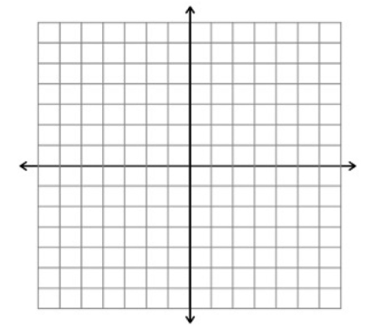
Graphing quadratics example
Example Graphing Quadratic Functions
Graph $f\left(x\right)= x^{2} −6x+3$.

Slide 22
Graphing quadratics example 2
Example Graphing Quadratic Functions
Graph $f\left(x\right)= {−2x}^{2}+8x−8$.

Slide 23
Finding the x- and y-Intercepts of a Quadratic Function application
Example Applying the Vertex and x-Intercepts of a Parabola
A ball is thrown upward from the top of a building. The ball’s height above ground can be modeled by the equation $H(t) = −4.9t^{2} +24t +8.$
When does the ball reach the maximum height?
What is the maximum height of the ball?
When does the ball hit the ground?

Slide 24
Quadratic function application
Try It: A rock is thrown upward from the top of a 112-foot high cliff overlooking the ocean at a speed of 96 feet per second. The rock’s height above ocean can be modeled by the equation H(t) = −16t² + 96t + 112.
When does the rock reach the maximum height?
What is the maximum height of the rock?
When does the rock hit the ocean?

Slide 25
Chapter 5 polynomial and rational functions
Section 5.2 – POWER FUNCTIONS AND POLYNOMIAL FUNCTIONS

Slide 26
Section 5.2 Learning Objectives
In this section students will:
Identify power functions.
Identify end behavior of power functions.
Identify polynomial functions.
Identify the degree and leading coefficient of polynomial functions.

Slide 27
5.2 POWER FUNCTIONS AND POLYNOMIAL FUNCTIONS
POWER FUNCTION
A power function is a function that can be represented in the form
f(x) = kx^{p}
where k and p are real numbers, and k is known as the coefficient.
Example Identifying Power Functions
Which of the following functions are power functions?
$f(x)=1$ Constant function
$f(x)=x$ Identify function
$f(x)=x^{2}$ Quadratic function
$f(x)= x^{3}$ Cubic function
$f(x) = \frac{1}{x}$ Reciprocal function
$f(x)=\frac{1}{x^{2}}$ Reciprocal squared function
$f ( x ) = \sqrt{x}$ Square root function
$f ( x ) = \sqrt[3]{x}$ Cube root function

Slide 28
Identifying Power Functions
Try It: Which functions are power functions?
f(x) = 2x⋅4x³ g(x) = −x⁵+5x³ $h(x) = \frac{2x5−1}{3x2+4 }$

Slide 29
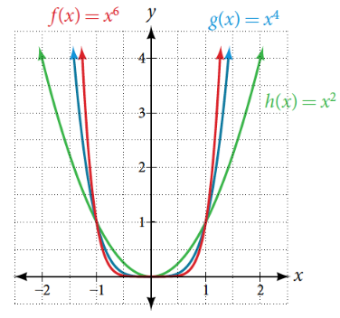
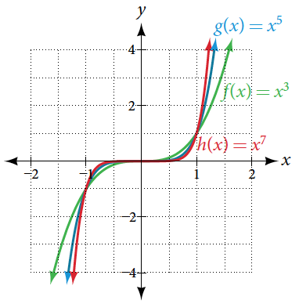
Identifying End Behavior of Power Functions
Given a power function f(x) = kx^{n} where n is a non-negative integer, identify the end behavior.
Determine whether the power is even or odd.
Determine whether the constant is positive or negative.
Use Figure to identify the end behavior.

Slide 30
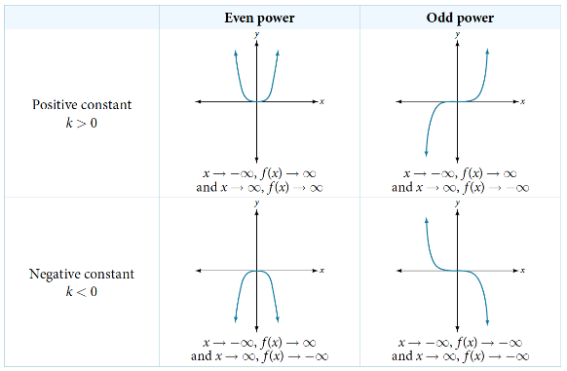
Identifying End Behavior of Power Functions chart

Slide 31
Identifying End Behavior of Power Functions example
Example Identifying the End Behavior of a Power Function
Describe the end behavior of the graph of $f(x) = x^{6}$.
Example Identifying the End Behavior of a Power Function
Describe the end behavior of the graph of $f(x) = {−x}^{7}$.
Try It: Describe in words and symbols the end behavior of f(x) = −5x⁴.

Slide 32
Identifying Polynomial Functions
POLYNOMIAL FUNCTIONS
Let n be a non-negative integer. A polynomial function is a function that can be written in the form
f(x) = a_{n}x_{n}+...+a₂x₂+a₁x+a₀
This is called the general form of a polynomial function. Each a_{i} is a coefficient and can be any real number, but a_{n} cannot = 0. Each expression a_{i}x_{i} is a term of a polynomial function.

Slide 33
Identifying Polynomial Functions (2)
TERMINOLOGY OF POLYNOMIAL FUNCTIONS
We often rearrange polynomials so that the powers are descending.
When a polynomial is written in this way, we say that it is in general form.
How To:
Given a polynomial function, identify the degree and leading coefficient.
Find the highest power of x to determine the degree function.
Identify the term containing the highest power of x to find the leading term.
Identify the coefficient of the leading term.

Slide 34
Identifying the Degree and Leading Coefficient of a Polynomial Function
Example Identifying the Degree and Leading Coefficient of a Polynomial Function
Identify the degree, leading term, and leading coefficient of the following polynomial functions.
$$f(x)=4+x^{2} −5x^{3}$$
$$g(t)=6t^{6} −3t^{2} +8t$$
$$h(p)=3p−4p^{3} −5$$

Slide 35
Identifying the Degree and Leading Coefficient of a Polynomial Function try it
Try It: Identify the degree, leading term, and leading coefficient of the polynomial f(x) = 4x² − x⁶ + 2x − 6.

Slide 36
Identifying End Behavior of Polynomial Functions
Example Identifying End Behavior and Degree of a Polynomial Function
Describe the end behavior and determine a possible degree of the polynomial function

Slide 37
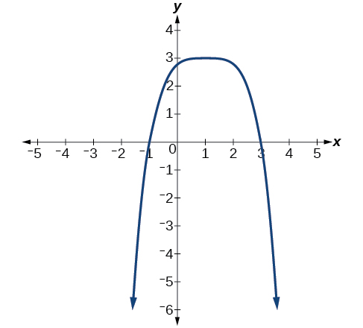
Identifying End Behavior of Polynomial Functions try it
Try It: Describe the end behavior, and determine a possible degree of the polynomial function in Figure.

Slide 38
Identifying End Behavior of Polynomial Functions example
Example Identifying End Behavior and Degree of a Polynomial Function
Given the function $f(x) = −2x^{2}(x −2)(x +3),$express the function as a polynomial in general form, and determine the leading term, degree, and end behavior of the function.

Slide 39
Identifying End Behavior of Polynomial Functions try it 2
Try It: Given the function f(x) = 0.2(x−2)(x+1)(x−5), express the function as a polynomial in general form and determine the leading term, degree, and end behavior of the function.

Slide 40
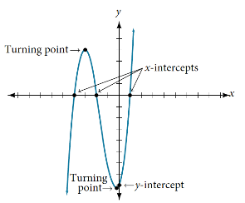
Identifying Local Behavior of Polynomial Functions
INTERCEPTS AND TURNING POINTS OF POLYNOMIAL FUNCTIONS
A turning point of a graph is a point at which the graph changes direction from increasing to decreasing or decreasing to increasing. The y-intercept is the point at which the function has an input value of zero. The x-intercepts are the points at which the output value is zero.
How To:
Given a polynomial function, determine the intercepts.
Determine the y-intercept by setting x = 0 and finding the corresponding output value.
Determine the x-intercepts by solving for the input values that yield an output value of zero.

Slide 41
Identifying Local Behavior of Polynomial Functions example
Example Determining the Intercepts of a Polynomial Function
Given the polynomial function $f(x) =2(x −1)(x +2)(x −3),$written in factored form for your convenience, determine the y- and x-intercepts.

Slide 42
Identifying Local Behavior of Polynomial Functions try it
Try It: Given the polynomial function f(x) = 2x³ − 6x² − 20x, determine the y- and x-intercepts.

Slide 43
Comparing Smooth and Continuous Graphs
INTERCEPTS AND TURNING POINTS OF POLYNOMIALS
A polynomial of degree n will have, at most, n x-intercepts and n−1 turning points.
Example Determining the Number of Intercepts and Turning Points of a Polynomial
Without graphing the function, determine the local behavior of the function by finding the maximum number of x-intercepts and turning points for
$f(x) = −5x^{10} + 4x^{6} −2x^{5} +3x^{3}.$

Slide 44
Comparing Smooth and Continuous Graphs try it
Try It: Without graphing the function, determine the maximum number of x-intercepts and turning points for f(x) = 108 − 13x⁹ − 8x⁴ + 14x¹² + 2x³.

Slide 45
a Polynomial Function graphs
Example Drawing Conclusions about a Polynomial Function from the Graph
What can we conclude about the polynomial represented by the graph shown based on its intercepts and turning points?

Slide 46
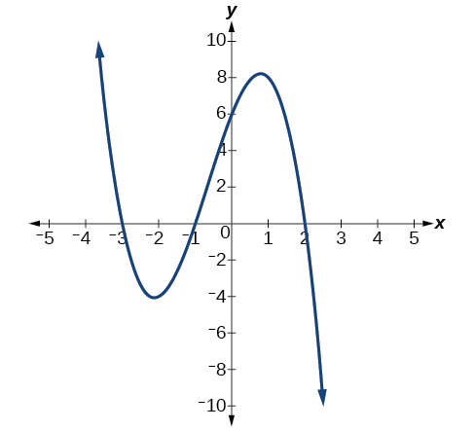
a Polynomial Function graphs (2)
Try It: What can we conclude about the polynomial represented by the graph shown in Figure based on its intercepts and turning points?

Slide 47
Identifying the Degree and Leading Coefficient of a Polynomial Function (2)
Example Drawing Conclusions about a Polynomial Function from the Factors
Given the function $f(x) = −2x(x −2)(x+3$), determine the local behavior.

Slide 48
Identifying the Degree and Leading Coefficient of a Polynomial Function try it
Try It:
Given the function f(x) = 0.2(x−2)(x+1)(x−5), determine the local behavior.

Slide 49
Chapter 5 polynomial and rational functions
Section 5.3 – GRAPHS OF POLYNOMIAL FUNCTIONS

Slide 50
Section 5.3 Learning Objectives
In this section students will:
Recognize characteristics of graphs of polynomial functions.
Use factoring to ﬁnd zeros of polynomial functions.
Identify zeros and their multiplicities.
Determine end behavior.
Understand the relationship between degree and turning points.
Graph polynomial functions.
Use the Intermediate Value Theorem.

Slide 51
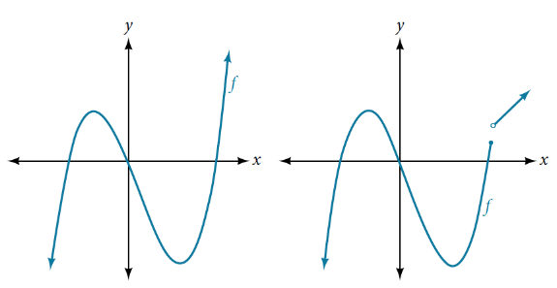
5.3 GRAPHS OF POLYNOMIAL FUNCTIONS
Recognizing Characteristics of Graphs of Polynomial Functions
Polynomial functions of degree 2 or more have graphs that do not have sharp corners. Polynomial functions also display graphs that have no breaks. Curves with no breaks are called continuous. Figure 1 shows a graph that represents a polynomial function and a graph that represents a function that is not a polynomial.

Slide 52
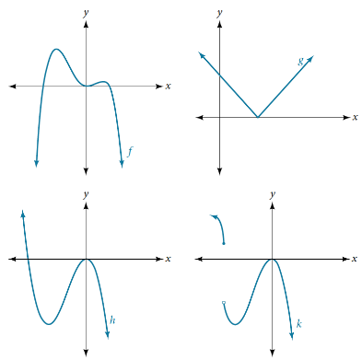
Recognizing Characteristics of Graphs of Polynomial Functions
Example Recognizing Polynomial Functions
Which of the graphs represent a polynomial function?

Slide 53
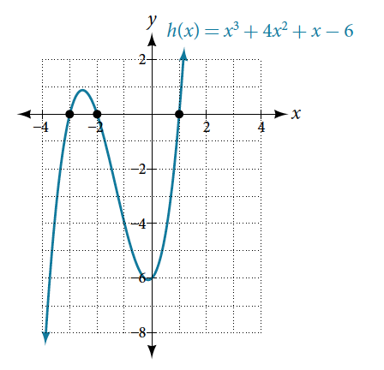
Using Factoring to Find Zeros of Polynomial Functions example
Example Finding the x-Intercepts of a Polynomial Function Using a Graph
Find the x-intercepts of $h(x) = x^{3} + 4x^{2} + x − 6$.

Slide 54
Using Factoring to Find Zeros of Polynomial Functions example 2
Example Finding the y- and x-Intercepts of a Polynomial in Factored Form
Find the y- and x-intercepts of $g(x) = {\left(x+3\right)}^{2}(x −2).$

Slide 55
Using Factoring to Find Zeros of Polynomial Functions
How To:
Given a polynomial function f, find the x-intercepts by factoring.
Set f(x) = 0.
If the polynomial function is not given in factored form:
Factor out any common monomial factors.
Factor any factorable binomials or trinomials.
Set each factor equal to zero and solve to find the x-intercepts.

Slide 56
Using Factoring to Find Zeros of Polynomial Functions example 3
Example Finding the x-Intercepts of a Polynomial Function by Factoring
Find the x-intercepts of $f\left(x\right)= x^{3}+2x^{2} −9x −18$.

Slide 57
Identifying Zeros and Their Multiplicities
GRAPHICAL BEHAVIOR OF POLYNOMIALS AT X-INTERCEPTS
If a polynomial contains a factor of the form (x−h)^{p}, the behavior near the x-intercept h is determined by the power p. We say that x = h is a zero of multiplicity p.
The graph of a polynomial function will touch the x-axis at zeros with even multiplicities. The graph will cross the x-axis at zeros with odd multiplicities.
The sum of the multiplicities is the degree of the polynomial function.

Slide 58
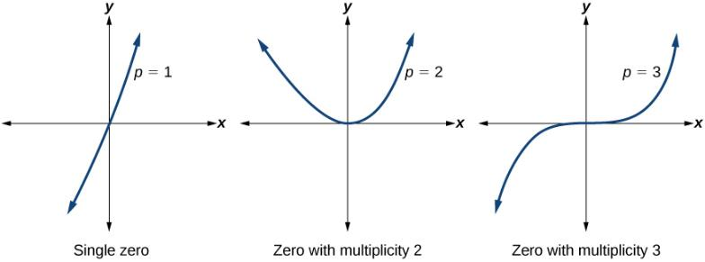
Identifying Zeros and Their Multiplicities (2)
How To:
Given a graph of a polynomial function of degree n, identify the zeros and their multiplicities.
If the graph crosses the x-axis and appears almost linear at the intercept, it is a single zero.
If the graph touches the x-axis and bounces off of the axis, it is a zero with even multiplicity.
If the graph crosses the x-axis at a zero, it is a zero with odd multiplicity.
The sum of the multiplicities is n.

Slide 59
Identifying Zeros and Their Multiplicities example
Example Identifying Zeros and Their Multiplicities
Use the graph of the function of degree 5 to identify the zeros of the function and their possible multiplicities.

Slide 60
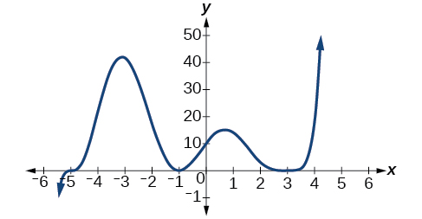
Identifying Zeros and Their Multiplicities try it
Try It: Use the graph of the function of degree 9 in Figure to identify the zeros of the function and their multiplicities.

Slide 61
Determining End Behavior

Slide 62
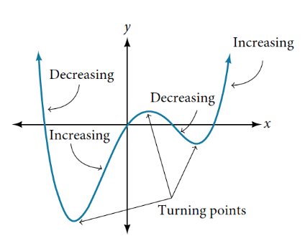
Understanding the Relationship Between Degree and Turning Points
INTERPRETING TURNING POINTS
A turning point is a point of the graph where the graph changes from increasing to decreasing (rising to falling) or decreasing to increasing (falling to rising).
A polynomial of degree n will have at most n−1 turning points.

Slide 63
Understanding the Relationship Between Degree and Turning Points example
Example Finding the Maximum Number of Turning Points Using the Degree of a Polynomial Function
Find the maximum number of turning points of each polynomial function.
a. $f\left(x\right)=−x^{3} +5x^{5}+4x^{2} +9$ b. $f(x)=−{(x+2)}^{2}\left(1+3x^{2}\right)$

Slide 64
Graphing Polynomial Functions
Given a polynomial function, sketch the graph.
Find the intercepts.
Check for symmetry. If the function is an even function, its graph is symmetrical about they- y-axis, that is, f(−x) = f(x). If a function is an odd function, its graph is symmetrical about the origin, that is, f(−x) = −f(x).
Use the multiplicities of the zeros to determine the behavior of the polynomial at the x- intercepts.
Determine the end behavior by examining the leading term.
Use the end behavior and the behavior at the intercepts to sketch a graph.
Ensure that the number of turning points does not exceed one less than the degree of the polynomial.
Optionally, use technology to check the graph.

Slide 65
Graphing Polynomial Functions example
Example Sketching the Graph of a Polynomial Function
Sketch a graph of $f (x) = −{\left(x+1\right)}^{2}(x −4).$

Slide 66
Graphing Polynomial Functions try it
Try It: Sketch a graph of $f(x)=\frac{1}{4}x(x−1)4(x+3)3$.

Slide 67
Writing Formulas for Polynomial Functions
FACTORED FORM OF POLYNOMIALS
If a polynomial of lowest degree p has horizontal intercepts at x = x₁, x₂, …,x_{n}, then the polynomial can be written in the factored form: f(x) = a(x − x₁)^{p1}(x−x₂)^{p2}⋯(x−x_{n})^{pn} where the powers pi on each factor can be determined by the behavior of the graph at the corresponding intercept, and the stretch factor a can be determined given a value of the function other than the x-intercept.
How To:
Given a graph of a polynomial function, write a formula for the function.
Identify the x-intercepts of the graph to find the factors of the polynomial.
Examine the behavior of the graph at the x-intercepts to determine the multiplicity of each factor.
Find the polynomial of least degree containing all the factors found in the previous step.
Use any other point on the graph (the y-intercept may be easiest) to determine the stretch factor.

Slide 68
Writing Formulas for Polynomial Functions example
Example Writing a Formula for a Polynomial Function from the Graph
Write a formula for the polynomial function shown.

Slide 69
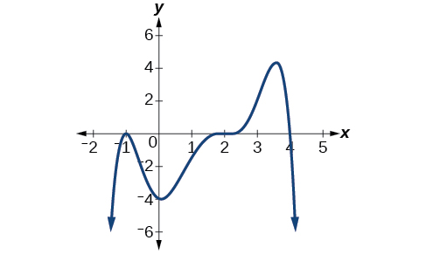
Writing Formulas for Polynomial Functions try it
Try It: Given the graph shown in Figure, write a formula for the function shown.

Slide 70
Chapter 5 polynomial and rational functions
Section 5.6 – rational functions

Slide 71
Section 5.6 Learning Objectives
In this section students will:
Use arrow notation.
Solve applied problems involving rational functions.
Find the domains of rational functions.
Identify vertical asymptotes.
Identify horizontal asymptotes.
Graph rational functions.

Slide 72
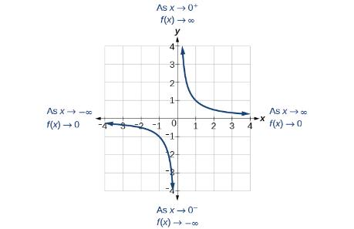
5.6 RATIONAL FUNCTIONS

Slide 73
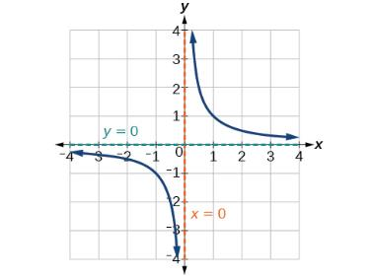
Using Arrow Notation
VERTICAL ASYMPTOTE
A vertical asymptote of a graph is a vertical line x = a where the graph tends toward positive or negative infinity as the inputs approach a. We write
As x → a, f(x) → ∞, or as x → a, f(x) → −∞.
HORIZONTAL ASYMPTOTE
A horizontal asymptote of a graph is a horizontal line y = b where the graph approaches the line as the inputs increase or decrease without bound. We write
As x → ∞ or x → −∞, f(x) → b.

Slide 74
Rational Functions
Example Using Transformations to Graph a Rational Function
Sketch a graph of the reciprocal function shifted down one unit and left three units. Identify the horizontal and vertical asymptotes of the graph, if any.

Slide 75
Rational Functions graph
Try It: Sketch the graph, and find the horizontal and vertical asymptotes of the reciprocal squared function that has been shifted right 3 units and down 4 units.

Slide 76
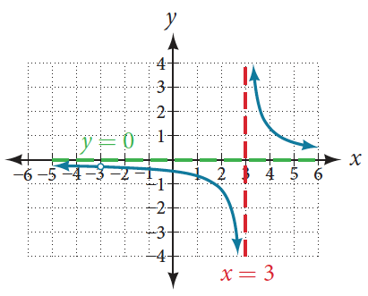
Solving Applied Problems Involving Rational Functions
RATIONAL FUNCTION
A rational function is a function that can be written as the quotient of two polynomial functions P(x) and Q(x).
$$f(x)=\frac{P(x)}{Q(x)}=\frac{apxp+ap−1xp−1+…+a1x + a0}{bqxq+bq−1xq−1+…+ b1x + b0}, Q(x)≠0$$

Slide 77
Finding the Domains of Rational Functions
DOMAIN OF A RATIONAL FUNCTION
The domain of a rational function includes all real numbers except those that cause the denominator to equal zero
How To:
Given a rational function, find the domain.
Set the denominator equal to zero.
Solve to find the x-values that cause the denominator to equal zero.
The domain is all real numbers except those found in Step 2.
Example Finding the Domain of a Rational Function
Find the domain of $f (x) = \frac{x+1}{x^{2}−1}$

Slide 78
Finding the Domains of Rational Functions try it
Try It: Find the domain of $f(x) = \frac{4x}{5(x−1)(x−5).}$

Slide 79
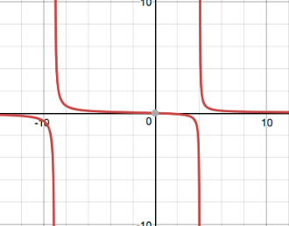
Identifying Vertical Asymptotes of Rational Functions
How To:
Given a rational function, identify any vertical asymptotes of its graph.
Factor the numerator and denominator.
Note any restrictions in the domain of the function.
Reduce the expression by canceling common factors in the numerator and the denominator.
Note any values that cause the denominator to be zero in this simplified version. These are where the vertical asymptotes occur.
Note any restrictions in the domain where asymptotes do not occur. These are removable discontinuities, or “holes.”
Example Identifying Vertical Asymptotes
Find the vertical asymptotes of the graph of $k(x) =\frac{x}{x^{2}+5x−36}$

Slide 80
Identifying Vertical Asymptotes of Rational Functions example
Example Identifying Vertical Asymptotes
Find the vertical asymptotes of the graph of $k(x) =\frac{x}{x^{2}+5x−36}$

Slide 81
Identifying Vertical Asymptotes of Rational Functions example 2
REMOVABLE DISCONTINUITIES OF RATIONAL FUNCTIONS
A removable discontinuity occurs in the graph of a rational function at x = a if a is a zero for a factor in the denominator that is common with a factor in the numerator. We factor the numerator and denominator and check for common factors. If we find any, we set the common factor equal to 0 and solve. This is the location of the removable discontinuity. This is true if the multiplicity of this factor is greater than or equal to that in the denominator. If the multiplicity of this factor is greater in the denominator, then there is still an asymptote at that value.
Example Identifying Vertical Asymptotes and Removable Discontinuities for a Graph
Find the vertical asymptotes and removable discontinuities of the graph of
$$k(x) =\frac{x+5}{x^{2}−25}$$

Slide 82
Identifying Vertical Asymptotes of Rational Functions try it
Try It: Find the vertical asymptotes and removable discontinuities of the graph of $f(x) = \frac{x2−25}{x3−6x2+5x}$.

Slide 83
Identifying Horizontal Asymptotes of Rational Functions
HORIZONTAL ASYMPTOTES OF RATIONAL FUNCTIONS
The horizontal asymptote of a rational function can be determined by looking at the degrees of the numerator and denominator.
Degree of numerator is less than degree of denominator: horizontal asymptote at y=0.
Degree of numerator is greater than degree of denominator by one: no horizontal asymptote; slant asymptote.
Degree of numerator is equal to degree of denominator: horizontal asymptote at ratio of leading coefficients.
Example Identifying Horizontal and Slant Asymptotes
For the functions listed, identify the horizontal or slant asymptote.
a. $g(x) = \frac{5x^{3}−12}{{10x}^{3}−x}$
b. $h(x) = \frac{x^{2}−3x+2}{x−2}$
c. $k(x) = \frac{x^{2}+x}{x^{3}−1}$

Slide 84
Identifying Horizontal Asymptotes of Rational Functions try it
Try It: Find the vertical and horizontal asymptotes of the function:
$$f(x) = \frac{(2x−1)(2x+1)}{(x−2)(x+3) }$$

Slide 85
Identifying Horizontal Asymptotes of Rational Functions example
INTERCEPTS OF RATIONAL FUNCTIONS
A rational function will have a y-intercept at f(0) , if the function is defined at zero. A rational function will not have a y-intercept if the function is not defined at zero.
Likewise, a rational function will have x-intercepts at the inputs that cause the output to be zero. Since a fraction is only equal to zero when the numerator is zero, x-intercepts can only occur when the numerator of the rational function is equal to zero.
Example Finding Intercepts
Find the intercepts of $f\left(x\right)= \frac{\left(x−1\right)\left(x+3\right)}{x−4}$

Slide 86
Identifying Horizontal Asymptotes of Rational Functions try it 2
Try It: Given the reciprocal squared function that is shifted right 3 units and down 4 units, write this as a rational function. Then, find the x- and y-intercepts and the horizontal and vertical asymptotes.

Slide 87
Graphing Rational Functions
How To:
Given a rational function, sketch a graph.
Evaluate the function at 0 to find the y-intercept.
Factor the numerator and denominator.
For factors in the numerator not common to the denominator, determine where each factor of the numerator is zero to find the x-intercepts.
Find the multiplicities of the x-intercepts to determine the behavior of the graph at those points.
For factors in the denominator, note the multiplicities of the zeros to determine the local behavior. For those factors not common to the numerator, find the vertical asymptotes by setting those factors equal to zero and then solve.
For factors in the denominator common to factors in the numerator, find the removable discontinuities by setting those factors equal to 0 and then solve.
Compare the degrees of the numerator and the denominator to determine the horizontal or slant asymptotes.
Sketch the graph.

Slide 88
Graphing Rational Functions example
Example Graphing a Rational Function
Sketch a graph of $f(x) = \frac{x^{2}−x−6}{x^{2}−4}$

Slide 89
Acknowledgements
The original PowerPoint file is copyright 2016, Rice University. All Rights Reserved.
This work is a derivative of a text by OpenStax, which is licensed under a Creative Commons Attribution License 4.0 license.
Material on this PowerPoint was adapted from Abramson, Jay. “Chapter 5: Polynomial and Rational Functions.” College Algebra. OpenStax College Algebra, College Algebra. OpenStax CNX. May 30, 2019 http://cnx.org/contents/9b08c294-057f-4201-9f48-5d6ad992740d@8.73.
This document has been reviewed for accessibility.

