Slide 1
Chapter 3 functions
Section 3.4 – composition of functions

Slide 2
Section 3.4 Learning Objectives
In this section students will:
Combine functions using algebraic operations.
Create a new function by composition of functions.
Evaluate composite functions.
Find the domain of a composite function.
Decompose a composite function into its component functions.

Slide 3
3.4 composition of Functions Combining Functions Using Algebraic Operations
For two functions f(x) and g(x) with real number outputs, we define new functions f + g, f − g, f g, and f/g by the relations
(f + g )(x) =f(x)+g(x)
(f − g )(x) = f(x)−g(x)
$$\left(fg\right) \left(x\right)= \text{f}\text{(}\text{x}\text{)}\text{g}\text{(}\text{x}\text{)}$$
$\left(\frac{f}{g}\right) \left(x\right)= \frac{\text{f}\text{(}\text{x}\text{)}}{\text{g}\text{(}\text{x}\text{)}}$, where g(x) ≠ 0

Slide 4
Combining Functions Using Algebraic Operations
Example Performing Algebraic Operations on Functions
Find and simplify the functions (g + f )(x) , (g − f )(x), $\left(fg\right) (x)$, and $\left(\frac{f}{g}\right) (x)$,
given $f \left(x\right)= x^{2}+2x$and $g\left(x\right)=6−x^{2}$.

Slide 5
Create a Function by Composition of Functions
COMPOSITION OF FUNCTIONS
When the output of one function is used as the input of another, we call the entire operation a composition of functions. For any input x and functions f and g, this action defines a composite function, which we write as f ∘ g such that
(f ∘ g)(x) = f(g(x))
The domain of the composite function f ∘ g is all x such that x is in the domain of g and g(x) is in the domain of f.
It is important to realize that the product of functions f g is not the same as the function composition f(g(x)), because, in general, f(x)g(x) ≠ f(g(x)).

Slide 6
Create a Function by Composition of Functions example
Example Determining whether Composition of Functions is Commutative
Using the functions provided, find f(g(x)) and g(f(x)). Determine whether the composition of the functions is commutative.
$$f \left(x\right)= x^{2} +9$$
$$g(x) = \sqrt{x+5}$$

Slide 7
Finding the Domain of a Composite Function example
Example Finding the Composite Function
Find (f ∘ g)(x) where $f(x) = \frac{1}{x^{2}+1}$ and $g(x) = {2x}^{4}$

Slide 8
Finding the Domain of a Composite Function example 2
Example Finding the Composite Function
Find (g ∘ f)(x) where $f(x) = \sqrt{x+4}$ and $g(x) =x^{2}$

Slide 9
Create a Function by Composition of Functions example 2
Example Interpreting Composite Functions
The function c(s) gives the number of calories burned completing s sit-ups, and s(t) gives the number of sit-ups a person can complete in t minutes. Interpret c(s(5)).

Slide 10
Evaluating Composite Functions
Try It: Using Table, evaluate f(g(1)) and g(f(4)).

Slide 11
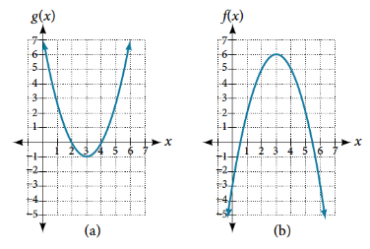
Evaluating Composite Functions Using Graphs
How To:
Given a composite function and graphs of its individual functions, evaluate it using the information provided by the graphs.
Locate the given input to the inner function on the x-axis of its graph.
Read off the output of the inner function from the y-axis of its graph.
Locate the inner function output on the x- axis of the graph of the outer function.
Read the output of the outer function from the y-axis of its graph. This is the output of the composite function.
Try It:
Using Figure, evaluate g(f(2)).

Slide 12
Evaluating Composite Functions Using Formulas
How To:
Given a formula for a composite function, evaluate the function.
Evaluate the inside function using the input value or variable provided.
Use the resulting output as the input to the outside function.
Try It: Given f(t) = t² − t and h(x) = 3x + 2 , evaluate
h(f(2))
h(f(−2))

Slide 13
Finding the Domain of a Composite Function
DOMAIN OF A COMPOSITE FUNCTION
The domain of a composite function f(g(x)) is the set of those inputs x in the domain of g for which g(x) is in the domain of f.
How To:
Given a function composition f(g(x)), determine its domain.
Find the domain of g.
Find the domain of f.
Find those inputs x in the domain of g for which g(x) is in the domain of f. That is, exclude those inputs x from the domain of g for which g(x) is not in the domain of f. The resulting set is the domain of f ∘ g.

Slide 14
Finding the Domain of a Composite Function try it
Try It:
Find the domain of (f ∘ g)(x) where $f(x) = \frac{1}{x−2 }$ and $g(x) =\sqrt{x+4}$

Slide 15
Decomposing a Composite Function into its Component Functions
Try It: Write $f(x) = \frac{4}{3−\sqrt{4+x2}}$ as the composition of two functions.

Slide 16
Chapter 3 functions
Section 3.5 – transformation of functions

Slide 17
Section 3.5 Learning Objectives
In this section students will:
Graph functions using vertical and horizontal shifts.
Graph functions using reflections about the x-axis and the y-axis.
Determine whether a function is even, odd, or neither from its graph.
Graph functions using compressions and stretches.
Combine transformations.

Slide 18
3.5 Transformation of functions Graphing Functions Using Vertical and Horizontal Shifts
VERTICAL SHIFT
Given a function f(x), a new function g(x) = f(x) + k , where k is a constant, is a vertical shift of the function f(x). All the output values change by k units. If k is positive, the graph will shift up. If k is negative, the graph will shift down.
HORIZONTAL SHIFT
Given a function f, a new function g(x) = f(x − h), where h is a constant, is a horizontal shift of the function f. If h is positive, the graph will shift right. If h is negative, the graph will shift left.

Slide 19
Transformation of functions Graphing Functions Using Vertical and Horizontal Shifts
Example Adding a Constant to a Function
$g(x)=f(x)−2$ $g(x)=f(x−2)$

Slide 20
Graphing Functions Using Vertical and Horizontal Shifts example
Example Shifting a Tabular Function Vertically
A function f (x) is given in the table below.
Create a table for the function $g\left(x\right)= f \left(x\right)+ 3.$
Create a table for the function g(x) = f(x + 3).

Slide 21
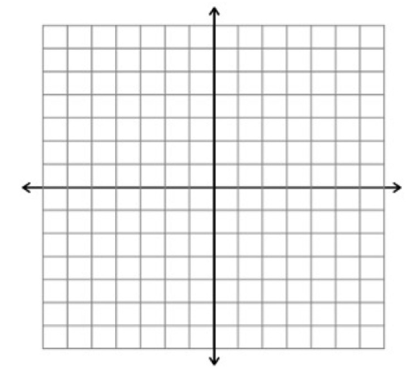
Graphing Functions Using Vertical and Horizontal Shifts
Given the function f(x) = √x, graph the original function f(x) and the transformation g(x) = f(x + 2) on the same axes. Is this a horizontal or a vertical shift? Which way is the graph shifted and by how many units?

Slide 22
Combining vertical and horizontal shifts
How To:
Given a function and both a vertical and a horizontal shift, sketch the graph.
Identify the vertical and horizontal shifts from the formula.
The vertical shift results from a constant added to the output. Move the graph up for a positive constant and down for a negative constant.
The horizontal shift results from a constant added to the input. Move the graph left for a positive constant and right for a negative constant.
Apply the shifts to the graph in either order.

Slide 23
Combining vertical and horizontal shifts example
Example Graphing Combined Vertical and Horizontal Shifts
Given $f(x) = \sqrt{x}$, sketch a graph of$h\left(x\right)= \sqrt{x−1}+ 3.$

Slide 24
Combining vertical and horizontal shifts
Example Identifying Combined Vertical and Horizontal Shifts
Write a formula for the graph shown below, which is a transformation of $f(x) = x^{2}$.

Slide 25
Combining vertical and horizontal shifts try it
Try It: Given f(x) = |x|, sketch a graph of h(x) = f(x − 2) + 4.

Slide 26
Combining vertical and horizontal shifts try it
Try It: Write a formula for a transformation of the toolkit reciprocal function $f(x) = \frac{1}{x}$ that shifts the function’s graph one unit to the right and one unit up.

Slide 27
Graphing Functions Using Reflections about the Axes
REFLECTIONS
Given a function f(x), a new function g(x) = −f(x) is a vertical reflection of the function f(x), sometimes called a reflection about (or over, or through) the x-axis.
Given a function f(x), a new function g(x) = f(−x) is a horizontal reflection of the function f(x), sometimes called a reflection about the y-axis.
How To:
Given a function, reflect the graph both vertically and horizontally.
Multiply all outputs by –1 for a vertical reflection. The new graph is a reflection of the original graph about the x-axis.
Multiply all inputs by –1 for a horizontal reflection. The new graph is a reflection of the original graph about the y-axis.

Slide 28
Graphing Functions Using Reflections about the Axes try it
Try It: Reflect the graph off(x)=∣x−1∣ (a) vertically and (b) horizontally.

Slide 29
Graphing Functions Using Reflections about the Axes example
A function f(x) is given as Table. Create a table for the functions below.
g(x) = − f(x)
h(x) = f(− x)

Slide 30
Graphing Functions Using Reflections about the Axes try it 2
Try It: Given the toolkit function f(x) = x², graph g(x) = − f(x) and h(x) = f(−x). Take note of any surprising behavior for these functions.

Slide 31
Graphing Functions Using Stretches and Compressions
VERTICAL STRETCHES AND COMPRESSIONS
Given a function f(x), a new function g(x) = a f(x), where a is a constant, is a vertical stretch or vertical compression of the function f(x).
If a > 1, then the graph will be stretched.
If 0 < a < 1, then the graph will be compressed.
If a < 0, then there will be combination of a vertical stretch or compression with a vertical reflection.

Slide 32
Graphing Functions Using Stretches and Compressions (Cont.)
Given a function, graph its vertical stretch.
Identify the value of a.
Multiply all range values by a.
If a > 1, the graph is stretched by a factor of a.
If 0 < a < 1, the graph is compressed by a factor of a.
If a < 0, the graph is either stretched or compressed and also reflected about the x-axis

Slide 33
Graphing Functions Using Stretches and Compressions try it
How To:
Given a tabular function and assuming that the transformation is a vertical stretch or compression, create a table for a vertical compression.
Determine the value of a.
Multiply all of the output values by a.
Try It:
A function f is given as Table. Create a table for the function g(x) = $\frac{3}{4}$f(x).

Slide 34
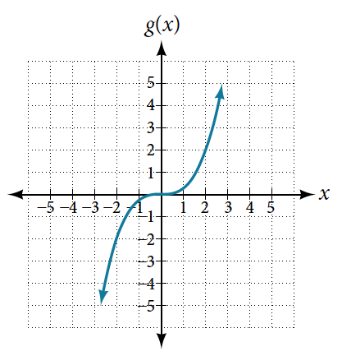
Graphing Functions Using Stretches and Compressions try it 2
Try It: Write the formula for the function that we get when we stretch the identity toolkit function by a factor of 3, and then shift it down by 2 units.

Slide 35
Performing a Sequence of Transformations
COMBINING TRANSFORMATIONS
When combining vertical transformations written in the form a f(x) + k, first vertically stretch by a and then vertically shift by k.
Horizontal and vertical transformations are independent. It does not matter whether horizontal or vertical transformations are performed first.
Example Finding a Triple Transformation of a Tabular Function
Given Table 15 for the function f (x), create a table of values for the function $g\left(x\right)=−3f\left(x\right)−2.$

Slide 36
Graphing Functions Using Reflections about the Axes example 2
Example Multiple transformations
Sketch a graph of $h(x)=−2∣ x−4∣+3$

Slide 37
Combining vertical and horizontal shifts example
Example Identifying Combined Vertical and Horizontal Shifts
Write a formula for the graph shown below, which is a transformation of $f\left(x\right)=\left|x\right|.$

Slide 38
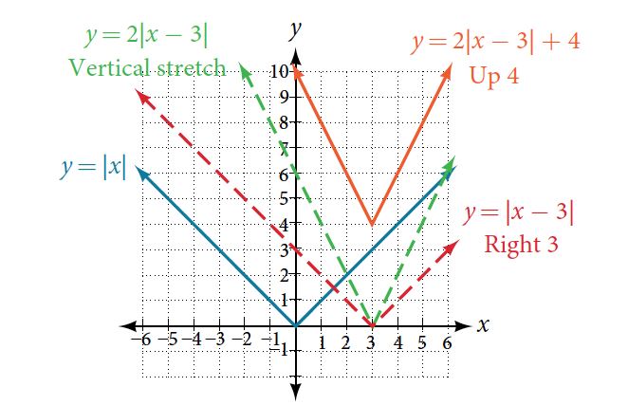
Graphing an Absolute Value Function
The most significant feature of the absolute value graph is the corner point at which the graph changes direction.

Slide 39
Solving an Absolute Value Equation
SOLUTIONS TO ABSOLUTE VALUE EQUATIONS
For real numbers A and B, an equation of the form |A|=B, with B ≥ 0, will have solutions when A = B or A = −B.
If B < 0, the equation |A|=B has no solution.
Given the formula for an absolute value function, find the horizontal intercepts of its graph.
Isolate the absolute value term.
Use |A| = B to write A = B or −A = B, assuming B > 0.
Solve for x.

Slide 40
Solving an Absolute Value Equation example
For the function f(x) = |x−1|−3, find the values of x such that f(x) = 0.

Slide 41
Determining Even and Odd Functions
EVEN AND ODD FUNCTIONS
A function is called an even function if for every input x
f(x) = f(−x)
The graph of an even function is symmetric about the y-axis.
A function is called an odd function if for every input x
f(x) = −f(−x)
The graph of an odd function is symmetric about the origin.
How To:
Given the formula for a function, determine if the function is even, odd, or neither.
Determine whether the function satisfies f(x) = f(−x). If it does, it is even.
Determine whether the function satisfies f(x) = −f(−x). If it does, it is odd.
If the function does not satisfy either rule, it is neither even nor odd.

Slide 42
Determining Even and Odd Functions examples
Example Determining whether a Function Is Even, Odd, or Neither
Are the functions even, odd, or neither?
a. $f\left(x\right)=2x−x^{3}$
b. $g\left(x\right)=3x^{4}$
c. $h\left(x\right)=x^{3}+1$

Slide 43
Determining Even and Odd Functions try it
Try It: Is the function f(s) = s⁴ + 3s² + 7 even, odd, or neither?

Slide 44
Chapter 3 functions
Section 3.7 – inverse functions

Slide 45
Section 3.7 Learning Objectives
In this section students will:
Verify inverse functions.
Determine the domain and range of an inverse function, and restrict the domain of a function to make it one-to-one.
Find or evaluate the inverse of a function.
Use the graph of a one-to-one function to graph its inverse function on the same axes.

Slide 46
3.7 Inverse functions
INVERSE FUNCTION
For any one-to-one function f(x) = y, a function f⁻¹(x) is an inverse function of f if f⁻¹(y) = x. This can also be written as f⁻1(f(x)) = x for all x in the domain of f. It also follows that f(f⁻1(x)) = x for all x in the domain of f⁻¹ if f⁻¹ is the inverse of f.
The notation f⁻¹ is read “f inverse.” Like any other function, we can use any variable name as the input for f⁻¹, so we will often write f⁻¹(x), which we read as “f inverse of x.” Keep in mind that
$$f−1\left(x\right)≠ \frac{1}{f\left(x\right) }$$
and not all functions have inverses.
Example Identifying an Inverse Function for a Given Input-Output Pair
If for a particular one-to-one function f (2) = 4 and f (5) = 12, what are the corresponding input and output values for the inverse function?

Slide 47
Verifying That Two Functions Are Inverse Functions
Given that h⁻¹(6)=2, what are the corresponding input and output values of the original function h?

Slide 48
Verifying That Two Functions Are Inverse Functions example
How To:
Given two functions f(x) and g(x), test whether the functions are inverses of each other.
Determine whether f(g(x)) = x or g(f(x)) = x.
If either statement is true, then both are true, and g = f⁻¹ and f = g⁻¹. If either statement is false, then both are false, and g ≠ f⁻¹ and f ≠ g⁻¹.
Example Testing Inverse Relationships Algebraically
If $f \left(x\right)=−3x +5$and $g (x) = \frac{x−5}{−3},$is $g = f^{−1}$?

Slide 49
Verifying That Two Functions Are Inverse Functions
Try It: If f(x) = x³ − 4 and $g(x) = \sqrt[3]{x + 4}$, is g = f⁻¹?

Slide 50
Verifying That Two Functions Are Inverse Functions example 2
Example Determining Inverse Relationships for Power Functions
If $f(x) = x^{5}$and $g(x) = \frac{1}{5} x$, is $g = f^{−1}$?

Slide 51
Verifying That Two Functions Are Inverse Functions try it
Try It: If f(x) = (x−1)³ and $g(x) = \sqrt[3]{x}+1$, is g = f⁻¹?

Slide 52
Finding Domain and Range of Inverse Functions
DOMAIN AND RANGE OF INVERSE FUNCTIONS
The range of a function f(x) is the domain of the inverse function f⁻¹(x).
The domain of f(x) is the range of f⁻¹(x).
How To:
Given a function, find the domain and range of its inverse.
If the function is one-to-one, write the range of the original function as the domain of the inverse, and write the domain of the original function as the range of the inverse.
If the domain of the original function needs to be restricted to make it one-to-one, then this restricted domain becomes the range of the inverse function.

Slide 53
Finding and Evaluating Inverse Functions
Try It: The domain of function f is (1,∞) and the range of function f is (−∞,−2). Find the domain and range of the inverse function.
Try It: Using Table, find and interpret (a) f(60), and (b) f⁻1(60)

Slide 54
Finding and Evaluating Inverse Functions try it
How To:
Given the graph of a function, evaluate its inverse at specific points.
Find the desired input on the y-axis of the given graph.
Read the inverse function’s output from the x-axis of the given graph.
Try It: Using the graph in Figure, (a) findg⁻¹(1), and (b) estimate g⁻¹(4).

Slide 55
Finding Inverses of Functions Represented by Formulas
Example Solving to Find an Inverse Function
Find the inverse of the function $f\left(x\right)= \frac{1}{3}x−5$.

Slide 56
Finding Inverses of Functions Represented by Formulas example
Example Solving to Find an Inverse with Radicals
Find the inverse of the function $f\left(x\right)=x^{3}−2$.

Slide 57
Finding Inverses of Functions Represented by Formulas try it
Try It: What is the inverse of the function f(x) = 2 − √x? State the domains of both the function and the inverse function.

Slide 58
Finding Inverse Functions and Their Graphs
Example Finding the Inverse of a Function Using Reflection about the Identity Line
Given the graph of f (x) below sketch a graph of f ⁻¹(x).

Slide 59
Acknowledgements
The original PowerPoint file is copyright 2016, Rice University. All Rights Reserved.
This work is a derivative of a text by OpenStax, which is licensed under a Creative Commons Attribution License 4.0 license.
Material on this PowerPoint was adapted from Abramson, Jay. “Chapter 3: Functions.” College Algebra. OpenStax College Algebra, College Algebra. OpenStax CNX. May 30, 2019 http://cnx.org/contents/9b08c294-057f-4201-9f48-5d6ad992740d@8.73.
This document has been reviewed for accessibility.

