Slide 1
Solar Sense: Sun Angle & Radiant Energy
Science Standards: SC.8.11.6.A
Rylan Cheney, Deb Harkless, Alison Kluthe

Slide 2
Height / Shadows, Sun Angle, Sunrise / Sunset Times
year-long observations, measurements,
data collection, and graphing

Slide 3
Procedure
measure beginning- and end-of-year height in cm
monthly . . .
measure Sun angle
measure length of shadow in cm
determine hours and minutes of daylight

Slide 4
Materials
200 cm tape measure (on classroom wall)
index cards
pencils
Sun angle measurers (specialized protractor)
100 cm tape measures
data pages
graph paper

Slide 5
Data Page

Slide 6
Data Page--sample

Slide 7
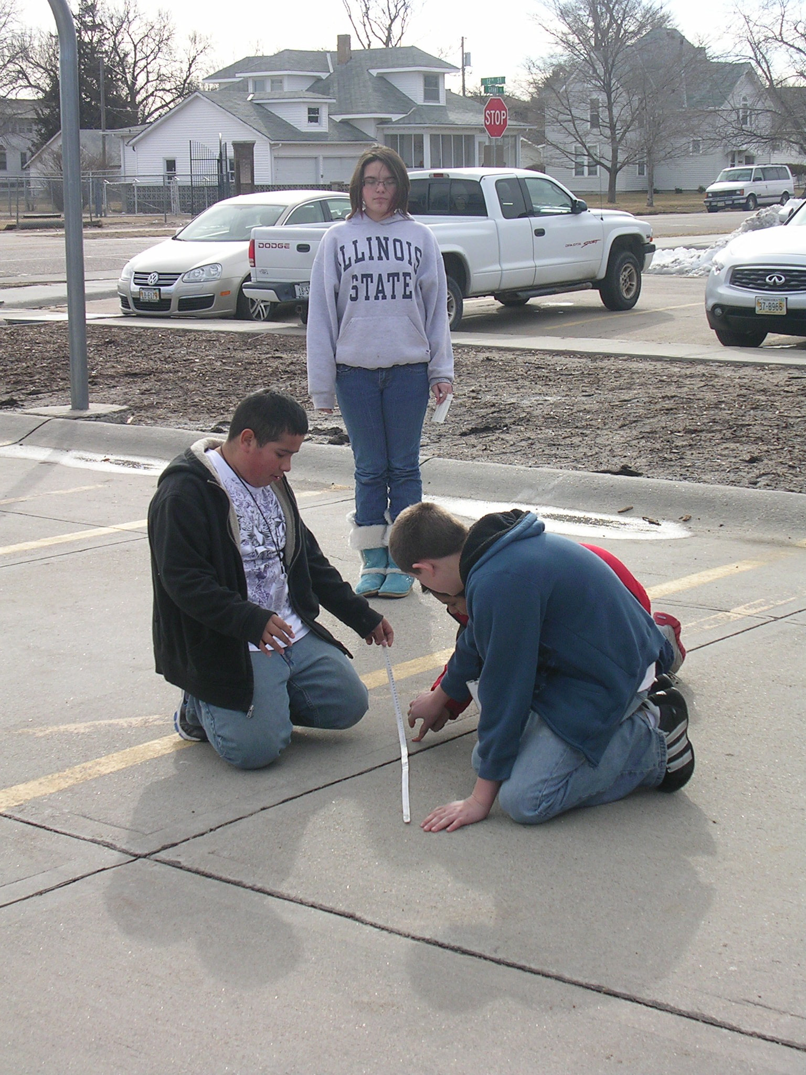
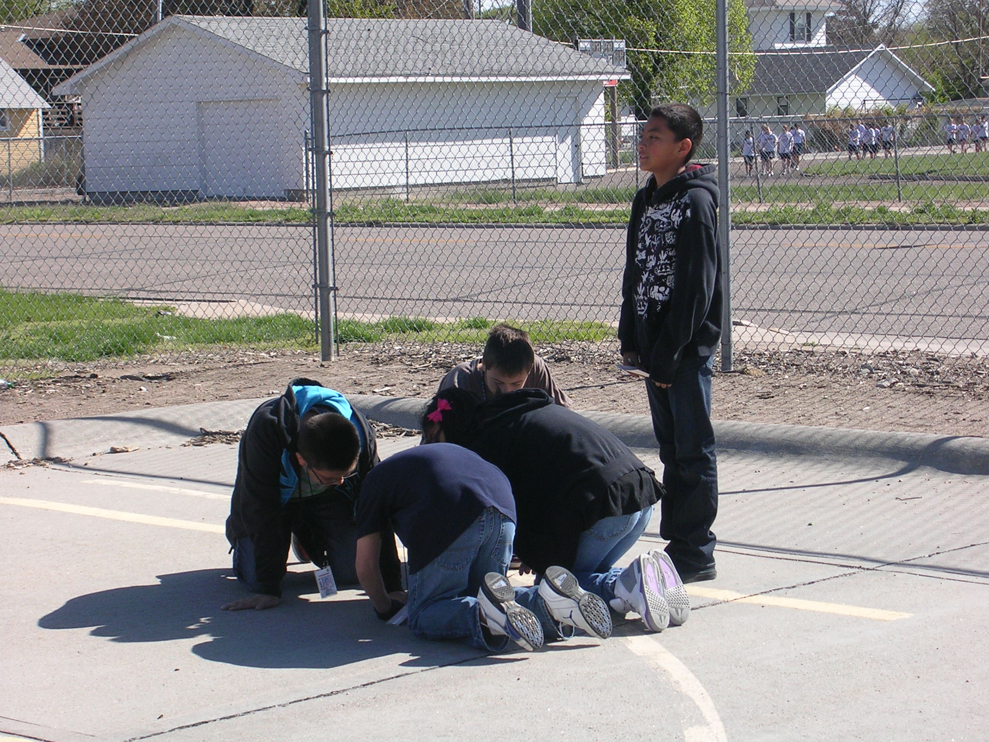
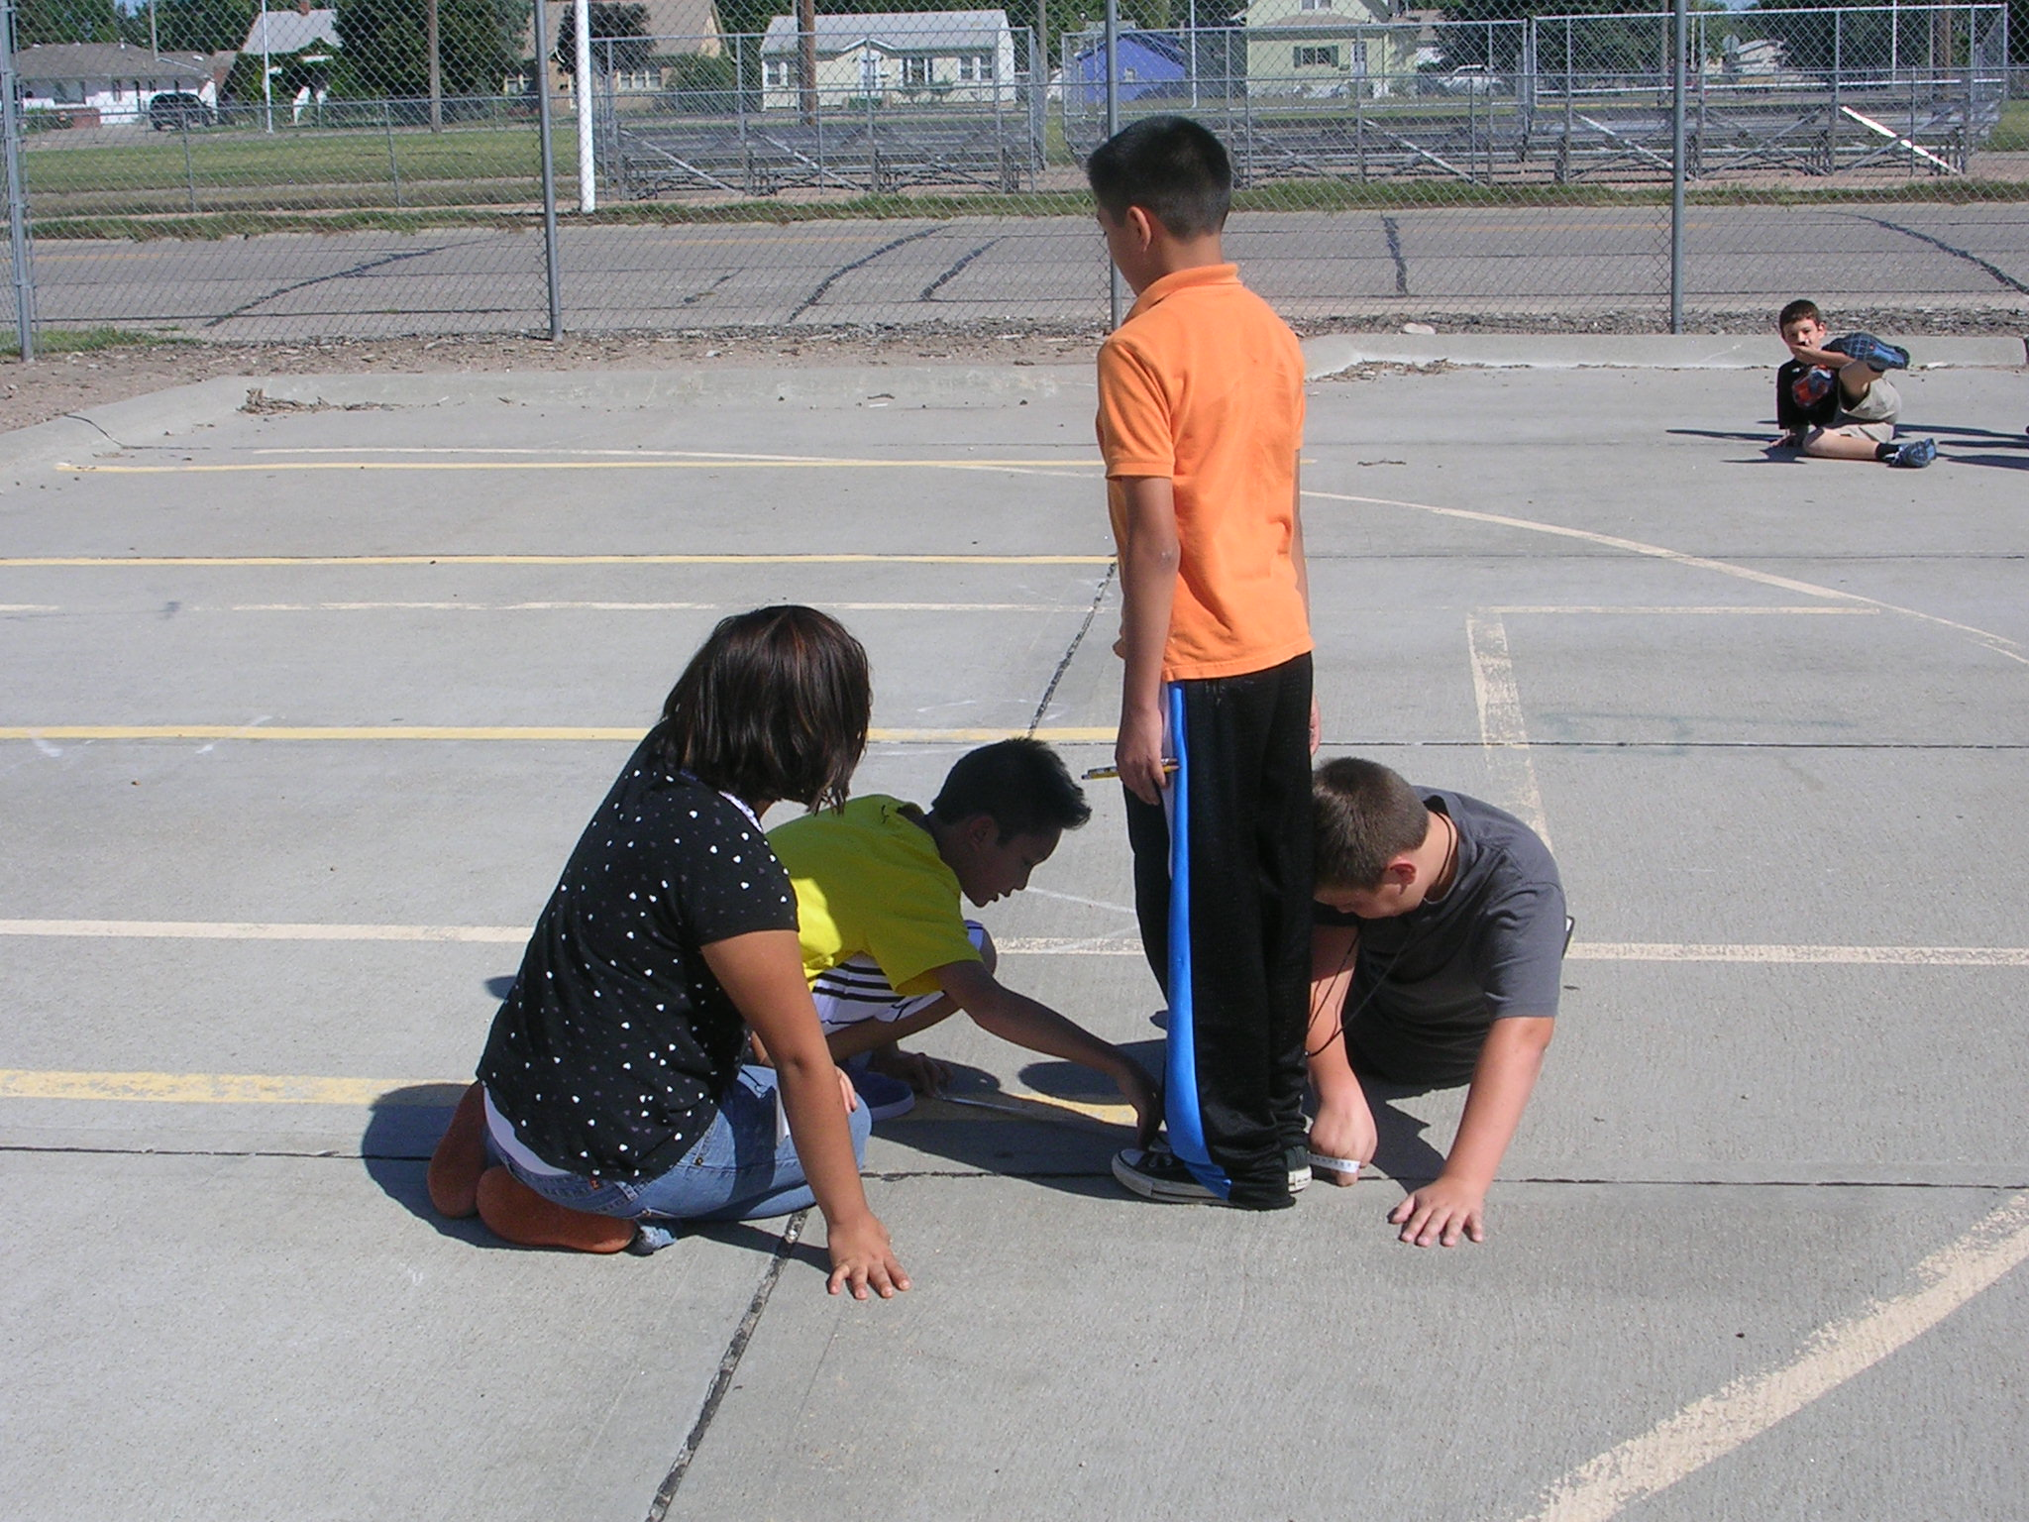
Measuring shadows . . .

Slide 9
Height & Shadows graph

Slide 11
Sun angle measurer . . .

Slide 12
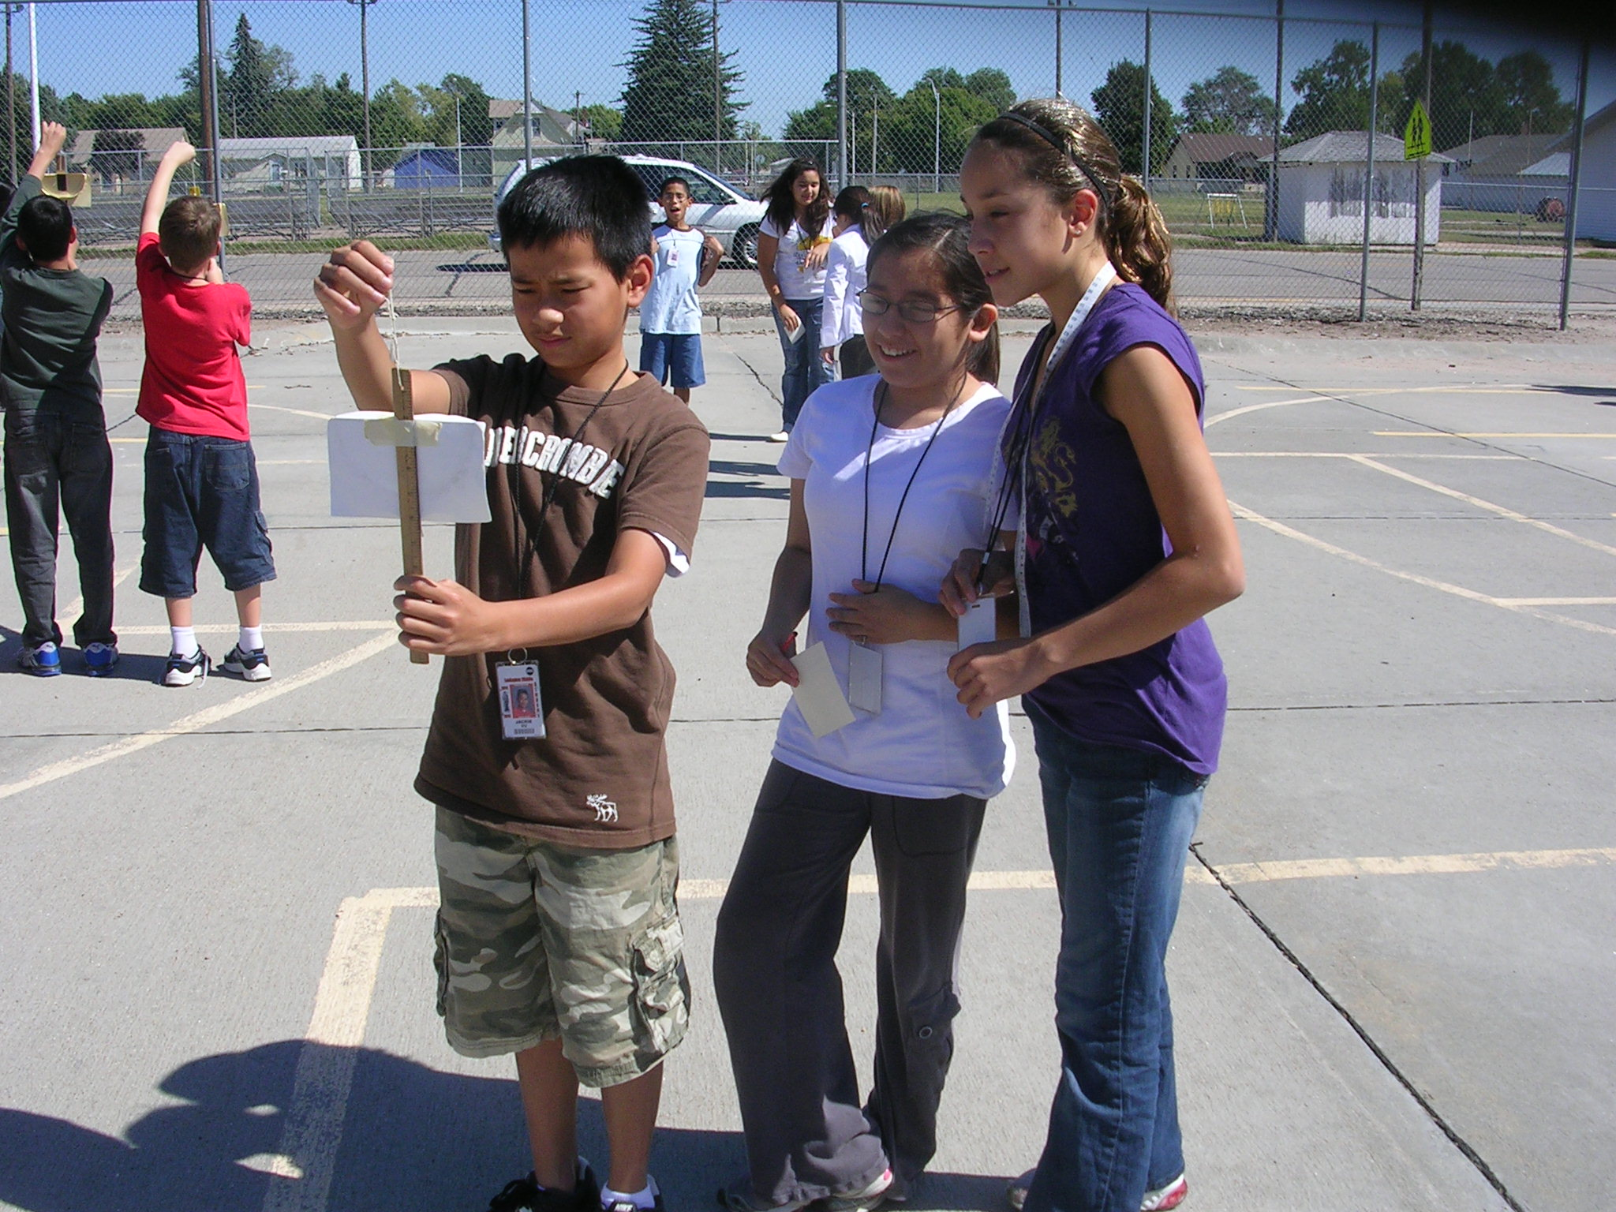
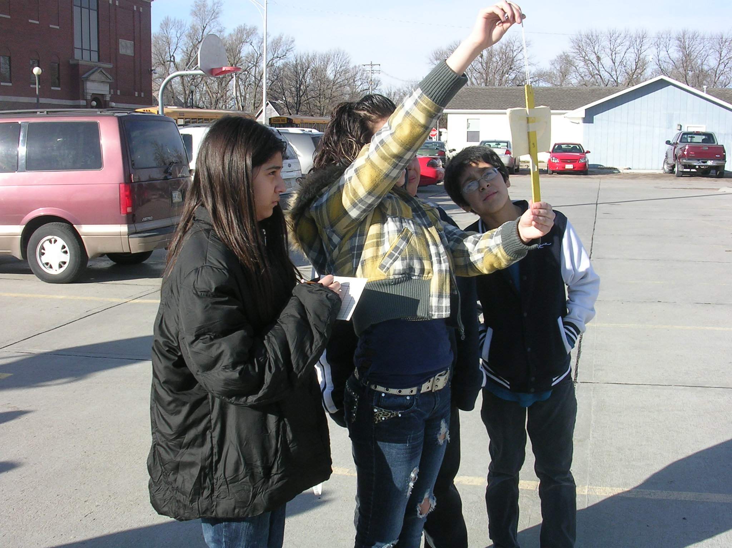
Measuring Sun Angles . . .

Slide 13
Sun Angle graph

Slide 16
What causes Earth’s Seasons?
Earth’s rotation causes day and night, but another important motion is Earth’s yearly revolution around the sun. If Earth’s orbit was a circle it would maintain a constant distance from the sun. But this is not the case. The sun is closest to the earth Jan. 3rd and farthest from the earth July 6th. The earth’s elliptical orbit does not cause the seasons.
john-daly.com

Slide 17
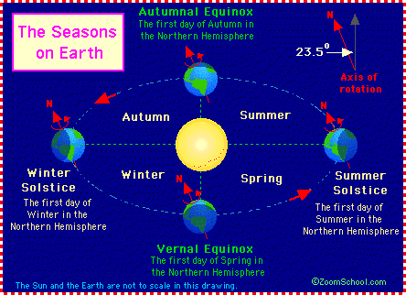
A Tilted Axis
enchantedlearning.com

Slide 18
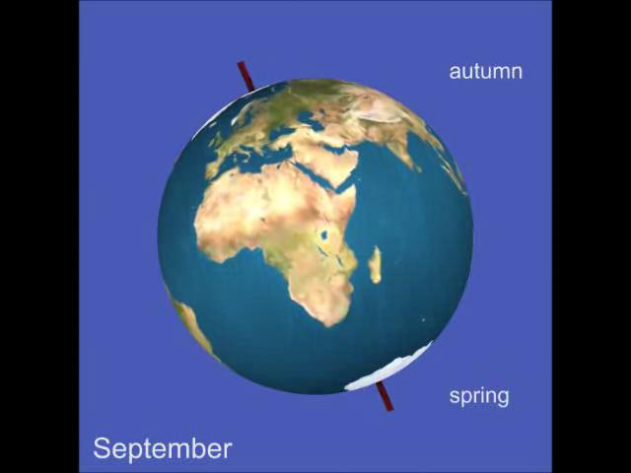
A Tilted Axis
Earth’s axis is tilted 23.5° from a line drawn perpendicular to the plane of its orbit.
It is this tilt that causes seasons.
en.wikipedia.org

Slide 19
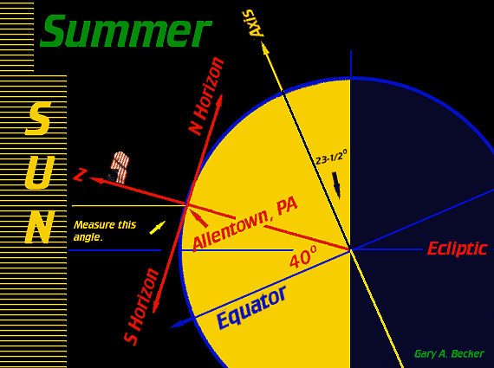
A Tilted Axis
Daylight hours are longer for the hemisphere tilted toward the sun.
The longer period of sunlight per day is one reason summer is warmer than winter, but not the only reason.
astronomy.org

Slide 20
Radiation from the sun
The earth’s tilt causes the sun’s radiation to strike the hemispheres at different angles.
The hemisphere tilted toward the sun receives more direct rays, while the hemisphere tilted away from the sun receives less direct or indirect rays.
The Direct sun radiation delivers more energy to the surface of the earth.

Slide 21
Thanks for attending Solar Sense! Rylan, Deb, and Alison

