Slide 1
Table Etiquette
Clarissa Gillham l Hastings Public Schools l Hastings, NE

Slide 2
Why is it Important?
Setting a table makes the food that is served appearance change.
Setting a table can set the tone of the meal.
By setting a table, the people feel important.
Eating with proper table etiquette makes it more pleasant for everyone involved.
How you eat reflects part of your personality to others.

Slide 3
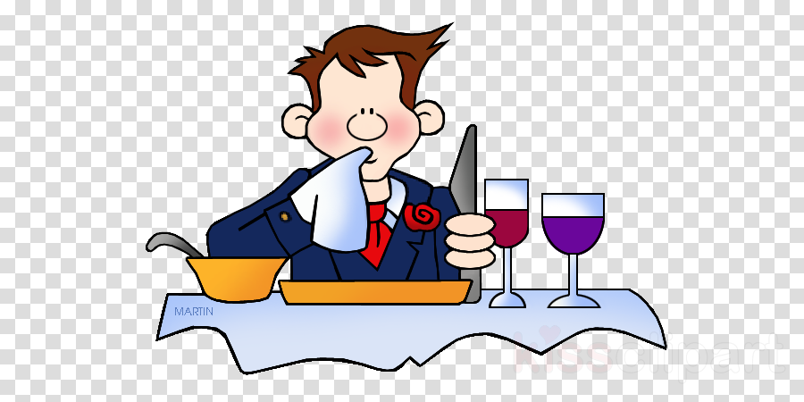
Table Etiquette
Defined as courtesy shown by good manners at a meal.
There are many table etiquette rules, some you already know while others are more refined depending on the situation.
Can differ from country to country
Most rules of etiquette involve common sense and consideration of those around you!

Slide 4
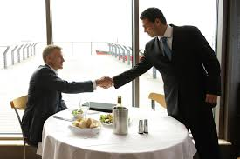
When You Might Use Table Etiquette…
Job interview
Scholarship meal
Date
Special Event
Every day!

Slide 5
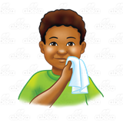
Etiquette Rules
When sitting down…
Sit down from the left side of the chair
Men should pull out the chair for the women
Napkin…
Place on your lap before starting to eat (some restaurants do this for you)
Cover your mouth or nose with it if you must cough or sneeze
If you have to leave the table, place your napkin on your chair if you are returning.
When finished eating, leave it to the left of the plate.

Slide 6
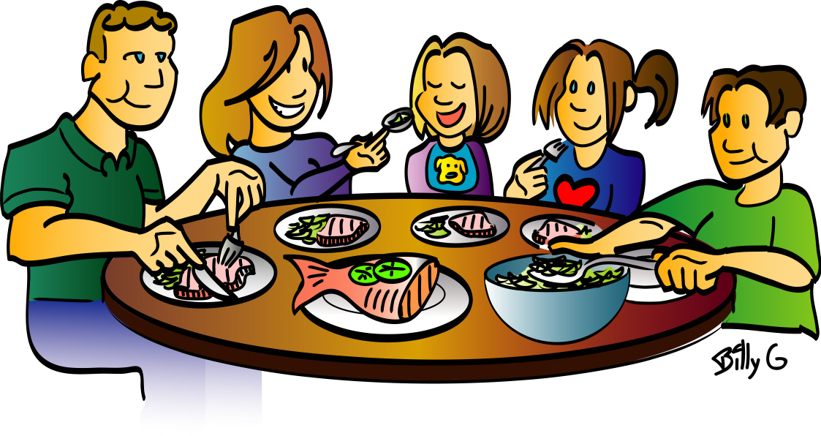
Etiquette Rules
When eating with a group…
Wait until everyone is served before you start to eat
Always follow the actions of the host/hostess
Avoid talking with food in your mouth
Chew with your mouth closed
If a utensil can be used, use it
Never place used flatware on the tablecloth
Never place food on the table

Slide 7
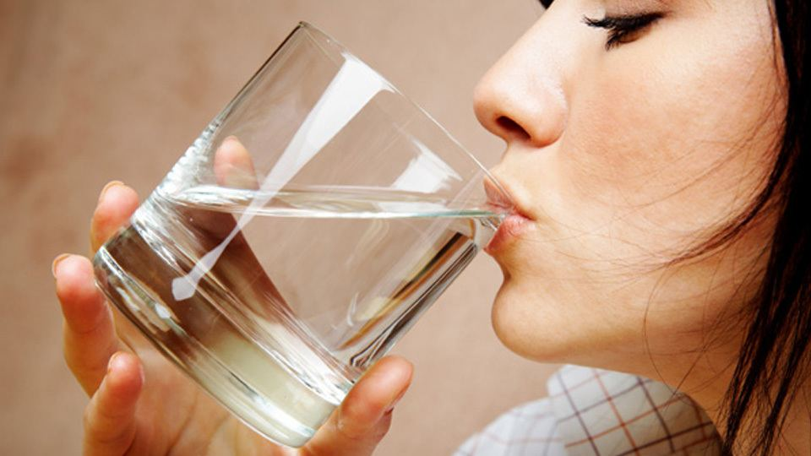
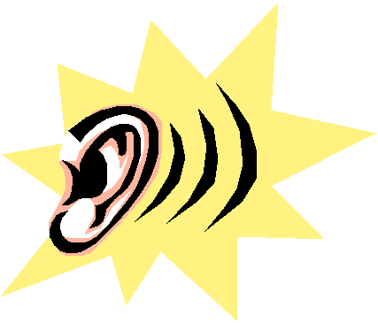
Etiquette Rules
Sit up straight in your chair with your feet flat on the floor
Avoid leaning on your elbow(s) while eating
Cut your food into bite-size pieces
One piece at a time, not all at once
Hold your class near the base
Do not make sipping or slurping sounds

Slide 8
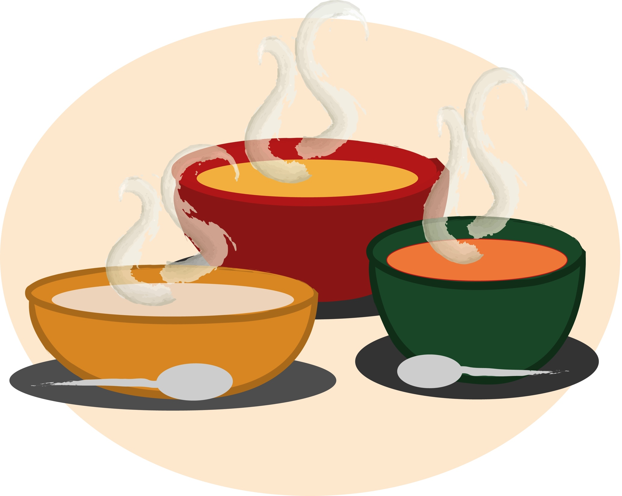
Etiquette Rules
When eating soup…
Scoop towards the back of the bowl
Place soup spoon on the soup plate
When eating a roll/bread…
Break off one piece at a time, butter that piece, then eat
If you want butter or jelly, place it on your own plate before putting it on your roll/bread
If food that you do not like is served to you, eat what you can.
When finished, leave your plate where it is, do not push it back.

Slide 9
Etiquette Rules
Tipping
15-20% of the total bill
Cost of food
Follow the host/hostess
If they order something more expensive, you do the same
DO NOT OFFEND THE HOST/HOSTESS
Do not assume that your bill will be covered, be ready to pay if needed.

Slide 10
Etiquette Rules
Cell Phones
Turn your cell phone to silent or off
Do not check your phone
If you are expecting a call for an emergency, let everyone know ahead of time.
Excuse yourself from the table if this call comes.
When talking on your phone, keep your voice down and find a private place.

Slide 11
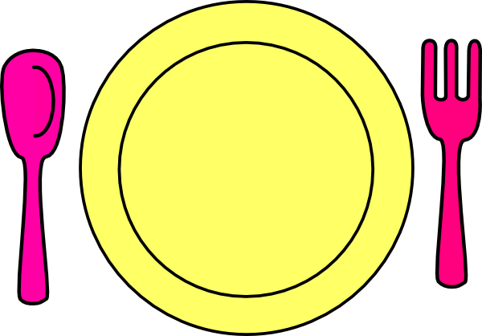
Parts of a Place Setting
What is a place setting?
Arrangement of a place setting for once person (roughly 20-24 inches in width).
Dinnerware
Plates, cups, bowls, platters, saucers, etc.
Flatware
Spoons, forks, and knives
Glassware
Goblets, glasses, and stemware

Slide 12
Dinnerware Components & Placement
Dinner Plate
1 inch from the edge of the table
Salad Plate
Above and to the left of the dinner plate
Above the napkin
Bread/Butter Plate
Above and to the left of the dinner plate
Above the salad plate
Soup Bowl
Served on top of the dinner plate or is served first, before plate is put on the table
Notes:
** an estimate of an inch is from the top of your thumb to your first knuckle

Slide 13
Flatware Components & Placement
Flatware needs to be placed in line with the dinner plate or ½ inch above the bottom of the plate with handles lined up evenly.
Forks
Left of the dinner plate
Dessert fork placed above the center of the plate
Knives and Spoons
Right of the dinner plate
Dessert spoon placed above the center of the plate
Arrange flatware in order of use
Start at the outside and work toward the center of the plate

Slide 14
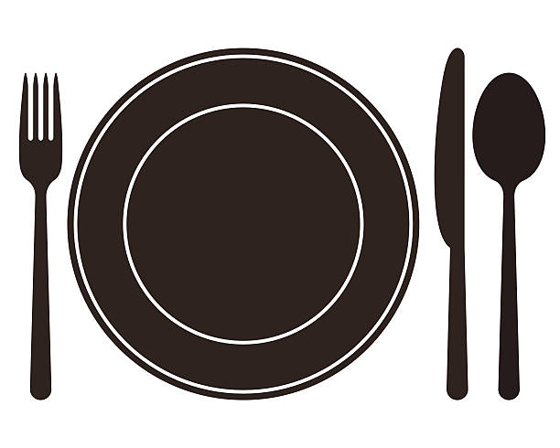
Flatware Components & Placement
Forks
Make sure the tines are up
Spoons
Make sure the bowls are up
Knives
Cutting edge faces towards the place
Butter Knife
On the bread/butter plate

Slide 15
Glassware Components & Placement
Water Goblet
Above the tip of the knife
Other Beverage Glasses
Slightly lower, to the right of the goblet and continue in a diagonal
Coffee Cup and Saucer
To the right of the Soup Spoon

Slide 16
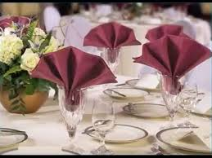
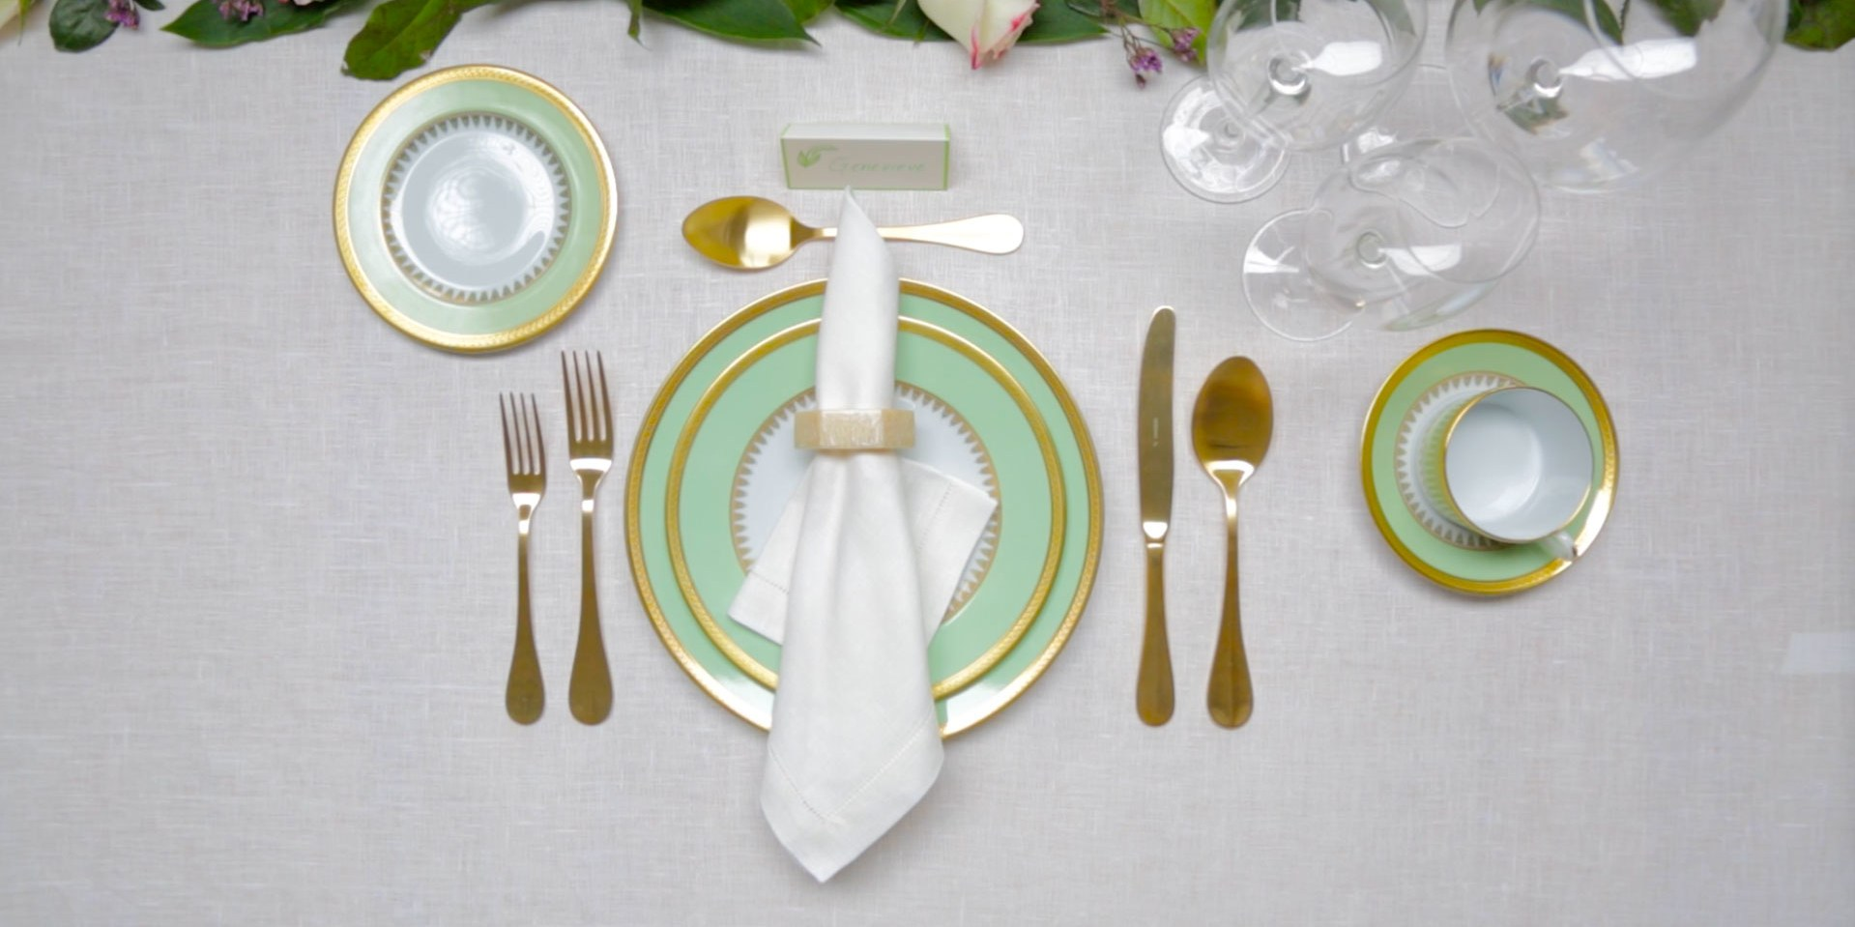
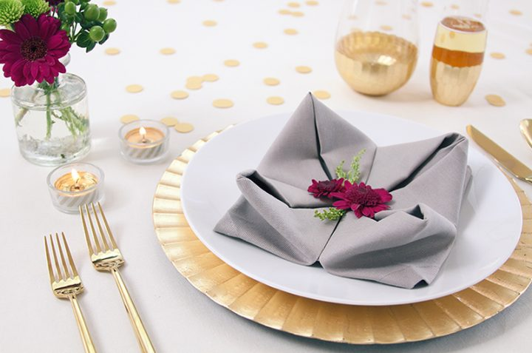
Where Does the Napkin Go?
There are three places the napkin can go:
To the left of the forks
On the center of the dinner plate
In the water goblet
When the napkin is removed to put on lap, it should not disturb the flatware.

Slide 17
Table Settings
There are three table settings:
Casual/Informal
Formal
Buffet

Slide 18
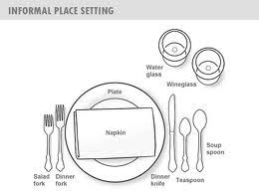

Slide 19
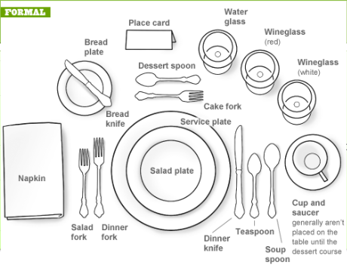

Slide 20
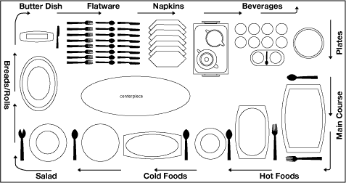
Buffet

Slide 21
Napkin Folding Activity
Classic Napkin Fold
Pocket Napkin Fold
Ring Napkin Fold
Accordion Napkin Fold
Tulip Napkin Fold
Snowflake Napkin Fold

