Slide 1
Chemistry: Atoms First
Chapter 9 Thermochemistry
PowerPoints Image Slideshow
Declaration: This set of slides has been adapted for a science-major General Chemistry course from Chemistry: atom first (Openstax) and other various Open Education Resources. Main sources for this set of slides are: 1) Chemistry: atom first (Openstax ); 2) Chemistry LibreTexts Library; 3) Wikipedia commons; 4) US- Energy information administration.. Various links to online available resources are included in the text.
Franco Pala, Ph.D.
Bridgewater State University
fpala@bridgew.edu

Slide 2
Thermodynamics and thermochemistry?
Thermodynamics study the transfer of energy between the system and its surroundings.
In thermodynamics the universe is divided in two parts: The system and surroundings
the system is the portion of the universe that we are studying.
The surroundings is the environment that is around our system, in other words the remaining part of the universe.
Energy transfer
SURROUNDINGS
https://commons.wikimedia.org/wiki/File:System_boundary.svg

Slide 3
Thermodynamics System
Source:https://commons.wikimedia.org/wiki/File:Water_bottle_with_handle.tif
The system is the portion of the universe that we are studying: it can be the water in our bottle, the engine of our car, or the battery of our car or cellphone, or can also be a the pond near our home of one cell of our body.
https://upload.wikimedia.org/wikipedia/commons/thumb/e/ee/Photo-CarBattery.jpg/800px-Photo-CarBattery.jpg
Wikipedia / commons A pond in Swarzynice, Poland/ Source Own workAuthor Mohylek
https://en.wikipedia.org/wiki/Cell_(biology)#/media/File:Celltypes.svg

Slide 4
The surroundings and the system’s boundary
The surroundings, i.e. the region outside the system can exchange energy with the system depending on the nature of the boundary that separate the system for the surroundings.
If the boundary allows the transfer of both matter and energy between the system and the surroundings we have an open system.
If the boundary does not allows the transfer of matter but allows transfer of energy, we have an closed system.
If the boundary does not allows neither the transfer of matter or energy, we have an isolated system.
Matter
Energy
Energy
Matter
Matter
Energy
open system
closed system
isolated system

Slide 5
Examples of system types
Cooking pan without lid
Pressure cooker
Thermos
https://commons.wikimedia.org/wiki/File:Super_Cocotte_decor_SEB-MGR_Lyon-IMG_9918.jpg
https://commons.wikimedia.org/wiki/File:Thermos.JPG
https://upload.wikimedia.org/wikipedia/commons/6/68/Copper-saucepot.jpg
Matter
Energy
Energy
Matter
Matter
Energy
open system
closed system
isolated system

Slide 6
Thermochemistry
Sliding a match head along a rough surface initiates a combustion reaction that release energy in the form of heat and light. (credit: modification of work by Laszlo Ilyes)
https://www.compoundchem.com/2014/11/20/matches/
safety matches reaction
2 P₄ + 5 KClO₄ → 2 P₄O₁₀ + 5 KCl + heat
Chemical reaction involve changes in energy as well as matter!!
Thermochemistry is the part of thermodynamic that study the transfer of energy that occur during a chemical reaction. In thermochemistry, a chemical reaction is the system of interest.
US, and global, economy largely function on the use of energy released by chemical reactions.

Slide 7
US energy consumption in 2017
https://www.eia.gov/energyexplained/?page=us_energy_home
In the United States, British thermal units (Btu), a measure of heat energy,
1 Btu = 1055.06 joule

Slide 8
Energy consumption and total primary energy production 1950-2017
The difference between the amount of total primary energy consumption and total primary energy production was mainly the energy content of net imports of crude oil.

Slide 9
Examples of energy exchanged in chemical processes
The energy involved in chemical changes is important to our daily lives: (a) A cheeseburger for lunch provides the energy you need to get through the rest of the day; (b) the combustion of gasoline provides the energy that moves your car (and you) between home, work, and school; and (c) coke, a processed form of coal, provides the energy needed to convert iron ore into iron, which is essential for making many of the products we use daily. (credit a: modification of work by “Pink Sherbet Photography”/Flickr; credit b: modification of work by Jeffery Turner)

Slide 10
Energy
Energy can be defined as the capacity to do work or supply heat
work (w) is the process of causing matter to move against an opposing force (w = F x s).
potential energy, the energy an object has because of its relative position, composition, or condition.
h
$$E_{p}=m g h$$
Water that is higher in elevation, for example, at the top of Victoria Falls, has a higher potential energy than water at a lower elevation. As the water falls, some of its potential energy is converted into kinetic energy.
If the water flows through generators at the bottom of a dam, such as the Hoover Dam shown here, its kinetic energy is converted into electrical energy. credit a: modification of work by Steve Jurvetson; credit b: modification of work by “curimedia”/Wikimedia commons
kinetic energy, the energy that an object possesses because of its motion.
$$\vec{v}$$

Slide 11
Laws of conservation of energy and conservation of mass
law of conservation of energy: during a chemical or physical change, energy can be neither created nor destroyed, although it can be changed in form. (This is also one version of the first law of thermodynamics, as you will learn later.)
Let’s consider the collision of two marbles under the assumption of an ideal collision with negligible loss of energy by heat or deformation of the marbles initial shapes
Before collision
After collision
$${\vec{v}}_{1_bf}>0$$
$${\vec{v}}_{2_bf}=0$$
$${\vec{v}}_{1_af}< {\vec{v}}_{1_bf}$$
$${\vec{v}}_{2_af}>{\vec{v}}_{2_bf}$$
$$m_{1}$$
$$m_{2}$$
$$m_{1}$$
$$m_{2}$$
$$E_{k1_bf}= \frac{1}{2} m_{1 }v_{1}^{2}$$
$$E_{k1_af}= \frac{1}{2} m_{1 }v_{2_af}^{2}$$
$$E_{k2_af}= \frac{1}{2} m_{2 }v_{2_af}^{2}$$
$$E_{k2_bf}=0$$
$$E_{k_bf}=E_{k1_bf}+E_{k2_bf}$$
$$E_{k_af}=E_{k1_af}+E_{k2_af}$$
$$E_{k_bf}=E_{k_af}$$
The law of conservation of energy is applicable to chemical reaction as we will see in the coming slides

Slide 12
Laws of conservation of energy and conservation of mass
The law of conservation of energy recall us the law of conservation of matter :
there is no detectable change in the total amount of matter during a chemical or physical change.
Are we sure the two laws are always true? When common physical and chemical phenomena occur, the energy changes are relatively modest and the mass changes are too small to measure, so the laws of conservation of matter and energy hold well.
However, in nuclear reactions, the energy changes are much larger (by factors of a million or so), the mass changes are measurable, and matter-energy conversions are significant. To encompass both chemical and nuclear changes, we combine these laws into one statement:
The total quantity of matter and energy in the universe is fixed.

Slide 13
Thermal energy = f (temperature)
Thermal energy is kinetic energy associated with the random motion of atoms and molecules.
Temperature is a quantitative measure of “hot” or “cold.”
If no chemical reaction or phase change occurs, increasing the amount of thermal energy in a sample of matter will cause its temperature to increase. And, decreasing the amount of thermal energy in a sample of matter will cause its temperature to decrease
(a) The molecules in a sample of hot water move more rapidly than (b) those in a sample of cold water.
When the atoms and molecules in an object are moving or vibrating quickly, they have a higher average kinetic energy (KE), and we say that the object is “hot.”
When the atoms and molecules are moving slowly, they have lower average KE, and we say that the object is “cold”
Thermal Energy = f(Temperature)

Slide 14
Volume = f (temperature)
Most substances expand as their temperature increases and contract as their temperature decreases.
In an alcohol or mercury thermometer, the liquid (dyed red for visibility) expands when heated and contracts when cooled, much more so than the glass tube that contains the liquid.
In a bimetallic thermometer, two different metals (such as brass and steel) form a two-layered strip. When heated or cooled, one of the metals (brass) expands or contracts more than the other metal (steel), causing the strip to coil or uncoil. Both types of thermometers have a calibrated scale that indicates the temperature. (credit a: modification of work by “dwstucke”/Flickr)

Slide 15
Heat (q) = transfer of thermal energy between bodies
Heat (q) is the transfer of thermal energy between two bodies at different temperatures. “Heat flow” a redundant term, but one commonly used. Heat already means “transfer of thermal energy”
Substances H and L are initially at different temperatures, and their atoms have different average kinetic energies.
When they are put into contact with each other, collisions between the molecules result in the transfer of kinetic (thermal)energy from the hotter to the cooler matter.
The two objects reach “thermal equilibrium” when both substances are at the same temperature, and their molecules have the same average kinetic energy.

Slide 16
Exothermic and endothermic reactions
Matter undergoing chemical reactions and physical changes can exchange heat. With the surrounding environment.
“Skatebiker”/ Wikimedia commons
A chemical change that releases heat is called an exothermic process.
A reaction that absorbs heat from the surrounding is an endothermic process.
An oxyacetylene torch produces heat by the combustion of acetylene in oxygen. exothermic reaction
Der-Wir-Ing, SVG by Majo statt Senf - Created with Affinity Designer - Own work based on: Brennschneiden.png/ Wikimedia commons
2 C₂H₂ + 5 O₂
4 CO₂ + 2 H₂O + Heat
Oxy-acetylene cutting
A cold pack uses an endothermic process to create the sensation of cold.
NH₄NO₃ (s) + H₂O + Heat
NH₄⁺(aq) + NO₃⁻(aq)

Slide 17
Energy unit conversion
Historically, energy was measured in units of calories (cal).
One calorie is the amount of energy required to raise one gram of water by 1 degree C (1 kelvin).
However, this quantity depends on the atmospheric pressure and the starting temperature of the water. Careful reading the food labels: The Calorie (with a capital C), or large calorie, commonly used in quantifying food energy content, is a kilocalorie.
The SI unit of heat, work, and energy is the joule.
One joule (J) is defined as the amount of energy used when a force of 1 newton moves an object 1 meter.
1joule =1 kg m²/s² = 1 newton–meter.
A kilojoule (kJ) is 1000 joules.
To standardize its definition, 1 calorie has been set to equal 4.184 joules.
1 cal = 4.184 J
1 Btu = 1055.056 J
1 Btu = 251.996 cal

Slide 18
Heat capacity (C)
The heat capacity (C) of a body of matter is the quantity of heat (q) it absorbs or releases when the body’s temperature change (ΔT) of 1 degree Celsius (or equivalently, 1 kelvin):
C = q/ΔT (J/K)
Heat capacity is determined by both the type and amount of substance that absorbs or releases heat. It is therefore an extensive property—its value is proportional to the amount of the substance.
Due to its larger mass, a large frying pan has a larger heat capacity than a small frying pan. Because they are made of the same material, both frying pans have the same specific heat. (credit: Mark Blaser)

Slide 19
Specific heat capacity (c_{p}) and molar heat
The specific heat capacity (c_{p}) of a substance, commonly called its “specific heat,” is the quantity of heat required to raise the temperature of 1 gram of a substance by 1 degree Celsius (or 1 kelvin):
c_{p} = q / (m ΔT) (J g⁻¹ °C⁻¹)
The molar heat capacity is the heat capacity per mole of a particular substance and has units of J/mol °C
Although the large pan is more massive than the small pan, since both are made of the same material, they both yield the same value for specific heat (for the material of construction, iron).
Specific heat depends only on the kind of substance absorbing or releasing heat. It is an intensive property—the type, but not the amount, of the substance is all that matters.

Slide 20
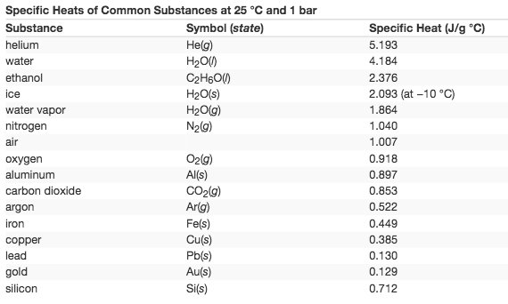
Specific heat capacity of common substances
Specific heat depends only on the kind of substance absorbing or releasing heat. It is an intensive property—the type, but not the amount, of the substance is all that matters.

Slide 21
Amount of heat (q) exchange between a substance and its surrounding
The amount of heat (q) exchange between a substance (we can call it system) and its surrounding can be calculated if mass (m) of the substance, it specific heat capacity (c_{p}) and change in temperature (ΔT) are known:
q =(specific heat)×(mass of substance)×(temperature change)
q = c_{p} × m ×ΔT = c_{p} × m × (T_{final}−Ti_{nitial})
If a substance gains thermal energy, its temperature increases: T_{final} > T_{initial} and T_{final} -T_{initial} > 0 therefore q > 0
if a substance loses thermal energy, its temperature decreases:
T_{final} < T_{initial} and T_{final} -T_{initial} < 0, therefore q < 0
.
substance gains thermal energy
substance loses thermal energy
q > 0
q < 0
system
system
T_{final} -T_{initial} > 0
T_{final} -T_{initial} < 0

Slide 22
Amount of heat (q) exchange between a substance and its surrounding
Measuring Heat
A flask containing 8.0 × 10² g of water is heated, and the temperature of the water increases from 21 °C to 85 °C. How much heat did the water absorb?
Solution
q = c_{p} × m ×ΔT = c_{p} × m × (T_{final}−T_{fnitial})
To answer this question, consider these factors:
c_{p} of water = 4.184 J/g °C,
m = 8.0 × 10² g of water
ΔT = 85 °C - 21 °C = 64 °C
q = (4.184 J/(g°C)) × (8.0x10² g) × (64°C)
q = (4.184 J/(g °C)) × (8.0x10² g) × (64 °C) = 210,000 (J) = 2.1 10⁵ (J)
Because the temperature increased, the water absorbed heat and q is positive.

Slide 23
Amount of heat (q) exchange between a substance and its surrounding
Determining Other Quantities
A piece of unknown metal weighs 348 g. When the metal piece absorbs 6.64 kJ of heat, its temperature increases from 22.4 °C to 43.6 °C. Determine the specific heat of this metal (which might provide a clue to its identity).
Solution
q = c_{p} × m ×ΔT
c_{p} = q /(m × ΔT)
To answer this question, consider these factors:
c_{p} of unknown metal = ? J/g °C,
m = 384 g
ΔT = 43.6 °C – 22.4 °C = 21.2 °C
q = 6.64 kJ = 6.64 10³ J
c_{p} = 6.64 10³ (J)/(384 (g) × 21.2 (°C)) = 0.900 J /(g °C)
c_{p} = 0.900 J /(g °C) = specific heat of aluminum, which suggests that the unknown metal may be aluminum.
q = 6.64 kJ
m = 384 g
Unknown
metal
T_{final} -T_{initial} = 21.2°C

Slide 24
Solar thermal energy power plants
Specific heat capacity is a key parameter of heat transfer fluid used in Solar thermal energy power plants.
Large-scale solar thermal plants concentrate sunlight to heat some substance; the heat “stored” in that substance is then converted into electricity
kWh/(m² day)
We will investigate the thermal energy storage system used in solar thermal energy power plants once we study enthalpy associated with the phase transition (solid←→-liquid, liquid ←→ vapor, etc). For now we focus on the specific heat capacity of heat transfer fluid .
The map shows, in the unit of kWh/(m² day) the how many kWh of solar energy we can convert in electricity conversion for each square meter per day in USA
https://www.eia.gov/energyexplained/index.php?page=solar_where

Slide 25
Solar thermal energy power plants
From the eia website:
Solar thermal power generation systems collect and concentrate sunlight to produce the high temperature heat needed to generate electricity.
All solar thermal power systems have :
solar energy collectors with two main components: reflectors (mirrors) that capture and focus sunlight onto a receiver.
In most types of systems, a heat-transfer fluid is heated and circulated in the receiver and used to produce steam.
The steam is converted into mechanical energy in a turbine, which powers a generator to produce electricity. Solar thermal power systems have tracking systems that keep sunlight focused onto the receiver throughout the day as the sun changes position in the sky.
Solar thermal power systems may also have a thermal energy storage system component that allows the solar collector system to heat an energy storage system during the day, and the heat from the storage system is used to produce electricity in the evening or during cloudy weather.
Solar thermal power plants may also be hybrid systems that use other fuels (usually natural gas) to supplement energy from the sun during periods of low solar radiation
https://www.eia.gov/energyexplained/?page=solar_thermal_power_plants#SolarPowerTowers

Slide 26
Solar thermal energy power plants
Concentrating collectors
Concentrating solar energy technologies use mirrors to reflect and concentrate sunlight onto receivers that absorb solar energy and convert it to heat. We use this thermal energy for heating homes and buildings or to produce electricity with a steam turbine or a heat engine that drives a generator

Slide 27
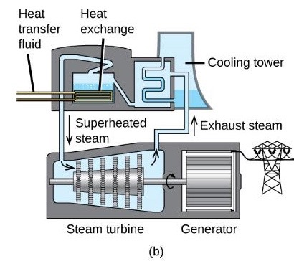
The Solana Generating Station
The Solana Generating Station in Arizona’s Sonora Desert produces 280 megawatts of electrical power. It uses parabolic mirrors that focus sunlight on pipes filled with a heat transfer fluid (HTF)
The HTF then does two things:
It turns water into steam, which spins turbines, which in turn produces electricity,
it melts and heats a mixture of salts, which functions as a thermal energy storage system. After the sun goes down, the molten salt mixture can then release enough of its stored heat to produce steam to run the turbines for 6 hours. Molten salts are used because they possess a number of beneficial properties, including high heat capacities and thermal conductivities.
This solar thermal plant uses parabolic trough mirrors to concentrate sunlight. (credit a: modification of work by Bureau of Land Management)

Slide 28
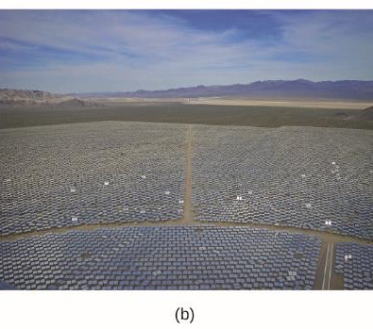
Ivanpah solar generating system
The 377-megawatt Ivanpah Solar Generating System, located in the Mojave Desert in California, is the largest solar thermal power plant in the world (Figure). Its 170,000 mirrors focus huge amounts of sunlight on three water-filled towers, producing steam at over 538 °C that drives electricity-producing turbines. It produces enough energy to power 140,000 homes. Water is used as the working fluid because of its large heat capacity and heat of vaporization.
The Ivanpah solar thermal plant uses 170,000 mirrors to concentrate sunlight on water-filled towers.
It covers 4000 acres of public land near the Mojave Desert and the California-Nevada border.(credit a: modification of work by Craig Dietrich; credit b: modification of work by “USFWS Pacific Southwest Region”/Flickr)

Slide 29
Historical curiosity: Archimedes heat ray
Image:Archimedes Heat Ray conceptual diagram.png
A legend has it that Archimedes used a "burning glass" to concentrate sunlight on the invading Roman fleet and repel them from Syracuse. In 1973 a Greek scientist, Dr. Ioannis Sakkas, curious about whether Archimedes could really have destroyed the Roman fleet in 212 BC, lined up nearly 60 Greek sailors, each holding an oblong mirror tipped to catch the sun's rays and direct them at a tar-covered plywood silhouette 49 m (160 ft) away. The ship caught fire after a few minutes; however, historians continue to doubt the Archimedes story.[19]
Artistic interpretation of Archimedes' mirror used to burn Roman ships. Painting by Giulio Parigi, c. 1599

Slide 30
Calorimetry
Calorimetry is used to measure amounts of heat transferred to or from a system.
Surroundings​
Surroundings​
q<0
System
System
q>0
In an exothermic process occurs and heat, q, is negative, indicating that thermal energy is transferred from the system to its surroundings.
In an endothermic process occurs and heat, q, is positive, indicating that thermal energy is transferred from the surroundings to the system.

Slide 31
Calorimeter
A calorimeter is a device used to measure the amount of heat involved in a chemical or physical process.
Insulating walls (the calorimeter is its self an isolated system) of the calorimeters prevent the transfer of energy between the surroundings of the system inside of the calorimeter and the remaining part of the universe. Consequently the only transfer of energy occur between the system and the surroundings inside of the calorimeter.
If mass and specific heat capacity of the surroundings are known, and ΔT of the surrounding before and after the process is accurately measured, the heat transferred during the chemical or physical process can be calculated.

Slide 32
Core idea behind calorimetry
Suppose we have a hot piece of metal (M), and cool water (W).
If we place the metal in the water, heat will flow from M to W.
The temperature of M will decrease, and the temperature of W will increase, until the M and W reach thermal equilibrium
No heat is transferred across the calorimeter’s wall
q_{M} < 0
q_{W} > 0
q_{M} + q_{W} = 0
q_{M} = - q_{W}
In a simple calorimetry process, (a) heat, q, is transferred from the hot metal, M, to the cool water, W, until (b) both are at the same temperature.

Slide 33
Simple calorimeter
A simple calorimeter can be constructed from two polystyrene cups. A thermometer and stirrer extend through the cover into the reaction mixture.

Slide 34
Commercial calorimeters
Commercial solution calorimeters range from (a) simple, inexpensive models for student use to (b) expensive, more accurate models for industry and research.

Slide 35
Heat Transfer between Substances at Different Temperatures, Example
A 360.0-g piece of rebar (a steel rod used for reinforcing concrete) is dropped into 425 mL of water at 24.0 °C. The final temperature of the water was measured as 42.7 °C. Calculate the initial temperature of the piece of rebar. Assume the specific heat of steel is approximately the same as that for iron, and that all heat transfer occurs between the rebar and the water
@ thermal equilibrium
q_{rebar} =−q_{water}
(c_{p} × m × ΔT)_{rebar}=−(c_{p}× m × ΔT)_{water}
c_{p_rebar} × m_{rebar} ×(Tf,_{rebar}−Ti,_{rebar})=−c_{p_water} x m_{water} ×(Tf,_{water}−Ti,_{water})
Specific Heats of Common Substances at 25 °C and 1 bar
Substance | Symbol (state) | Specific Heat (J/g °C)
water | H₂O(l) | 4.184
iron | Fe(s) | 0.449

Slide 36
Identifying a Metal by Measuring Specific Heat, Example
A 59.7 g piece of metal that had been submerged in boiling water was quickly transferred into 60.0 mL of water initially at 22.0 °C. The final temperature is 28.5 °C. Use these data to determine the specific heat of the metal. Use this result to identify the metal
@ thermal equilibrium
q_{metal} =−q_{water}
(c_{p} × m × ΔT)_{metal}=−(c_{p}× m × ΔT)_{water}
c_{p_metal} × m_{metal} ×(Tf,_{metal}−Ti,_{metal})=−c_{p_water} x m_{water} ×(Tf,_{water}−Ti,_{water})

Slide 37
Heat exchange by an chemical reaction
Let’s consider a chemical reaction that occur inside of calorimeter
Because energy is neither created nor destroyed during a chemical reaction, there is no overall change energy inside of the calorimeter during the reaction.
HCl(aq) + NaOH(aq)⟶NaCl(aq) + H₂O(l)
The heat exchanged in the reaction (the “system”), q_{reaction}, plus the heat absorbed or lost by the solution (the “surroundings”), q_{solution}, must add up to zero
q_{reaction} + q_{water} = 0
q_{reaction} =−q_{water}

Slide 38
Heat Produced by an Exothermic Reaction
When 50.0 mL of 1.00 M HCl(aq) and 50.0 mL of 1.00 M NaOH(aq), both at 22.0 °C, are added to a coffee cup calorimeter, the temperature of the mixture reaches a maximum of 28.9 °C. What is the approximate amount of heat produced by this reaction?
HCl(aq) + NaOH(aq)⟶NaCl(aq) + H₂O(l)
imagine that you could combine the two solutions so quickly that no reaction took place while they mixed; then after mixing, the reaction took place. At the instant of mixing, you have 100.0 mL of a mixture of HCl and NaOH at 22.0 °C. The HCl and NaOH then react until the solution temperature reaches 28.9 °C.
q_{reaction} + q_{water} = 0
q_{reaction} =−q_{water}
q_{solution}=(c ×m × ΔT)_{solution}

Slide 39
Heat Produced by an Exothermic Reaction , cont..
190123
HCl(aq) + NaOH(aq)⟶NaCl(aq) + H₂O(l)
q_{reaction} + q_{water} = 0
q_{reaction} =−q_{water}
q_{solution}=(c ×m × ΔT)_{solution}
reasonable assumptions :
Since the solution is aqueous, we can proceed as if it were water in terms of its specific heat and mass values.
The density of water is approximately 1.0 g/mL, so 100.0 mL has a mass of about 1.0 ×× 10² g (two significant figures).
The specific heat of water is approximately 4.184 J/g °C, so we use that for the specific heat of the solution.
q_{solution}=(4.184 J/g °C)(1.0 × 10² g) ( 28.9 °C − 22.0 °C)= 2.9 × 10³ J
q_{reaction}= −q_{solution} = −2.9 × 10³ J

Slide 40
Thermochemistry of hand warmers
Supersaturated solution (crystallization-type)
A reusable hand warmer contains a supersaturated solution of NaC₂H₃O₂ (sodium acetate) and a metal disc. Bending the disk creates nucleation sites around which the metastable NaC₂H₃O₂ quickly crystallizes (a later chapter on solutions will investigate saturation and supersaturation in more detail).
NaC₂H₃O₂(aq)⟶NaC₂H₃O₂(s) exothermic reaction
video :
https://en.wikipedia.org/wiki/File:Hand_warmer_activation.webm#file
Chemical hand warmers produce heat that warms your hand on a cold day. In this one, you can see the metal disc that initiates the exothermic precipitation reaction. (credit: modification of work by Science Buddies TV/YouTube)

Slide 41
Thermochemistry of hand warmers, cont..
Another common hand warmer produces heat when it is ripped open, exposing iron and water in the hand warmer to oxygen in the air.
One simplified version of this exothermic reaction
4 Fe(s)+6 O₂(g)⟶ 2 Fe2O3(s)
Salt in the hand warmer catalyzes the reaction, so it produces heat more rapidly; cellulose, vermiculite, and activated carbon help distribute the heat evenly.
https://commons.wikimedia.org/wiki/File:Handwarmers.JPG

Slide 42
Thermochemistry of cold pack
An instant cold pack consists of a bag containing solid ammonium nitrate and a second bag of water. When the bag of water is broken, the pack becomes cold because the dissolution of ammonium nitrate is an endothermic process that removes thermal energy from the water. The cold pack then removes thermal energy from your body.
NH₄NO₃ (s) + H₂O + Heat
NH₄⁺(aq) + NO₃⁻(aq)

Slide 43
bomb calorimeter
bomb calorimeter, is used to measure the energy produced by reactions that yield large amounts of heat and gaseous products, such as combustion reactions. (The term “bomb” comes from the observation that these reactions can be vigorous enough to resemble explosions that would damage other calorimeters.)
The reactants are contained in the gas-tight “bomb,” which is submerged in water and surrounded by insulating materials. (credit a: modification of work by “Harbor1”/Wikimedia commons)

Slide 44
Measuring nutritional calories
Amaunt per serving Calories 250
Calories, or nutritional calories, are used to quantify the amount of energy in foods.
One calorie (cal) = exactly 4.184 joules, and one Calorie (note the capitalization) = 1000 cal, or 1 kcal. (This is approximately the amount of energy needed to heat 1 kg of water by 1 °C.)
The food’s nutritional information is shown on the package label. In the US, the energy content is given in Calories (per serving); the rest of the world usually uses kilojoules. (credit a: modification of work by “Rex Roof”/Flickr)

Slide 45
Internal energy (U)
This slide contains important information not clearly mentioned in your textbook
The internal energy (U), sometimes symbolized as E, is the sum of the potential energy and kinetic energy of the atoms, molecules, or ions that constitute the system.
U= U_{potential} + U_{kinetic}
Let’s consider a water in the three phases, solid, liquid and gas.
Internal potential energy includes, but it is not limited to, the energy of the chemical bonds holding together H and O in the H₂O molecule, molecule-molecule interaction between H₂O molecules, the energy that hold together the subatomic particles in the O and H atoms, etc…
Internal kinetic energy is the sum of the energy due the motions of all the system's particles with respect to the center-of-mass of the system its self: transitional movement of the molecules, vibrations between molecules hold together by molecule-molecule interaction, vibration of the H and O hold together by a chemical bonds etc…
Can you discuss the changes in internal potential and kinetic energy moving form ice (crystalline solid), to liquid, to gas in the above picture?

Slide 46
What it is not internal energy
This slide contains important information not clearly mentioned in your textbook
U does not include:
kinetic energy due to the motion of the system as a whole
potential energy due the location of the system
$$\vec{v}$$
Not Internal Energy
h
$$E_{p}=m g h$$
Not Internal Energy
If a flask containing a crystalline solid is being transported from a laboratory facility to another facility, in a car traveling at velocity v, the internal energy of the crystallize solid is not influenced by the traveling velocity v of the car
If a flask containing a crystalline solid is raised at a height h form the counter, it internal energy does not change

Slide 47
First law of thermodynamics
first law of thermodynamics: the internal energy of a system changes through heat into or out of the system
or
work done on or by the system.
ΔU= q + w
The internal energy, U, of a system can be changed by q flow and w.
If heat flows into the system, q_{in}, or work is done on the system, w_{on}, its internal energy increases, ΔU < 0.
If heat flows out of the system, q_{out}, or work is done by the system, w_{by}, its internal energy decreases, ΔU > 0.
If the system is isolated from the surrounding, the internal energy of the system is constant

Slide 48
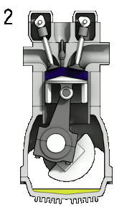
First law of thermodynamics, the car engine
Induction
(Fuel enters)
Compression
Ignition (Fuel is burnt)
Emission
(Exhaust out)
https://upload.wikimedia.org/wikipedia/commons/d/dc/4StrokeEngine_Ortho_3D_Small.gif
The reaction of gasoline and O₂ is exothermic. In the car engine some of the change in internal energy of the system (combustion of gasoline) is given off as q, and some does w pushing the piston in the cylinder.
ΔU = U_{products} - U_{reagents} = q + w
System: chemical reaction
2 C₈H₁₈ + 25 O₂
16 CO₂ + 18 H₂O
Surroundings: engine and the rest of the universe.

Slide 49
State functions
U is a type of quantity known as a state function (or state variable).
The value of U depends only on the state that a system is in, and not on how that state is reached.
q and w are not state functions but are path dependent, therefore called path functions.
Let’s consider again the combustion of gasoline.
Paths X and Y represent two different routes to the summit of Mt. Kilimanjaro. Both have the same change in elevation (elevation on a mountain is a state function; it does not depend on path), but they have very different distances traveled (distance walked is not a state function; it depends on the path). (credit: modification of work by Paul Shaffner)
2 C₈H₁₈ + 25 O₂
16 CO₂ + 18 H₂O
ΔU is seclusively due on the difference between U_{products} and U_{reagents}
ΔU = U_{products} - U_{reagents}
The amount of q and w produced by the reaction depends on how the reaction is performed
https://commons.wikimedia.org/wiki/File:Gasoline-fire.png

Slide 50
Introduction to Enthalpy
Work
Let’s consider to provide heat to two different systems
System 1: a gas is in a close, rigid, tank
System 2: a gas in a cylinder w/piston that is able to expand and contract at constant pressure (for instance 1 atm).
p = 1atm
Vi =V₁
Ti = T₁
Vf =V2
Tf = T₂
T₂ > T₁
dz
Heat
Heat
ΔU = q + w
ΔU < q
ΔU = q
w = 0
The heat transferred to system 1 cause a change in the internal energy of the gas since the kinetic energy of the gas particle increase due to the temperature increase.
The heat transferred to system 2 cause a change in the internal energy of the gas since the kinetic energy of the gas particle increase due to the temperature increase.
Since the tank is rigid, there is not expansion or work performed on the soundings
Because of the gas expansion, the piston travel a distance dz and the system perform work on the soundings

Slide 51
Introduction to Enthalpy, cont..
So.. For the system 1 (V= constant) we can measure $∆U$ simply measuring the q exchanged between the system and the surrounding
Let’s analyze more in details the changes occurring in system 2
A = surface are of the piston
Work
dz = distance traveled by the piston because of the gas expansion
p = 1atm
Vf =V2
Tf = T₂
T₂ > T₁
dz
A x dz = volume change of the gas.
A x dz = V₂-V₁ = ΔV
A
p = 1atm Vi =V₁
Ti = T₁
Heat
$$P ∆V=P A dz$$
$$P A dz= \frac{F}{A} A dz$$
$P ∆V=F dz$ =- w
$P ∆V$=- w
PΔV represents the expansion work (By their definitions, the arithmetic signs of ΔV and w will always be opposite:

Slide 52
Enthalpy (H)
To complete the analysis of the system 2 studied in the previous slides, we need to introduce a new state function:
enthalpy (H) is defined as the sum of a system’s internal energy (U) and the mathematical product of its pressure (P) and volume (V):
H=U+PV
Therefore the enthalpy change in the system 2 (P = constant) can be expressed as
ΔH=ΔU+PΔV
Since PV=-w and ΔU = q+w
ΔH= q_{p}
So the variation of enthalpy (ΔH) during a process at P=constant is equivalent to the amount of heat exchanged between the surrounding ad the system
In conclusion
For an event occurring at V=const., ΔU = q_{v}
For an event occurring at P = constant ΔH = q_{p}

Slide 53
Enthalpy (H)
The heat given off when you operate a Bunsen burner is equal to the enthalpy change of the methane combustion reaction that takes place, since it occurs at the essentially constant pressure of the atmosphere.
The heat produced by a reaction measured in a bomb calorimeter is not equal to ΔH because the closed, constant-volume metal container prevents expansion work from occurring.
Chemists usually perform experiments under normal atmospheric conditions, at constant external pressure with q = ΔH,.

Slide 54
The following conventions apply to ΔH
Thermochemical equations represent the changes in both matter and energy.
Enthalpy change of a reaction is shown as a ΔH value following the equation for the reaction.
This ΔH value indicates the amount of heat associated with the reaction involving the number of moles of reactants and products as shown in the chemical equation.
H₂(g) +1/2 O₂(g) ⟶ H₂O(l) ΔH=−286kJ
1 mole of hydrogen gas and 1/2 mole of oxygen gas at some temperature and pressure change to 1 mole of liquid water at the same temperature and pressure, 286 kJ of heat are released to the surroundings.
ΔH is an extensive property
2 H₂(g) + O₂(g) ⟶ 2 H₂O(l) ΔH=−572kJ

Slide 55
The following conventions apply to ΔH, Cont..
The enthalpy change of a reaction depends on the physical state of the reactants and products of the reaction (whether we have gases, liquids, solids, or aqueous solutions), so these must be shown.
H₂(g) +1/2 O₂(g) ⟶ H₂O (g) ΔH=−242kJ
A negative value of an enthalpy change, ΔH, indicates an exothermic reaction; a positive value of ΔH indicates an endothermic reaction. If the direction of a chemical equation is reversed, the arithmetic sign of its ΔH is changed (a process that is endothermic in one direction is exothermic in the opposite direction).

Slide 56
ΔH and standard state
IUPAC standard state:
Pressure = 1 bar (1 bar = 0.987 atm),
Solution concentration = 1 M,
does not specify a temperature.
The symbol ΔH∘ indicate that the enthalpy change was measured under standard state conditions.
The symbol ΔH is used to indicate an enthalpy change for a reaction occurring under nonstandard conditions
The enthalpy changes for many types of chemical and physical processes are available in the reference literature, including those for combustion reactions, phase transitions, and formation reactions. As we discuss these quantities,
Since ΔH is extensive property (ΔH) tables usually report the ΔH/(1 mole substance)

Slide 57
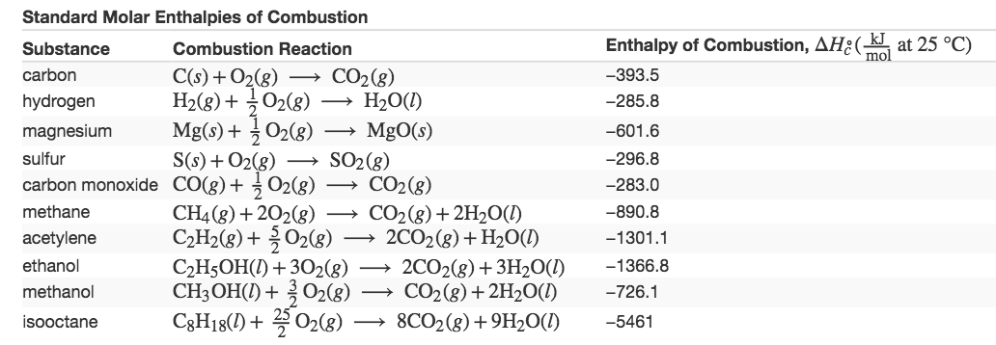
Enthalpy of Combustion
Standard enthalpy of combustion (ΔH°_{C}) is the enthalpy change when 1 mole of a substance burns under standard state conditions; it is sometimes called “heat of combustion.”

Slide 58
Emerging algae-based energy technologies (biofuels)
(a) Tiny algal organisms can be (b) grown in large quantities and eventually (c) turned into a useful fuel such as biodiesel. (credit a: modification of work by Micah Sittig; credit b: modification of work by Robert Kerton; credit c: modification of work by John F. Williams)

Slide 59
Emerging algae-based energy technologies (biofuels)
Cellana - Algae-based Products for a Sustainable Future™
https://www.youtube.com/watch?time_continue=39&v=qPcZfA7FB6w
Algae convert sunlight and carbon dioxide into oil that is harvested, extracted, purified, and transformed into a variety of renewable fuels.

Slide 60
Standard Enthalpy of Formation
A standard enthalpy of formation ΔH∘_{f} Is an enthalpy change for a reaction in which exactly 1 mole of a pure substance is formed from free elements in their most stable states under standard state conditions.
C(s) + O₂(g) ⟶ CO₂(g) ΔH∘_{f} = ΔH₂₉₈°= −393.5 kJ
starting with the reactants at a pressure of 1 atm and 25 °C (with the carbon present as graphite, the most stable form of carbon under these conditions) and ending with one mole of CO₂, also at 1 atm and 25 °C.
table of standard enthalpies of formation of many common substances are in Appendix G.
By definition, the standard enthalpy of formation of an element in its most stable form is equal to zero under standard conditions, which is 1 atm for gases and 1 M for solutions.
.

Slide 61
Hess’s law
Hess’s law: If a process can be written as the sum of several stepwise processes, the enthalpy change of the total process equals the sum of the enthalpy changes of the various steps.
Enthalpy is a state function: Enthalpy changes depend only on where a chemical process starts and ends, but not on the path it takes from start to finish.
The formation of CO₂(g) from its elements can be thought of as occurring in two steps, which sum to the overall reaction, as described by Hess’s law. The horizontal blue lines represent enthalpies. For an exothermic process, the products are at lower enthalpy than are the reactants.

Slide 62
Hess’s law can be used to determine the enthalpy change of any reaction
Hess’s law can be used to determine the enthalpy change of any reaction if the corresponding enthalpies of formation of the reactants and products are available.
The stepwise reactions we consider are:
decompositions of the reactants into their component elements (for which the enthalpy changes are proportional to the negative of the enthalpies of formation of the reactants), followed by
re-combinations of the elements to give the products (with the enthalpy changes proportional to the enthalpies of formation of the products).
The standard enthalpy change of the overall reaction is therefore equal to: (ii) the sum of the standard enthalpies of formation of all the products plus (i) the sum of the negatives of the standard enthalpies of formation of the reactants.

Slide 63
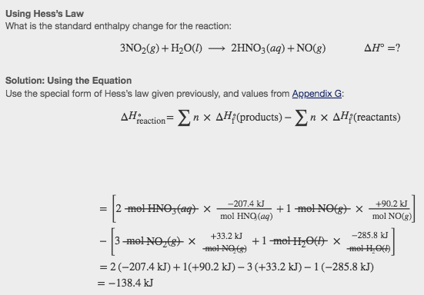
Using Hess’s Law

Slide 64
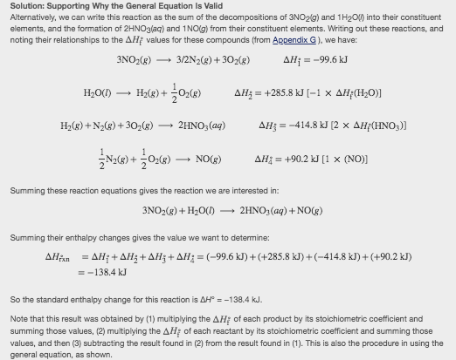
Solution: Supporting Why the General Equation Is Valid

Slide 65
Bond’s strength
Bond’s strength describes how strongly each atom is joined to another atom, and therefore how much energy is required to break the bond between the two atoms.
Stable molecules exist because covalent bonds hold the atoms together. We measure the strength of a covalent bond by the energy required to break it, that is, the energy necessary to separate the bonded atoms. Separating any pair of bonded atoms requires energy The stronger a bond, the greater the energy required to break it.
The energy required to break a specific covalent bond in 1 mole of gaseous molecules is called the bond energy or the bond dissociation energy.
The bond energy for a diatomic molecule, D_{X–Y}, is defined as the standard enthalpy change for the endothermic reaction

Slide 66
Molecules with three or more atoms
Molecules with three or more atoms have two or more bonds. The sum of all bond energies in such a molecule is equal to the standard enthalpy change for the endothermic reaction that breaks all the bonds in the molecule. For example, the sum of the four C–H bond energies in CH4, 1660 kJ, is equal to the standard enthalpy change of the reaction:
The average C–H bond energy, D_{C–H}, is 1660/4 = 415 kJ/mol

Slide 67
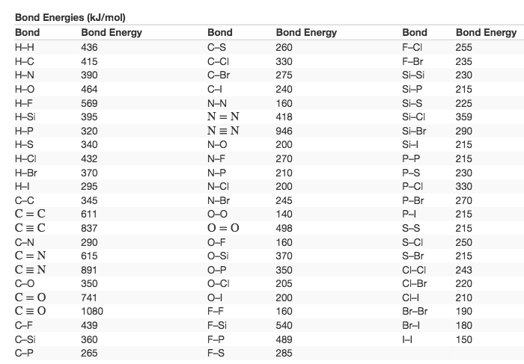
Bond Energies Table (kJ/mol)
The bond energy is the difference between the energy minimum (which occurs at the bond distance) and the energy of the two separated atoms.

Slide 68
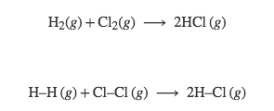
ΔH for a chemical reaction
The enthalpy change, ΔH, for a chemical reaction is approximately equal to the sum of the energy required to break all bonds in the reactants (energy “in”, positive sign) plus the energy released when all bonds are formed in the products (energy “out,” negative sign). This can be expressed mathematically in the following way:

Slide 69
Using Bond Energies to Calculate Approximate Enthalpy ChangesMethanol
,CH₃OH, may be an excellent alternative fuel. The high-temperature reaction of steam and carbon produces a mixture of the gases carbon monoxide, CO, and hydrogen, H₂, from which methanol can be produced. Using the bond energies in Table, calculate the approximate enthalpy change, ΔH, for the reaction here:

Slide 70
Born-Haber cycle
It is not possible to measure lattice energies directly. However, the lattice energy can be calculated using the equation given in the previous section or by using a thermochemical cycle. The Born-Haber cycle is an application of Hess’s law that breaks down the formation of an ionic solid into a series of individual steps:
ΔH∘f,ΔHf°, the standard enthalpy of formation of the compound
IE, the ionization energy of the metal
EA, the electron affinity of the nonmetal
ΔH∘s,ΔHs°, the enthalpy of sublimation of the metal
D, the bond dissociation energy of the nonmetal
ΔH_{lattice}, the lattice energy of the compound

Slide 71
The Born-Haber Cycle
The Born-Haber cycle shows the relative energies of each step involved in the formation of an ionic solid from the necessary elements in their reference states.

Slide 72
This OpenStax ancillary resource is © Rice University under a CC-BY 4.0 International license; it may be reproduced or modified but must be attributed to OpenStax, Rice University and any changes must be noted.

