Slide 1
Reading a Recipe
Measuring, abbreviations & equivalents
Clarissa Gillham l Hastings Public Schools l Hastings, NE

Slide 2
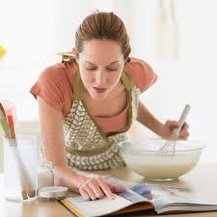
Why is this important?
In order to be successful in the kitchen, you need to know:
How to read a recipe
Measuring techniques
Abbreviations
Equivalents
How to change a recipe

Slide 3
What is in a recipe?
A recipe is a formula for the given product that you are wanting to make.
When you have a recipe, it is important that you read the entire thing first, before you cook.
Different parts of a recipe:
Name of food
Ingredients
Equipment
Directions
Yield (number of servings)
Nutritional analysis (sometimes, not always)

Slide 4
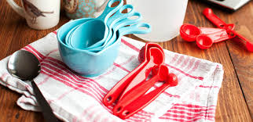
What is an Abbreviations?
Shortened form of a word.
Why are they used?
Saves space on the cookbook page.
Can make reading recipes easier and faster

Slide 5
Most Common Abbreviations
Teaspoon = tsp. or t.
Tablespoon = tbsp. or T.
Cup = C. or c.
Pint = pt.
Quart = qt.
Gallon = gal.
Ounce/fluid ounce = oz./fl. Oz
Pound = lb. or #
Dozen = doz.
Inch = in.
Second = sec.
Minute = min.
Hour = hr.
Degree = °
Fahrenheit/Celcius = F./C.

Slide 6
Pop Quiz
What do these stand for?
Lb.
tsp. or t.
F.
Fl. Oz
Qt.
Gal.
T. or tbsp
C. or c.
°

Slide 7
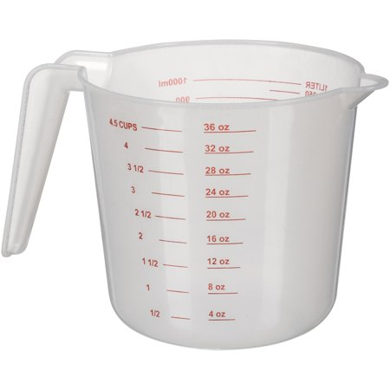
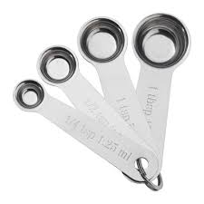
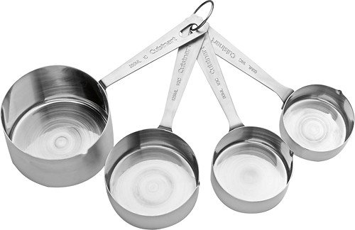
What are Those?!?
Liquid Measuring Cup
Measuring spoons
1/4 t., 1/2 t., 1 t., 1 T.
Dry Measuring Cups
1 c., 1/2 c., 1/3 c., 1/4 c.

Slide 8
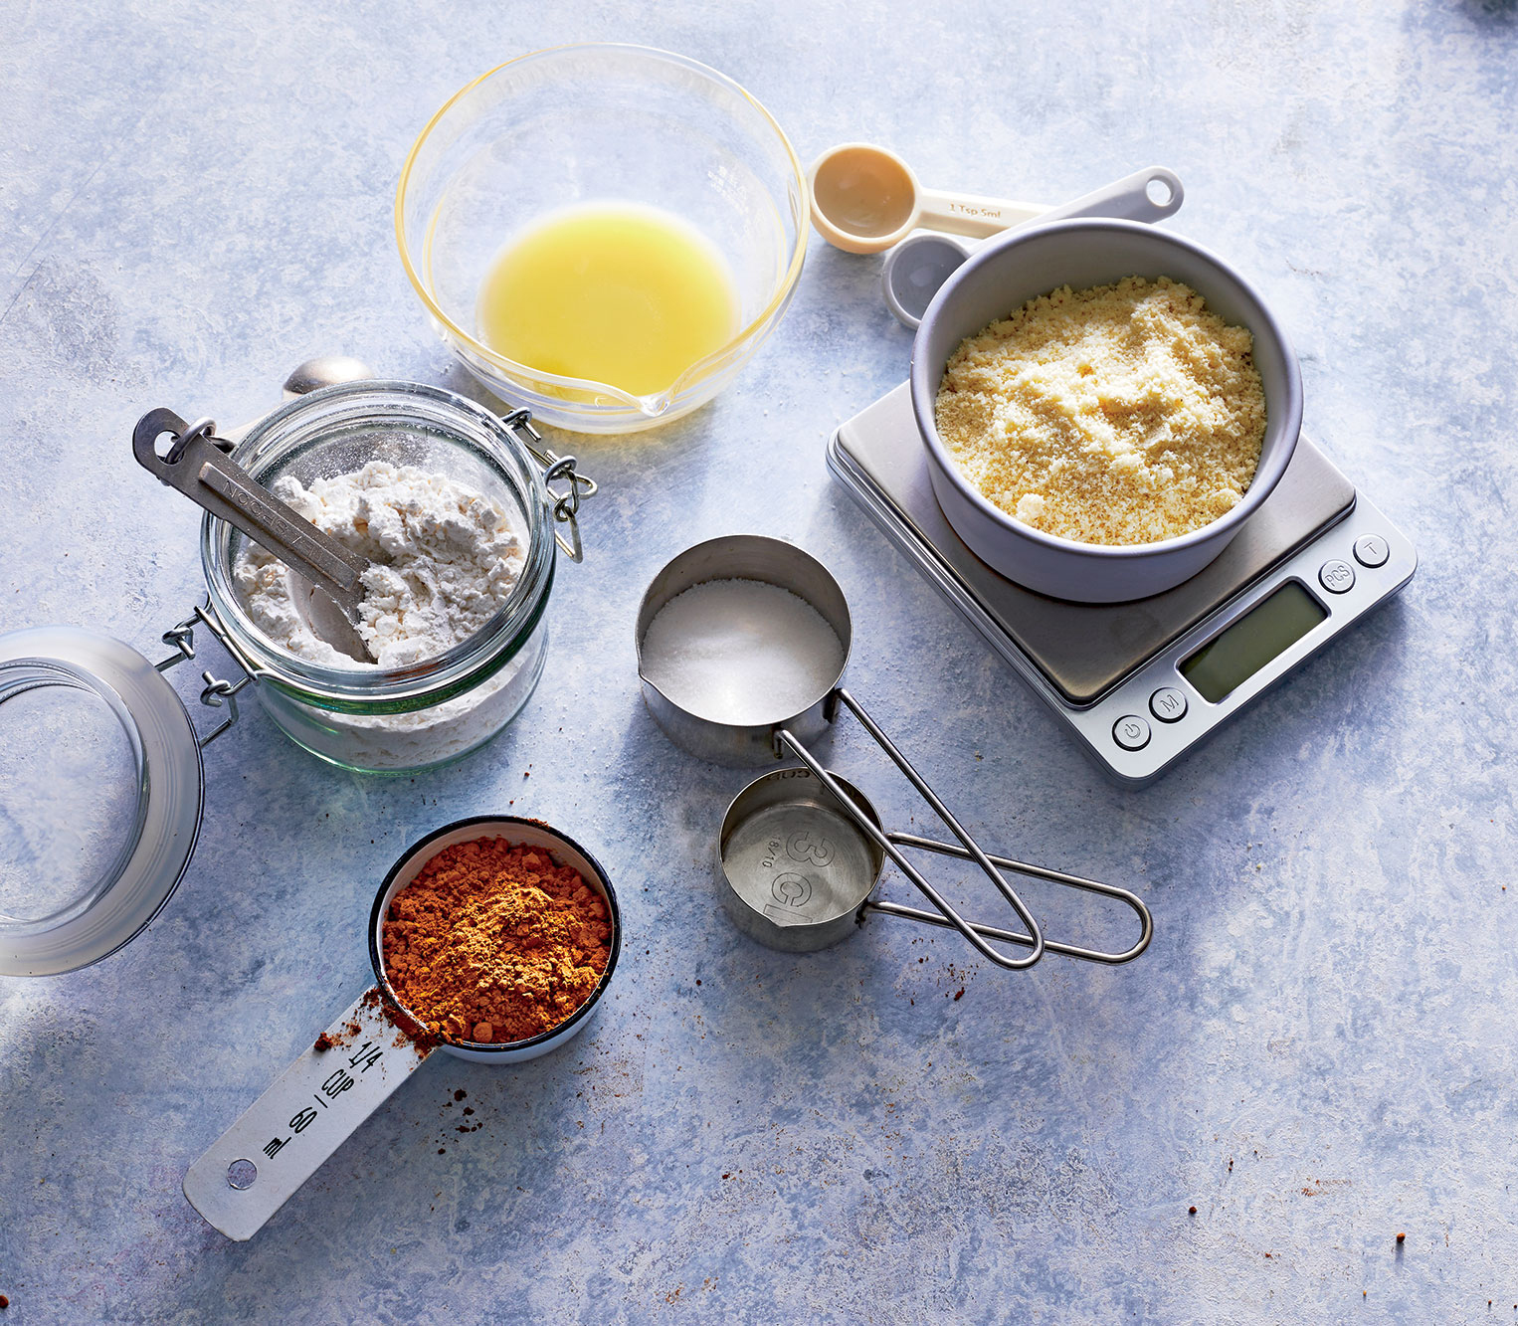
What do I Use?
When measuring, it is important to use the correct measuring utensil for the job.
What are some ingredients that you would measure when using:
A liquid measuring cup?
Measuring spoons?
Dry measuring cups?
Which utensil, and what size(s) would you use to measure the following:
1 1/2 cup sugar
3/4 cup water
2 teaspoons of syrup
1/3 cup flour
3 tablespoons of baking powder

Slide 9
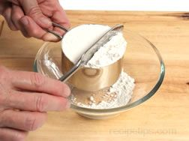
Measuring Dry Ingredients
Dry ingredients include flour, brown sugar, baking powder, powdered sugar, salt, etc.
Whenever measuring 1/4 cup or more, use a dry measuring cup.
Whenever measuring less than 1/4 cup, use a measuring spoon.
To measure dry ingredients:
Scoop ingredient into measuring cup/spoon
Level the top of your measuring cup/spoon with a straight-edge spatula or the back of a knife (must be straight) over a clean bowl (so that way you can pour the excess back in.
Put into your mixing bowl, etc. to make your product
For more delicate dry ingredients, like flour and powdered sugar, it is important to spoon in your ingredients in to the measuring cup.
For brown sugar, you need to pack it in until it is overfilled and then level it off.
Some recipes may call for weight instead of a measurement.
Video

Slide 10
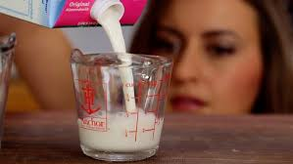
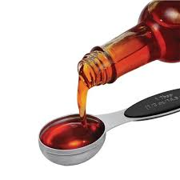
Measuring Liquid Ingredients
Liquid ingredients include water, oil, milk, juice, vanilla extract, etc.
When measuring a 1/4 c. or more, use a liquid measuring cup.
When measuring less than 1/4 c., use measuring spoons.
How to measure liquids:
Place your liquid measuring cup on a level surface.
Get down to eye level and pour liquid until it reaches the desired amount.
If you are measuring liquid in a measuring spoon, fill the spoon until a slight dome is visible.
Video

Slide 11
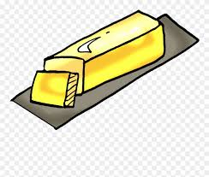
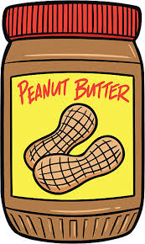
Measuring Solid Ingredients
Solid ingredients include butter, shortening, peanut butter, etc.
Sticks of butter and margarine have measurements marked on the wrapper- follow them if on straight and cut straight down.
One stick = 8 T. or 1/2 c.
Solid fats like shortening, peanut butter, etc. can be measured in a dry measuring cup or in a liquid.
Cup method:
Just like brown sugar, these products need to be packed into the cup well and then leveled off.
Be sure to get all of the product out of the measuring cup.
Liquid displacement method:
Fill a liquid measuring cup with 1 cup of water.
Spoon in your solid ingredient until the water level reaches the desired amount.
Video

Slide 12
Pop Quiz
What are the names of these utensils pictured?
How to you properly measure flour? Sugar? Brown sugar? Milk?
1 stick of butter is what measurement?
What do you use whenever measuring ingredients less than 1/4 cup?

Slide 13
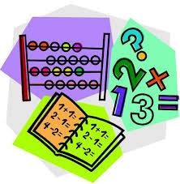
Do You Know Your Fractions?
When knowing the difference between the sizes of measuring cups and spoons, it is important to know which fractions/measurements are larger or smaller.
Which of these amounts is greater?
1 1/3 c. or 1 1/4 c.
1/2 c. or 1/4 c.
3/4 c. or 1/2 c.
2 T. or 1/4 c.
3 tsp. or 3 T.
1 c. or 8 T.

Slide 14
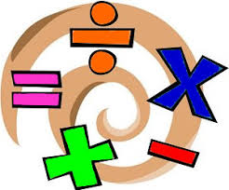
Basic Equivalents
Equivalent means that the amounts are equal to each other.
You need to know equivalents for recipes in case you need to modify the recipe, or if some measuring utensils are not available to use.
Pinch or dash = about 1/8 t.
1/3 cup = 5 Tablespoons + 1 teaspoon
1/4 cup = 4 Tablespoons
1 Tablespoon = 3 teaspoons
1/2 cup = 8 Tablespoons
3/4 cup = 12 Tablespoons
1 cup = 16 Tablespoons
8 ounces = 1 cup
16 ounces = 1 pound
1 fluid ounce = 2 Tablespoons
**If you can remember the ones underlined, you can do the math to figure out all of the other equivalents!!
**To help you remember 1 Tablespoon =3 t e a spoons

Slide 15
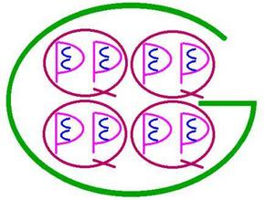
Basic Equivalents
2 cups = 1 pint
2 pints = 1 quart
4 quarts = 1 gallon
For the Visual:
C = cup, P = Pint
Q = quart, G = Gallon

Slide 16
Equivalents Math
Now that you know some of the basic equivalents, you should be able to do the math that builds up to larger measurements… Let’s try it out together!!
1 cup = ? oz.
1/2 pint = ? oz.
1 pint = ? oz.
1 quart = ? oz.
1 gallon = ? oz.
3 teaspoons = ? T.
16 Tablespoon = ? C.
1/2 cup = ? T
1 cup = ? t.

Slide 17
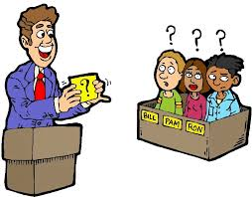
Pop Quiz
1/2 cup = ? tablespoons
1/3 cup = ? tablespoons
1 Tablespoon = ? teaspoons
1 pint = ? cups
1 quart = ? cups
1 gallon = ? quarts
1 cup = ? ounces
1 pound = ? ounces
1 cup = ? teaspoons
1 quart = ? pints
1 gallon = ? cups
1/4 cup = ? ounces
1 ounce = ? tablespoons

