Slide 1
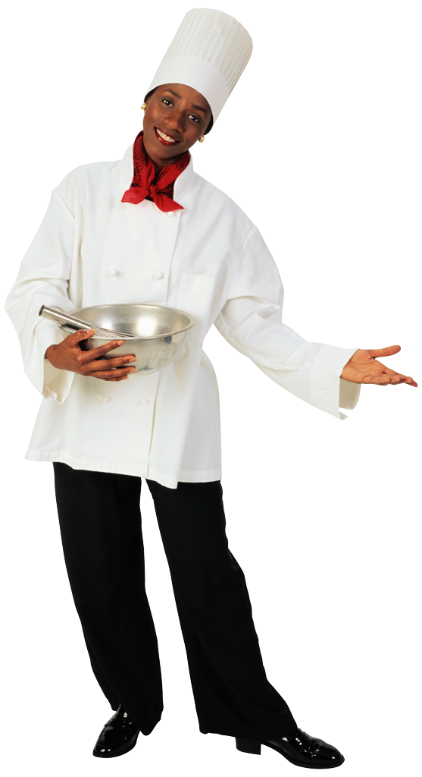
Kitchen Utensils
and Materials
Clarissa Gillham I Hastings Public Schools I Hastings, NE

Slide 2
Cutting Tools
There are different knives for different cutting tasks.
Mostly made of carbon steel or stainless steel.
Carbon steel is easy to sharpen
It can stain and rust easily unless you wash and dry immediately after use
Stainless steel is durable and will not rust
Hard to sharpen
Handles can be made of wood, plastic, or bone.
For safety, the tang should extend at least 1/3 of the way into the handle and at least 2 rivets should join the blade and handle.
There are more than just knives that are needed to properly cut things in the kitchen!

Slide 3
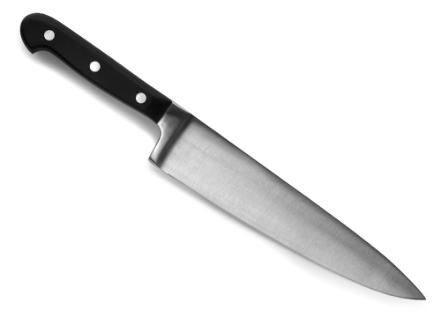
Chef’s/French Knife
The most versatile kitchen knife
Used to cut, chop, and dice any food

Slide 4
Serrated Knife
Also known as a bread knife
Has a serrated blade (sawtooth edge).
Helpful for cutting foods in which you don’t want to flatten the air cells.

Slide 5
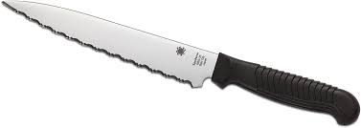
Utility Knife
Good all-around knife.
Use it to trim fat from meat and cut tender vegetables, cheese, and cold cuts.

Slide 6
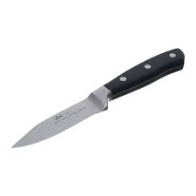
Paring Knife
The smallest kitchen knife.
Used to peel fruits and vegetables

Slide 7
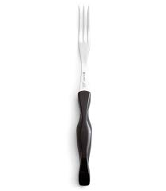
Turning Fork
Used to hold meats in place when cutting.
It can be used to flip meats on the grill.

Slide 8
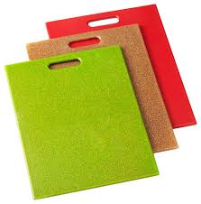
Cutting Boards
Use a cutting board when cutting and chopping foods to protect tables and countertops.

Slide 9
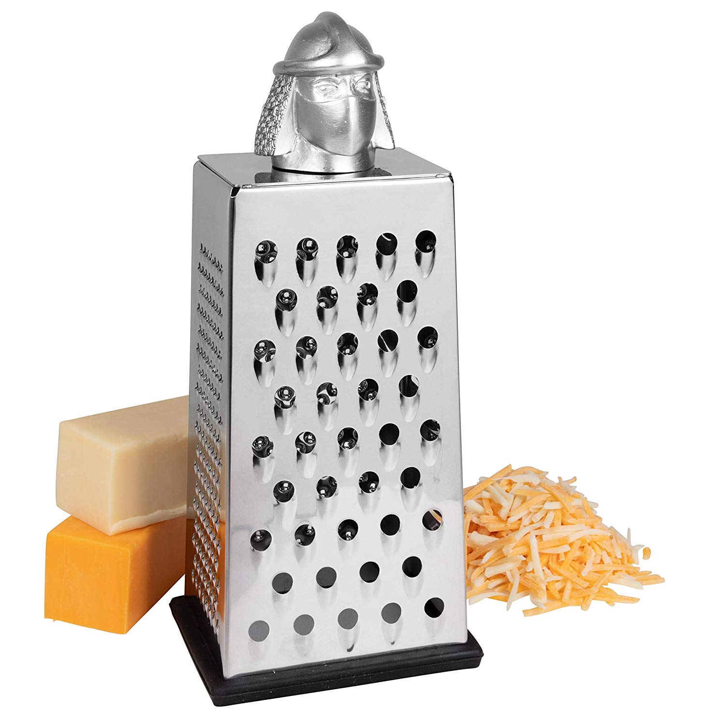
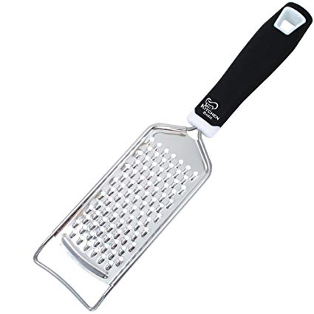
Shredder-Grater
Used to shred food such as cheese, lettuce, cabbage, onions, etc into different sizes.
Can be multi-sized options (such as the photo above) or can be in one size option (the photo below)

Slide 10
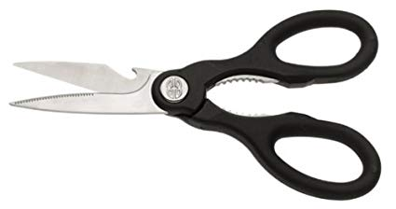
Kitchen Shears
These are not normal scissors!
Used to snip herbs, meat, or dough.

Slide 11
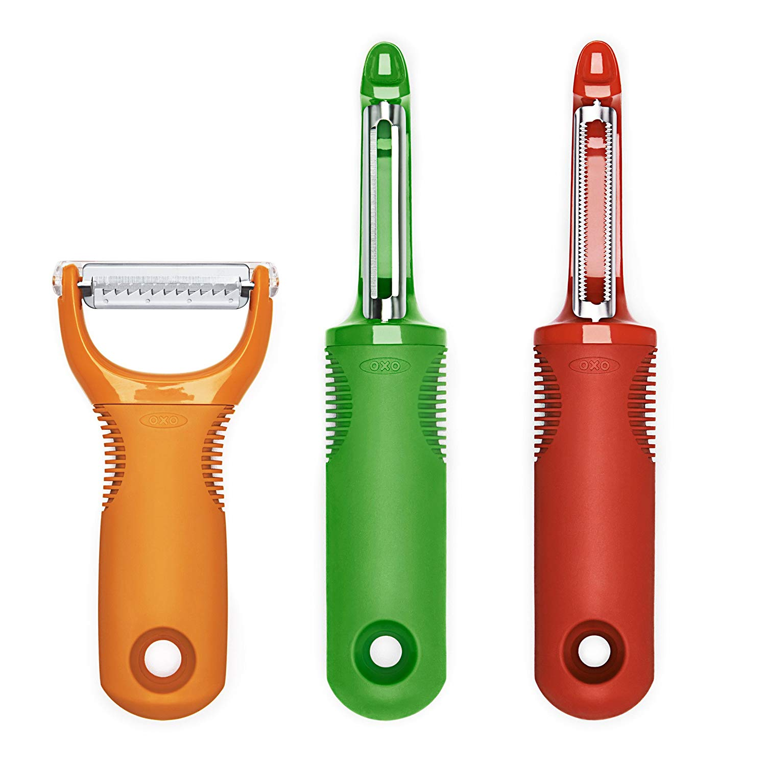
Peeler
Used to peel the skin off of fruits and vegetables.
Can have an “eye” remover to cut out bad spots on potatoes, etc.

Slide 12
Measuring Tools
Every recipe you will use, will require you to measuring your ingredients.
Whether the ingredients are liquid, dry, or solid, there are specific tools you need to know of so you can properly measure the exact amount that you need.

Slide 13
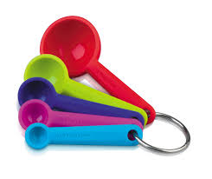
Measuring Spoons
Used to measuring any ingredients (liquid or dry) as long as it is less than ¼ cup.
Standard sizes are 1 T, 1 t, ½ t, ¼ t.

Slide 14
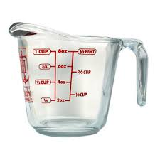
Liquid Measuring Cup
Used to measure any liquids.
Made of glass or hard plastic.

Slide 15
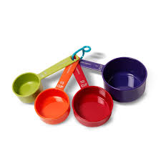
Dry Measuring Cups
Used to measure any dry ingredients.
Standard sizes are: 1 cup, 1/2 cup, 1/3 cup, 1/4 cup

Slide 16
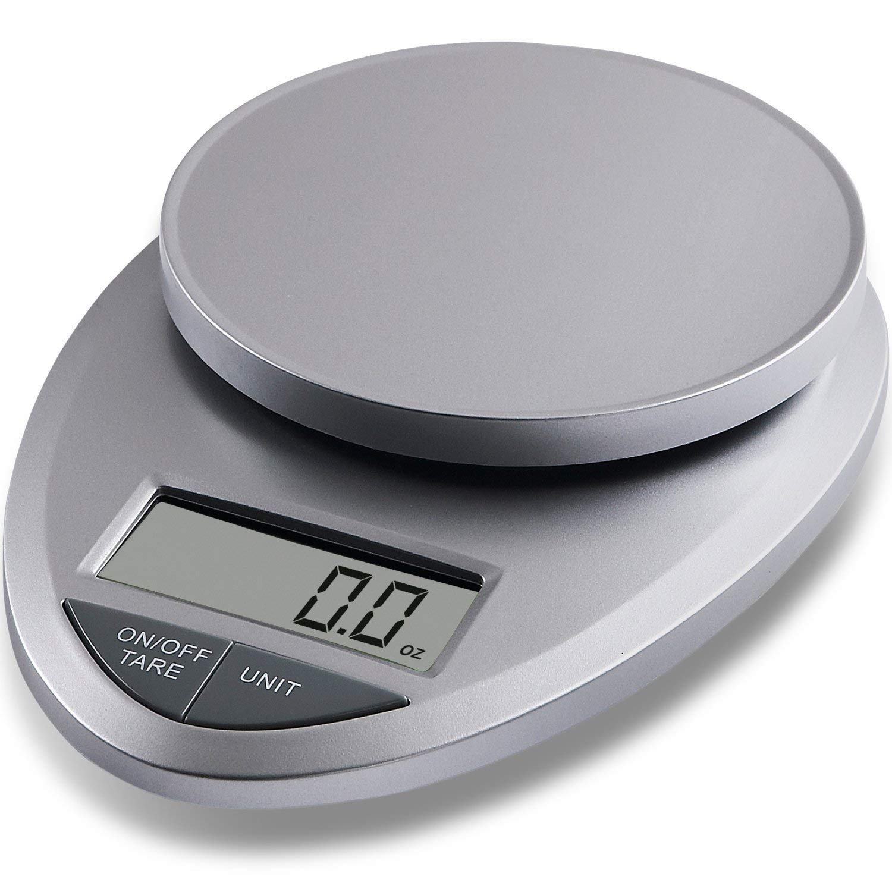
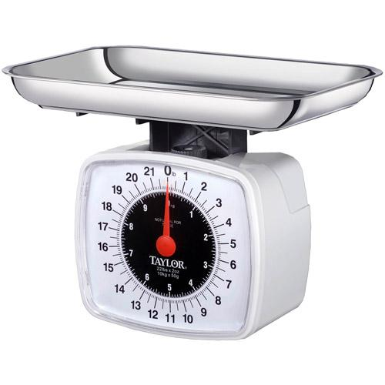
Scale
Some recipes will call for weight measurements rather than cups, teaspoons, etc.
Can be digital or analog

Slide 17
Mixing Tools
Almost every recipe requires you to mix ingredients together. You can use spoons for many mixing tasks.
Wooden spoons are available in many sizes and shapes, will not scratch pan surfaces, and handles remain cool. However, they absorb liquid.
Heavy metal spoons are to be used to stir thick mixtures.

Slide 18
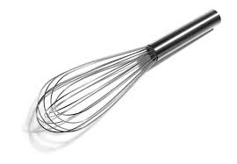
Whisk
Used to incorporate air into foods.
Use them for eggs, soufflés, and meringues.
When preparing sauces, use this to prevent lumps from forming.

Slide 19
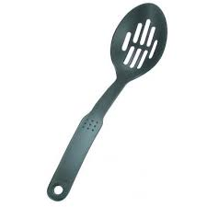
Slotted Spoon
Used to remove pieces of food from a liquid.
Has holes in the spoon.
Can be plastic or metal.

Slide 20
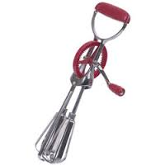
Rotary Beater
Used to beat, blend, and incorporate air into foods.
Manually turn the drank to rotate the beaters.

Slide 21
Baking Tools

Slide 22
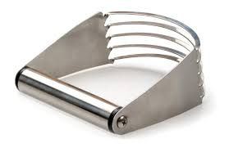
Pastry Blender
Made of several thin pieces of curved metals attached to a handle.
Used to blend shortening with flour when making pastry.
Used to blend butter and cheese mixtures.

Slide 23
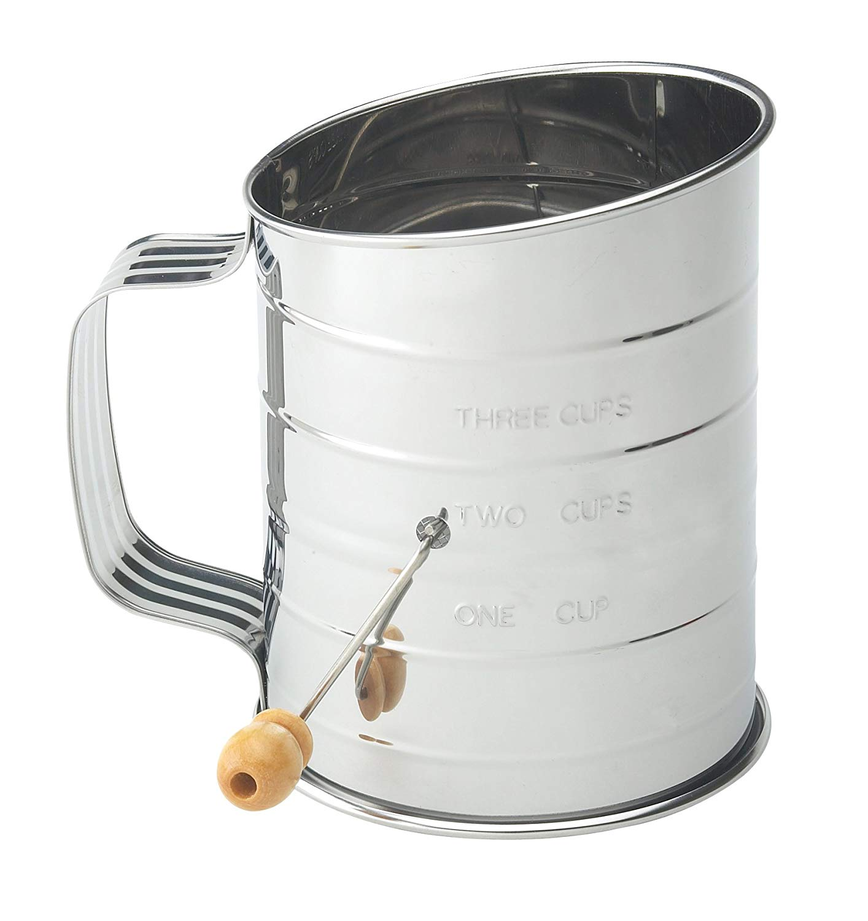
Sifter
Used to “sift” dry ingredients like flour to add air and remove lumps.

Slide 24
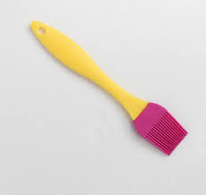
Pastry Brush
Used to brush butter or sauces on foods.
Can use it to remove crumbs from a cake before frosting it and to baste foods in the oven.

Slide 25
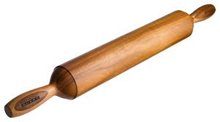
Rolling Pin
Used to roll out dough or pastry.
Can be covered by a stockinette to prevent dough from sticking to it.

Slide 26
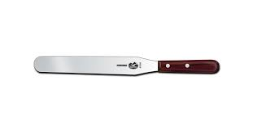
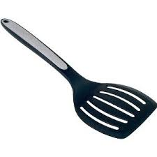
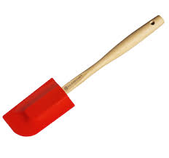
Spatulas
Bent-edged spatulas: used to remove cookies from a baking tray, turn meats, fish, pancakes, eggs, and omelets.
Straight-edged spatula: used to spread cake icings and meringues and to level ingredients
Rubber spatula: used to scrape bowls and saucepans and to fold one ingredient into another.

Slide 27
Thermometers
Whenever you need to check the temperature of something, it is important to know which thermometer is for what.

Slide 28
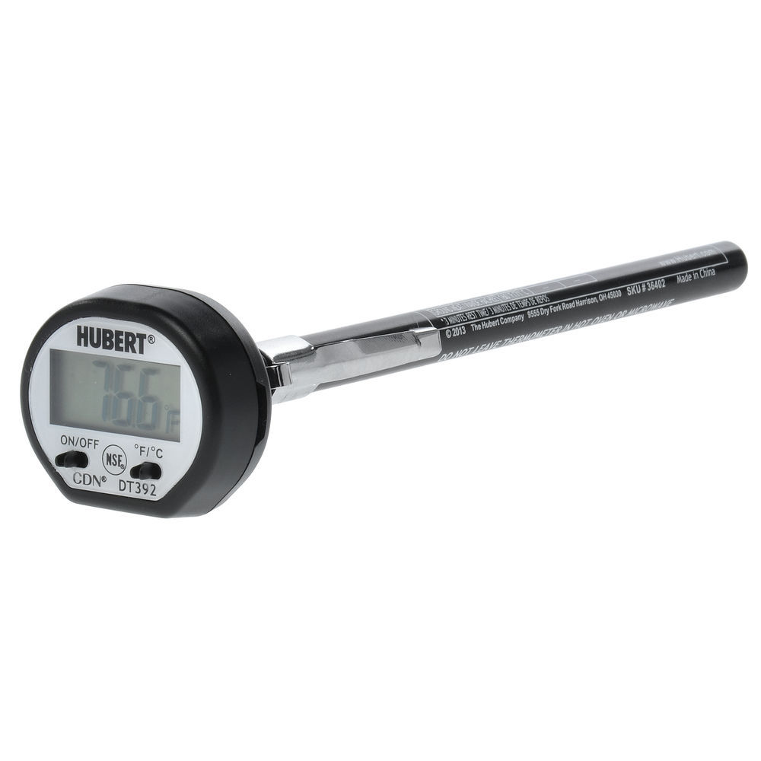
All purpose digital thermometer
Use a temperature-sensitive semiconductor that is attached to the tip of the probe (thin probe).
Suitable for checking the temperature of thin foods.
Cannot be used while food is cooking in an oven.
Reads the temperature out digitally.

Slide 29
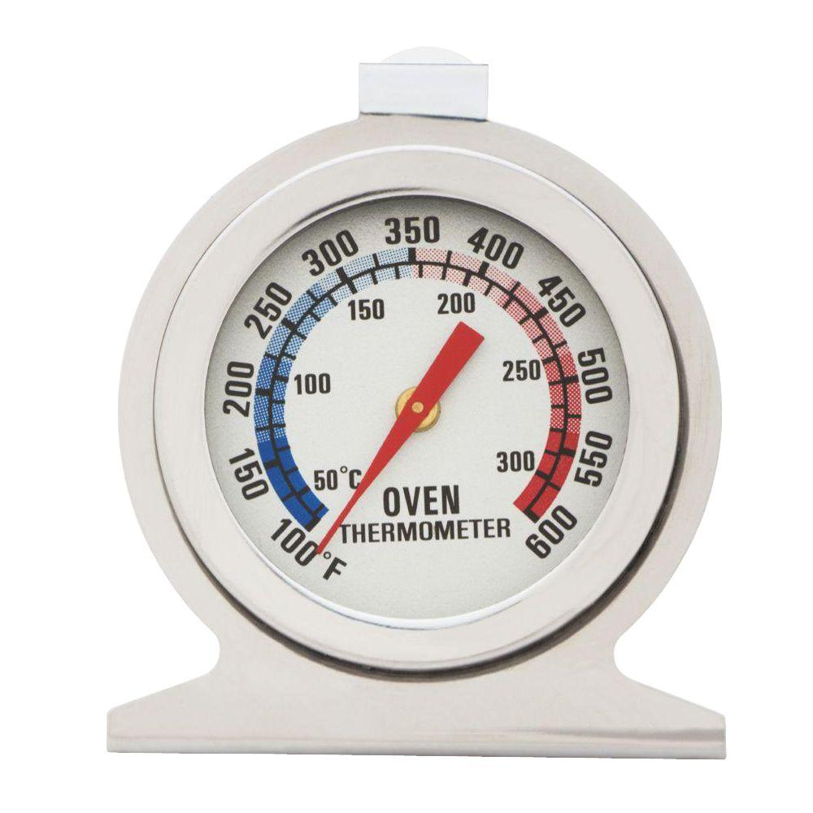
Oven thermometer
Used to make sure your oven is heating at the correct temperature.
Can also change position in oven to see if there are hot spots.

Slide 30
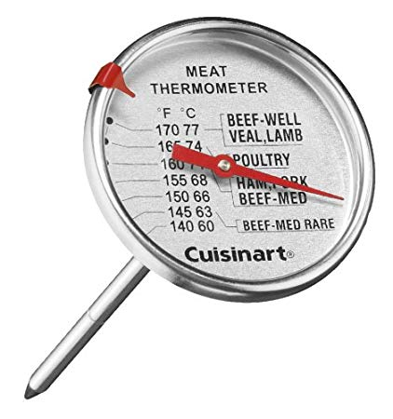
Meat Thermometer
Tells you the internal temperature of the meat.
Be sure to check the guide on what the correct temperature of your meat is supposed to be!

Slide 31
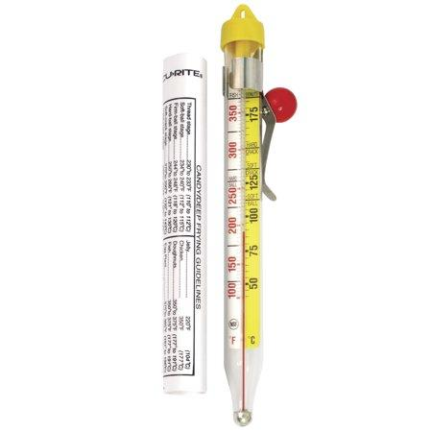
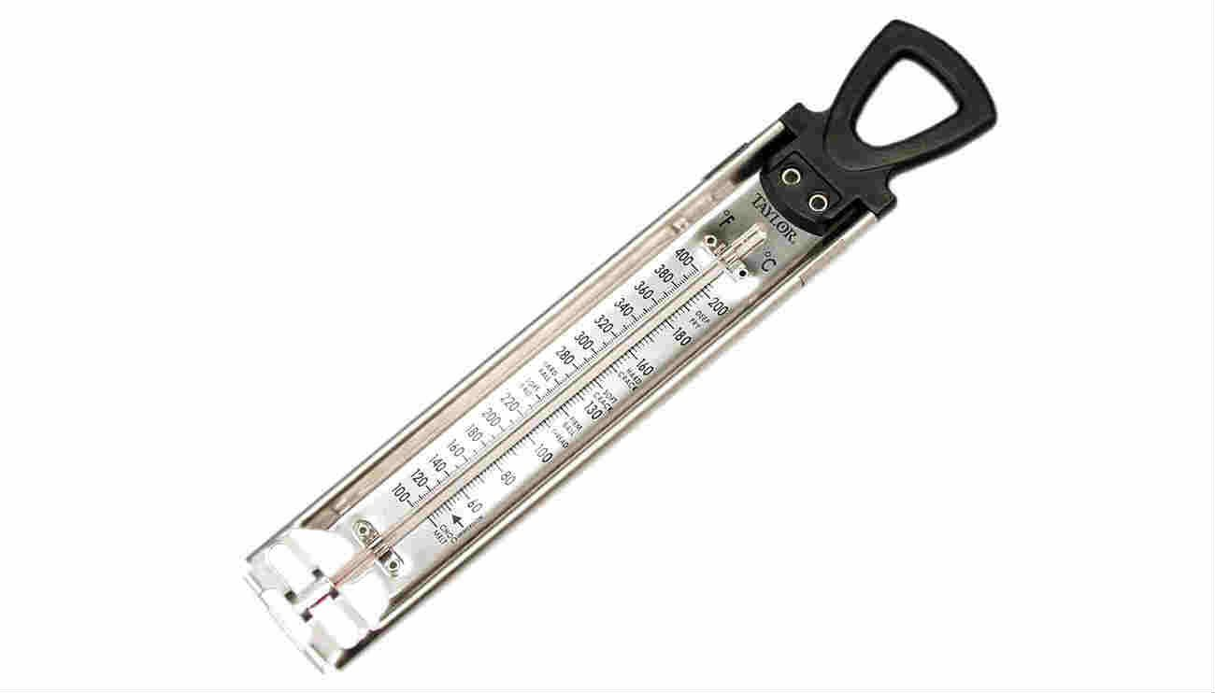
Candy/Deep Fat Thermometer
Most instant-read thermometers cannot exceed the temperature of boiling, so for liquid it is best to use a candy or deep fat thermometer.

Slide 32
Other Preparation Tools

Slide 33
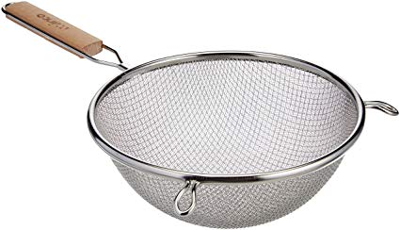
Strainer
Used to strain liquids from solid portions of food.
Used to “sift” flour and other dry ingredients.
NOT THE SAME THING AS A COLANDER.

Slide 34
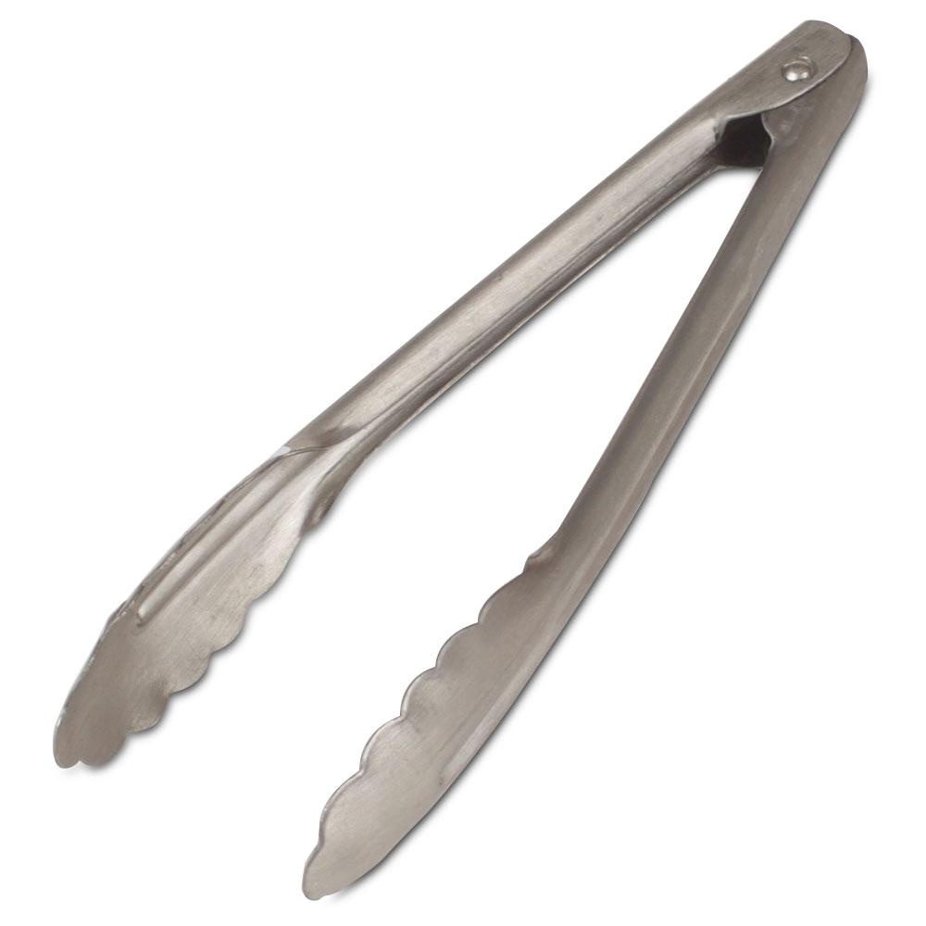
Tongs
Used to handle hot foods
Used to flip meat

Slide 35
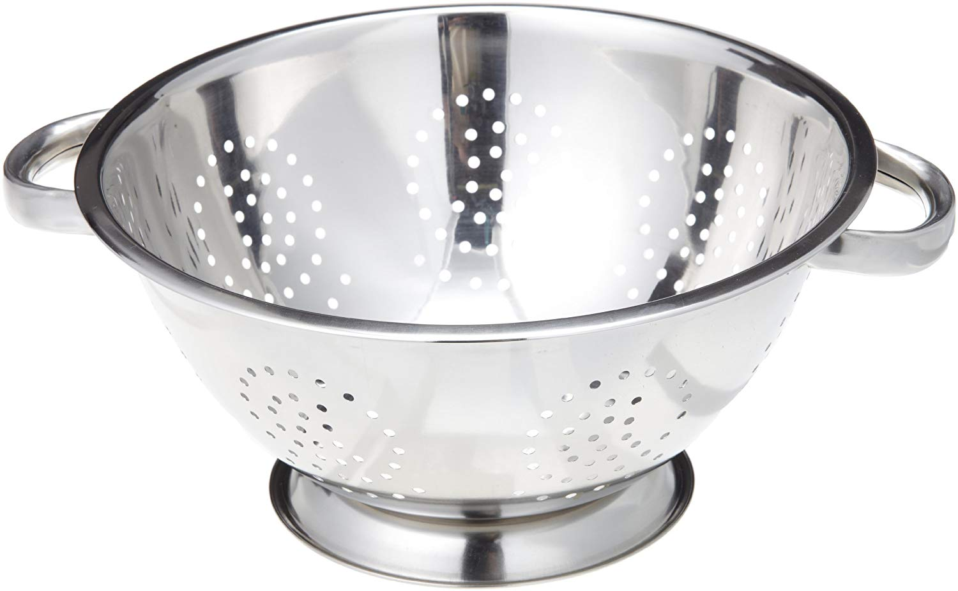
Colander
Used to drain foods from their liquid
Used to wash fruits and vegetables
NOT THE SAME THING AS A STRAINER

Slide 36
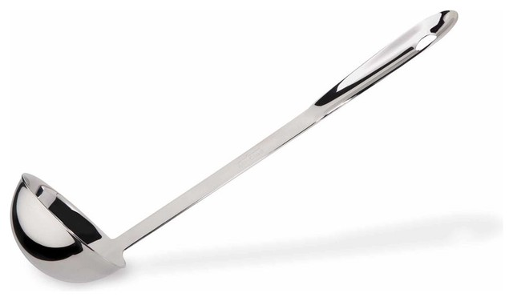
Ladle
Long handled serving utensil for foods with a lot of liquid like soups, stews, etc.

Slide 37
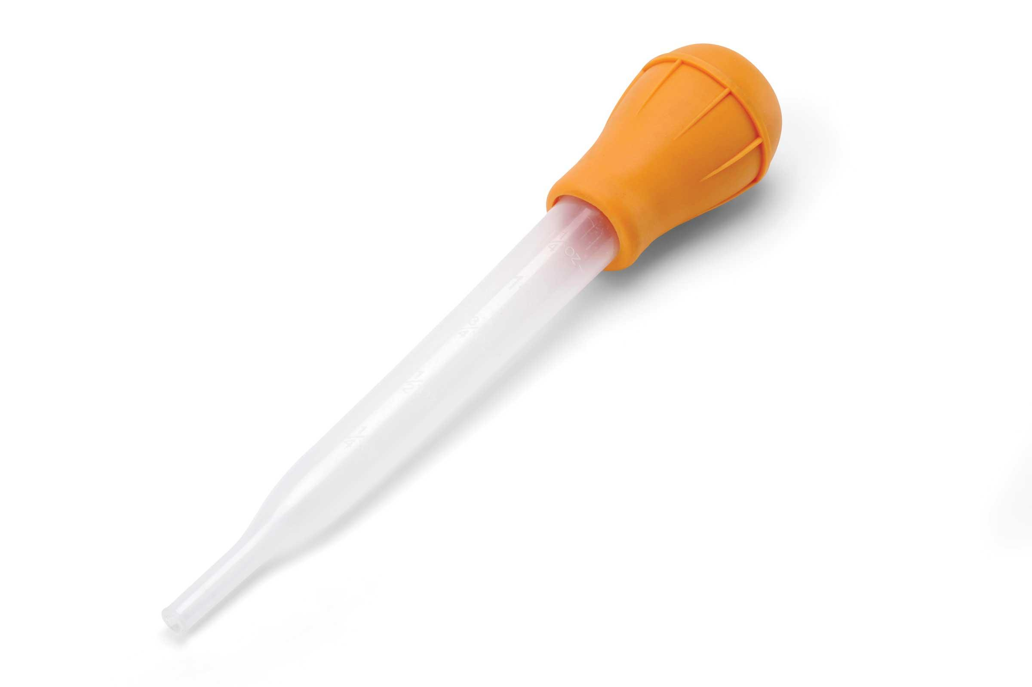
Baster
Uses suction to collect juices and fat from foods like meat and stews.

Slide 38
Cookware and Bakeware Materials
Metal
Cast iron
Aluminum
Copper
Stainless Steel
Plastic
Glass and Ceramic
--Transparent glass
--Glass-ceramic
--Porcelain enamel
--Ceramic
Earthenware and terra-cotta
Nonstick Finishes

Slide 39
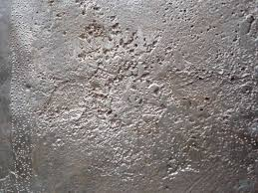
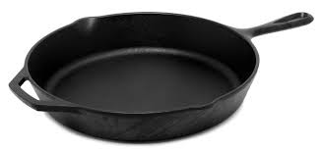
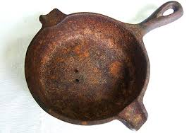
Cast Iron
Holds and distributes heat well
Porous surface holds oils that help prevent sticking and enhances flavor.
Heavy
Can rust, retain flavors, and can lose its nonstick quality if not taken care of.
Want to try to avoid using soap when washing, because then you have to re-season the pan.
Check out how it’s made!
How to clean/use cast iron

Slide 40
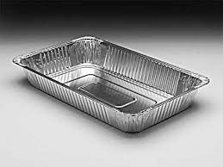
Aluminum
Lightweight
Corrosion-resistant
Conducts heat rapidly
Reasonably priced
Susceptible to scratches, dents, and detergent damage.
Foods and minerals may cause pitting.
Hard water, eggs, alkalis (like baking soda) can cause darkening in color.

Slide 41
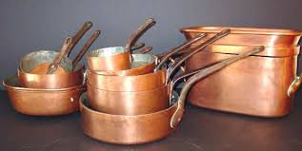
Copper
Good heat conductor
Cannot use pure copper utensils for cooking because it reacts with food and may form poisonous compounds.
Must be lined with another material
Must clean with a special cleaner to keep it from discoloring

Slide 42
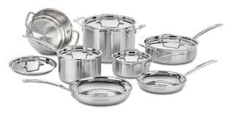
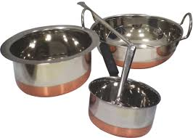
Stainless Steel
An alloy of steel, nickel, and chromium
Resists stains
Does not discolor
Strong and durable
Does not distribute heat evenly (hot spots may develop)
May darken if overheated

Slide 43
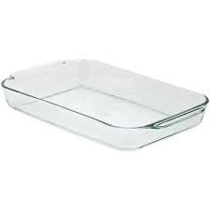
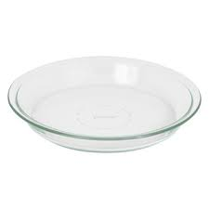
Transparent Glass
Allows you to see food while it is cooking
Does not react with flavors or colors of food
Poor heat conductor
Cannot go from one extreme temperature to the other
Breakable!

Slide 44
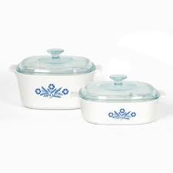
Glass-Ceramic
Strong and durable
Unlike transparent glass, this can withstand a wide range of temperatures (can go from fridge to oven and vise versa)
Develops hot spots
Poor heat conductor
Breakable!

Slide 45
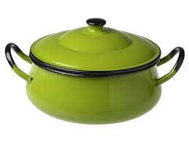
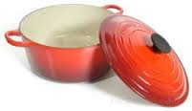
Porcelain Enamel
Glasslike material
Fused to a base metal at a very high temperature, but the outer surfaces are coated with porcelain enamel
Makes it colorful and easy to clean

Slide 46
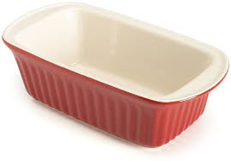
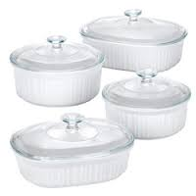
Ceramic Materials
Made from nonmetallic minerals that are fired at very high temperatures
Include earthenware and terra-cotta (think pottery).
Not suitable for rangetop cooking
Retains heat well

Slide 47
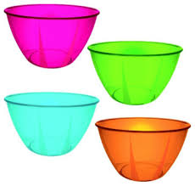
Plastic Materials
Some are dishwasher safe
Typically stain resistant
Break-resistant
Easy to clean
Cannot withstand oven temperatures above 350 degrees F
Cannot withstand direct heat
Great for use in the microwave (if able to go in)

Slide 48
Non-stick Finishes
Prevents foods from sticking to utensils
May be applied to both the inside and outside of cookware & bakeware
Metal utensils and scouring pads will scratch these finishes

Slide 49
Microwavable Materials
Main requirement to be microwavable: microwaves must be able to pass through it.
Can pass through ceramic, plastics, glass, wood, and paper
Metal reflects microwaves
Some cookware containing metal are specifically designed for the microwave by having metal qualities to allow browning of food.
MAKE SURE IT SAYS MICROWAVE SAFE!

Slide 50
Cooking Utensils
What is the difference between a saucepan and a pot?
Saucepan
Pot
What am I?
What am I used for?
Notes:
what am I? double boiler- delicately cook foods like chocolate, caramel, cheese, etc.

Slide 51
Cooking Utensils
I am used to cook foods more quickly than conventional saucepans. What am I?
Pressure Saucepan
Or Pressure Cooker
Griddle
Skillet

Slide 52
Baking Utensils
When buying baking utensils, it is important to consider whether the surface is shiny or dull
Shiny=reflects part of the heat away from food
Lighter crusts
Dull/dark=absorbs head
Darker, crisper crusts

Slide 53
Baking Utensils
Vs.
Cookie Sheet
Baking Sheet
What is the difference between these two sheets? Why are they different?

Slide 54
Baking Utensils
Angel Food Pan
Cake Pan
Springform Pan
Loaf Pan

Slide 55
Baking Utensils
Muffin Pan
Casserole Dish
Roasting Pan
Pie Plate
Pizza Pan

Slide 56
Proper Care/Use
Whenever you get new cookware, be sure to read the directions.
Not all things are safe in/on the microwave, dishwasher, stove top, or oven!
Most utensils are very easy to wash- scrub with hot water and soap, rinse, and dry.
Some utensils/equipment might need extra care due to dark spots/stains or the material that they are made out of.
When in doubt, do some research!

