Slide 1
The Engineering Design Process
Jana Bonds 2018

Slide 2
The Engineering Design Process (EDP)
The EDP is a series of steps that engineers follow to develop a product or create a solution to meet humans needs and wants.
Basically it is a set of steps to help you solve a problem

Slide 3
1. Define the Problem
What problem you are trying to solve?
Are you improving something already made?
Are you trying to make a task easier?
Create a problem statement to help focus your thinking
The problem statement clearly identifies the problem the solution will solve

Slide 4
2. Identify criteria & constraints
You need to know what you are limited to and what specific requirements must be met.
Criteria = requirements
Constraints = limitations
Time
Money
Materials
Tool & Machines

Slide 5
3. Brainstorm multiple solutions
You have to learn new things to better understand the problem
Be sure you follow the criteria & constraints of your design
Brainstorm!!! By yourself or with others
Generate multiple ideas to correctly solve the problem (sketch, CAD, graphic)
Non-limiting number of possible solutions.

Slide 6
4. Select a Solution
After you have generated ideas, you should pick the one solution you think is has the most promise to be successful
Build a first version of the solution called a prototype

Slide 7
5. Prototype the solution
Build a first version of the solution called a prototype
A visual prototype - one that looks like the solution
A working prototype - one that works like the solution (it may also look like their solution)

Slide 8
6. Test and Evaluate
Run your model or prototype through a real world test to see if it works the way it is supposed to
While testing evaluate what works and what does not
What type of data would you be generating from tests

Slide 9
7. Iterate
We Iterate to improve our prototype
To do this we ask questions like:
Did the prototype work as intended (if tested)?
What was successful?
What were the problems?
What questions did others have?
What could be improved?
Then if we need to we go back to the beginning and make adjustments

Slide 10
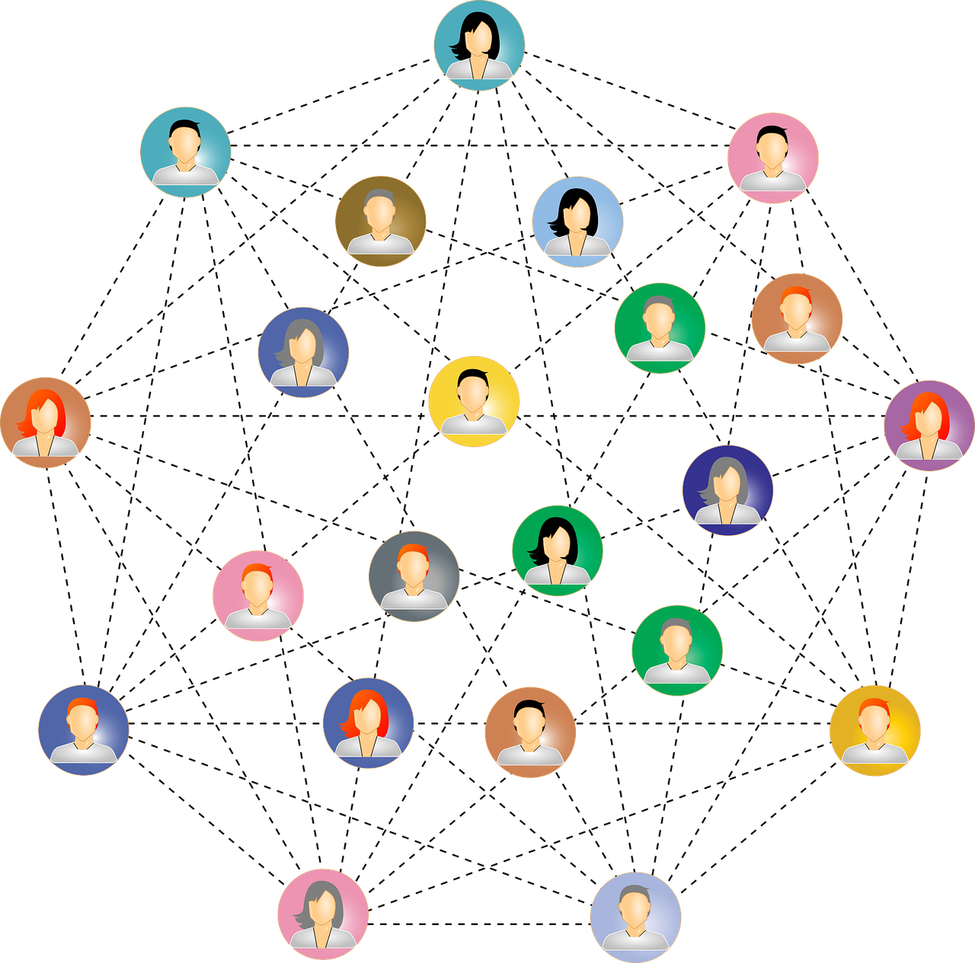
8. Communicate Results
Share your findings with the intended audience
State the problem/need that is being addressed
Describe and show the solution
Describe how the solution meets the need
State why it is a good solution

Slide 11
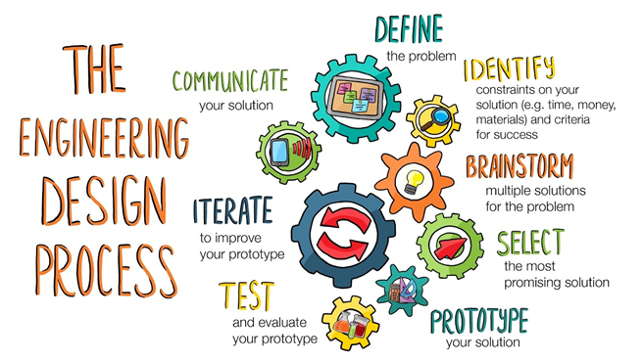
From KQED & PBS Learning Media

